Slide 1
CBRFC Evapotranspiration study
Improve the physics of the treatment of ET (and hence evaporative demand) in CBRFC operations, and thereby improve water supply forecast skill.
Cooperate with NWS Western Region Scientific Services Division in provision of scientifically sound, distributed ET-related forecasts to end-users.
ET = actual evapotranspiration

Slide 2
How ET is currently estimated by the NWS River Forecast System
Sacramento-Soil Moisture Accounting (Sac-SMA) model evaporates soil moisture from two depths.
E_{p} driven by E_{pan} climatology:
  e.g., Jan 1, 1979 = Jan 31, 1979 = Jan 31, 2010
  seasonal data disaggregated to daily,
  missing seasons filled in,
  adjustment factor PEADJ calibrated to water balance.
Wetter years in southern CBRFC region (e.g., San Juan), or when/where Prcp drives Runoff, we under-forecast Runoff, or over-estimate ET.
Option to use time-series in Sac-SMA, down to six-hourly:
  best option is to use observed E_{p},
    cannot use E_{pan} at a daily or sub-daily scale,
  best modeling option is a Penman-based estimate,
    heavy on data inputs/parameters.
E_{p} = evaporative demand
E_{pan} = pan evaporation
Prcp = precipitation

Slide 3
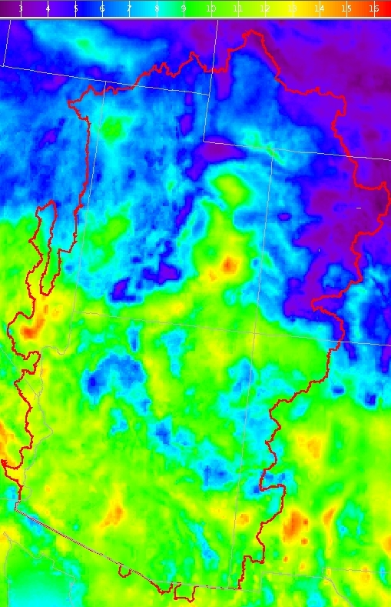
Physically based models:
PenPan E_{pan} (synthetic pan evaporation)
Q_{n} = energy available for ET
U₂ = wind speed
e_{sat}-e_{a} = vapor pressure deficit (~ humidity)
IR = infra-red, or long-wave radiation
synthetic measure of evaporative demand to synthesize E_{pan} observations.
mixture of radiation (sunshine and IR) and drying power of the air (humidity and wind).
accounts for instrumentation effects:
  extra sunshine interception by pan walls,
  increased turbulence across water surface.
E_{pan} for April 25, 2010 (mm)

Slide 4
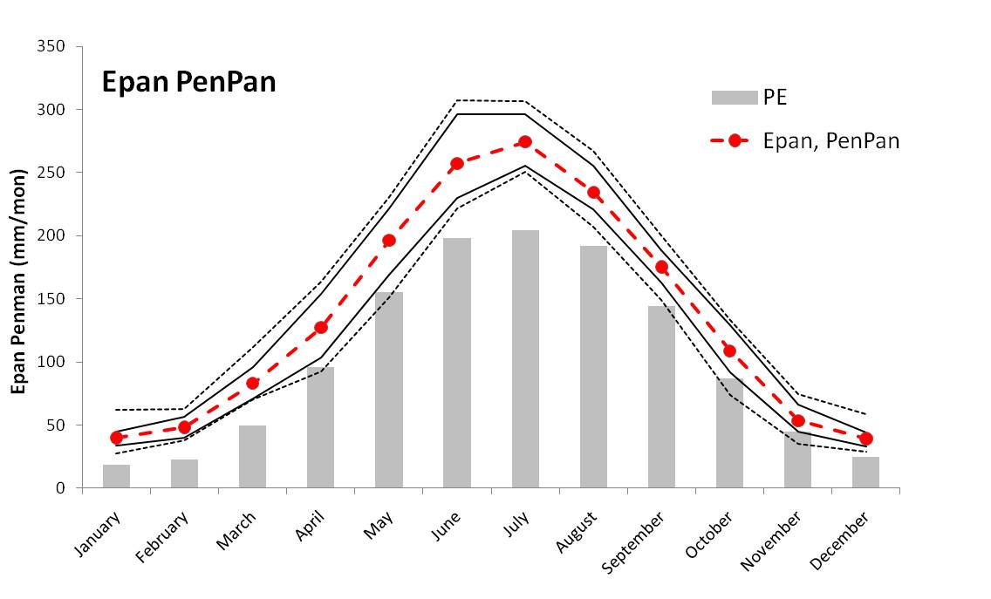
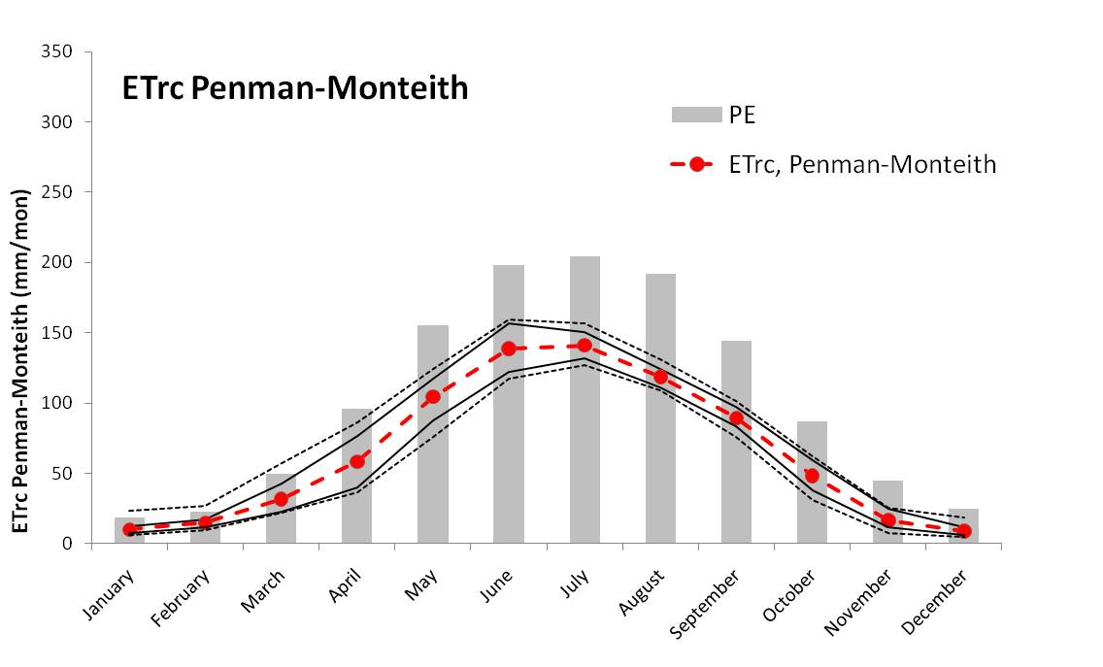
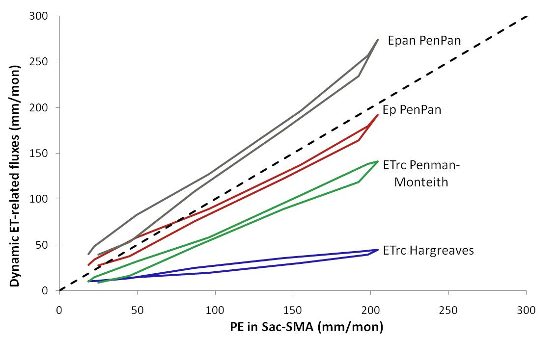
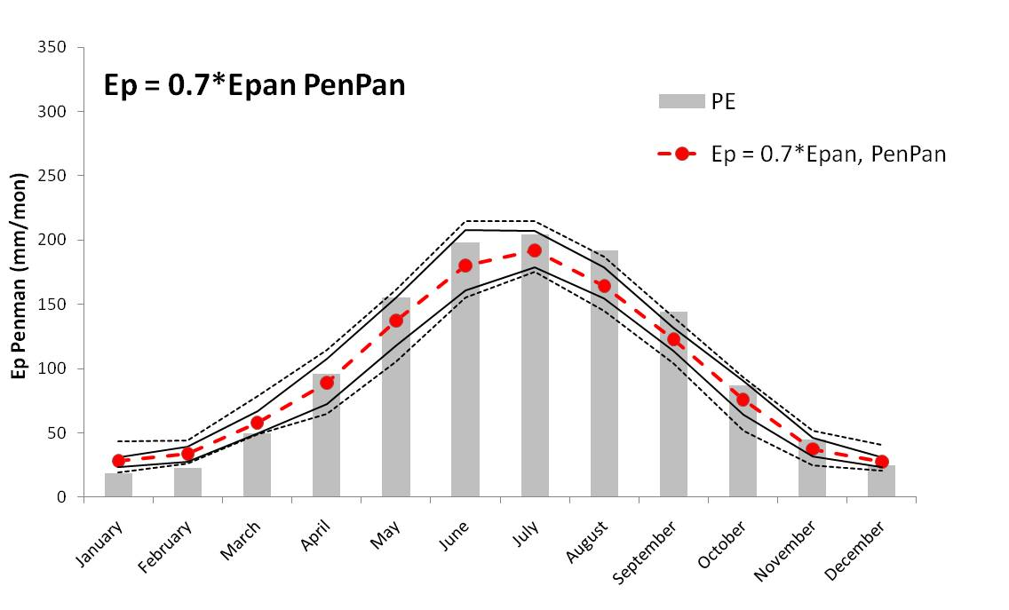
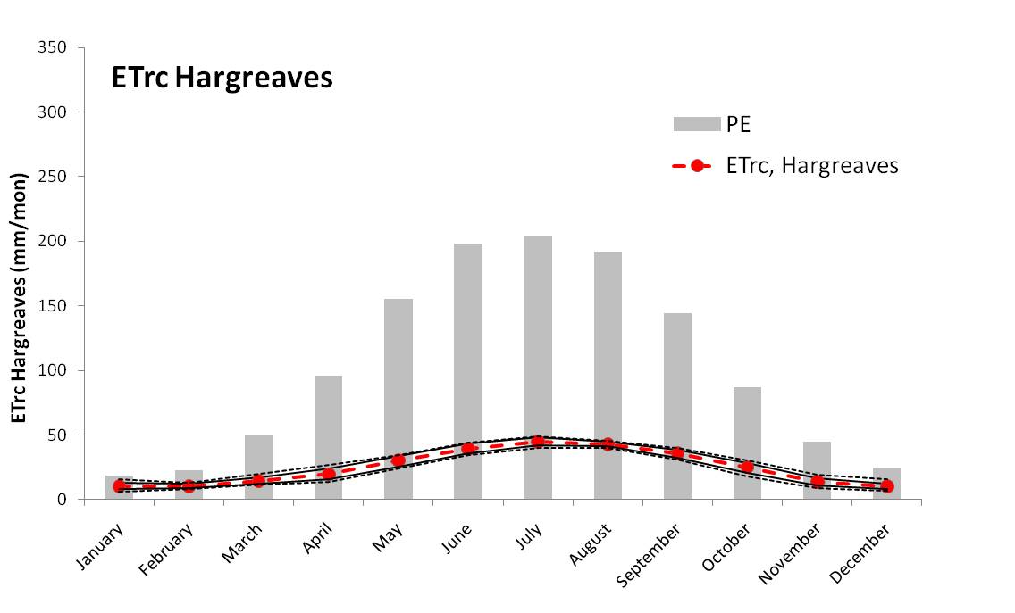
Preliminary results:
climatology of dynamic daily Epan, Ep, and ETrc – Tenmile Creek, CO
Ep = 0.7 * Epan

Slide 5
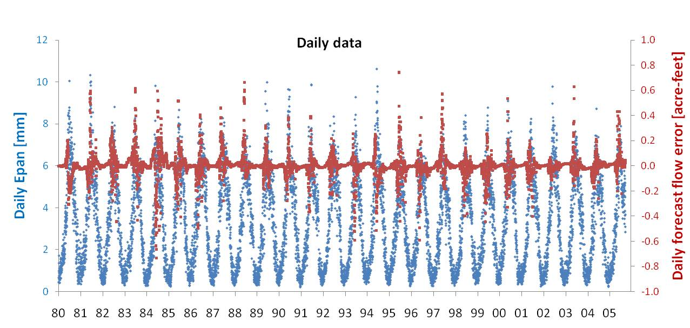
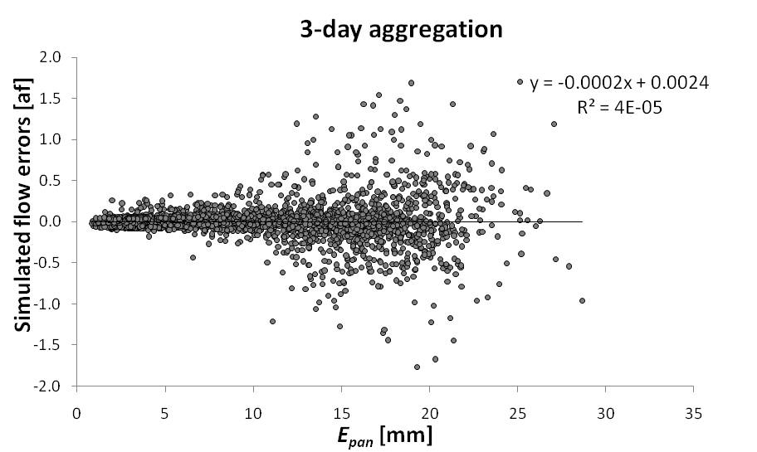
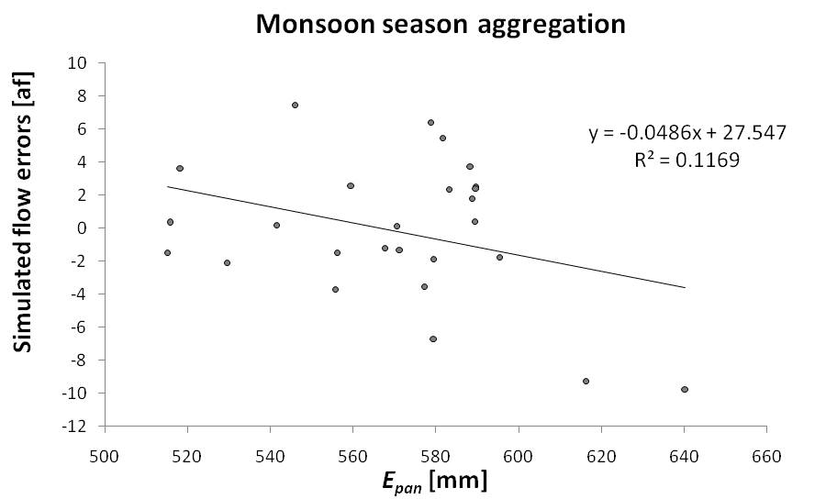
Preliminary results:
dynamic Epan vs. historic simulated streamflow errors

Slide 6
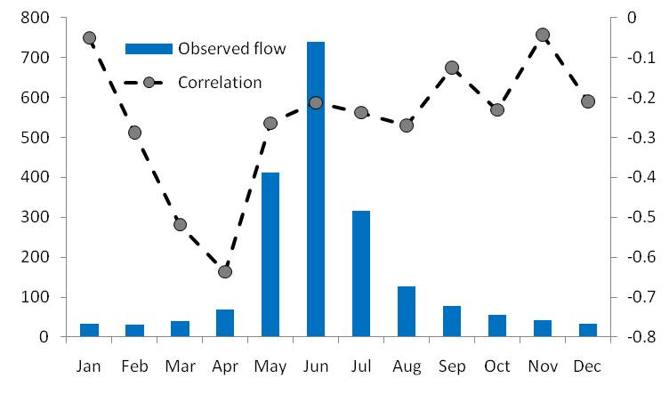
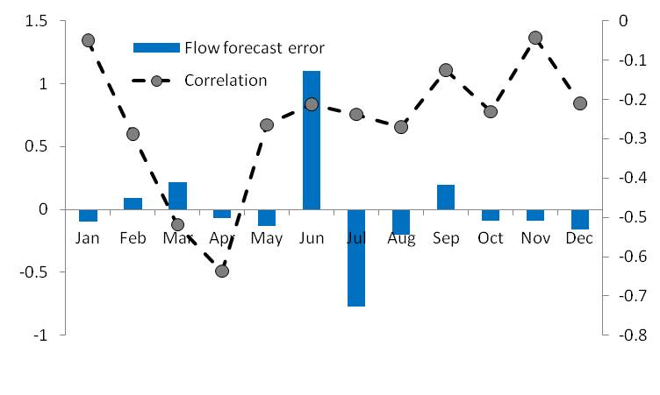
Preliminary results:
dynamic Epan vs. historic simulated streamflow errors
Concept:
    daily simulated streamflow errors are generated from Sac-SMA/SNOW-17 model in RFC operations, running static E_{p} (i.e., climatologic monthly),
    errors are compared to dynamic E_{pan} from a 30-year time-series.
Results:
    greatest streamflow errors (+/-) occur with highest E_{pan} at all time-scales to 3-monthly,
    relation is less clear at higher time-scales (monsoon and water supply seasons, annual),
    highest correlation between monthly error and monthly E_{pan} is March/April.
Caveat:
this is one basin:
  Tenmile Creek near Breckenridge, CO
  high-elevation headwater basin,
  snowmelt-dominated.

Slide 7
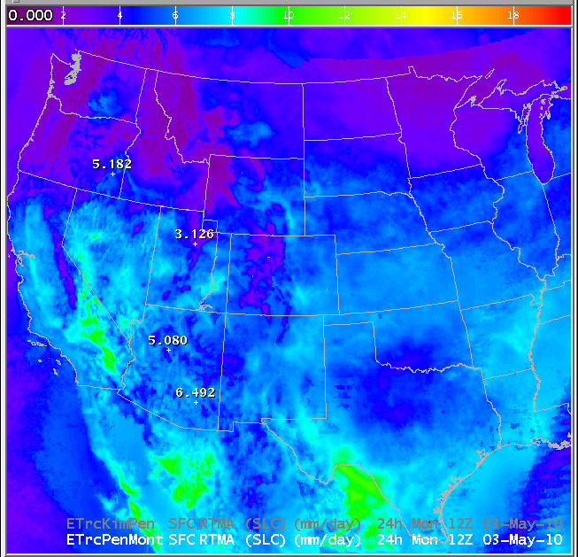
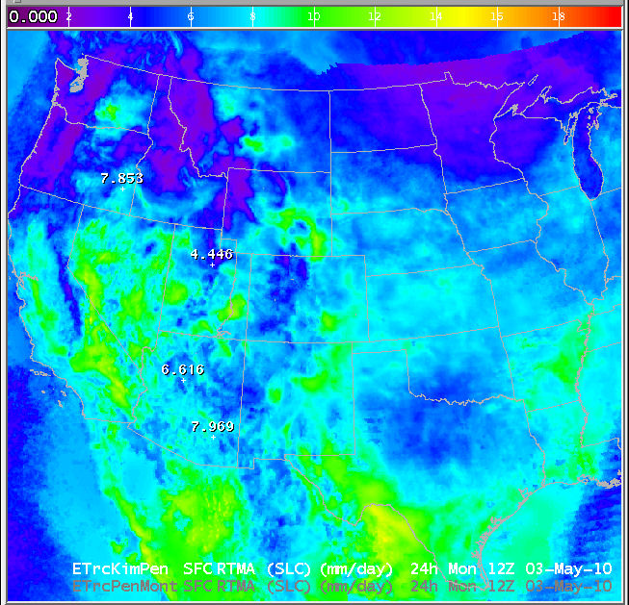
Forecasting ET_{rc} across NWS Western Region:
Penman-Monteith ET_{rc}
Kimberly Penman ET_{rc}
here, ET_{rc} is a specific case of ET calculated for specific biological and physical conditions (a hypothetical reference crop):
well-watered alfalfa/grass of height 0.12 m, r_{s} = 70 sec/m, α = 0.23, r_{s} = 208 sec/m,
uses regularly forecast meteorological data,
international standard (FAO-56).
very commonly used in agricultural community.
adjusts Penman E_{p} to model seasonality in vapor transfer process through a_{KP} and b_{KP}:
  seasonal functions of day of year,
  calibrated in Kimberly, ID,
  uses regularly forecast meteorological data.
ET_{rc} forecast for May 3, 2010 (mm)

Slide 8

Forecasting ET_{rc} across NWS Western Region:
delivery concept
Wind
Temperature
Dewpoint
Sky cover
Input forecast grids
NDFD-derived
2.5-km resolution
hourly
WFO FORECAST
+ + +
ET_{rc} climatology grids
NLDAS-derived
0.125º resolution
CONUS-wide
daily / weekly
moving window / static weeks
CBRFC & WR-SSD
mean
GFE
script
variance
minimum
90% exceedance
median (50%)
10% exceedance
maximum
ET_{rc} forecast grid
2.5-km resolution
daily/weekly outlook
ET_{rc} point forecast
value-added
statistical context
spatial context
WFO PRODUCT
e.g., http://www.wrh.noaa.gov/sto/et

