Slide 1
SWE & April-July Runoff Volume
Kristen Yeager
Colorado Basin River Forecast Center

Slide 2
Outline
Motivation
Objective
Results
Conclusions
Future Work

Slide 3
Motivation & Objective
A CBRFC April 2010 analysis of Lake Powell inflows showed that spring SWE and April-July runoff exhibited a non-linear relationship, prompting questions from stakeholders who expect that “normal” conditions would produce “normal” runoff.
To provide insight on the relationship between spring SWE and April-July runoff volume.

Slide 4
Colorado—Glen Canyon Dam
0.74738 R² correlation.
Residual plot shows scatter with no obvious trend—indicative of a linear relationship.

Slide 5
Colorado—Glen Canyon Dam
Residual plot shows scatter with no obvious trend—indicative of a linear relationship.

Slide 6
Green—Above Flaming Gorge
0.57421 R² correlation.
0.65992 R² correlation without 1983 .

Slide 7
Yampa—Maybell NR
0.70364 R² correlation.

Slide 8
Duchesne—Myton
0.79128 R² correlation

Slide 9
Colorado—Lake Granby, Granby NR
0.83629 R² correlation

Slide 10
Colorado—Cameo NR
0.70601 R² correlation.

Slide 11
Gunnison—Blue Mesa Reservoir
0.76428 R² correlation.

Slide 12
San Juan—Bluff NR
0.69158 R² correlation.

Slide 13
Weber—Oakley NR
0.75372 R² correlation.

Slide 14
Ogden—Pineview Reservoir, Ogden NR
0.8294 R² correlation.

Slide 15
In all three scenarios, max-SWE-to-date is the better predictor of April-July runoff.

Slide 16
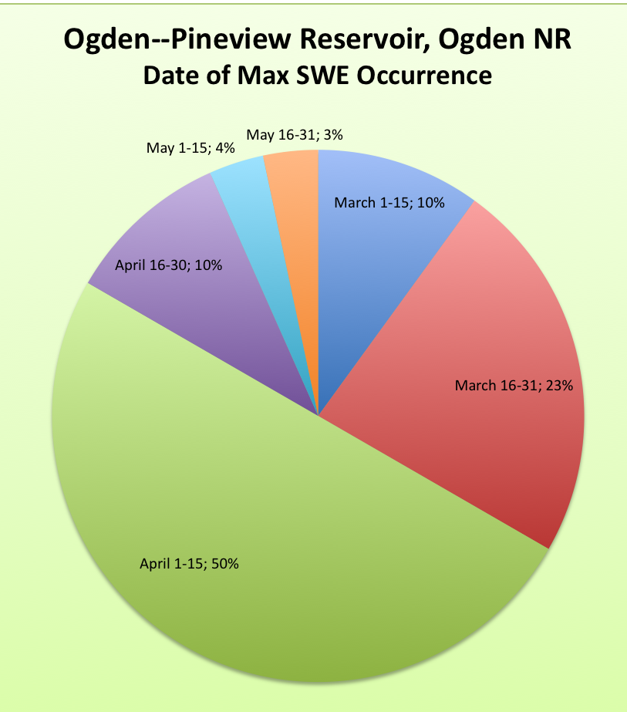
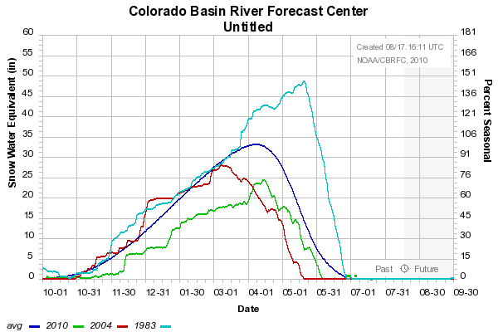
PRPC2, SLMC2
BLPU1, HRGU1
The mean date of max SWE is April 8th, approximately three weeks before May 1. Significant melt out has already occurred, thus using the May 1 SWE may underestimate the runoff volume.

Slide 17
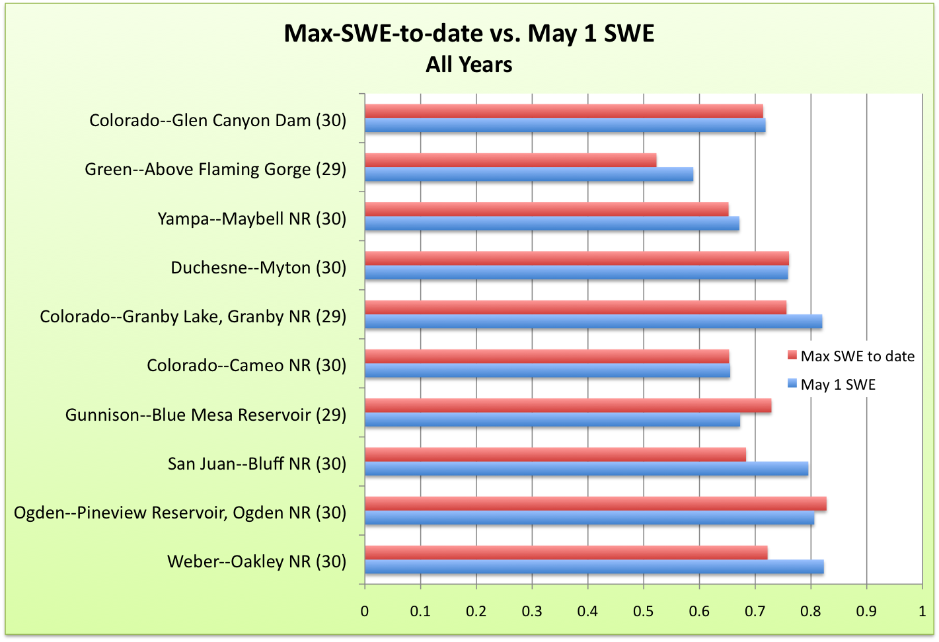

Slide 18
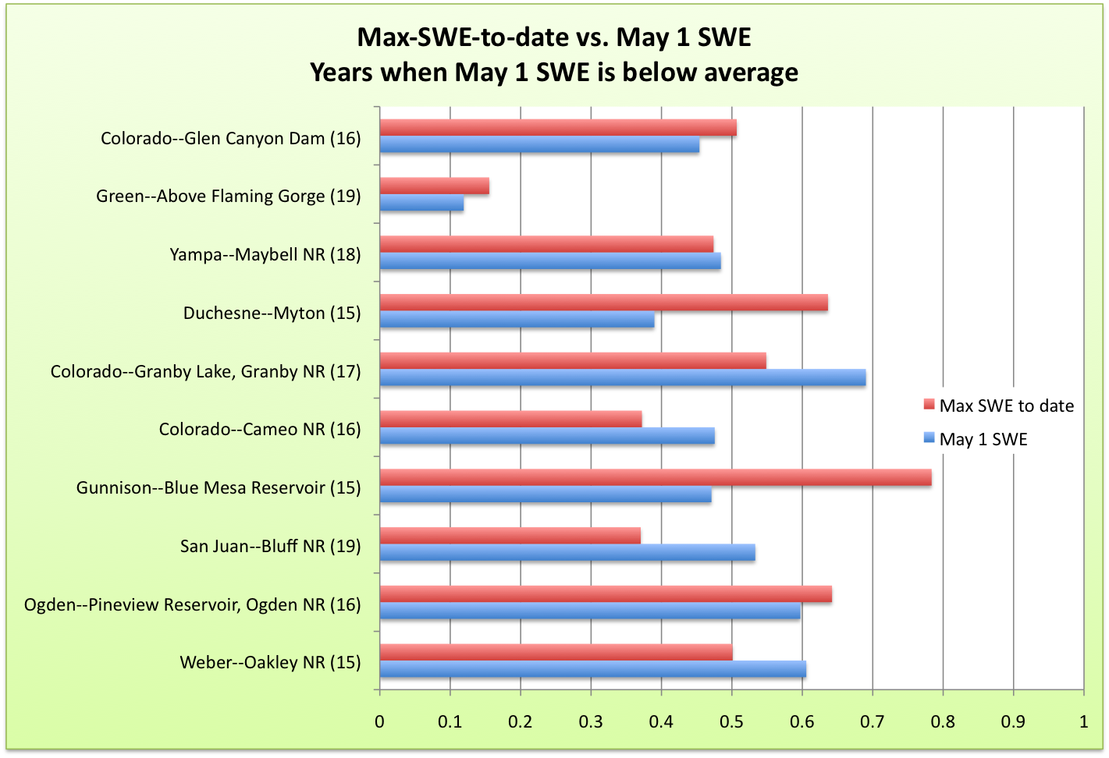
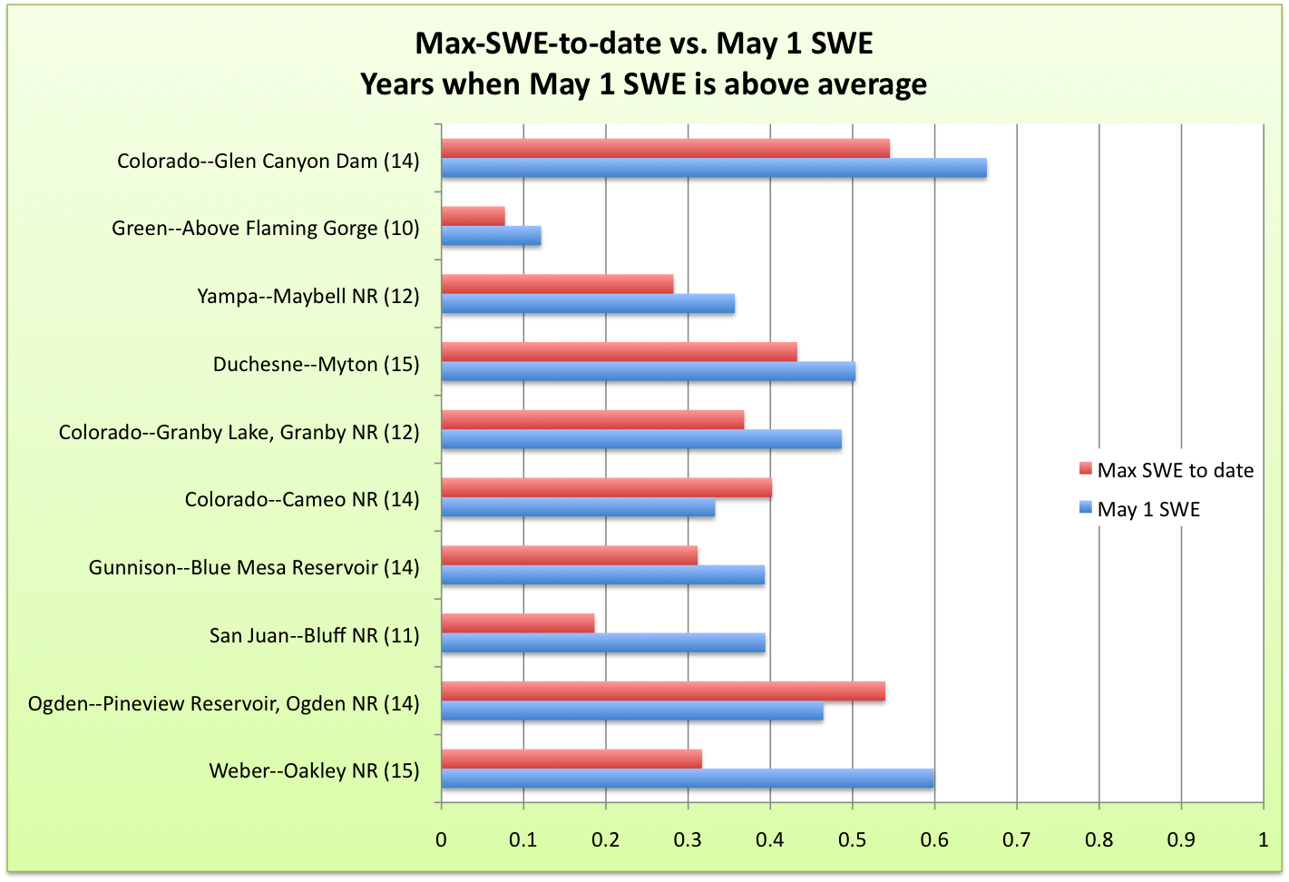

Slide 19
Conclusion and Discussion
Spring SWE and April-July runoff volume display a linear relationship, but not a perfect linear relationship (100% average SWE will not necessarily produce 100% average runoff).
Linearity varies from basin to basin.
Using max-SWE-to-date instead of May 1 SWE does not yield more accurate runoff forecasts for most basins.

Slide 20
Future Work
What factors may contribute to interannual variability?
Does runoff efficiency (runoff/SWE) vary as a function of spring or winter temperatures?

