Slide 1
CHPS
CHPS – Community Hydrologic Prediction System
The whole system, ie data collection, quality control, future forcing creation
Includes FEWS
FEWS – Flood Early Warning System
The hydrologic modelling software
Within CHPS
Replaces NWSRFS

Slide 2
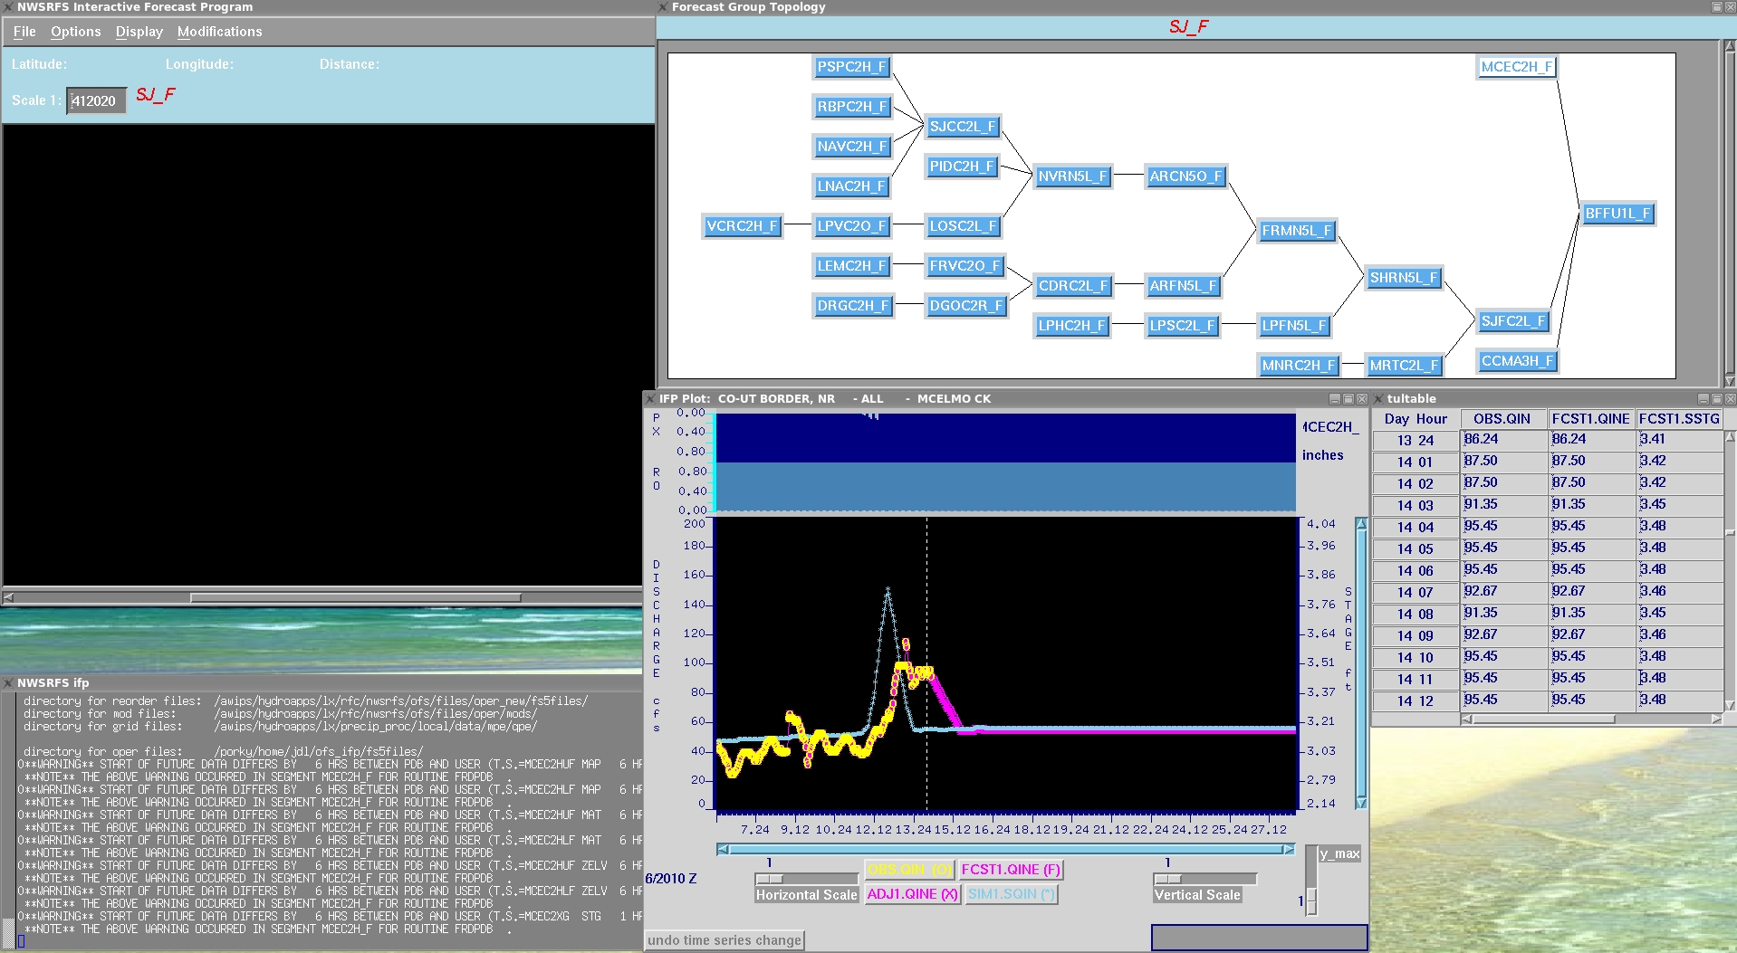
Current IFP interface with NWSRFS

Slide 3
New IFD interface for FEWS
Highlights of new features
More logging of system
Easier navigation of model plots
Better integration of segment information
Ability to view all data in system

Slide 4
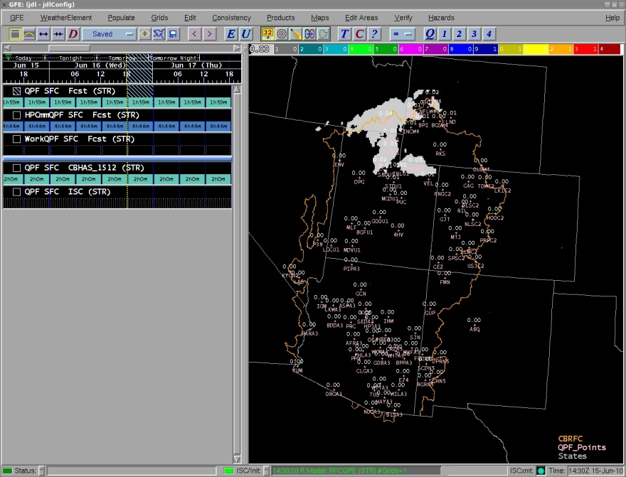
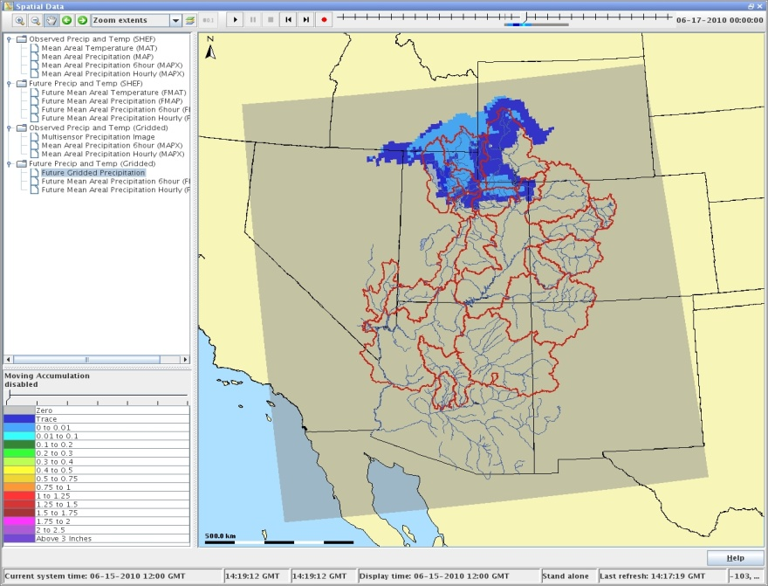
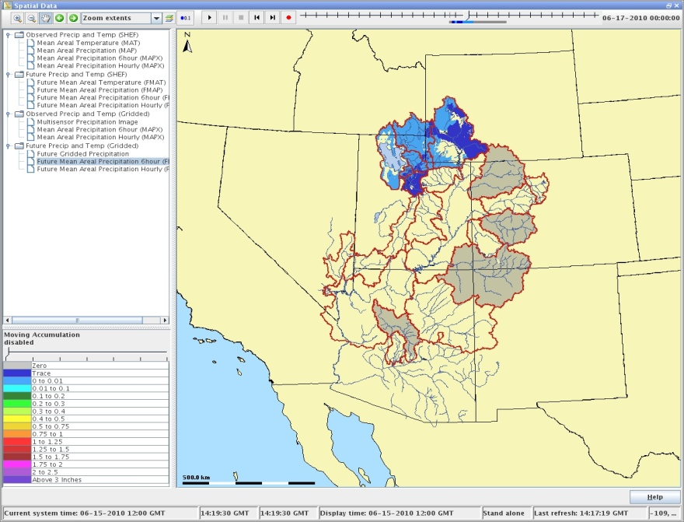
Gridded data into FEWS QPF example

Slide 5
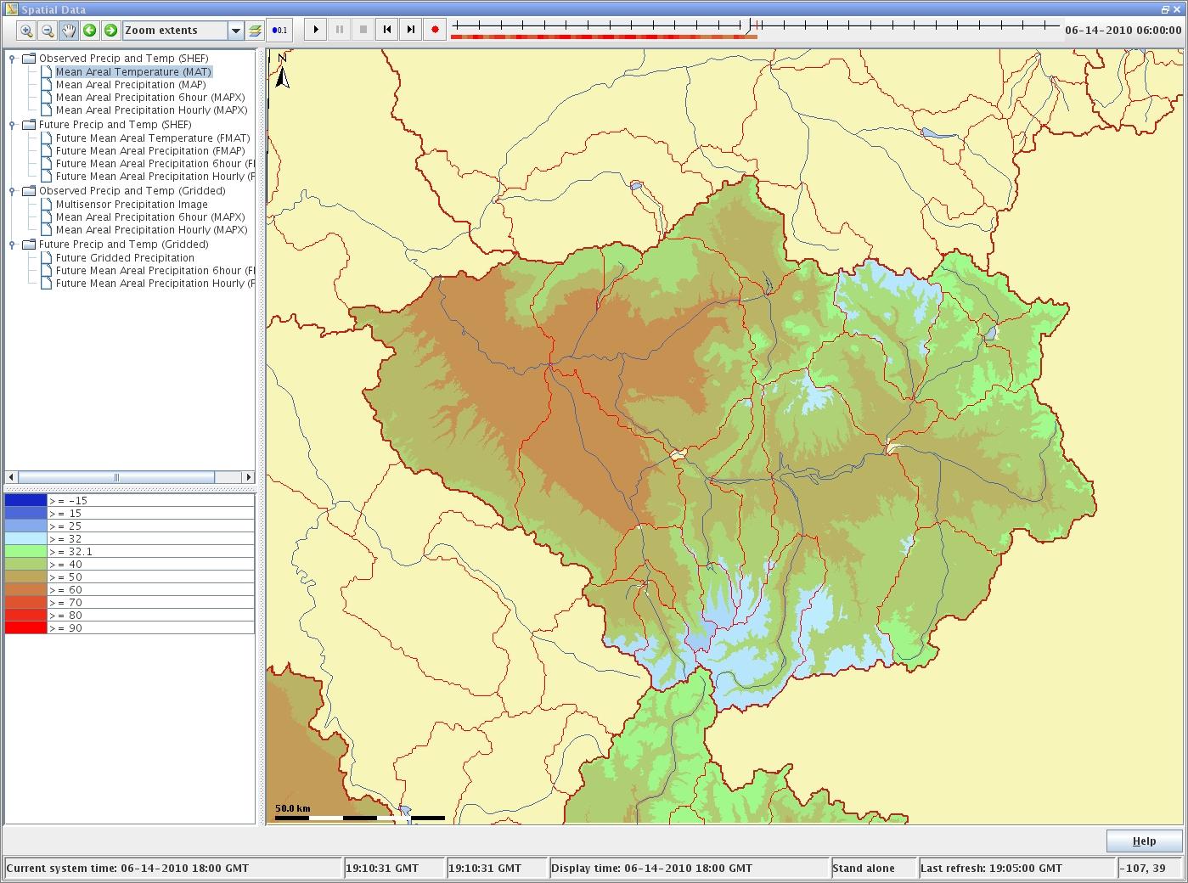
Gridded Temperatures and Freezing Levels will be imported too

Slide 6
Other things to come with CHPS
Ability to provide Stand Alone systems.
Ability to add new models to the system.
Facilitate collaborations with stakeholders, academia, and research-to-operations implementations.
International hydrologic community.

