Slide 1
Decision Support
CBRFC
Stakeholder Workshop
Kevin Werner
Service Coordination Hydrologist
Colorado Basin RFC

Slide 2
Forecast Process
Hydrologic Model Analysis
hydrologic
expertise &
judgment
model
guidance
Weather and Climate Forecasts
River
Forecast
System
Forecast
precip / temp
Outputs
Graphics
River Forecasts
Analysis &
Quality Control
Rules, values, other factors, politics
parameters
Observed
Data
Calibration
Decisions

Slide 3
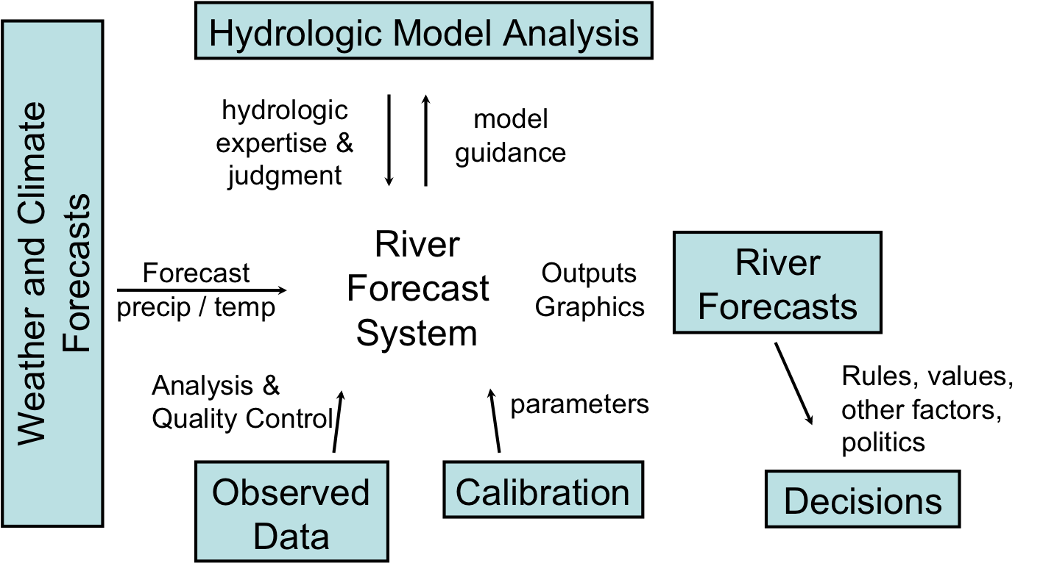
CBRFC Research Needs
3. Develop reliable ensemble forecast system
4. Improve physical process understanding and modeling
2. Improve use of weather and climate forecasts
1. Improve precipitation analysis
5. Decision Support: Work with stakeholders to use forecasts

Slide 4
Previous Research on decision support in the water sector
Study | Method(s) | Geographic Area(s)
(Rayner et al., 2005) | Field Research: Semi-structured Interviews | USA: Pacific Northwest, Southern California, and Washington, DC
(O'Connor et al., 2005) | Survey | USA: South Carolina and Susquehanna River Basin of Pennsylvania
(Lemos, 2008) | Field Research: Observation of Meetings | USA and Brazil
(Dow et al., 2007) | Survey (building on earlier work (O'Connor et al., 2005)) | USA: South Carolina and Susquehanna River Basin of Pennsylvania
(Callahan & Miles, 1999) | Field Research: Semi-structured interviews | USA: Pacific Northwest
(Ziervogel et al., 2010) | Case Study | South Africa
(Pulwarty & Redmond, 1997) | Field Research: Semi-structured interviews | USA: Pacific Northwest
Forecasts generally not used. Water management agencies value reliability and quality above all else. Unless those are threatened, agencies have little incentive to use forecasts.
Forecast use correlates with perceived risk. Forecast usage not dependent on agency size or on understanding of forecast skill and reliability.
Policy and infrastructure in USA limit use of forecasts. Many operating decisions are tied to observed data and do not allow flexibility.
Hopeless?
No! Long term drought, increasing demands, and climate change projections for less water each present opportunities for increasing forecast usage.
4

Slide 5
Colorado River Supply and Demand
Credit: USBR
Notes:
5
5

Slide 6

















CBRFC Partnerships

Slide 7
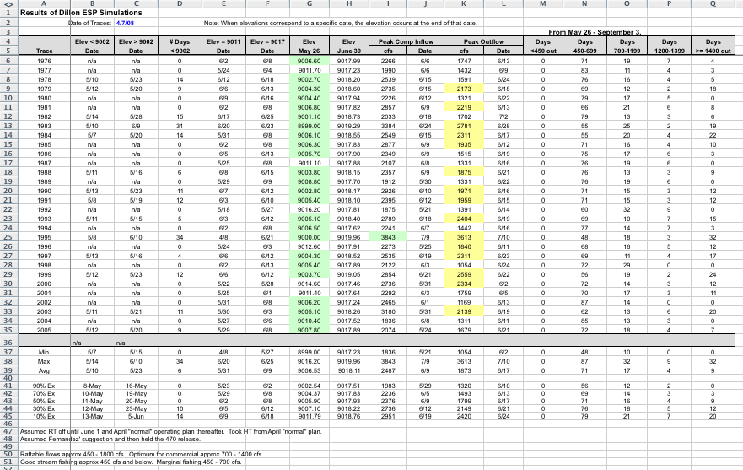
Example:
Denver Water Application
RFC ESP Forecasts
Reservoir Management
Credit: Bob Steger, Denver Water

Slide 8
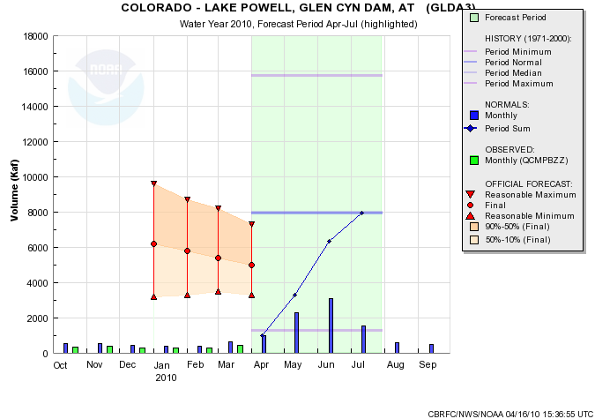
Example: Lake Powell Forecast

Slide 9
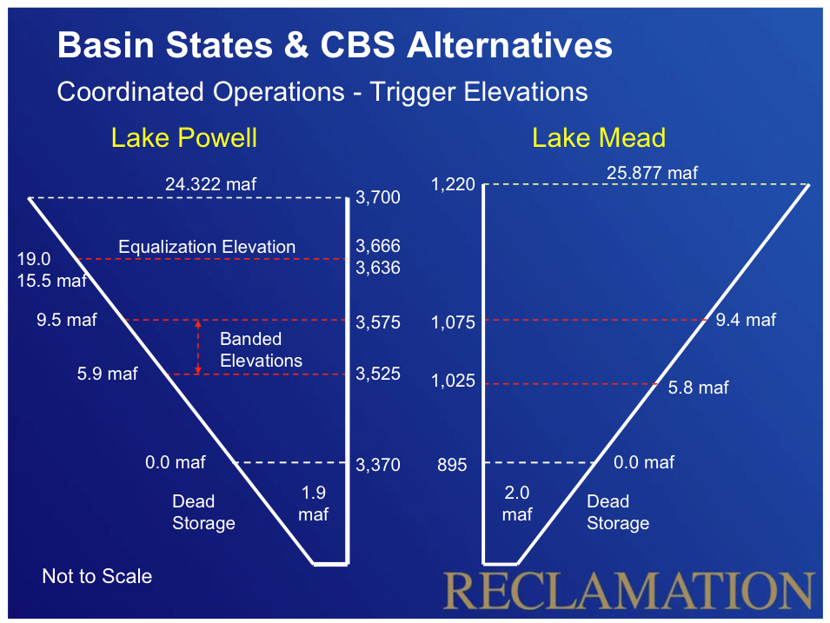
Lake Powell
Probability of Equalization Forecast
Background:
Drought conditions in the Colorado Basin severely stressed water supplies
In 2007, the USBR in consultation with the seven basin states adopted an interim operating agreement in affect until 2026 that defines how water shortages and surplus will be allocated to the basin states.
Allocations are determined by lake elevation triggers. In many cases, these triggers are based on forecasts.
Stakeholders requested forecasts for probabilities of triggering various actions.
In 2009, CBRFC and USBR developed a forecast of the chance that Lake Powell will reach the equalization level by the end of the water year. Somewhat different from the chance that April 1 forecast will forecast the same.

Slide 10
After October the water year to date observed volume is include in all numbers
This is the forecast of the chance that Lake Powell will reach the equalization level by the end of the water year – not the chance that
equalization will be triggered.

Slide 11
Toolkit for User Engagement
Previous efforts:
  Forecast verification – Large workshop in Boulder, CO in 2008 with hands on lab exercises and presentations (collaboration with WWA)
  Soil moisture – Focus group workshop in Tucson, AZ in 2009 with specific questions and social science techniques (collaboration with CLIMAS)
Goal: Develop a systematic workshop to gauge forecast usage, potential usage, and
Engaged with WWA (Kristen Averyt) and CLIMAS (Gigi Owen) to develop toolkit
Dry run at CBRFC in March 2010
First toolkit workshop April 2010 in Grand Junction, CO
Follow on workshops in Utah and SE USA.

Slide 12
NWS River Forecast Center
April 23, 2010: Grand Junction, CO
Introduce and evaluate the new national Water Resource Outlook web-based tool developed by the CBRFC
Climate Literacy and Information Use Survey
  (Pre- and Post-Workshop)
Computer-based usability evaluation
Scenario Exercises
  Used to evaluate how the tool might be used & what information people use to make decisions
WWA Funding: July 2009–onward
Leveraged Funding: NOAA NWS CBRFC
Notes:
A few weeks ago, workshop working with water resource managers on the West Slope:
Introduced participants to new Water Resources Outlook tool
Used climate literacy survey, computer-based usability survey and new iteration of the scenarios.

Slide 13
Working with NOAA West…
Deliver a broader suite of improved water services to support management of the Nation’s Water Supply

Slide 14
Summary
  RFCs develop and maintain a real time hydrologic modeling and forecasting environment to support water related decisions nation wide
  RFCs are looking more to provide water resources decision support
  We’re looking to work with groups like yours to develop these concepts and prototype services
Notes:
14
The NWS started making water supply forecasts in the 1940s for the Colorado basin. Eventually these forecasts were expanded to cover most western snow melt dominated basins through cooperation with the NRCS. Seasonal streamflow forecasts tradionally derive nearly all of their skill from current snowpack conditions in the basin. In fact, the NRCS SNOTEL network was deployed beginning in the late 1970s explicitly to improve seasonal streamflow prediction.
Bullets on left give background information on water supply forecasts.
The upper right figure is hyperlinked to “live” website (www.cbrfc.noaa.gov/westernwater). - Suggest clicking on website and giving a brief synopsis of current forecasts for western US. Note that most areas are extremely dry this year – particularly most all of California and the Colorado Basin. The Washington Cascades and the upper Arkansas River Basin are the only areas with above normal forecasts this year.

Slide 15
Wrap up from this meeting
  Action Items….
Notes:
15

Slide 16


Kevin Werner
CBRFC Service Coordination Hydrologist
Phone: 801.524.5130
Email: kevin.werner@noaa.gov

