Slide 1
National Weather Service River Forecast System (NWSRFS) Interactive Forecast Program (IFP)
CBRFC Open House
August 18, 2010

Slide 2
Observed Inputs:
Precipitation
Temperature
Freezing Levels
Stage/Flow
Pool Elev/Storage
Forecast Inputs:
Precipitation (5 days)
Temperature (10 days)
Freezing Levels (5 days)
NWSRFS
Operational Forecast System (OFS)
Forecaster:
Quality Control
Analysis
Run-time mods
Outputs:
Simulated flow, storage
Short term deterministic forecast flow, storage
Updated model states
Interactive Forecast Program (IFP)

Slide 3
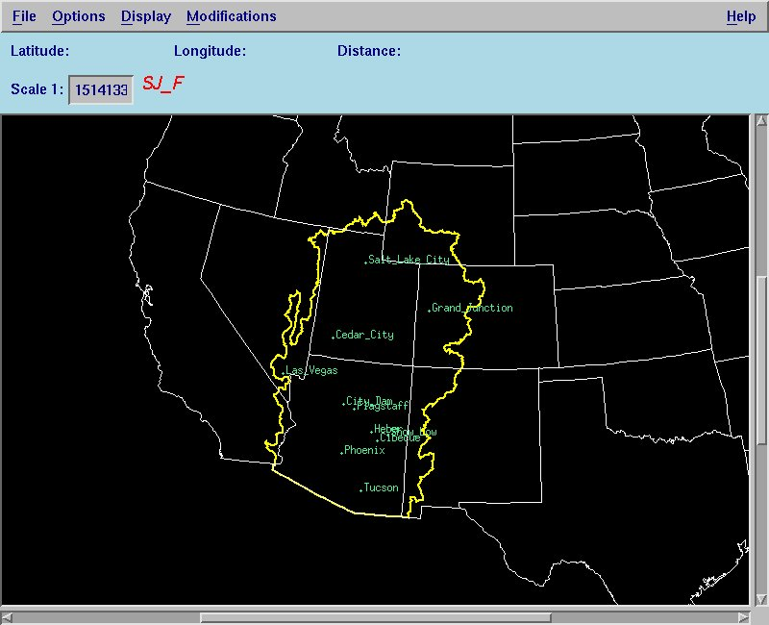
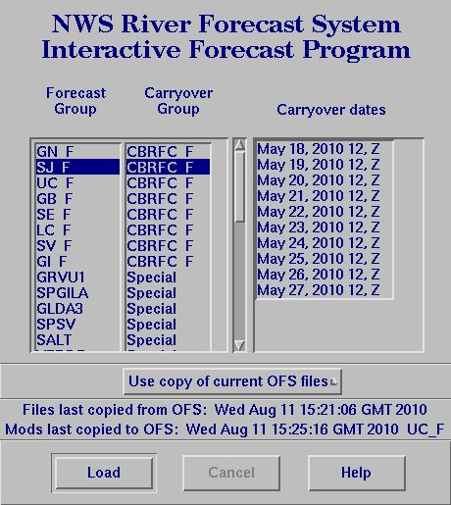

Slide 5
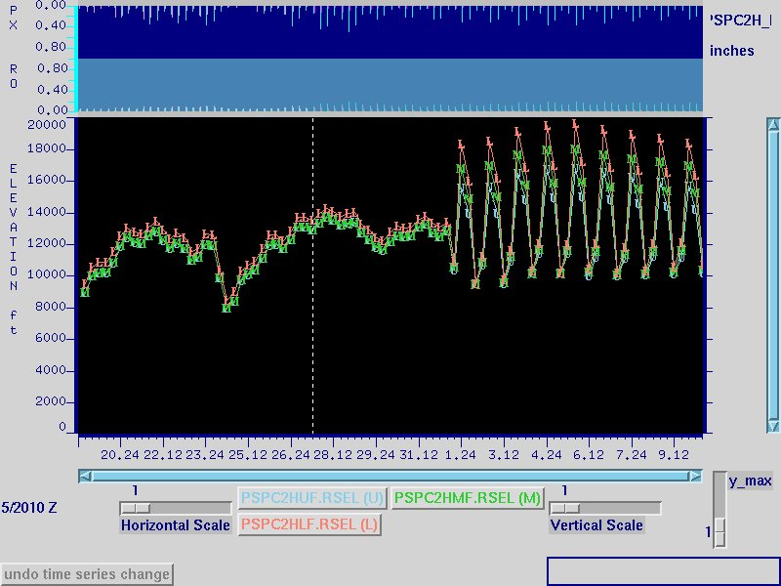
Rain+Melt
San Juan River at Pagosa Springs
OFS Inputs
Runoff
Past/observed
Future/forecast
Current Time
5/27 18z
Rain/Snow Elevation – determined from freezing levels when available, otherwise calculated from temperatures (more variable)
3 elevation zones

Slide 6
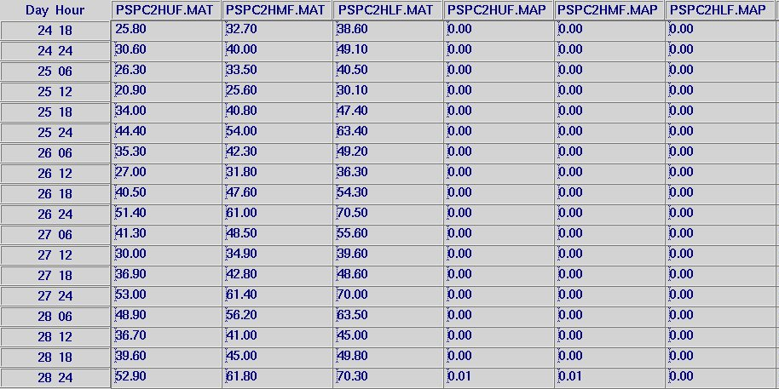
Mean Areal Temperature
Mean Areal Precipitation

Slide 7
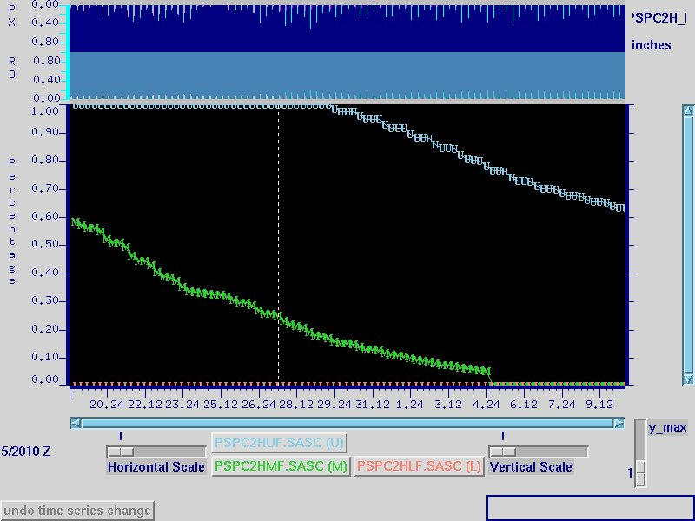
San Juan River at Pagosa Springs
Snow Model States
Simulated Areal Extent of Snow Cover
Upper zone = 11,000 – 12,700 ft (mean 11,485); 60 mi²
Middle zone = 8,500 – 11,000 ft (mean 9,755) ; 155 mi²
Lower zone = 7,200 – 8,500 ft (mean 7,850) ; 90 mi²

Slide 8
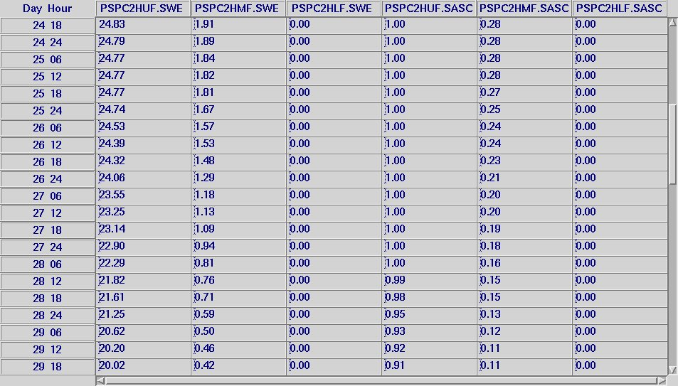
Snow Water Equivalent
Areal Extent Snow Cover

Slide 9
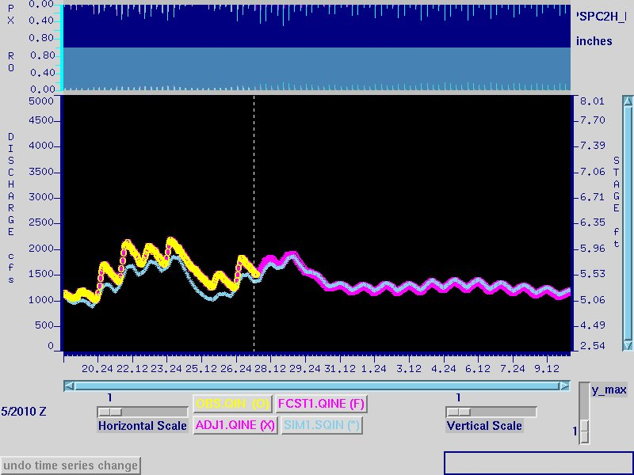
San Juan River at Pagosa Springs
Hydrograph
‘Adjusted’/‘Forecast’ is a single time series broken into observed and future pieces.
It equals obs when available, otherwise patterned with sim
Can control how quickly it blends into the actual values of the sim
Observed
Simulated

Slide 10
Run Time Modifications
Why:
Input data is not perfect
Calibration is not perfect
Models are not perfect
Most commonly used at CBRFC:
Time series
Set data to missing
Change values - TSCHNG
Precipitation
Temperature
Diversions
Change the blend period
Set reservoir releases - SETQMEAN
Snow model
Change the amount of snow water equivalent
Change the areal extent of snow cover
Increase or decrease melt with a ‘melt factor correction’ - MFC
Force precipitation type to rain or snow
Soil moisture model
Change the contents of tanks

Slide 11
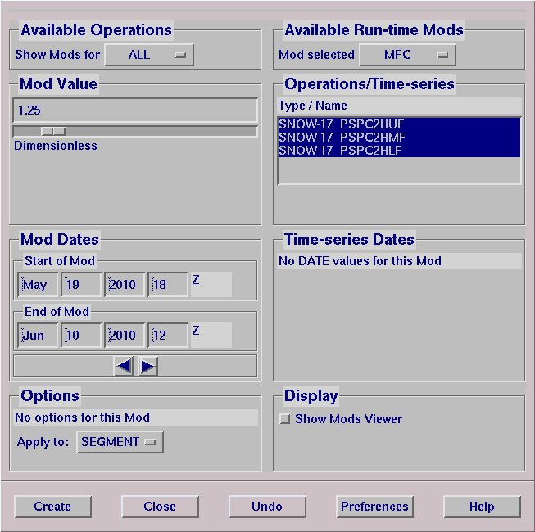

Slide 12
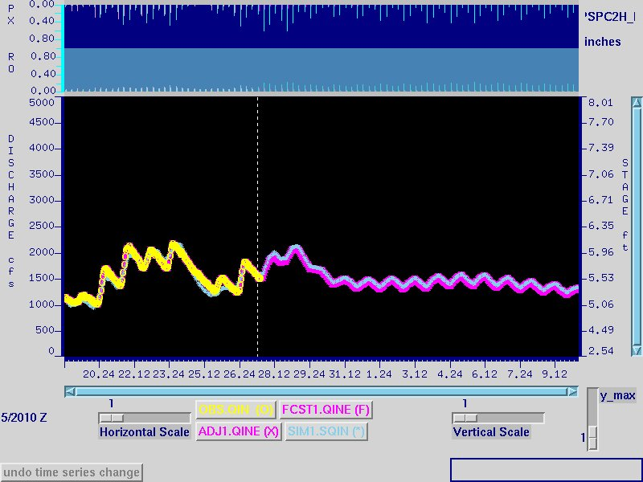
San Juan River at Pagosa Springs
Hydrograph after mod
Simulated flow now tracking observed flow better after MFC mod
Forecast flow higher than before

Slide 13
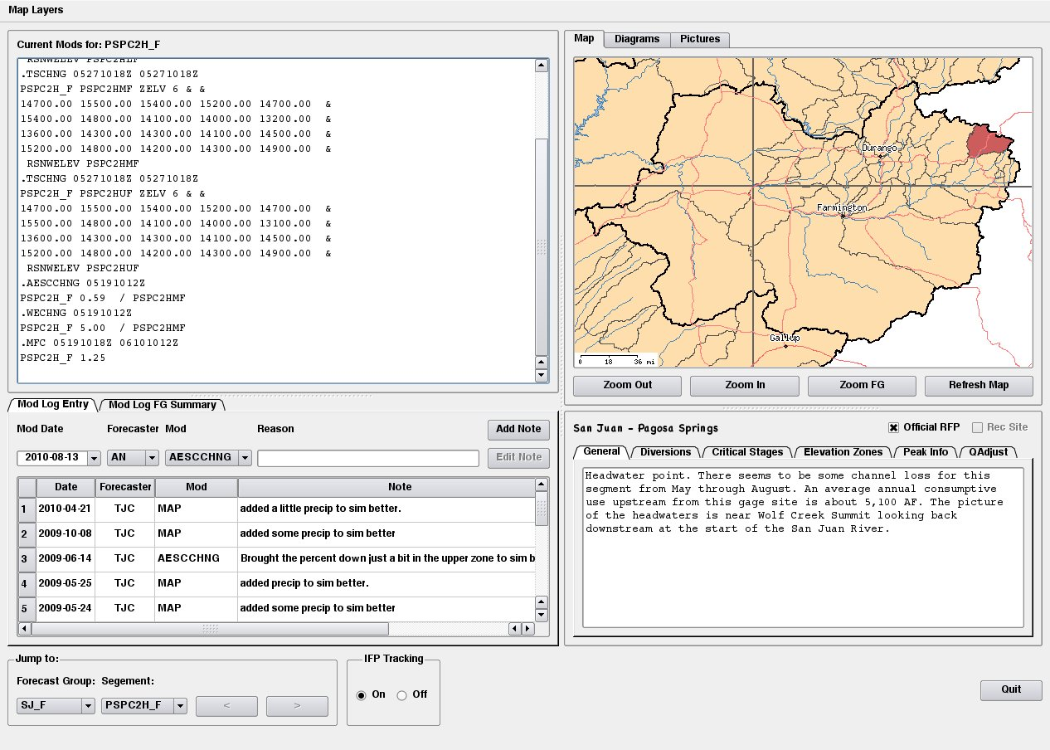
IFP COMPANION

Slide 14
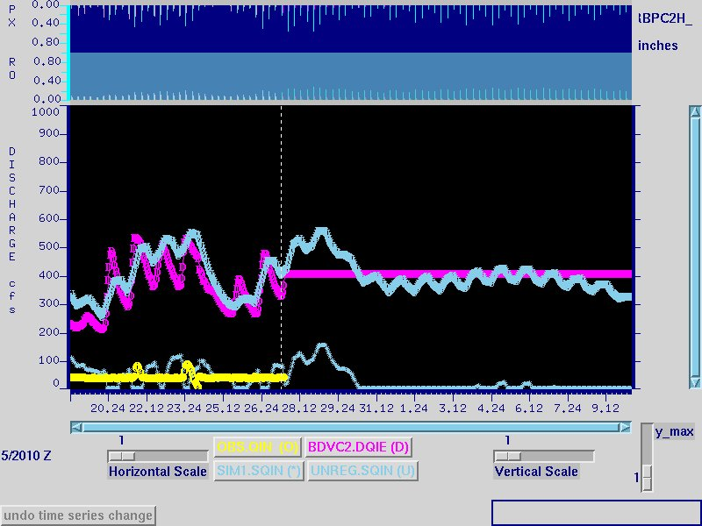
Rio Blanco River near Pagosa Springs
Hydrograph with diversion
Observed diversion
Unregulated – sim flow before diversion subtracted
Future diversion – holds last observed value constant
Simulated flow after diversion subtracted
Observed

Slide 15
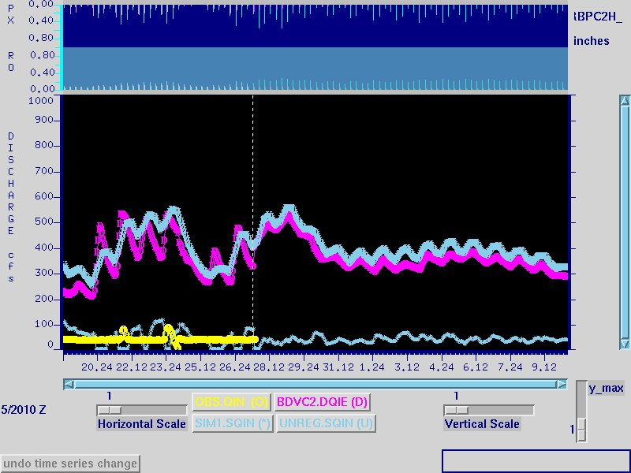
Rio Blanco River near Pagosa Springs
Hydrograph with TSCHNG mod
for future diversion
Future diversion – hand-drawn by forecaster to estimate how it will likely behave
(TSCHNG mod)
Simulated flow after diversion subtracted –
now more consistent with past flow

Slide 16
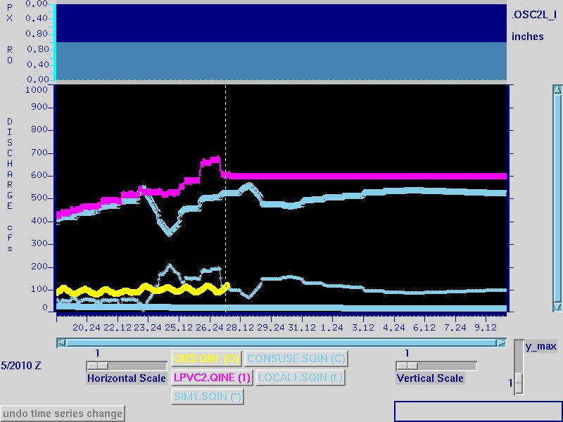
Los Pinos River at La Boca
Hydrograph with Routed flow, Local sim, and Cons use
Flow routed from upstream
segment
Model calculated consumptive use
Local simulated = addition to flow below upstream segment(s)
Final simulated =
Routed + Local – Cons use
Observed

Slide 17
Navajo Reservoir Inflow
Hydrograph with routed flow
Observed inflow
Total routed
Final simulated =
Total routed + Local
San Juan –
Carracas
Piedra – Arboles
Local sim
Los Pinos – La Boca

Slide 18
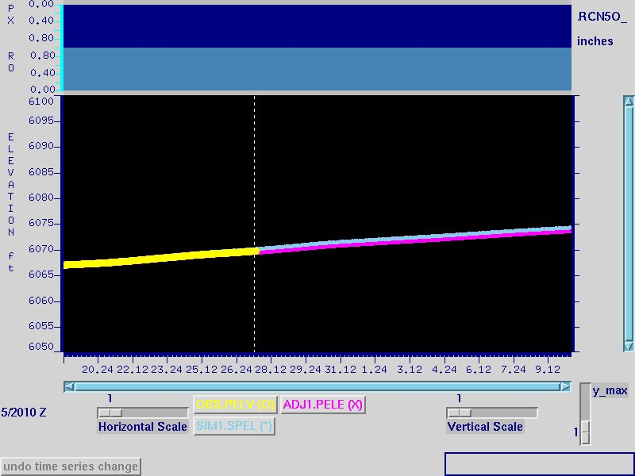
Navajo Reservoir
Pool Elevation
Adjusted pool elev – equals obs when available, otherwise patterned with sim
Observed pool elev
Simulated
pool elev

Slide 19
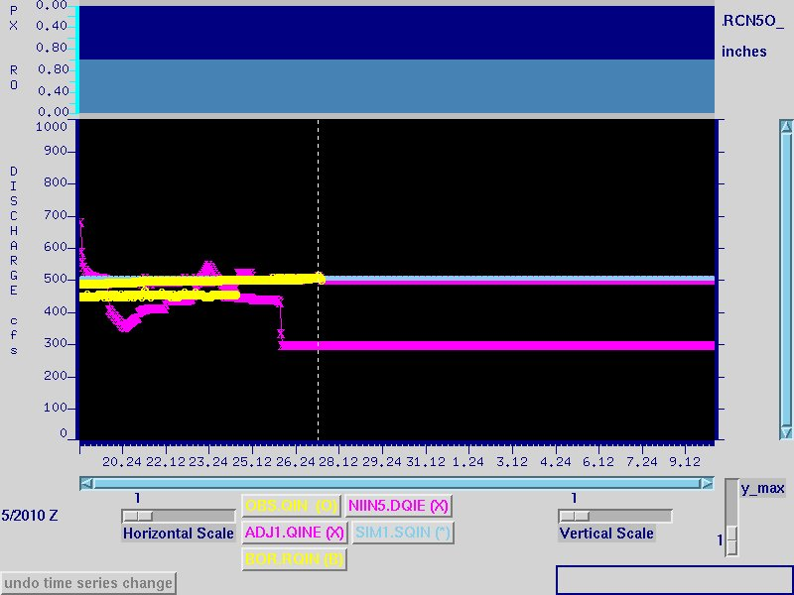
Navajo Reservoir
Outflow – standard
SETQMEAN mod
Observed release from dcp (primary)
Simulated release explicitly set to the observed values in the past and the last obs value for the future (SETQMEAN mod)
Adjusted – equals obs when available, otherwise patterned with sim
Obs release from Reclamation
Diversion taken straight out of reservoir – does not affect release values, but needed to simulate pool elevation correctly.

Slide 20
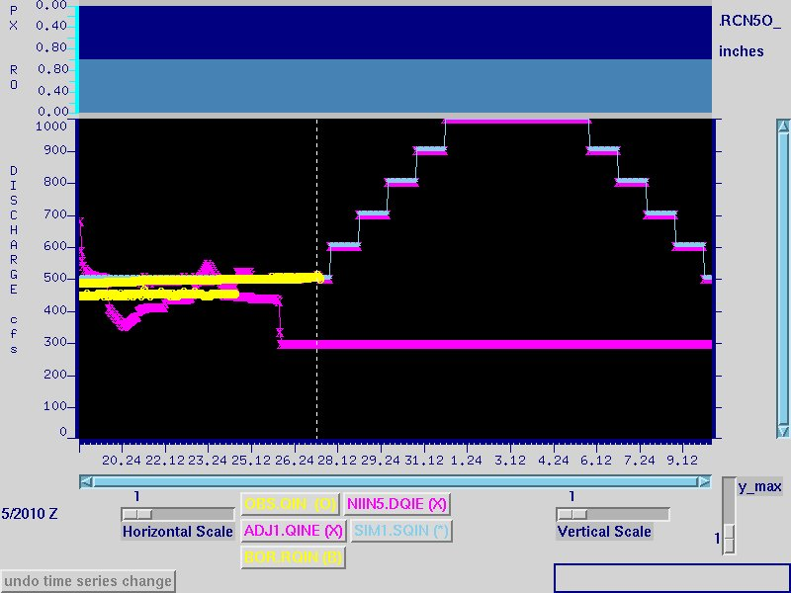
Navajo Reservoir
Outflow – release schedule in SETQMEAN mod
Simulated release explicitly set to the observed values in the past and an agency defined release schedule for the future (SETQMEAN mod)

Slide 21
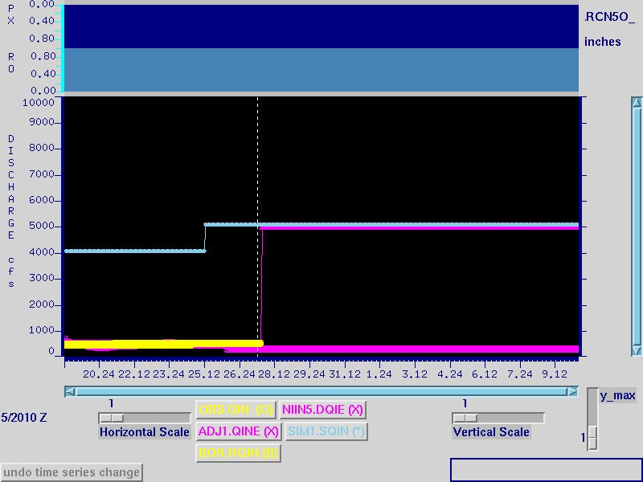
Navajo Reservoir
Outflow – reservoir rules
(no SETQMEAN mod)
Simulated release not set in the past or the future – model simulation is based on reservoir rules
Adjusted – the blend period to the simulation has been set very short

