Slide 1
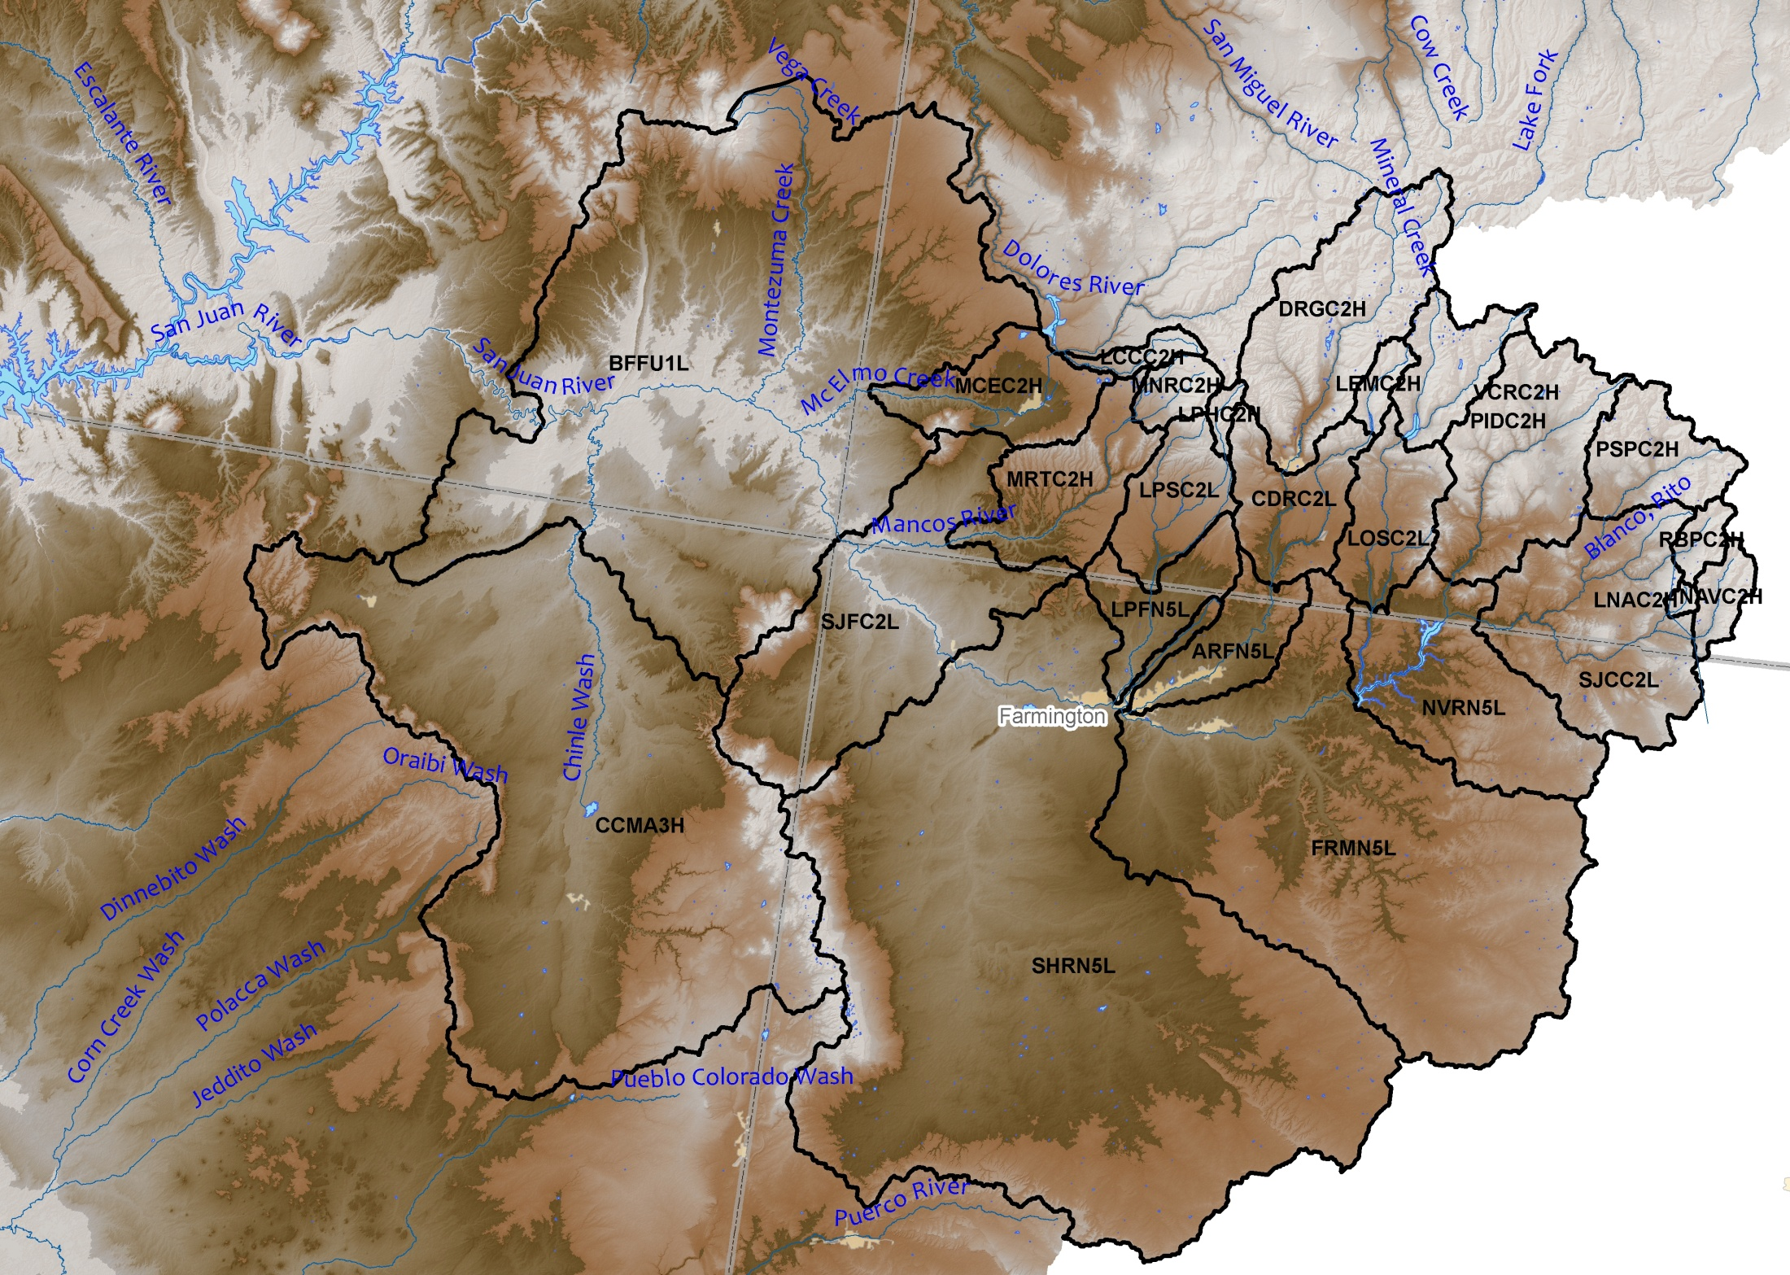
San Juan Basin

Slide 2
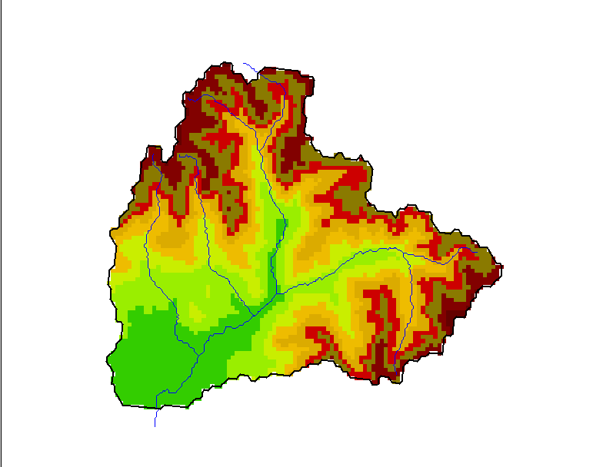
San Juan-Pagosa Springs(PSPC2)

Slide 3
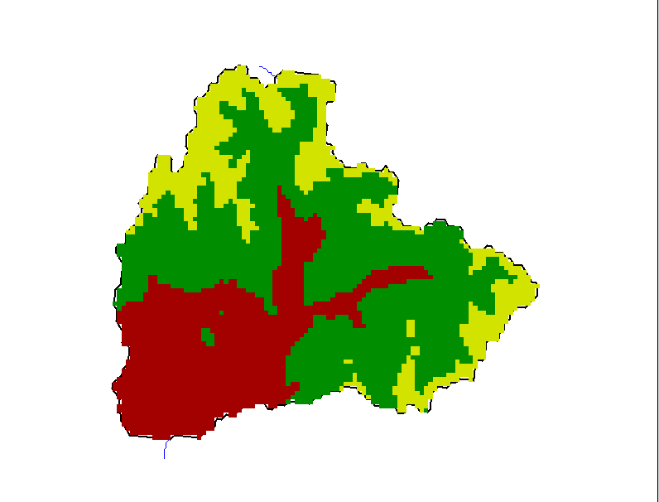
San Juan-Pagosa Springs(PSPC2)
Upper (11000-12644)
Middle (8500-11000)
Lower (7198-8500)

Slide 4
Calibrations/Simulations - inputs
In reality the 3 areas (upper, middle and lower) are represented (simulated) by only 3 points
The inputs our model needs for calibrations and operations (at these 3 points) are:
  precipitation
  temperature
  freezing level

Slide 5
For San Juan River at Pagosa Springs (PSPC2)
PSPC2 upper area
Elevation = 11437
Area=60nm
PSPC2 middle area
Elevation = 9774
Area=152nm
PSPC2 lower area
Elevation = 7844
Area=88nm

Slide 6
Calibrations/Simulations - Precipitation
Each area (upper, middle and lower) MAP is built using precipitation stations that (hopefully) have similar characteristics to that area
For the PSPC2
  Upper area – Upper San Juan.4, Lily Pond.35, Middle Creek.36
  Middle area - Upper San Juan.31, Lily Pond.31, Middle Creek.32
  Lower area - Pagosa Springs 1.06
These weights were chosen to guarantee water balance in each area. The water balance in each area was calculated using the PRISM sets

Slide 7
San Juan-Pagosa Springs(PSPC2)
mdlc2
usjc2
lpdc2
pagc2

Slide 8
Calibrations/Simulations - Temperature
Nearby stations (whose climatology is known) area used to calculate the temperature at the mid-point elevation of the area (whose climatologies are calculated using the climatology of the nearby stations)
Temperature is calculated by using the difference in station and area climatology

Slide 9
Calibrations/Simulations - Inputs
Precipitation and temperature are calculated every six hours at each area within the basin
  30 years
  Used to calibrate hydrologic models
Operationally done in a similar way
  Ensures our forecasts will have similar quality/characteristics to 30 years of calibration
For the San Juan at Pagosa Springs this is done for the upper, middle and lower areas

Slide 10
Calibrations/Simulations - Models
A snow model (accumulates/ablates snow) is run for each area in the basin
A soil moisture model (controls amount of water from the snow model which is retained in the soil/evaporates or ends up in the stream) is run for each area
  Evaporation is a calibrated amount :
    E=P-Q

Slide 11
Precipitation
and
Air Temperature
SNOW ACCUMULATION
AND ABLATION MODEL (SNOW-17)
Rain
or
Snow
Accumulated
Snow Cover
Energy Exchange
at
Snow-Air
Interface
Areal Extent
of the
Snow Cover
Bare ground
or
snow cover
Snow Cover
Heat Deficit
Deficit = 0
Rain
on
Bare
Ground
Liquid Water
Storage
Ground
Melt
Transmission
of
Excess Water
Snow
Cover
Outflow
Rain
plus
Melt

Slide 12
Sacramento Soil Moisture
Accounting Model
TENSION WATER STORAGE
UPPER ZONE
DIRECT
RUNOFF
FREE WATER STORAGE
SURFACE
RUNOFF
INTERFLOW
LOWER ZONE
PRIMARY
FREE
WATER
STORAGE
TENSION
WATER
STORAGE
TENSION
WATER
STORAGE
SUPPLEMENTARY
FREE WATER
STORAGE
BASEFLOW
SUBSURFACE
OUTFLOW

Slide 13
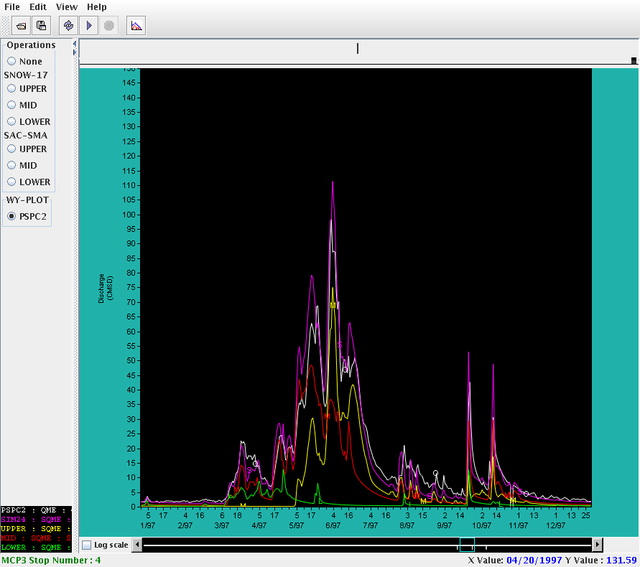
Calibrations/Simulations - Results

Slide 14
Calibrations/Simulations
456 basins
1130 areas (2-3 per basin)
85 reservoirs

Slide 15
Calibrations/Simulations - Reservoirs
Reservoir modeling is difficult as they are not physically based. However, we calibrate the reservoir models assuming two different modes:
  Irrigation (use average releases)
  Spillway/passflow
Operationally we do the following:
  Assume the current release
  Input a schedule
  Allow the spill/passflow rules

Slide 16
Adjustments to Flow
Unregulated flow=
  Observed flow + Diversions (measured) + Storage
Natural flow=
  Unregulated flow + Consumptive Use
Consumptive use (in basin irrigation) can only be estimated
In our simulations we simulate natural flow but subtract out the consumptive use so the output is always unregulated flow
So:
  We simulate “natural flow”
  We remove the in-basin irrigation (consumptive use)
  This is the simulated unregulated flow. It simulates the actual flow plus the measured diversions (adjusted flow)
Operational considerations
  Observed flow=Unregulated flow-Diversions-Storage

Slide 17
