Slide 1
Peak Flow Forecasts
Methods and Evaluation
CBRFC Open House
August 17, 2010
Ashley Nielson
Hydrologist

Slide 2
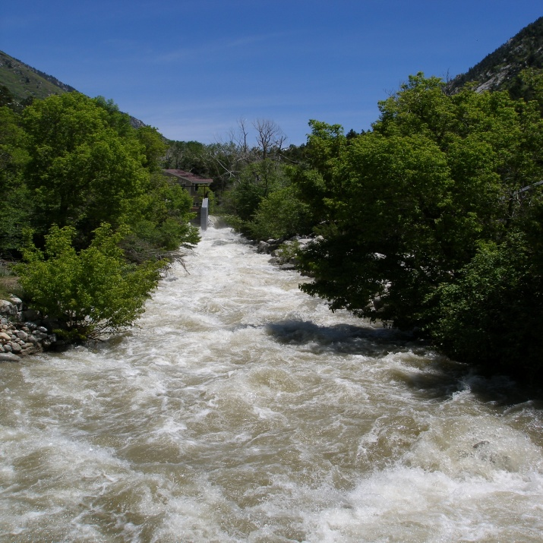
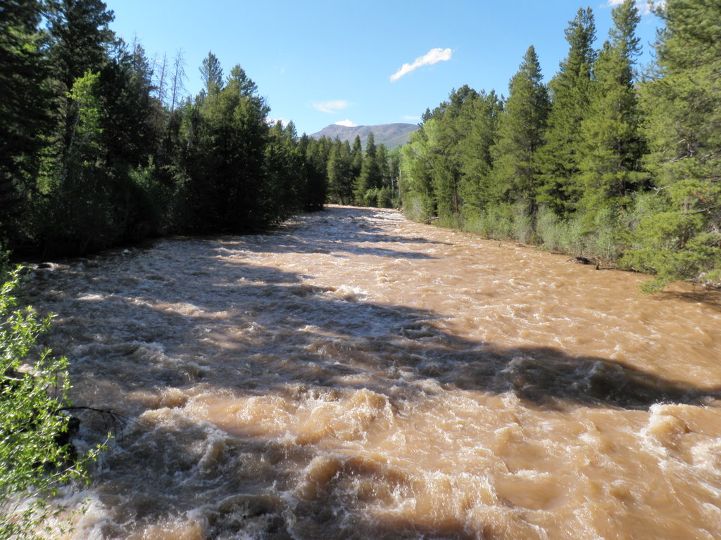
Outline
What is a peak flow forecast?
How do we make a peak flow forecast?
Forecast Evaluation
Summary
Questions/Discussion

Slide 3
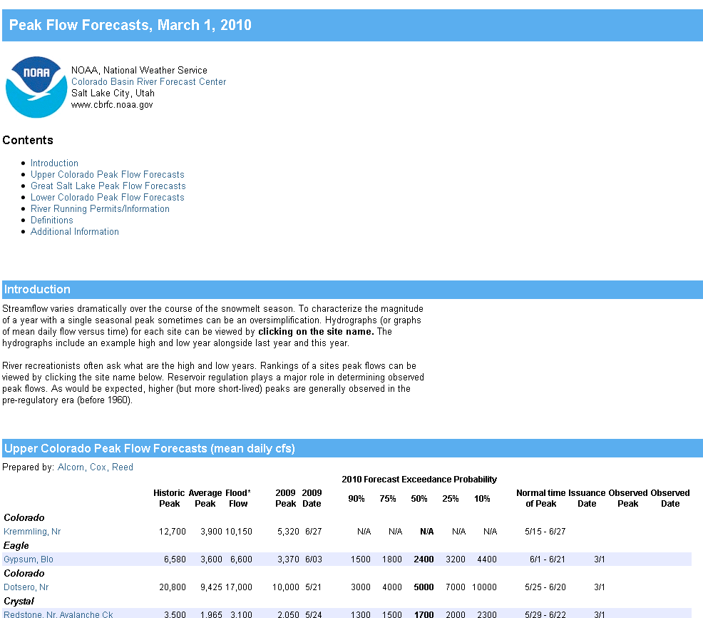
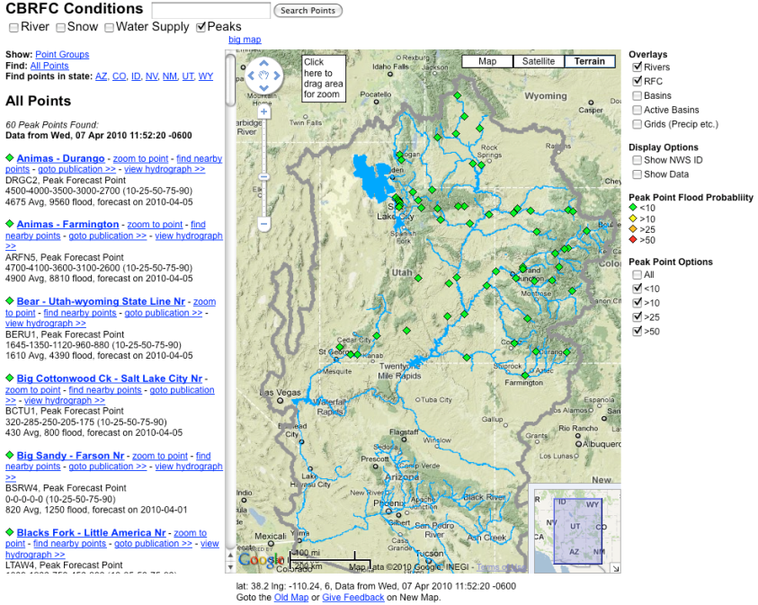
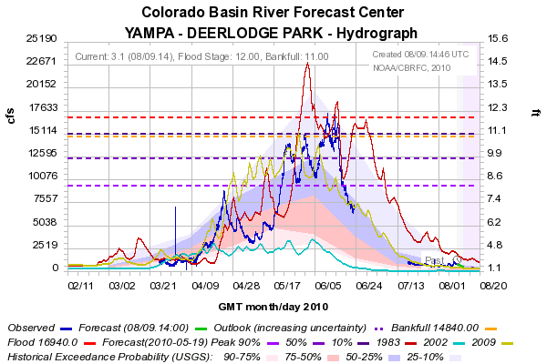
What is a Peak Flow Forecast?
Snowmelt Mean Daily Maximum Flow (April-July)
Probabilistic Forecasts
Exceedence Probabilities -10%,25%,50%, 75%, 90%
Issued (at least) monthly from March-June
60 points (could change)
Updated as needed

Slide 4
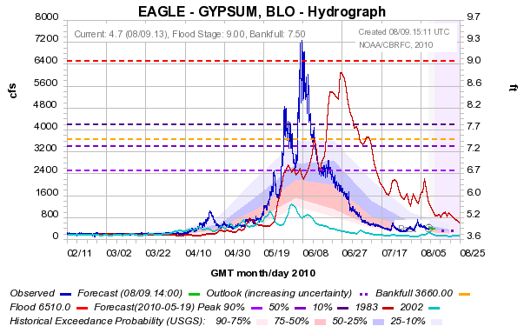
10%
50%
90%

Slide 5
How do we make a Peak Flow Forecast?
Main Variables:
1. Current Soil Moisture States
2. Snowpack Conditions
3. Current Base Flow
4. Reservoir Regulation Plans
5. Future Precipitation Events
6. Future Temperature
Methods:
1. ESP
(Max mean daily flow April-July)
2. Regressions
(Historical Peaks vs Historical Volumes)
3. Hybrid method of ESP + Regressions

Slide 6
Forecast Evaluation
Why peak flow forecast verification?
No previous verification information -Unlike water supply and event forecasts
Large uncertainty in forecasts - Heavily dependent on weather conditions during the melt period
Forecast process is difficult - Verification studies should help drive decisions about changes to peak flow forecast program (e.g. When to start making forecasts? When to update?)
Forecasting tools (ESP) – How are the current tools performing? How the skill/error change over the current and historical forecast period?
Prototype - Validate tools and proof of concept before widespread verification of peak flow sites

Slide 7
Verification Methods
Selected 8 sites- 4 unregulated, 4 regulated
Collected peak flow forecasts from March-May for 1997-2009
Constructed ESP reforecasts of peak flow 1997-2005
Calculated error of forecasts and reforecasts
Calculated skill of forecasts and reforecasts
Compared error/skill of forecasts and reforecasts
Verified exceedance probabilities and forecast spread
Limitations
-Small sample size
-No future QPF or temperature forecasts included in reforecasts (coming soon)
-Reforecasts currently only available to 2005
-Observed peaks may be rain enhanced
-No archived documentation on forecast methodology

Slide 8
Little Snake nr Lily (LILC2)
FORECASTS (1997-2009)
March r²=0.37, MAE=1161cfs
April r²=0.62, MAE=913cfs
May r²=0.82, MAE=572cfs
10 %
25%
50 %
75 %
90 %

Slide 9
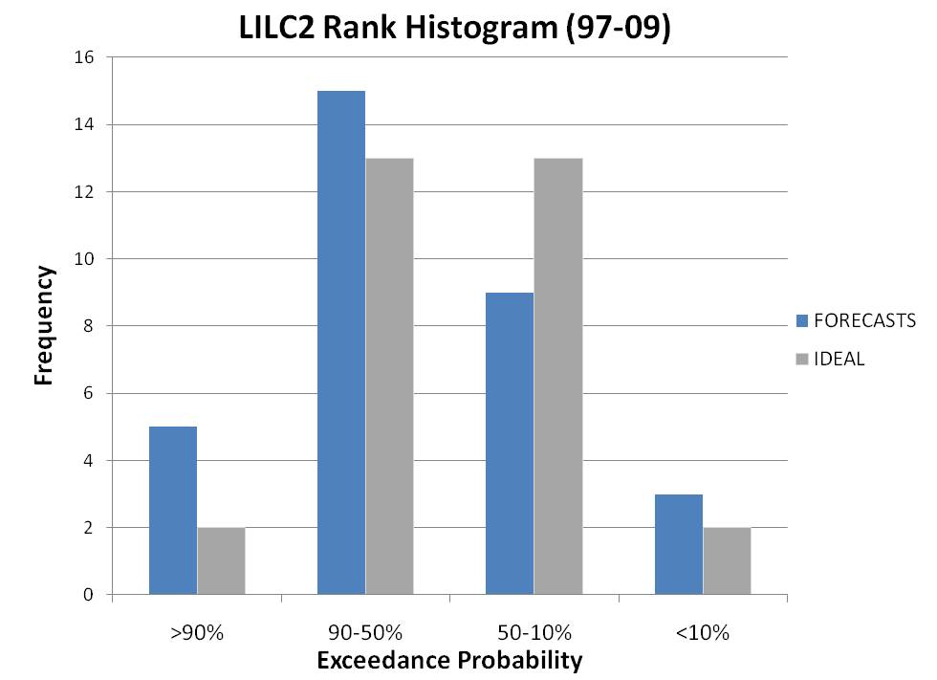
Little Snake nr Lily (LILC2)
FORECASTS (1997-2009)
* Includes first of month forecasts from March, April, and May*

Slide 10
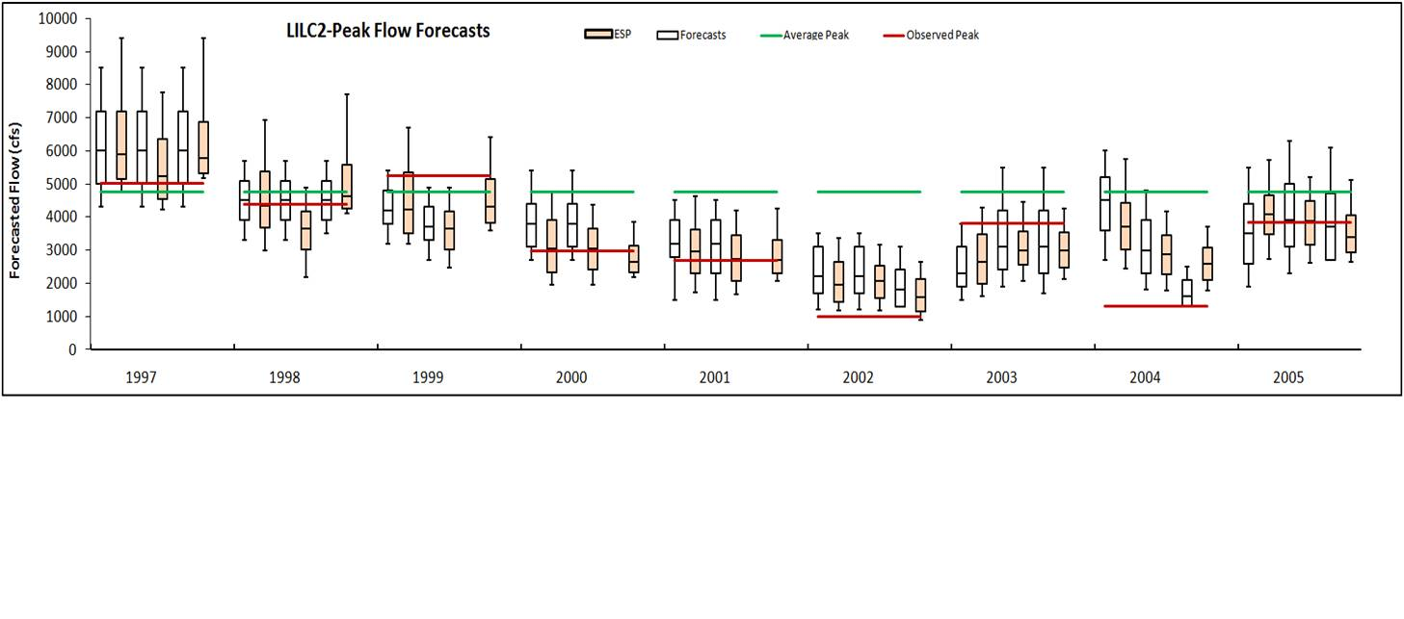
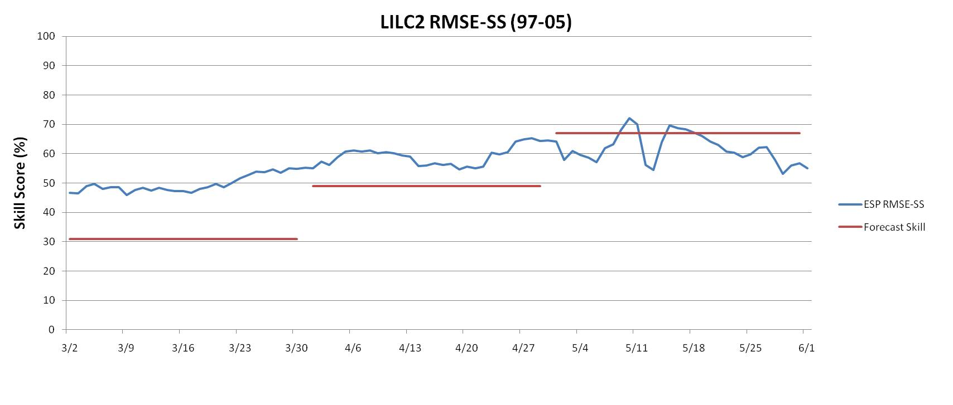
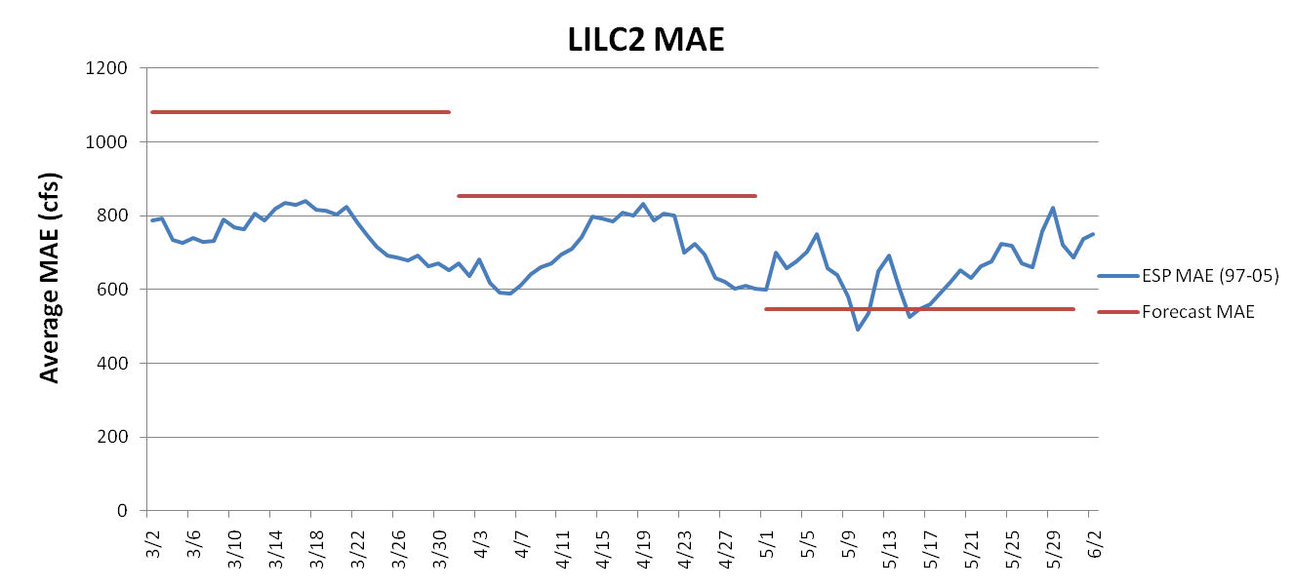
Little Snake nr Lily (LILC2)
ESP REFORECASTS (1997-2005)

Slide 11
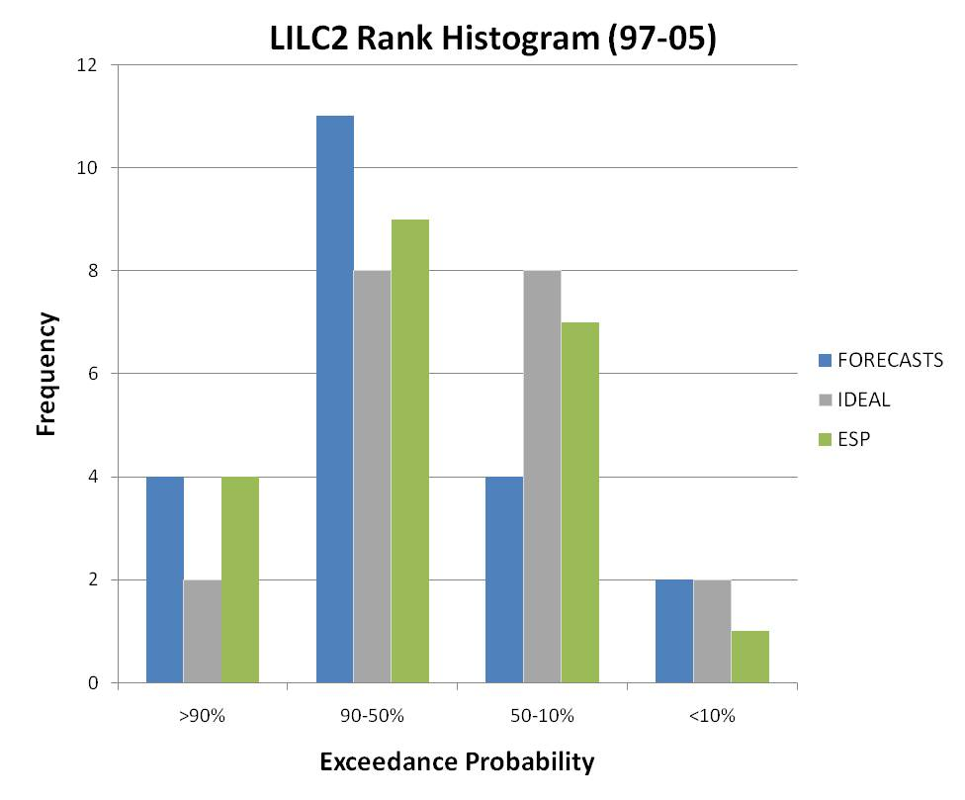
Little Snake nr Lily (LILC2)
ESP REFORECASTS (1997-2005)
* Includes first of month forecasts from March, April, and May*

Slide 12
Summary
Forecasts and ESP Reforecasts (4 unregulated sites)
MAE
- April ESP reforecasts less error at 3 sites; difference in error <20%
- May forecasts less error (3 sites <10%, 1 site ~30%) at all 4 sites
- No clear trend in MAE
- Reforecasts and forecasts error trends match at 3 of 4 sites
Skill
-March ESP reforecasts had greater skill at 3 of 4 sites
-April ESP reforecasts had greater skill at all 4 sites
-No clear trend in skill
Histograms
-Forecasts are statistically reliable (e.g. 10% exceeded ~10% of the time)
-ESP reforecasts are statically reliable at 3 of 4 unreg sites
Future Plans: Forecast verification will drive future forecast program (e.g. forecast frequencies, locations, issuance dates, etc)
What do you want?
Questions/Comments?

