Slide 1
Precipitation Estimation and Analysis
Colorado Basin River Forecast Center

Slide 2
Outline
Precipitation analysis methodology
Web sites overview

Slide 3
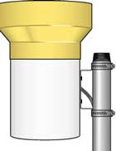
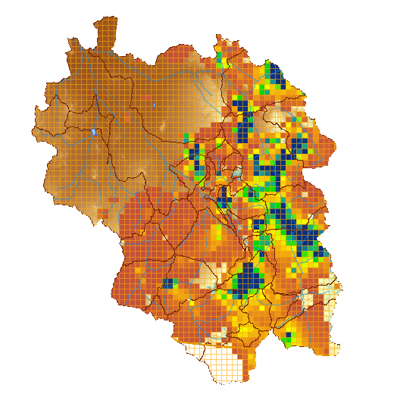
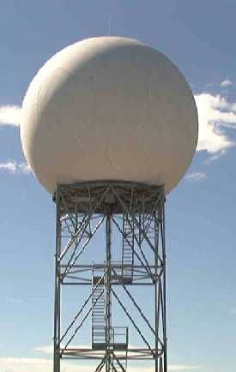
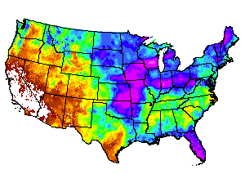
Quantitative Precipitation Estimates (QPE)
Rain Gage Measurement
Gridded Precipitation Estimate
GOES Satellite Estimate
Radar Estimate
Climate patterns
Forecaster Analysis

Slide 4
QPE (con’t)
Produced hourly, daily, monthly and seasonally
Analysis procedures address bad sensors (e.g. frozen gauges)
Daily_qc software: Screens gauges based on nearby gauges using PRISM climatology to spatially interpolate
Multi-sensor Precipitation Estimator: Combines gauge, radar, and sometimes satellite estimates
Output available through webpages

Slide 5
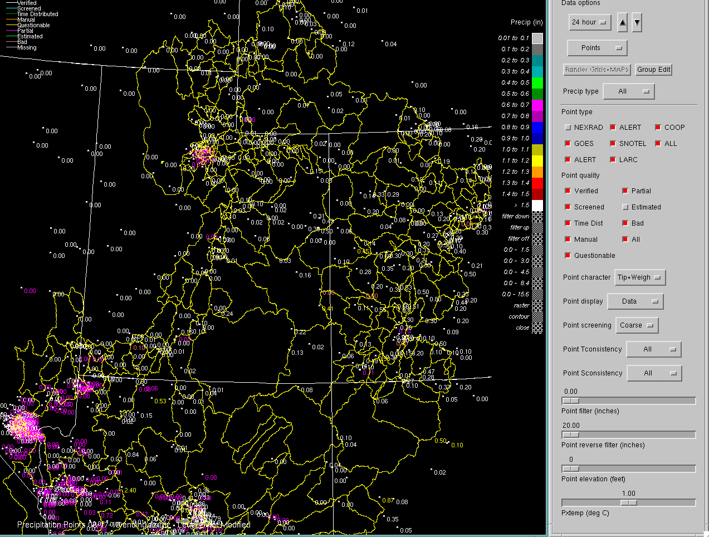

Slide 6
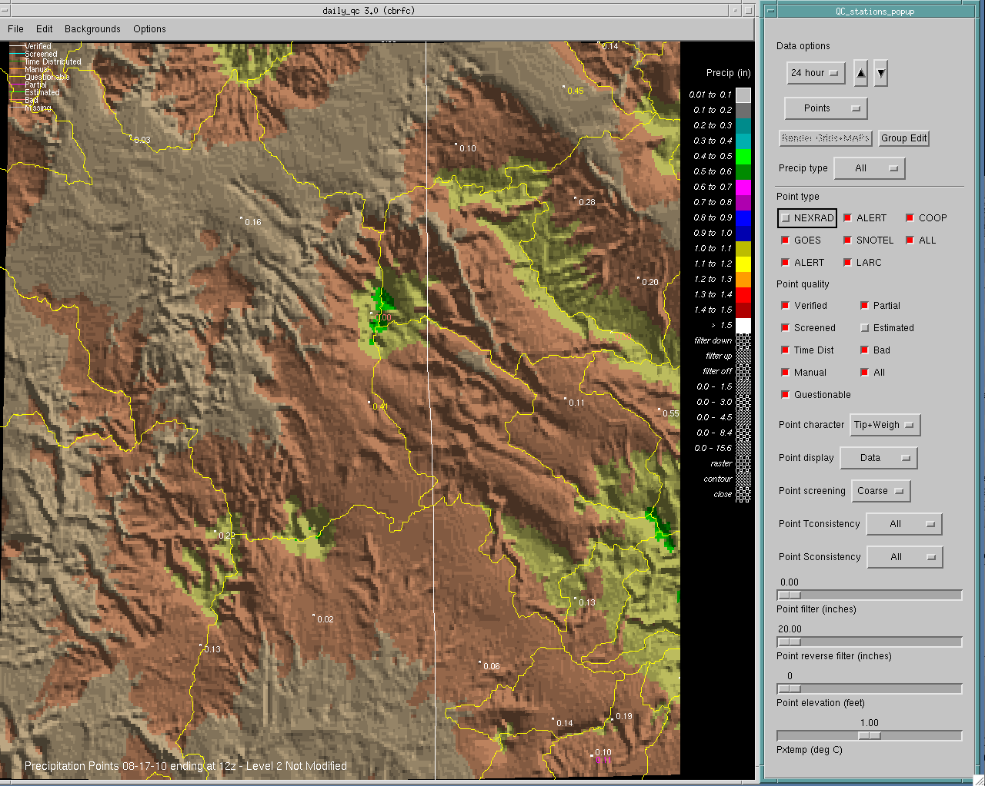

Slide 7
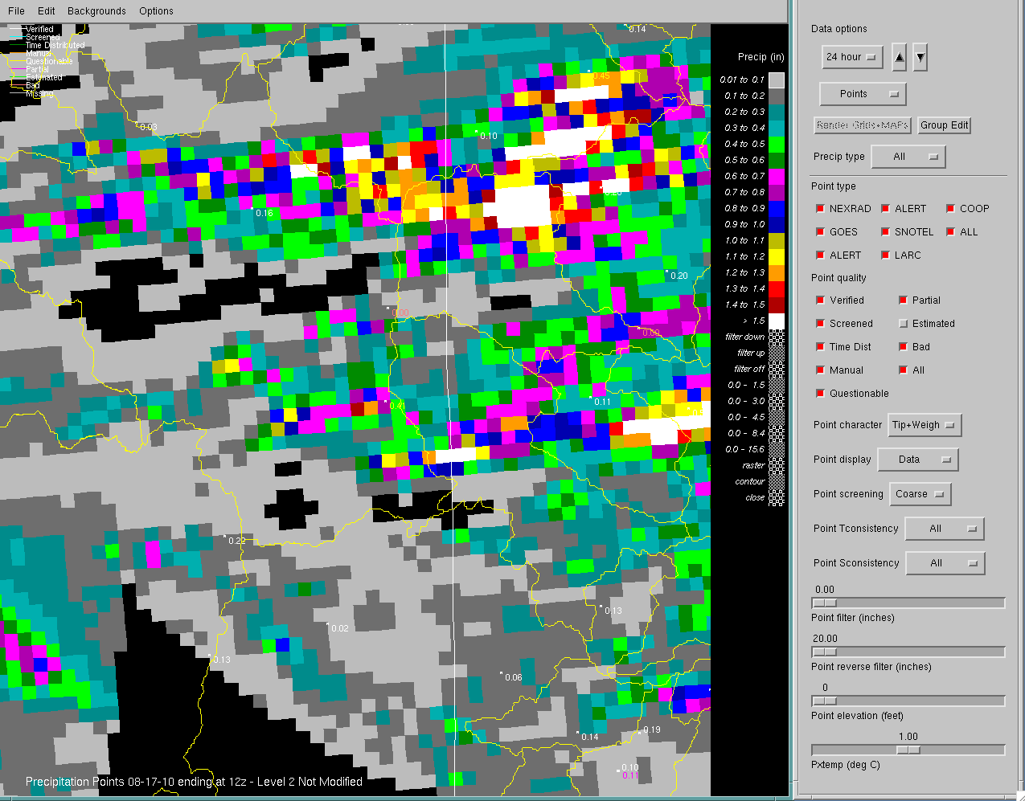

Slide 8
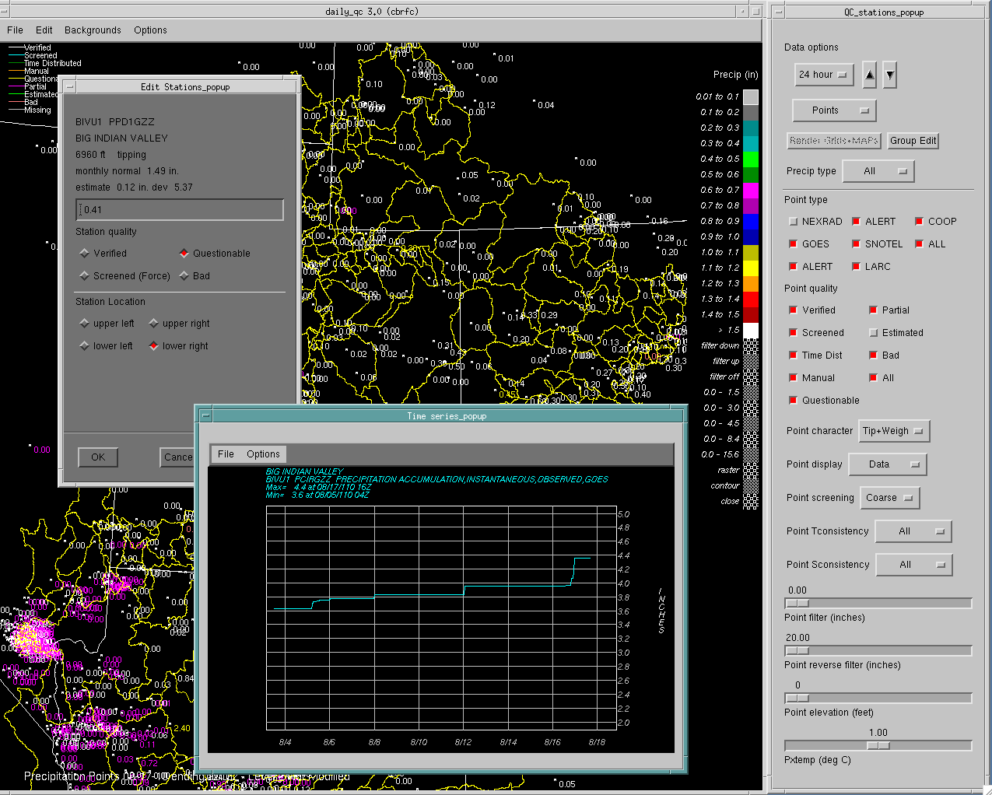

Slide 9
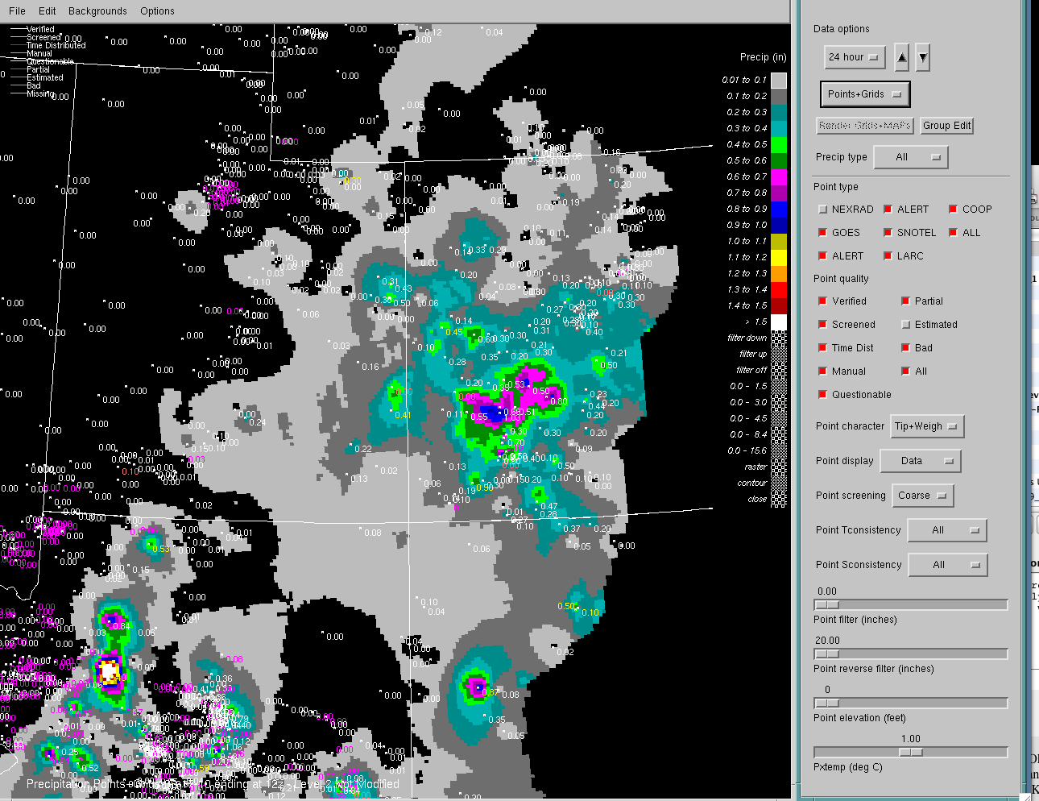

Slide 10
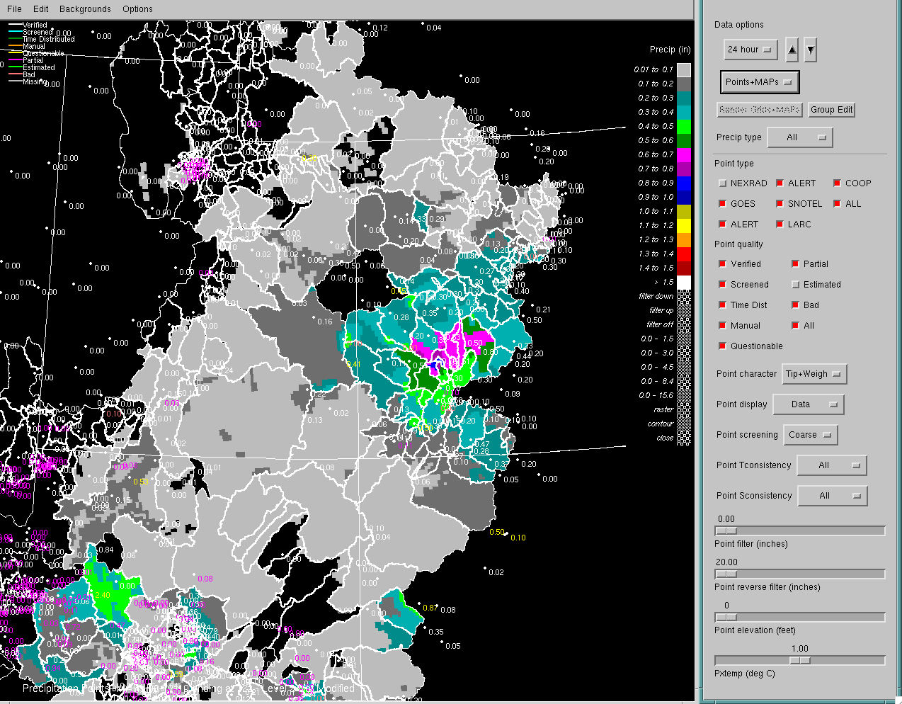

Slide 11
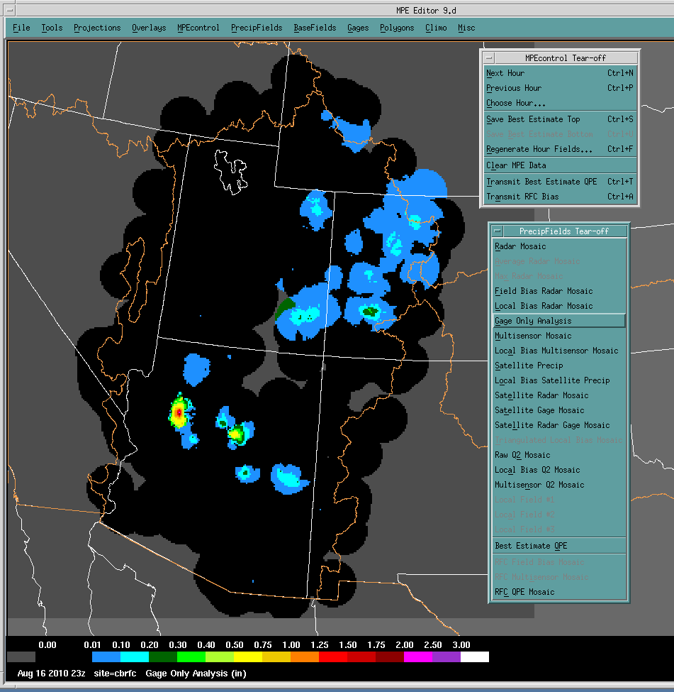

Slide 12
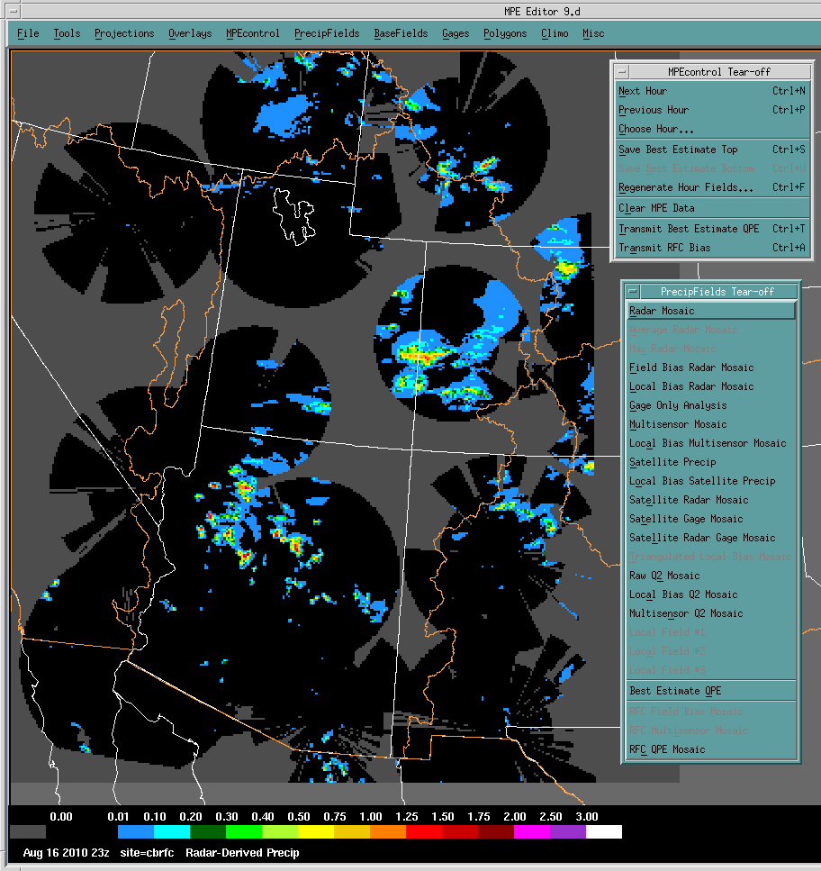

Slide 13
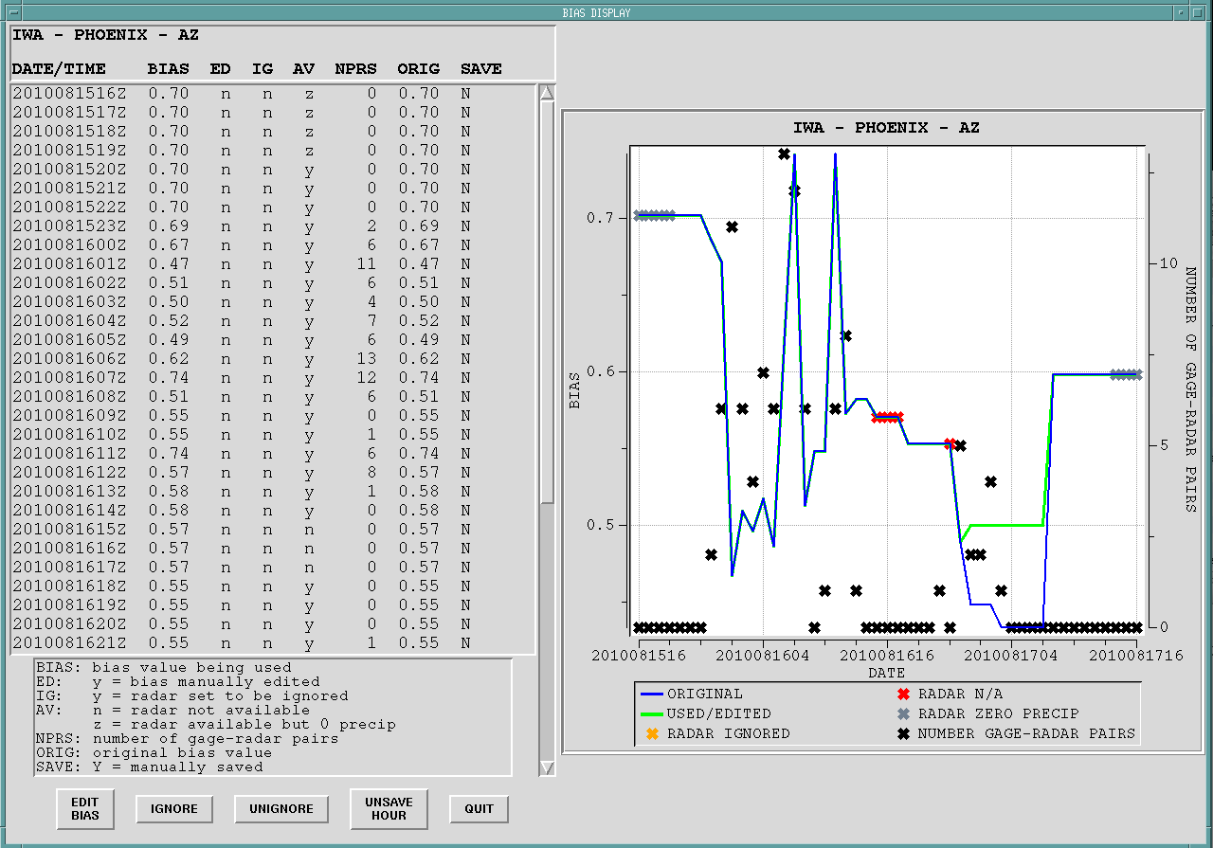

Slide 14
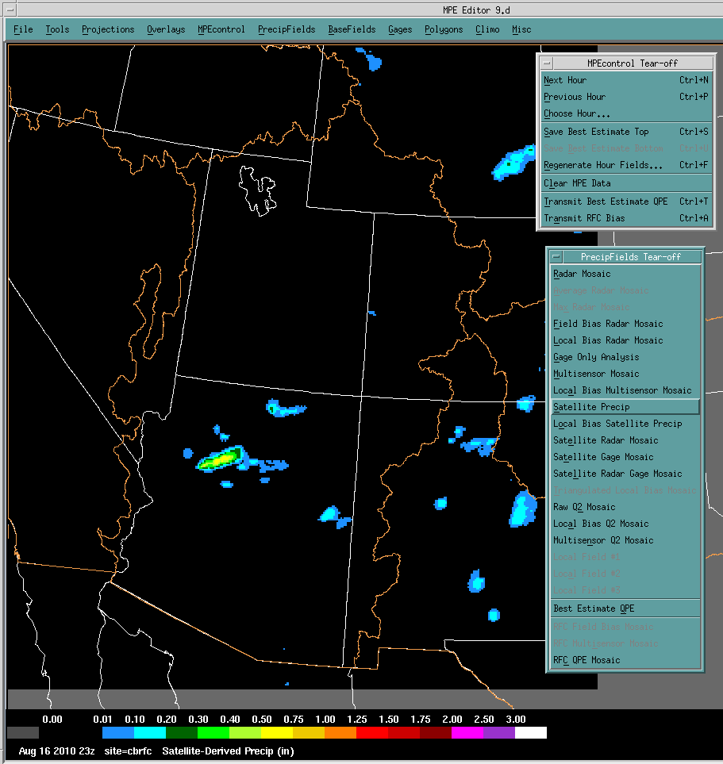

Slide 15
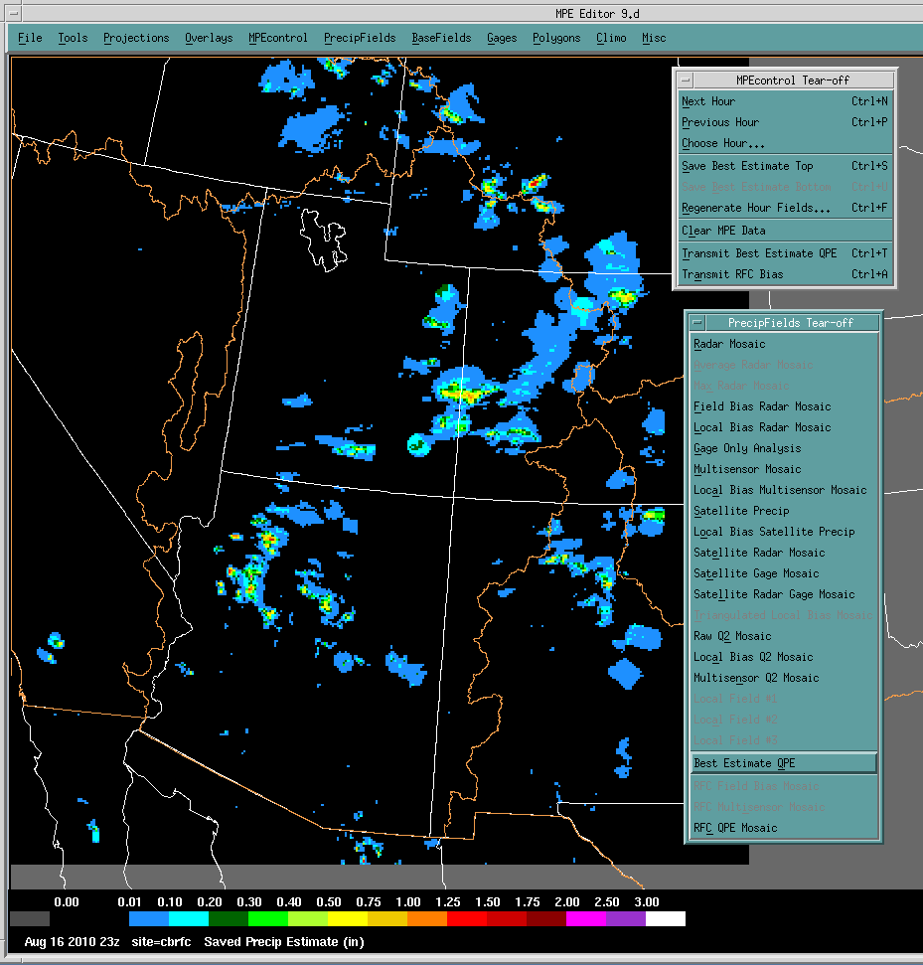

Slide 16
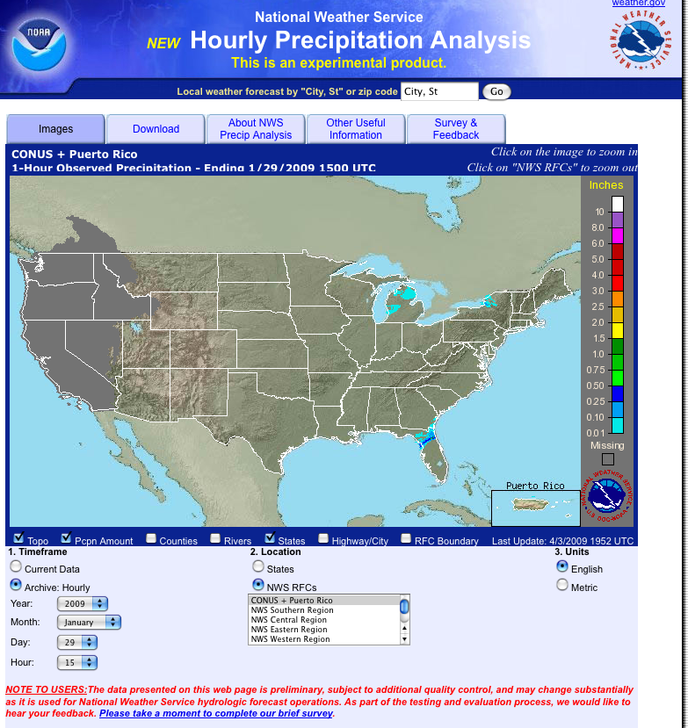
Area selection (or just click on map)
Time period selection
www.srh.noaa.gov/rfcshare/precip_analysis_hourly.php

Slide 17
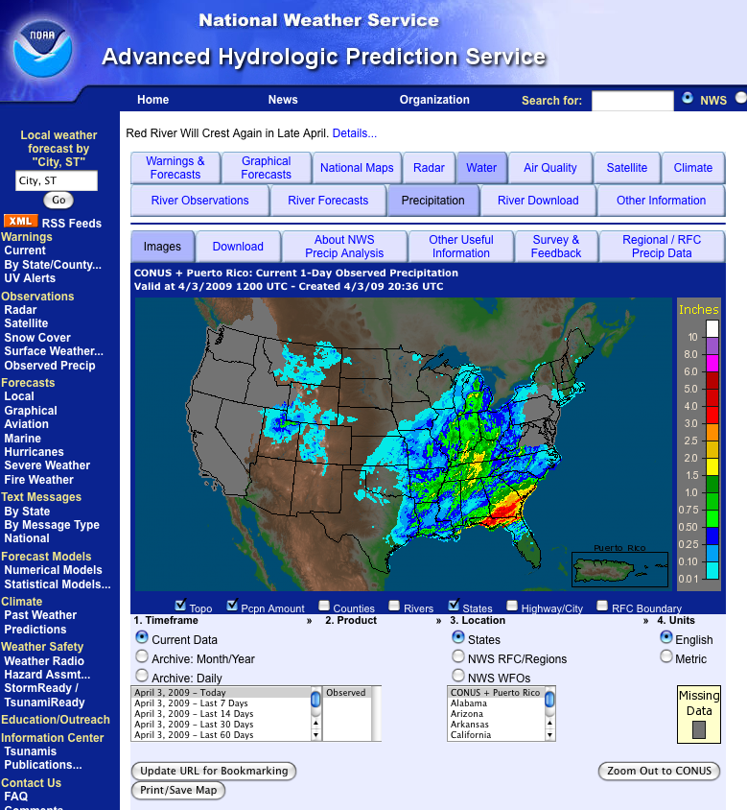
Area selection (or just click on map)
Time period selection
Product selection
Water.weather.gov

Slide 18
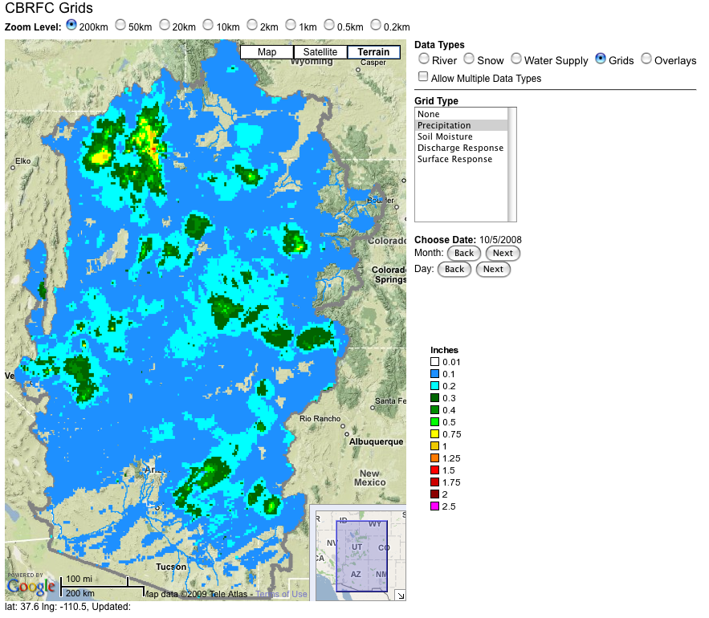
www.cbrfc.noaa.gov

Slide 19
Discussion Questions
What information – if any – do you need about how the precipitation analysis was constructed?
How useful is the precipitation analysis? How could it be more useful?
How do you know if the analysis is “good enough” for your purposes? What is “good enough”?
Are the precipitation pages useful?
Is there anything you particularly like about the precipitation webpages?
Is there anything you dislike about the precipitation webpages
What additional features would you like to see on the webpages?

