Slide 1
Water Year 2010 Review
CBRFC Open House
August 17, 2010

Slide 2
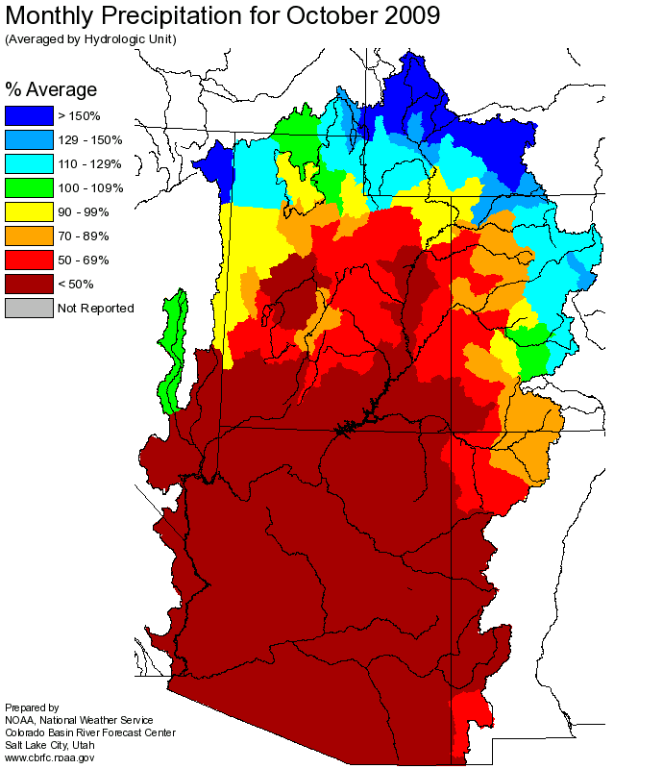
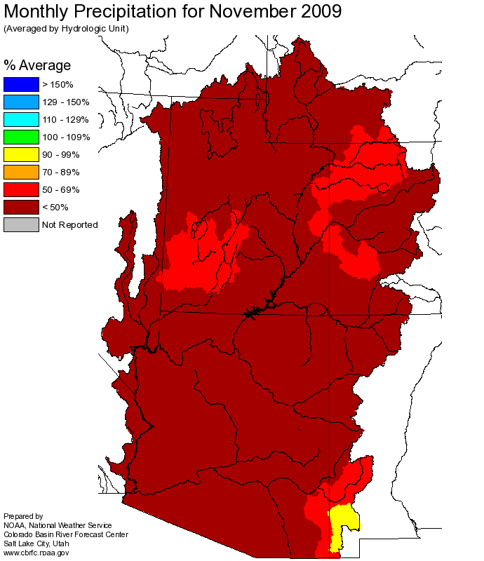
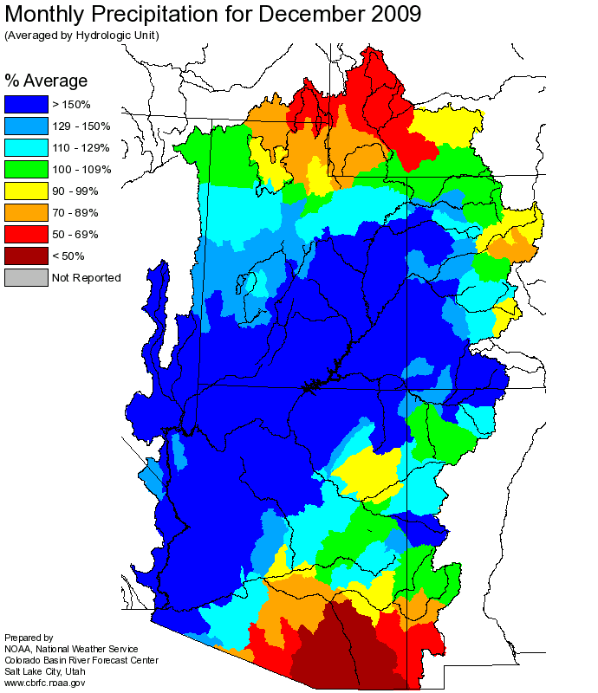
October – December Precipitation

Slide 3
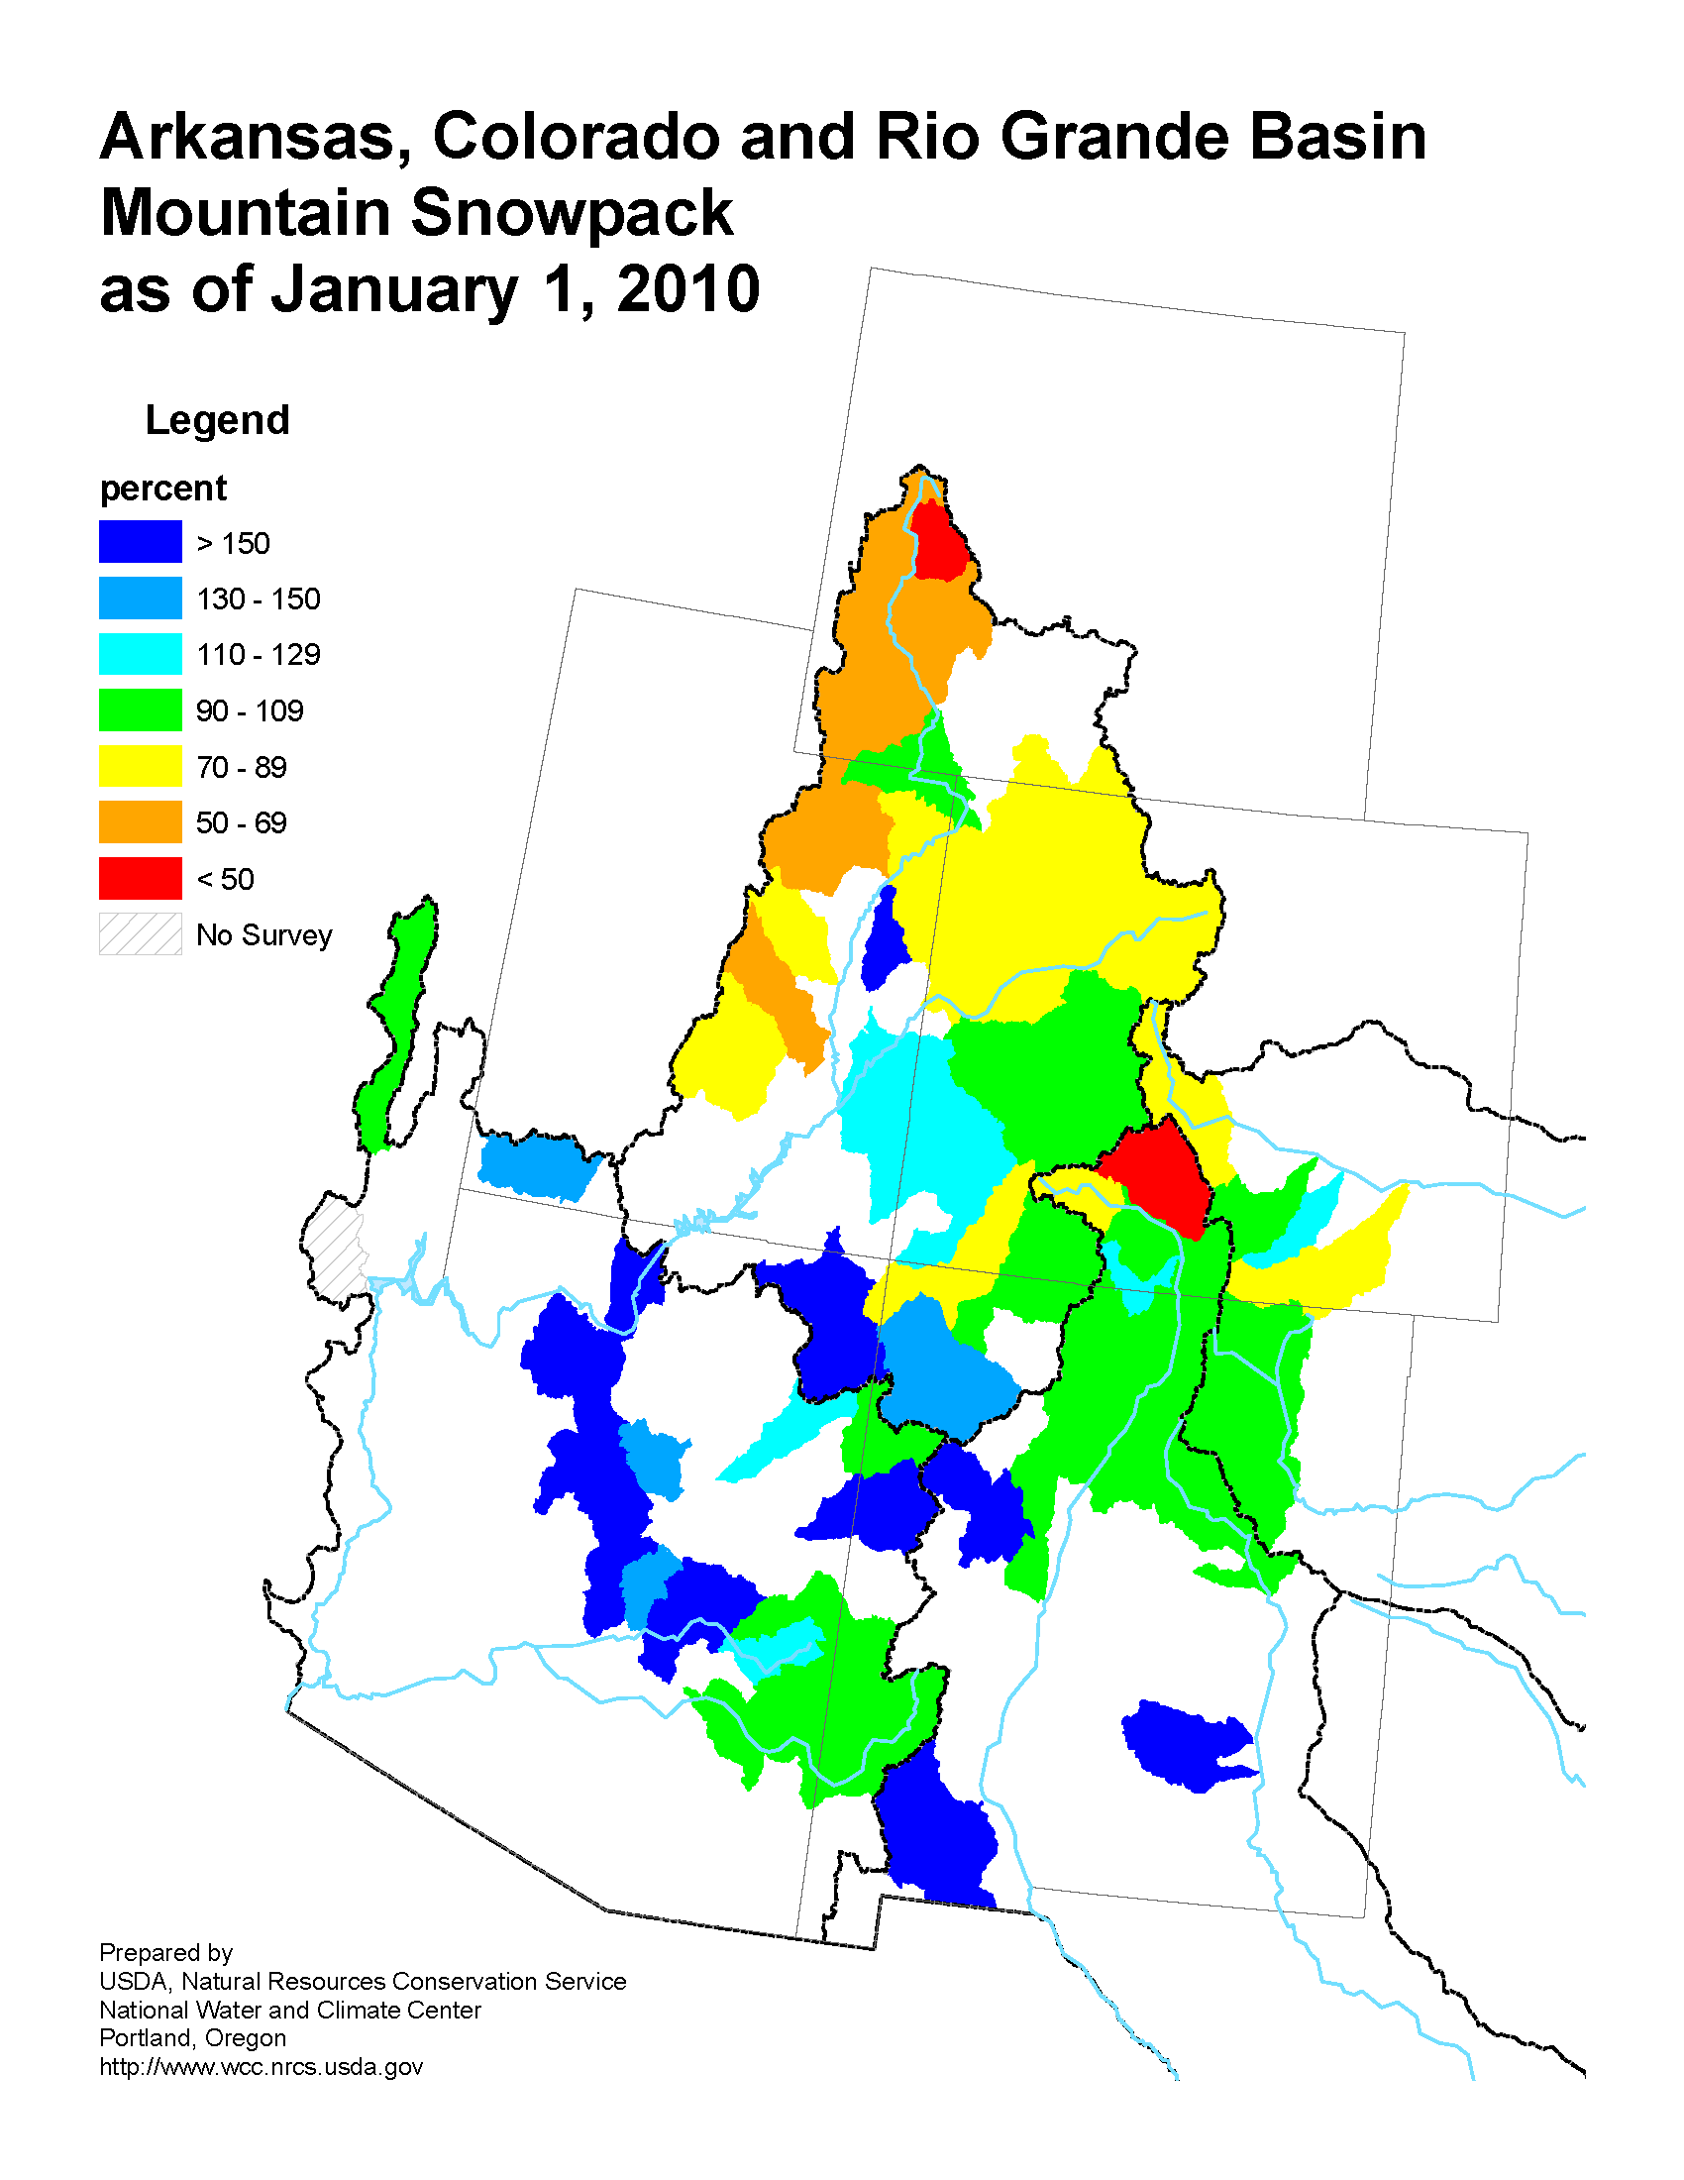
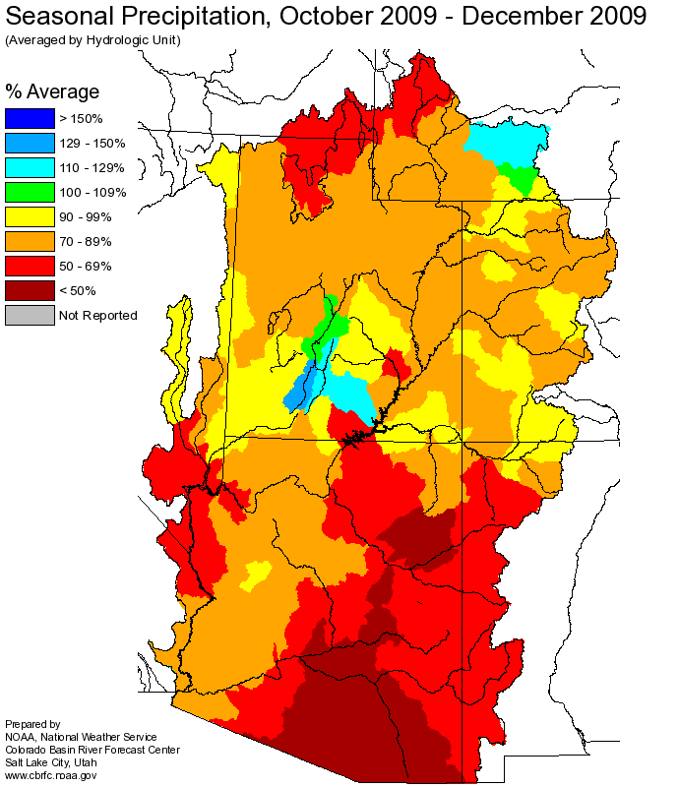
January 1, 2010
Green
Green
Green
Upper
Colorado
Upper
Colorado
San Juan
San Juan
Rio
Grande
Upper
Colorado
San Juan

Slide 4
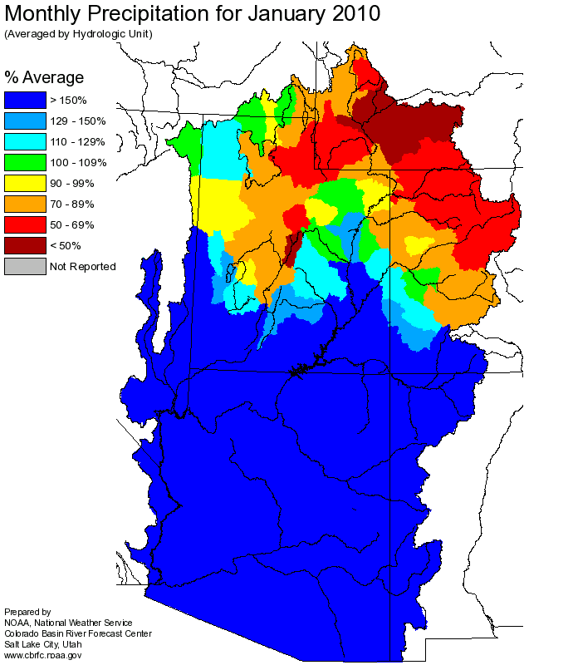
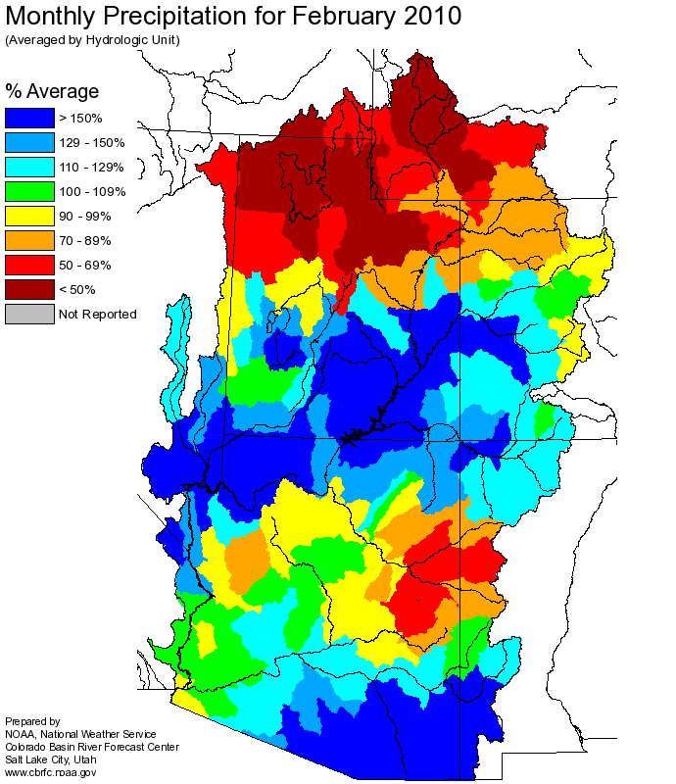
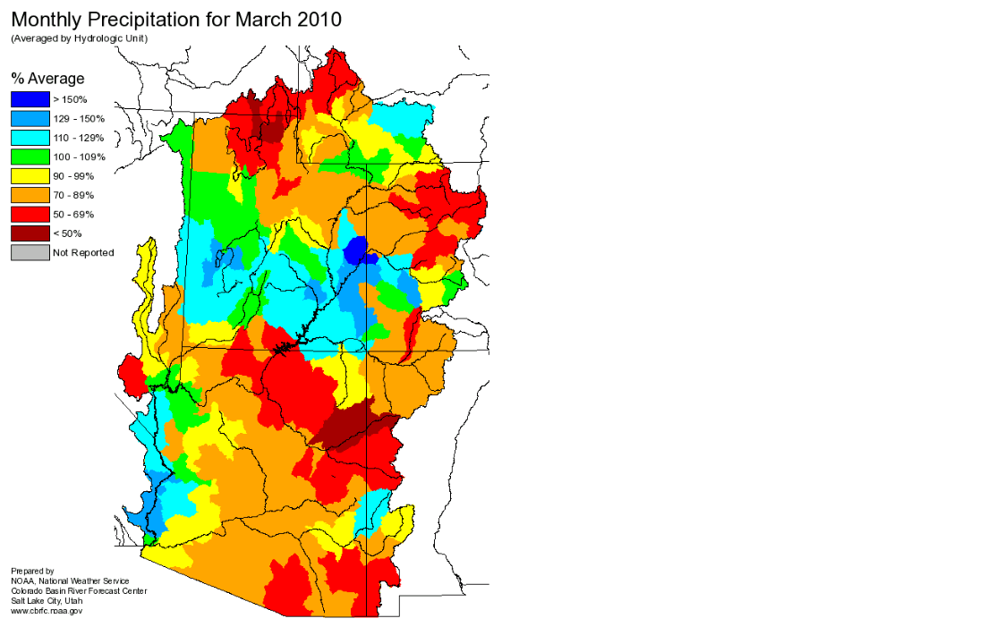
January – March Precipitation

Slide 5
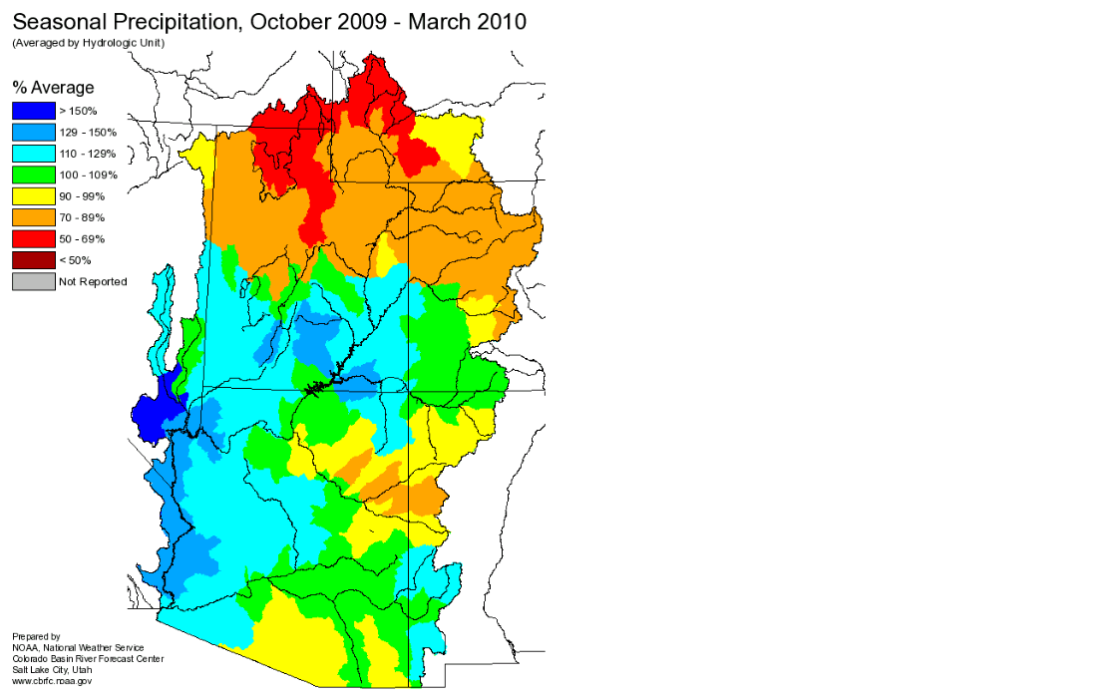
April 1, 2010

Slide 6
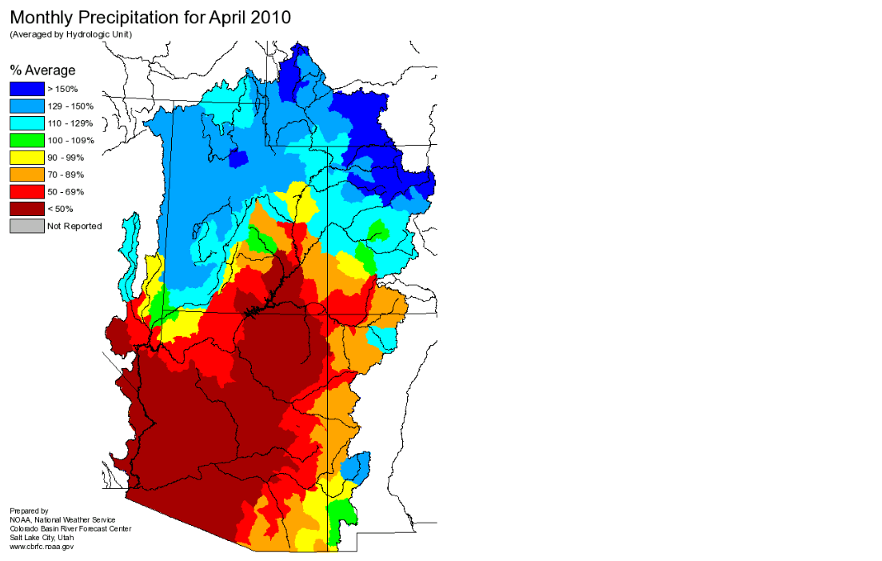
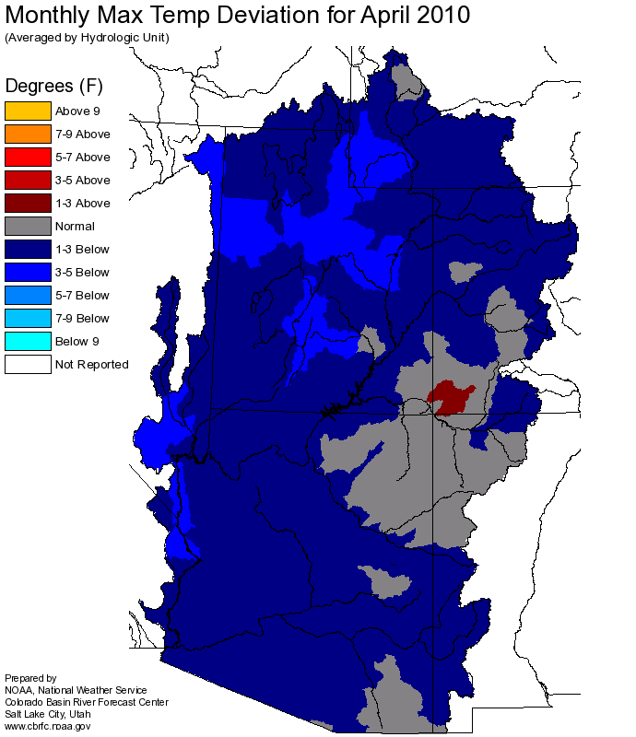
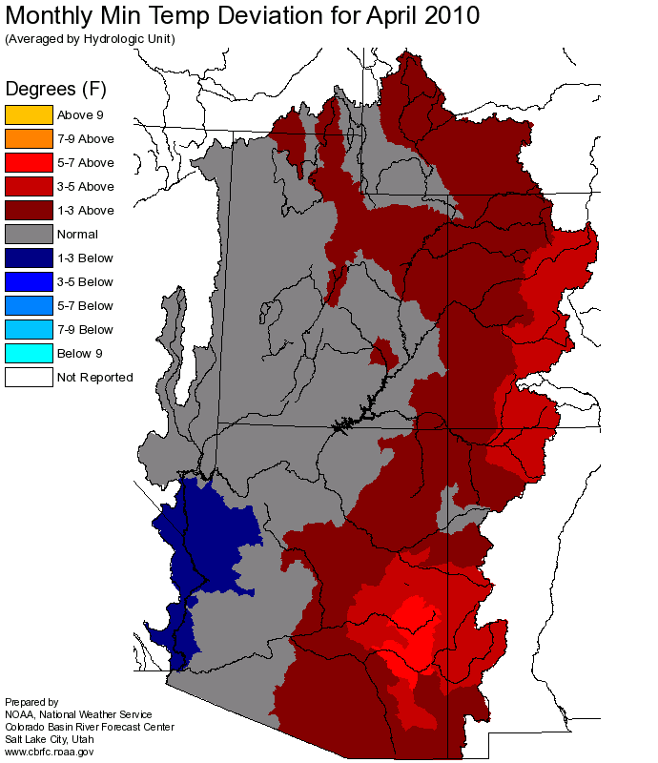
April Precipitation and Temperature

Slide 7
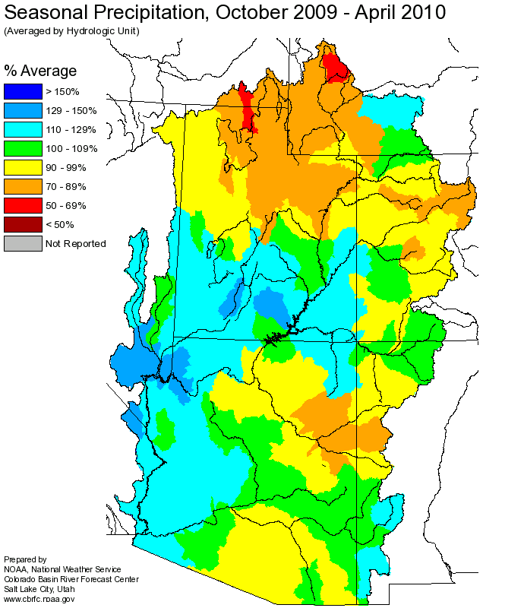
May 1, 2010

Slide 8
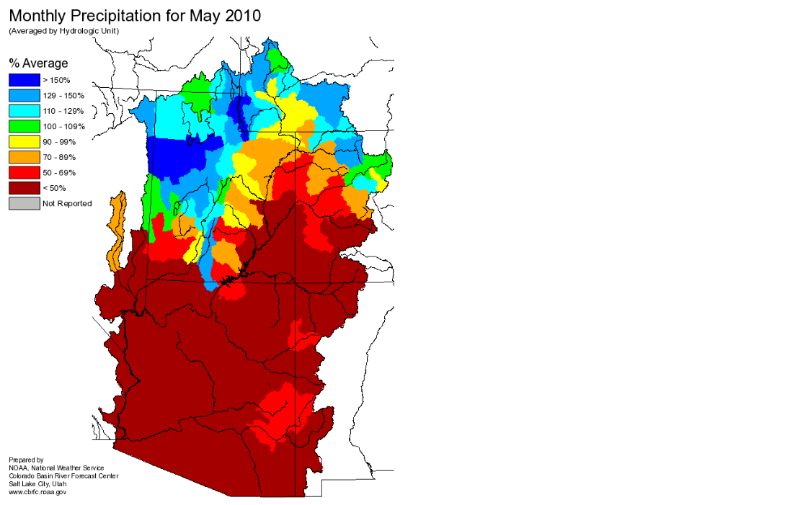
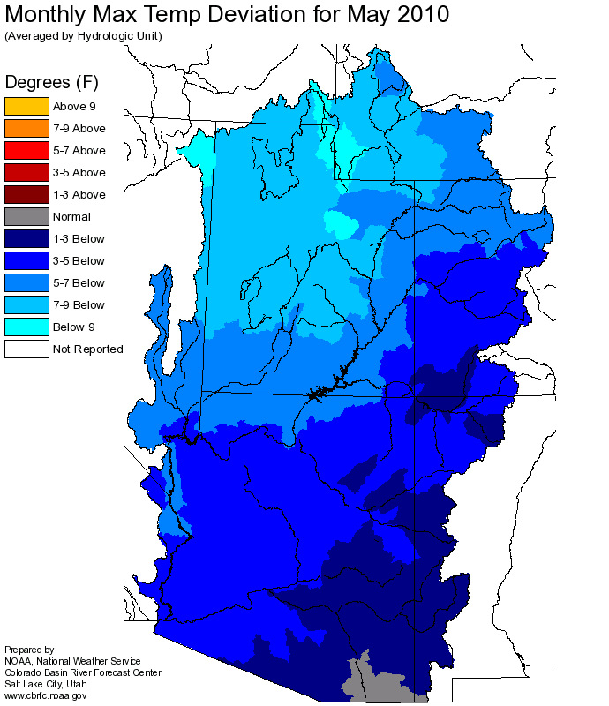
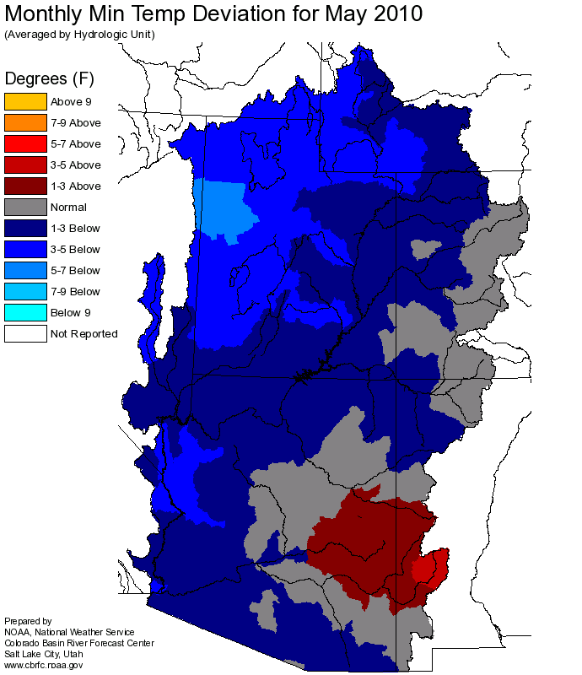
May Precipitation and Temperature

Slide 9
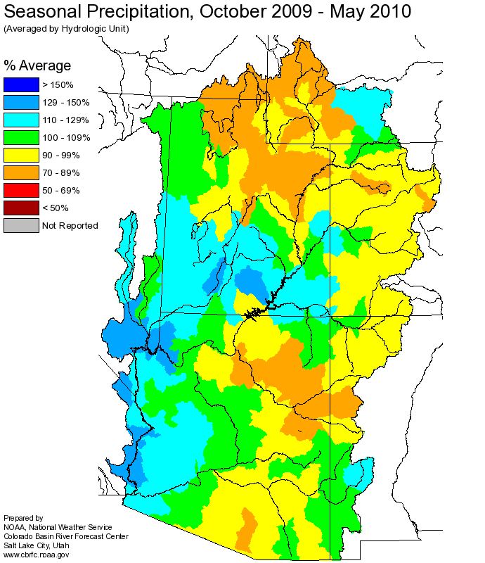
June 1, 2010
June 1, 2010 Snow Water Equivalent

Slide 10
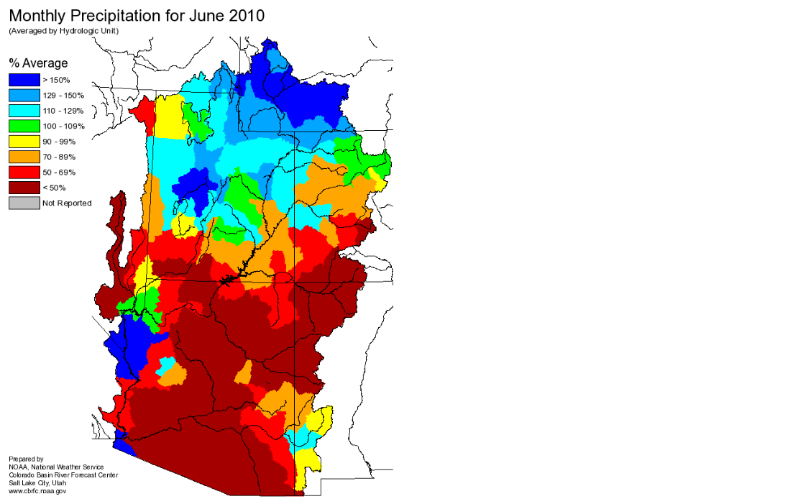
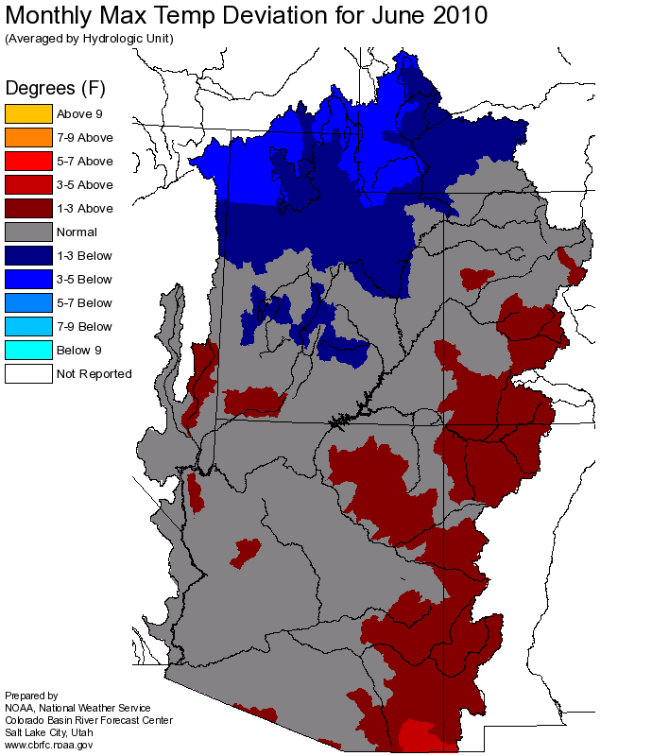
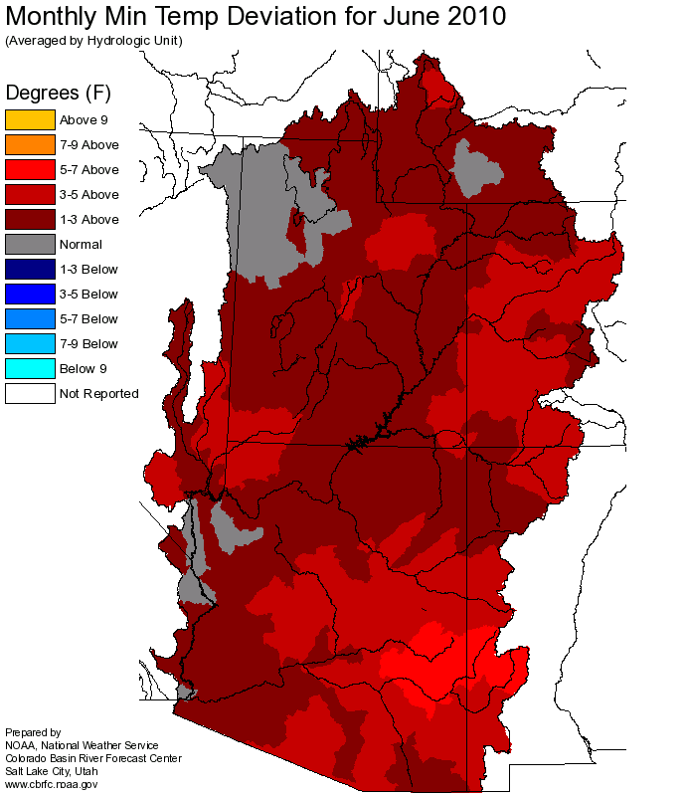
June Precipitation and Temperature

Slide 11
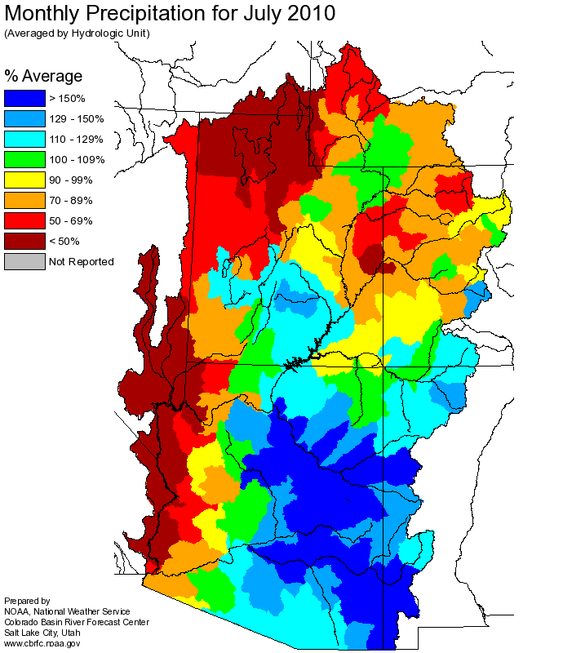
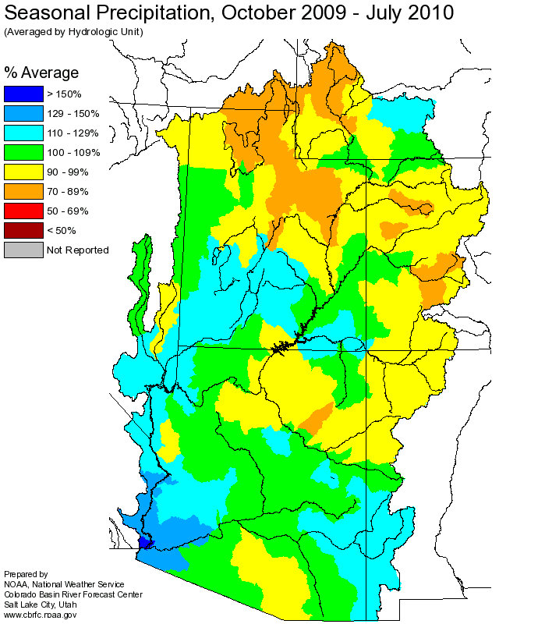
July Precipitation

Slide 12
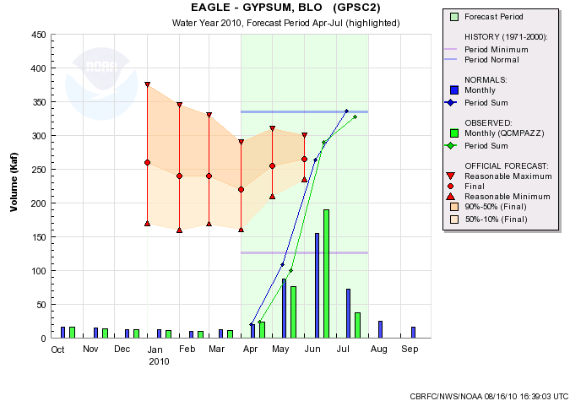
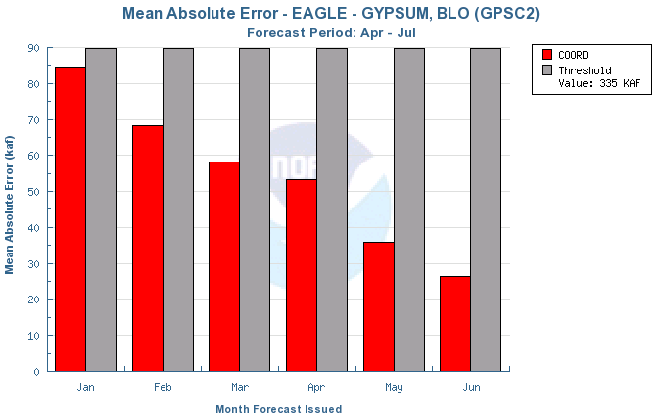
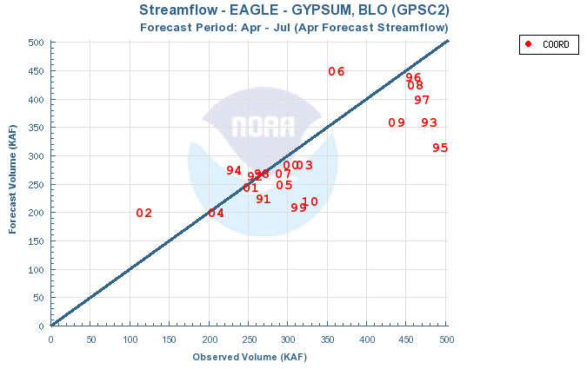
327 KAF
98% avg

Slide 13
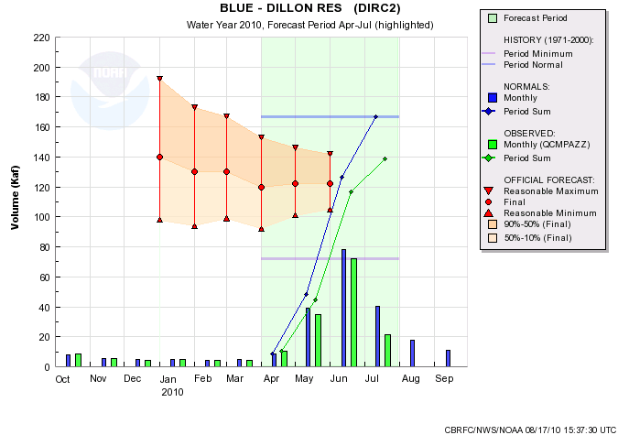
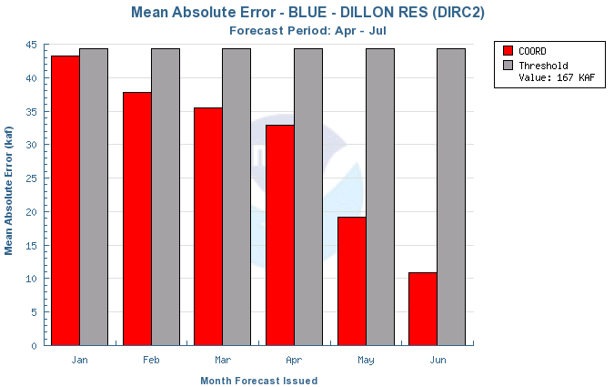
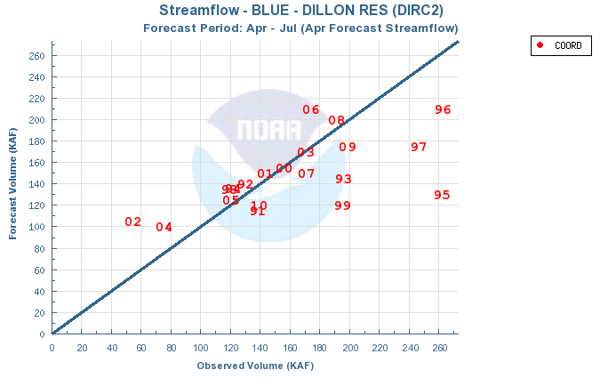
139 KAF
83% avg

Slide 14
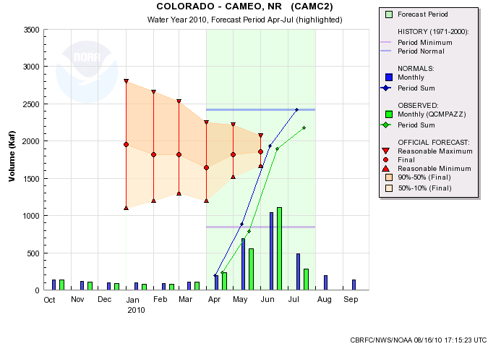
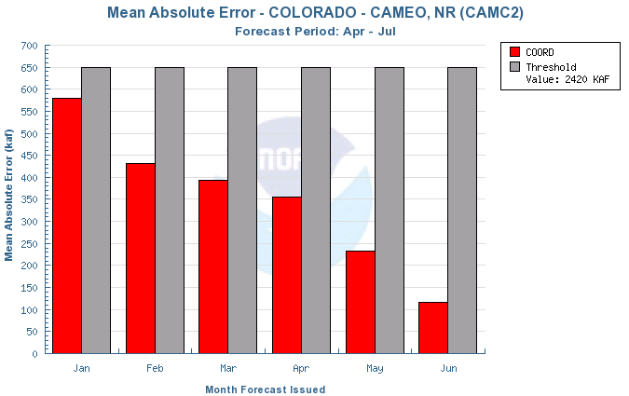
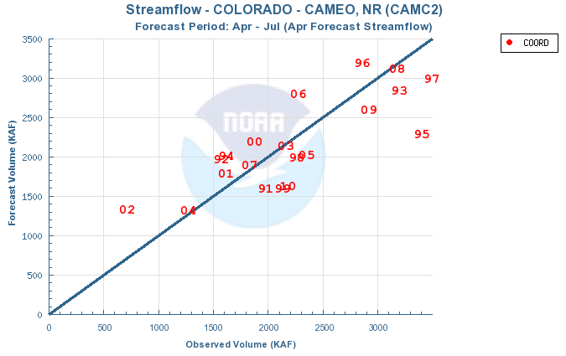
2175 KAF
90% avg

Slide 15
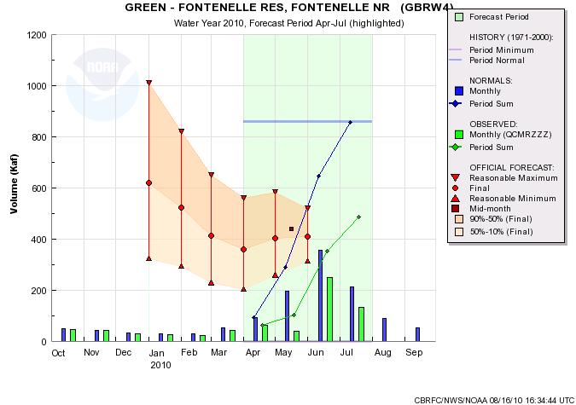
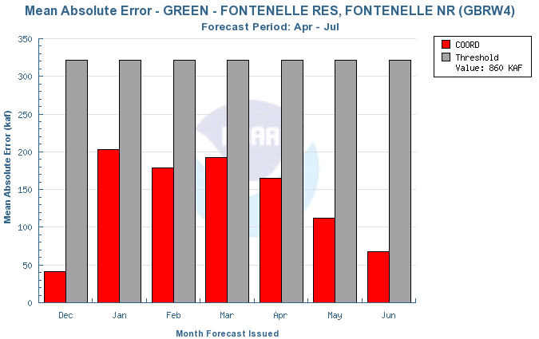
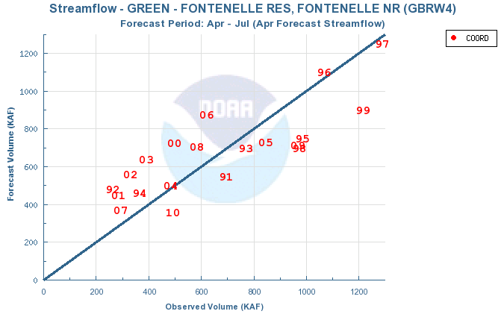
488 KAF
57% avg

Slide 16
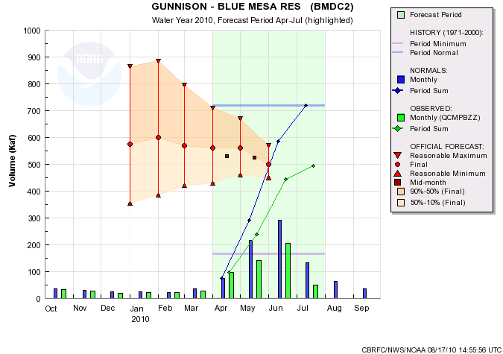
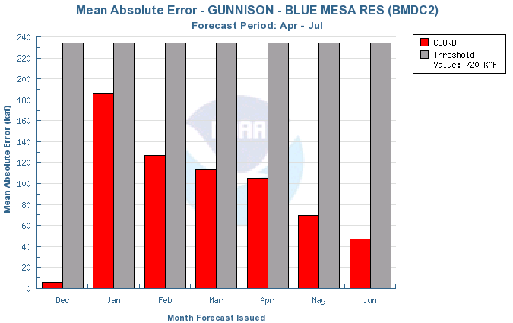
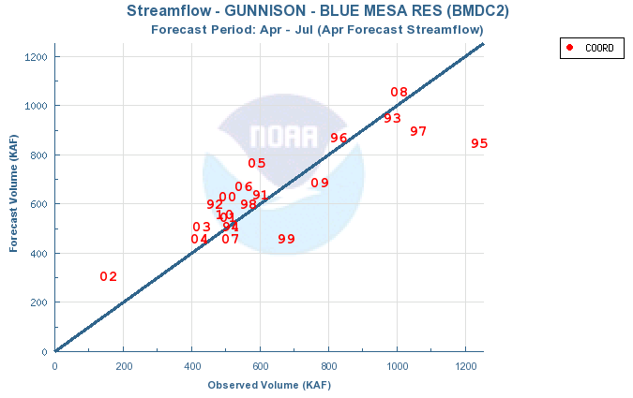
494 KAF
69% avg

Slide 17
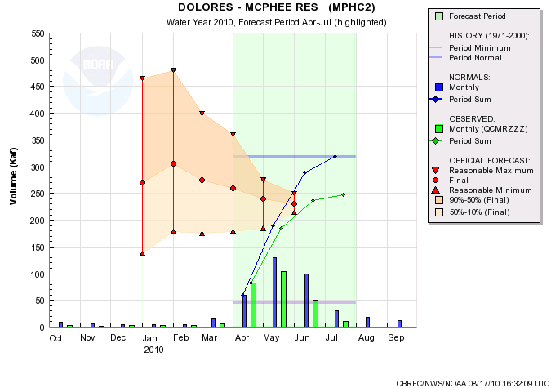
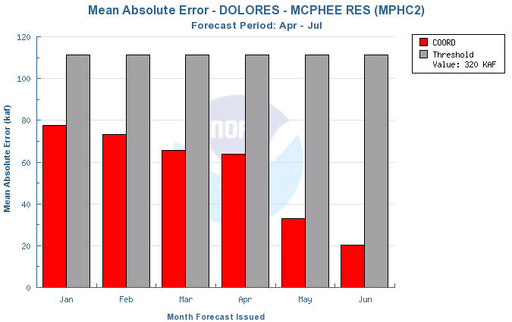
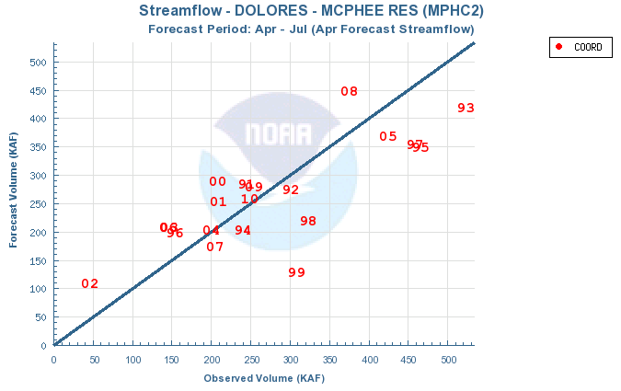
247 KAF
77% avg

Slide 18
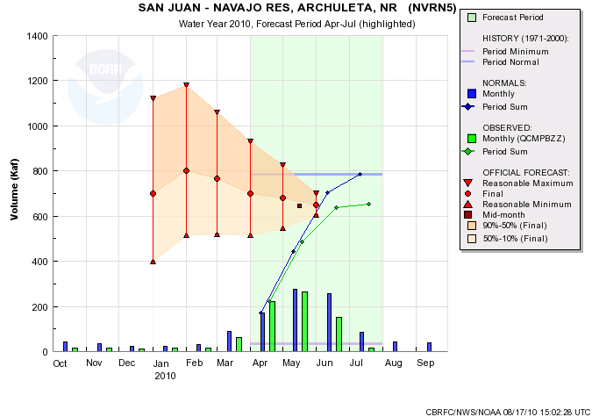
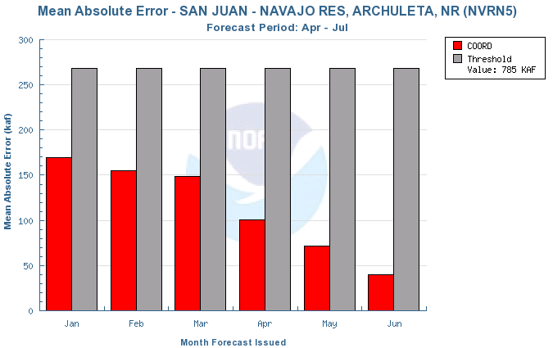
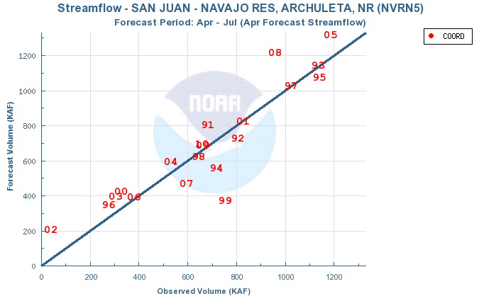
654 KAF
83% avg

Slide 19
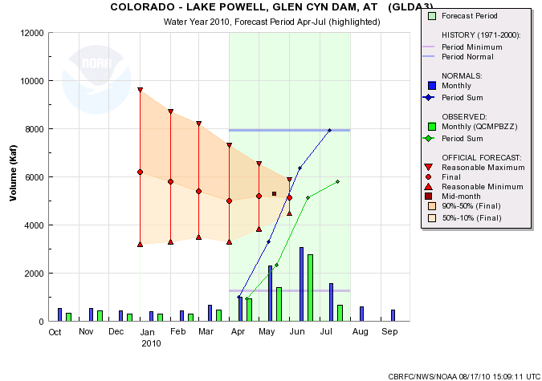
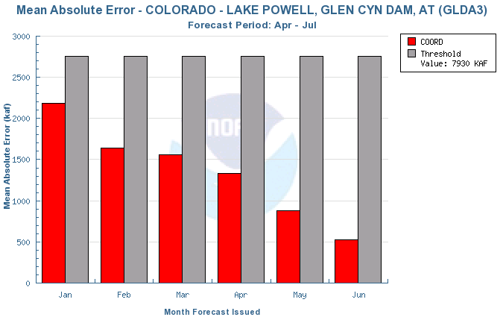
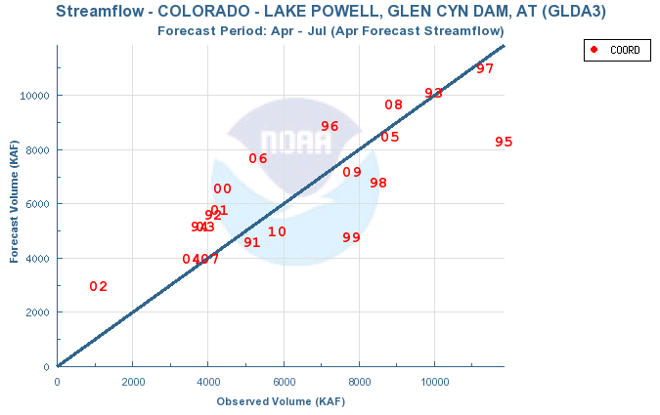
5795 KAF
73% avg

Slide 20
Fontenelle Reservoir
1991-2008 - 19%
2010 – 20%
Eagle-Gypsum
1991-2008 - 16%
2010 – 33%
Dillon Reservoir
1991-2008 - 20%
2010 – 14%
Colorado-Cameo
1991-2008 - 15%
2010 – 15%
Blue Mesa Reservoir
1991-2008 - 15%
2010 – 20%
McPhee Reservoir
1991-2008 - 21%
2010 – 5%
Navajo Reservoir
1991-2008 - 13%
2010 – 8%
Lake Powell
1991-2008 - 17%
2010 – 14%

Slide 21
Some Observations (Craig)
7 days of high flow (6/6-6/13)
Near normal/below normal seasonal precipitation
Below Normal temperatures in May (slightly below in April)
Melt was delayed
Season volumes affected somewhat
Seen on:
Roaring Fork
Eagle
Uncompahgre (a little)
Granby (a little)
Yampa
Big/Little Cottonwood
Headwaters of Provo/Weber/Bear/Uinta streams
Did not affect
Gunnison/San Juan Rivers
Blue
Upper Green

Slide 22
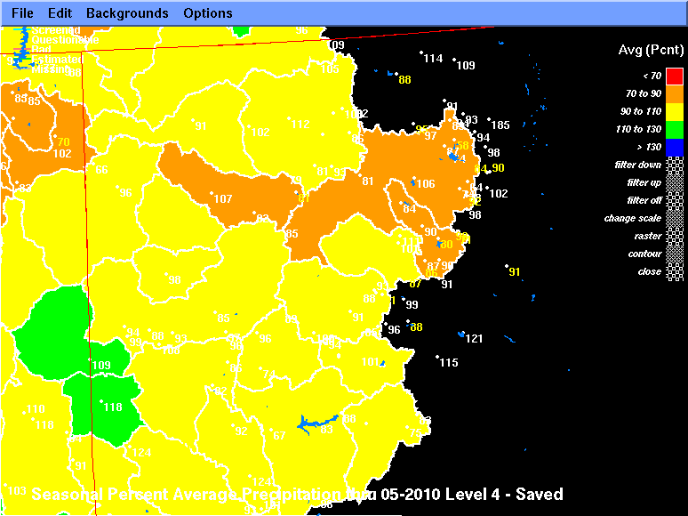

Slide 23
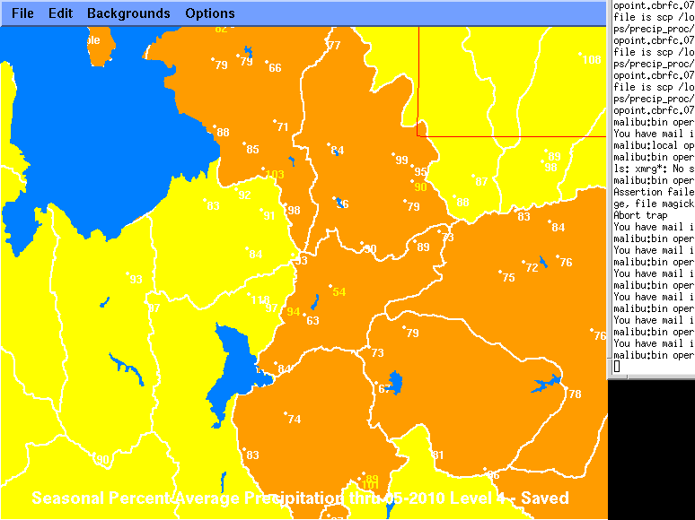

Slide 24
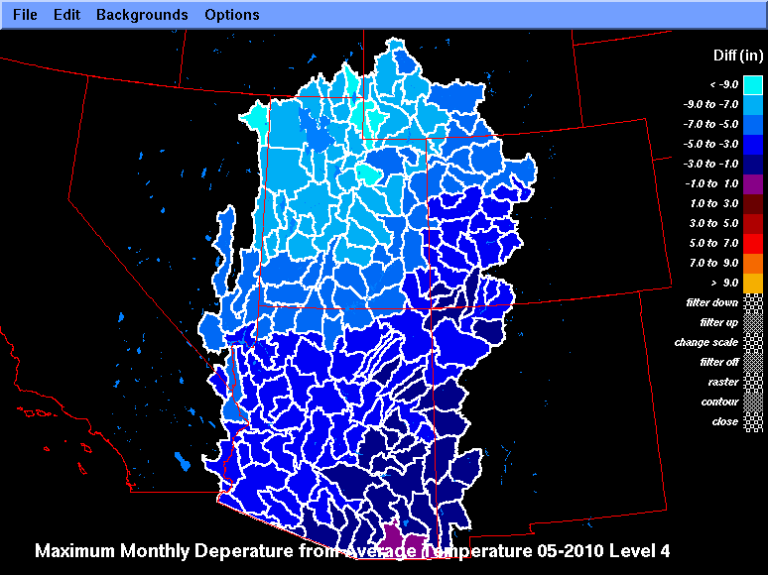

Slide 25
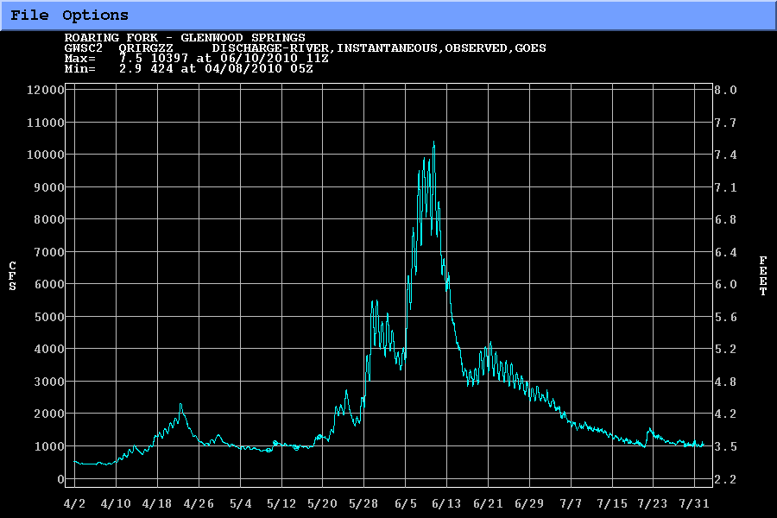

Slide 34
Possible Reasons
Possible Input errors
Precipitation
Temperature
Fixes for the future
Running model in calibration mode showed similar errors
Known SNOW-17 low bias in rapid melt situations
Temperature index model
Melt of snow probably was atypical
Model is split by elevation zones not aspect
Significant melt in May in exposed areas
Delay of melt in colder, less exposed areas
Hypothesis: North facing lower level melted at same time as south facing high level
Not captured by SNOTEL network or model
Similar error in one other year (1984)

Slide 35
Possible Solutions
Areal Extent updates
Distributed models
Late melt = flooding potential

