Slide 1
CBRFC Web Pages

Slide 2
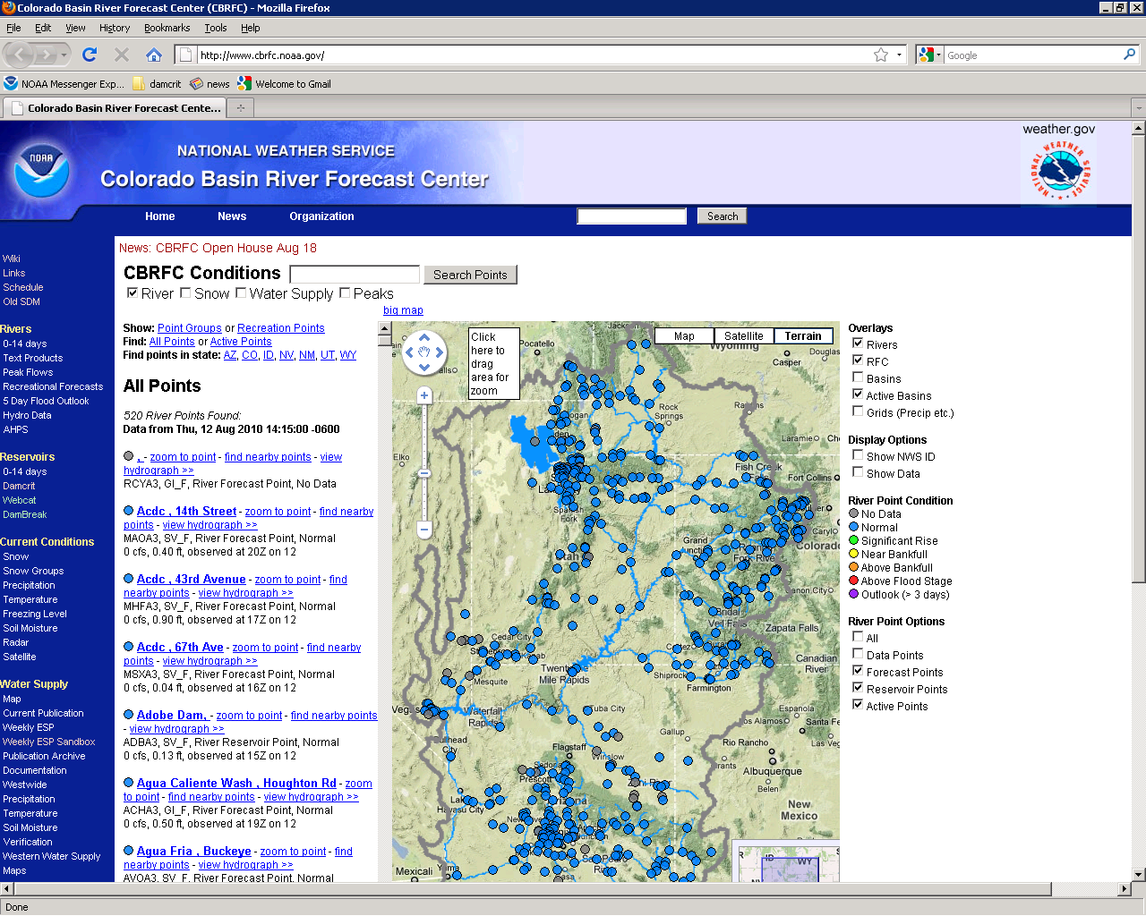
River
www.cbrfc.noaa.gov

Slide 3
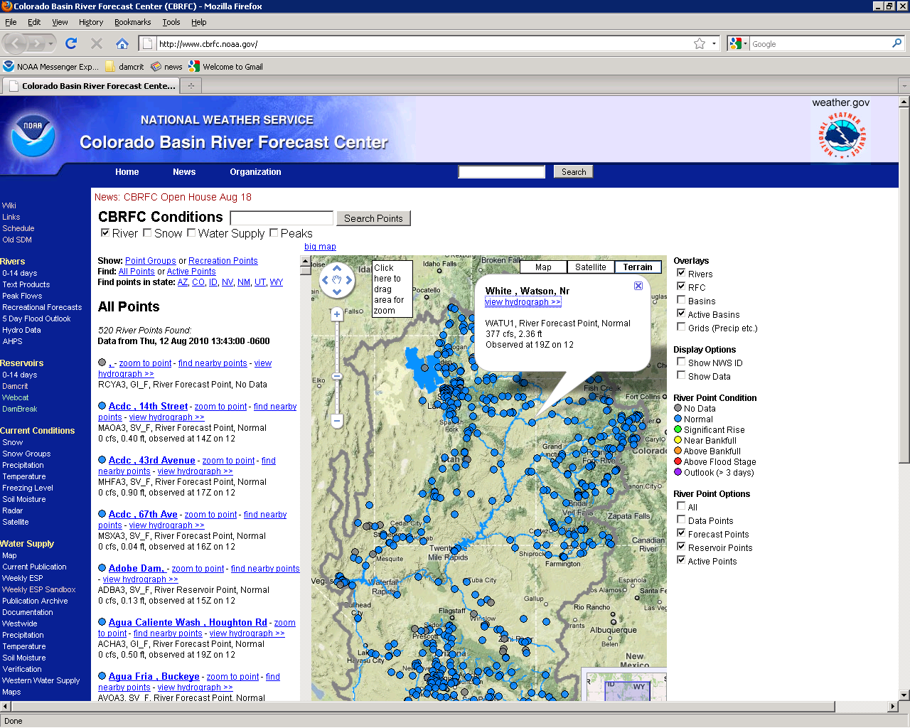
Click Point
New pop up window when you click on point.

Slide 4
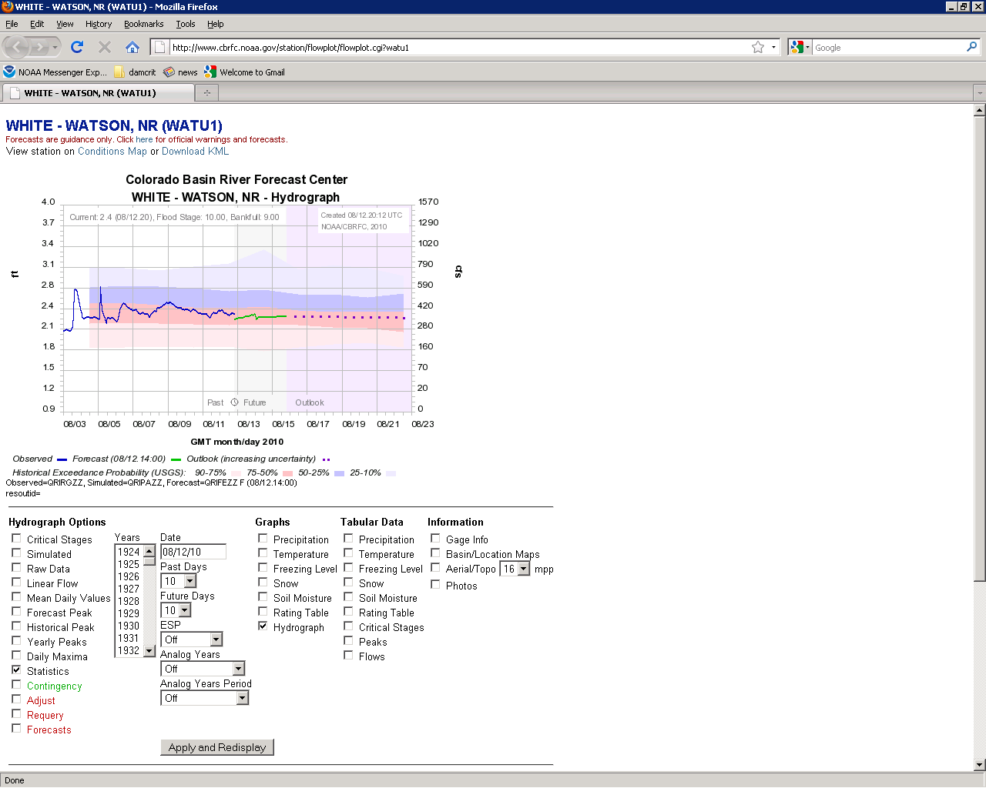
Will take you to hydrograph.

Slide 5
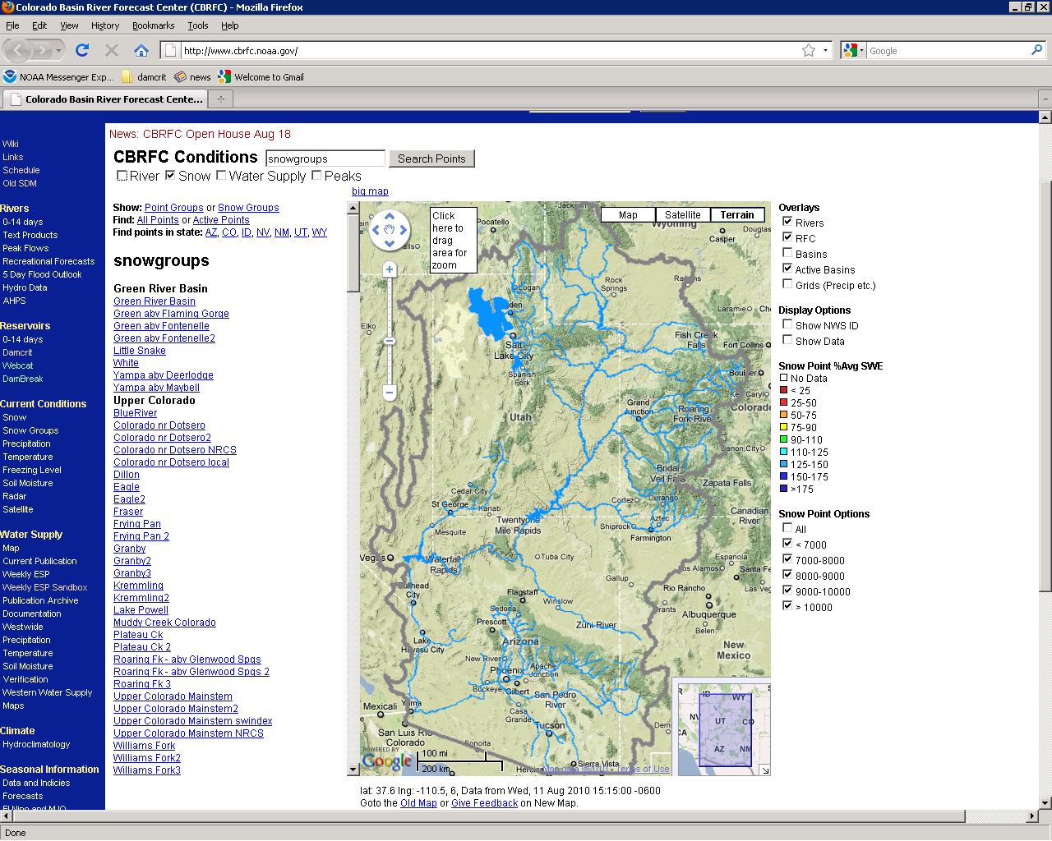
Snow
Snow Group
List of Snow Groups.

Slide 6
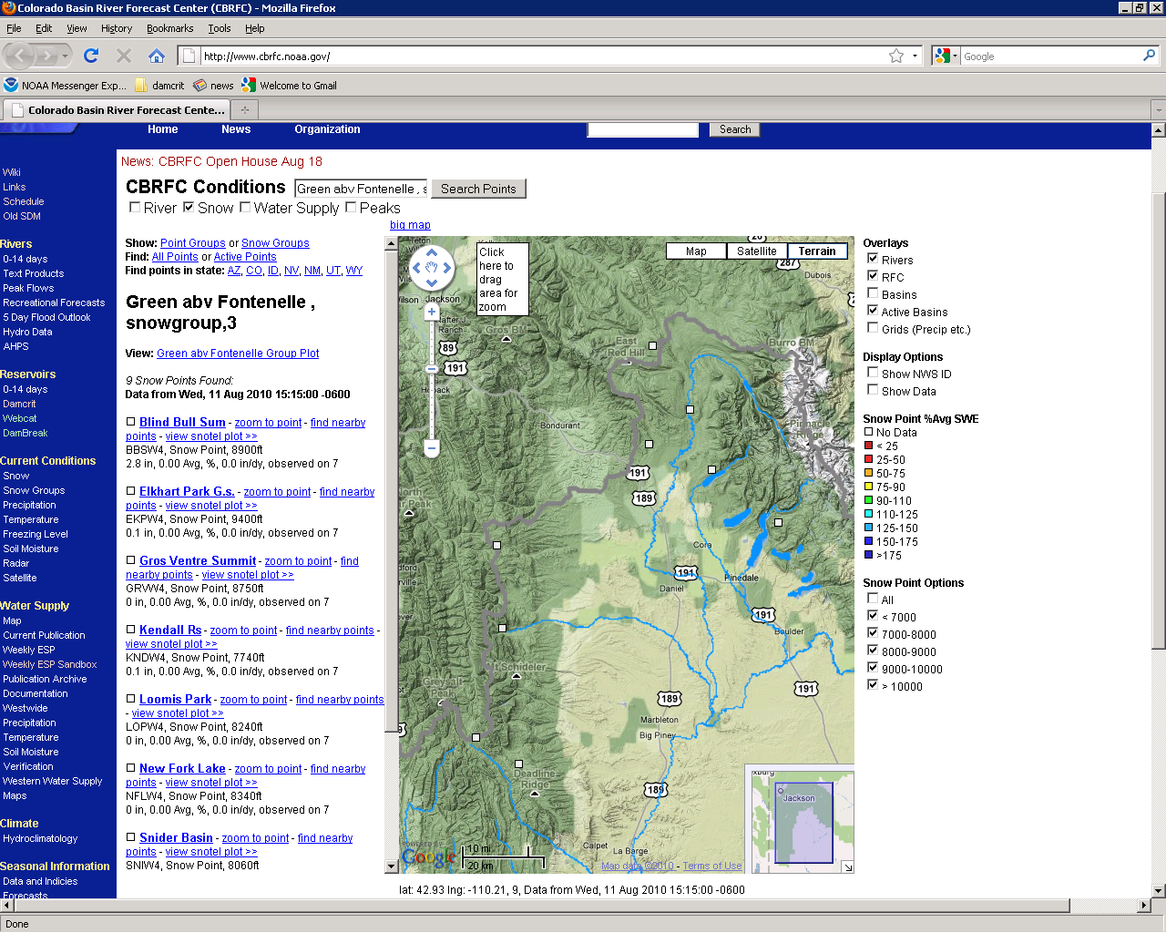
Snow Group
List of Stations Within Selected Snow Group.

Slide 7
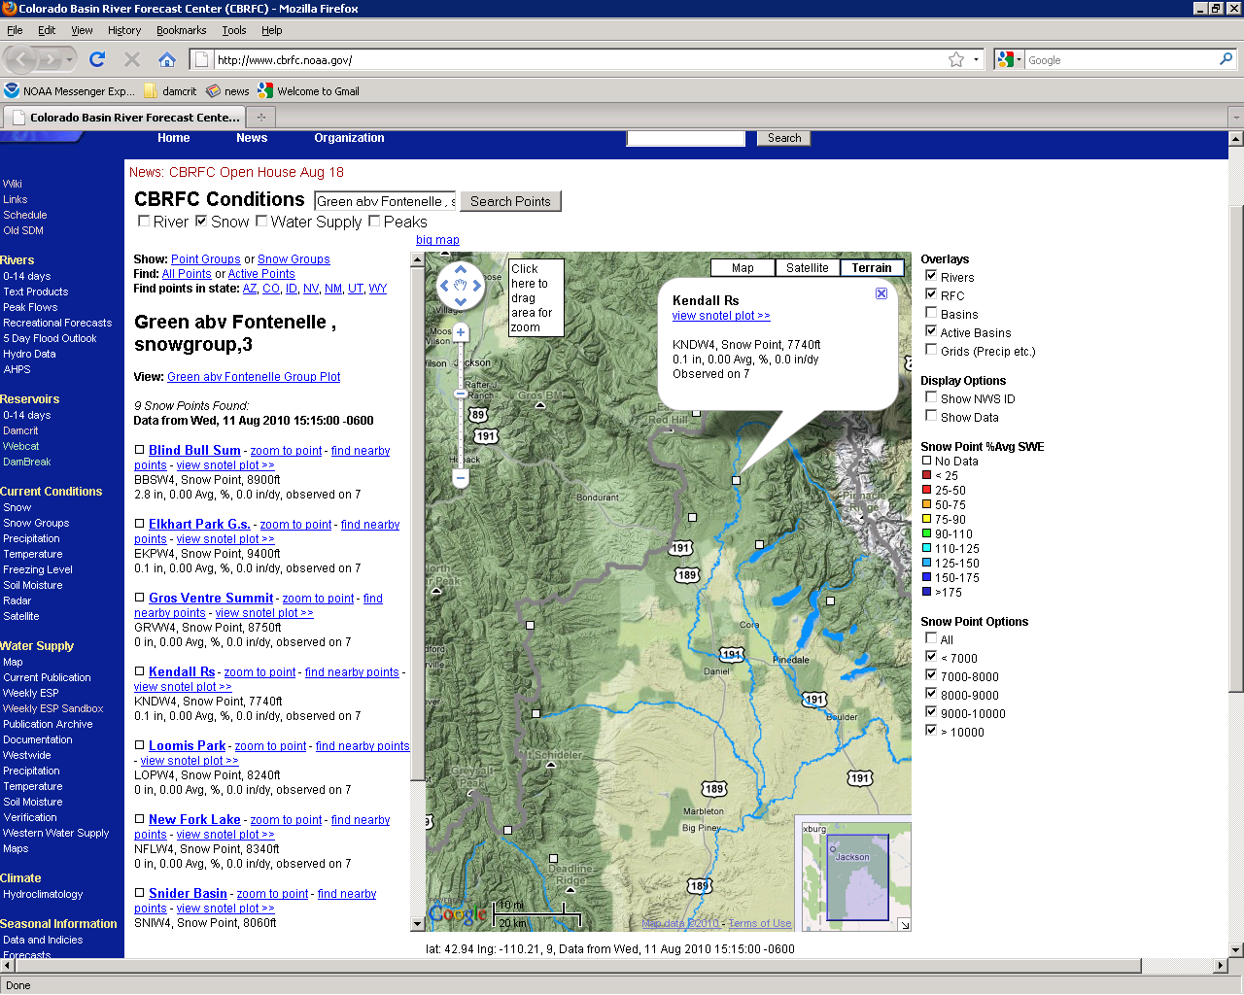
Snow Group
New pop up window when you click on point.

Slide 8
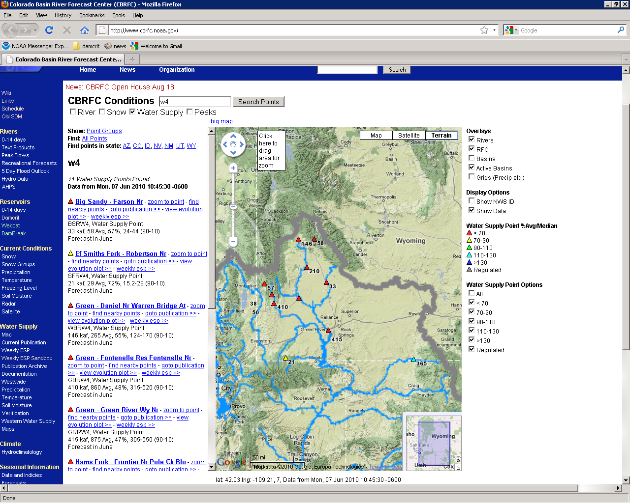
Water Supply
State
Show data
Water Supply Data for WY.

Slide 9
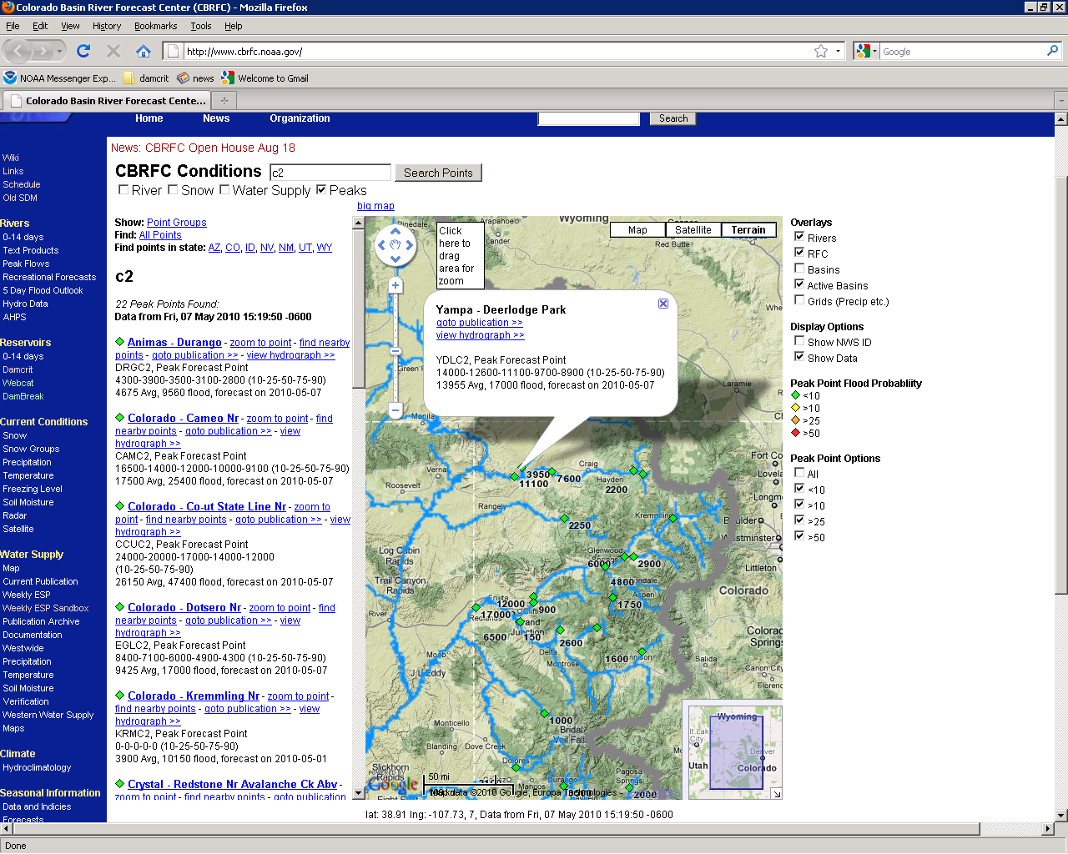
Peaks
State
Peak Flow Data Most Recent Forecast Shown.

Slide 10
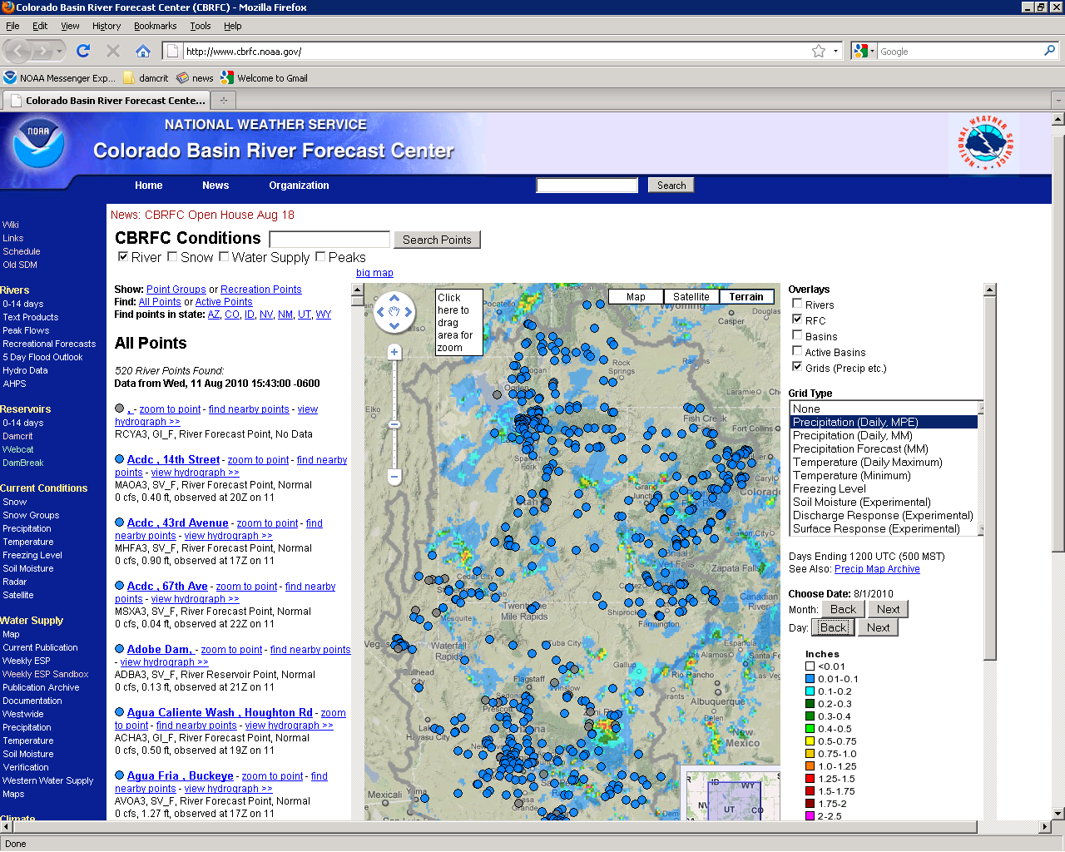
Grids
Grids/Grid Type.

Slide 11
Bill Reed
CBRFC Senior Hydrologist
Phone: 801.524.5130
Email: bill.reed@noaa.gov
www.cbrfc.noaa.gov

