Slide 1
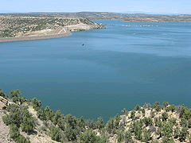
Colorado Basin River Forecast Center
Navajo Operations Meeting
Image: Wikipedia
Greg Smith
Senior Hydrologist
National Weather Service
Colorado Basin River Forecast Center
January 25, 2011

Slide 2
Outline
River Forecast Center Overview
Forecasting Water Supply (Navajo Inflow)
forecasting methods
primary data inputs & limitations
Navajo inflow forecast performance
A Look at Current Conditions
Forecast Products and Resources
Notes:
2
The NWS started making water supply forecasts in the 1940s for the Colorado basin. Eventually these forecasts were expanded to cover most western snow melt dominated basins through cooperation with the NRCS. Seasonal streamflow forecasts tradionally derive nearly all of their skill from current snowpack conditions in the basin. In fact, the NRCS SNOTEL network was deployed beginning in the late 1970s explicitly to improve seasonal streamflow prediction.
Bullets on left give background information on water supply forecasts.
The upper right figure is hyperlinked to “live” website (www.cbrfc.noaa.gov/westernwater). - Suggest clicking on website and giving a brief synopsis of current forecasts for western US. Note that most areas are extremely dry this year – particularly most all of California and the Colorado Basin. The Washington Cascades and the upper Arkansas River Basin are the only areas with above normal forecasts this year.

Slide 3
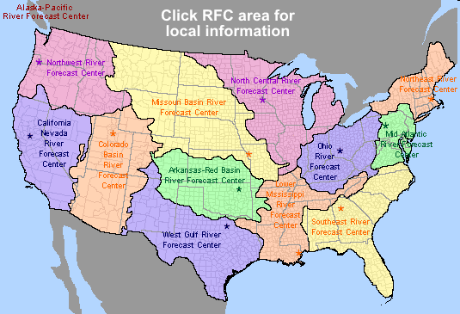
Colorado Basin River Forecast Center
One of 13 River Forecast Centers
Established in the 1940s for water supply forecasting
Three primary missions:
1. Seasonal Water supply forecasts for water management
2. Daily forecasts for flood, recreation, water management
3. Flash flood warning support
www.cbrfc.noaa.gov

Slide 4
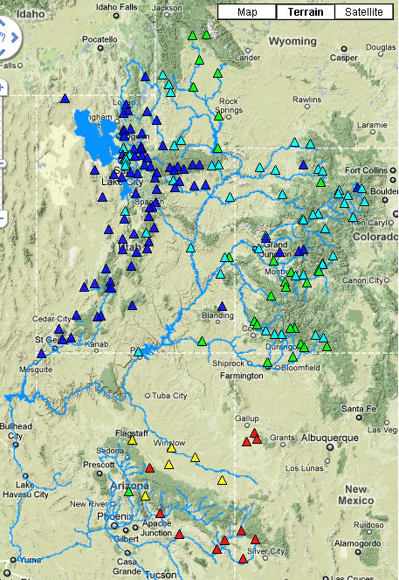
Water Supply Forecasts Issued by the CBRFC
January 1st 2011
Seasonal stream flow volume forecasts for Upper & Lower Colorado River Basins and eastern Great Basin of Utah.
Northern basin seasonal runoff is dominated by snow melt. Lower Colorado runoff is dominated by liquid precipitation events.
Forecasts are produced twice monthly (Jan-Jun):
April-July for Navajo inflow
Weekly & Monthly Volumes
Forecasts are coordinated with the NRCS.
Notes:
4
The NWS started making water supply forecasts in the 1940s for the Colorado basin. Eventually these forecasts were expanded to cover most western snow melt dominated basins through cooperation with the NRCS. Seasonal streamflow forecasts tradionally derive nearly all of their skill from current snowpack conditions in the basin. In fact, the NRCS SNOTEL network was deployed beginning in the late 1970s explicitly to improve seasonal streamflow prediction.
Bullets on left give background information on water supply forecasts.
The upper right figure is hyperlinked to “live” website (www.cbrfc.noaa.gov/westernwater). - Suggest clicking on website and giving a brief synopsis of current forecasts for western US. Note that most areas are extremely dry this year – particularly most all of California and the Colorado Basin. The Washington Cascades and the upper Arkansas River Basin are the only areas with above normal forecasts this year.

Slide 5
Water Supply Forecasts
Forecasts
Begin
Jan 1
Forecast Target
(April – Jul Volume)
August
Early Outlook
Period
Month:
A S O N D J F M A M J J
Observed snow water equivalent
Observed Precipitation
Observed Streamflow
Updated Soil Moisture Conditions
Updated Climate/Weather Forecasts
Historical Observations
Streamflow (recession)
Soil Moisture Conditions
Climate Forecasts/Indices
Outlook
Drivers
Forecast
Drivers

Slide 6
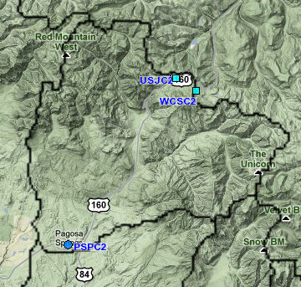
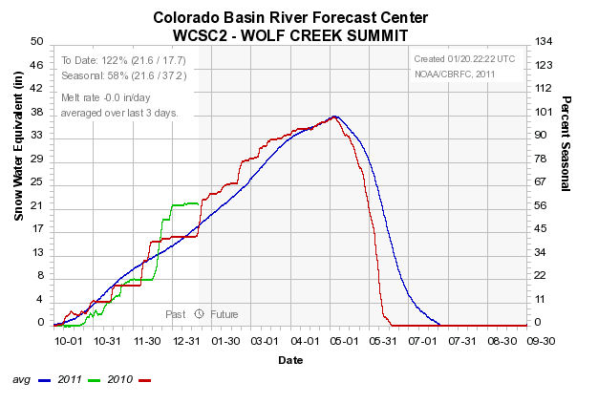
Water Supply Forecast Methods
Using historical data – relationships were developed between streamflow and snowpack / precipitation conditions throughout the season.
Statistical Equations
April Eqn: Apr-Jul Runoff = 3.71 * USJC2 + 4.22 * WCSC2 – 32.92
Pagosa Springs Basin

Slide 7
Existing Water Supply Forecast Methods
Statistical Water Supply (SWS)
Statistical Regression Equations
Primary method from 1940’s to mid 1990’s.
Historical Relationships between streamflow, snow, & precipitation (1971-2000+)
Tied to first of the month data and for a fixed runoff period (inflexible)
Ensemble Streamflow Prediction (ESP)
A component of the operational model being run at the RFC.
Continuous real time inputs of observed and forecast temperatures & precipitation.
Accounts for soil moisture conditions within a river basin - drives runoff efficiency
Builds and melts snowpack – based on observed & forecast temperatures
Flexible run date, forecast period, forecast parameters.
Evolving toward ESP as primary forecast tool

Slide 8
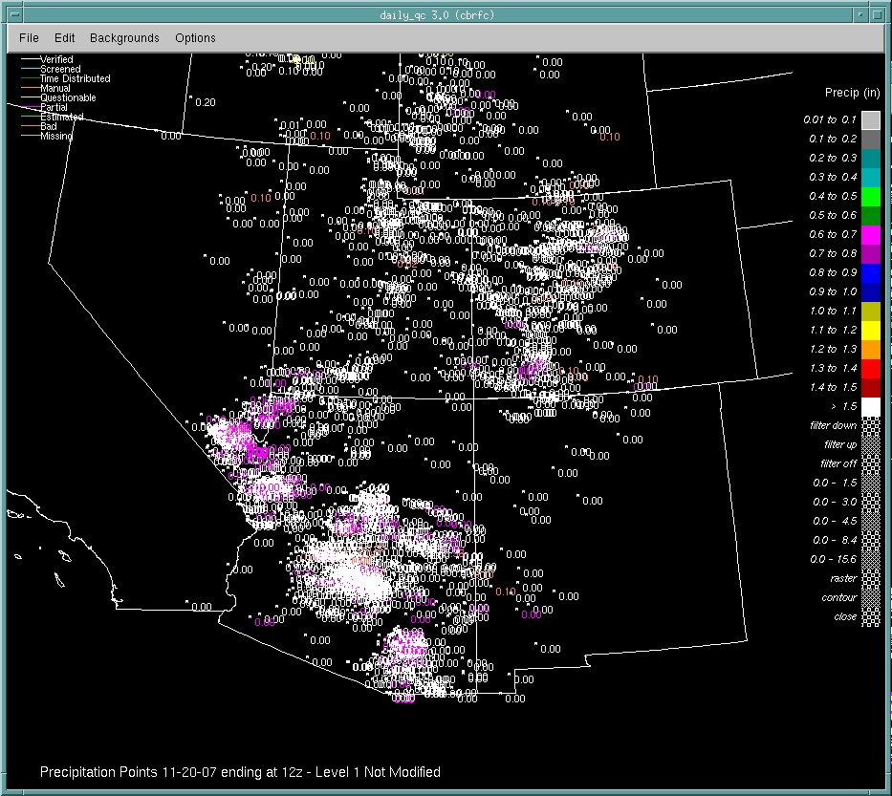
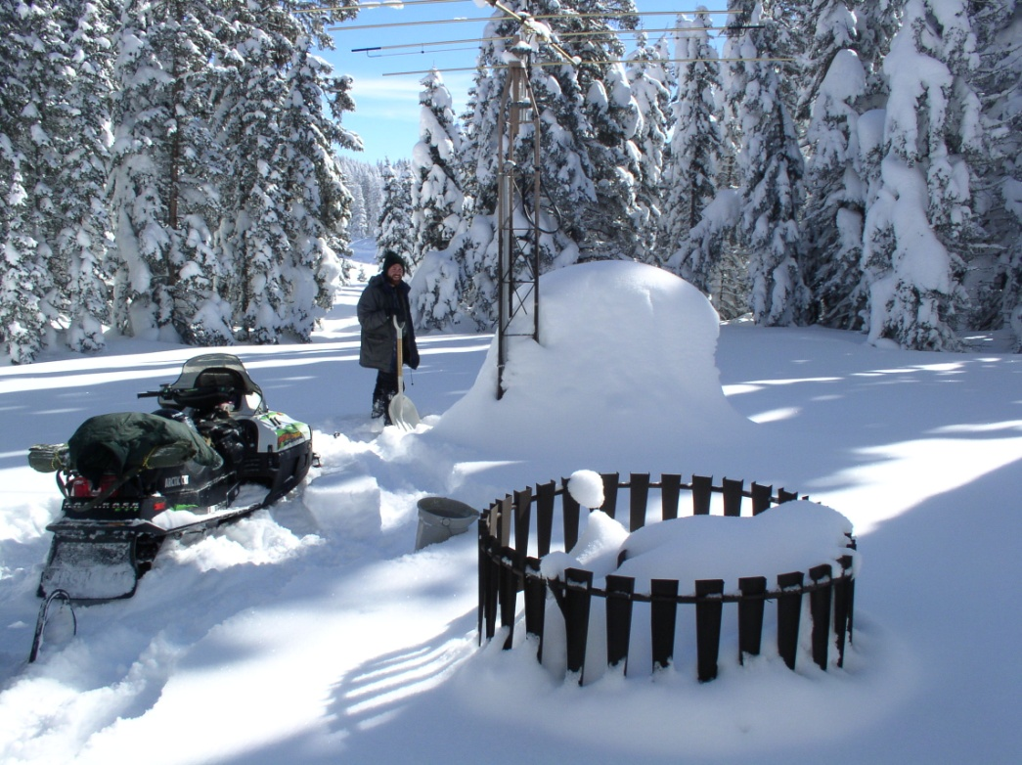
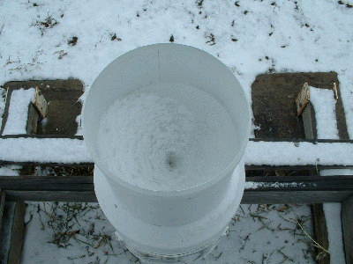
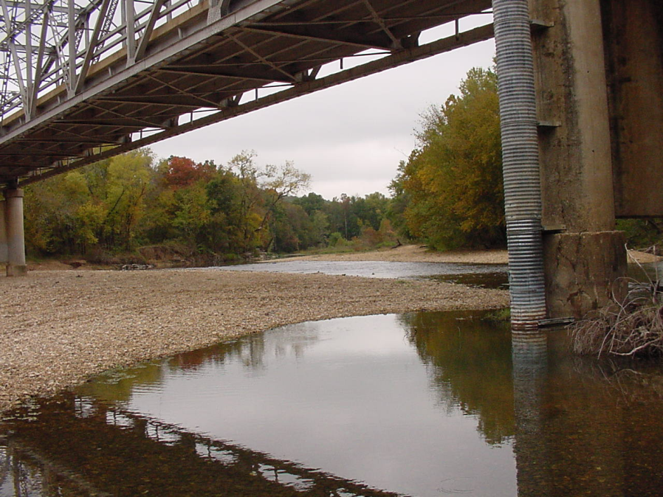
Water Supply Forecast Methods
Ensemble Streamflow Prediction (ESP) – Long Term Forecasts
Begins with daily operations at the River Forecast Center – Quality check the data
Images courtesy NRCS & USGS
Notes:
8
The NWS started making water supply forecasts in the 1940s for the Colorado basin. Eventually these forecasts were expanded to cover most western snow melt dominated basins through cooperation with the NRCS. Seasonal streamflow forecasts tradionally derive nearly all of their skill from current snowpack conditions in the basin. In fact, the NRCS SNOTEL network was deployed beginning in the late 1970s explicitly to improve seasonal streamflow prediction.
Bullets on left give background information on water supply forecasts.
The upper right figure is hyperlinked to “live” website (www.cbrfc.noaa.gov/westernwater). - Suggest clicking on website and giving a brief synopsis of current forecasts for western US. Note that most areas are extremely dry this year – particularly most all of California and the Colorado Basin. The Washington Cascades and the upper Arkansas River Basin are the only areas with above normal forecasts this year.

Slide 9
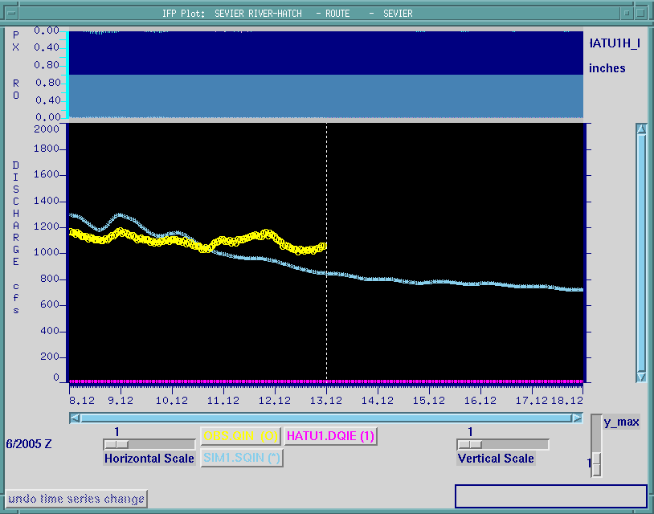
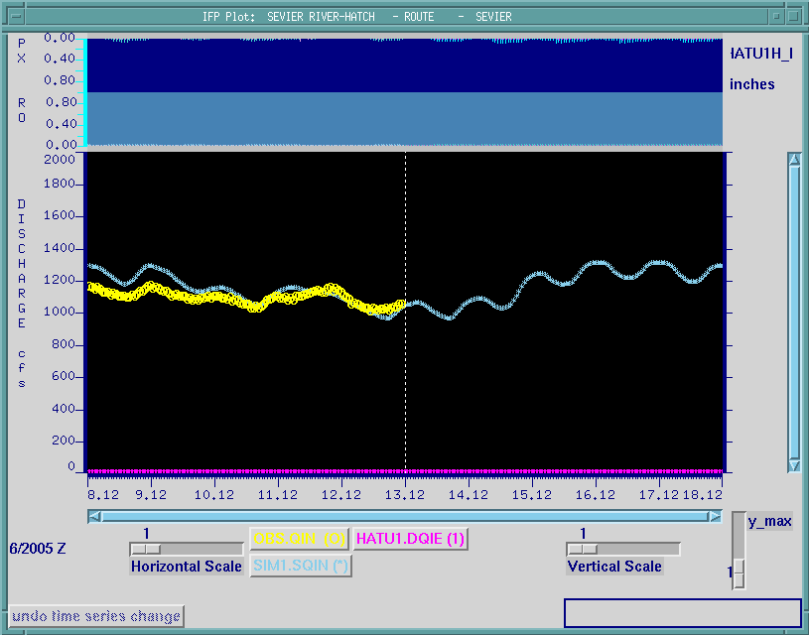
Water Supply Forecast Methods
Ensemble Streamflow Prediction (ESP) – Long Term Forecasts
Begins with daily operations at the River Forecast Center – Interact with operational model
Observed stream flow and model simulated flow are not tracking
After hydrologist interaction: simulated flow is now tracking

Slide 10
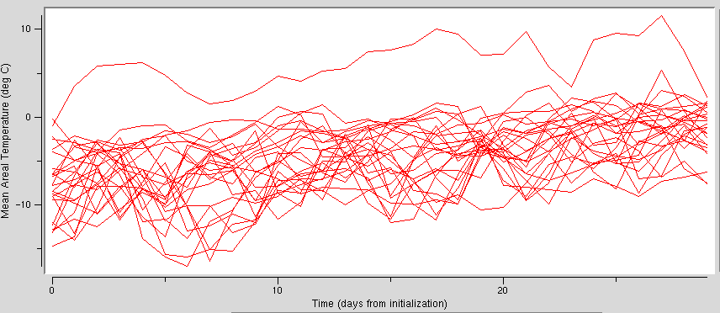
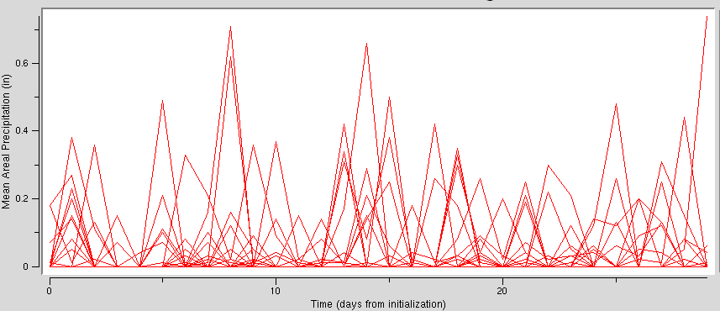
Water Supply Forecast Methods - ESP
Today’s Conditions
River Levels
Reservoir Levels
Soil Moisture
Snowpack
Future Streamflow
1971
1972
1973
1974
1975
Past <-
-> Future
1971
Temperature
Precipitation
Start with Today’s Conditions - Create several possible future streamflow patterns - Based on historical climate.

Slide 11
Water Supply Forecast Methods - ESP
Today’s Conditions
River Levels
Reservoir Levels
Soil Moisture
Snowpack
Future Streamflow
Past <-
-> Future
April-July
Low chance of this level of flow or higher
10% Exceedance
Medium chance of this level of flow or higher
50% Exceedance
High chance of this level of flow or higher
90% Exceedance

Slide 12
Water Supply Forecast Methods
.
Deterministic forecast
(single value)
.
Probabilistic forecast
(range of values)
Exceedance probability
Above green
< 10%
10 - 25%
Flow
25 – 50%
50 – 75%
75 – 90%
≥ 90%
Date of interest
Time
©The COMET Program
Notes:
A deterministic model will produce a single hydrograph with a single value for any particular day.
On the other hand, an ensemble of streamflow values can be used to create a probability graph for various flows. Here, the gray represents a very high exceedance probability, or a good chance that the flow will be this level or higher since all the traces were above this level. The color scale shows progressively lower chances of higher flows occurring.
Now this is where deterministic and probabilistic forecasts differ. Say you would like to know streamflow conditions for a particular date of interest. If you used a deterministic approach, you would have a single value. This value is either right or wrong. However, with a probabilistic forecast, you would have a full range of flows and the associated chances of exceedance. In this case, the probabilistic forecast is neither right nor wrong. This is a verification challenge and is discussed later in this presentation.

Slide 13
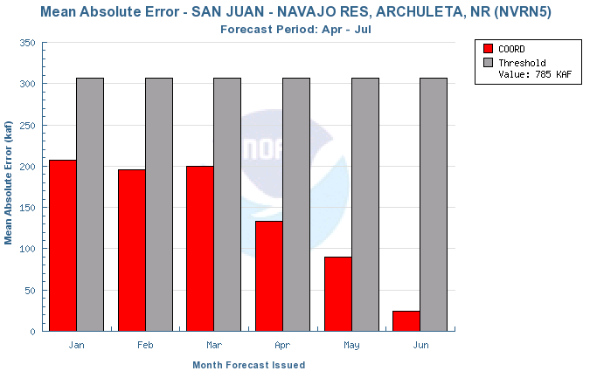
How good are we? – Navajo Inflow

Slide 14
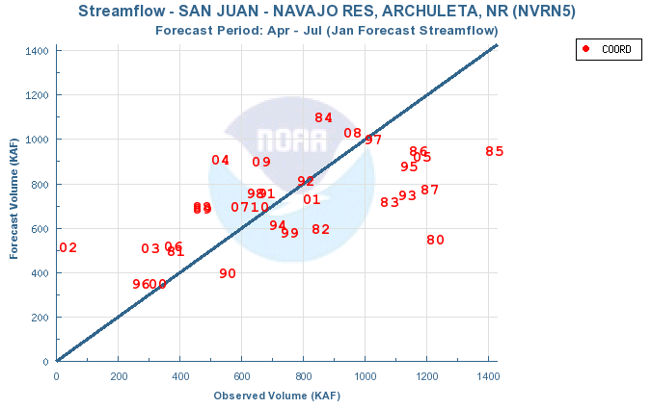
Largest January errors are “under” forecasts

Slide 15
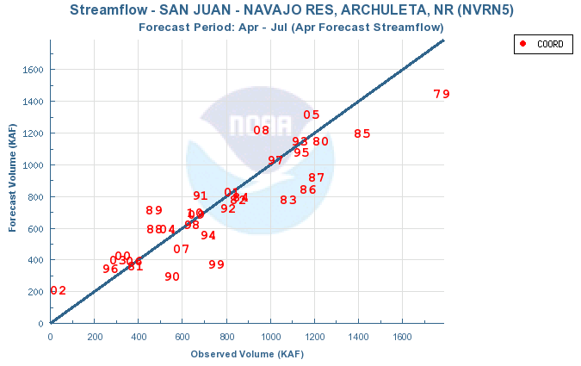
Significant improvement in forecasts by April

Slide 16
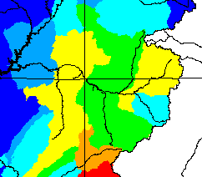
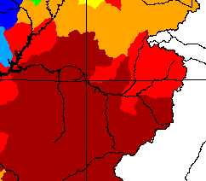
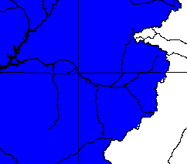
A Look At This Year:
Seasonal Precipitation
October 2010
November 2010
95%
December 2010
55%
225%

Slide 17
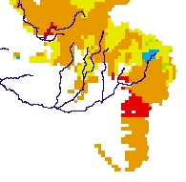
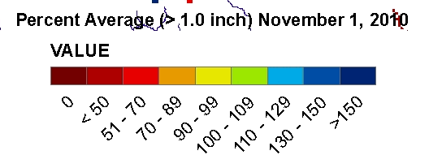
A Look At This Year:
Autumn 2010 Modeled Soil Moisture Conditions

Slide 18
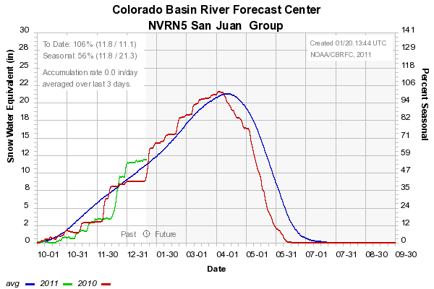
A Look At This Year:
January 20th Snow Conditions above Navajo Reservoir

Slide 19
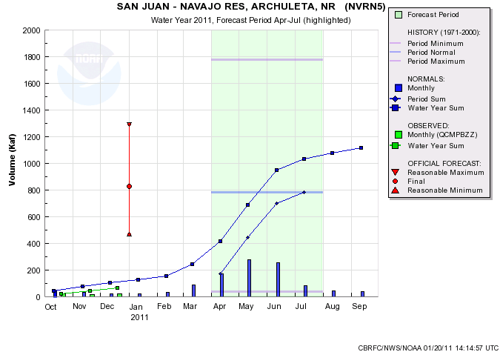
A Look At This Year:
10% Chance
830
800
Average
90% Chance

Slide 20
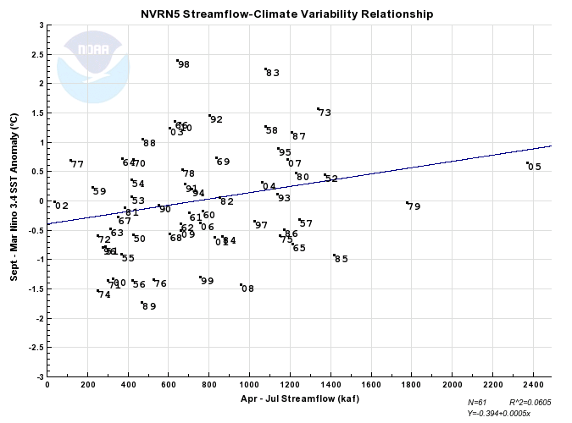
A Look At This Year:

Slide 21
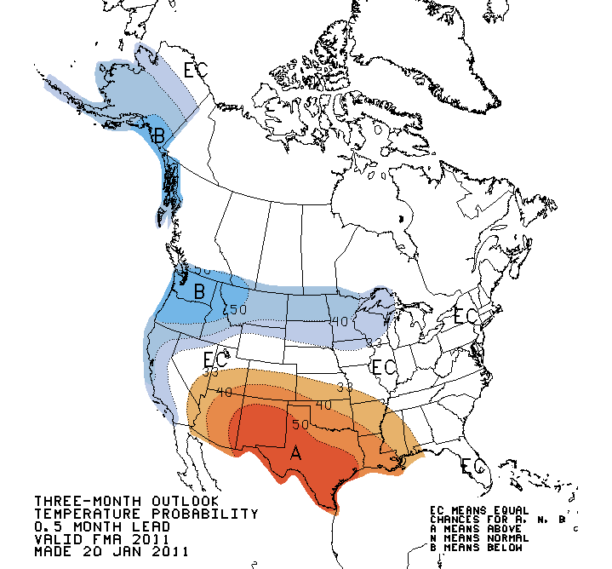
A Look At This Year:
Climate Prediction Center Feb-Apr Temperature

Slide 22
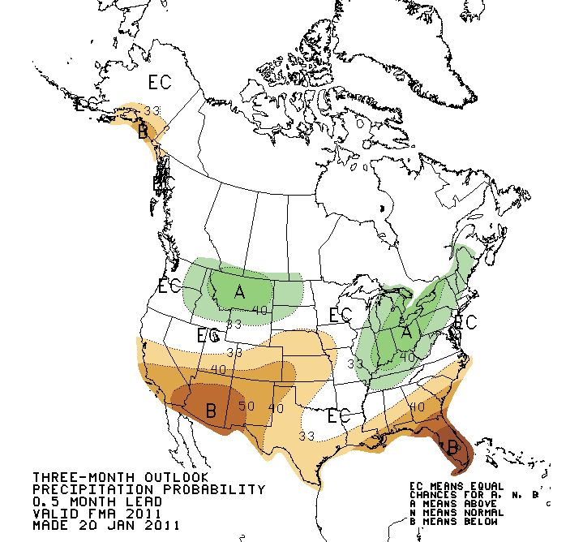
A Look At This Year:
Climate Prediction Center Feb-Apr Precipitation

Slide 23
Water Supply Forecasts and Resources:
CBRFC Web Page: www.cbrfc.noaa.gov
Weekly raw model guidance (ESP) updates (see the forecast trend)
Precipitation and Snow site Graphics (NRCS SNOTEL)
Monthly online water supply publications (San Juan Basin conditions)
Links to climate forecasts
Seasonal snow melt peak flow forecasts
National Water Resources Outlook:
wateroutlook.nwrfc.noaa.gov
View forecast trend throughout the season.
Streamflow and climate relationships for forecast points
Forecast performance information (how good are we?)

