Slide 1
NWS February 2011 CUWCD Briefing
2pm, February 8, 2011
These slides: www.cbrfc.noaa.gov/present/present.php

Slide 2
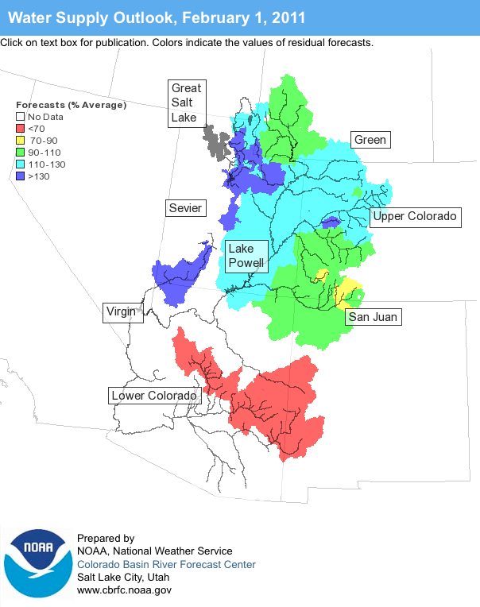
Outline
January Weather Review
Snow States
Water Supply Forecasts
Web Reference: www.cbrfc.noaa.gov/wsup/pub2/map/html/cbrfc.1.2011.html

Slide 3
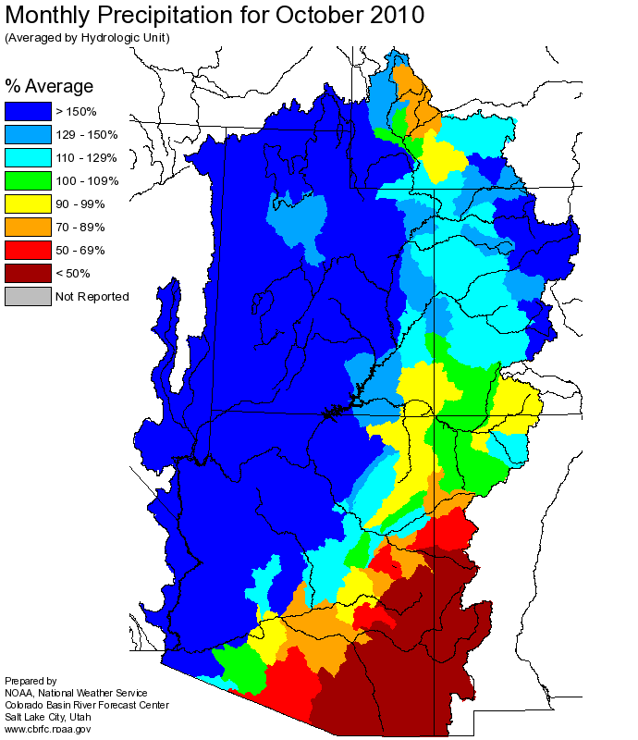
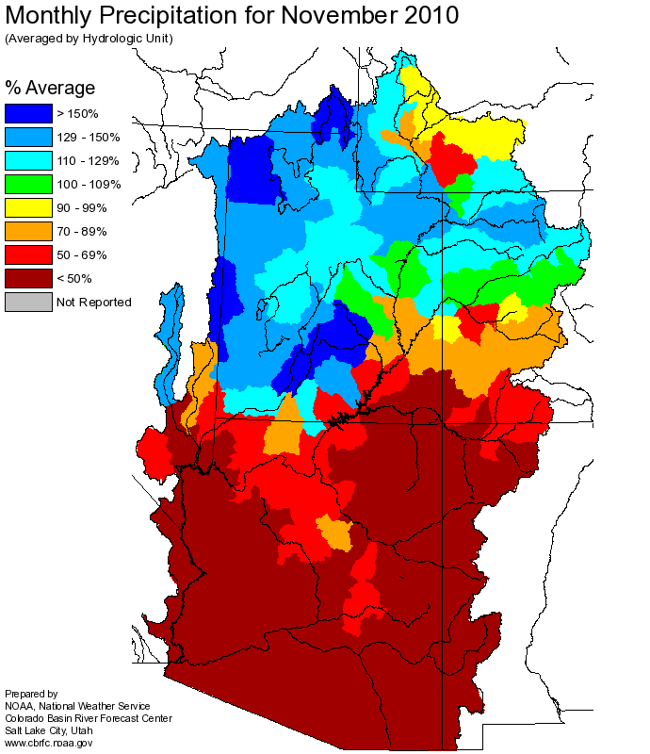
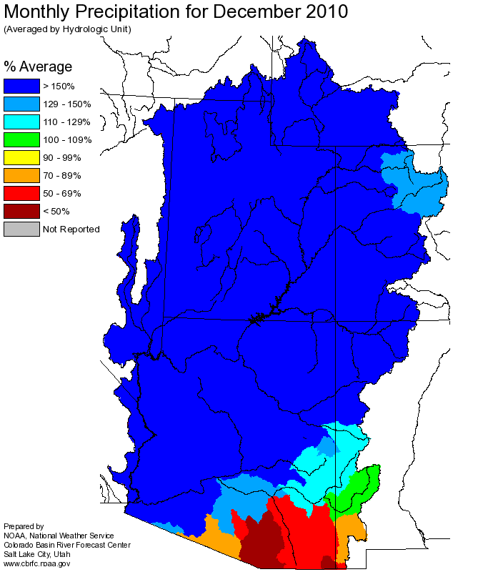
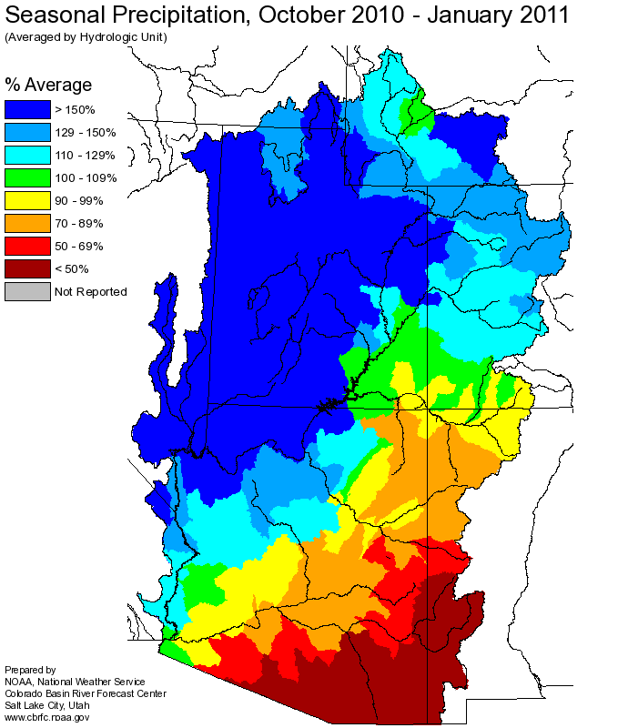
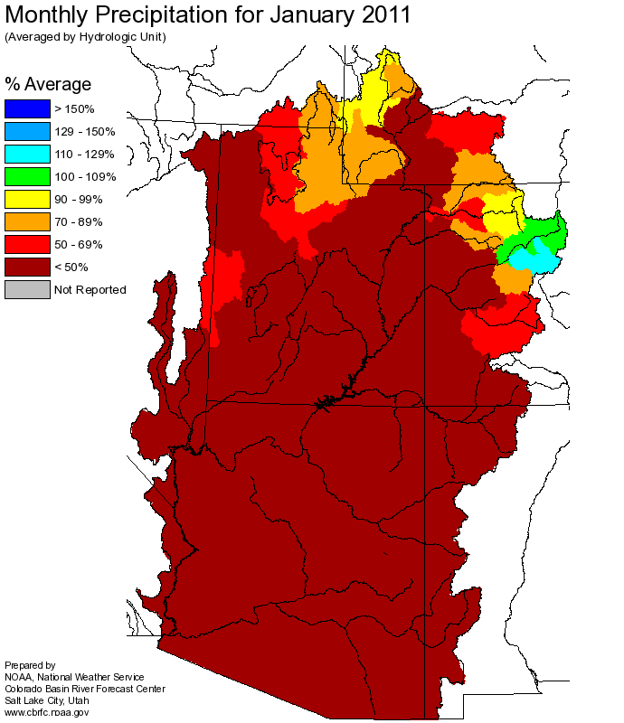
Web Reference: http://www.cbrfc.noaa.gov

Slide 4
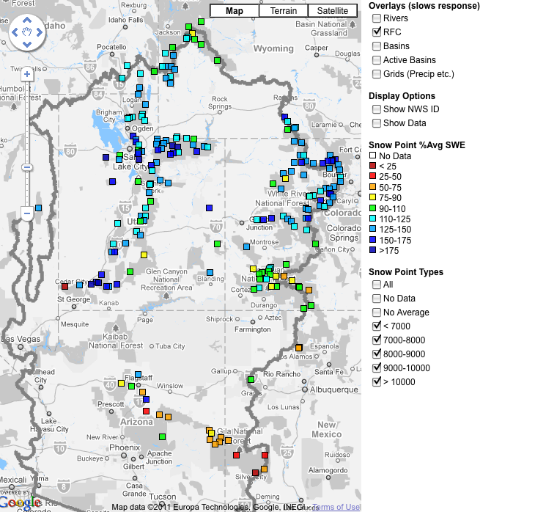
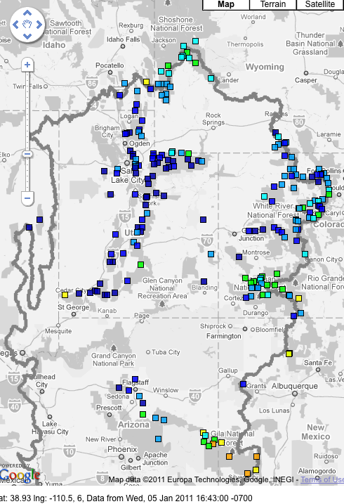
Snow
January 6 (above)
February 7 (right)
Web Reference: http://www.cbrfc.noaa.gov/gmap/gmapm.php?scon=checked

Slide 5
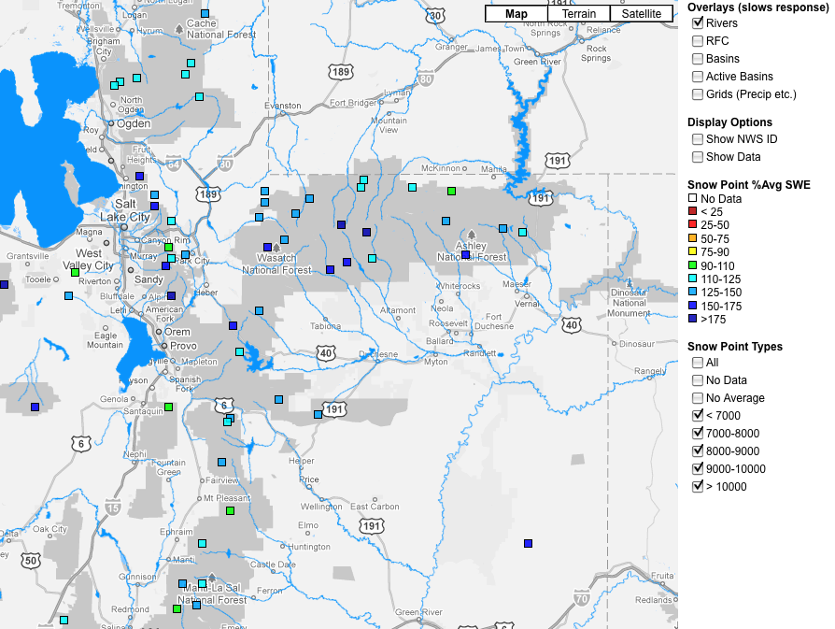
Web Reference: http://www.cbrfc.noaa.gov/gmap/gmapm.php?scon=checked

Slide 6
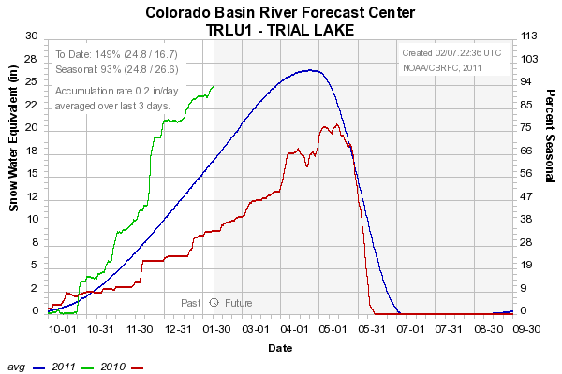
Snow: Trial Lake
Web Reference: http://www.cbrfc.noaa.gov/station/sweplot/sweplot.cgi???open

Slide 7
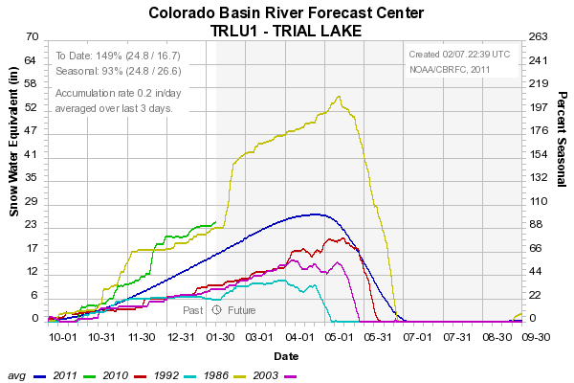
Snow: Trial Lake
Web Reference: http://www.cbrfc.noaa.gov/station/sweplot/sweplot.cgi???open

Slide 8
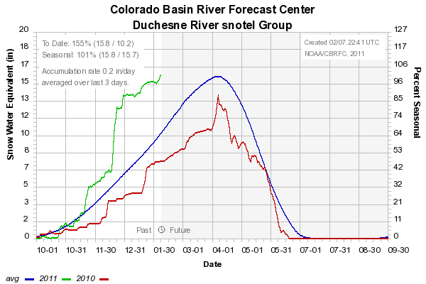
Snow: Duchesne River Group
Web Reference: http://www.cbrfc.noaa.gov/station/sweplot/sweplot.cgi???open

Slide 9
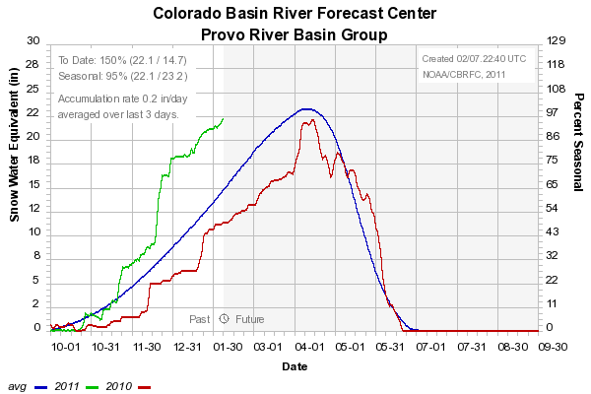
Snow: Provo River Group
Web Reference: http://www.cbrfc.noaa.gov/station/sweplot/sweplot.cgi???open

Slide 10
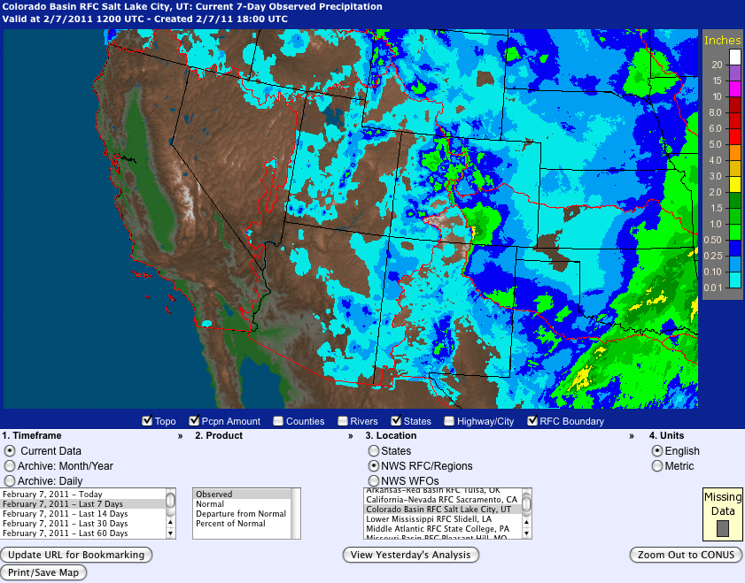
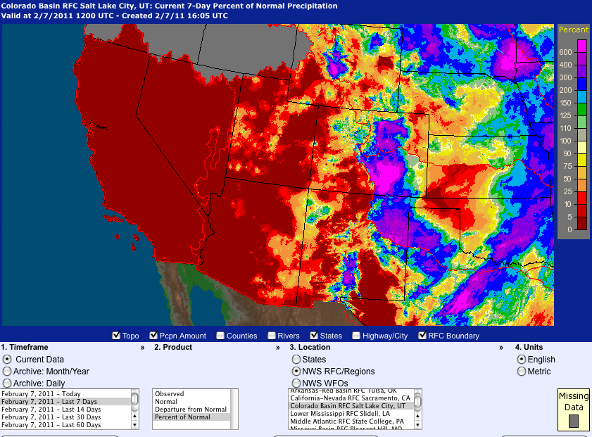
Last 7 days…
Web Reference: http://water.weather.gov

Slide 11
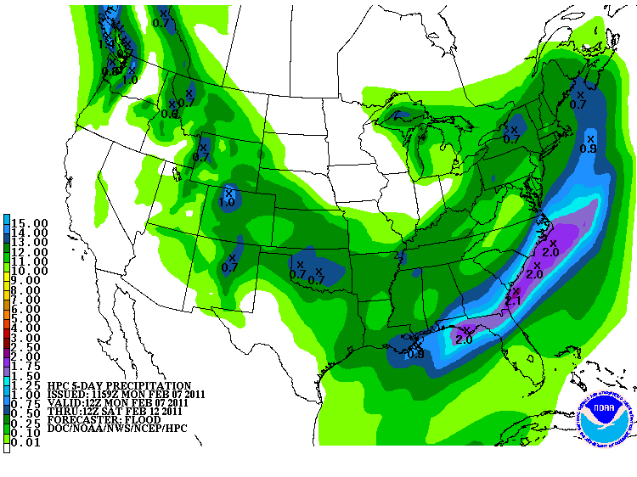
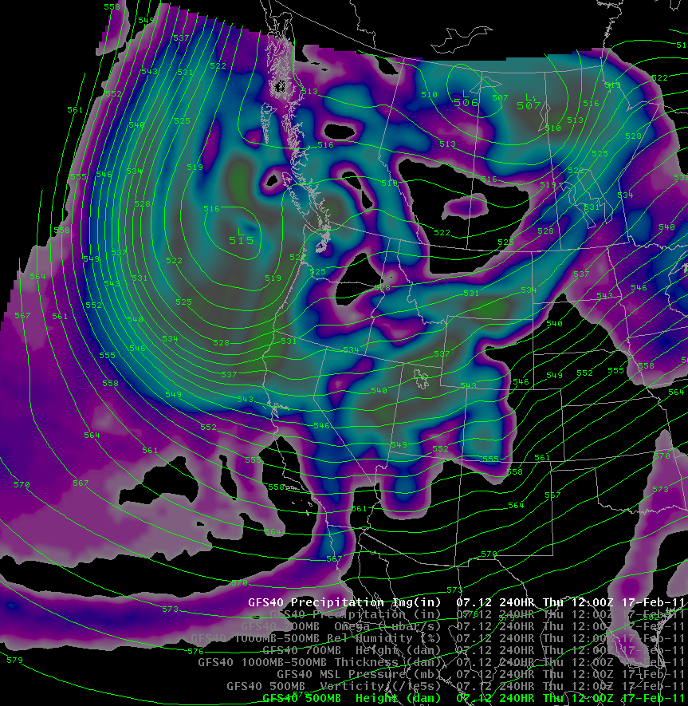
Forecast Precipitation
One storm Mon/Tues/Wed (max SWE ~1”)
Second small storm early next week (max SWE ~1/2”)
Third, more major, but uncertain, storm late next week
Web Reference: www.hpc.noaa.gov

Slide 12
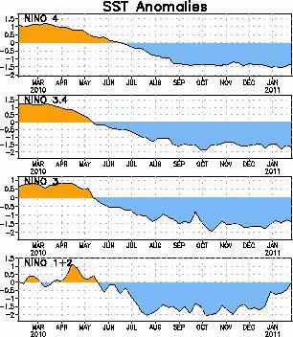
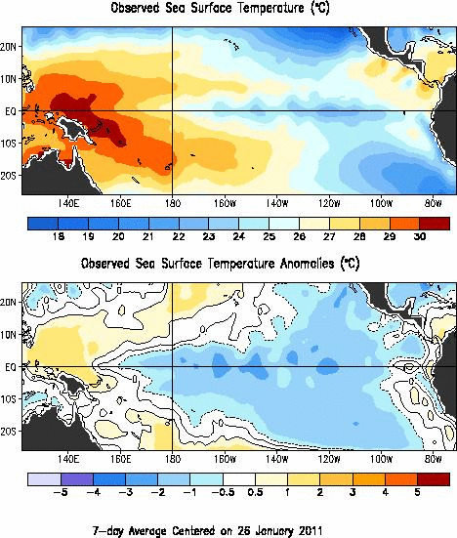
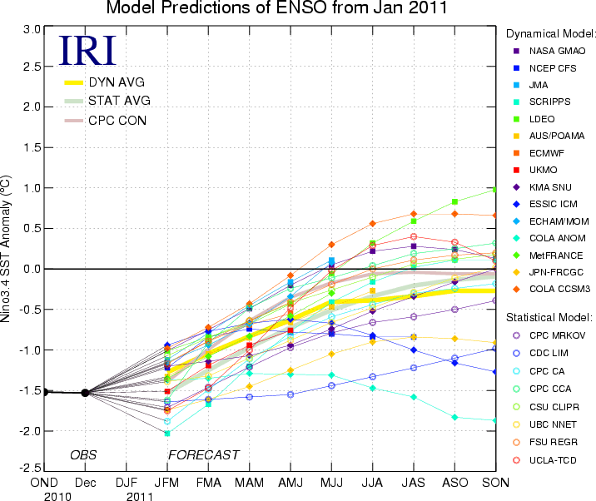
La Nina Update
Web Reference: http://www.cpc.noaa.gov and iri.columbia.edu/climate/ENSO

Slide 13
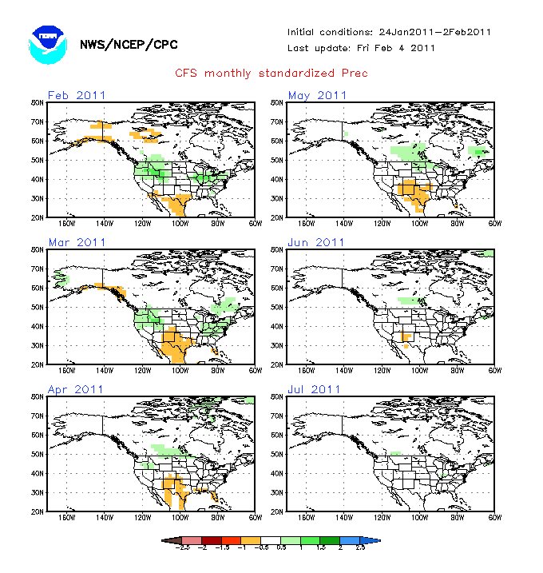
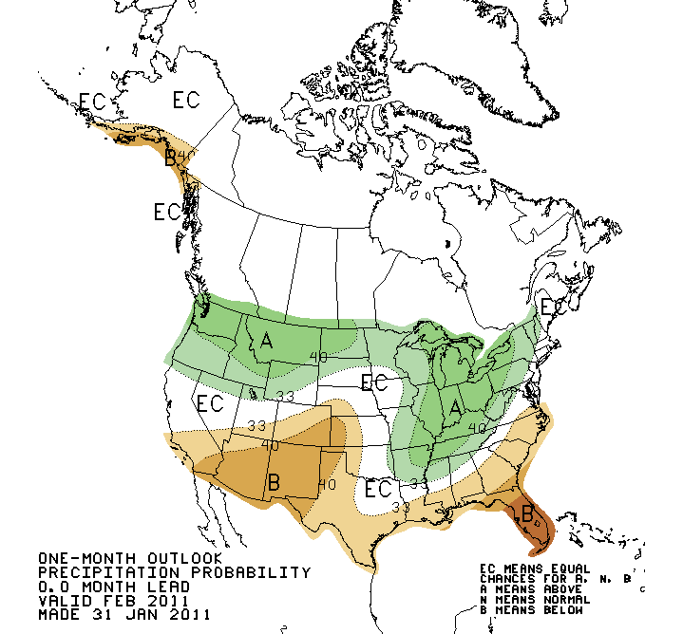
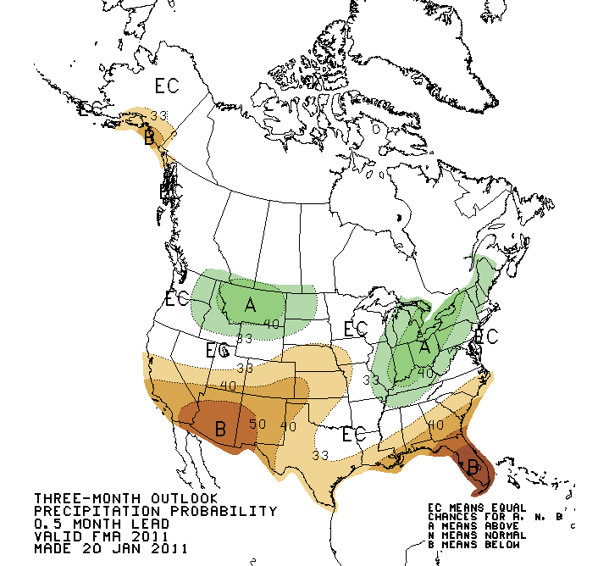
Web Reference: http://www.cbrfc.noaa.gov/climate/climoForecasts.cgi

Slide 14
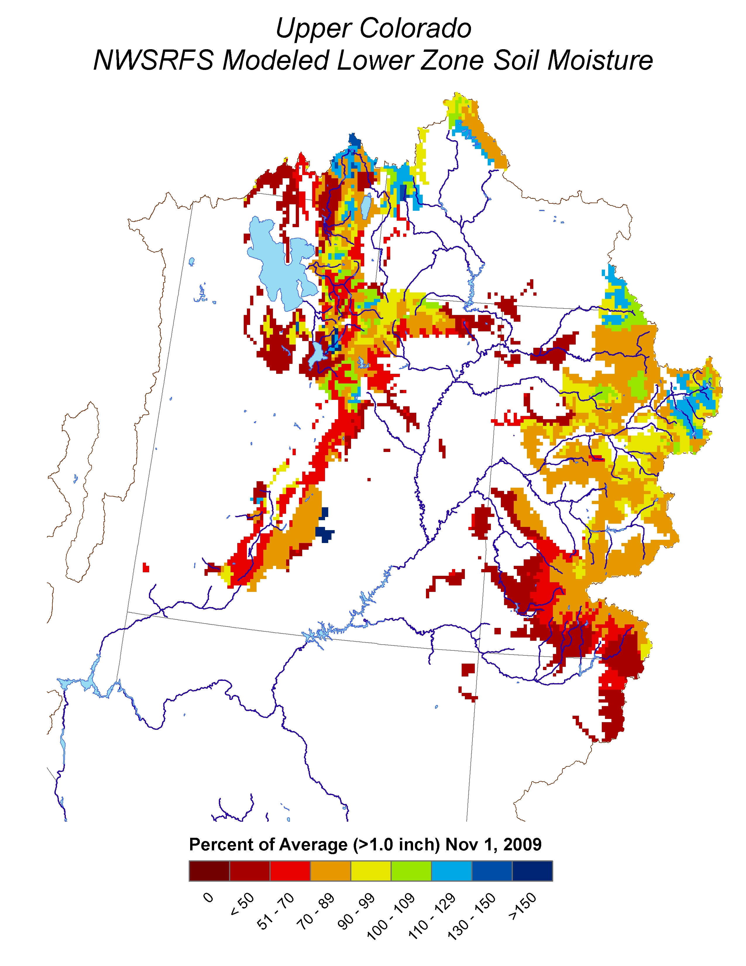
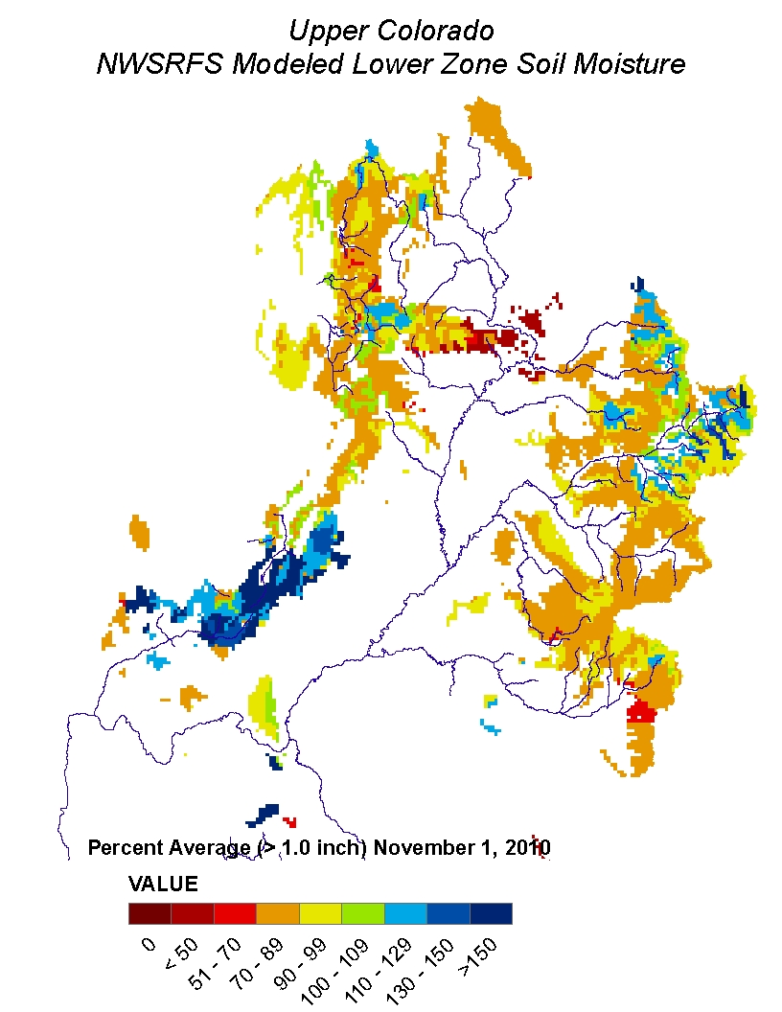
Soil Moisture

Slide 15
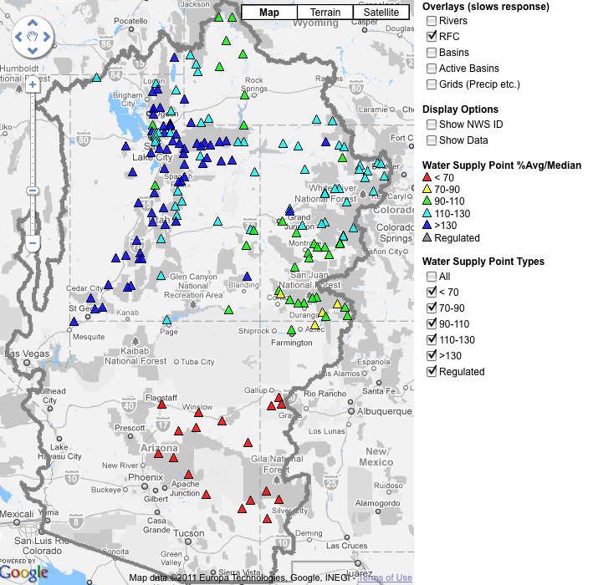
February 1, 2011
Water Supply Forecasts
Highlights:
Duchesne forecasts about the same as Jan 1
Provo forecasts down slightly
Web Reference: www.cbrfc.noaa.gov/gmap/gmapm.php?wcon=checked

Slide 16
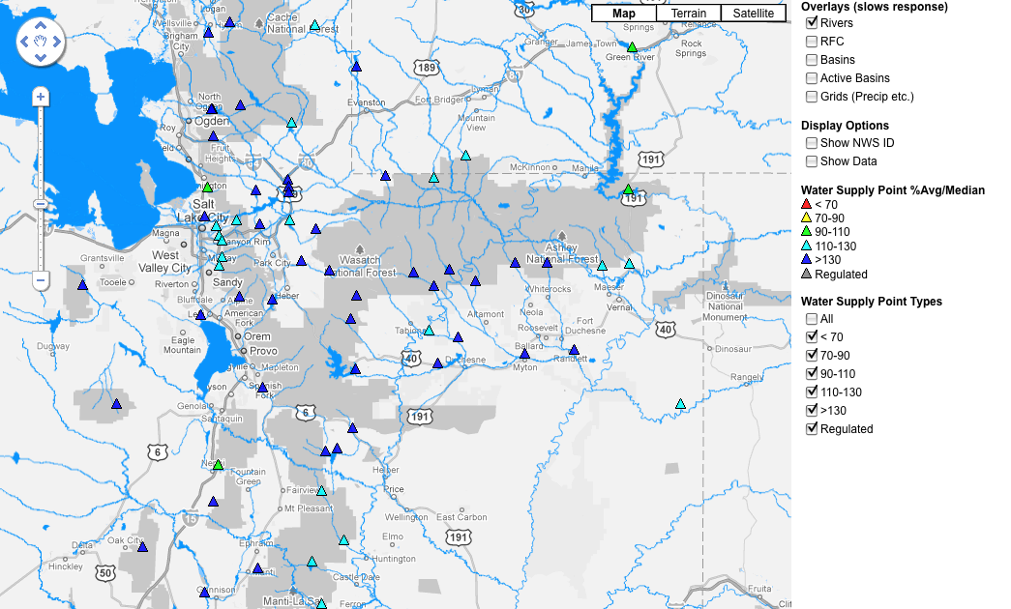

Slide 17
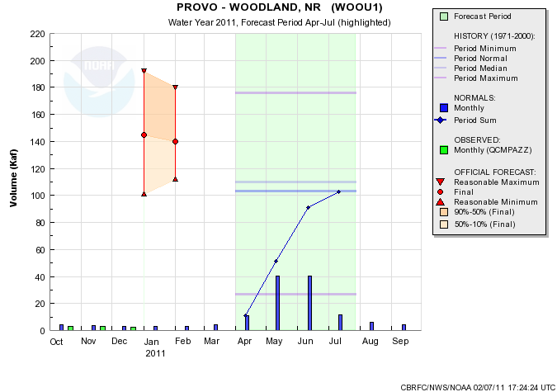
Web Reference: www.cbrfc.noaa.gov/gmap/gmapm.php?wcon=checked

Slide 18
Web Reference: www.cbrfc.noaa.gov/gmap/gmapm.php?wcon=checked

Slide 19
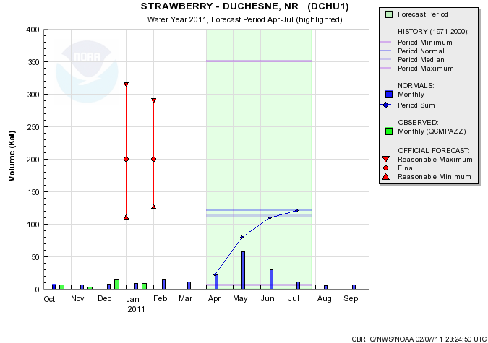
Web Reference: www.cbrfc.noaa.gov/gmap/gmapm.php?wcon=checked

Slide 20
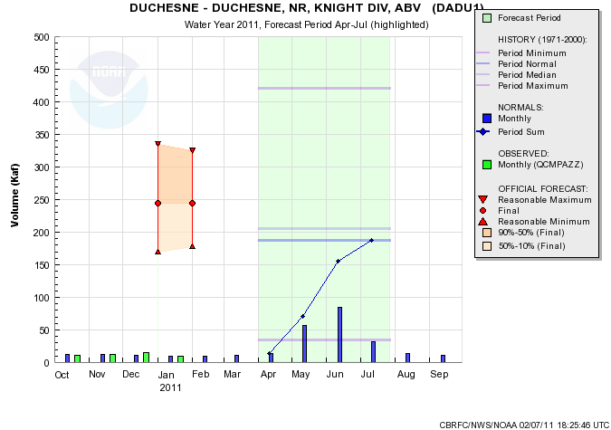
Web Reference: www.cbrfc.noaa.gov/gmap/gmapm.php?wcon=checked

Slide 21
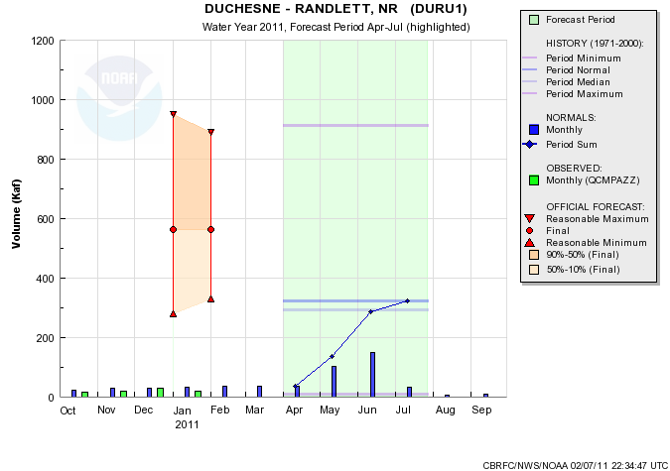
Web Reference: www.cbrfc.noaa.gov/gmap/gmapm.php?wcon=checked

Slide 22
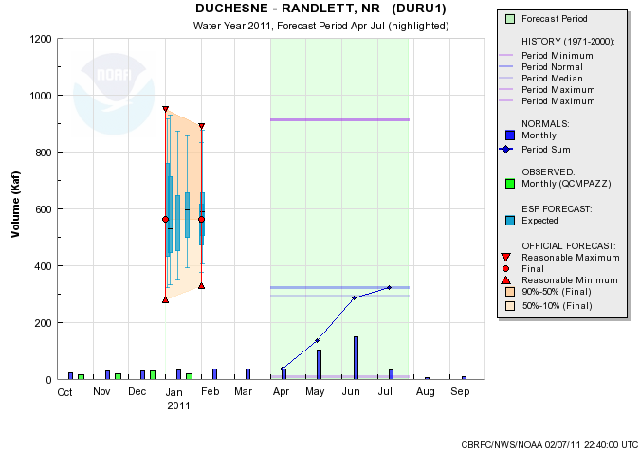
Web Reference: www.cbrfc.noaa.gov/gmap/gmapm.php?wcon=checked

Slide 23
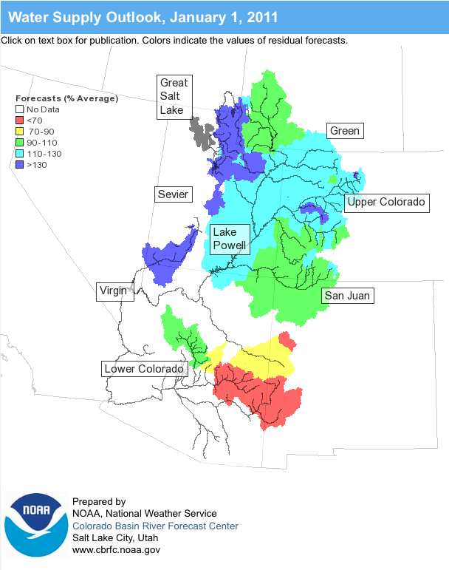
Online Publication
Web Reference: www.cbrfc.noaa.gov/wsup/pub2/map/html/cpub.php

Slide 24
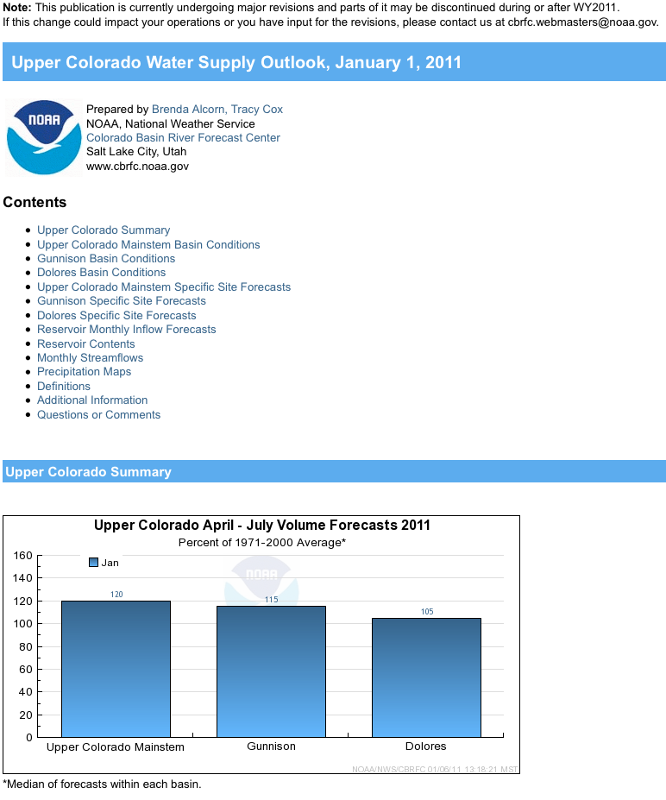
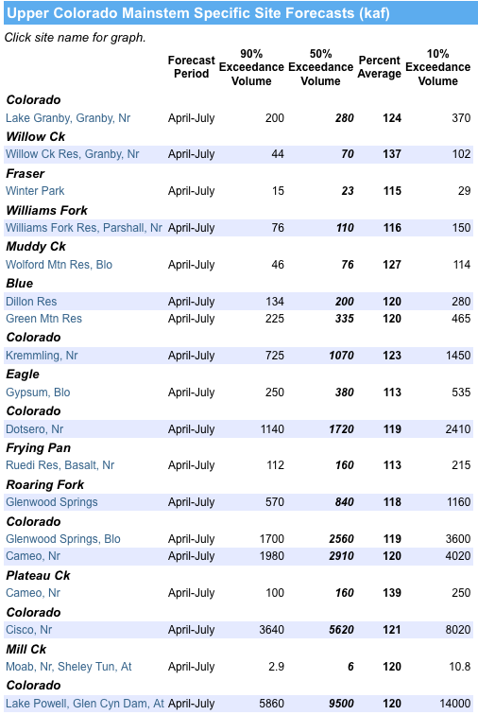
Web Reference: www.cbrfc.noaa.gov/wsup/pub2/map/html/cpub.php

Slide 25
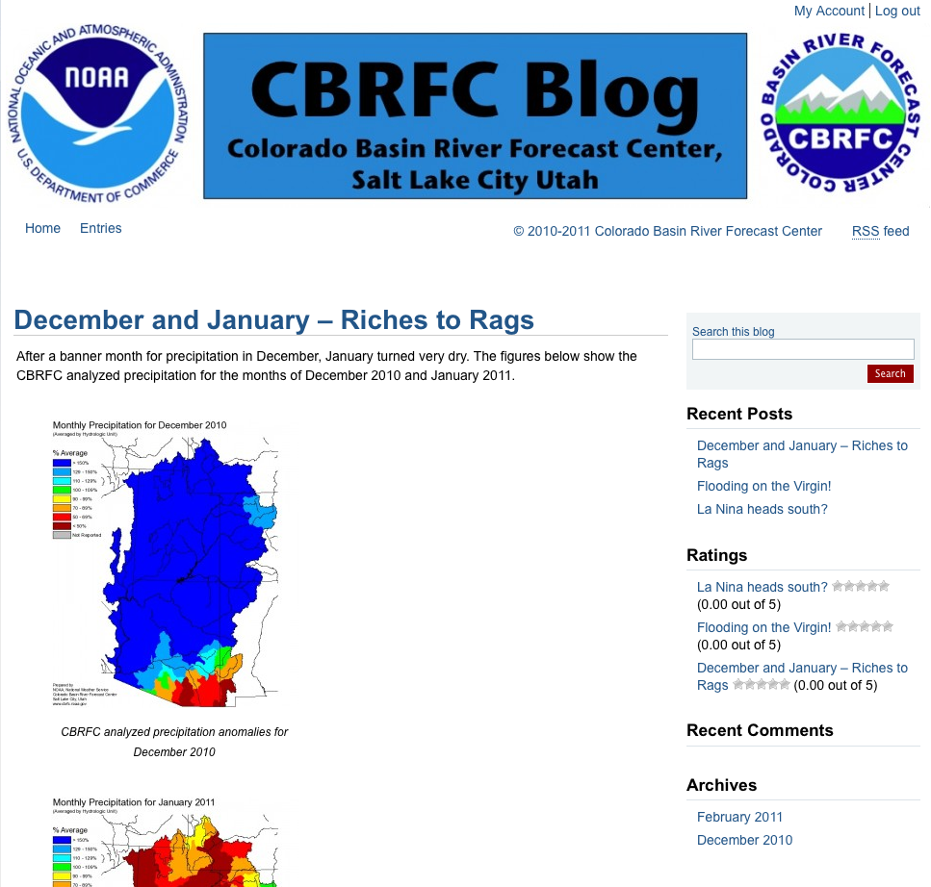
CBRFC News
Basin Focal Points (Available to discuss forecasts: 801.524.5130)
Upper Colorado: Brenda Alcorn
Green: Ashley Nielson
San Juan / Gunnison: Tracy Cox
Great Basin: Brent Bernard
Lower Colorado (below Lake Powell): Greg Smith
Here now:
Sign up for all webinars through May 2011
Weekly ESP model guidance
Email product updates via govdelivery (can add more products / webpages upon request)
Changes to CBRFC webpage
Blog (blog.citizen.apps.gov/cbrfc)
Coming soon:
New water supply publication – will share next month

Slide 26
More Resources
www.cbrfc.noaa.gov
Wateroutlook.nwrfc.noaa.gov

Slide 27
Feedback, Questions, Concerns always welcome….
Kevin Werner
CBRFC Service Coordination Hydrologist
Phone: 801.524.5130
Email: kevin.werner@noaa.gov

