Slide 1
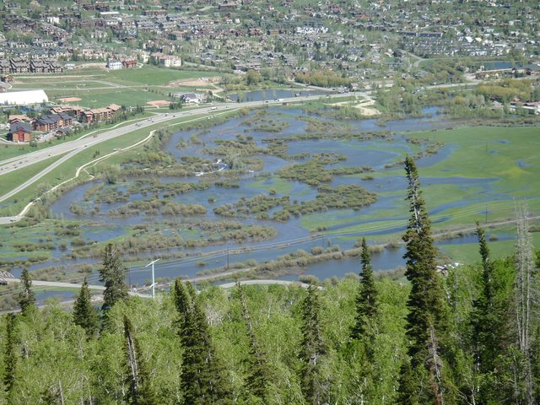
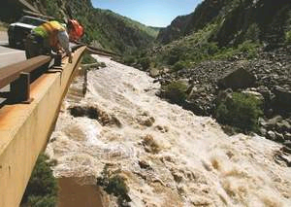
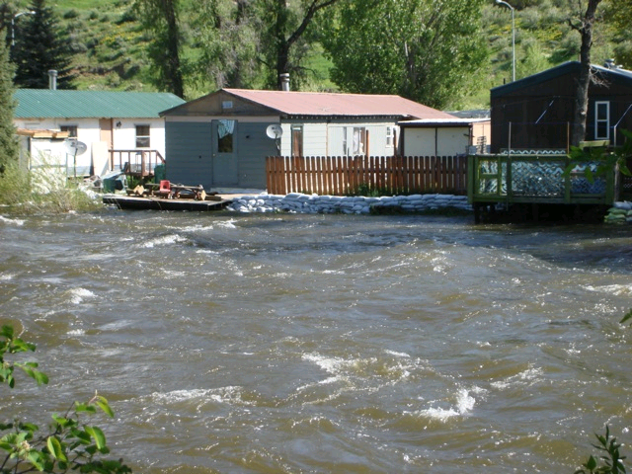
2011 Peak Flows and Daily Forecasts
CBRFC 2011 Stakeholder Forum
November 3, 2011

Slide 2
OUTLINE
Brief overview of daily and peak flow forecasts
Runoff Review
North-South tour of spring/summer runoff
December storm and Lake Mead

Slide 3
CBRFC Daily/Peak Forecasts
Peak Flow Forecasts
Snowmelt Mean Daily Maximum Flow (April-July)
Long Lead-Probabilistic Forecasts
(10%,25%,50%, 75%, 90%)
Issued (at least) monthly from March-June (this year weekly starting April 19)
~60 forecast points – UNREGULATED and REGULATED
Regulated points HIGHLY impacted by upstream reservoir operations
Daily Forecasts
Hydrograph time series for future 10 days (deterministic)
5 days of forecasted precipitation
10 days of forecasted temperature
Include known future reservoir operations
Issued as least daily by 10 am MT
Updated multiple times a day during high flows or flood events

Slide 4
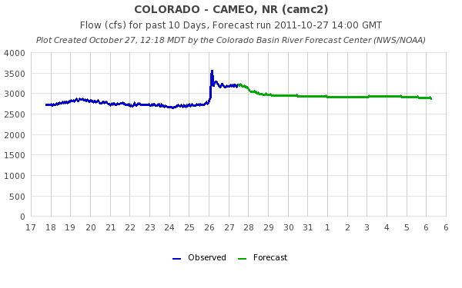
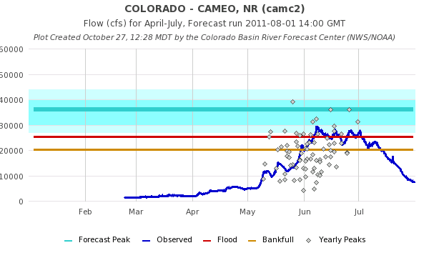
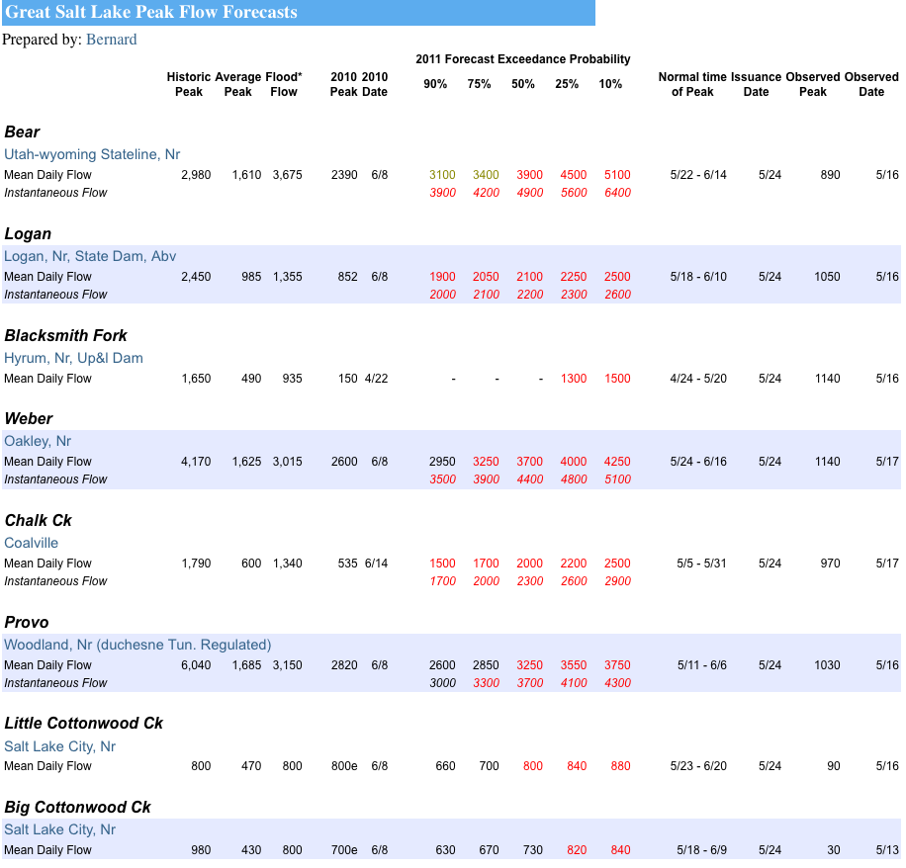
Daily Forecast
Peak Flow Forecasts

Slide 5
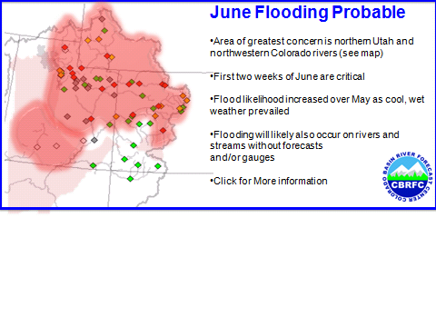
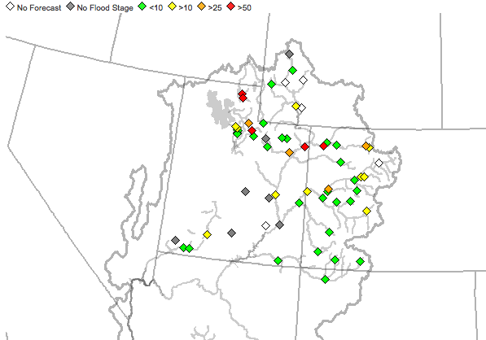
2011 Runoff Review
Where did we start?
April 1 Peak flow forecasts:
Very significant chances for flooding in Utah, Colorado

Slide 6
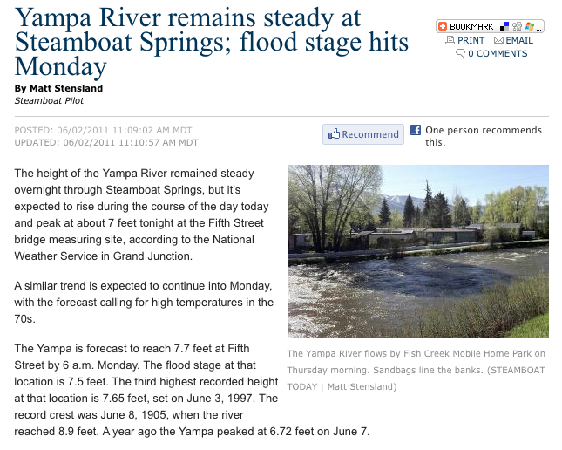
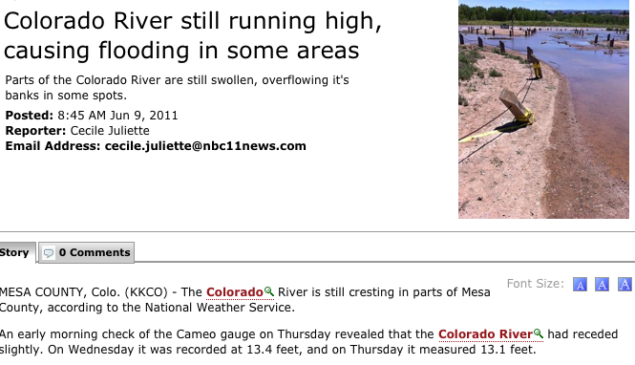
Flooding and High Flows

Slide 7
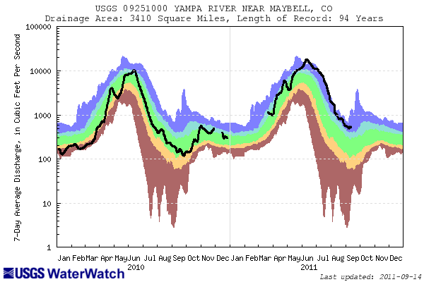
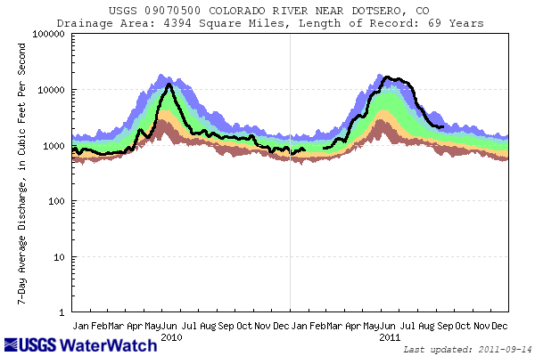
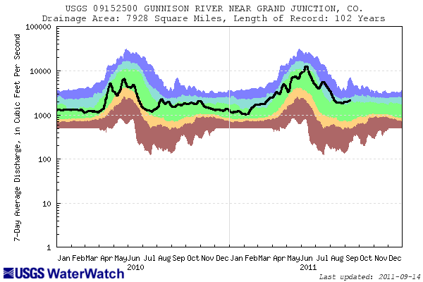
Wettest area was northern Colorado
Upper Colorado also very wet
Gunnison divided wet from normal
Dolores, San Juan basins near normal

Slide 8
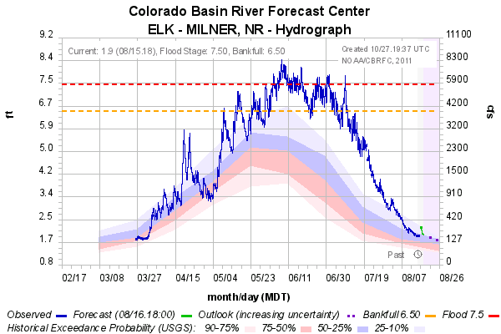
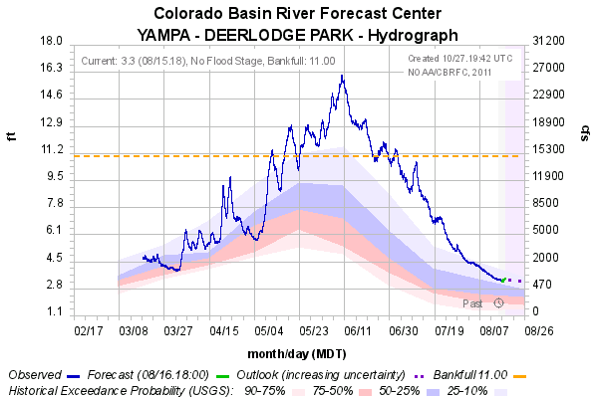
Yampa River Basin
Yampa / White Rivers generally peaked in June
Very high (many records) snowpack
Cool June somewhat mitigated high flows although rivers flowed high for several weeks
Record or near record peaks

Slide 9
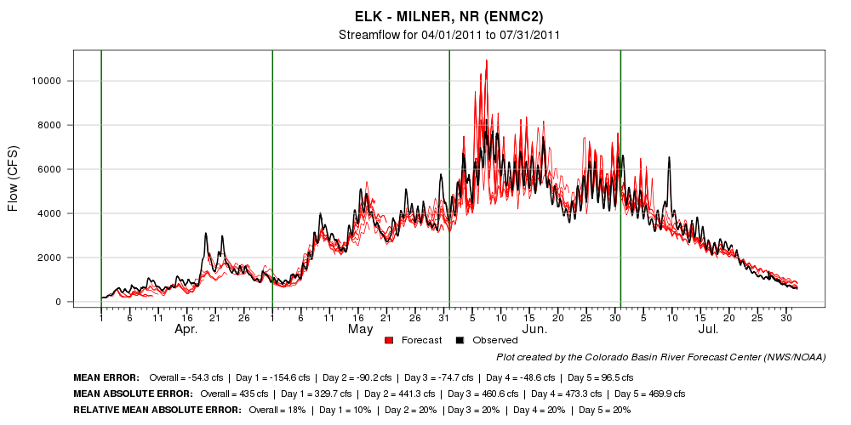
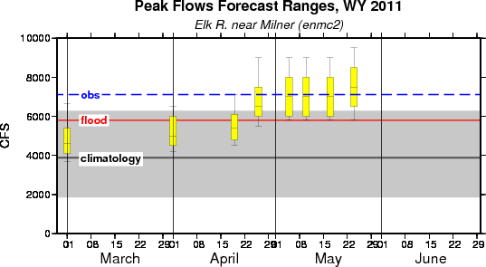
DAILY
PEAKS

Slide 10
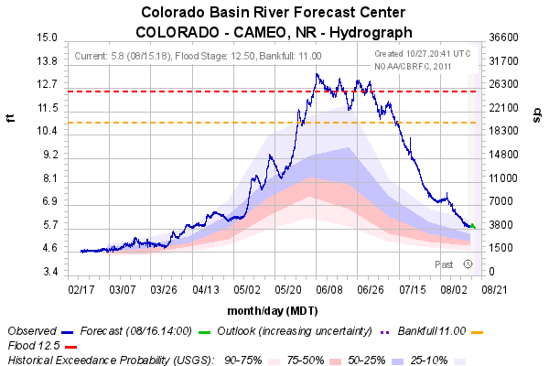
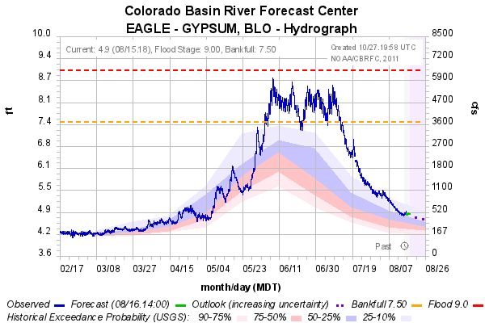
UPPER COLORADO
Upper Colorado includes many high elevation basins that peaked late into June or early July
Near record snowpack caused high flows
High flows were mitigated by cool June temperatures

Slide 11
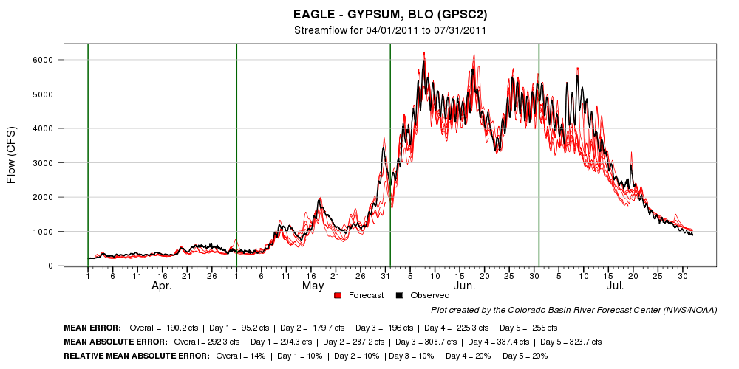
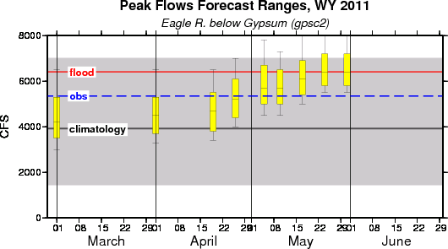
DAILY
PEAKS

Slide 12
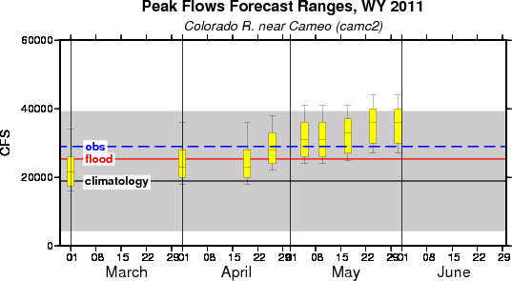
REGULATED PEAK FLOW FORECAST
Numerous upstream reservoirs and diversions
Assumptions included:
Many reservoirs spilling
Spills occurring during peaks
Reservoir operations mitigated spills

Slide 13
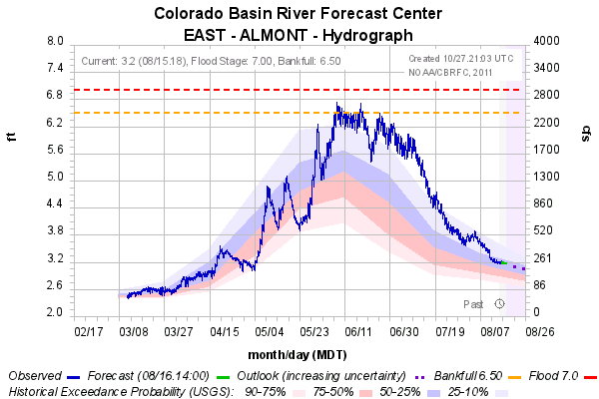
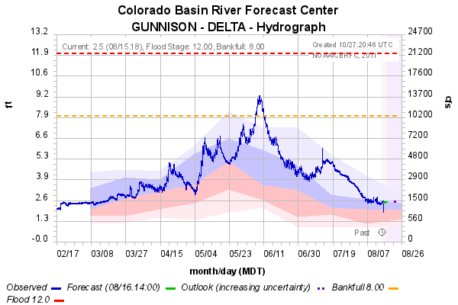
Gunnison
Gunnison basin divided wet conditions to the north and near average to the south. Hwy 50 was a rough dividing line
Peaks mostly in early June with continued high flows through June and even July (monsoon moisture)

Slide 14
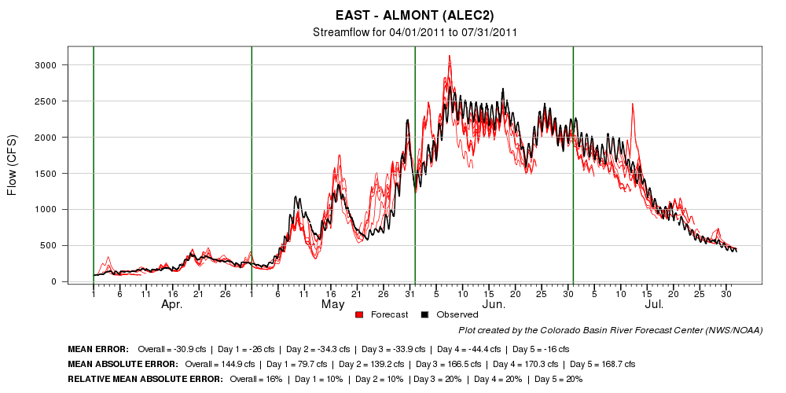
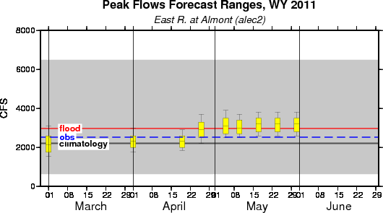
DAILY
PEAKS

Slide 15
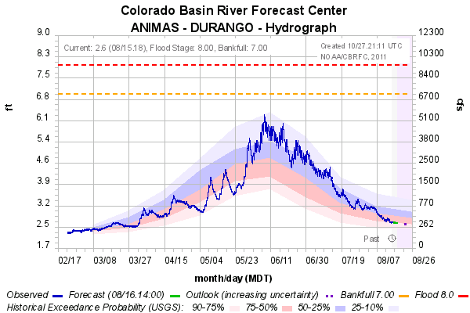
SAN JUAN BASIN
San Juan Basin much drier with near to below average conditions
Peaks mostly in early June with continued high flows through June

Slide 16
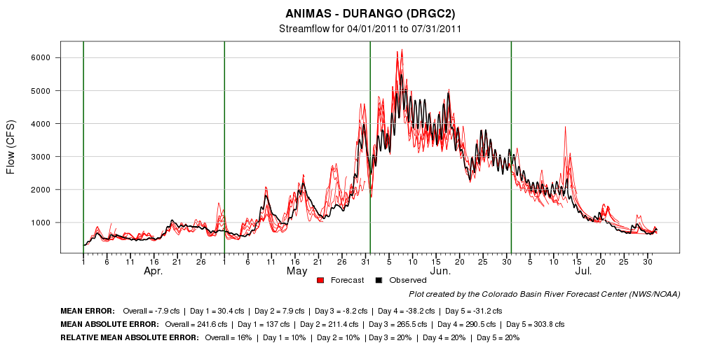
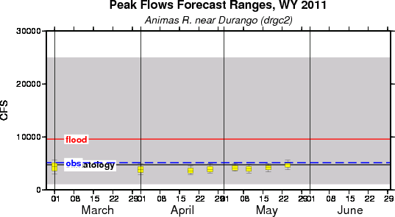
DAILY
PEAKS

Slide 17
SUMMARY
Runoff characteristics are largely determined by the day-to-day spring weather.
Record snowpack increased the chances for flooding; however, flooding was not widespread
Small snow pack years can flood with the right sequence of spring temperatures
Long lead and daily forecasts performed relatively well

Slide 18
SUMMARY
WHERE DID WE GO WRONG?
Areal snow cover
Struggled with some reservoir release schedules
Temperature forecasts in late May/early June were too high causing daily forecasts to be to high
WHAT ARE WE DOING TO FIX ERRORS?
Snow covered area project (stay tuned)
Reservoir releases- more information from users!

Slide 19
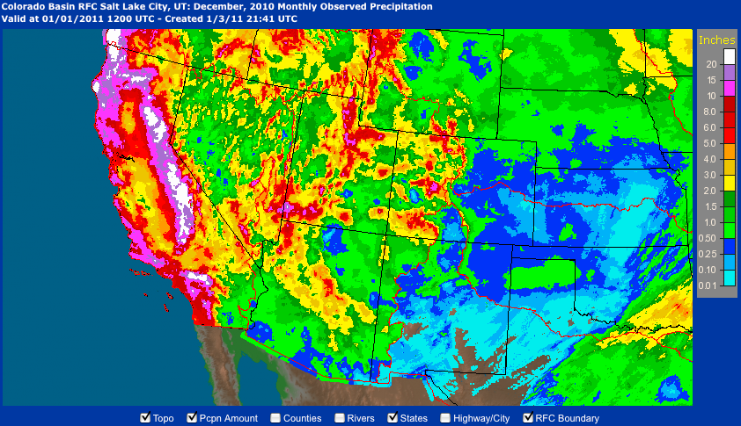
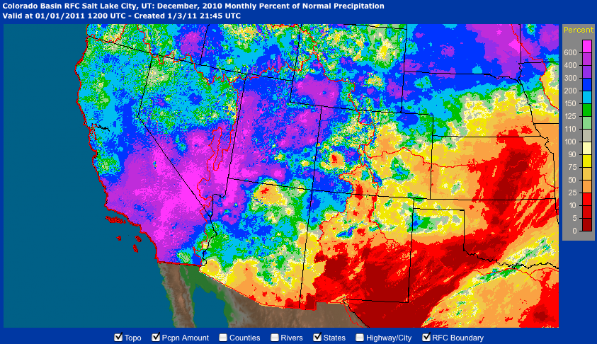
December Event and Lake Mead

Slide 20
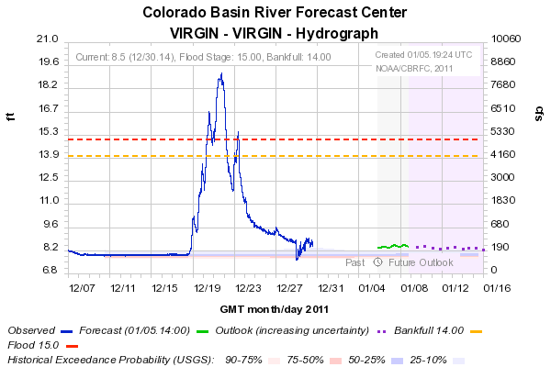
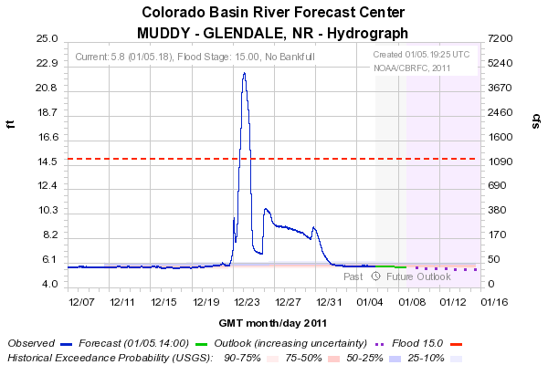
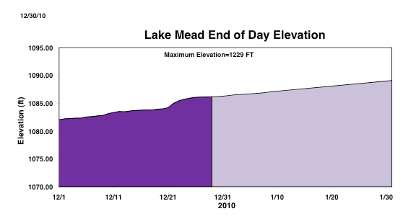
Pre Holiday Storm:
Lake Mead up ~2 feet from local runoff
Large snow accumulation

Slide 21
QUESTIONS???

