Slide 1
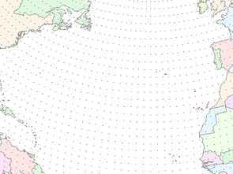



June 23, 2011
NOAA / CBRFC
Water Supply Forecast Overview
Inputs - Outputs
Michelle Schmidt
NWS Colorado Basin River Forecast Center
1

Slide 2
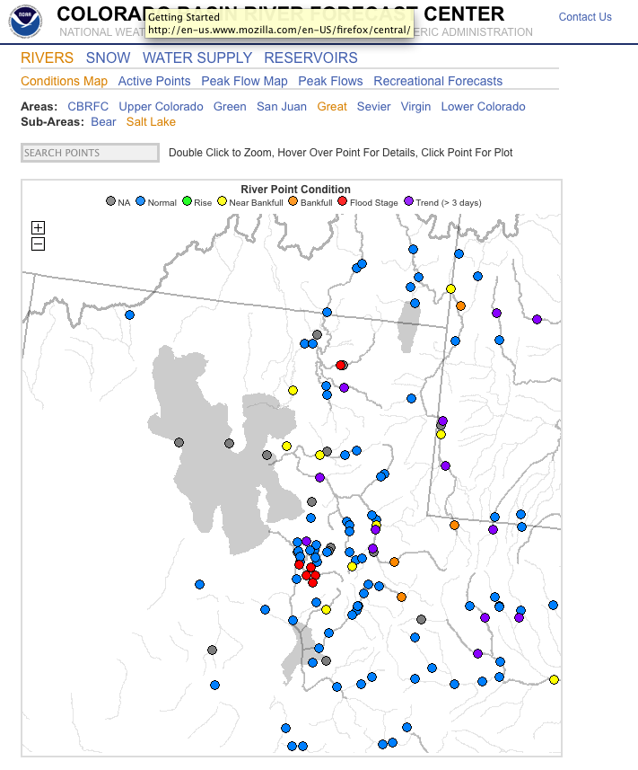
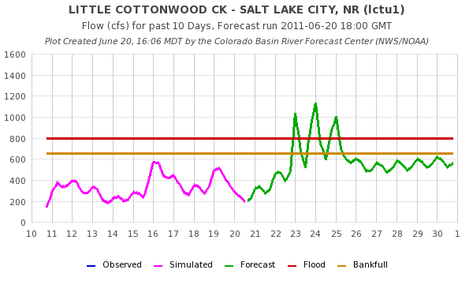
Flood Forecasts / Routine Forecasts
Nominally provided at ~400 points every 6 hours out to 14 days.
Flexible web interface to forecasts and data
Requires large amounts of data (e.g. snow, precip, temps, streamflow)

Slide 3
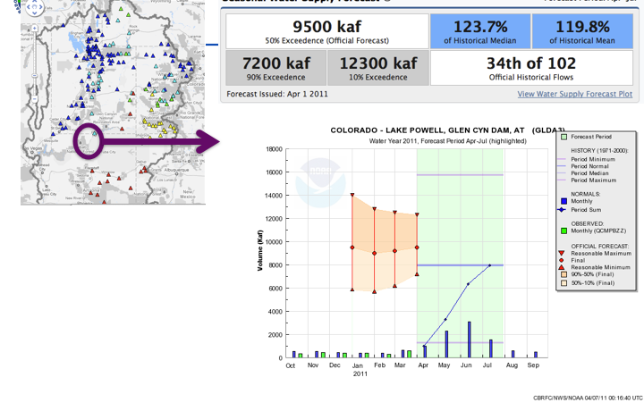
Water Supply Forecasts
Generated seasonally
Typically January through June
Updated monthly or as needed
Forecast runoff volume (usually April – July)
Probabilistic

Slide 4
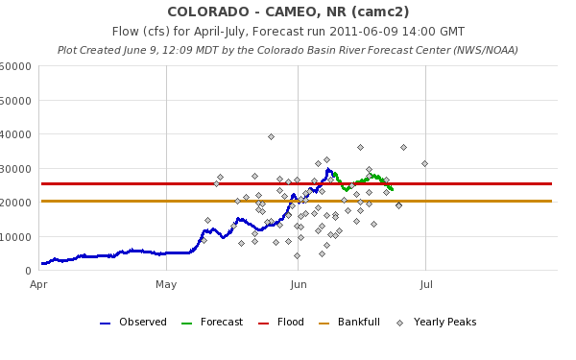
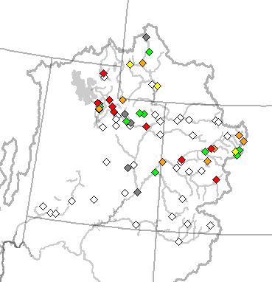
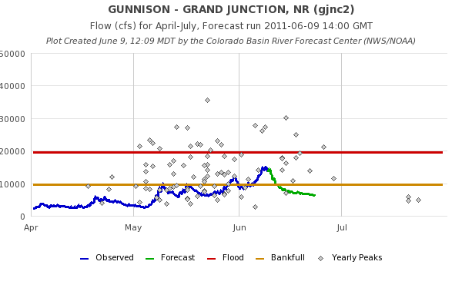
Peak Flow Forecasts

Slide 5
General RFC Model
Hydrologic Model Analysis
hydrologic
expertise &
judgment
model
guidance
River
Forecast
System
Forecast
precip / temp
Outputs
Graphics
River Forecasts
Weather and Climate Forecasts
Analysis &
Quality Control
parameters
Observed
Data
Calibration

Slide 6
RFC Model Inputs
Observed:
Precipitation
Streamflow
Temperature
Freezing Levels
Forecast:
Precipitation (5 days)
Temperature (10 days)
Freezing levels
6

Slide 7
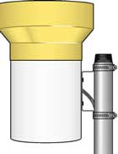
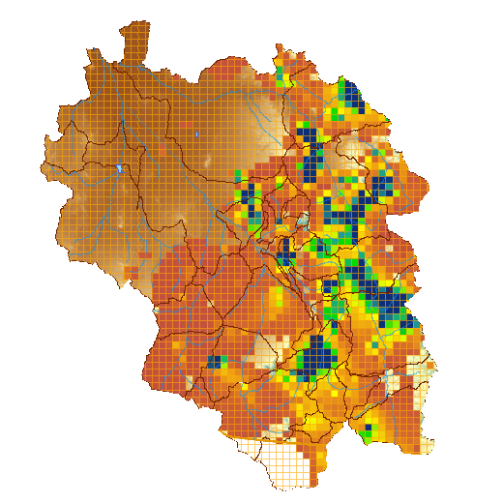

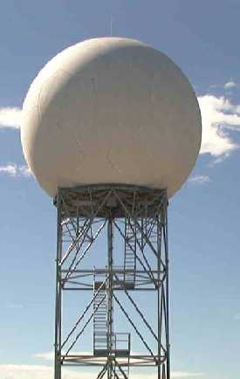
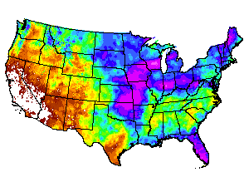

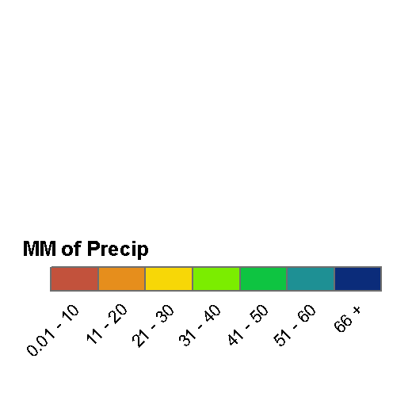
Observed Precipitation (QPE)
Gridded Precipitation Estimate
Rain Gage Measurement
GOES Satellite Estimate
Radar Estimate
Climate patterns
Forecaster Analysis
7

Slide 8
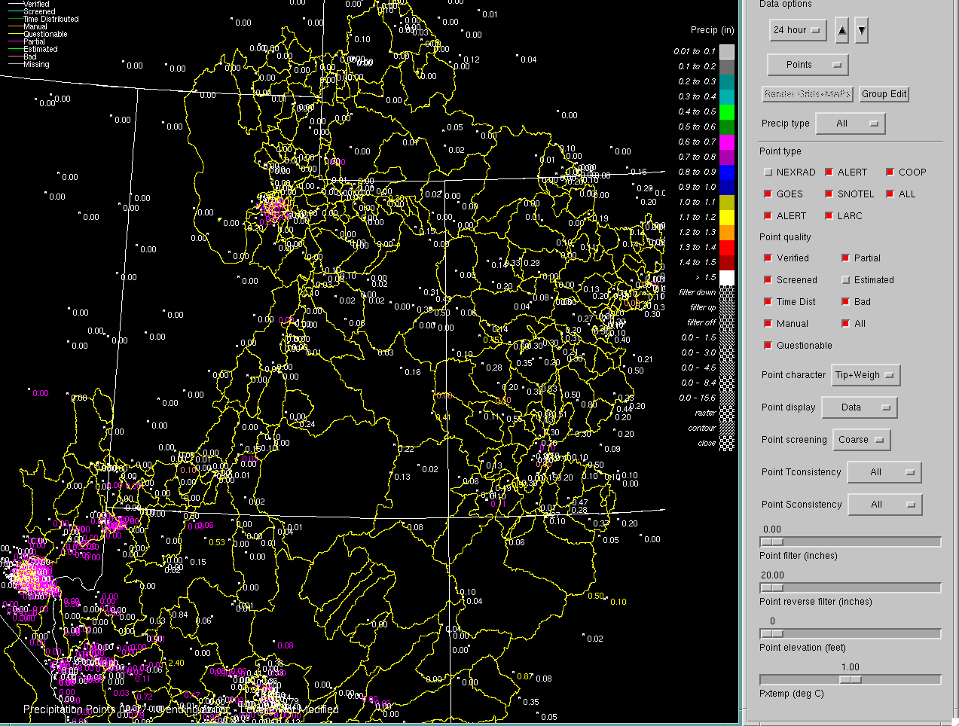

Slide 9
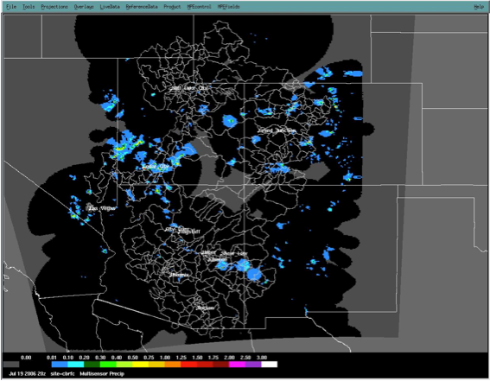
Hourly Precipitation
9

Slide 10
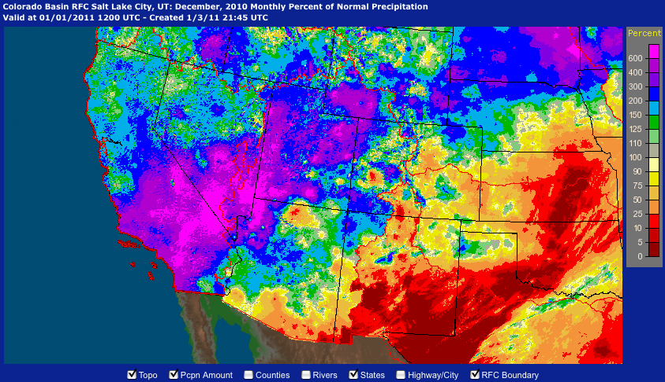
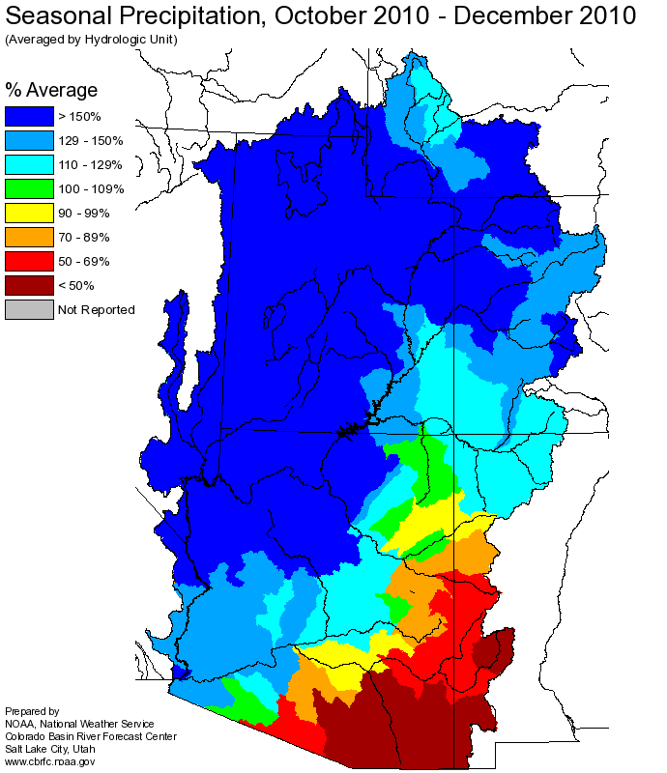
Source: water.weather.gov
Source: www.cbrfc.noaa.gov

Slide 11
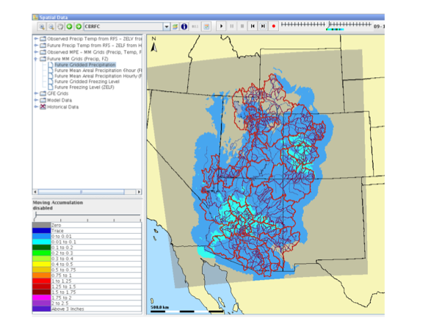
11

Slide 12
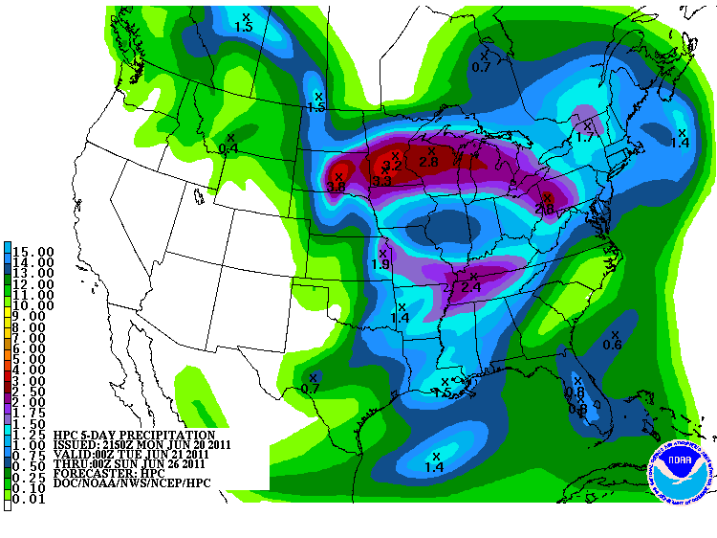
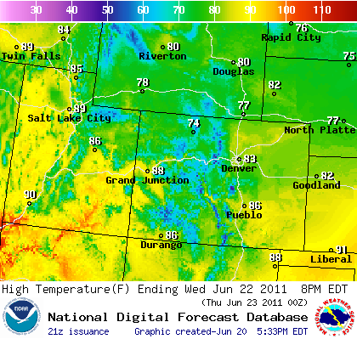
Weather and Climate Forecasts
RFC forecast system incorporates both weather and climate forecasts:
Weather forecasts integrated into daily operations with forecaster control over point and basin average values
Water supply forecasts typically only use QPF during late season or in lower basin
When QPF is used, it is used in a deterministic manner
Climate forecasts integrated into seasonal water supply forecasts through probability shifts of forcing ensemble
Climate forecasts are typically only considered in lower basin and only in ENSO years

Slide 13
Questions?

