Slide 1
Improving Snow Modeling
Why should we consider using observations of SCA in the RFC forecasting process?
Snowpack is obviously important. Estimates of snowpack conditions are used to forecast meltwater runoff which, in turn, affects:
Seasonal water supply
Short term streamflow
Snowpack estimates have uncertainty in them.
uncertainty in model-derived snowpack estimates can be large, especially in abnormal years.
confidence in those estimates can be low
Snow Cover Area (SCA) particularly uncertain (and important!) during runoff period
Better knowledge of real-world snowpack conditions (including observed SCA) should improve snowmelt-driven streamflow forecasts
especially in abnormal years when improved forecasts would have a bigger benefit to users.

Slide 2
Improving Snow Modeling (con’t)
Current sources of snowpack information used at CBRFC:
SNOTEL SWE observations
SNODAS via NOHRSC web site (used subjectively by hydrologists/forecasters to make model modifications)
SNOW-17 model-derived estimates of SWE and SCA (termed AESC in SNOW-17)
No satellite-derived observations of SCA (which are readily available) are used explicitly in the RFC forecasting process at this time.
Satellite-derived SCA obs would provide a beneficial, quantitative source of SCA information in addition to, and independent of, the datasets already in use at the RFC.
CBRFC currently engaged with:
CWCB Rti project
OHD data assimilation project

Slide 3
CWCB SCA Project
Purpose of project: use SCA to improve snow modeling and water forecasts
Groups involved:
CWCB, RTi, NRCS, RFCs (CB, WG, MB, AB)
RTi is processing two types of SCA data:
MODIS SCA from NASA (higher priority for CBRFC)
SCA derived from NOHRSC/SNODAS.

Slide 4
CWCB SCA Project - Overview of Datasets
MODIS Datasets: 2000 to 2011
SNODAS Datasets: 2003 to 2011
FSCA Grids
- daily mosaic over CO, most of Colorado Basin
- some bad values rm’d
NASA MODIS SCA tiles
- MOD10A1 (Terra only)
- 500 m resolution
FSCA averages by basin and elevation zones
- with quality info
Binary SCA Grids: if the SNODAS SWE pixel is > 0.10”, then it assumed to be snow-covered.
NOHRSC SNODAS SWE Product
SCA averages by basin and elevation zones

Slide 5
CWCB SCA Project – MODIS FSCA Grids
4 separate MODIS MODA10 tiles are merged into one grid for complete coverage over CO.
CBRFC is not entirely covered, but mostly
From Amy Volckens, Riverside

Slide 6
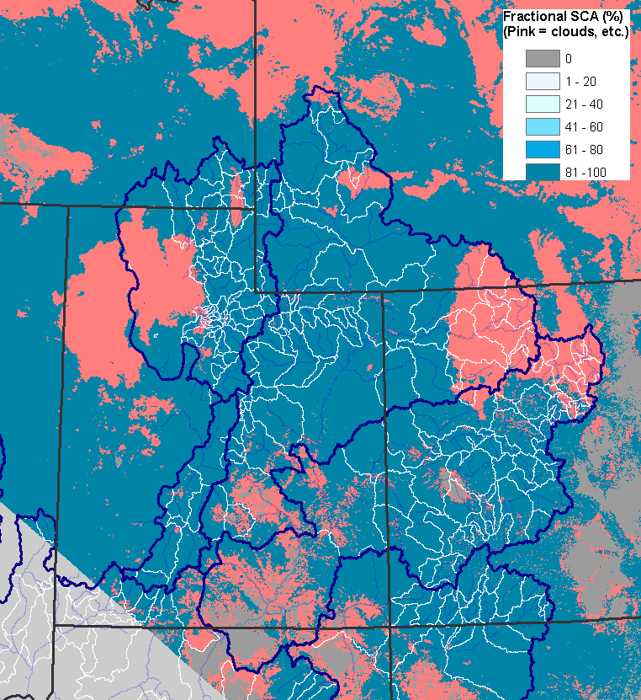
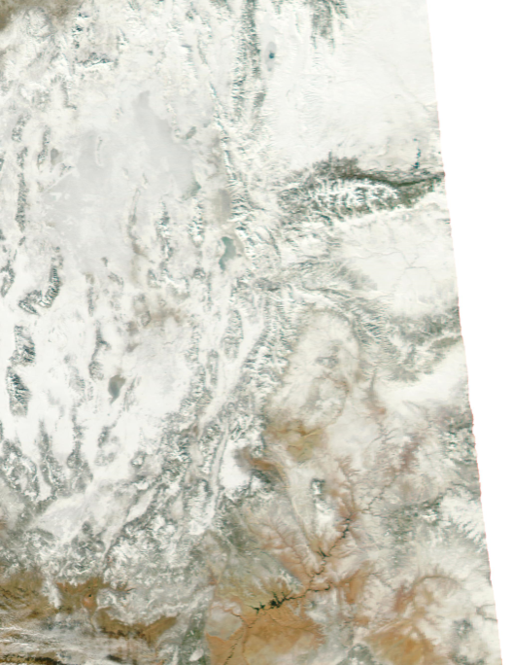
CWCB SCA Project – MODIS FSCA Grids
RTi Gridded Datasets:
FSCA grids: pixels are assigned FSCA values or other values if the pixel is cloudy or otherwise not snow-covered
Quality information grids:
0 if the pixel has valid FSCA
100 if the pixel is cloudy or the FSCA info is otherwise lacking (nighttime, missing values, etc.)
GRID SAMPLES – FSCA, QC, visible image
Jan 7, 2011
→ MODIS FSCA Grid from RTi
→ MODIS Visible image from USFS (http://activefiremaps.fs.fed.us/imagery.php?op=fire&passID=117676)

Slide 7
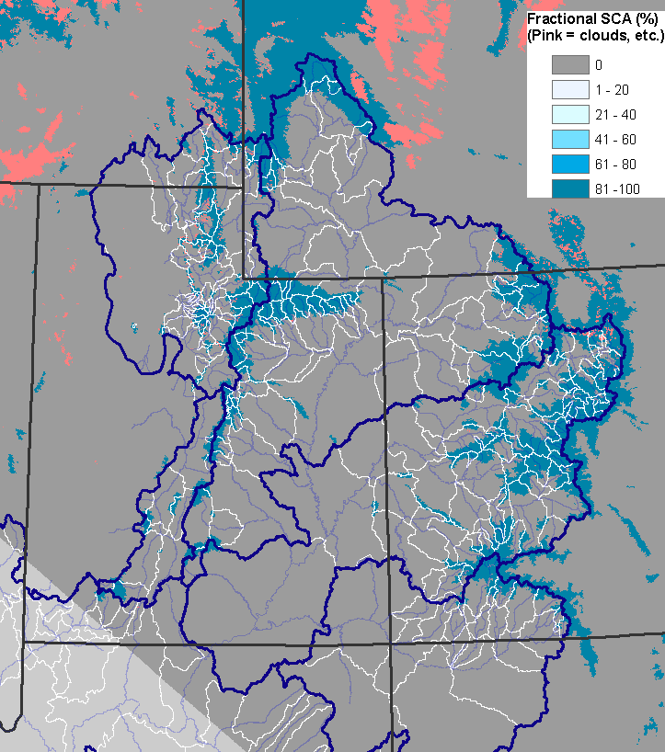
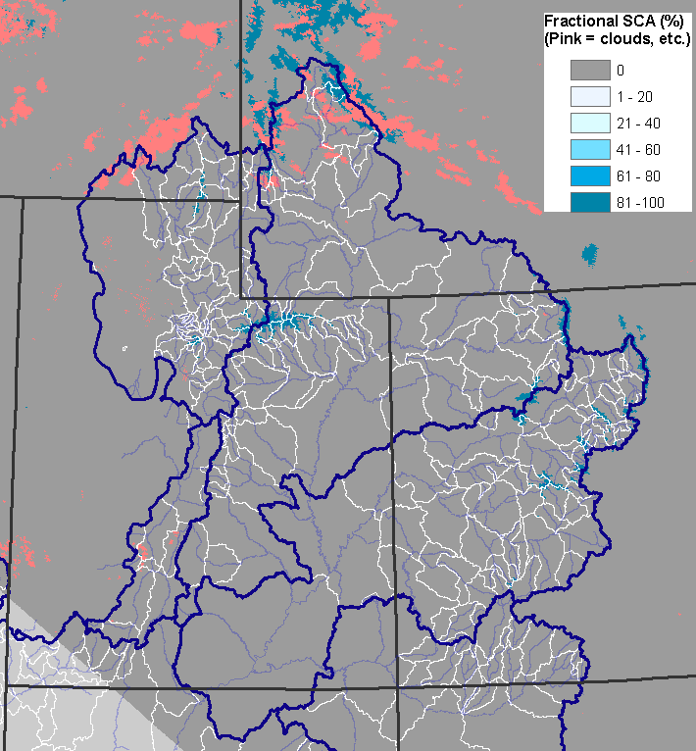
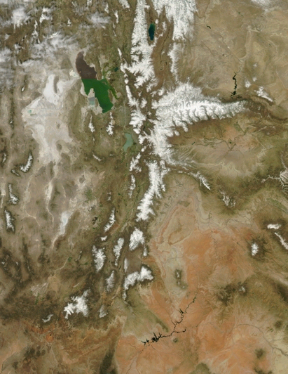
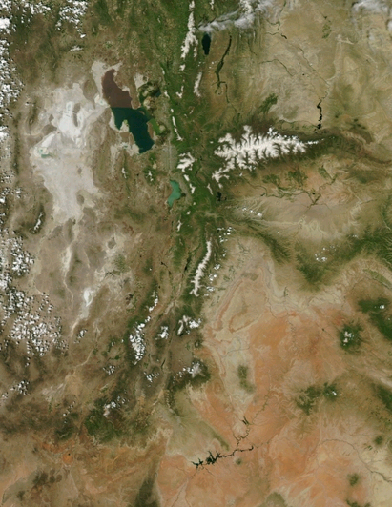
CWCB SCA Project – MODIS FSCA Grids
May 5, 2011
→ MODIS FSCA Grid from RTi
→ MODIS Visible image from USFS (http://activefiremaps.fs.fed.us/imagery.php?op=fire&passID=130779)
June 22, 2011
→ MODIS FSCA Grid from RTi
→ MODIS Visible image from USFS (http://activefiremaps.fs.fed.us/imagery.php?op=fire&passID=136716)

Slide 8
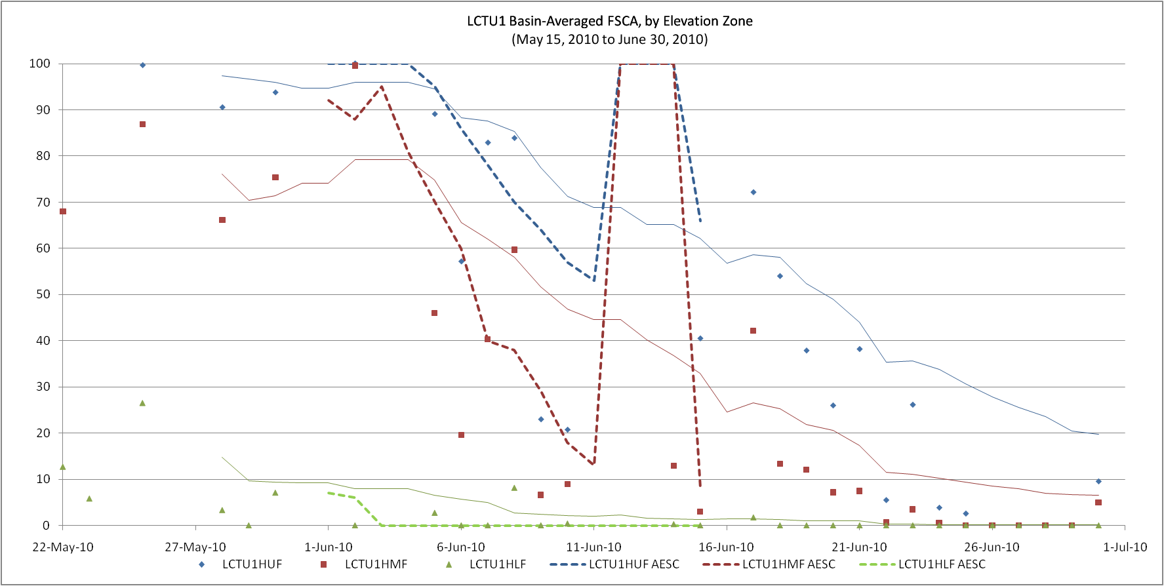
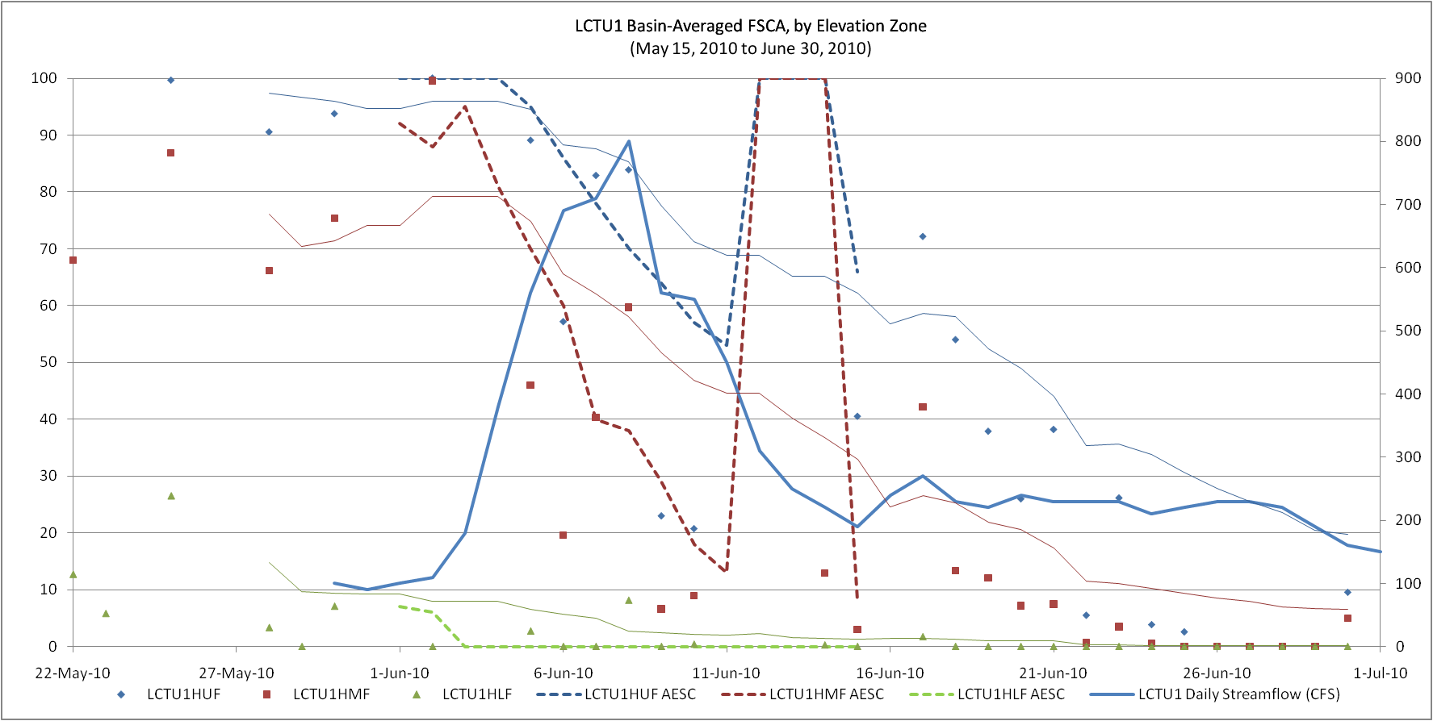
w/o Q plotted: dashed = model AESC, solid lines = 14 d moving avg from the MODIS-derived SCA points:
WITH Q plotted… not sure that adding Q to the plot helps all that much, especially since there’s no meltwater volume info in SCA.

Slide 9
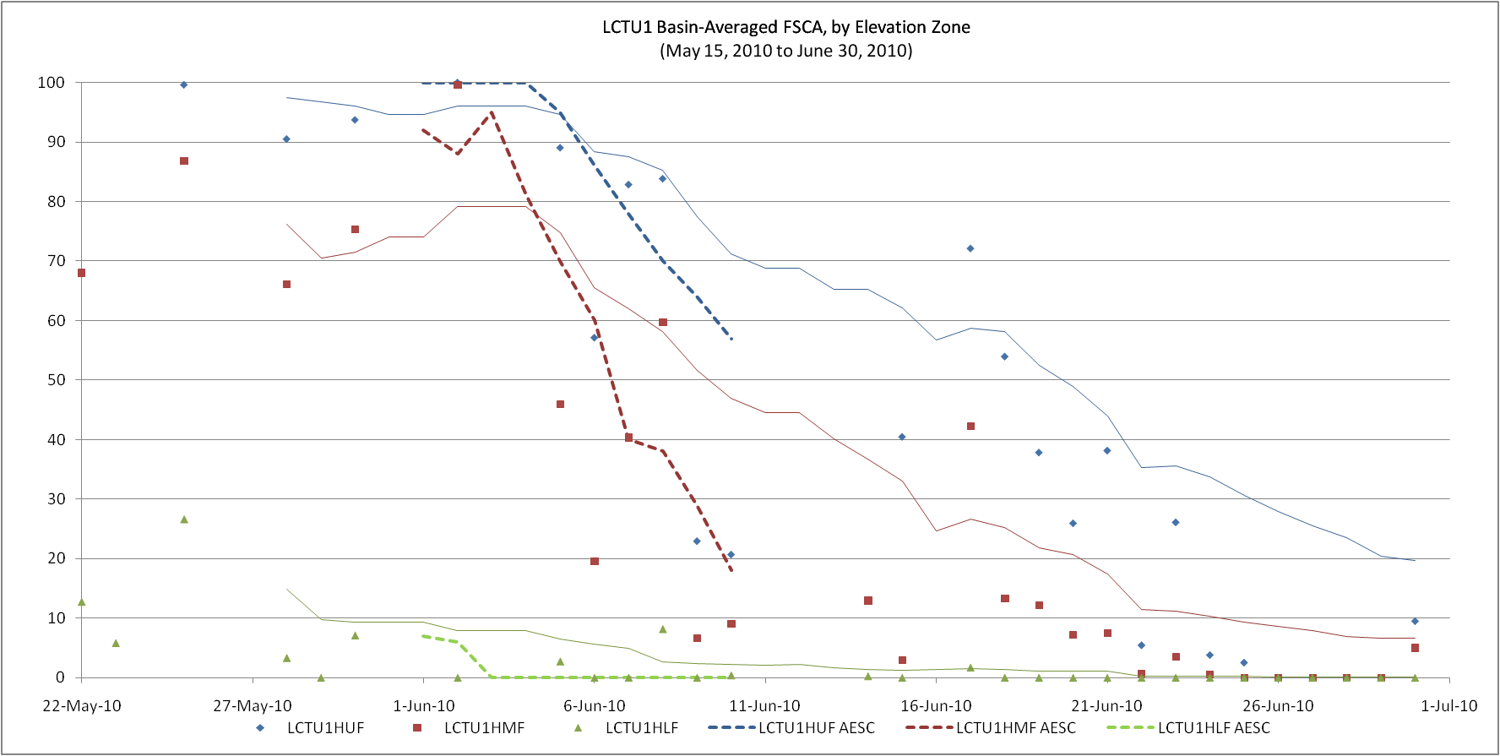
Little Cottonwood Creek
2010 Melt
dashed = model AESC
solid lines = 14 d moving avg from the MODIS-derived SCA points

Slide 10
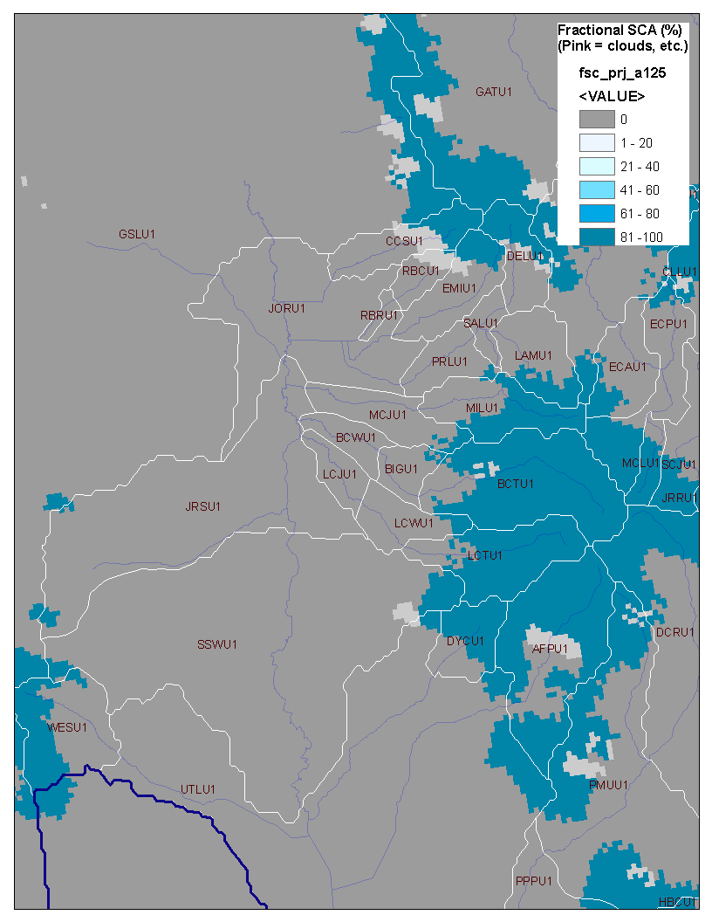
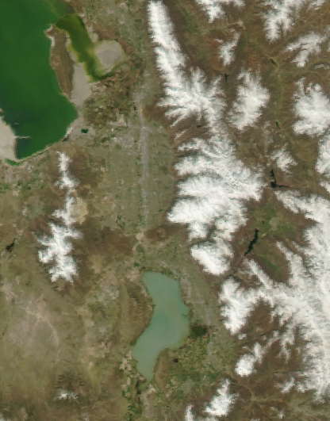
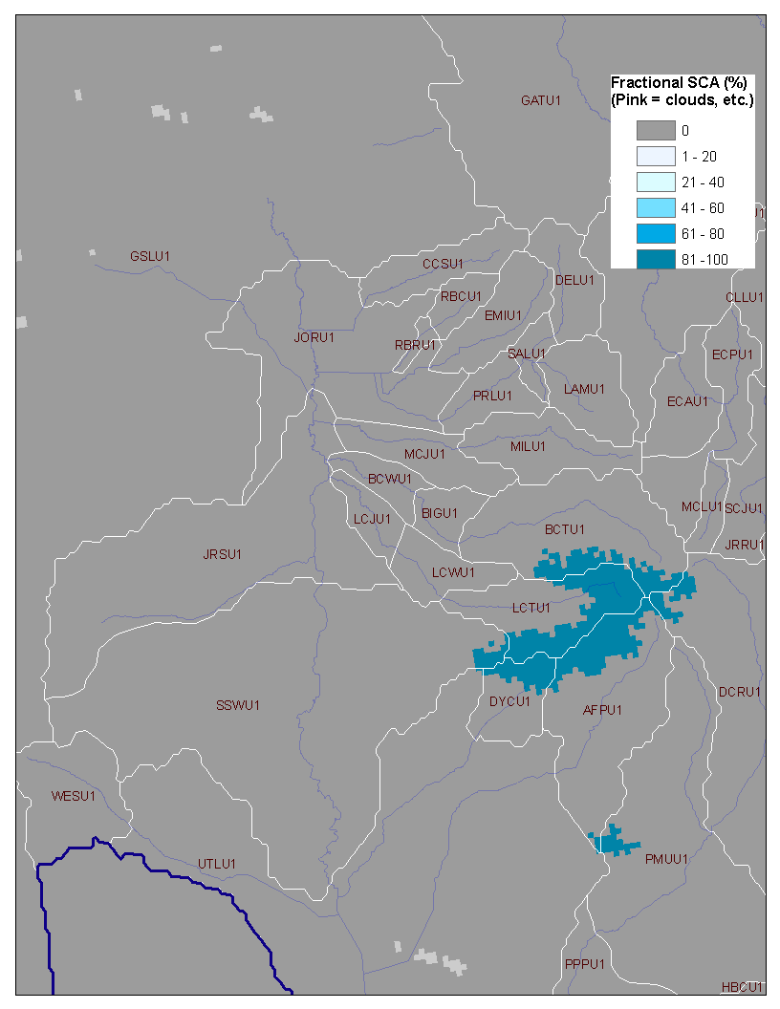
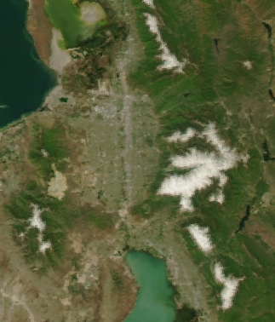
May 5, 2011
June 22, 2011
MODIS snow product misses some areas of snow?
Were the snow areas outside of Little Cottonwood mislabeled somehow?
Zoomed in examples for LCC or some other high profile basin?
Sevier, Virgin, UIntas, Wasatch?
Plots of basin SCA (not just grids)?
MODIS SNOW PROUCT FSCA
MODIS VZ IMAGES

Slide 11
CWCB SCA Project – MODIS FSCA Grids
Some quality issues noted by RTi:
Missing tiles from FTP site
RTi has a list of days with incomplete tile sets
“Zeroed out” SCA grids in the middle of winter (rare problem)
RTi will replace these zeroes with missing values
Striping in the grids/bands of “no data” (not very common)
Data will remain in the final grids
RTi has a list of days on which this occurs
Cloud cover (most common problem they found)
Cloudy pixels will remain in the final datasets so that we can process them as we want
Clouds reduce the confidence in the basin FSCA estimates
Perhaps an effort to estimate FSCA for cloudy pixels?
Variety of methods out there: terra/aqua combos, use MW, similarity meth., etc.
Some methods better than others
Stretching of pixels at edges of scan not addressed in RTi datasets

Slide 12
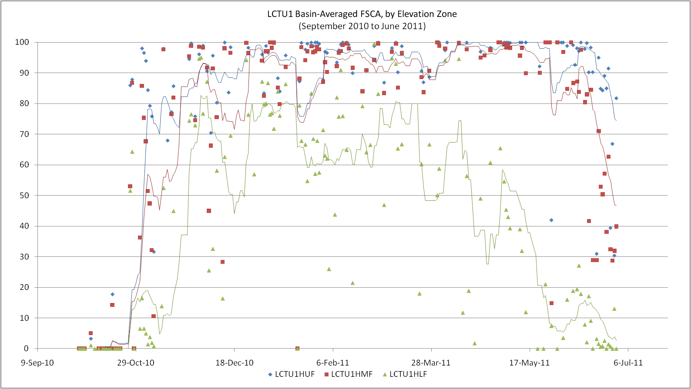
CWCB SCA Project – MODIS Basin FSCA Time Series
RTi-produced MODIS FSCA Grids
+ CBRFC basin and elevation zone shapefiles
= daily estimates of FSCA for basins and elevation zones
Pixels with problems are ignored in the calculations
The remaining pixels within the basin polygon are used to estimate the basin FSCA
Quality values for the FSCA estimates:
0 = most confidence in the FSCA values.
100 = worst confidence in the FSCA values

Slide 13
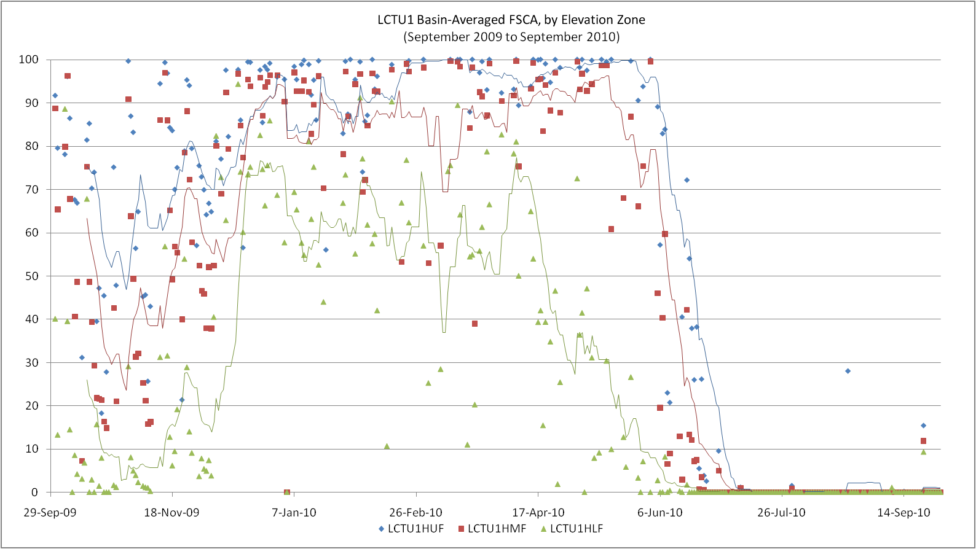
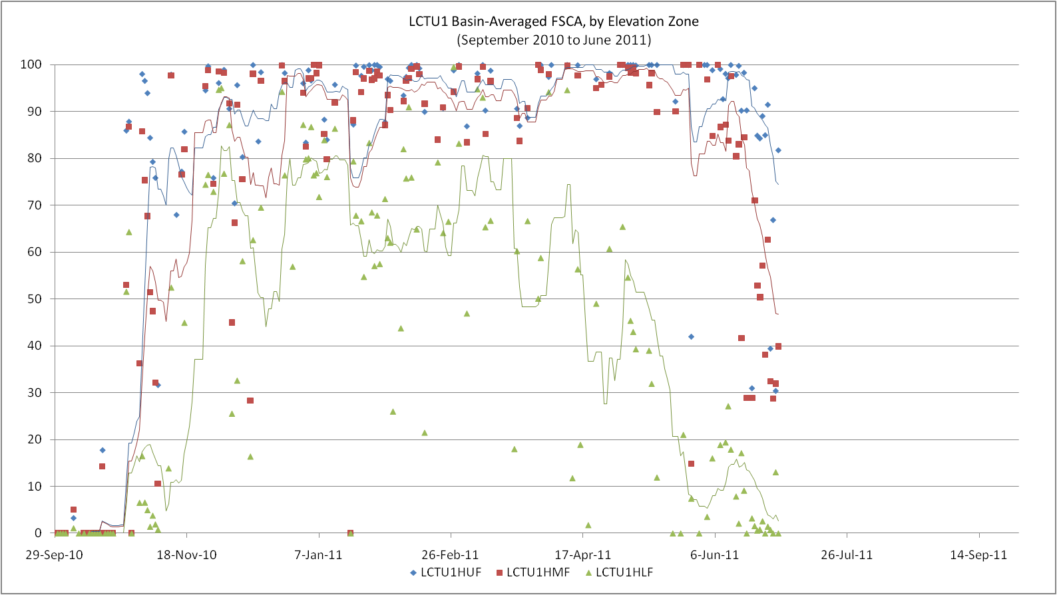
CWCB SCA Project – MODIS Basin FSCA Time Series
Same plot for WY10 (LCC Case)
+ FSCA grids zoomed in on that basin
RTi dataset ends on June 30, 2011

Slide 14
CWCB SCA Project – SNODAS Datasets
NRCS wanted SCA derived from SNODAS, so RTi is processing it as well.
SNODAS-derived SCA =Lower priority than MODIS-derived SCA for CBRFC
SNODAS SCA grids will be binary
Derived from SWE product
If SWE > 0.10”, the pixel is assumed to be snow-covered.
Basin SCA estimates are calculated from the grids in a similar manner to the MODIS data

Slide 15
CWCB SCA Project – Where to go from here?
SCA comparisons among the different products?
MODIS vs. MODSCAG vs. SNODAS vs. others? (SCA wrestling match!)
Get grids available in CHPS for forecaster use in real time?
Would need to port RTi ArcGIS/ArcPy scripts to another language/platform/etc.
MODIS SCA grids may come from NOHRSC eventually?
SCA assimilation experiments/sandbox/testbed?
Model AESC != observed SCA
Would have to transform observed SCA from MODIS to model-equivalent AESC somehow
MODIS will kick the bucket someday
both Aqua and Terra MODIS are > their design life of 6 yrs
Need to keep processing flexible for future instruments

Slide 16
OHD SWE Data Assimilation Project
OHD contacts: Kevin He, Haksu Lee
Purpose of the project is to answer:
Would assimilation of SNOTEL SWE obs into SNOW-17 via an Ensemble Kalman Filter (EnKF) help retrospective streamflow simulations in certain CBRFC basins?
Or, would updating the SWE states with observed SWE information degrade the simulations?
If the results are a mixed bag:
id where and why the assimilation helped
where and why it caused the simulations to be worse than the control
Still in early stages

Slide 17
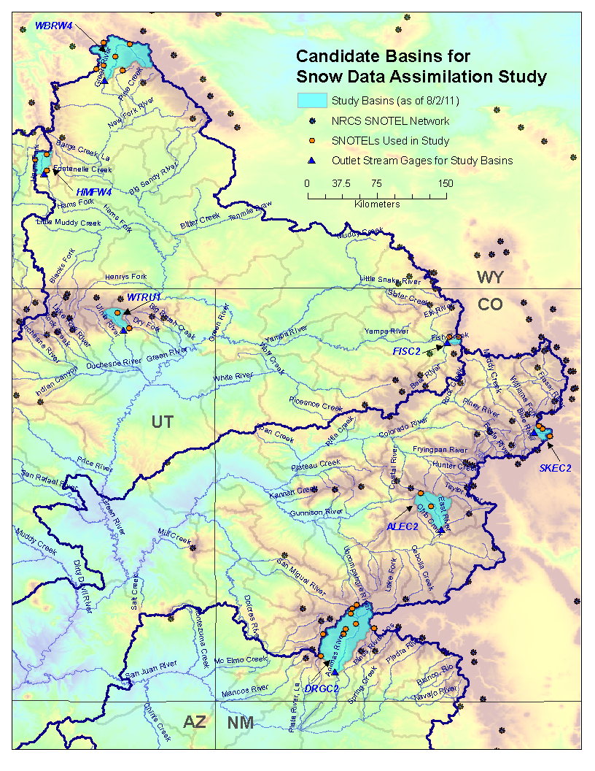
Study basins
(as of 8/2/11):
WBRW4
HMFW4
WTRU1
FISC2
SKEC2
ALEC2
DRGC2

Slide 18
OHD SWE Data Assimilation Project (cont.)
Study methodology is similar to a previous study of the North Fork of the American River in the Sierras by He, et al.
Create mean areal SWE values (for assimilation) via PCR using obs and model information.
Perturb MAT/MAP forcings to create ensembles.
Precip: log-normal distribution, Temp: normal distribution
Assimilate the computed mean areal SWEs and update SNOW-17 SWE states via an EnKF
Uses uncertainty information in the observed SWE and the model SWE to weight one over the other.
Check how the assimilation affects the streamflow simulations.

Slide 19
Painter Proposal
Proposed work to NASA (currently under review)
Goal: Introduce MODSCAG dataset into CBRFC modeling system
Method: Highly interactive between research group and CBRFC with personnel exchanges, data exchanges, etc.

