Slide 1
Hydrologic Ensemble Forecasts (Ensemble Streamflow Prediction – ESP)
CBRFC 2011 Stakeholder Forum
November 3, 2011

Slide 2
ESP Technique
Multiple streamflow scenarios with historic meteorological or forecast weather/climatic data
Historical time series of
precipitation and temperature
81
82
83
84
85
Possible scenarios
Flow
Scenario 2
Scenario 1
Currently using water years 1976-2005.
Will use 1981-2010 for wy2012
Scenario 3
Saved model states reflect current conditions (snow, soil moisture, current river/reservoir levels)
Time
Forecast weather:
Use 10 days of forecast max/min temperatures.
Two runs –
5 days of forecast precipitation
0 days of forecast precipitation
Results used in statistical analysis to produce
forecasts with probabilistic values

Slide 3
ESP Technique (cont.)
Now
Low chance of this level flow or higher
Past
Future
Medium chance of this level flow or higher
Flow
High chance of this level flow or higher
Time

Slide 4
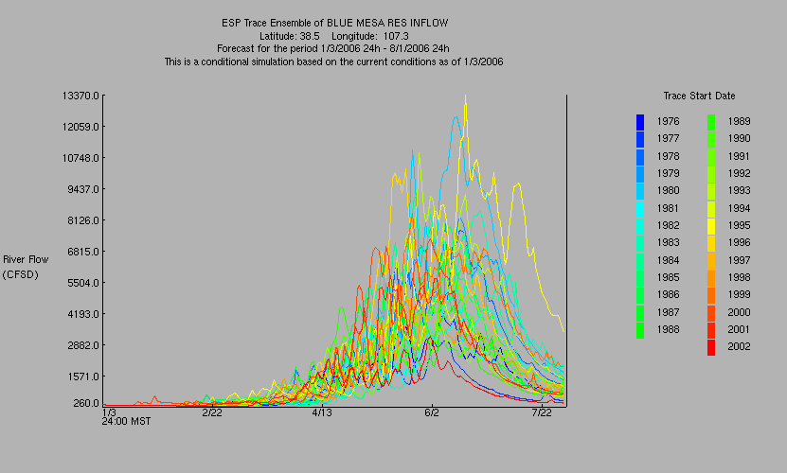
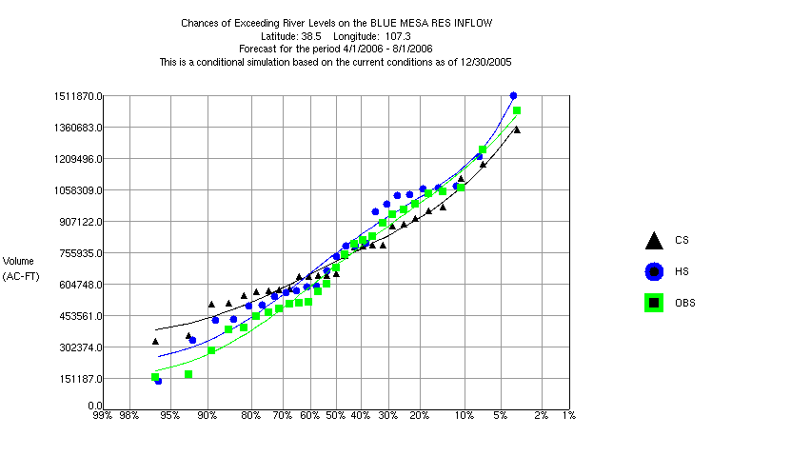
Ensemble Streamflow Prediction (ESP)
April – July
Volume
Select a forecast window
Select a forecast variable
Model derives a distribution function
50% exceedance value = most probable forecast
Also use 10%/90% levels

Slide 5
ESP ‘Modes’
UNREGULATED
(Water Supply Volume Forecasts)
REGULATED
(Peak Flow Forecasts)
Not what will be observed in the rivers.
No diversions (for places we have historical/real time measurements).
Trans-basin diversions.
No water held by reservoirs (passes through).
Consumptive Use operation still in effect.
Observed mean daily peak.
Historical diversion data used in calculation of each year’s hydrograph.
Reservoirs operated based on a set of ‘rules’.
Time of year or elevation.
Similar to daily forecast methodology.

Slide 6
Historic development of ESP
ESP Analysis and Display Program (ESPADP) development started
Work to incorporate climate forecasts
NWS/HRL begins ESP development
ESP used for drought assessment
Climate Prediction Center (CPC) forecast pre-adjustment developed for use in ESP
ESP released with NWSRFS
1970
1980
1990
2000
ESP first used at California-Nevada River Forecast Center
Water Resources Forecasting Services (WARFS) quantifies value of ESP
ESP used for water supply forecasts
ESP first presented at the Western Snow Conference
ESPADP deployed to the field
Experimental Ensemble Forecast System (XEFS) work begins
Medium to long-range ESP
short-medium-long range ESP
Western Snow Conference paper, 1977

Slide 7
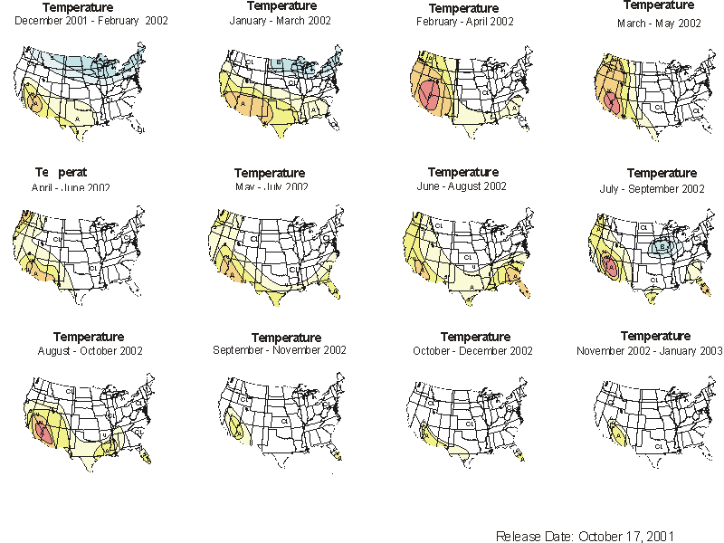
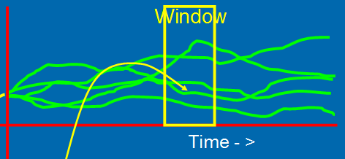
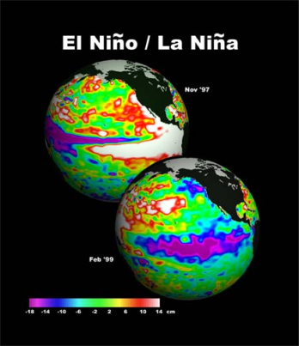
Incorporating Climate Forecasts in ESP
Pre-Adjustment Technique
Weight/Modify Inputs
Climate Forecasts
81
82
83
84
85
Post-Adjustment Technique
Weight Outputs
Current and historical
ENSO states

Slide 8
Incorporating Climate Forecasts in ESP
Use pre-adjustment technique – modify inputs.
Old – shift historical climate inputs based on a forecast of the probability of above or below average precipitation and temperature (CPC Long-Lead Seasonal Outlooks).
New – shift based on precipitation and temperature anomalies generated by the GFS (14 days) and CFS (9 months) models.
NOAA system upgraded this year
Links ocean-land-atmosphere models
Includes retrospective forecasts, too:
30 years of past forecasts
used for determining the skill of a current forecast
used for correcting biases in a current forecast

Slide 9
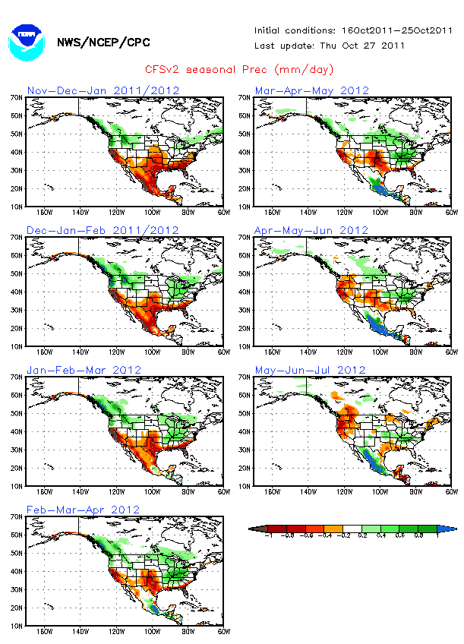
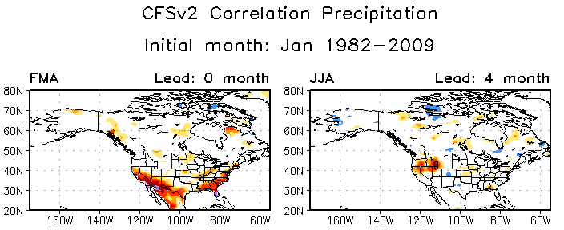
CFS climate forecasts
example, current precipitation forecasts
forecasts of precipitation have fairly low skill
forecasts of temperature have higher skill

Slide 10
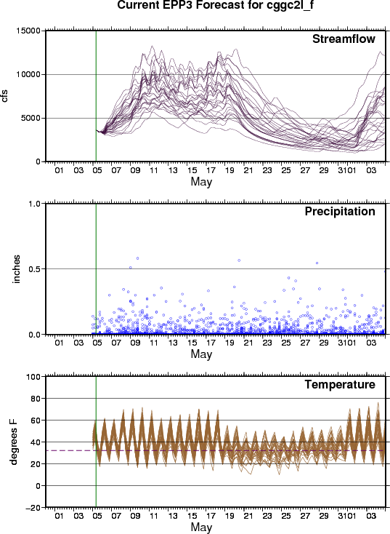
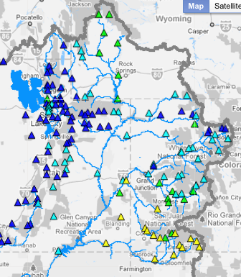
CBRFC began running experimental ensembles last year (with short to long range climate inputs)
Yampa River Below Craig, CO
GFS (14 days) and CFS based ensembles: experimental products updated daily at Colorado RFC (CBRFC) & California-Nevada RFC (CNRFC)
flood
GFS
CFS
www.cbrfc.noaa.gov/devel/hefs/
Notes:
10

Slide 11
Summary
Evaluation of results planned.
Verification of the climate forecasts as well as the resulting streamflow forecasts.
Climate signals not that strong across much of the Colorado River basin.
We will continue to run HEFS this year in an experimental mode.
Available to forecasters as another input to the forecast process.

