Slide 1
Upper Colorado River Basin WY 2011 Water Supply Forecast Verification
CBRFC 2011 Stakeholder Forum
November 3, 2011

Slide 2
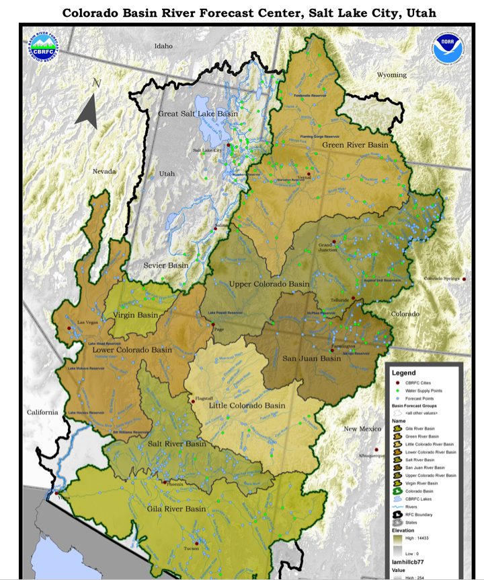
Green River Basin
Slightly above normal seasonal precipitation through March 2011
Sustained cool and wet period April-June
Runoff delayed (especially to the north and west)
Many record or near records for precipitation, runoff volumes, etc
Upper Green
Duchesne
Yampa

Slide 3
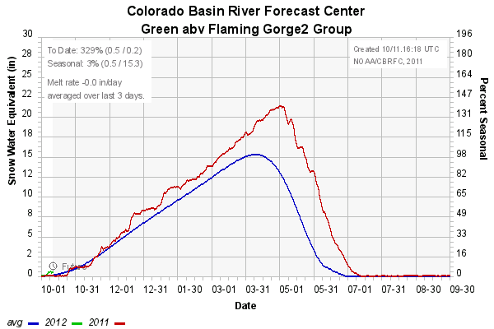
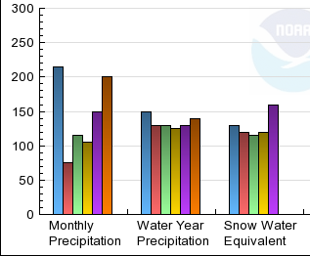
Upper Green Basin Conditions
160 %
120 %
115 %
Two new records for April-July volume at points coming off the north slope of the Uintas.

Slide 4
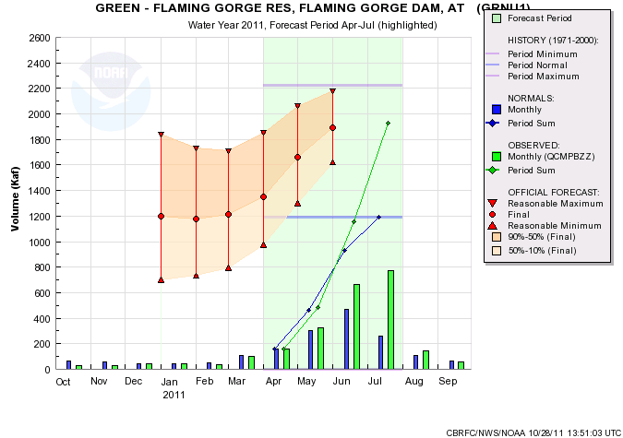
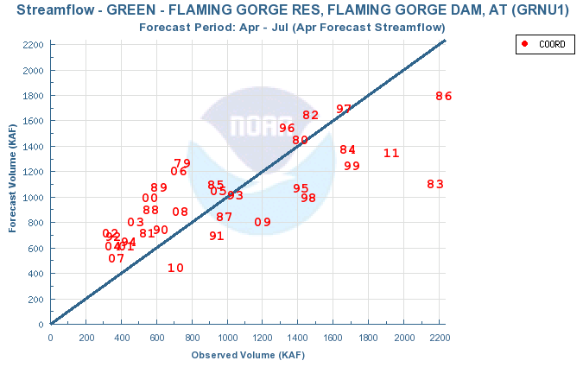
1926
162%

Slide 5
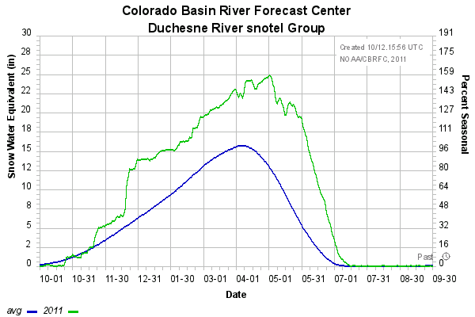
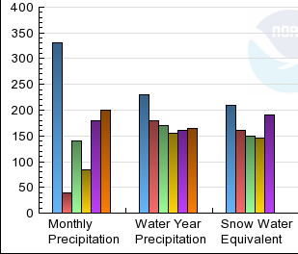
Duchesne Basin Conditions
145 %
215 %
10/16 forecast points set records for April-July volume.
Notes:
3/1 120%
4/1

Slide 6
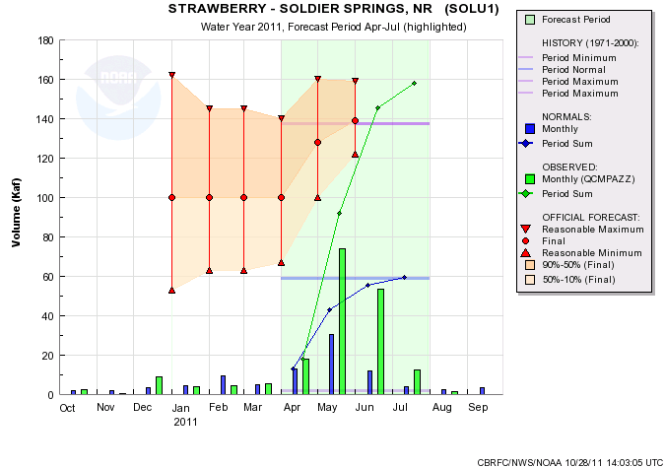
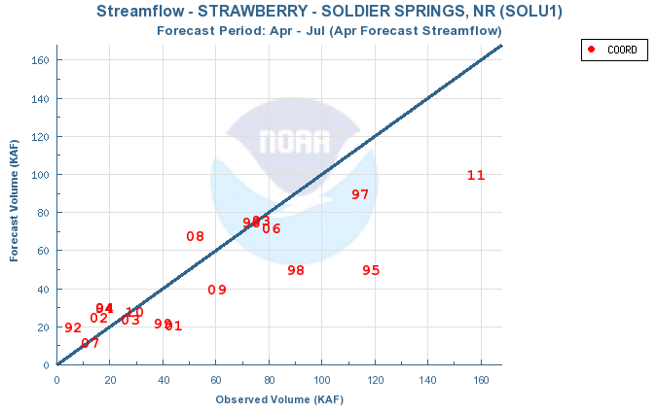
158
268%

Slide 7
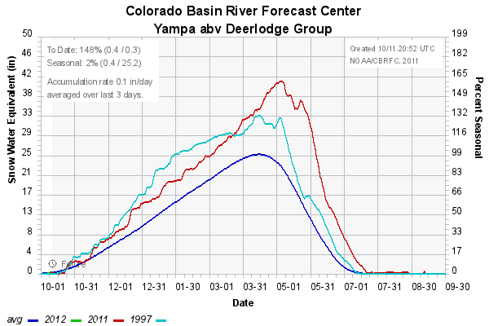
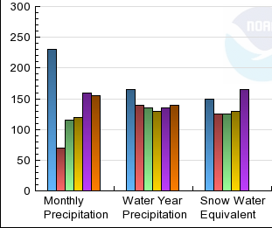
Yampa Basin Conditions
Record Snowpack
All forecast points set records for April-July volume.
Notes:
3/1 120%
4/1

Slide 8
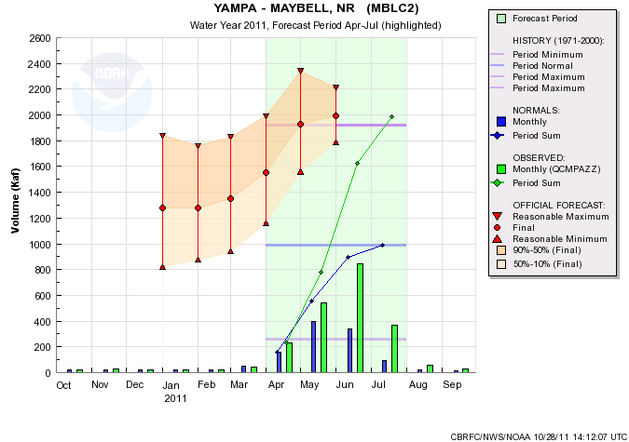
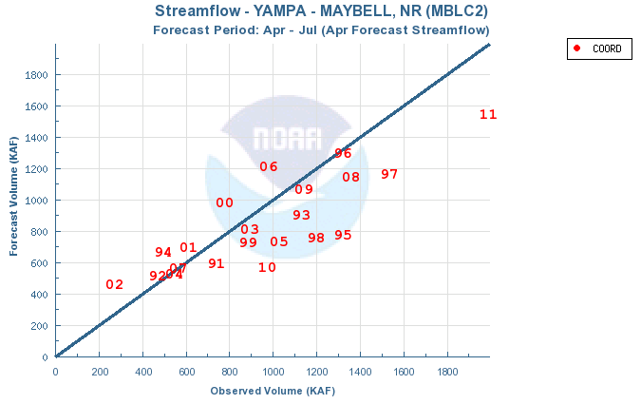
1988
201%

Slide 9
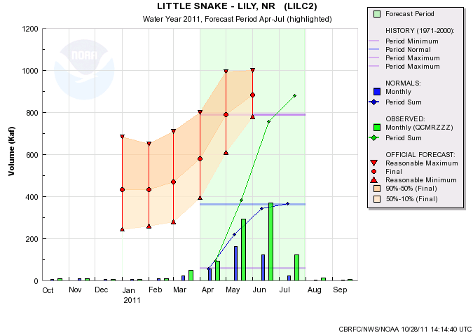
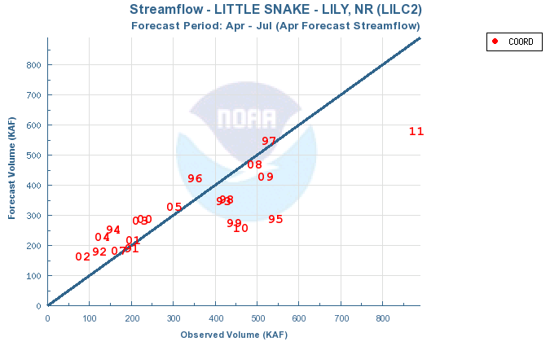
881
241%

Slide 10
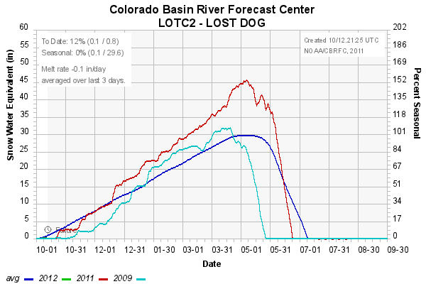
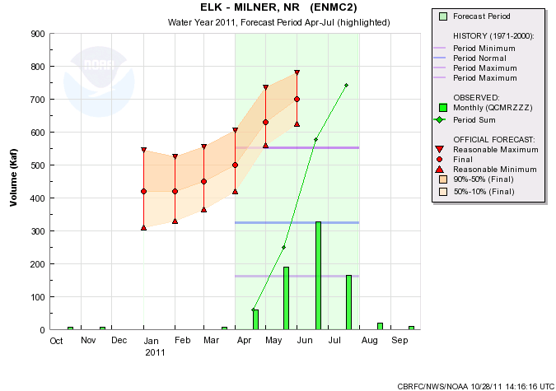
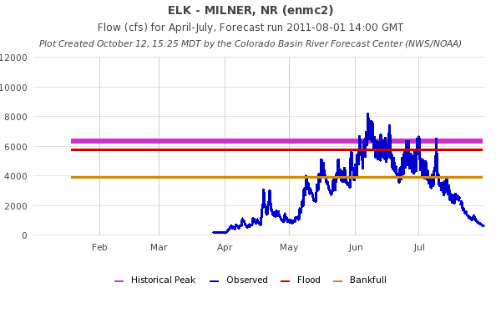
Elk River nr Milner…….the Record Breaker!!
Record Snow
Record (42 yr) Volume: 742 KAF
Old Record : 552 KAF
Record (42yr) Peak: 7110 cfs
Notes:
Snotel has short period of record 1998 but others show same pattern.

Slide 11
Green River Basin Records
LOCATION | NEW RECORD | OLD RECORD | % DIFF | OLD RECORD YEAR
East Fork of Smiths Fork | 64 | 57 | 12% | 1983
Blacks Fork nr Robertson | 202 | 125 | 62% | 1975
Yampa abv Stagecoach | 69 | 56 | 23% | 1997
Yampa at Steamboat Springs | 507 | 506 | 0% | 1984
Elk nr Milner | 742 | 552 | 34% | 1917
Elk Head nr Hayden | 171 | 119 | 44% | 1997
Yampa at Maybell | 1988 | 1921 | 3% | 1984
Little Snake nr Slater | 353 | 281 | 26% | 1984
Little Snake at Dixon | 775 | 754 | 3% | 1984
Little Snake at Lily | 881 | 790 | 12% | 1984
White River nr Meeker | 521 | 519 | 0% | 1984
West Fork Duchesne | 44 | 38 | 16% | 1986
Duchesne nr Tabiona | 217 | 189 | 15% | 1952
Upper Stillwater-Rock Creek | 153 | 136 | 13% | 1986
Rock Creek | 186 | 158 | 18% | 1986
Strawberry nr Solider Springs | 158 | 137 | 15% | 1986
Lake Fork- Moon Lake | 127 | 112 | 13% | 2005
Yellowstone nr Altonah | 125 | 114 | 10% | 2005
Duchesne-Myton | 824 | 766 | 8% | 1952
Duchesne-Randlett | 1011 | 942 | 7% | 1983
Green River-Green River,UT | 6490 | 5856* | 11% | 1983
RED=Single Month Volume > April-July Average
*POR after regulation
White/Yampa=10 /10
Duchesne=10/16

Slide 12
Upper Colorado Basin
Slightly above normal seasonal precipitation through March 2011
Sustained cool and wet period April-June
Many record or near records for precipitation, runoff volumes, etc
Precipitation and runoff volumes greater to the north (e.g. Granby, Dillon, etc) and less to the south (e.g. Gunnison) and still less in the Dolores
Mainstem
Gunnison
Dolores

Slide 13
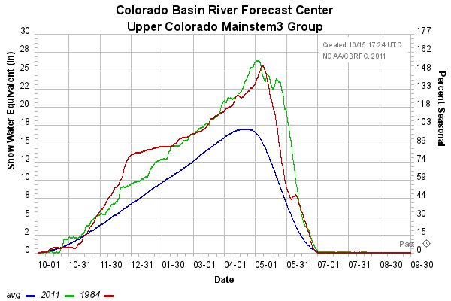
Upper Colorado Mainstem Basin Conditions
As of July 1, 2011
As of August 1, 2011

Slide 14
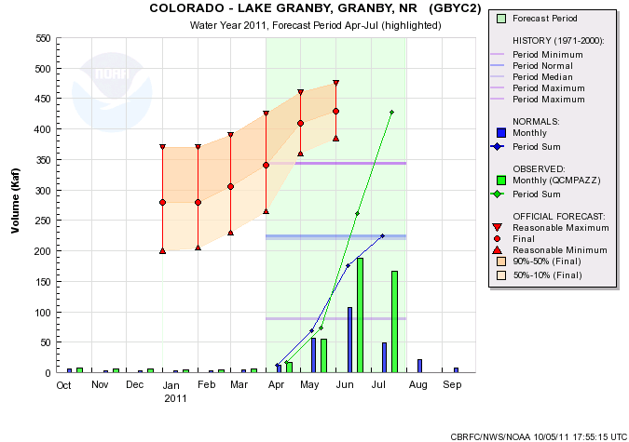
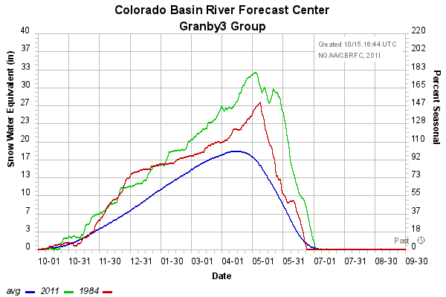
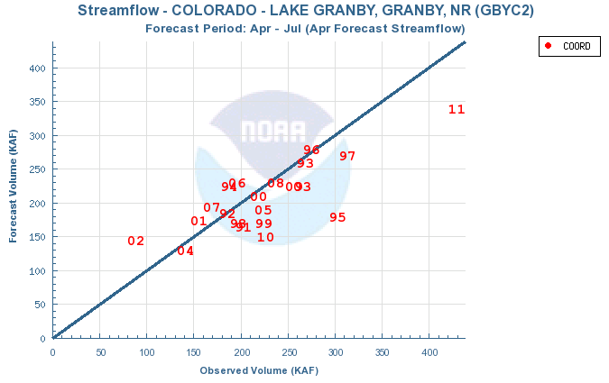
Record Runoff
428
190%
343 (1984)
225

Slide 15
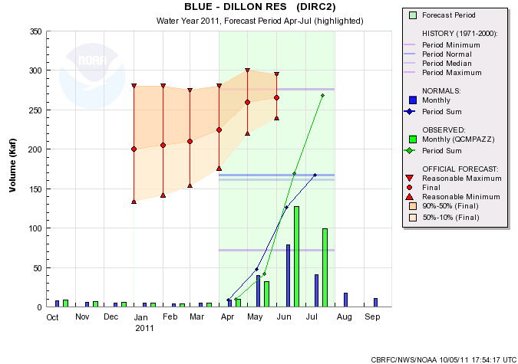
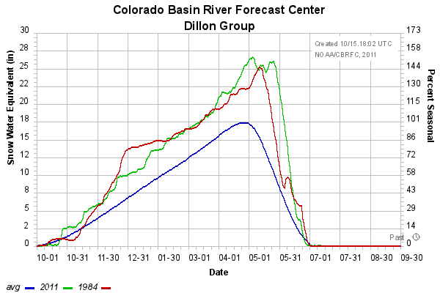
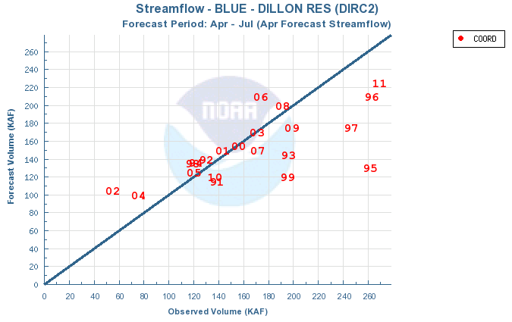
276 (1984)
268
161%
167

Slide 16
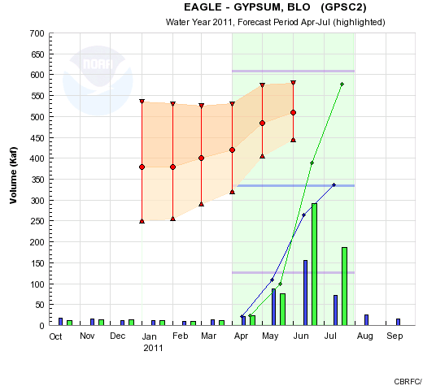
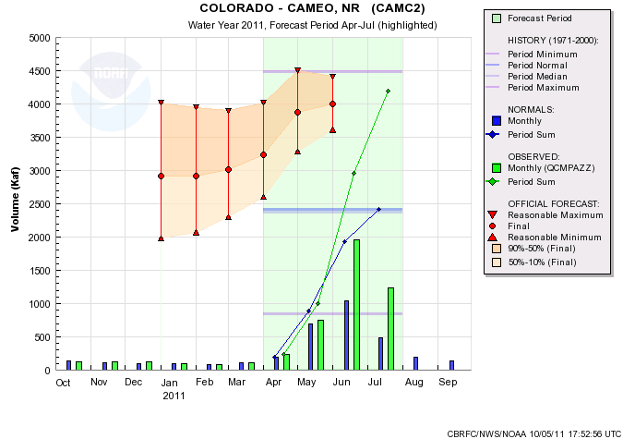
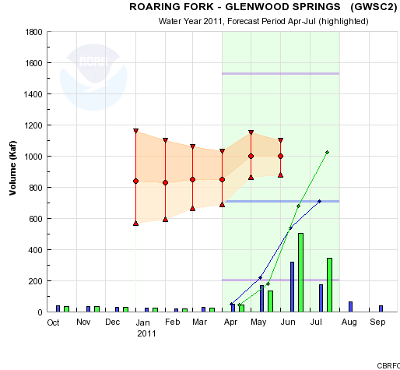
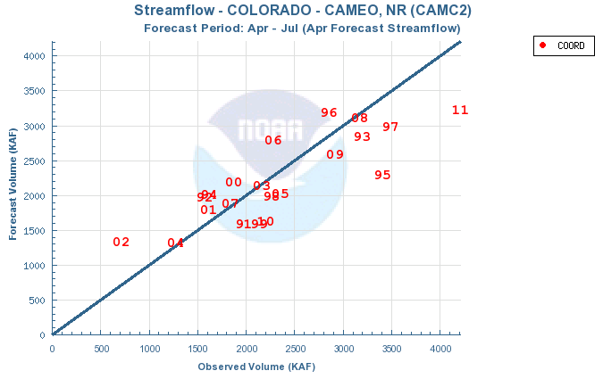
4489 (1984)
577
172%
4200
174%
2420
1026
145%

Slide 17
Upper Colorado Mainstem 2011 Volumes
 | April - July 2011 |  | Historical
 | Volume (kaf) | % avg | Ranking | Max (kaf) | Year
Lake Granby | 428 | 190% | 1 / 84 | 343 | 1984
Willow Creek Res | 125 | 245% | 1 / 92 | 85 | 1986
Fraser - Winter Park | 32 | 159% | 2 / 41 | 34 | 1984
Williams Fork Res | 155 | 163% | 2 / 52 | 162 | 1984
Dillon Res | 268 | 161% | 2 / 52 | 276 | 1984
Green Mountain Res | 468 | 167% | 3 / 74 | 490 | 1984
Wolford Mountain Res | 114 | 190% | 1 / 30 | 112 | 1984
Colorado - Kremmling | 1,767 | 203% | 1 / 41 | 1,562 | 1984
Eagle - Gypsum | 577 | 172% | 2 / 65 | 608 | 1984
Colorado - Dotsero | 2,720 | 189% | 1 / 71 | 2,496 | 1984
Ruedi Res | 218 | 154% | 2 / 42 | 255 | 1984
Roaring Fork - Glenwood | 1,026 | 145% | 3 / 42 | 1,244 | 1984
Colorado -Glenwood | 3,730 | 173% | 1 / 55 | 3,716 | 1984
Colorado - Cameo | 4,200 | 174% | 2 / 78 | 4,489 | 1984
Plateau Ck - Cameo | 164 | 142% | 13 / 76 | 318 | 1983
Colorado - Cisco | 6,894 | 148% | 5 / 42 | 8,988 | 1984
Lake Powell | 12,920 | 163% | 3 / 48 | 15,406 | 1984

Slide 18
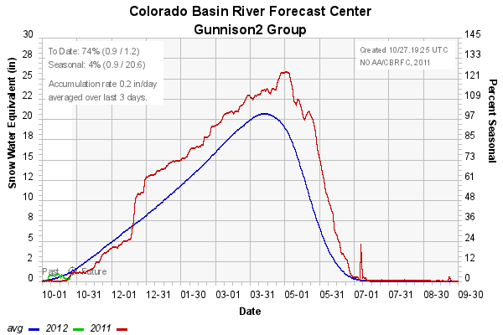
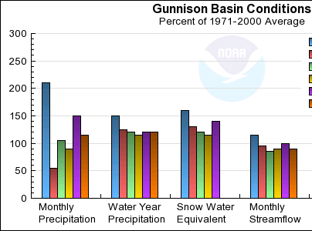
Gunnison Basin Conditions

Slide 19
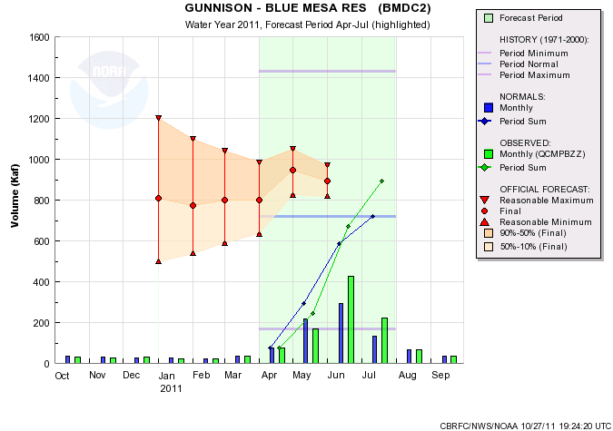
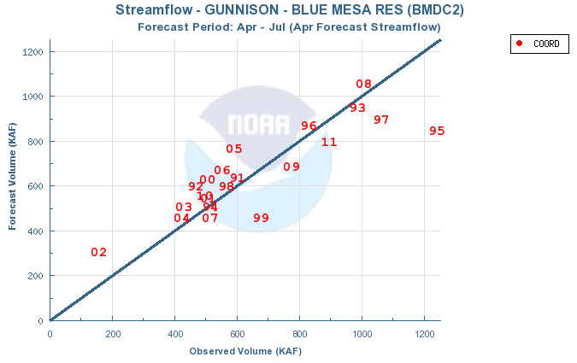
893
124%

Slide 20
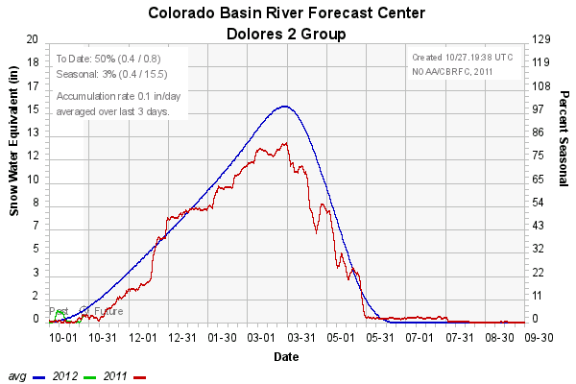
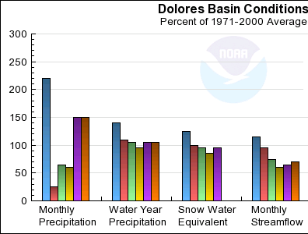
Dolores Basin Conditions

Slide 21
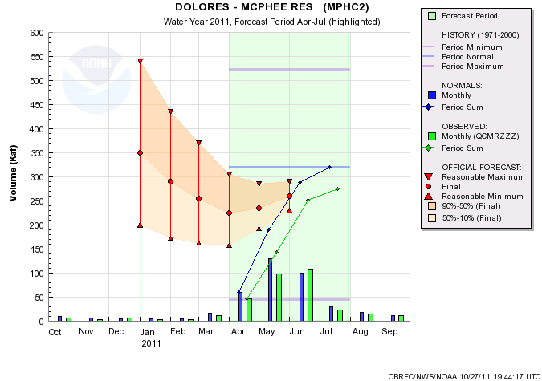
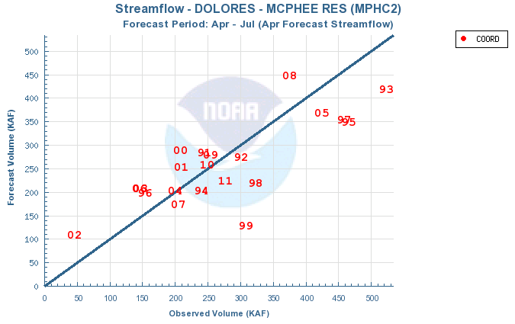
275
86%

Slide 22
San Juan Basin
Near to Below normal year
Evidence of La Nina

Slide 23
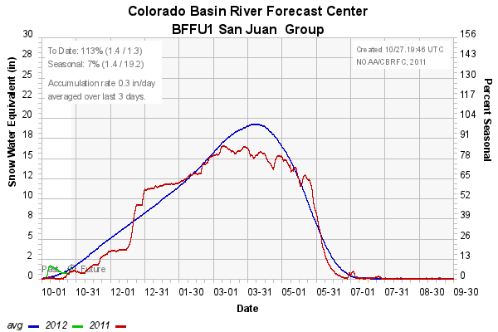
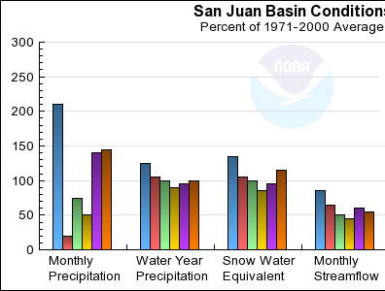
San Juan Basin Conditions

Slide 24
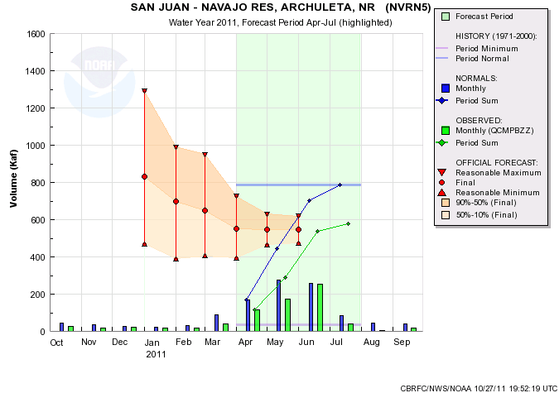
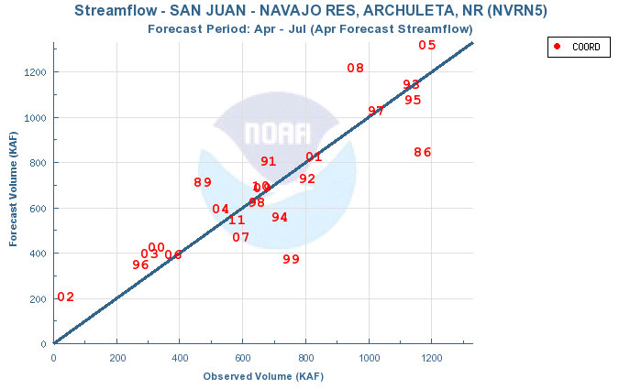
579
75%

Slide 25
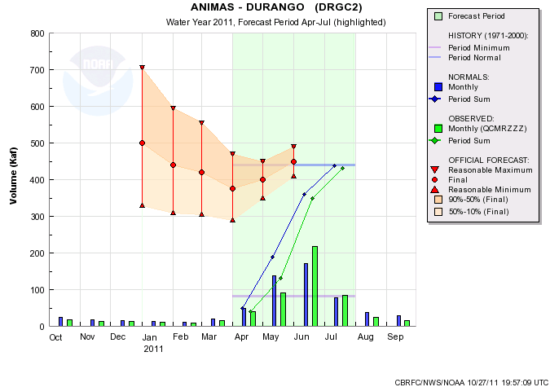
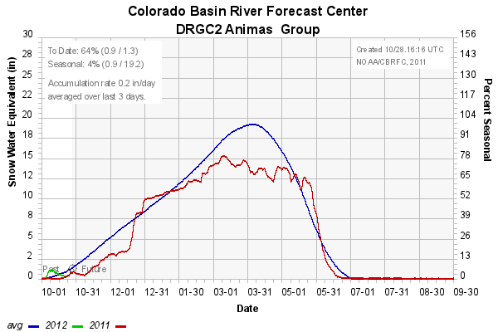
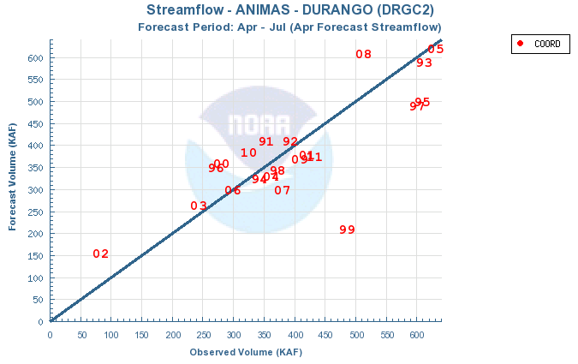
431
98%

Slide 26
Lake Powell
Historical Observed Apr-Jul Volumes (kaf) 1970-2010 (winter ENSO status)
( 1) - 1984 - 15406.41 (neutral)
( 2) - 1983 - 14838.93 (el nino)
( 3) - 1986 - 12601.21 (neutral)
( 4) - 1995 - 11833.18 (el nino)
( 5) - 1985 - 11701.11 (la nina)
( 6) - 1997 - 11320.89 (neutral)
( 7) - 1973 - 11262.74 (el nino)
( 8) - 1979 - 11104.25 (neutral)
( 9) - 1980 - 10606.60 (neutral)
( 10) - 1993 - 9984.42 (neutral)
( 11) - 1975 - 9953.16 (la nina 2)
( 12) - 2008 - 8908.50 (la nina)
( 13) - 2005 - 8844.02 (el nino)
( 14) - 1978 - 8678.09 (el nino 2)
( 15) - 1998 - 8510.14 (el nino)
( 16) - 1982 - 8210.63 (neutral)
( 17) - 1971 - 8180.35 (la nina)
( 18) - 1970 - 8037.76 (neutral)
( 19) - 2009 - 7806.72 (neutral)
( 20) - 1999 - 7788.09 (la nina)
( 21) - 1987 - 7758.54 (el nino)
( 22) - 1996 - 7233.47 (la nina)
( 23) - 1974 - 6915.13 (la nina)
( 24) - 2010 - 5795.43 (el nino)
( 25) - 1972 - 5494.26 (neutral)
( 26) - 2006 - 5319.56 (neutral)
( 27) - 1976 - 5297.75 (la nina 3)
( 28) - 1991 - 5159.33 (el nino)
( 29) - 1988 - 4567.47 (el nino 2)
( 30) - 2000 - 4367.05 (la nina 2)
( 31) - 2001 - 4320.62 (la nina 3)
( 32) - 1992 - 4124.42 (neutral)
( 33) - 2007 - 4053.47 (el nino)
( 34) - 2003 - 3910.17 (el nino)
( 35) - 1994 - 3766.48 (neutral)
( 36) - 2004 - 3542.00 (neutral)
( 37) - 1989 - 3524.63 (la nina)
( 38) - 1990 - 3228.85 (neutral)
( 39) - 1981 - 3058.61 (neutral)
( 40) - 1977 - 1277.39 (el nino)
( 41) - 2002 - 1126.76 (neutral)
2011 – 12,920 (la nina)
3rd highest April-July volume since the closure of the dam

Slide 27
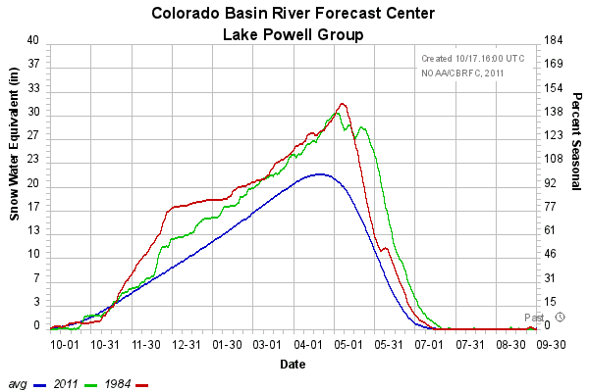
Lake Powell Basin Conditions

Slide 28
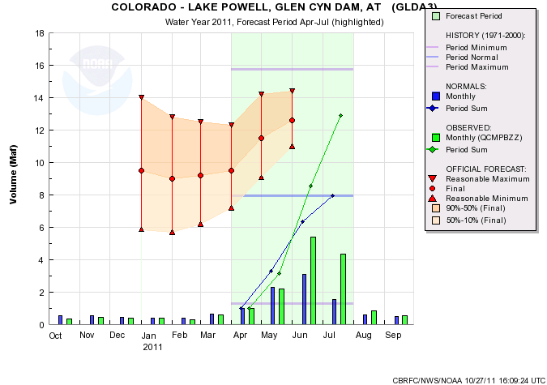
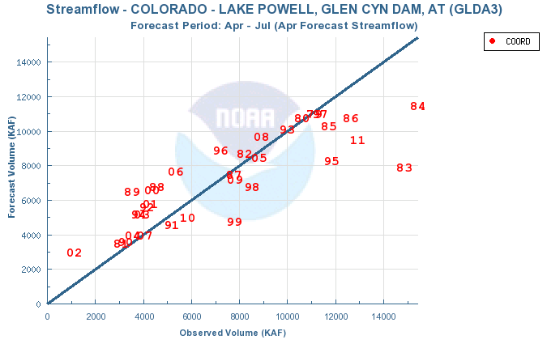
15.7 (1917)
12.9 maf
163%
7.9

Slide 29
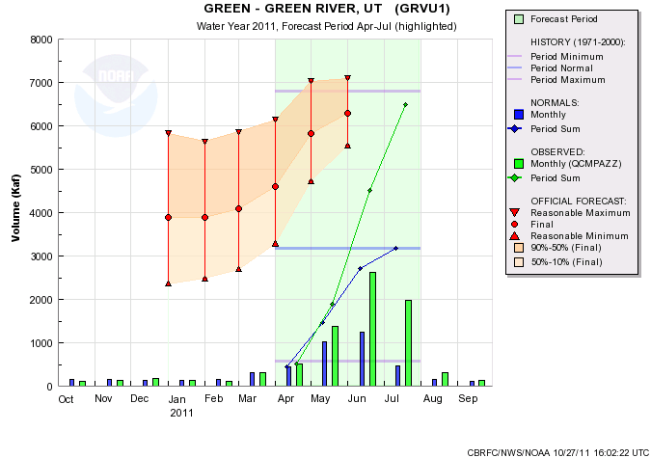
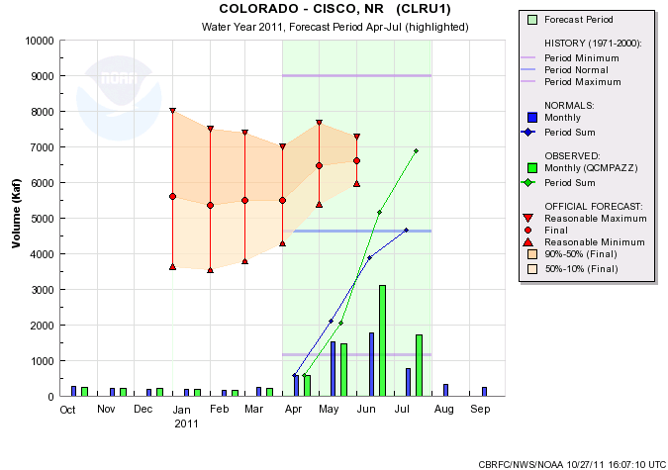
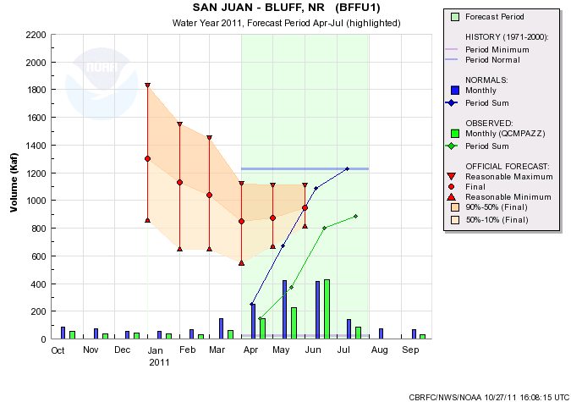
6490
205%
6894
148%
12.9
163%
888
72%

Slide 30
Lower Colorado Basin
Much below average except in northwest (e.g. Virgin, Muddy, etc)
Virgin:
December 2010 storm track was important, but also wet April-May.
Snowpack persisted due to cool temperatures; melt delayed.
Virgin
Phoenix dust storm

Slide 31
Precipitation for December 2010

Slide 32
Virgin Basin Conditions

Slide 33
149
217%

Slide 34
2011 Summary
Extremely wet in the north and dry in the south – dryness in the south was consistent with La Nina.
Volume forecasts generally started too low in the north and too high in the south.
Extremes are difficult to predict but many forecasts this year were for extremes.

