Slide 1
CBRFC April 2011 mid-month Peak Flow Forecast Webinar
11am, April 27, 2011
Kevin Werner
These slides: www.cbrfc.noaa.gov/present/present.php

Slide 2
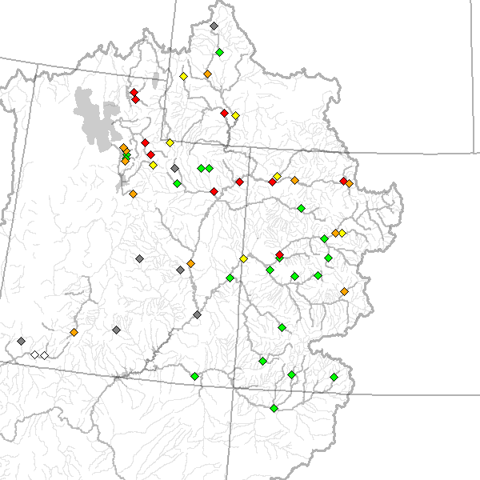
Outline
Recent and Upcoming Weather Review
Snow States
Peak Flow Forecasts
Web Reference: www.cbrfc.noaa.gov/wsup/pub2/map/html/cbrfc.1.2011.html

Slide 3
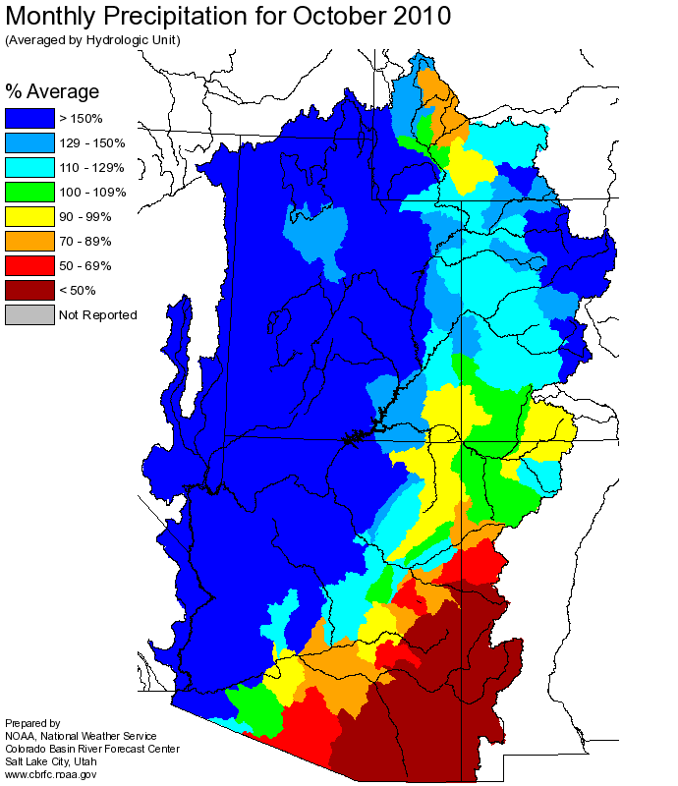
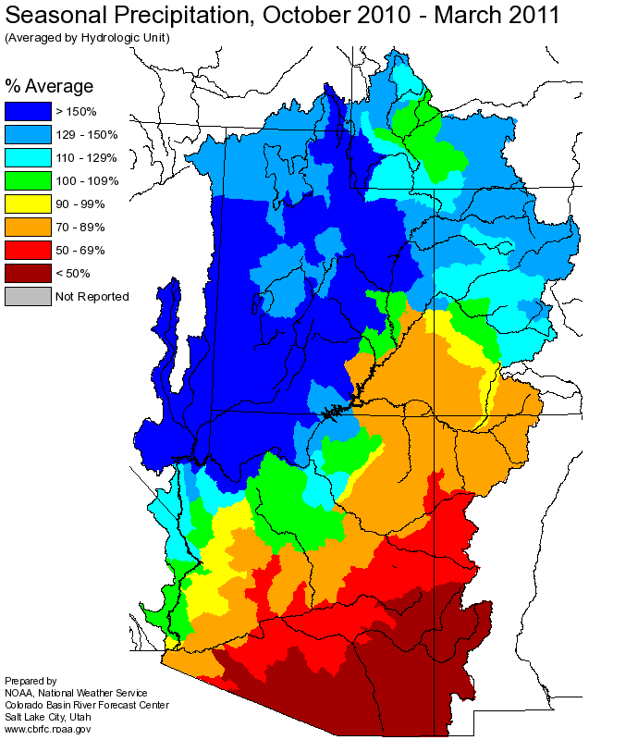
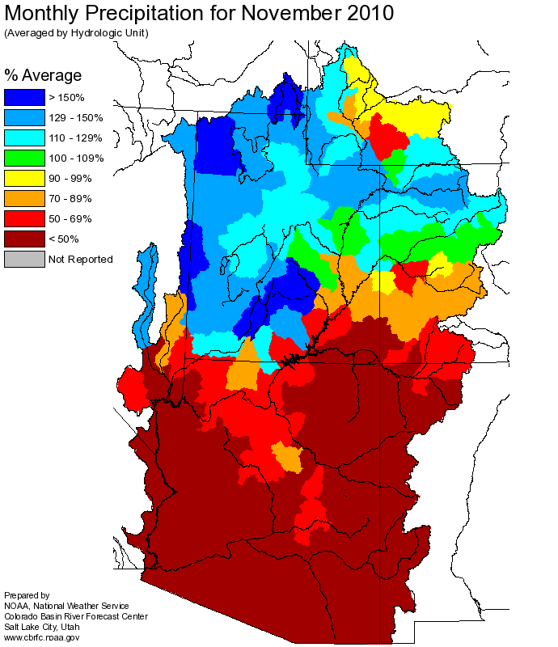
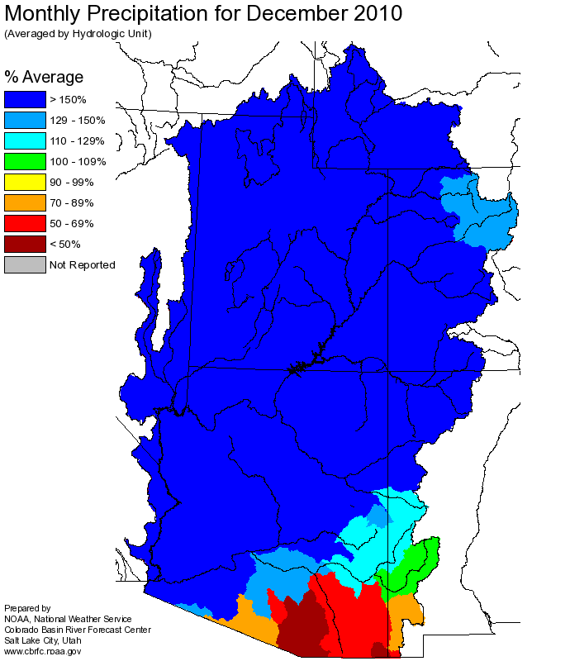
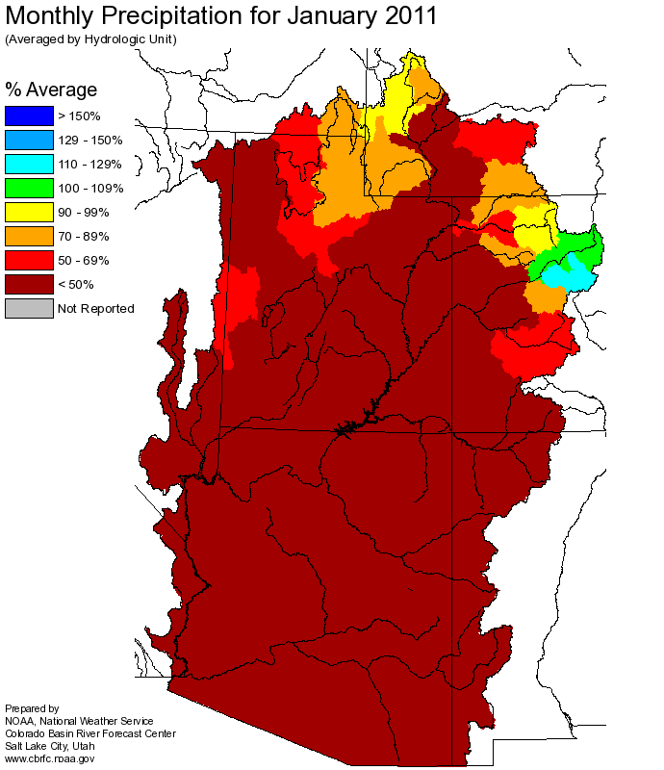
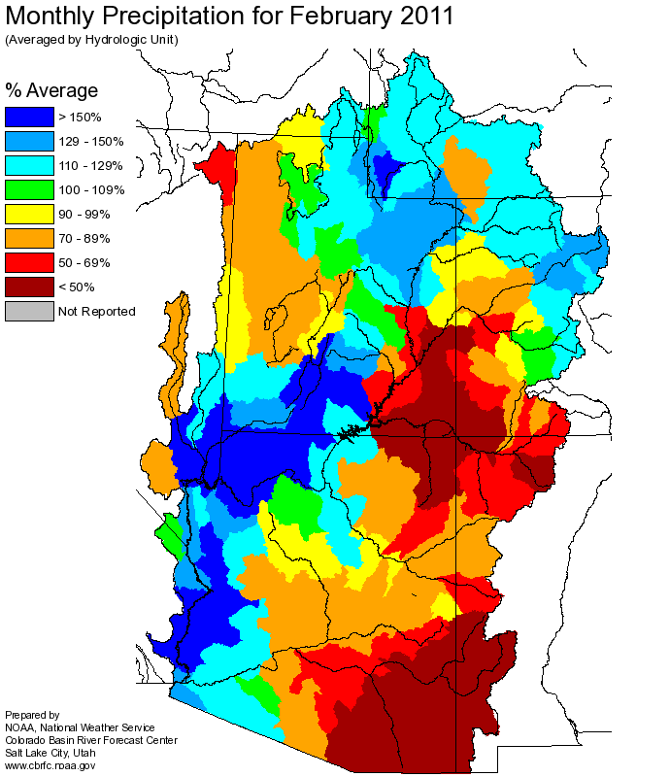
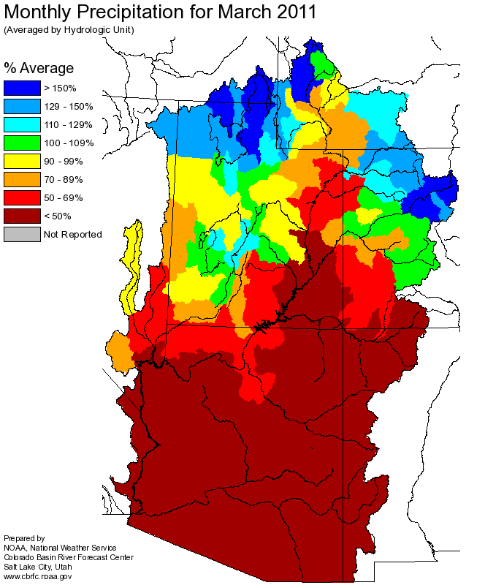
Web Reference: http://www.cbrfc.noaa.gov

Slide 4
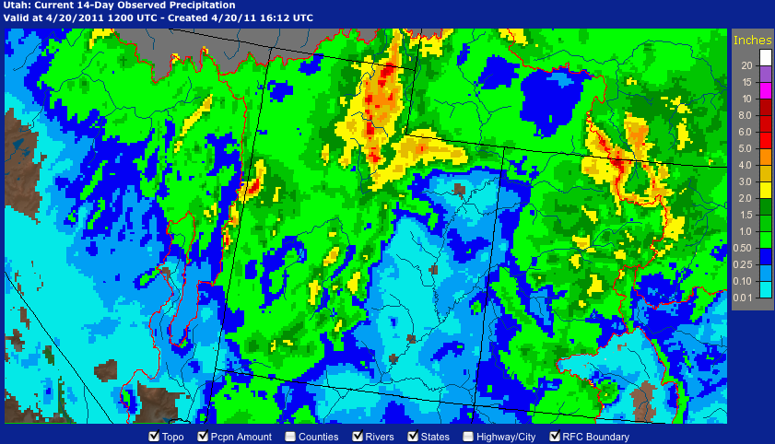
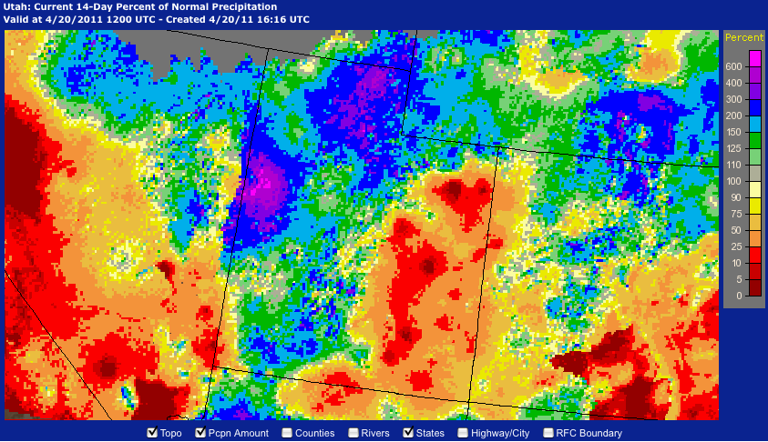
Precipitation April 6-20
Web Reference: http://water.weather.gov/precip

Slide 5
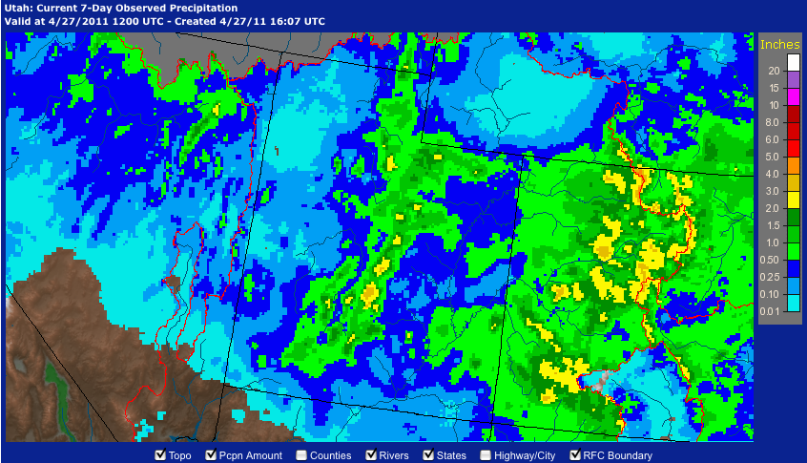
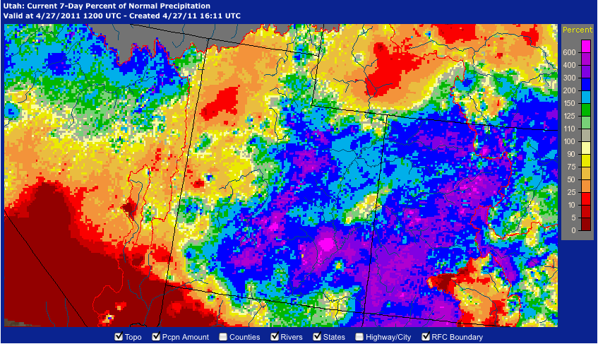
Precipitation April 20-27

Slide 6
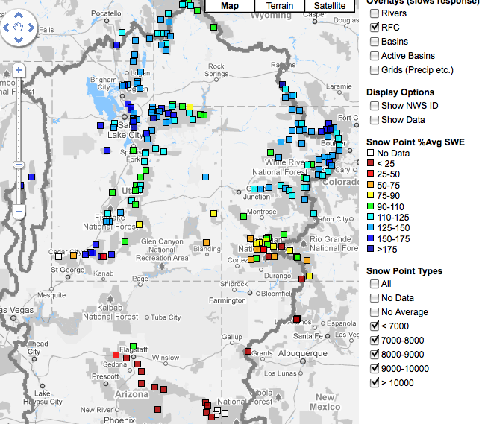
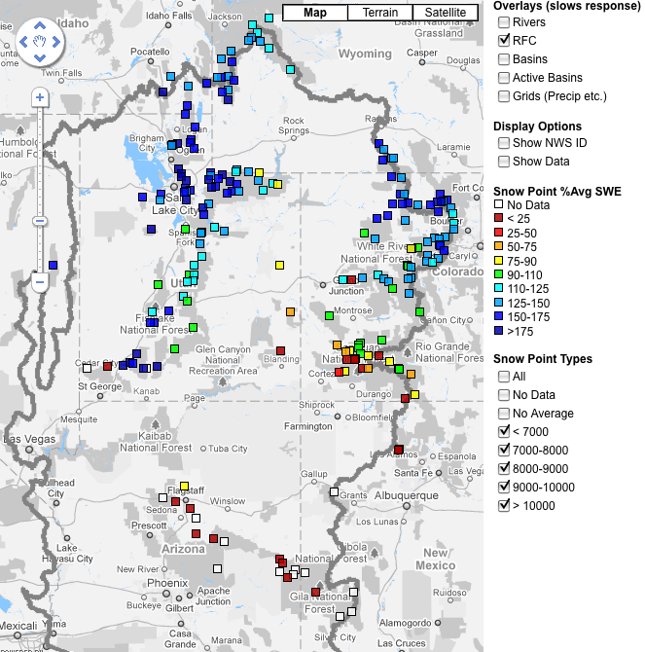
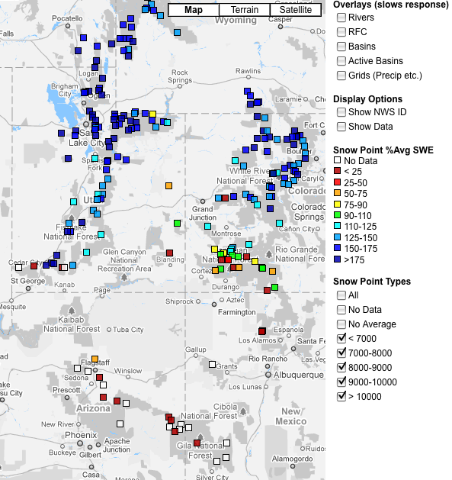
Snow
April 7 April 20 April 27
Web Reference: http://www.cbrfc.noaa.gov/gmap/gmapm.php?scon=checked

Slide 7
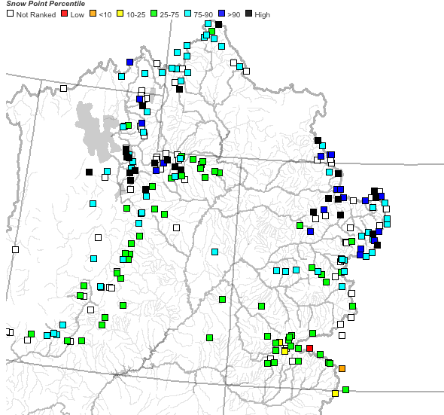
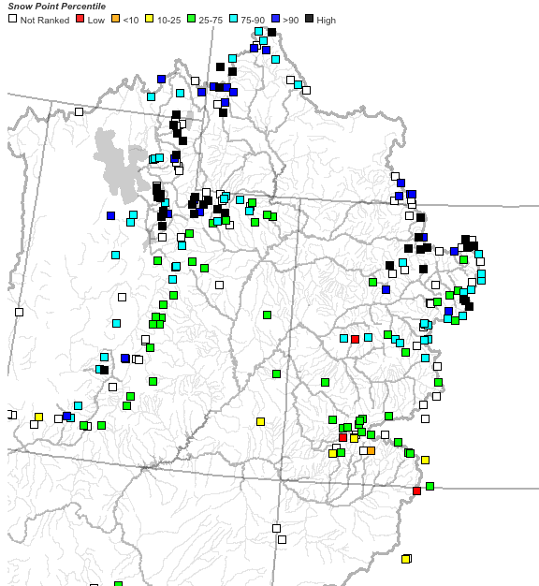
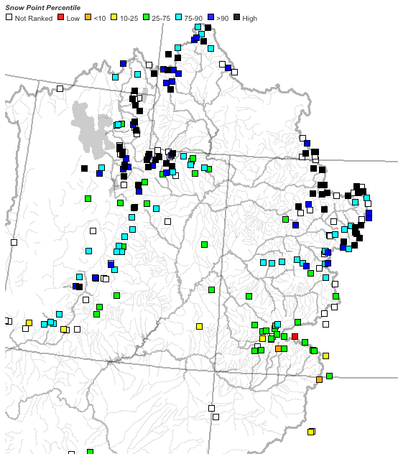
April 7 April 20 April 27

Slide 8
71 sites showing highest value for today

Slide 9
229 sites with 10+ years of record; 71/229 or 31% of sites with daily record

Slide 10
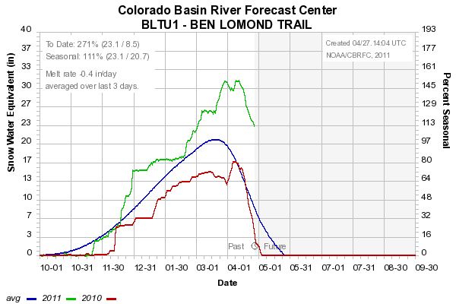
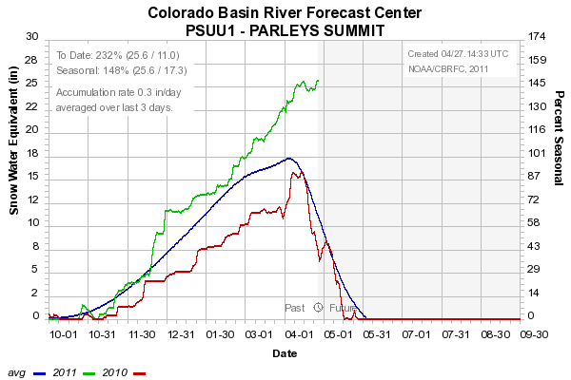
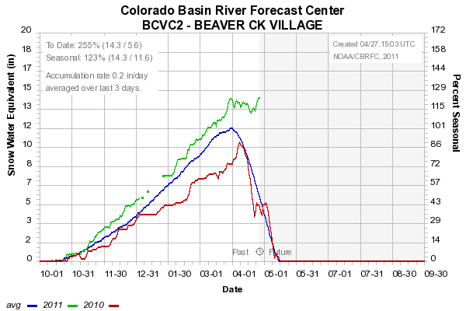
Sites below ~8500’
starting to melt
8000’
7500’
8400’

Slide 11
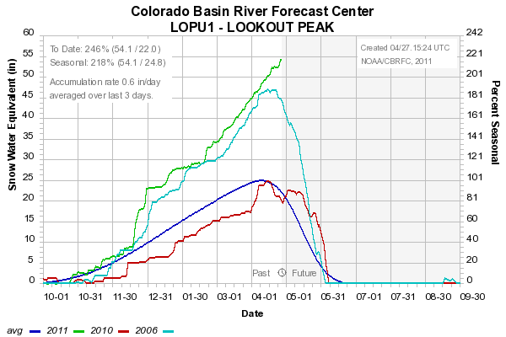
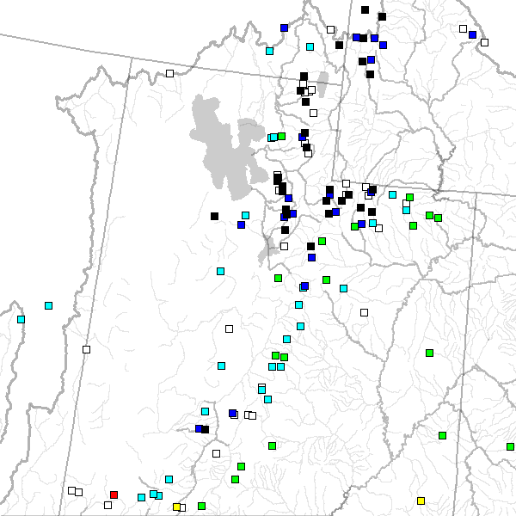
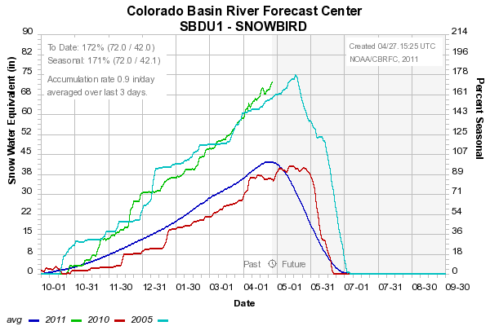
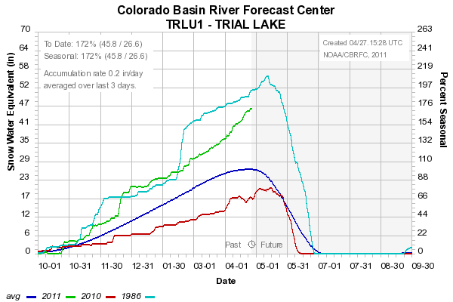
Sites above 8000’
Still accumulating snow
8200’
9600’
8400’

Slide 12
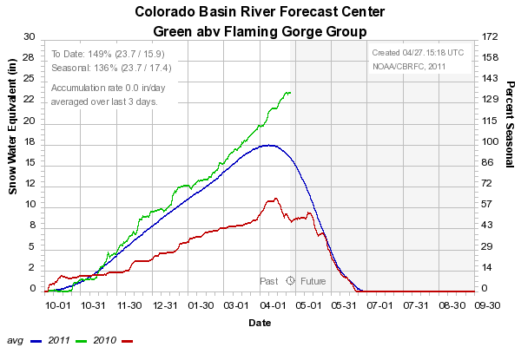
Snow: Upper Green Basin (above Flaming Gorge)
Web Reference: http://www.cbrfc.noaa.gov/station/sweplot/sweplot.cgi???open

Slide 13
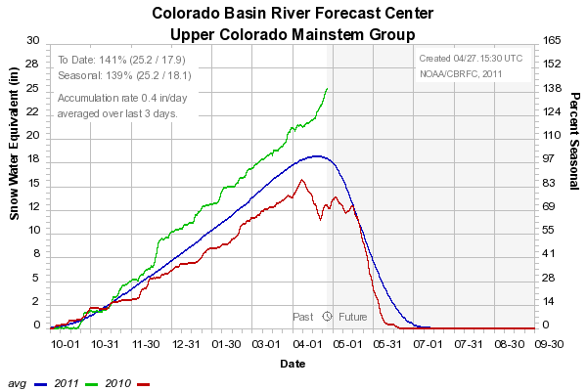
Snow: Colorado Mainstem (above Cameo)
Web Reference: http://www.cbrfc.noaa.gov/station/sweplot/sweplot.cgi???open

Slide 14
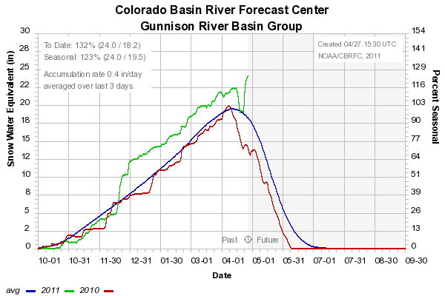
Snow: Gunnison Basin
Web Reference: http://www.cbrfc.noaa.gov/station/sweplot/sweplot.cgi???open

Slide 15
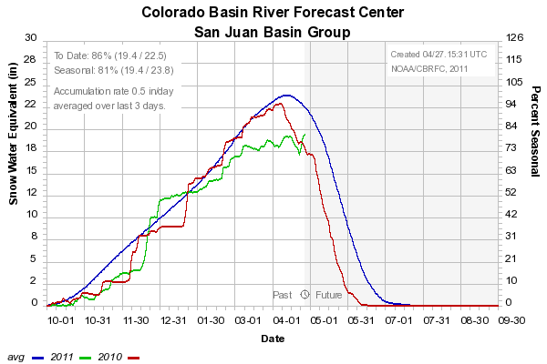
Snow: San Juan Basin
Web Reference: http://www.cbrfc.noaa.gov/station/sweplot/sweplot.cgi???open

Slide 16
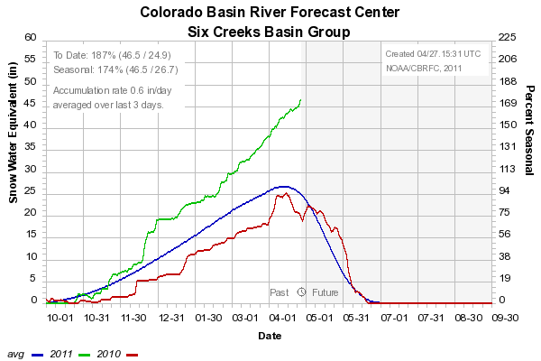
Snow: Six Creeks in Salt Lake County
Web Reference: http://www.cbrfc.noaa.gov/station/sweplot/sweplot.cgi???open

Slide 17
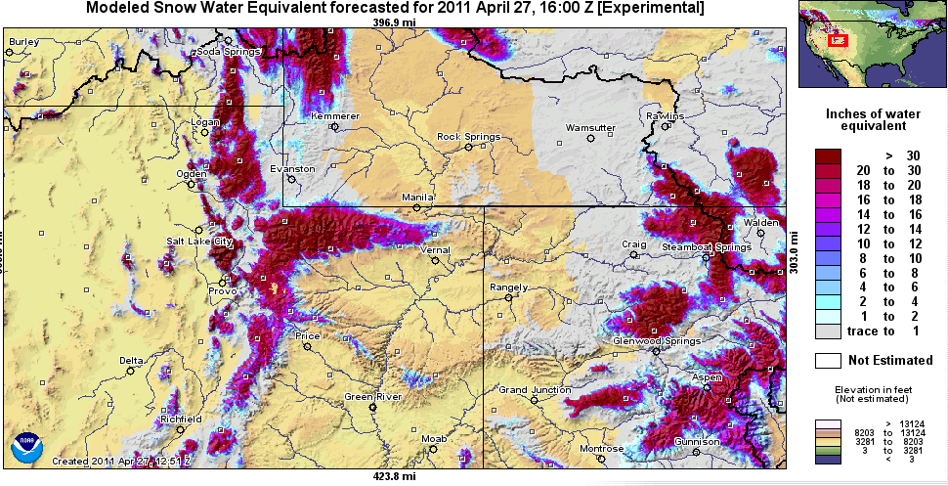
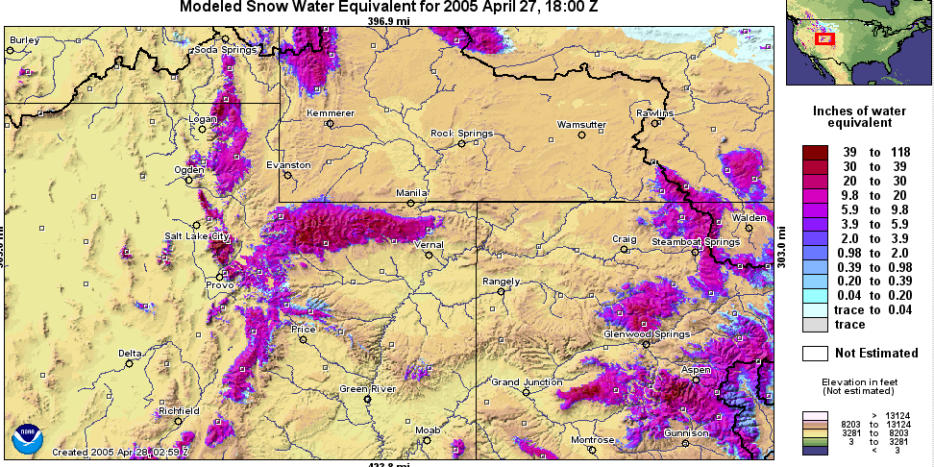
Snow Maps
Web Reference: http://www.nohrsc.nws.gov

Slide 18
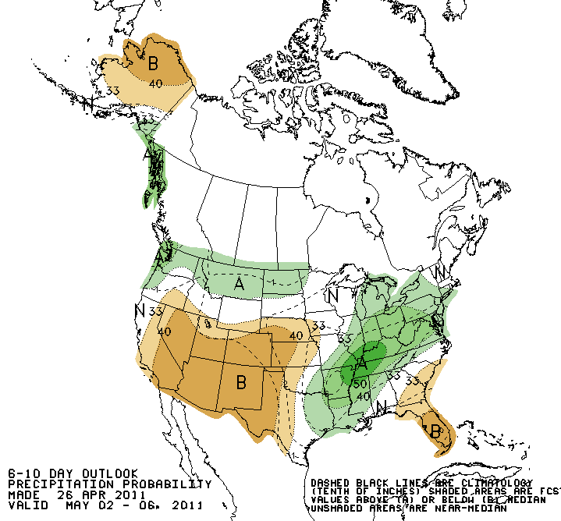
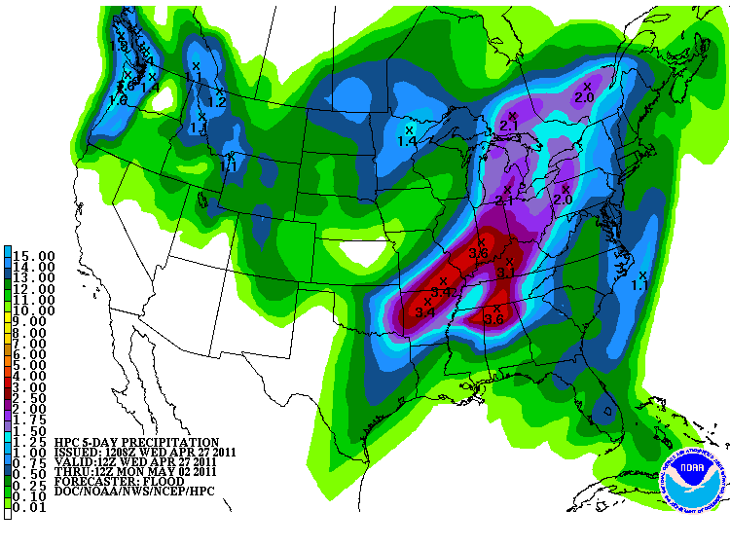
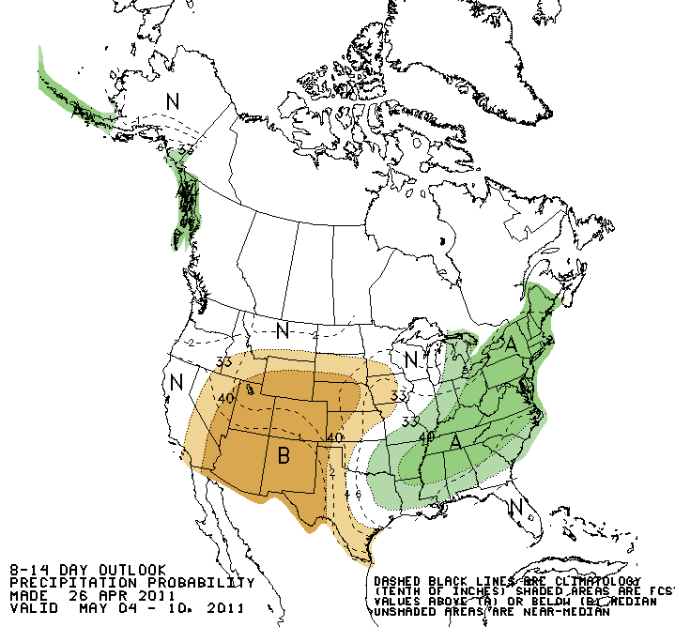
Forecast Precipitation
Next storm: Friday/Saturday
Weak storm possible middle of next week
Spring to follow??
Web Reference: www.hpc.noaa.gov

Slide 19
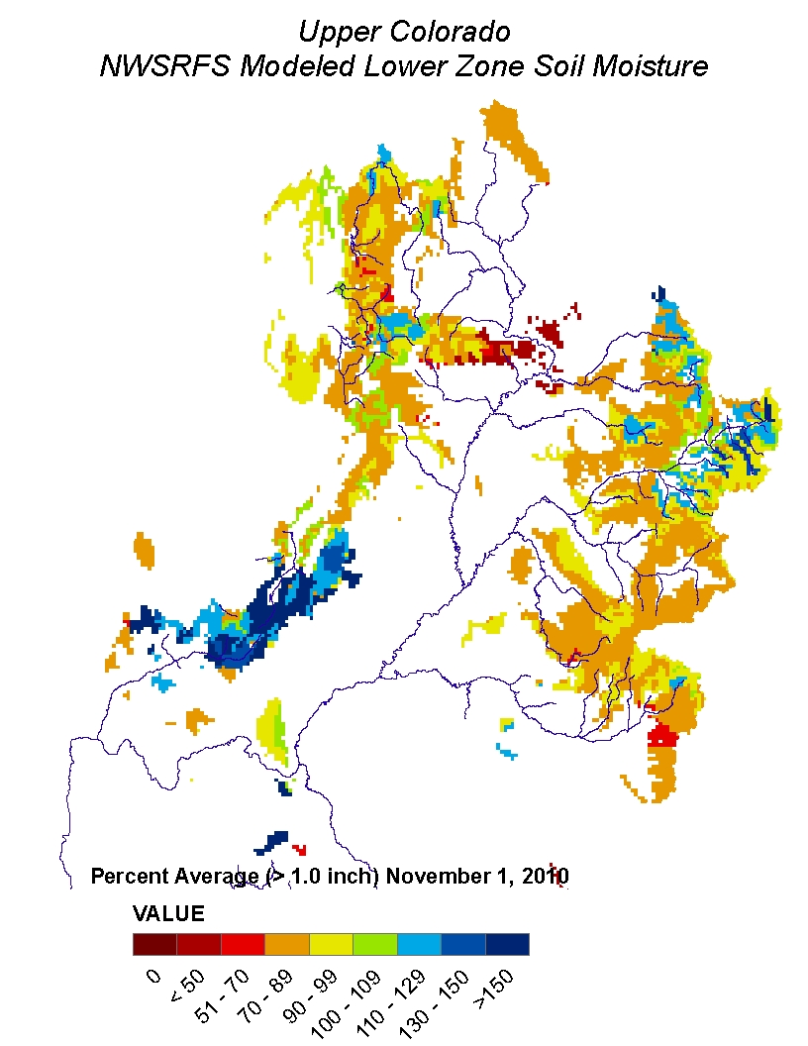
Soil Moisture

Slide 20
What is a Peak Flow Forecast?
Snowmelt Mean Daily Maximum Flow (April-July)
Probabilistic Forecasts
Exceedence Probabilities -10%,25%,50%, 75%, 90%
Issued (at least) monthly from March-June (this year weekly starting April 19)
~60 forecast points – some unregulated, some regulated
Updated as needed
Forecast Users include:
Emergency Managers
USGS hydrologists
Water Managers
River Recreation

Slide 21
Spring Weather Really Matters
Runoff characteristics are largely determined by the day-to-day spring weather.
While large snow pack years increase chances for flooding, it is not an inevitability
Small snow pack years (like last year) can flood with the right sequence of spring temperatures

Slide 22
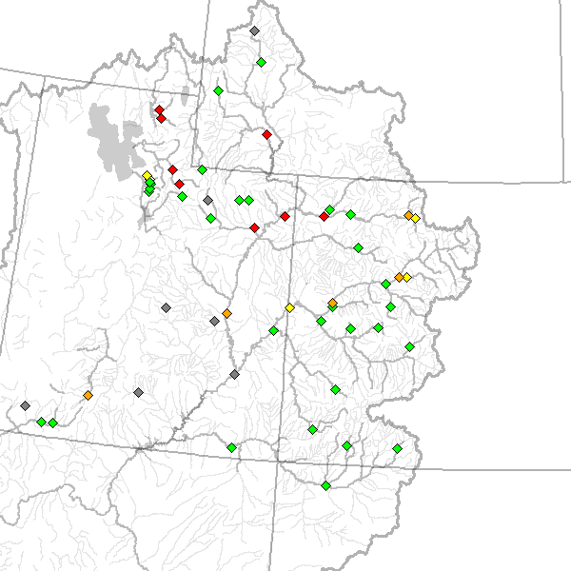
April 26 Peak Flow Forecasts
April 19 Forecasts
April 26 Forecasts

Slide 23
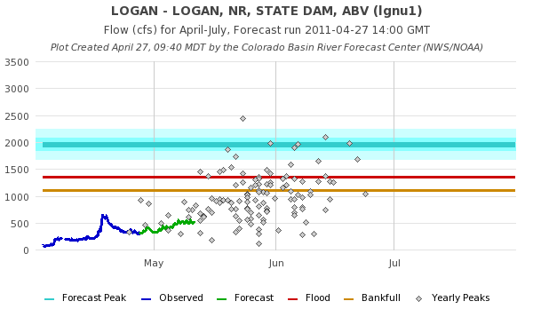
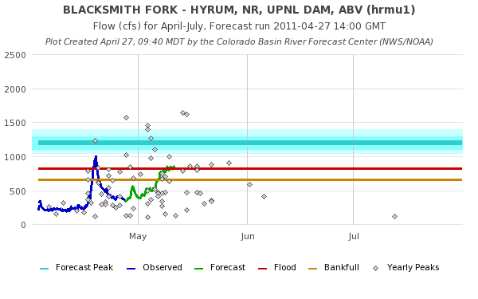

Slide 24
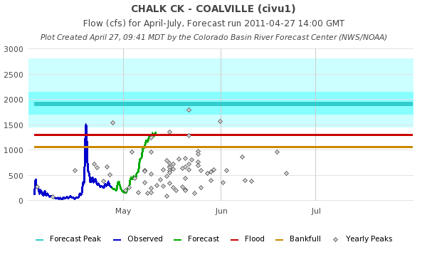
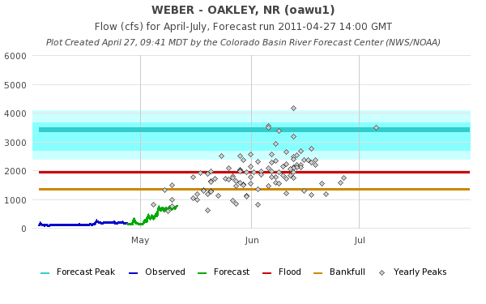

Slide 25
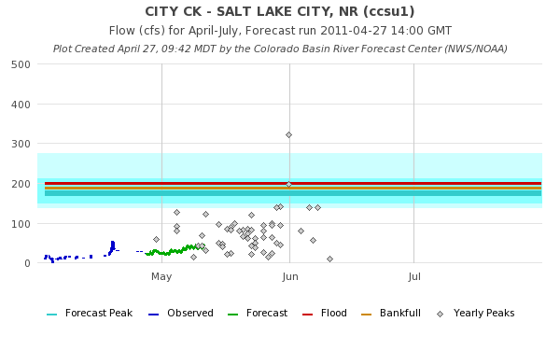
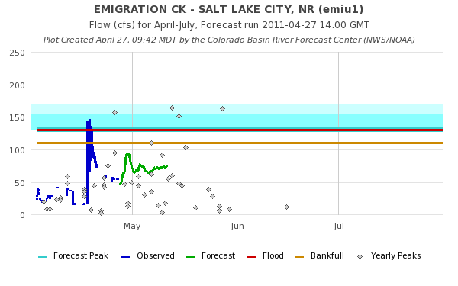

Slide 26
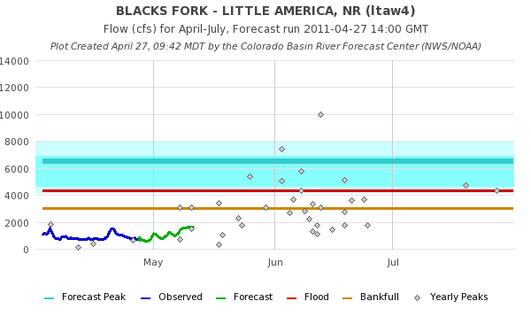
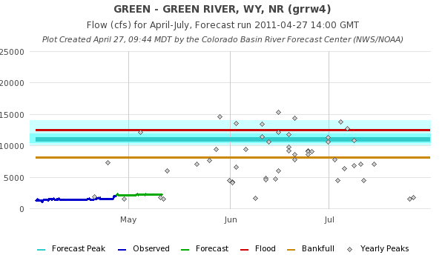

Slide 27
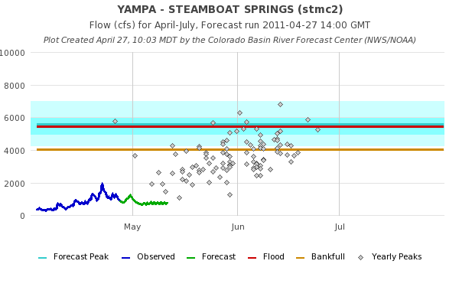
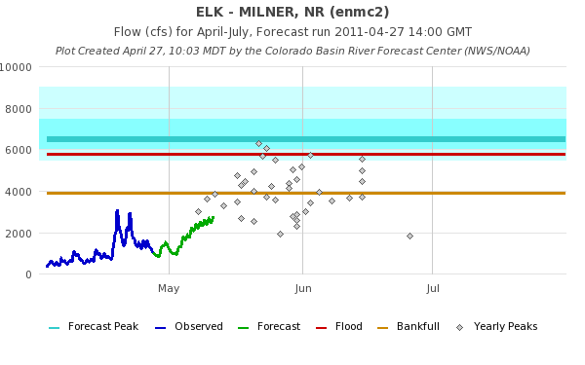

Slide 28
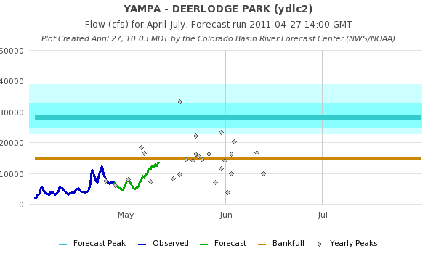
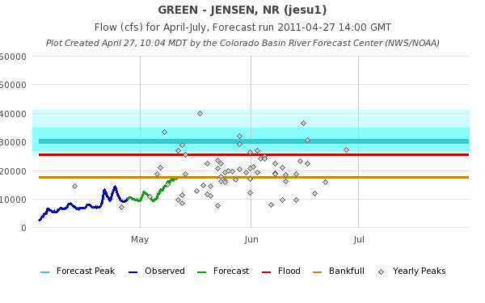

Slide 29
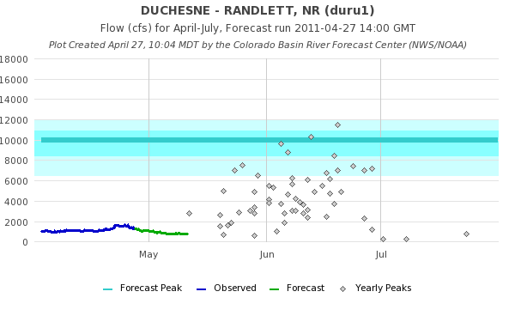

Slide 33
Peak Flow Publication

Slide 34
April 1, 2011
Water Supply Forecasts
Highlights:
Wet winter continues for much of the basin with many forecasts higher than any year since 1997
Some northern basins predicting flows near the top 10%
Most northern basins higher than Mar 1
San Juan and lower basin somewhat lower since Feb 1 and again Mar 1
Web Reference: www.cbrfc.noaa.gov/gmap/gmapm.php?wcon=checked

Slide 35
Spring Flooding Probable in northern Utah and northwestern Colorado rivers
Chances continue to increase without a prolonged warm period to melt snow in early to mid May
Expect some problems on rivers even below flood stages

Slide 36
Peak Flow Forecasts
Forecast updates planned for:
4/5, 4/19, 4/26 (done), 5/5, 5/10, 5/17, 5/24
Webinars: 4/20,4/27,5/11
“beta” website developments:
SNOTEL percentiles
Simplified peak flow chart
Publication referencing forecasts above historic peaks
New peak flow forecast points added
In progress: instantaneous peaks (vs mean daily)
Discussion:
Anything else you need??

Slide 37
CBRFC News
Basin Focal Points (Available to discuss forecasts: 801.524.5130)
Upper Colorado: Brenda Alcorn
Green: Ashley Nielson
San Juan / Gunnison: Tracy Cox
Great Basin: Brent Bernard
Lower Colorado (below Lake Powell): Greg Smith
Upcoming:
Weekly ESP model guidance
Email product updates via govdelivery (can add more products / webpages upon request)
Changes to CBRFC webpage: www.cbrfc.noaa.gov/gmap/gmap3.php
Blog (blog.citizen.apps.gov/cbrfc)

Slide 38
Feedback, Questions, Concerns always welcome….
Kevin Werner
CBRFC Service Coordination Hydrologist
Phone: 801.524.5130
Email: kevin.werner@noaa.gov

