Slide 1
CBRFC
May 25
Peak Flow and Water Supply Forecast Webinar
11am, May 25, 2011
Kevin Werner
These slides: www.cbrfc.noaa.gov/present/present.php

Slide 2
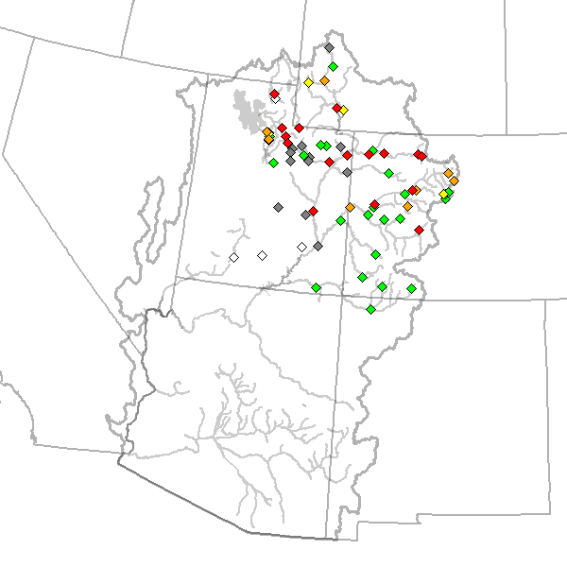
Outline
Recent and Upcoming Weather Review
Snow States
Peak Flow Forecasts
Web Reference: www.cbrfc.noaa.gov/wsup/pub2/map/html/cbrfc.1.2011.html

Slide 3
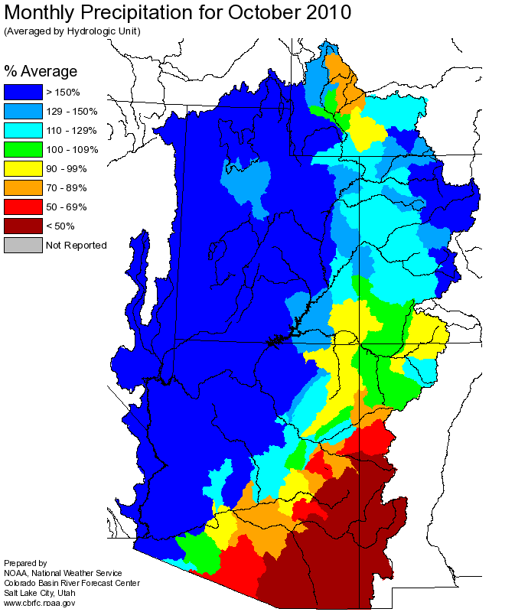
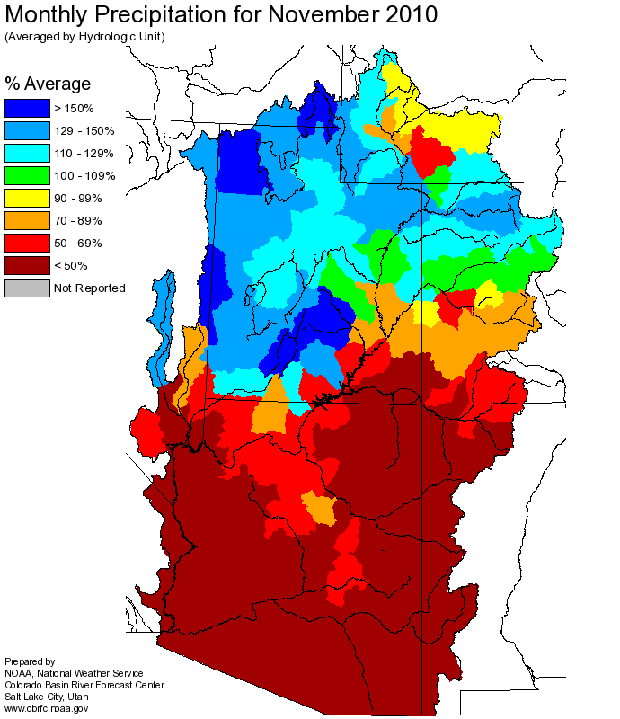
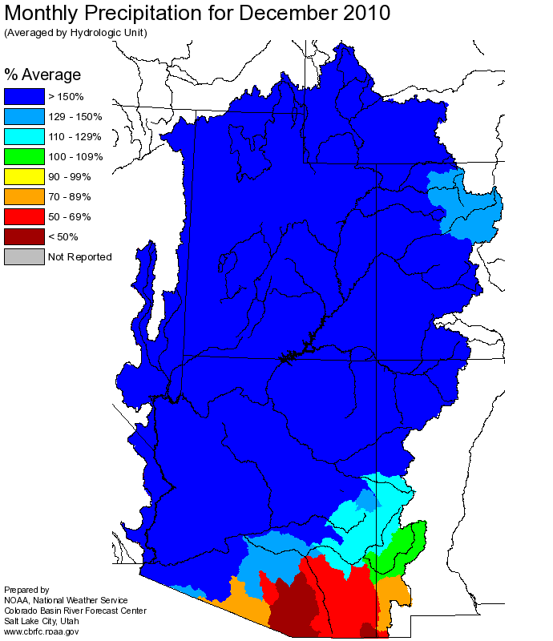
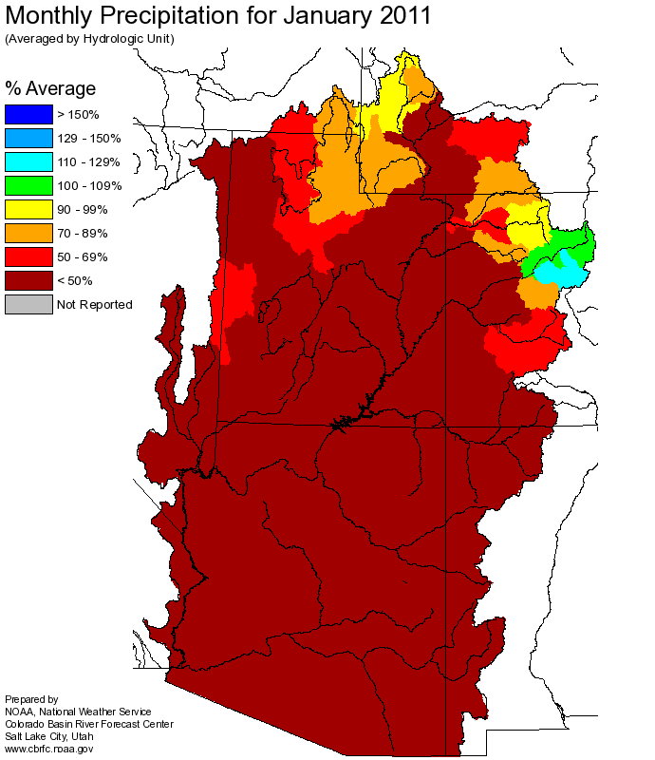
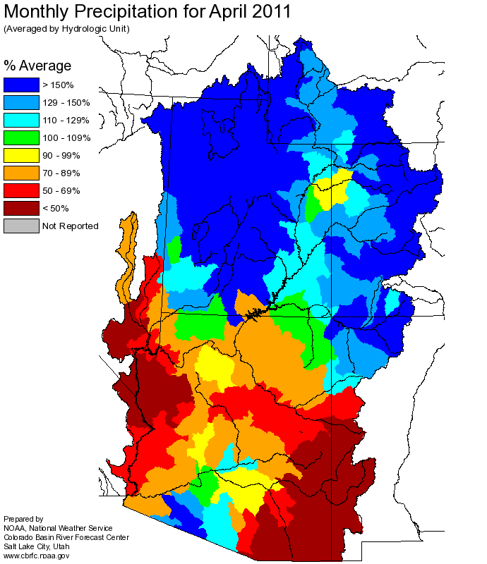
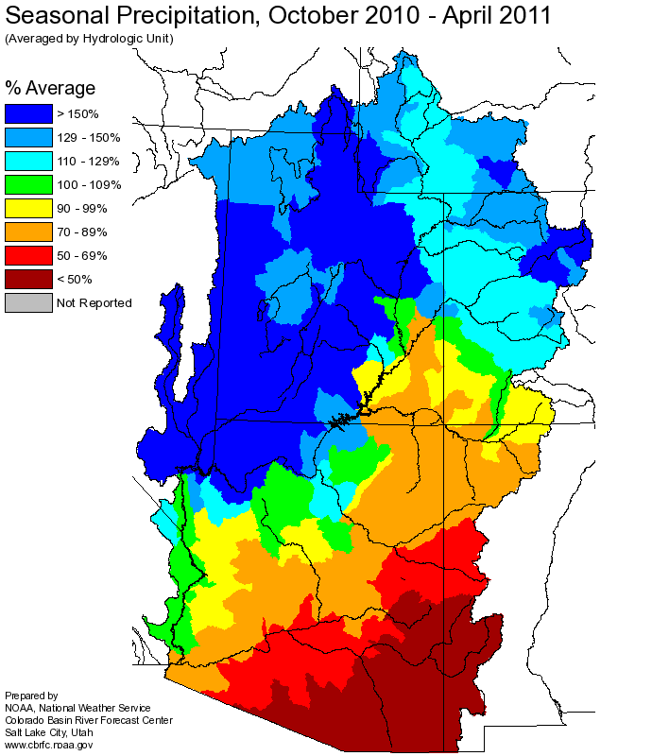
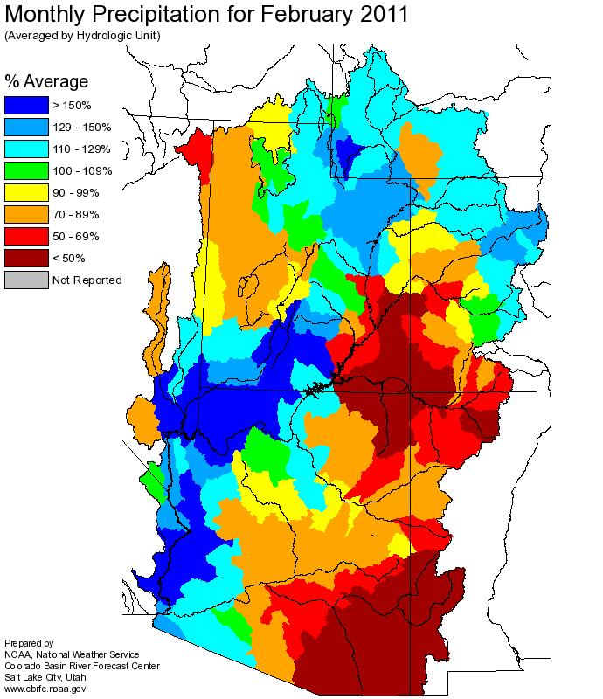
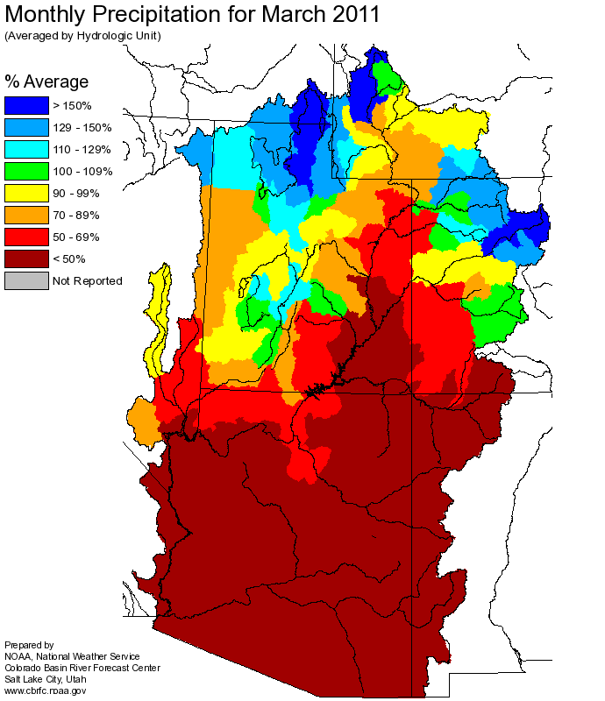
Web Reference: http://www.cbrfc.noaa.gov

Slide 4
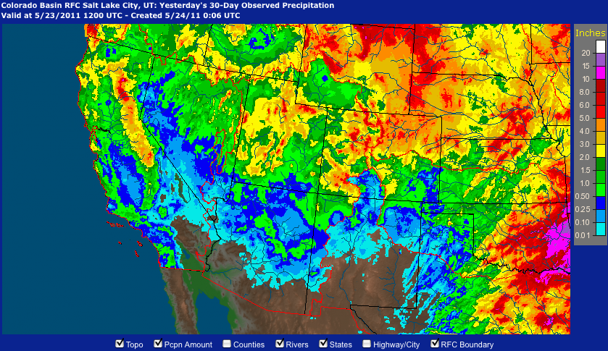
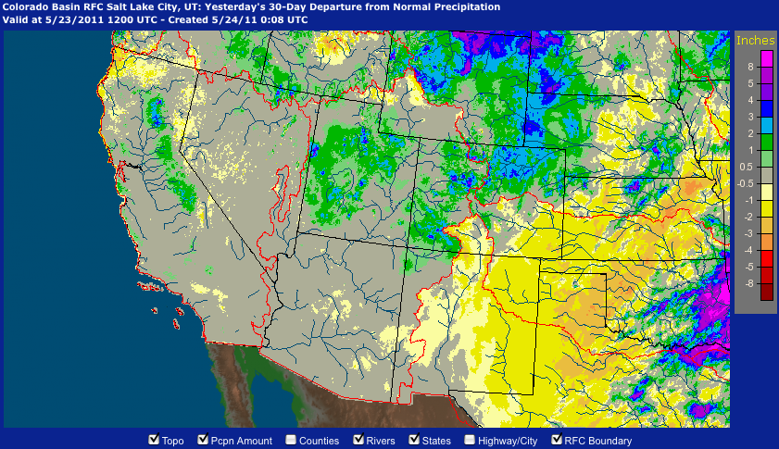
Precipitation
April 25 – May 23
Web Reference: http://water.weather.gov/precip

Slide 5
Temperature

Slide 6
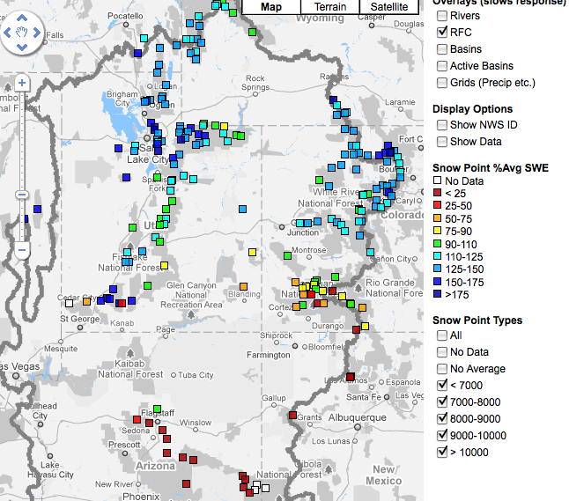
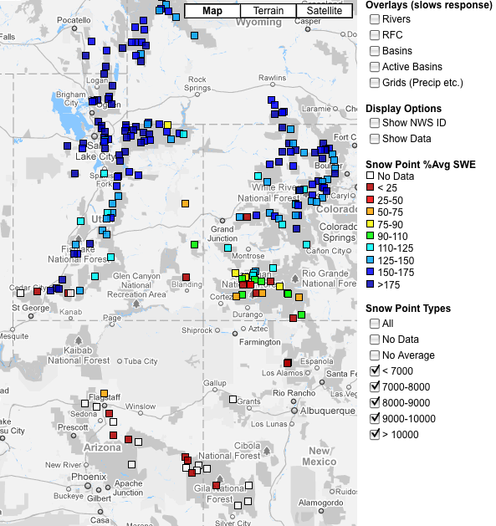
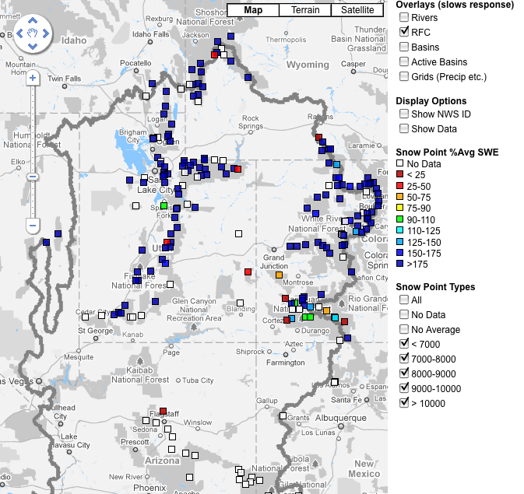
Snow
April 7 April 27 May 24
Web Reference: http://www.cbrfc.noaa.gov/gmap/gmapm.php?scon=checked

Slide 7
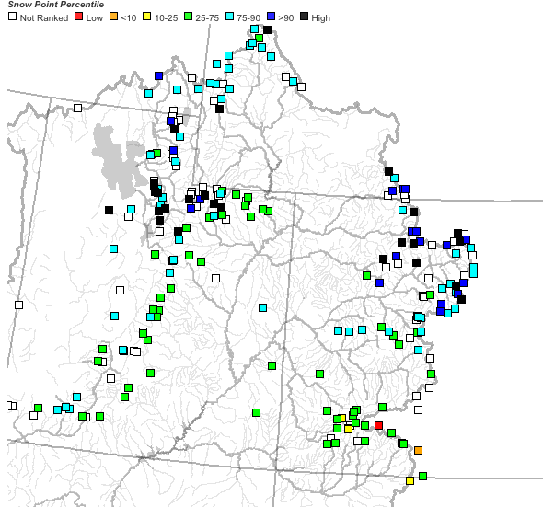
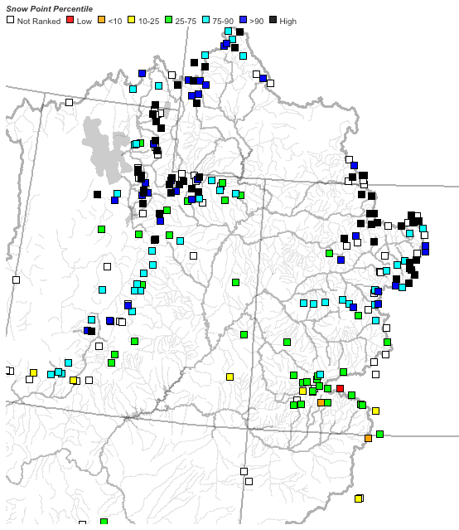
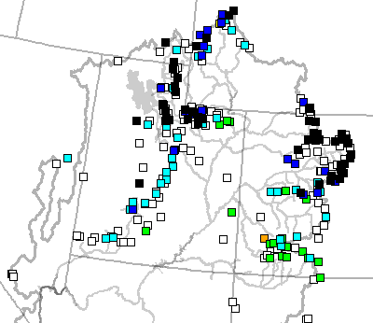
April 7 April 27 May 24

Slide 8
95 sites showing highest value for today!!

Slide 9
229 sites with 10+ years of record; 71/229 or 31% of sites with daily record

Slide 10
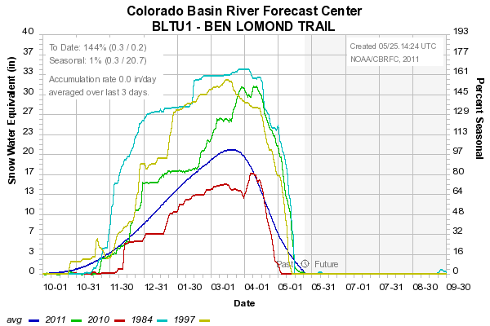
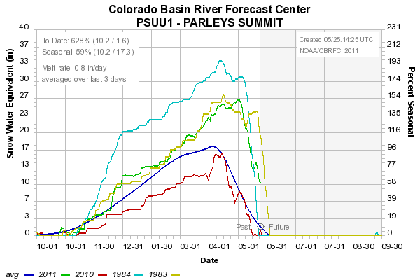
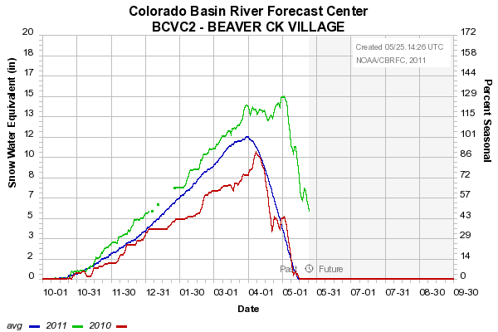
Sites below ~8500’
Very significant melt
8000’
7500’
8400’

Slide 11
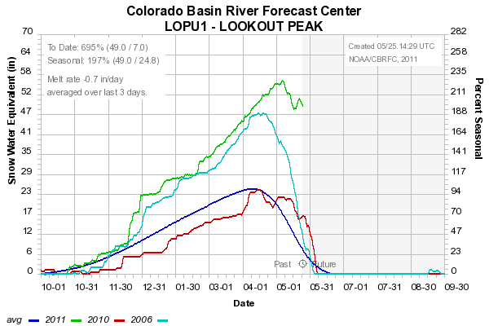
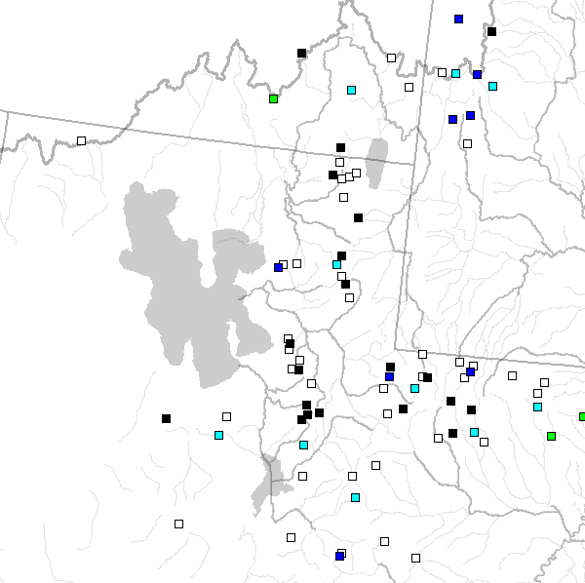
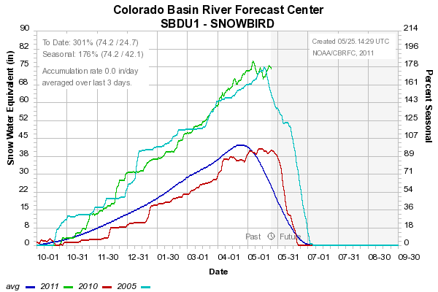
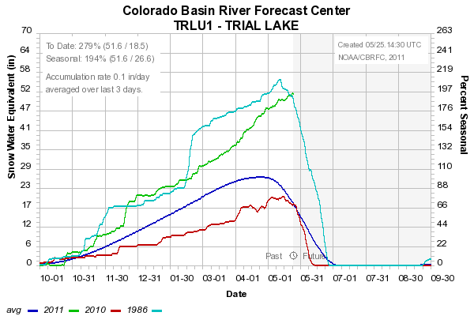
8200’
9600’
8400’
Sites above 8000’: Peaking? Starting to melt?

Slide 12
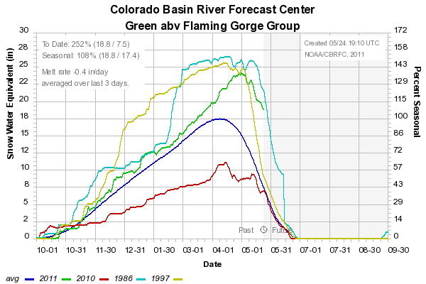
Snow:
Upper Green Basin (above Flaming Gorge)
Web Reference: http://www.cbrfc.noaa.gov/station/sweplot/sweplot.cgi???open

Slide 13
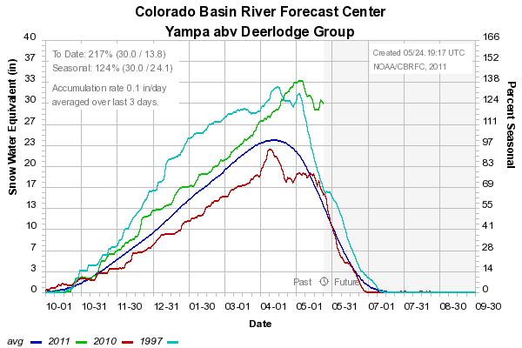
Snow:
Yampa
Web Reference: http://www.cbrfc.noaa.gov/station/sweplot/sweplot.cgi???open

Slide 14
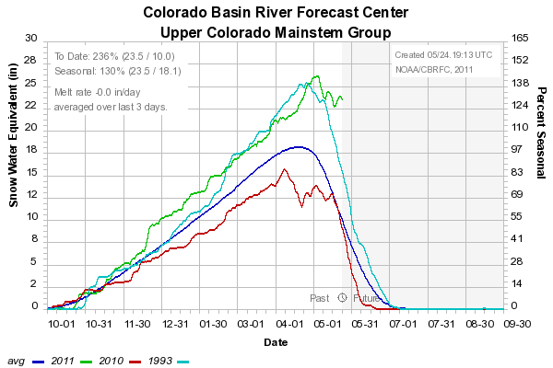
Snow:
Colorado Mainstem (above Cameo)
Web Reference: http://www.cbrfc.noaa.gov/station/sweplot/sweplot.cgi???open

Slide 15
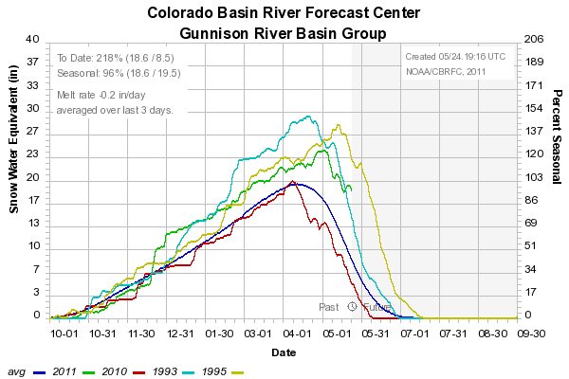
Snow:
Gunnison Basin
Web Reference: http://www.cbrfc.noaa.gov/station/sweplot/sweplot.cgi???open

Slide 16
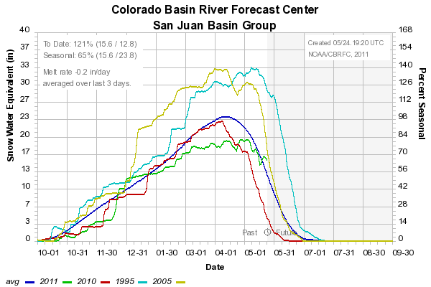
Snow:
San Juan Basin
Web Reference: http://www.cbrfc.noaa.gov/station/sweplot/sweplot.cgi???open

Slide 17
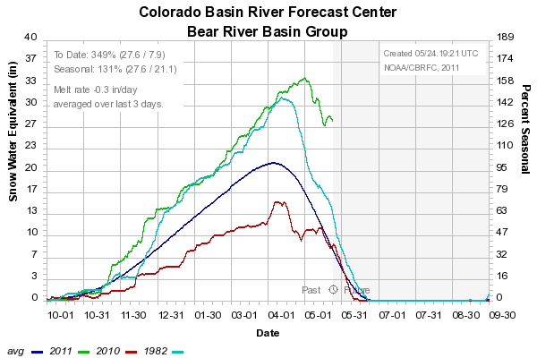
Snow:
Bear River Basin
Web Reference: http://www.cbrfc.noaa.gov/station/sweplot/sweplot.cgi???open

Slide 18
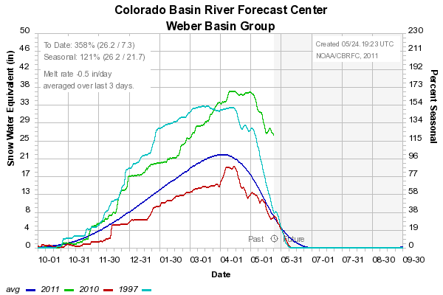
Snow:
Weber River Basin
Web Reference: http://www.cbrfc.noaa.gov/station/sweplot/sweplot.cgi???open

Slide 19
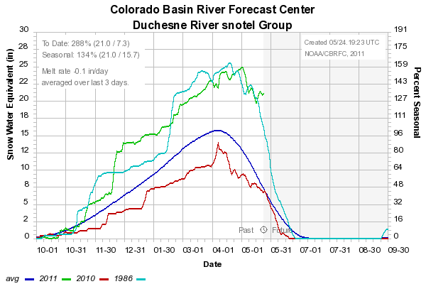
Snow:
Duchesne River Basin
Web Reference: http://www.cbrfc.noaa.gov/station/sweplot/sweplot.cgi???open

Slide 20
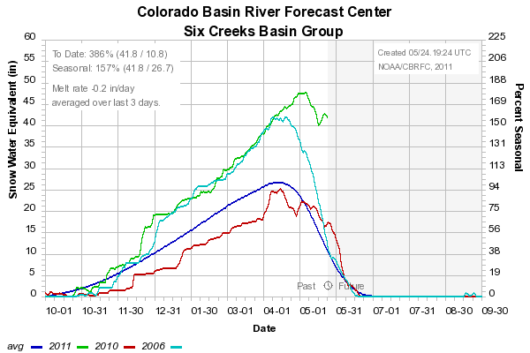
Snow:
Six Creeks in Salt Lake County
Web Reference: http://www.cbrfc.noaa.gov/station/sweplot/sweplot.cgi???open

Slide 21
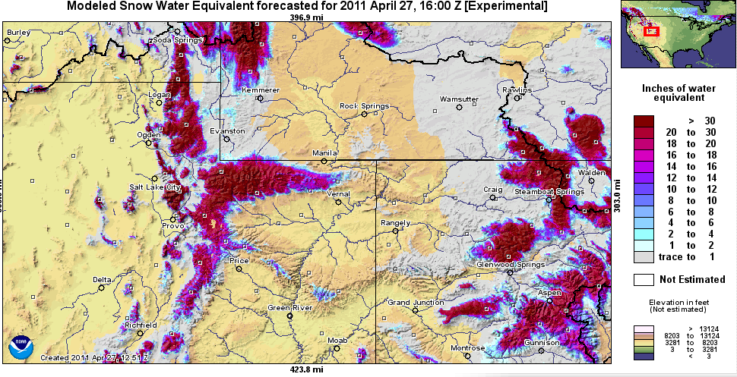
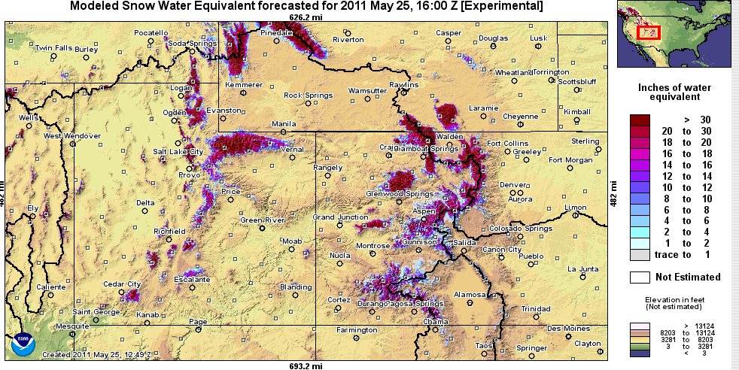
Snow Maps
Web Reference: http://www.nohrsc.nws.gov

Slide 22
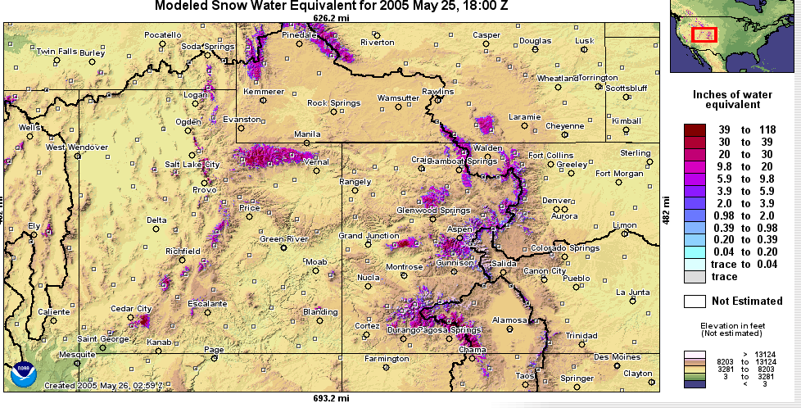
Snow Maps
Web Reference: http://www.nohrsc.nws.gov

Slide 23
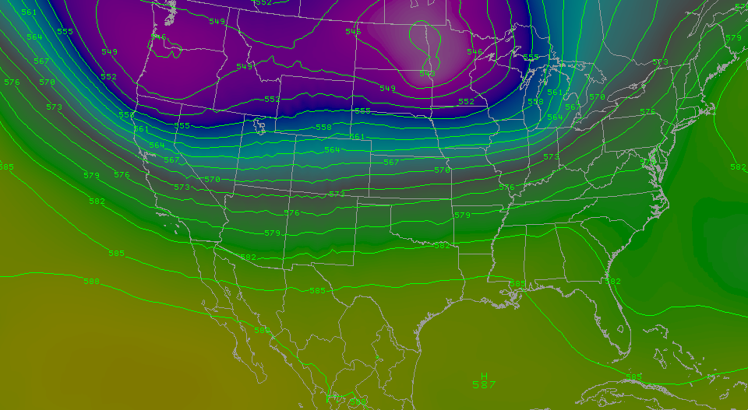
Weather Forecast:
Memorial Day Weekend
Two cold fronts moving through the area:
Thursday
Sat/Sun
Cool but mostly dry conditions over the weekend

Slide 24
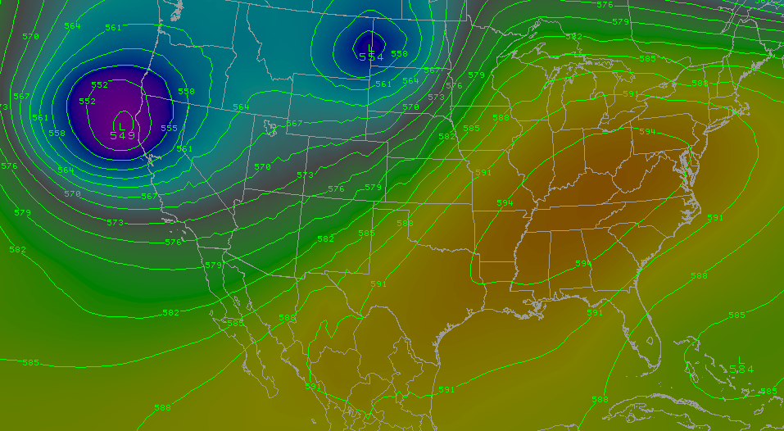
Weather Forecast:
Next Week
Major ridge developing over eastern US and trough over west coast
Warming over Colorado and Utah
Likely more warming over CO than UT
Forecast will evolve over next couple days… stay tuned.

Slide 25
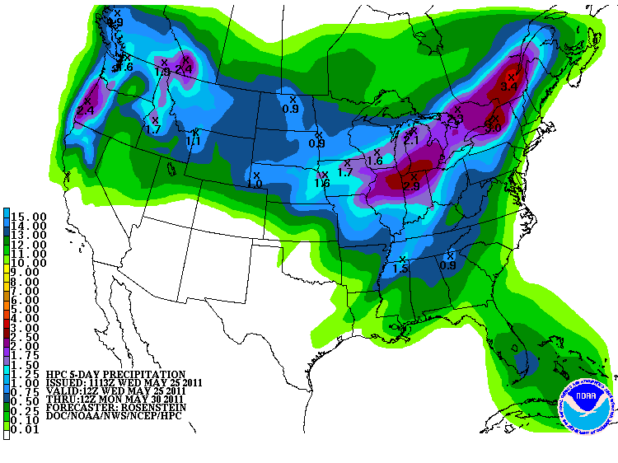
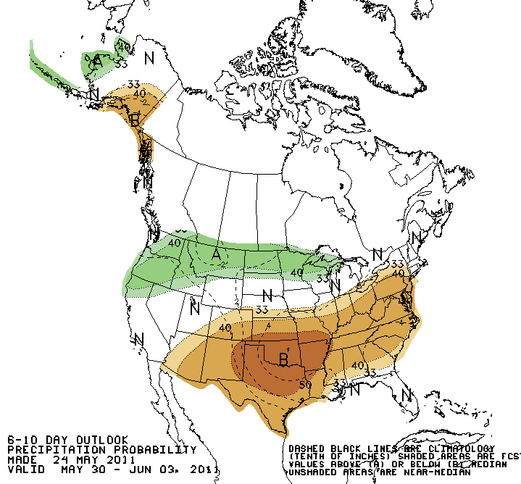
Forecast Precipitation
Cool – but fairly dry - weather pattern for the next 5 days
Then warming
Web Reference: www.hpc.noaa.gov

Slide 26
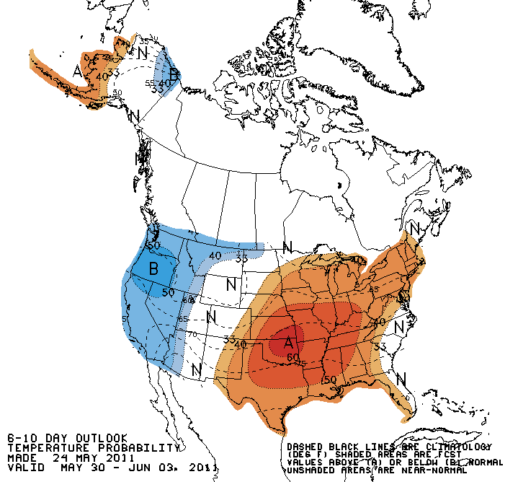
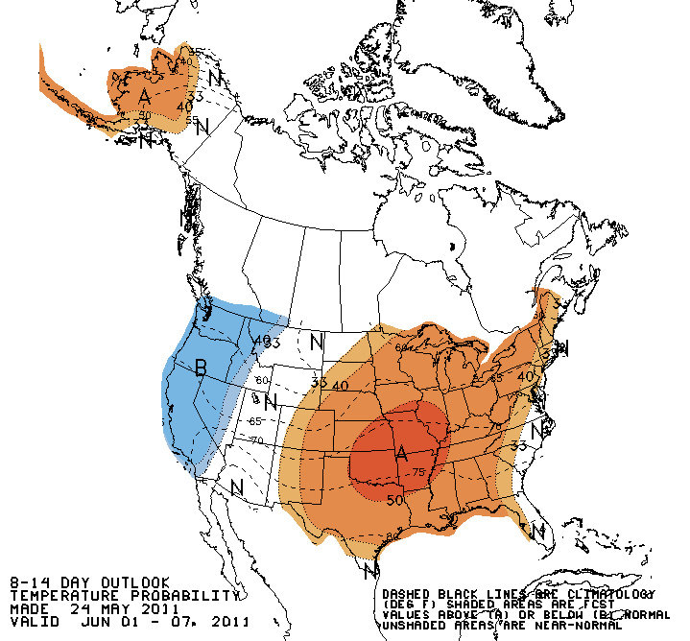
Forecast Temperature

Slide 27
Soil Moisture

Slide 28
What is a Peak Flow Forecast?
Snowmelt Mean Daily Maximum Flow (April-July)
Probabilistic Forecasts
  Exceedence Probabilities -10%,25%,50%, 75%, 90%
Issued (at least) monthly from March-June (this year weekly starting April 19)
~60 forecast points – some unregulated, some regulated
Updated as needed
Forecast Users include:
  Emergency Managers
  USGS hydrologists
  Water Managers
  River Recreation

Slide 29
Spring Weather Really Matters
Runoff characteristics are largely determined by the day-to-day spring weather.
  While large snow pack years increase chances for flooding, it is not an inevitability
  Small snow pack years (like last year) can flood with the right sequence of spring temperatures

Slide 30

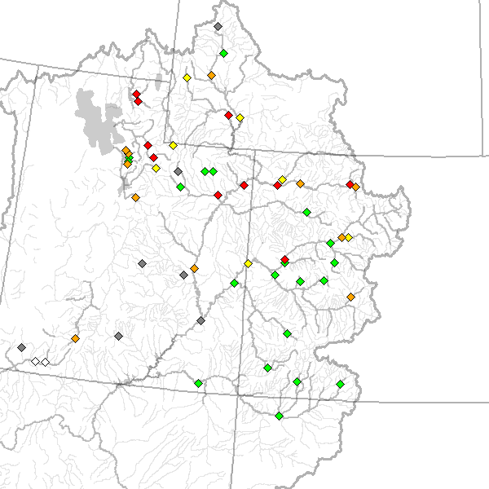
May 24 Peak Flow Forecasts
April 26 Forecasts
May 24 Forecasts

Slide 31
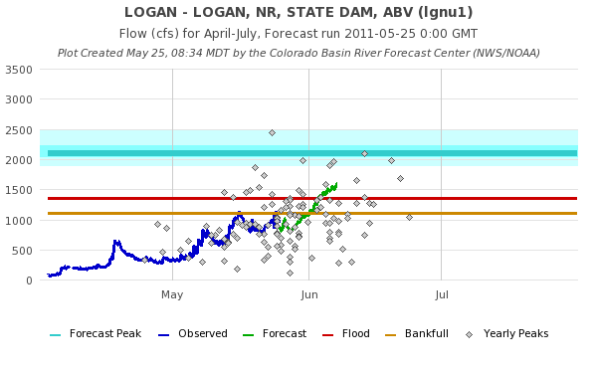
Peak Flow Charts
Long lead peak forecast
Observed streamflow since April 1
Daily forecast
web reference: www.cbrfc.noaa.gov/gmap/gmap3.php

Slide 32
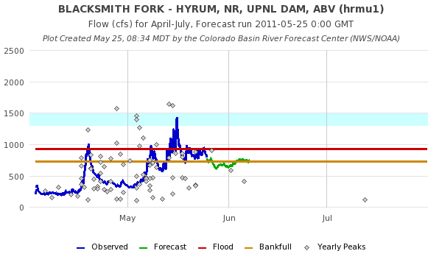

Slide 33
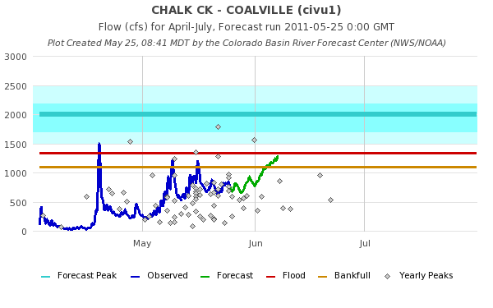
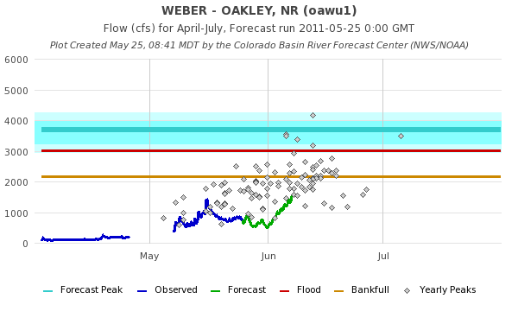

Slide 34
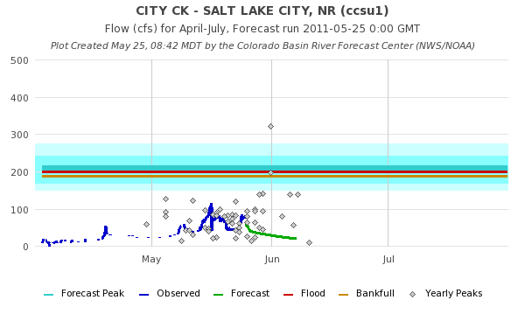
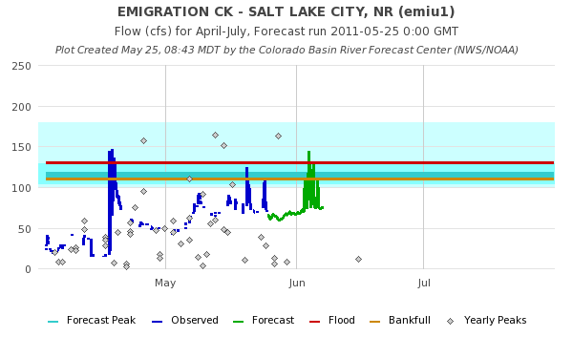

Slide 35
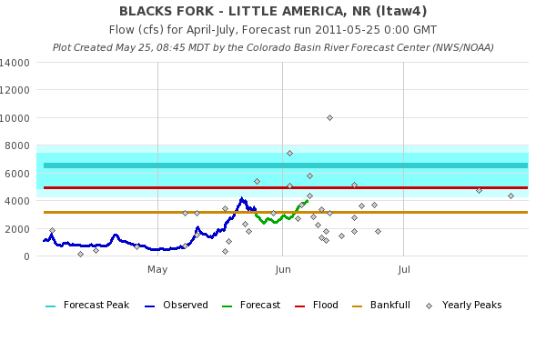


Slide 36



Slide 37



Slide 38



Slide 39



Slide 40



Slide 41



Slide 42



Slide 43


Streamflow Ensemble Forecast
Temperature Ensemble Forcing

Slide 44

Peak Flow Publication
New: Instantaneous Flow Forecasts!

Slide 45
June Flooding Probable
Area of greatest concern is northern Utah and northwestern Colorado rivers (see map)
First two weeks of June are critical
Flood likelihood increased over May as cool, wet weather prevailed
Flooding will likely also occur on rivers and streams without forecasts
and/or gauges
Click for More information

Slide 46

May 1, 2011
Water Supply Forecasts
Highlights:
Wet winter + April has led to significant rises in most forecasts
Web Reference: www.cbrfc.noaa.gov/gmap/gmapm.php?wcon=checked

Slide 47
Peak Flow Forecasts
Peaks are coming soon!!
Long lead peak forecasts will continue to be updated on Tuesdays until we capture peak flows in our daily forecasts. This could happen as soon as next week
Daily forecasts posted by ~10am MDT each (and updated later during the day). When temperatures are forecast to warm, please check here for the latest peak flow forecasts.
“beta” website developments:
  SNOTEL percentiles
  Simplified peak flow chart
  Publication referencing forecasts above historic peaks
  New peak flow forecast points added
Discussion:
  Anything else you need??
  One more webinar?

Slide 48

CBRFC News
Basin Focal Points (Available to discuss forecasts: 801.524.5130)
  Upper Colorado: Brenda Alcorn
  Green: Ashley Nielson
  San Juan / Gunnison: Tracy Cox
  Great Basin: Brent Bernard
  Lower Colorado (below Lake Powell): Greg Smith

Slide 49


Feedback, Questions, Concerns always welcome….
Kevin Werner
CBRFC Service Coordination Hydrologist
Phone: 801.524.5130
Email: kevin.werner@noaa.gov

