Slide 1

Reclamation Mid-Term Operational Modeling
Seasonal to Year-Two Colorado River Streamflow Prediction Workshop
CBRFC March 21-22, 2011
Katrina Grantz, PhD
Upper Colorado Region Hydraulic Engineer

Slide 2
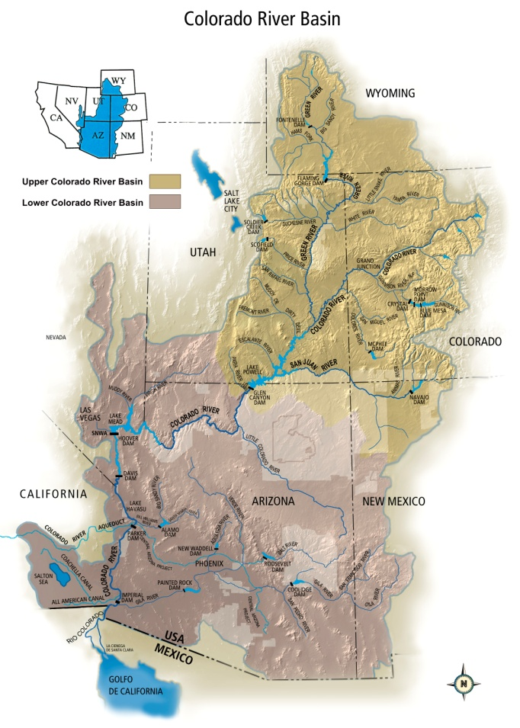
Reclamation Operational Modeling
Overview
“Mid-Term” operations for the Colorado River
  Operations of major reservoirs in the monthly to 2-year and beyond timeframe
2 operational models
  24-Month Study (deterministic, official)
  Mid-Term Ops Model (probabilistic,
  additional analysis)

Slide 3
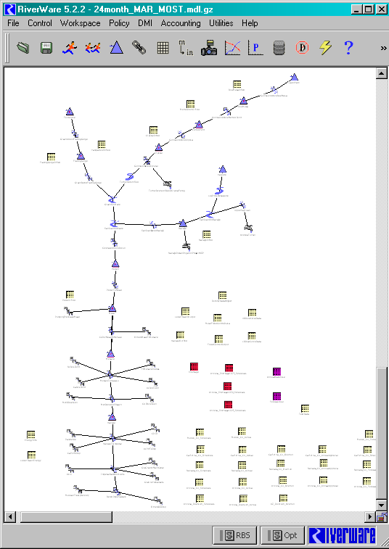
24-Month Study
Reservoir Operations
  12 major reservoirs (9 UB, 3 LB)
Monthly timestep, ~2 years, updated monthly
Used for best guess at mid-term reservoir conditions (storage, elevation, release, hydropower)

Slide 4

24-Month Study: “Official model”
Annual Operating Plan (AOP) for all reservoirs
Determines operating tier for Lake Powell
  August run of the 24-Month Study (sometimes April)
Official model projection for determining Lower Basin shortages
  Secretary declares a shortage

Slide 5
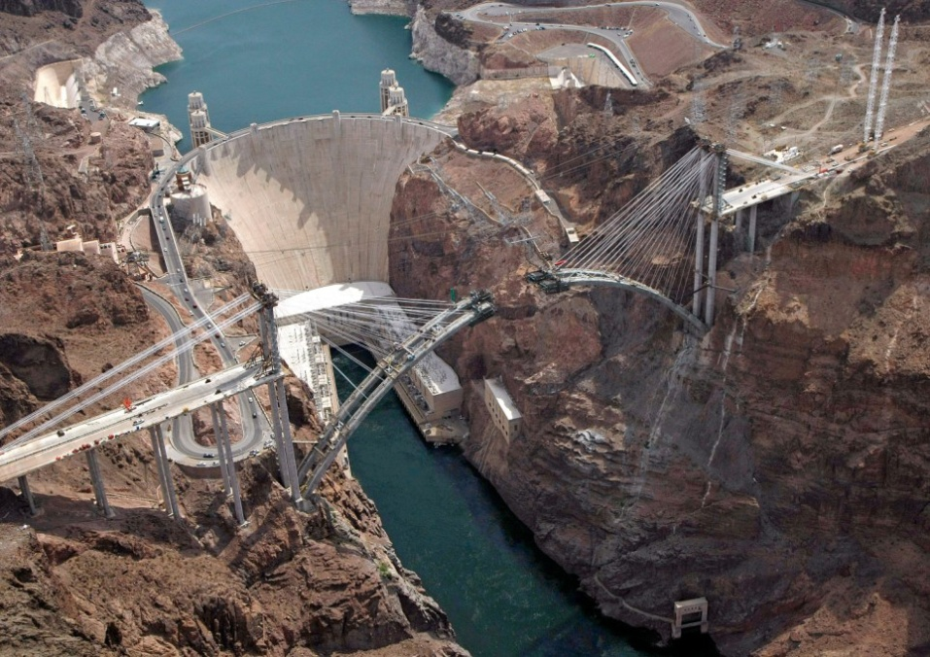
3 categories of model assumptions
Inflows
Reservoir operations
Demands

Slide 6

24 Month Study: Inflows
Upper Basin
Forecasted inflows issued by RFC/NRCS
Unregulated inflow
1 trace
  (3 if min/max month)
Lower Basin
5-year average for side inflows

Slide 7
24-Month Study: UB Inflows and Model Run Duration (Most Probable)

Slide 8
24-Month Study: UB Inflows and Model Run Duration (Max/Min Prob)

Slide 9
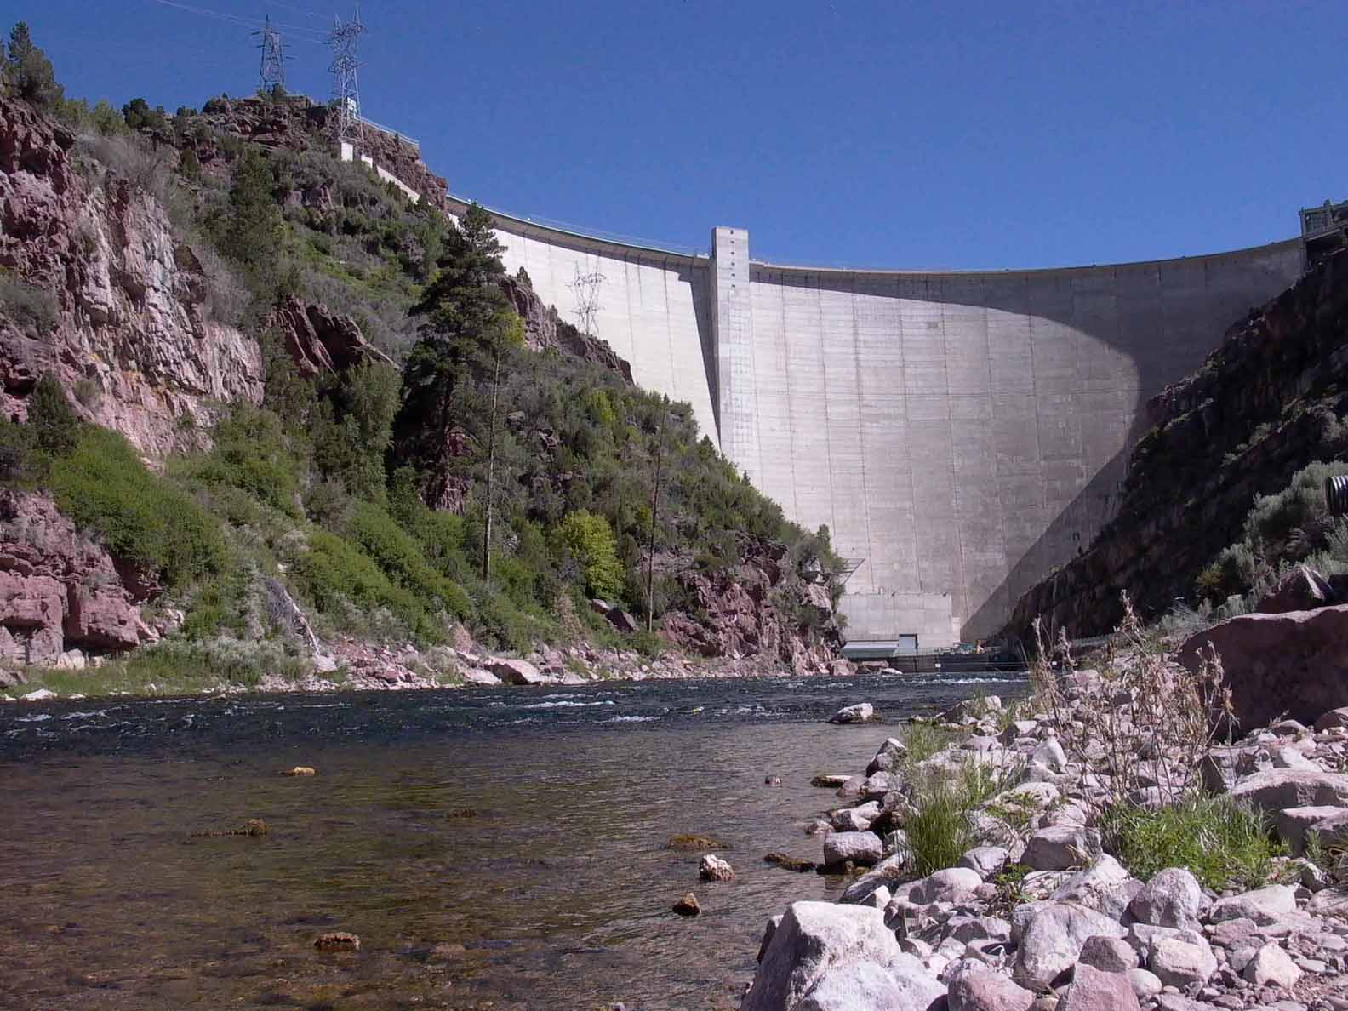
24-Month Study: Reservoir Operations
Up-to-date operations input by reservoir operators each month
  Manual process: for each reservoir evaluate inflows, set releases,
  re-evaluate (sometimes
  an iterative process)
  Coordination between
  Powell and Mead
Notes:
Maintenance issues, power issues, not represented in CRSS

Slide 10
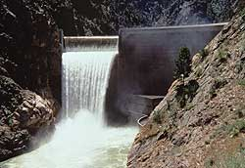
24-Month Study: Demands
Upper Basin
Implicit in unregulated inflow forecast
  Based on assumptions in RFC models (consider historic and current use patterns)
  Adjusts for wet/dry years
Lower Basin
Actual approved water orders for
the year
  adjusted for ICS, paybacks, etc

Slide 11
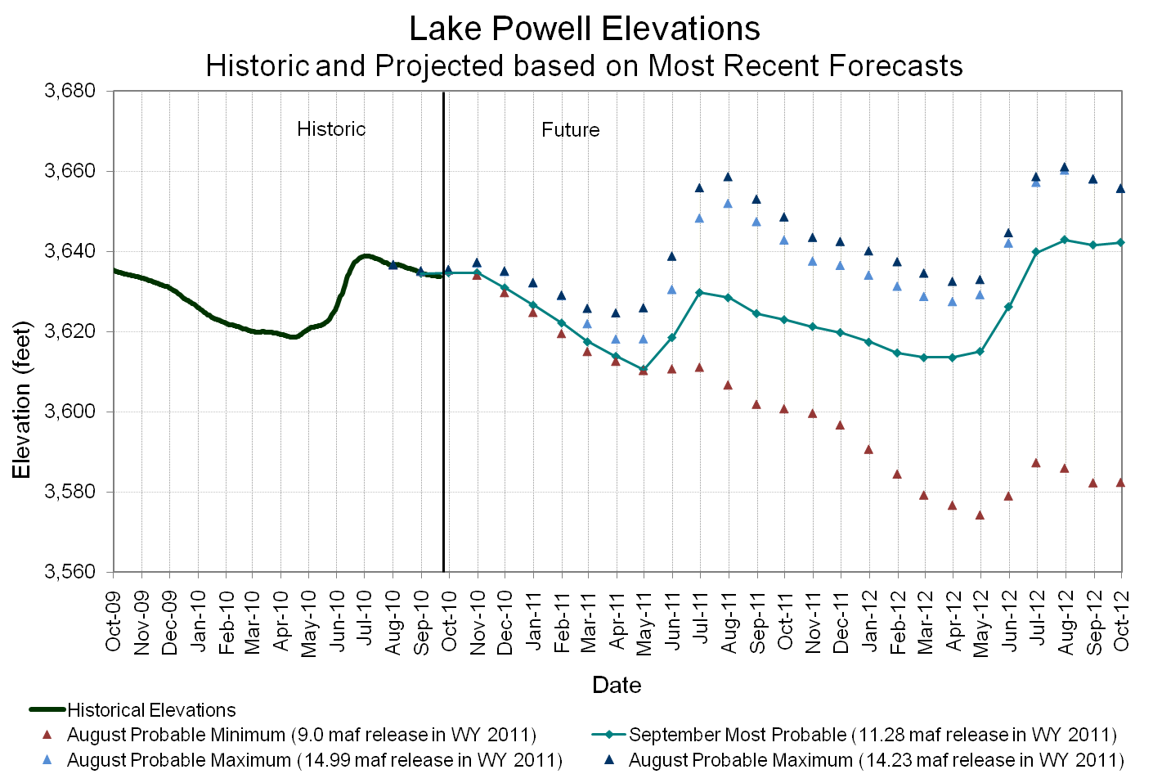
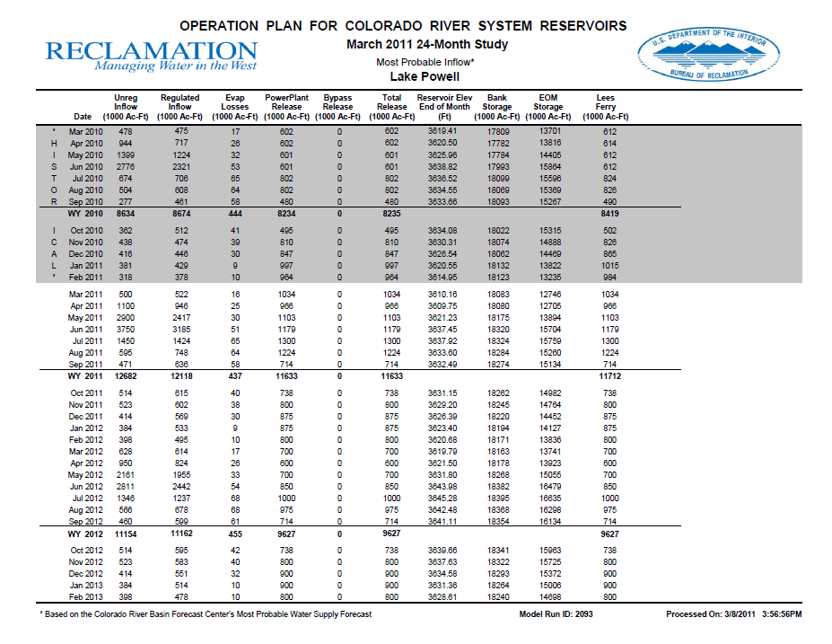
24-Month Study: Output
AOP (written document)
24-Month Study Report (mostly tabular data), monthly update to the AOP

Slide 12
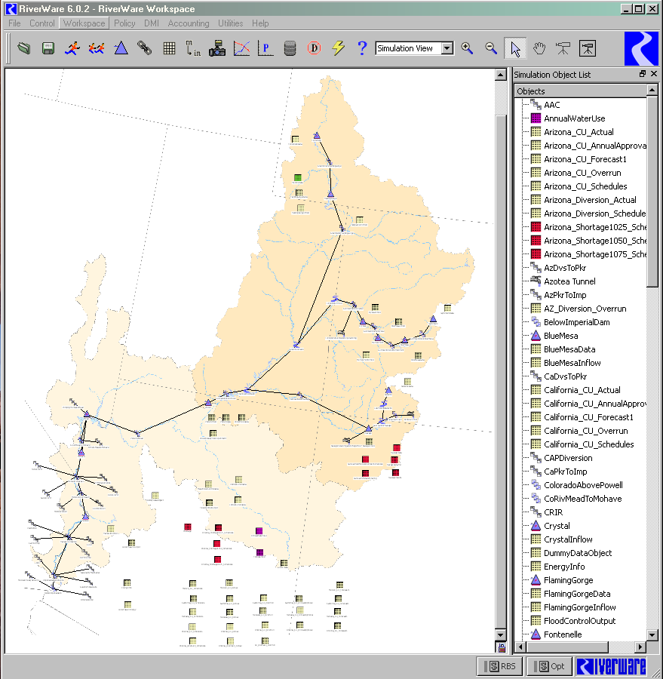
Mid-Term Operations Model
Motivation
24-Month Study currently a deterministic model
  Upper Basin driven primarily by
  most probable inflow forecast
  Lower Basin driven by scheduled
  demands
Need to better quantify range
of possible operations in the
Colorado River Basin
Notes:
E.g., the reasonable max inflow scenario does not translate to the reasonable max elevation

Slide 13
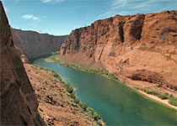
Mid-Term Operations Model
Model currently in development
Based on current 24-Month Study model
Accomodates ensemble forecast rather than most probable inflow forecast
Uses “rules” (prioritized logic) to
set UC reservoir releases rather
than manually set by operators

Slide 14
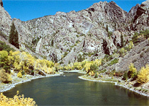
Mid-Term Operations Model
Inflows
Model input is range of probable inflows
  CBRFC’s ESP forecasts (30 traces) will drive first and second years of model
  Ongoing research to develop
  forecasting techniques for
  beyond 2 years (2-10 yrs)

Slide 15
Mid-Term Operations Model
Inflows
Model currently uses unregulated inflow ESP forecasts
  Depletions are implicit in the forecast
Eventually want to move to natural inflow
  Explicitly model water use

Slide 16
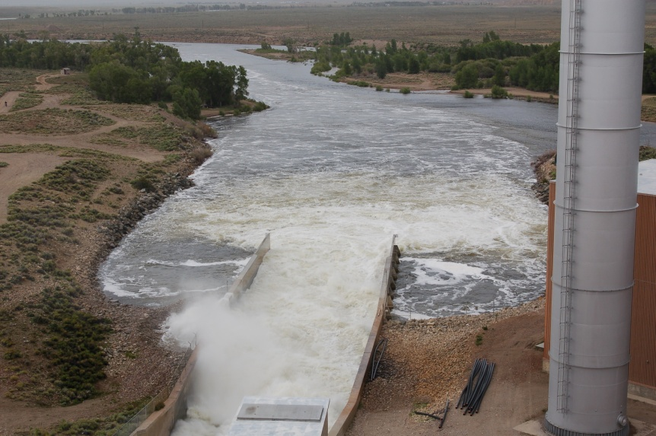
Mid-Term Operations Model Operations
Rules have been written, tested, and verified to set releases for all upper basin reservoirs
Good exercise, added documentation, transparency
Lower basin reservoirs are demand driven
  No new rules needed to
  be written
Notes:
Currently, UC operators manually input operations (releases) into the 24-Mo Study model

Slide 17
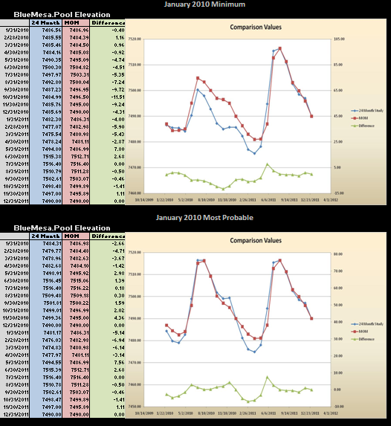
Mid-Term Probabilistic Ops Model Model validation
Compared 24-MS official results against MTOM to verify reservoir rules
Evaluated min, most, max model runs for months in 2010
Evaluated elevations and releases using
Notes:
Currently, UC operators manually input operations (releases) into the 24-Mo Study model

Slide 18
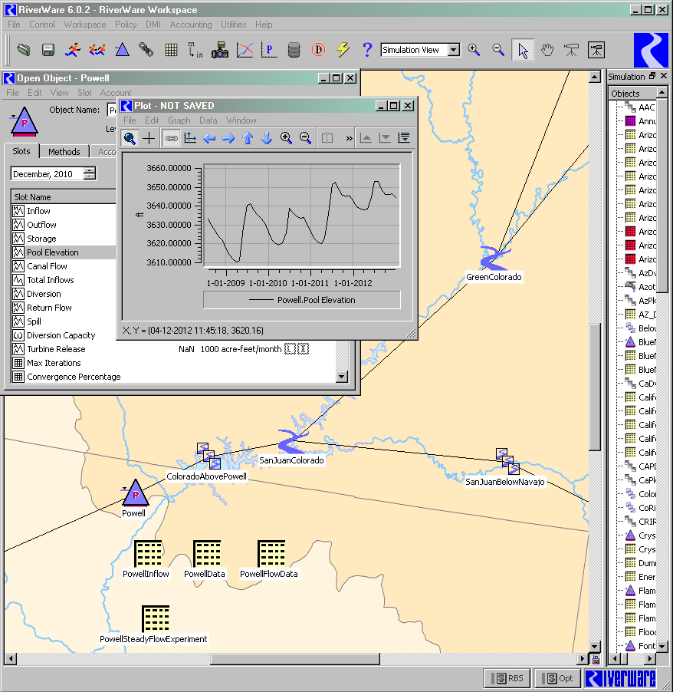
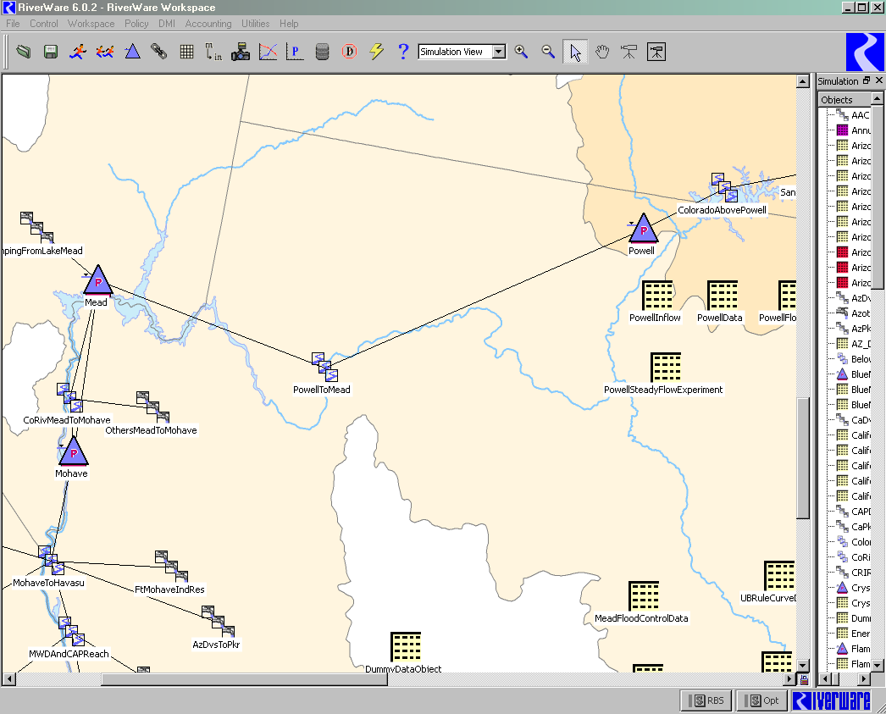
Mid-Term Operations Model

Slide 19
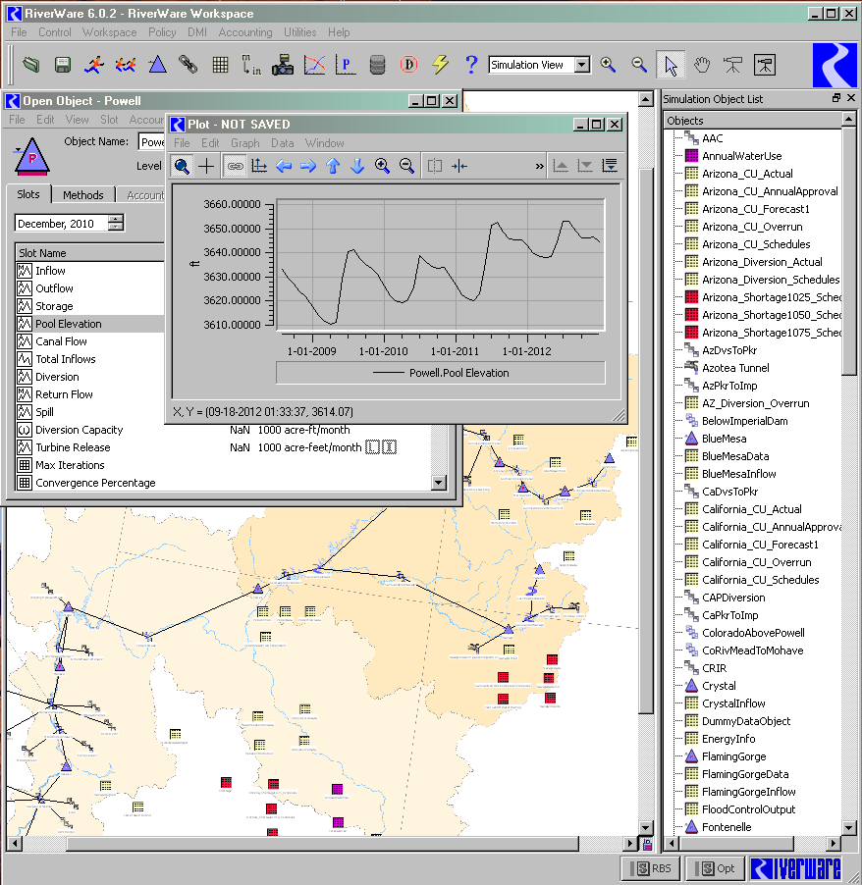
Mid-Term Operations Model

Slide 20
Mid-Term Operations Model

Slide 21
Questions we hope to better answer…
Back-to-back 8.23 years? Probability of equalization next year? Balancing? Shortage? What about two years out?
Notes:
We’re getting much more complex questions now…

Slide 22
Mid-Term Ops Model: Expected Output
Probabilistic information and plots
  Range of reservoir elevations
  Range of reservoir releases
  Probability of equalization
  Probability of lower basin shortages

Slide 23
Colorado River Hydrology Workgroup
Research to improve Reclamation’s operations and planning on Colorado River
Focus on “applied” research

Slide 24
Extra Slides Follow

Slide 25
Regulated Inflow vs. Unregulated Inflow

Slide 26
ESP run – CDF Powell WY Release

Slide 27
Probability of Equalization Estimate
Current Methodology

Slide 28
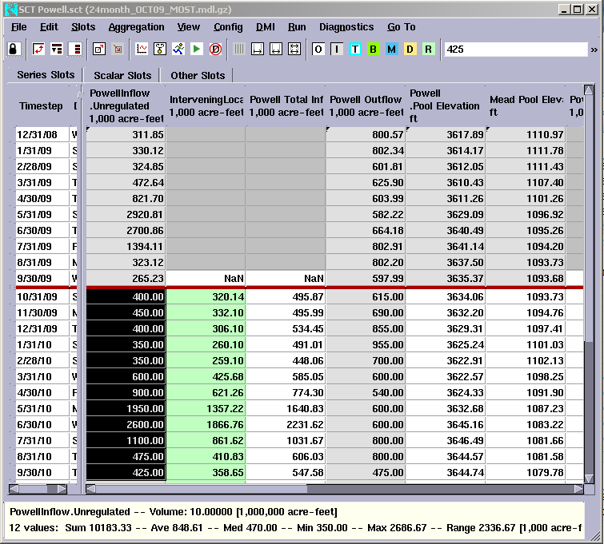

Slide 29
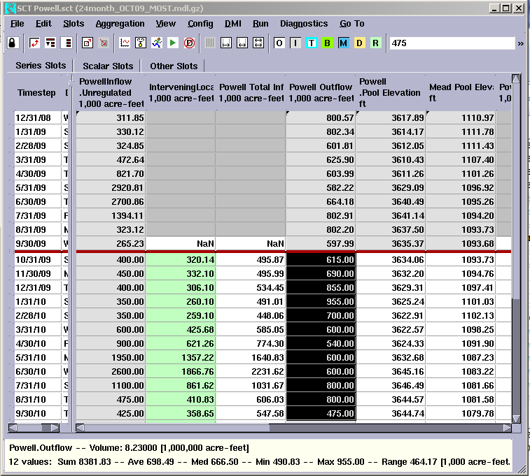

Slide 30


Slide 31
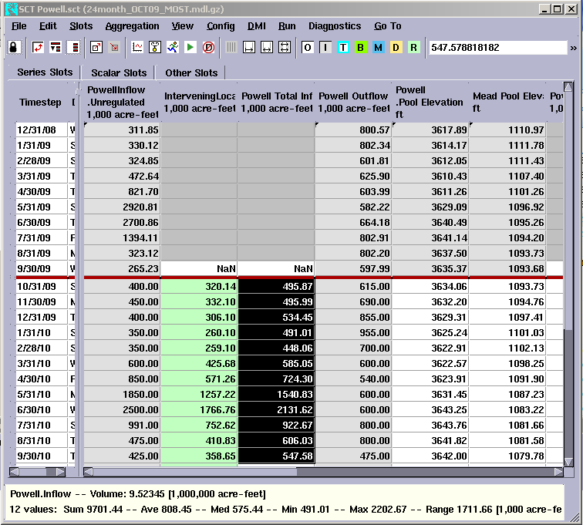

Slide 32
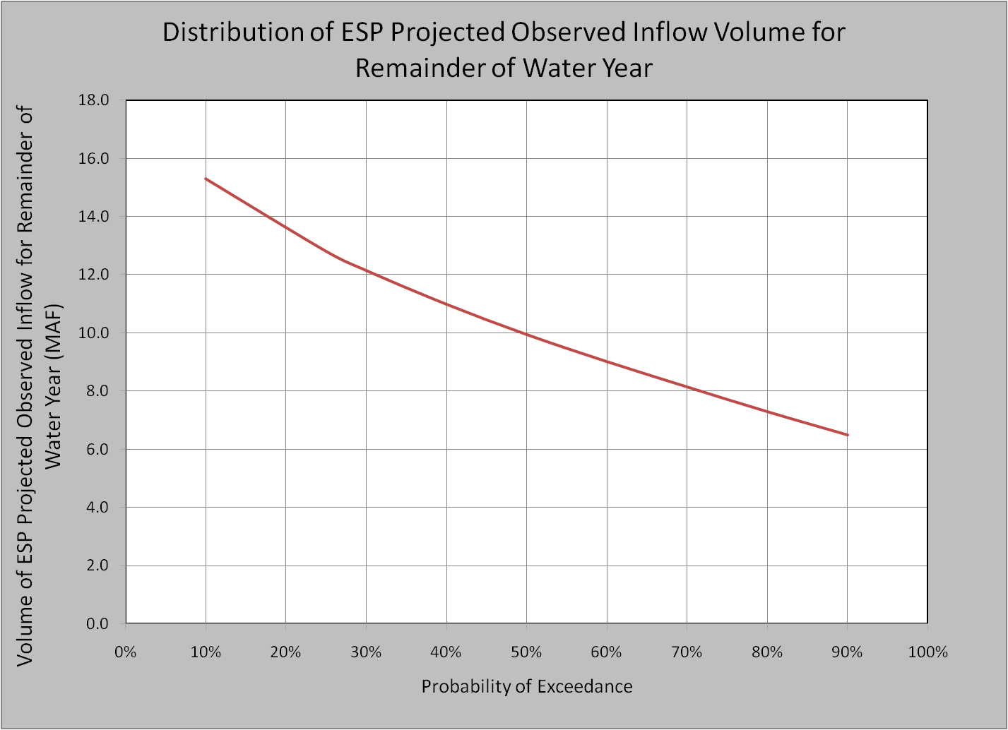
Distribution of Observed Inflow Volumes for Remainder of WY (Provided by RFC and Based on ESP Model Output)
9.52 MAF
Volume determined from October 2009 Most Probable 24-Month Study. Volume required to trigger Equalization in WY2010
55% Probability of Equalization

Slide 33
Additional Analysis Request
SWE → Equalization

Slide 34
Upper Basin SWE → Powell Unregulated Inflow
Significant error in April 1st SWE – Inflow relationship
Need this info well before April

Slide 35
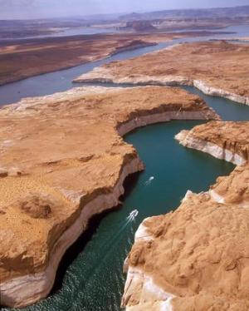
What we can provide:
Regulated inflow volume that would likely trigger equalization
  % of average inflows to Powell
  that (if forecasted in April)
  could trigger equalization
Stakeholders can relate
that to other variables

Slide 36
Additional Analysis Request
24-Mo Study out-year min and max

Slide 37
Min and Max Runs - Current Practice
Run in August, October, January, April
Min and Max probable inflows for current
year only
  Current year: 10th and 90th percentile official unregulated UB inflow forecast
  Out-year: average historic (1976-2005) UB inflows
  LB side inflows use 10th and 90th percentile of last 5 years (current year) and 5-yr avg (out-year)

Slide 38
Min and Max Runs - Request
Continue Min and Max probable analysis into the out-year
  Current year: 10th and 90th forecast
  Out-year: 25th and 75th of historic (1976-2005) inflows
Simulates dry year following
dry year and wet year
following wet year

Slide 39
Quick Analysis of Natural Flows
Considered bottom 10% and top 10% natural flow at Lee’s Ferry (1906-2007)
  Following year: wet, normal, or dry (terciles)?
Makes sense to take min/max analysis into out year (for more reasons than one…)
Dry → Dry Dry → Norm Dry → Wet | 6 (of 10) 2 (of 10) 2 (of 10)
Wet → Dry Wet → Norm Wet → Wet | 0 (of 10) 6 (of 10) 4 (of 10)
Notes:
25th and 75th percentile seem reasonable
Tentative plan to start doing this in August 2010

