Slide 1
Colorado River Basin
Long Lead Forecasting Research
Tom Piechota (UNLV)
Kenneth Lamb (UNLV)
Glenn Tootle (University of Tennessee)
Tyrel Soukup (University of Tennessee)
Oubeid Aziz (University of Tennessee)
U.S. Bureau of Reclamation
National Oceanic and Atmospheric Administration
National Science Foundation
Wyoming Water Development Commission

Slide 2
Recent Publications
Tootle, G.A., A.K. Singh, T.C. Piechota and I. Farnham, 2007. Long Lead-Time Forecasting of U.S. Streamflow Using Partial Least Squares Regression. ASCE Journal of Hydrologic Engineering, 12(5), 442-451.
Soukup, T., O.A. Aziz, G.A. Tootle, S. Wulff and T. Piechota, 2009. Long-lead Time Streamflow Forecasting of the North Platte River Incorporating Oceanic-Atmospheric Climate Variability. Journal of Hydrology, 368(2009), 131-142.
Aziz, O.A., G.A. Tootle, S.T. Gray and T.C. Piechota, 2010. Identification of Pacific Ocean Sea Surface Temperatures influences of Upper Colorado River Basin Snowpack. Water Resources Research, 46, W07536.
Lamb, K., T. Piechota, O. Aziz, G. Tootle, 2011. Establishing A Basis For Extending Long-Term Streamflow Forecasts In The Colorado River Basin. ASCE Journal of Hydrologic Engineering (In Press).

Slide 3
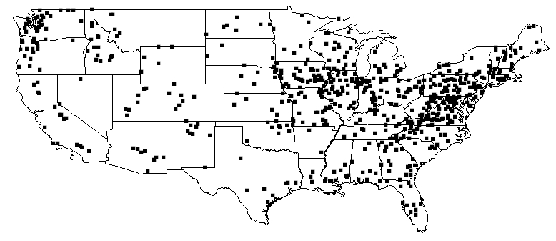
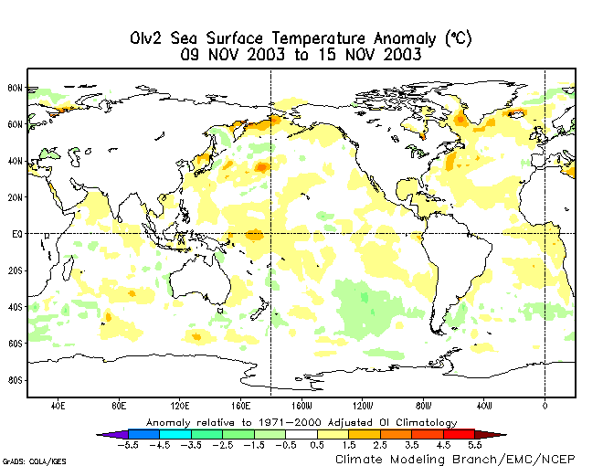
Long Lead-Time Forecasting of U.S. Streamflow Using Partial Least Squares Regression
(Journal of Hydrologic Engineering, 2007)
Data Sets
- Pacific & Atlantic Ocean Sea Surface Temperatures (SSTs)
1950 -2001
April – September of previous year (-)
- Continental U.S. streamflow from USGS Unimpaired data (1950 – 2002)
1951 – 2002
Water year volume
Methods
- Partial Least Squares Regression (PLSR)
- Based on optimized Principal Component Regression of two fields (SSTs and streamflow)
Contributions
- Skillful long lead-time forecast of continental U.S. streamflow using SSTs
- Calibration, Cross-validation and Uncertainty in model development

Slide 4
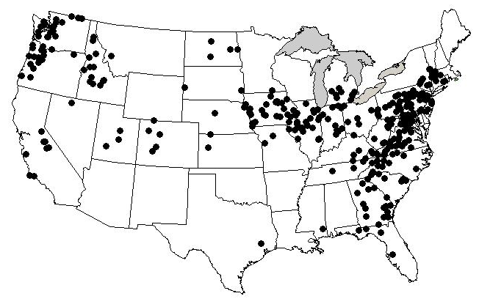
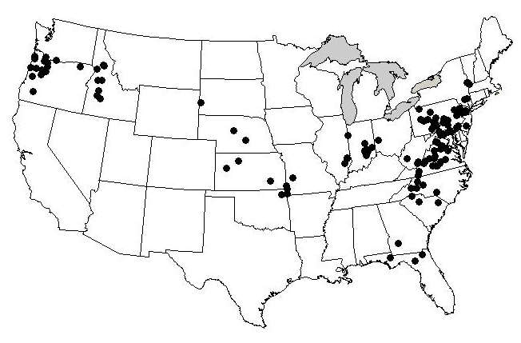
PLSR Calibration Model Results
(Leading April – September SSTs, Water Year Streamflow)
Pacific Ocean SSTs
Streamflow Stations
(R² > 0.80)
Upper Colorado River Basin
(White River)
Atlantic Ocean SSTs
Streamflow Stations
(R² > 0.80)

Slide 5
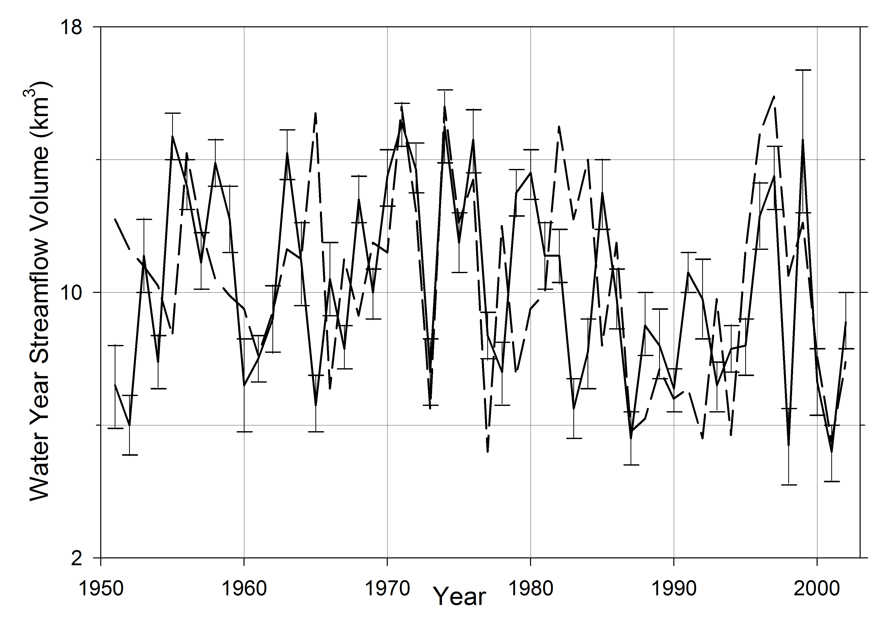
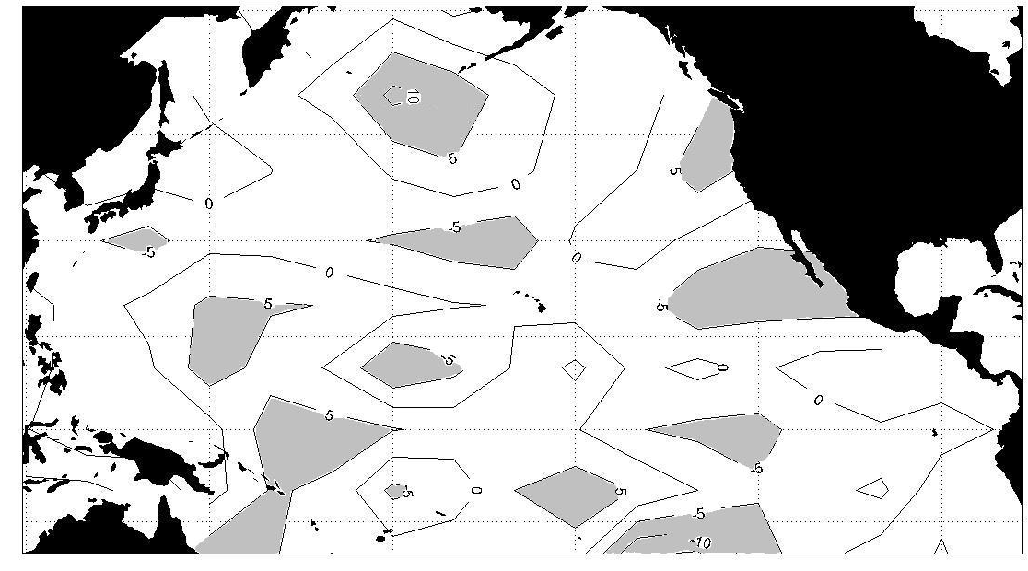
PLSR Cross-validation Model Results – White River

Slide 6
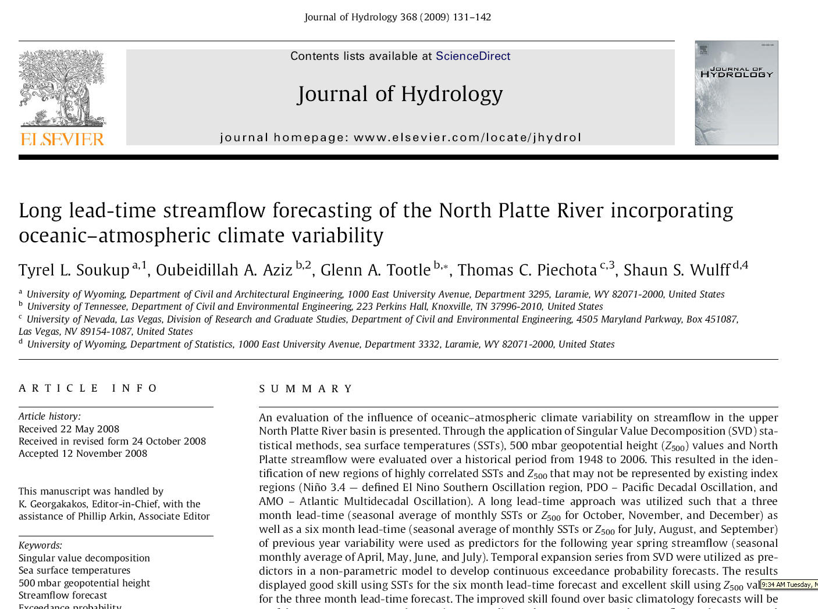

Slide 7
Long Lead-Time Streamflow Forecasting of the North Platte River Incorporating Oceanic-Atmospheric Climate Variability
(Journal of Hydrology, 2009)
Data Sets
- Pacific Ocean Sea Surface Temperatures (SSTs) and 500 mb geopotential heights
1948 -2006
July - September of previous year (-)
- North Platte River streamflow
1948 – 2006
April – July volume
Methods
- Singular Value Decomposition for diagnostics
- Non parametric exceedance probablity forecasts (Piechota et al., 2001)

Slide 8
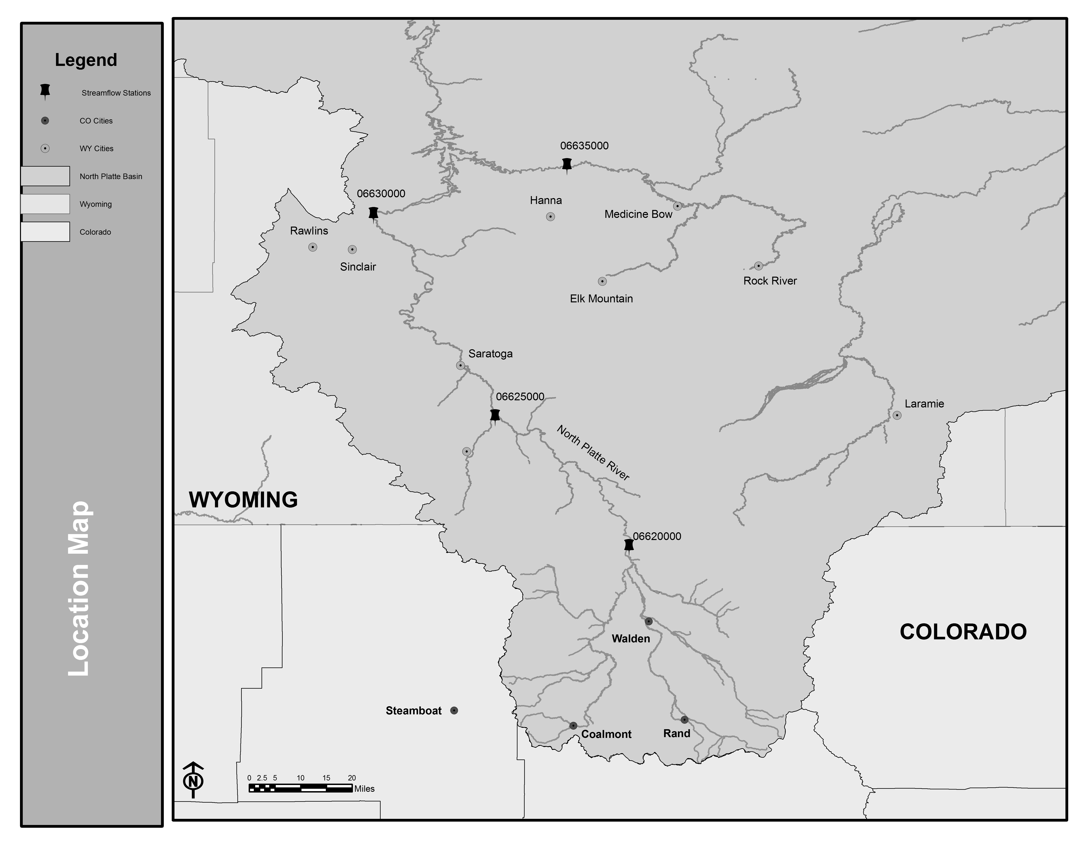

Slide 9
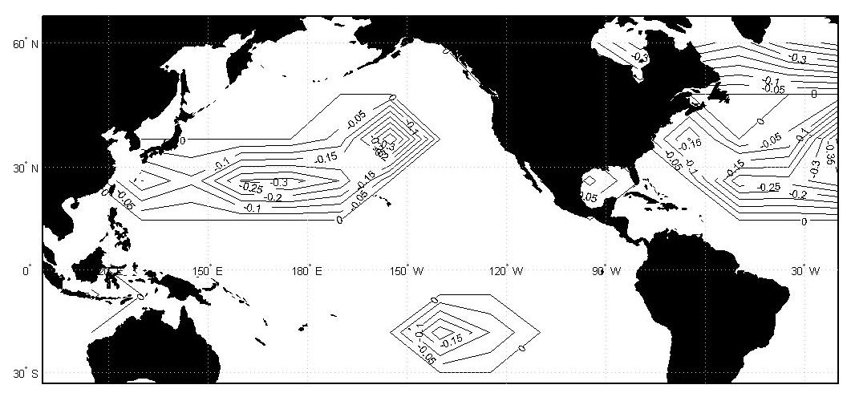
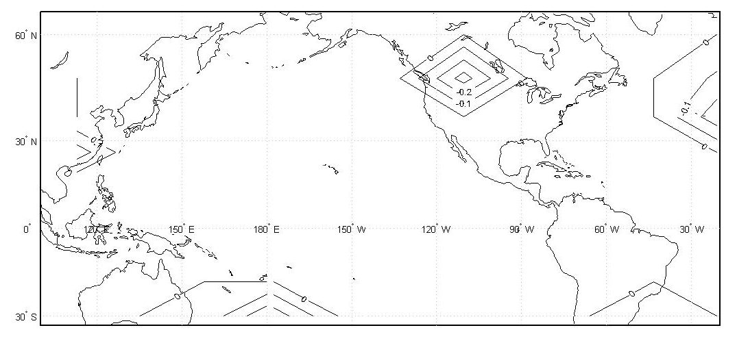
Results
SSTs
Figure 2: Heterogeneous correlation map showing significant SST regions as related to NPRB streamflow stations for JAS(-1) six month lead-time.
Z₅₀₀
Figure 4: Heterogeneous correlation map showing significant Z₅₀₀ regions as related to NPRB streamflow stations for OND(-1) three month lead-time.

Slide 11
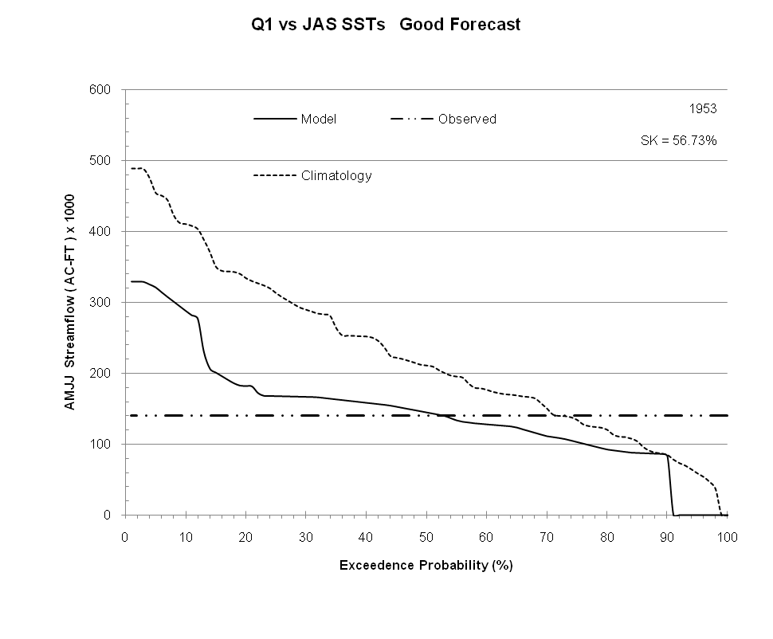
Streamflow Forecast Example
Example: 20% chance (80% risk) of exceeding 190,000 acre-feet (Average monthly volume summed for the 4 months of interest)
Research Question #3

Slide 12
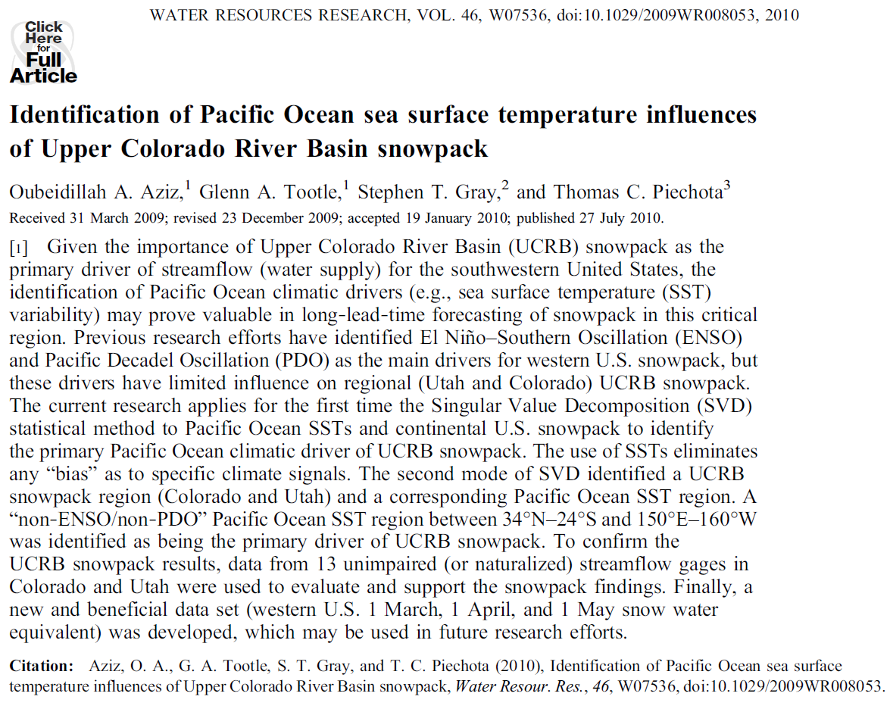
Research Question #1

Slide 13
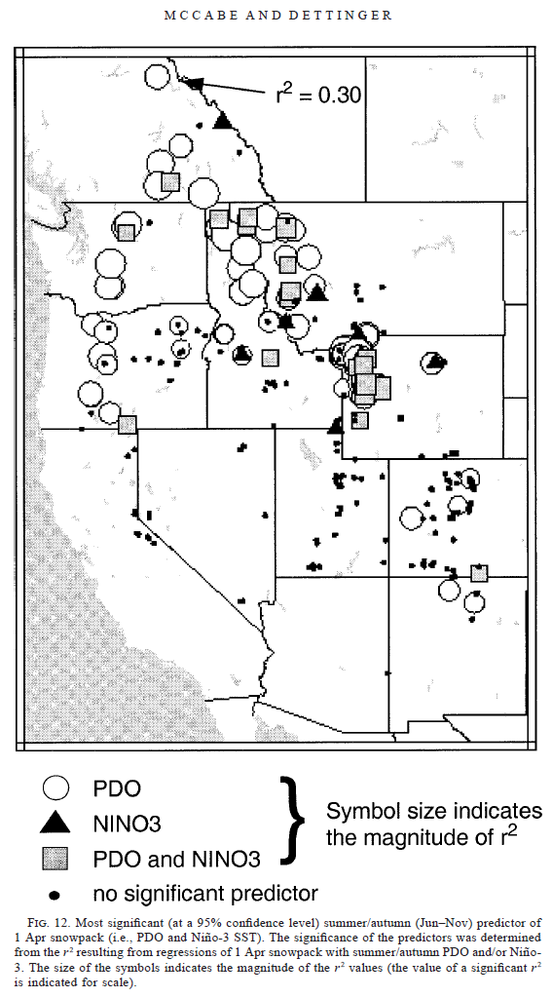
Upper Colorado River Basin (UT, CO) Snowpack
?
McCabe and Dettinger (2002)
Aziz et al. (2010)

Slide 14

0 – 2 Year Forecasting of Colorado River
Water Volume
Prepared by
Kenneth Lamb, Tom Piechota, Simon Wang,
Sajjad Ahmad, AJ Kahlra
14

Slide 15
Statistical Forecast Model
Support Vector Machine (SVM)
  Neural Network – Statistical Learning Model
  Inputs: Calendar year mean SOI, PDO, NAO, AMO
  Predictand: Following year precipitation
  Performance Measure: RMSE Standard Ratio of Deviation (RSR)

Slide 16
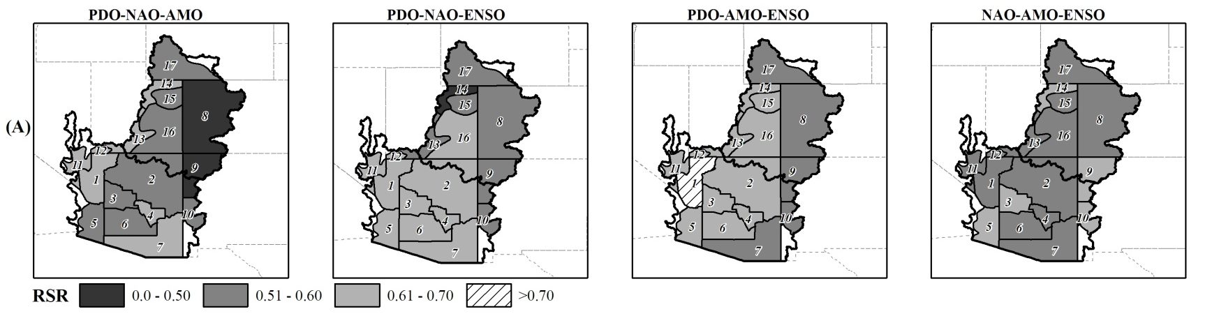
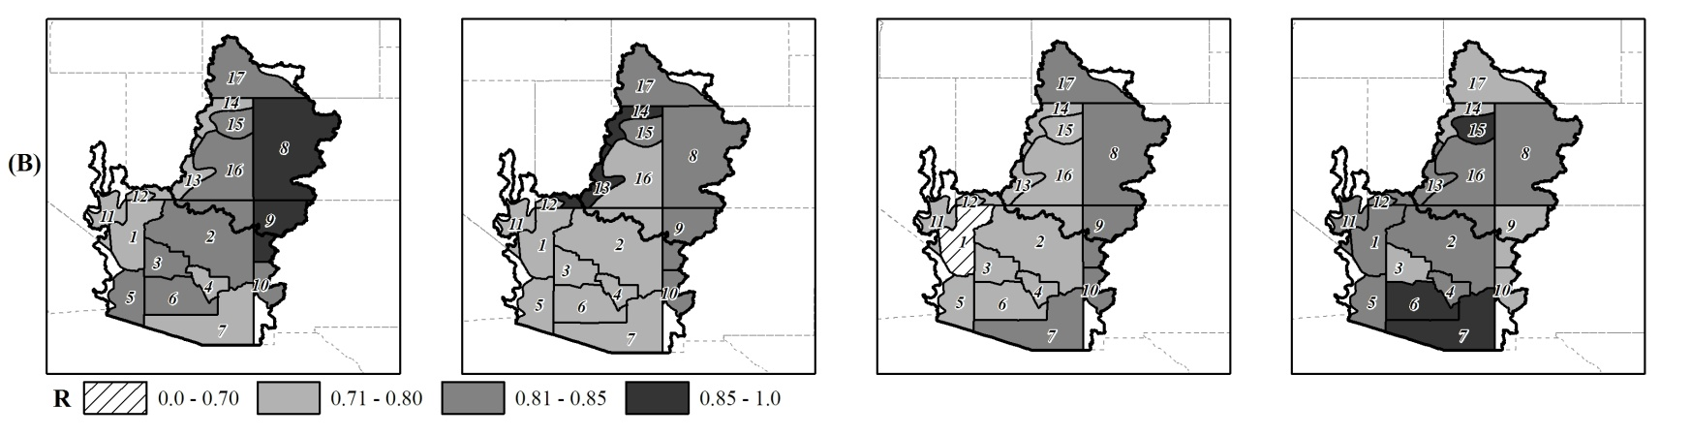
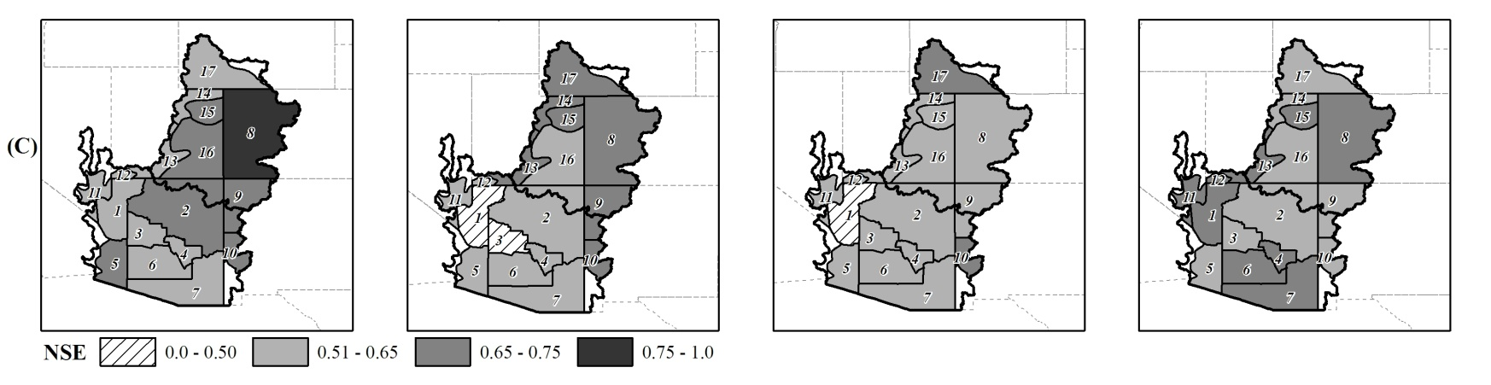
SVM Results – Upper CRB

Slide 17
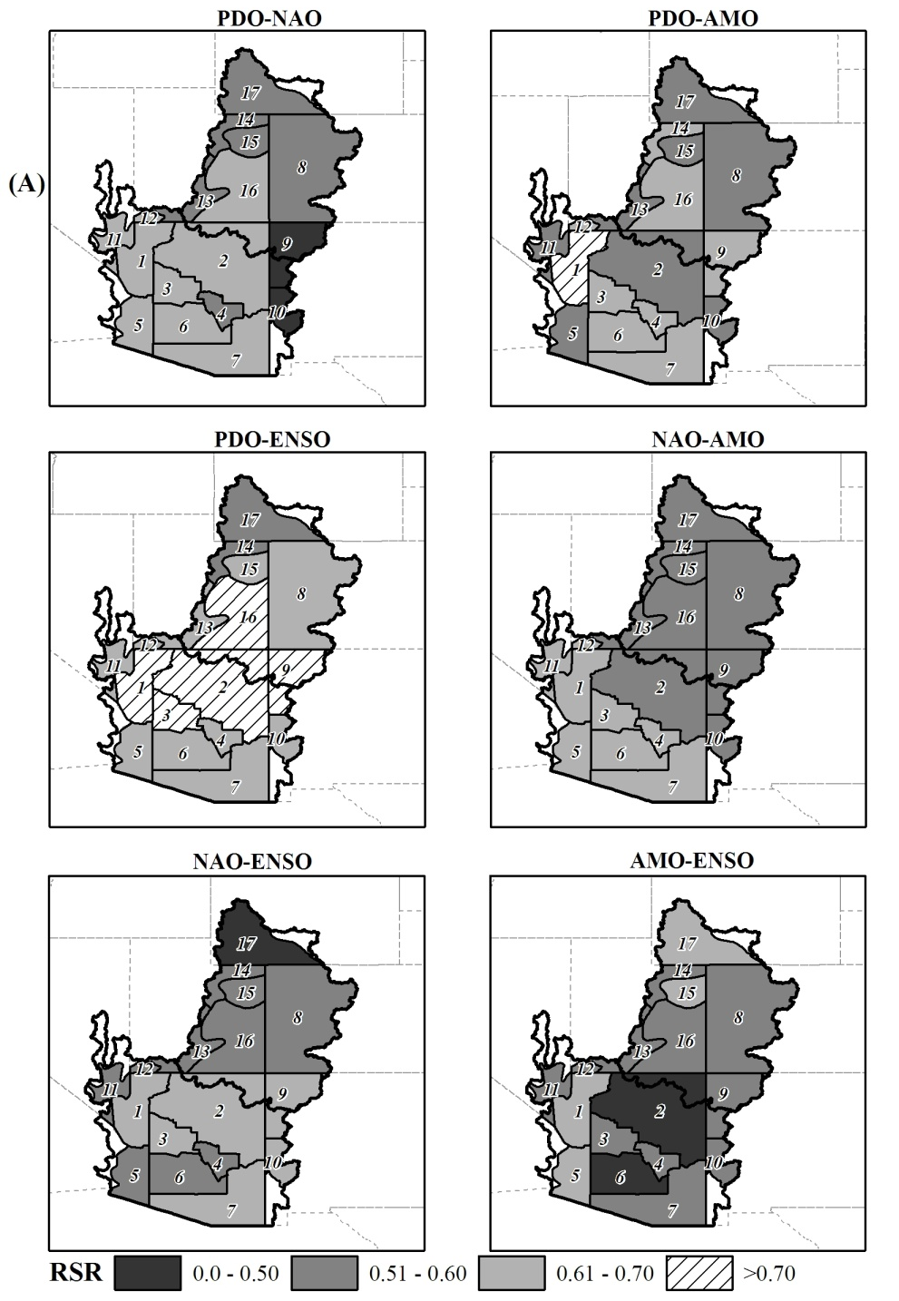
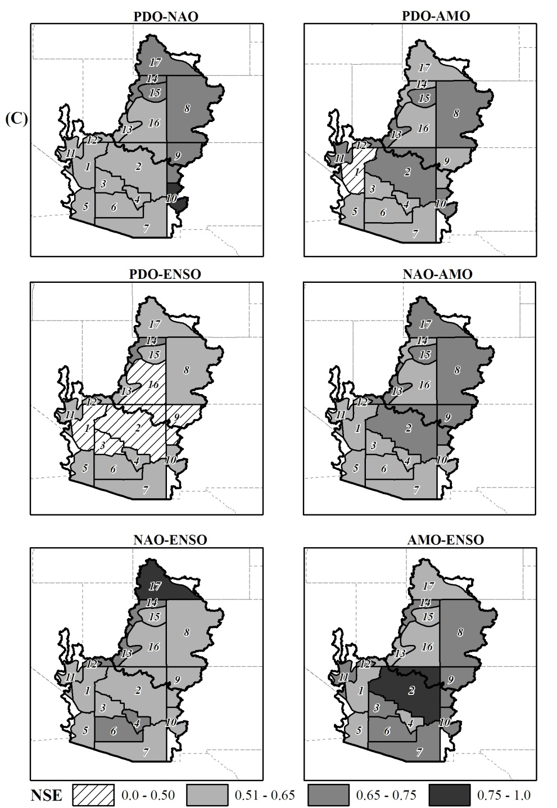
SVM Results – Lower CRB

Slide 18
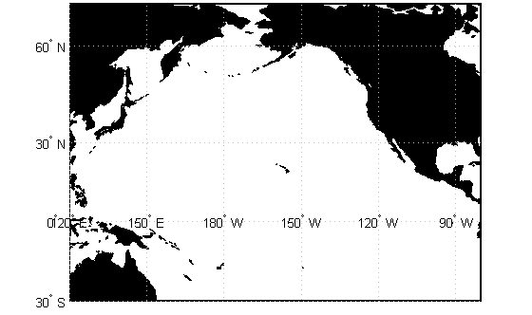
Ocean-Atmosphere-Streamflow
During the winter months …
L
Notes:
1) During the winter a Low Pressure system located over the Pacific North West. This system typically brings us the large-scale frontal passages which, when passing over the Rockies, dump most of our yearly snow.
2) The Storm tracks entering this system are driven by the East Asian Jet Stream. In the mid-pacific, the jet stream weakens and bifurcates: Part of the storm tracks head north into the northwestern low, while another part turns south entering the US via Mexico.

Slide 19
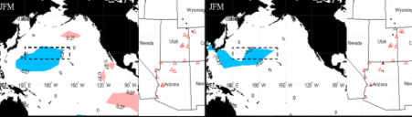
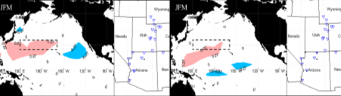
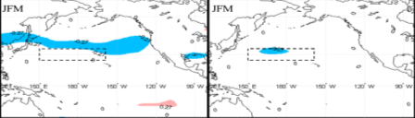
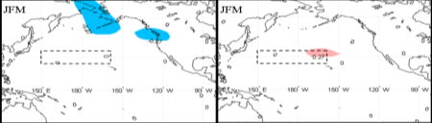
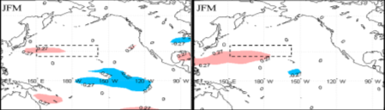
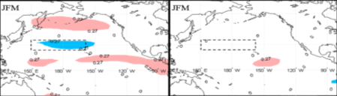
SVD/Correlation Results
Simultaneous Year
1 Year Lag
2 Year Lag
3 Year Lag
500mb Geopotential Height
200mb Zonal Wind

Slide 20
Forecast Method
Weighted Resampling of Observed Naturalized Streamflow
  Split sample forecast verification alternatives
    1st ~ 1976-2005 used to forecast 1906-1975
    2nd ~1956-2005 used to forecast 1906-1955
    3rd ~ 1906-1945 used to forecast 1956-2005
  Weight based upon 3-month avg. SST of Hondo region

Slide 21
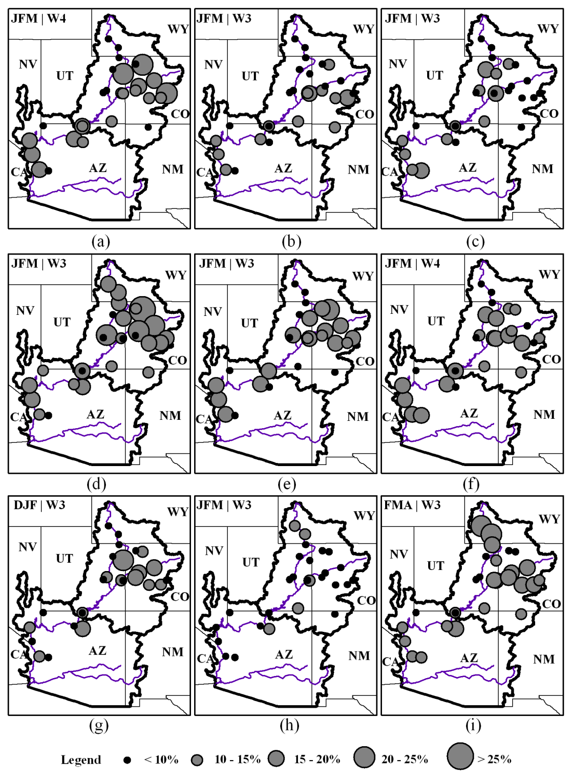
Forecast Skill Maps – LEPS
0 Lag
1-yr Lag
2-yr Lag
Alternative 1
Alternative 2
Alternative 3
Notes:
The top skill scores from the previous table are plotted on a map of the Colorado River Basin.
This shows that Alternative 2 performed the best
All maps show that the upper Green and San Juan rivers as well as the lower basin do not respond well to this forecasting technique.

Slide 22
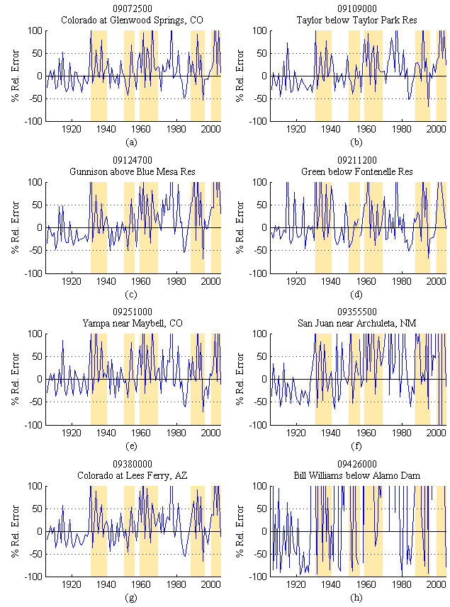
Relative Error ~ Drought Comparison
Notes:
Plots of the relative error time series better display the period of success and failure of this forecast technique
The highlighted regions are periods of below average streamflow on the Colorado River Basin
Unsuccessful periods coincide with low flow periods.

Slide 23
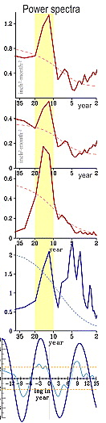
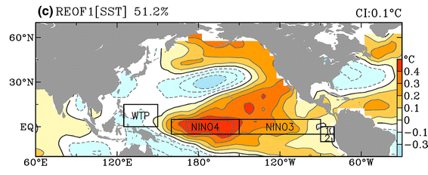
Identifying Climate Cycles
10-20 year cycle in data
PDO leads precipitation by 3 years
SST cycle highly correlated with Nino4 region
References: Wang et al, 2009; Wang et al 2010a.
Notes:
Started with the desire to understand the anecdotal observations of a 10-20 year cycle in the Intermountain west climate.
Identified that Precipitation and SST data have a 10-20 year cycle
Also, the SST Cycle leads the precipitation cycle by three years
The majority of the SST variance is highly correlated with the NINO4 region.

Slide 24
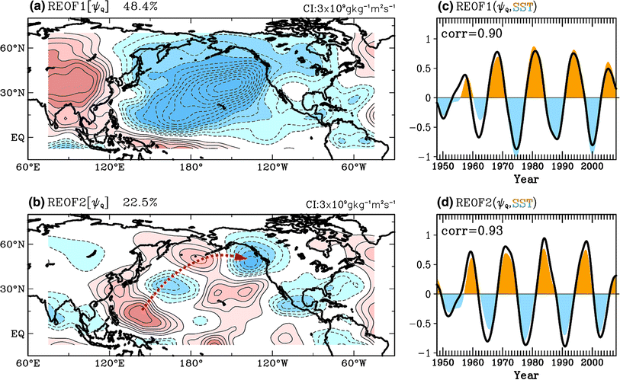
Pacific Ocean – Precipitation Lag
Figure 2 - Wang et al (2010a). A transition-phase Teleconnection of the Pacific Quasi-Decadal Oscillation. Clim Dyn DOI 10.10007/s00382-009-0722-5.
Notes:
First mode of stream function desmotnrates a Wave number 1 pattern that is responsible for pushing synoptic scale frontal passages in the atmosphere.
First mode is highly correlated, and in phase, with SST signal.
Second mode identifies a short wave train originating in the western tropical pacifc and terminating in the northwest U.S./Canada.
Second mode is highly correlated with precipitation cycle.
Since the streamfunction demonstrates the lagged correlation between SSTs and precipitation, then we have a physical connection between the Ocean and the Intermountain west

Slide 25
Ocean-Atmosphere-Streamflow
Another physical basis for long-lead forecasting
L
NINO 4
Notes:
1) During the winter a Low Pressure system located over the Pacific North West. This system typically brings us the large-scale frontal passages which, when passing over the Rockies, dump most of our yearly snow.
2) The Storm tracks entering this system are driven by the East Asian Jet Stream. In the mid-pacific, the jet stream weakens and bifurcates: Part of the storm tracks head north into the northwestern low, while another part turns south entering the US via Mexico.

Slide 26
Questions

