Slide 1
CBRFC April 2011 Water Supply Webinar
1pm, April 7, 2011
Kevin Werner
These slides: www.cbrfc.noaa.gov/present/present.php

Slide 2
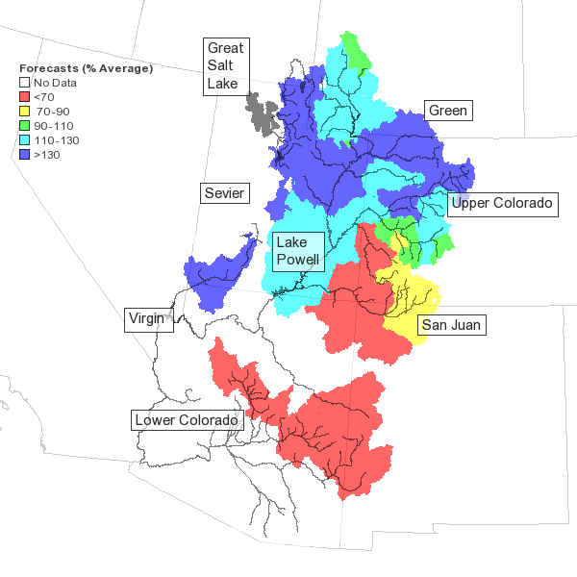
Outline
March Weather Review
Snow States
Water Supply Forecasts
Web Reference: www.cbrfc.noaa.gov/wsup/pub2/map/html/cbrfc.1.2011.html

Slide 3
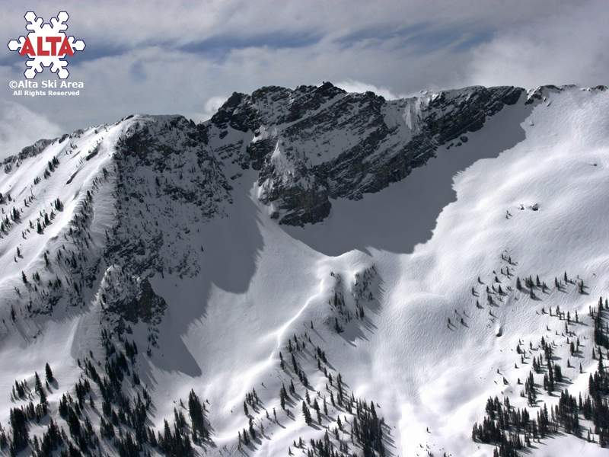

Slide 4
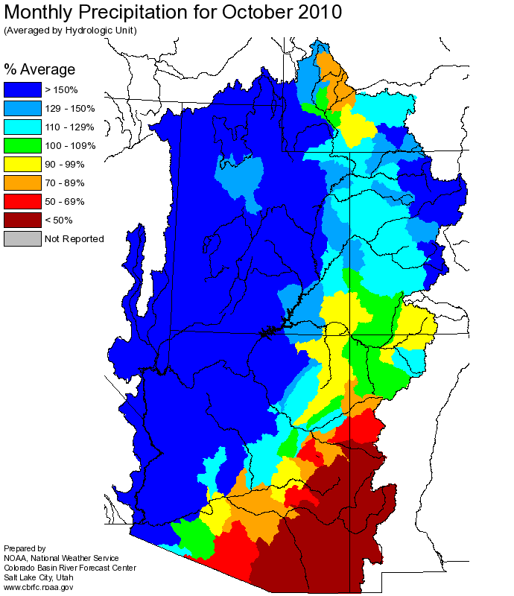
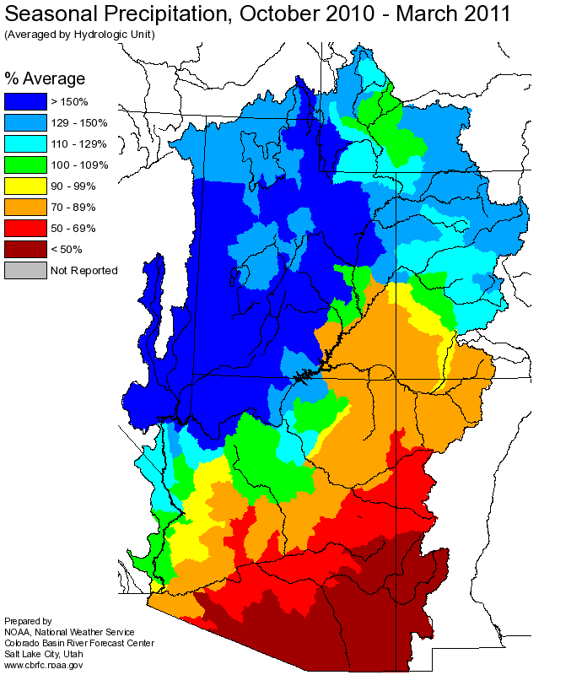
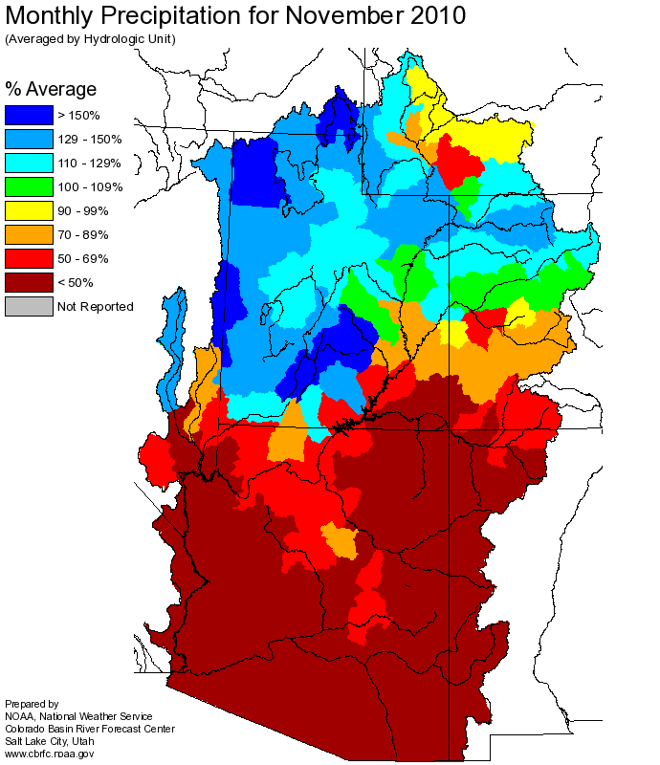
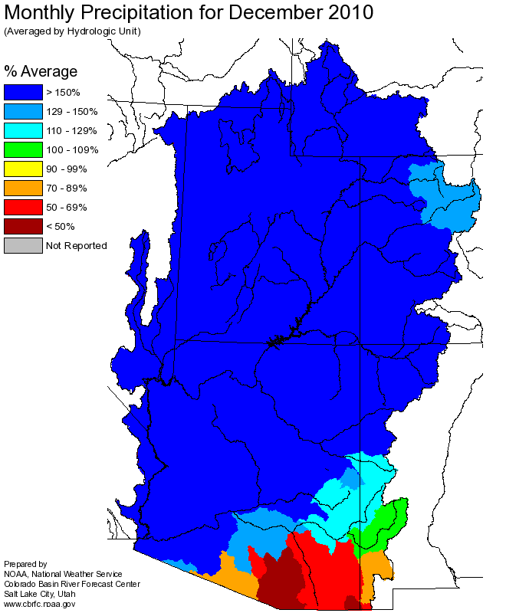
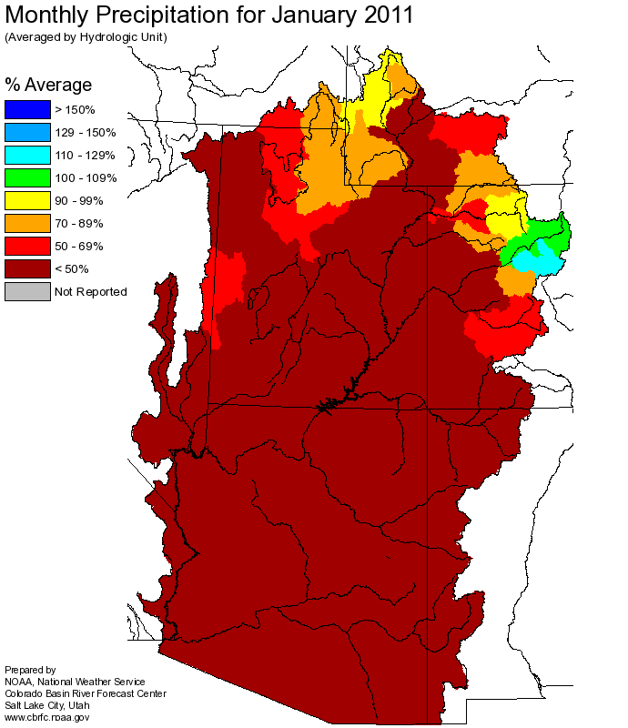
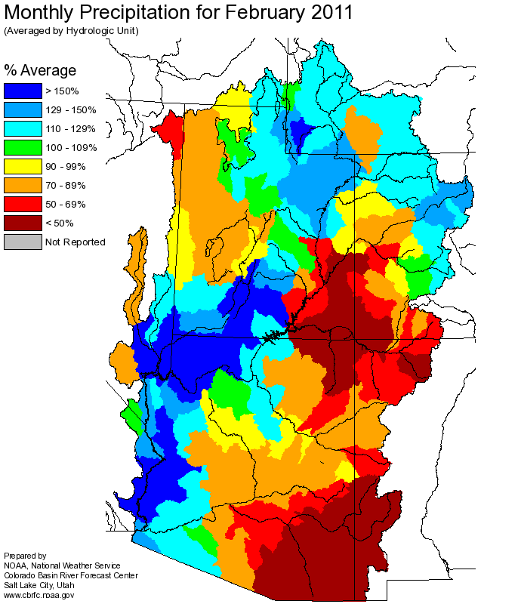
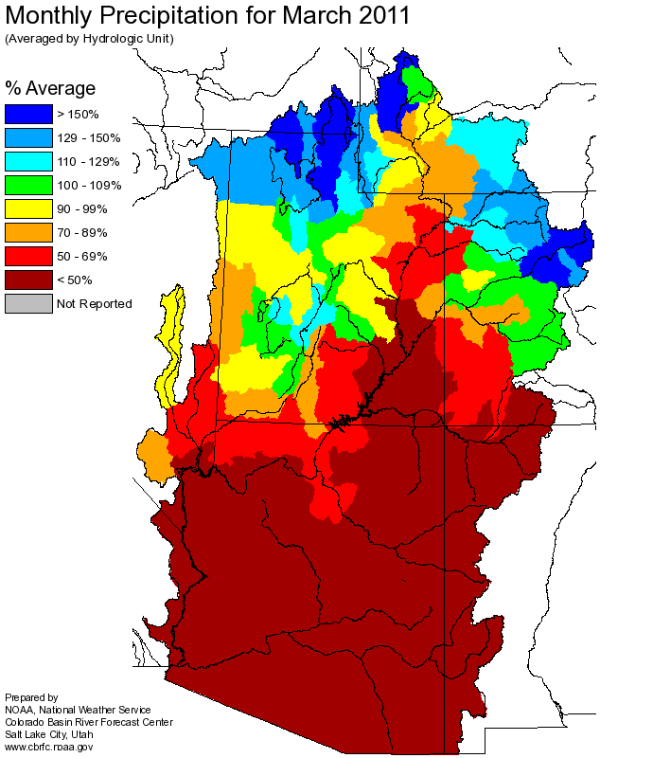
Web Reference: http://www.cbrfc.noaa.gov

Slide 5
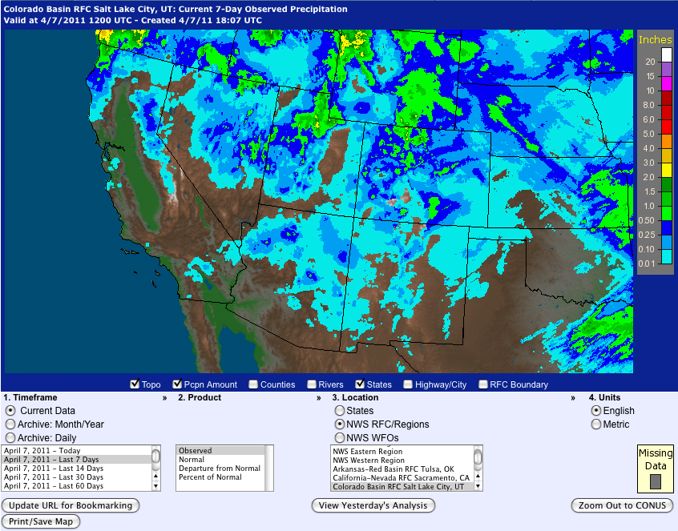
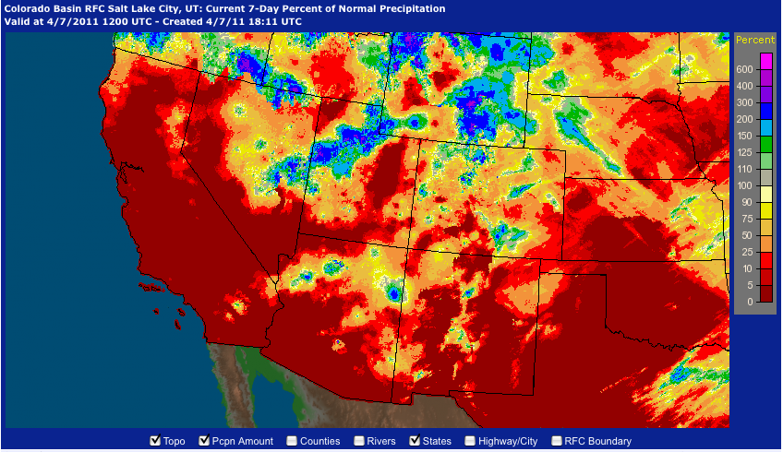
Web Reference: http://water.weather.gov/precip

Slide 6
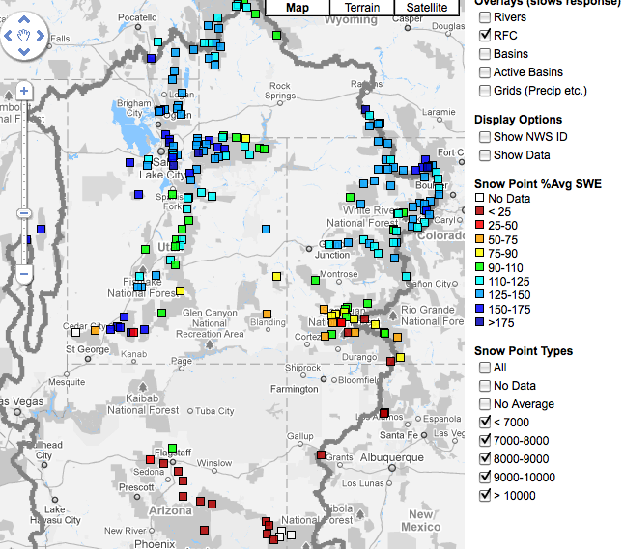
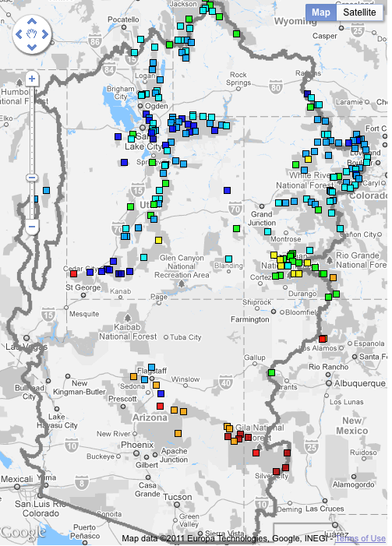
Snow
March 7 (above)
April 7 (right)
Web Reference: http://www.cbrfc.noaa.gov/gmap/gmapm.php?scon=checked

Slide 7
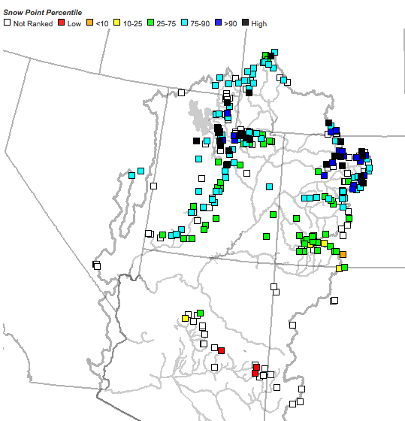
Snow
April 7 as a percent of average (above)
April 7 as a percentile (right)
Web Reference: http://www.cbrfc.noaa.gov/gmap/gmapm.php?scon=checked

Slide 8
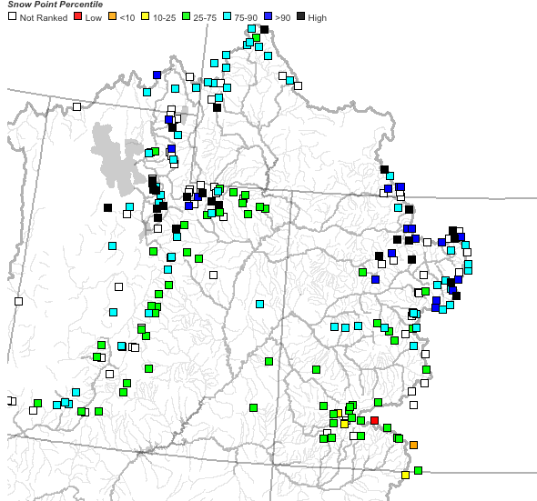
~25 sites showing highest value ever for today!!

Slide 9
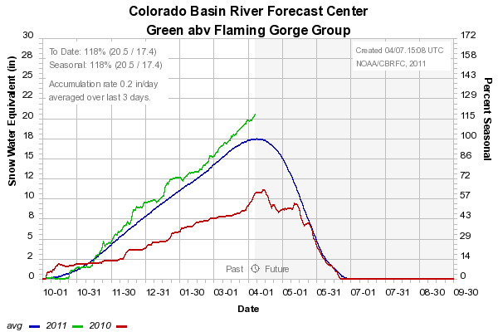
Snow: Upper Green Basin (above Flaming Gorge)
Web Reference: http://www.cbrfc.noaa.gov/station/sweplot/sweplot.cgi???open

Slide 10
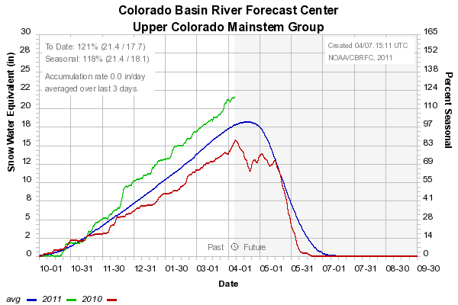
Snow: Colorado Mainstem (above Cameo)
Web Reference: http://www.cbrfc.noaa.gov/station/sweplot/sweplot.cgi???open

Slide 11
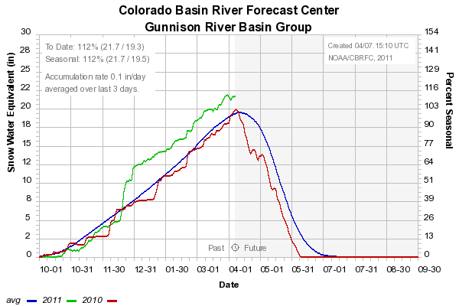
Snow: Gunnison Basin
Web Reference: http://www.cbrfc.noaa.gov/station/sweplot/sweplot.cgi???open

Slide 12
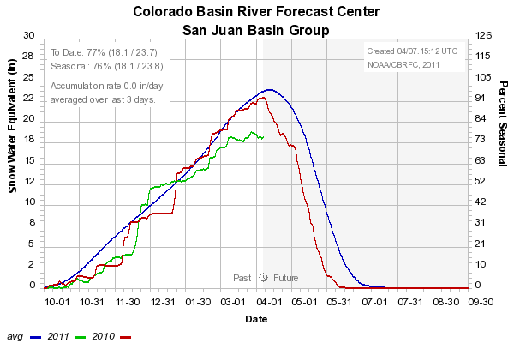
Snow: San Juan Basin
Web Reference: http://www.cbrfc.noaa.gov/station/sweplot/sweplot.cgi???open

Slide 13
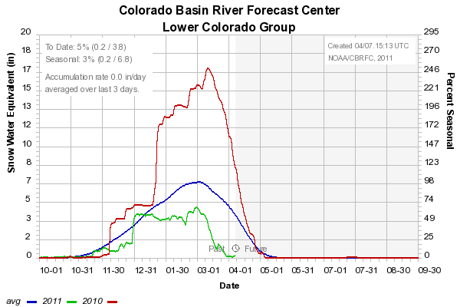
Snow: Lower Colorado
Web Reference: http://www.cbrfc.noaa.gov/station/sweplot/sweplot.cgi???open

Slide 14
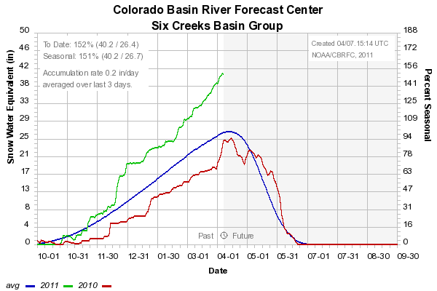
Snow: Six Creeks in Salt Lake County
Web Reference: http://www.cbrfc.noaa.gov/station/sweplot/sweplot.cgi???open

Slide 15
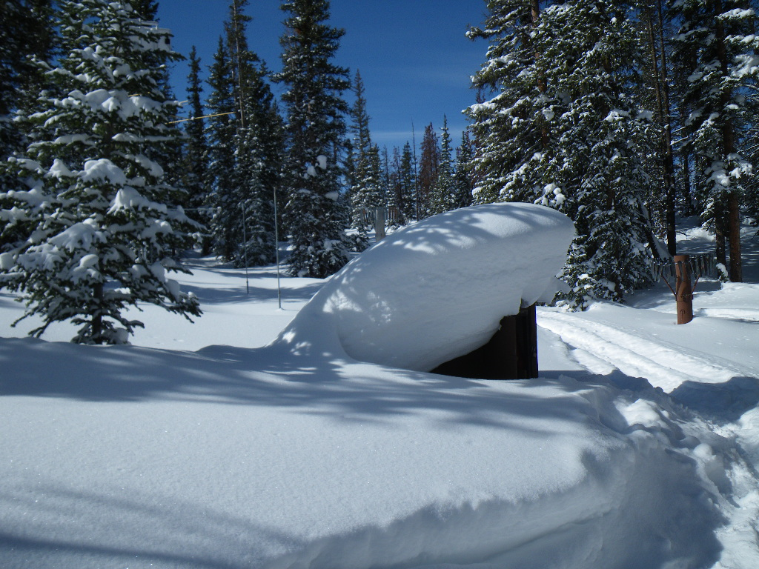
NRCS SNOTEL pictures:
Garden Summit (Right)
Trial Lake (Bottom)

Slide 16
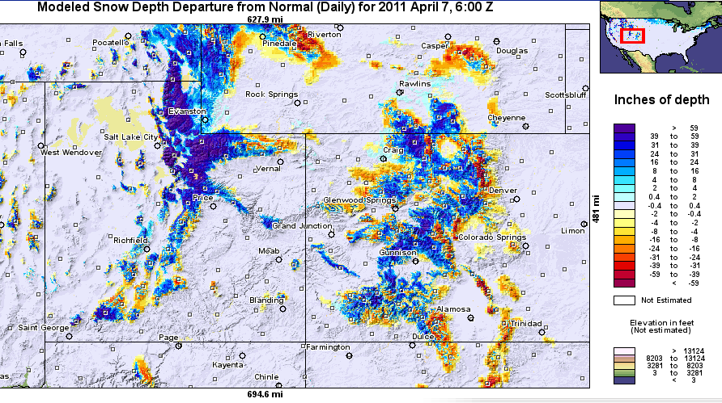
Snow Maps
Web Reference: http://www.nohrsc.nws.gov

Slide 17
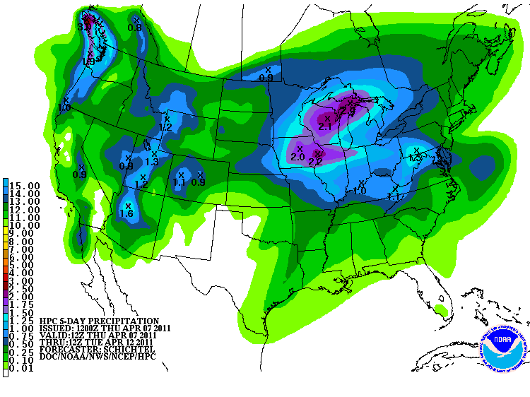
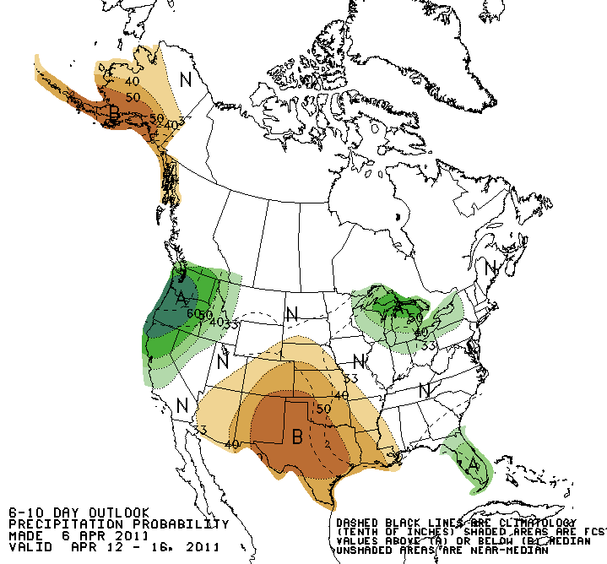
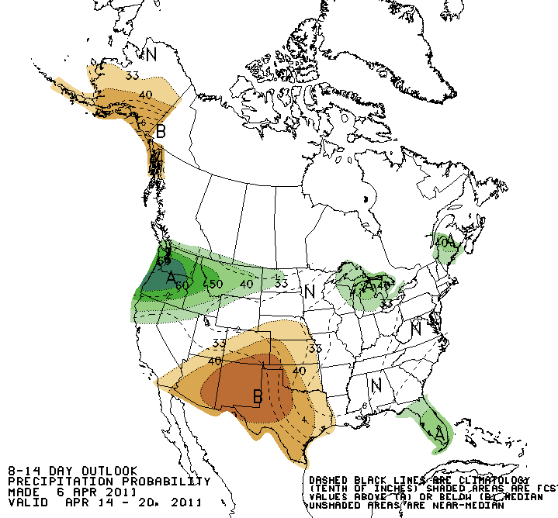
Forecast Precipitation
Active weather period continues!!
Weak storm today/tomorrow
Cold, more powerful storm for the weekend affecting entire basin
Another weaker storm for the middle of next week
Web Reference: www.hpc.noaa.gov

Slide 18
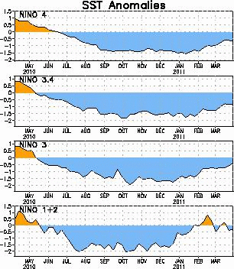
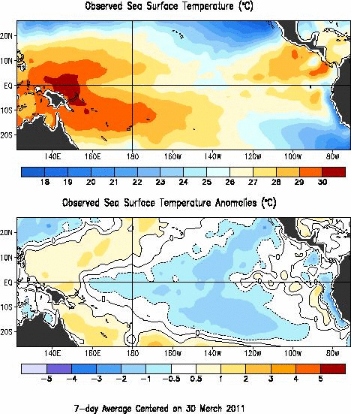
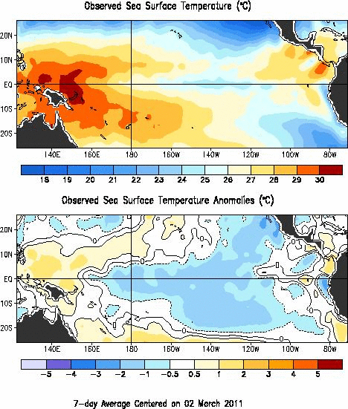
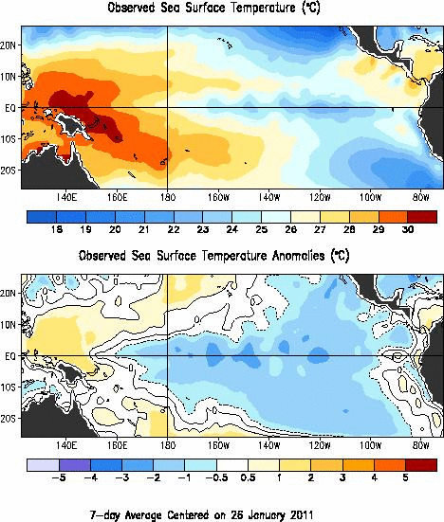
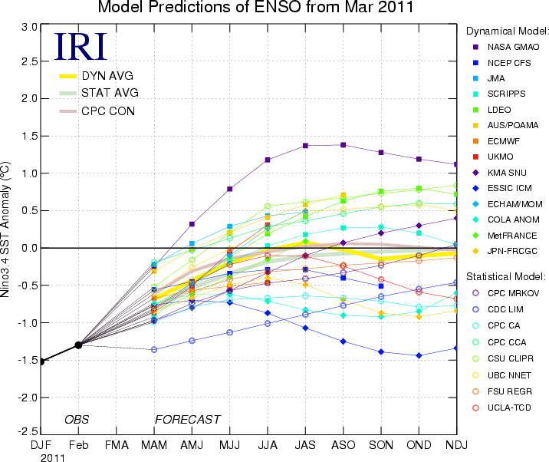
La Nina Update
Web Reference: http://www.cpc.noaa.gov and iri.columbia.edu/climate/ENSO

Slide 19
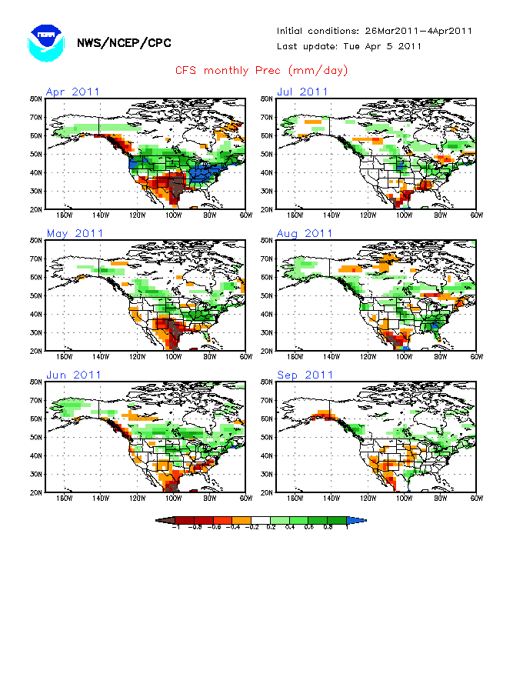
Web Reference: http://www.cbrfc.noaa.gov/climate/climoForecasts.cgi

Slide 20
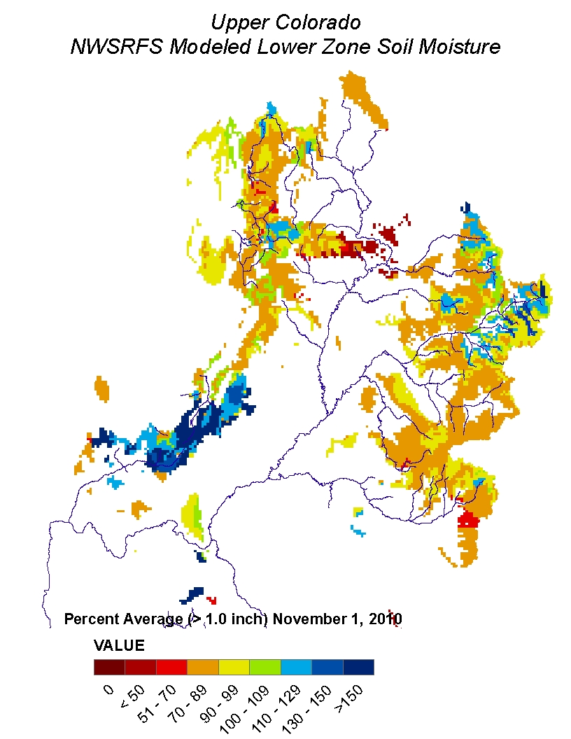
Soil Moisture

Slide 21
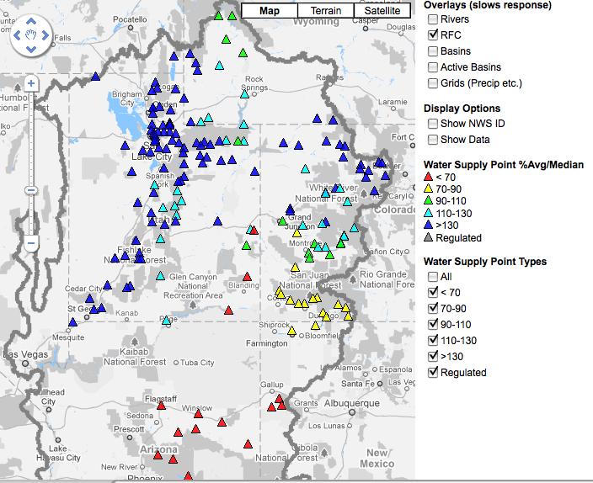
April 1, 2011
Water Supply Forecasts
Highlights:
Wet winter continues for much of the basin with many forecasts higher than any year since 1997
Some northern basins predicting flows near the top 10%
Forecasts slightly higher across northern basins since Feb 1
San Juan and lower basin somewhat lower since Feb 1
Web Reference: www.cbrfc.noaa.gov/gmap/gmapm.php?wcon=checked

Slide 22
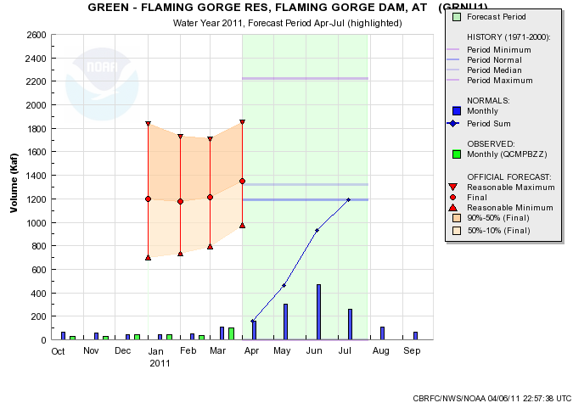
Web Reference: www.cbrfc.noaa.gov/gmap/gmapm.php?wcon=checked

Slide 23
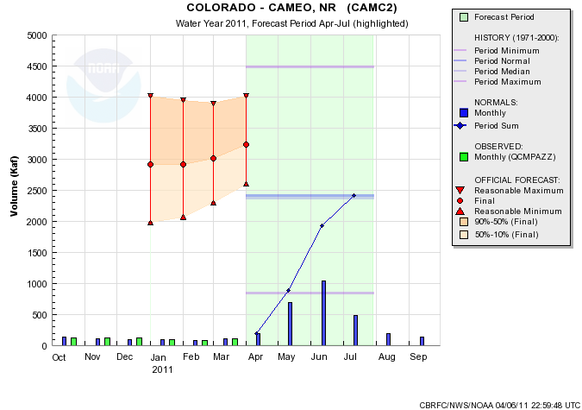
Web Reference: www.cbrfc.noaa.gov/gmap/gmapm.php?wcon=checked

Slide 24
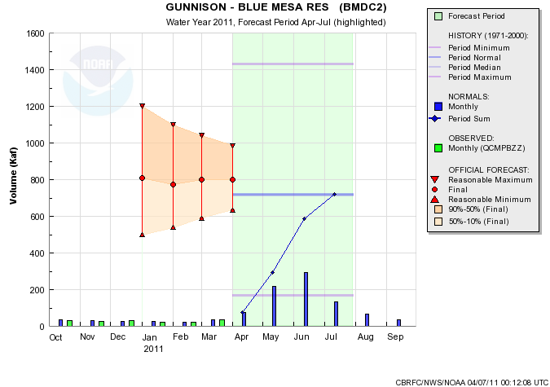
Web Reference: www.cbrfc.noaa.gov/gmap/gmapm.php?wcon=checked

Slide 25
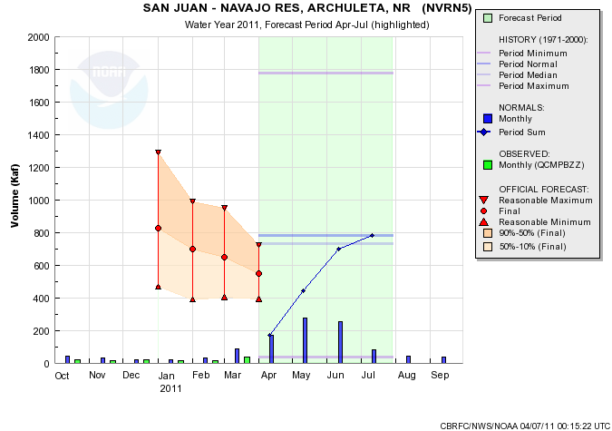
Web Reference: www.cbrfc.noaa.gov/gmap/gmapm.php?wcon=checked

Slide 26
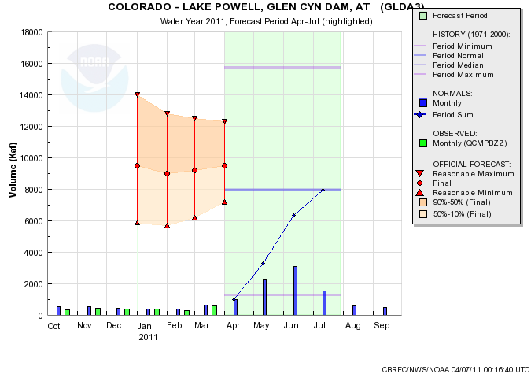
Web Reference: www.cbrfc.noaa.gov/gmap/gmapm.php?wcon=checked

Slide 27
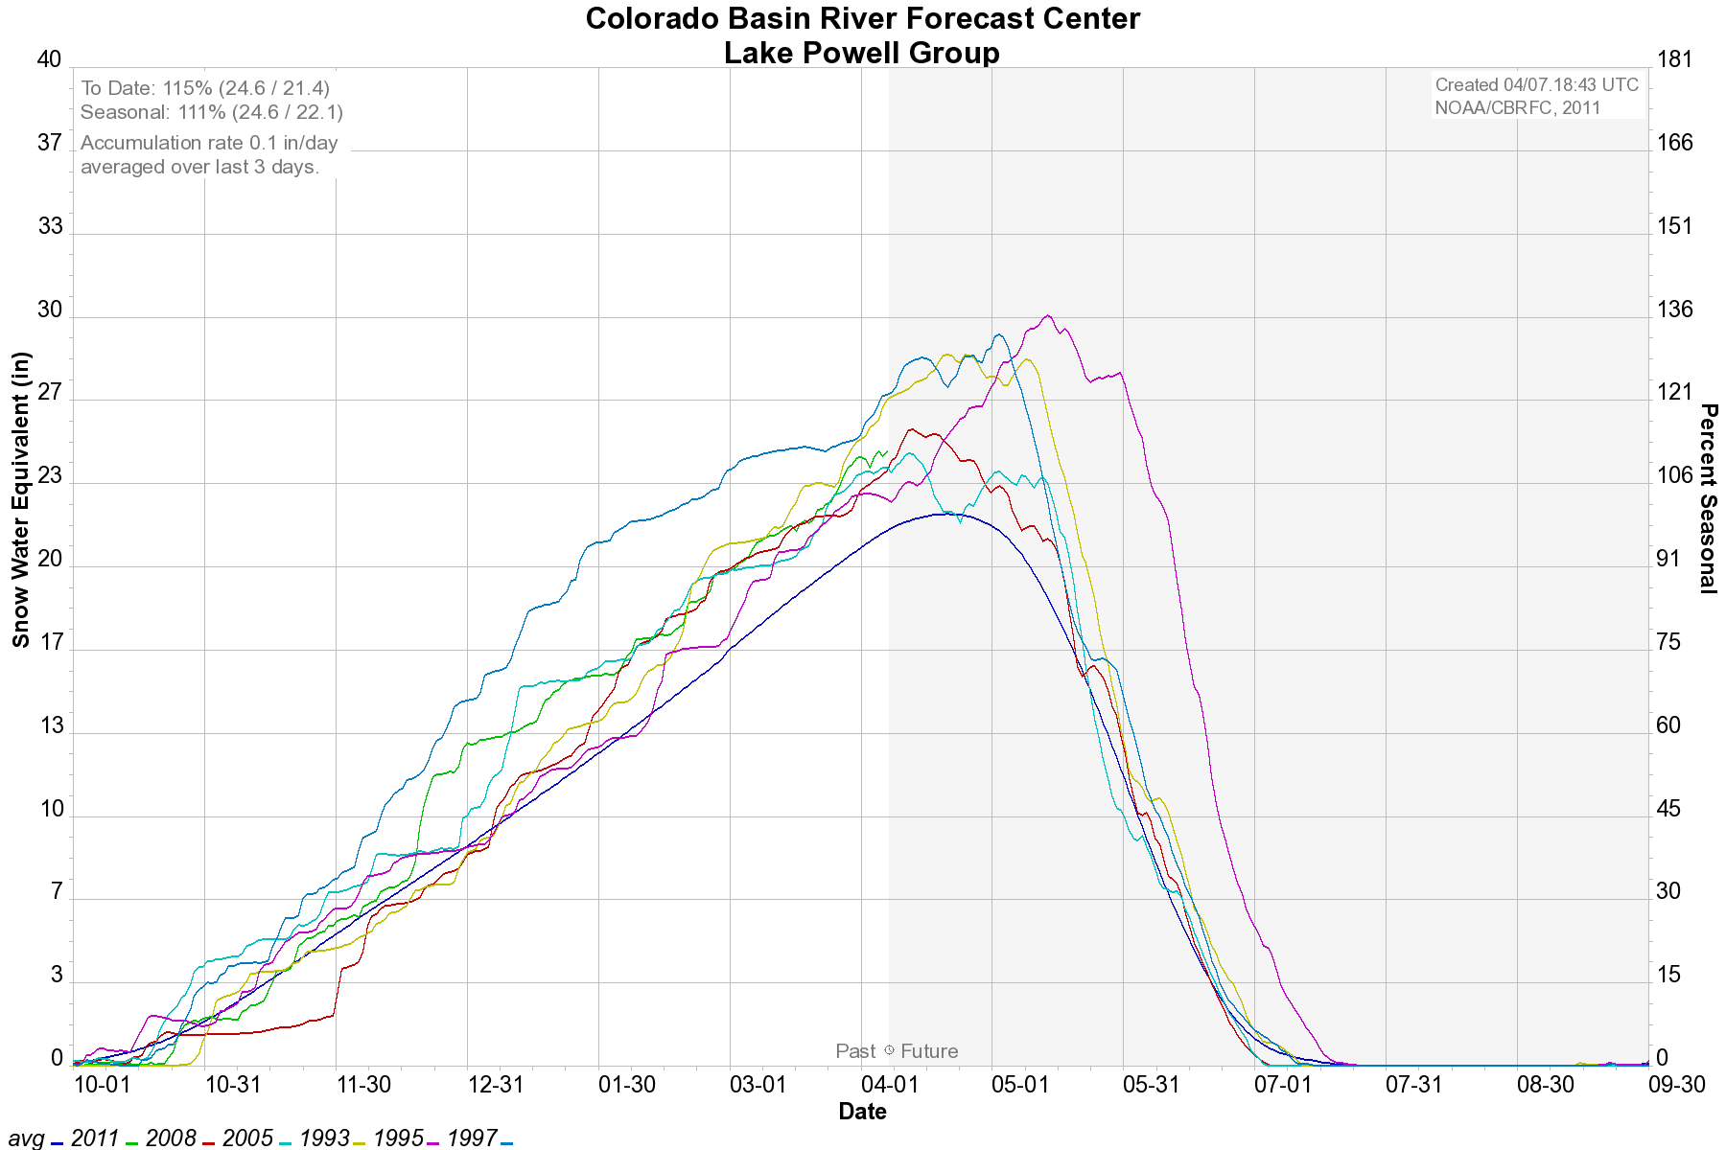
YEAR | OBS VOL (KAF) / %AVG | RANK (101 YRS)
2005 | 8844 / 112% | 39
2008 | 8909 / 112% | 38
1993 | 9984 / 126% | 29
Lake Powell historical inflows

Slide 28
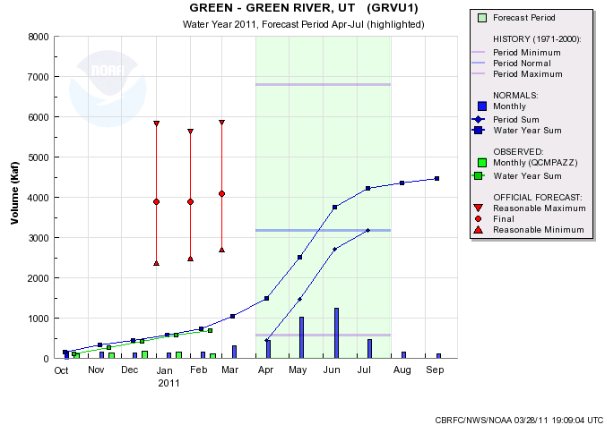
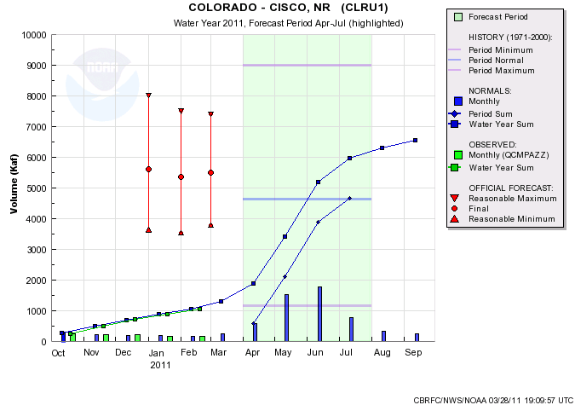
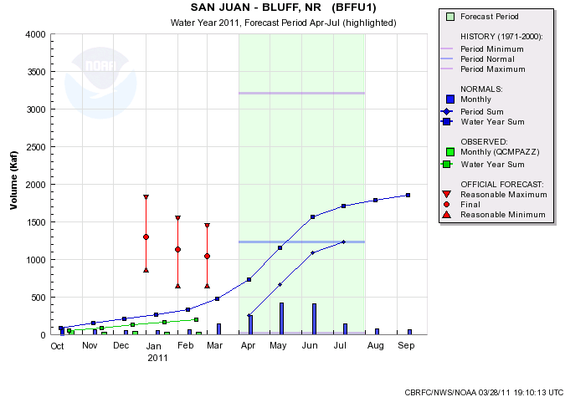
5500/118%
4090/129%
Average contribution to Lake Powell Apr-Jul inflow:
Green River-Green River, UT 34%
Colorado River-Cicso, UT 50%
San Juan River-Bluff, UT 13%
1040/85%

Slide 29
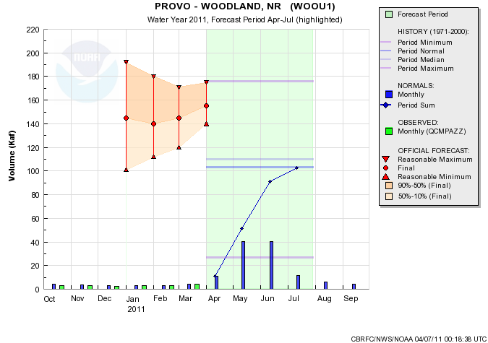
Web Reference: www.cbrfc.noaa.gov/gmap/gmapm.php?wcon=checked

Slide 30
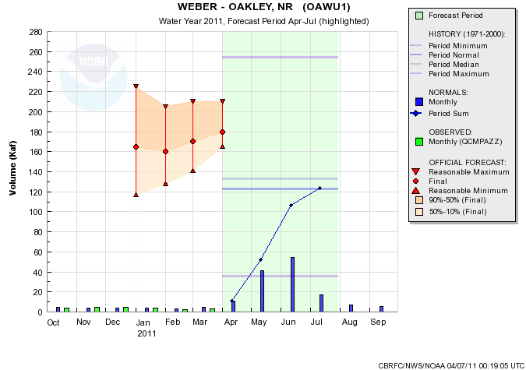
Web Reference: www.cbrfc.noaa.gov/gmap/gmapm.php?wcon=checked

Slide 31
Web Reference: www.cbrfc.noaa.gov/gmap/gmapm.php?wcon=checked

Slide 32
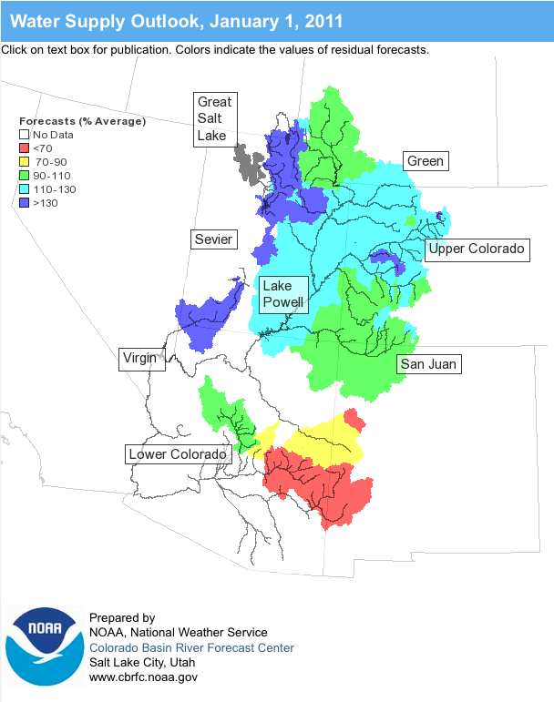
Online Publication
Web Reference: www.cbrfc.noaa.gov/wsup/pub2/map/html/cpub.php

Slide 33
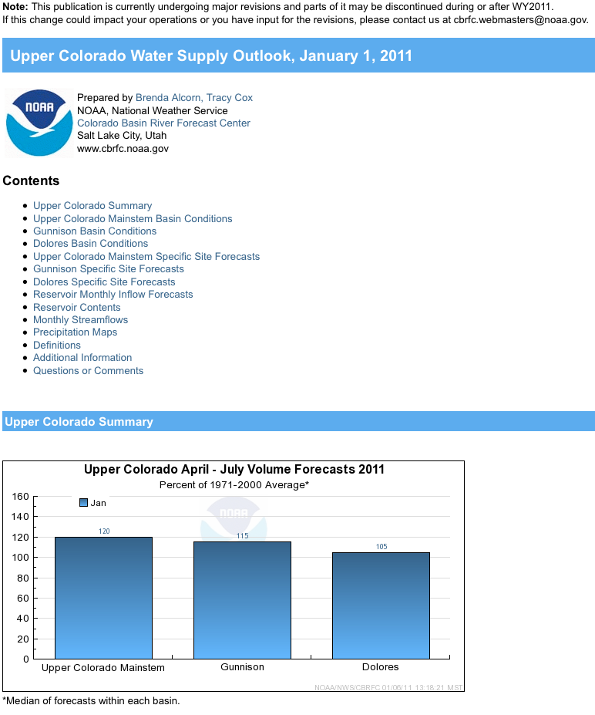
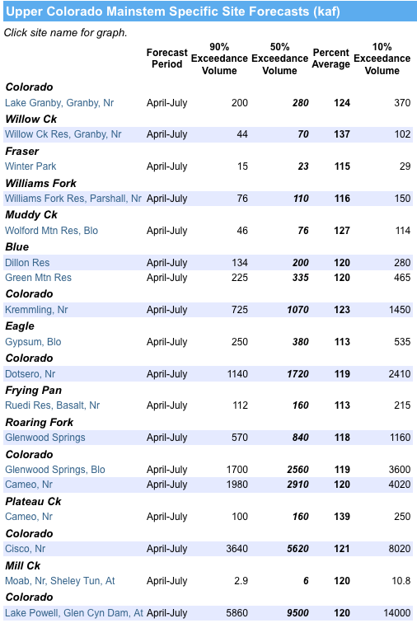
Web Reference: www.cbrfc.noaa.gov/wsup/pub2/map/html/cpub.php

Slide 34
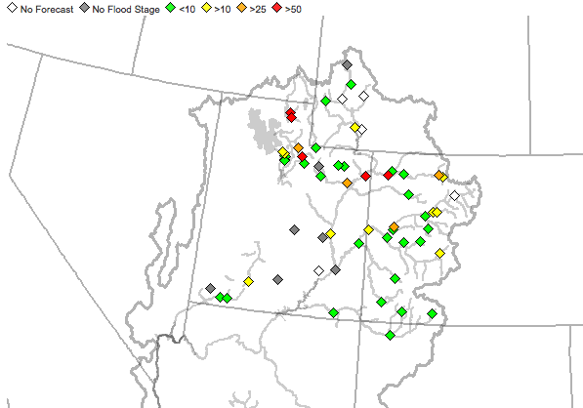
Peak Flow Forecast
April 1 Peak flow forecasts highlights:
Very significant chances for flooding in Utah, Colorado
Peak Flow webinar Friday, April 8

Slide 35
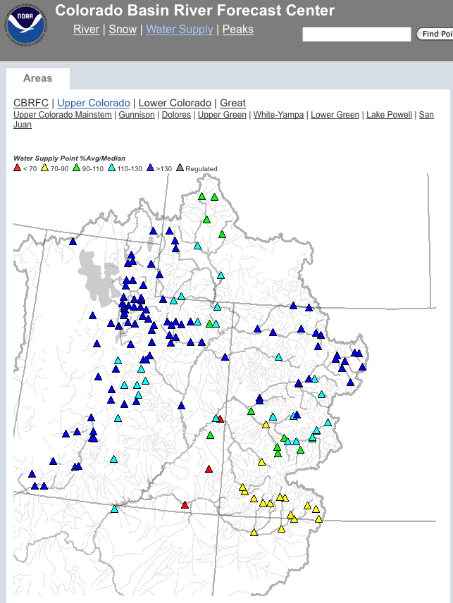
CBRFC News
Basin Focal Points (Available to discuss forecasts: 801.524.5130)
Upper Colorado: Brenda Alcorn
Green: Ashley Nielson
San Juan / Gunnison: Tracy Cox
Great Basin: Brent Bernard
Lower Colorado (below Lake Powell): Greg Smith
Upcoming:
Weekly ESP model guidance
Email product updates via govdelivery (can add more products / webpages upon request)
Changes to CBRFC webpage: www.cbrfc.noaa.gov/gmap/gmap3.php
Blog (blog.citizen.apps.gov/cbrfc)

Slide 36
More Resources
www.cbrfc.noaa.gov
Wateroutlook.nwrfc.noaa.gov
Tentative April webinar: 1pm May 6
April peak flow webinar: 1pm tomorrow (April 8)

Slide 37
Feedback, Questions, Concerns always welcome….
Kevin Werner
CBRFC Service Coordination Hydrologist
Phone: 801.524.5130
Email: kevin.werner@noaa.gov

