Slide 1
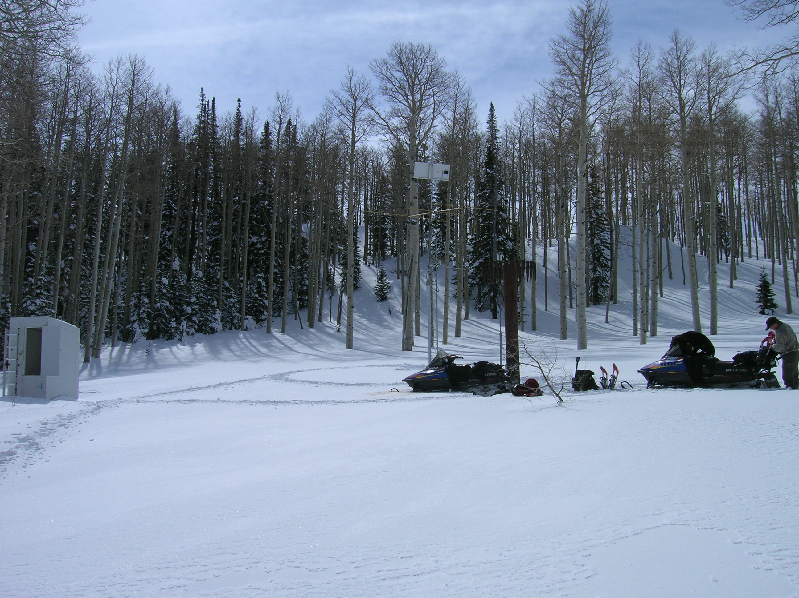
SNOTEL

Slide 2
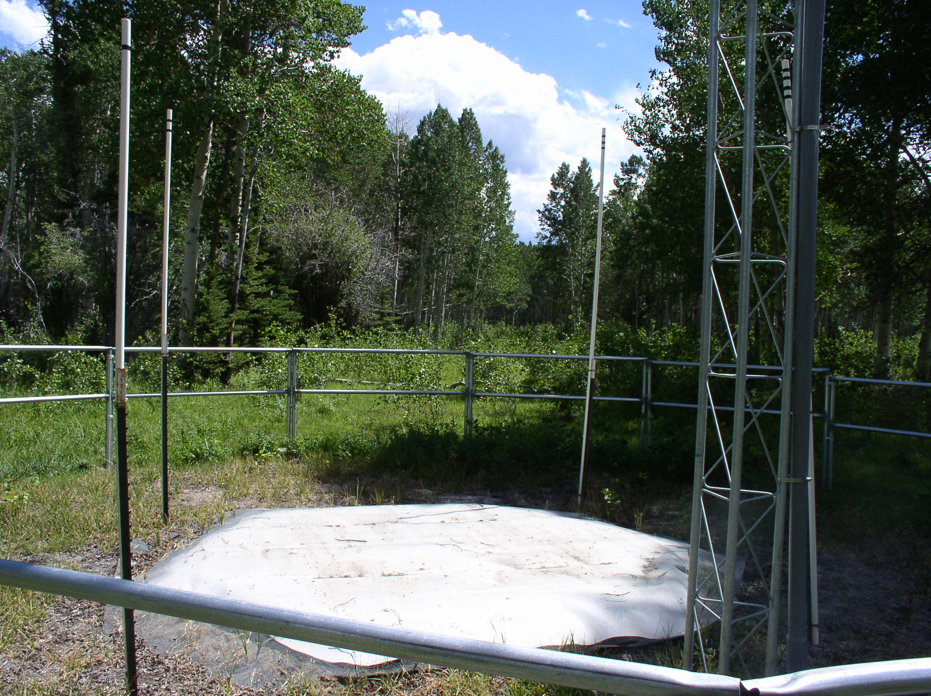
Hourly Data Collected at
Each SNOTEL site….
SWE – quality – good
+/- 0.2 inch
Record length: 20-30 yrs.

Slide 3
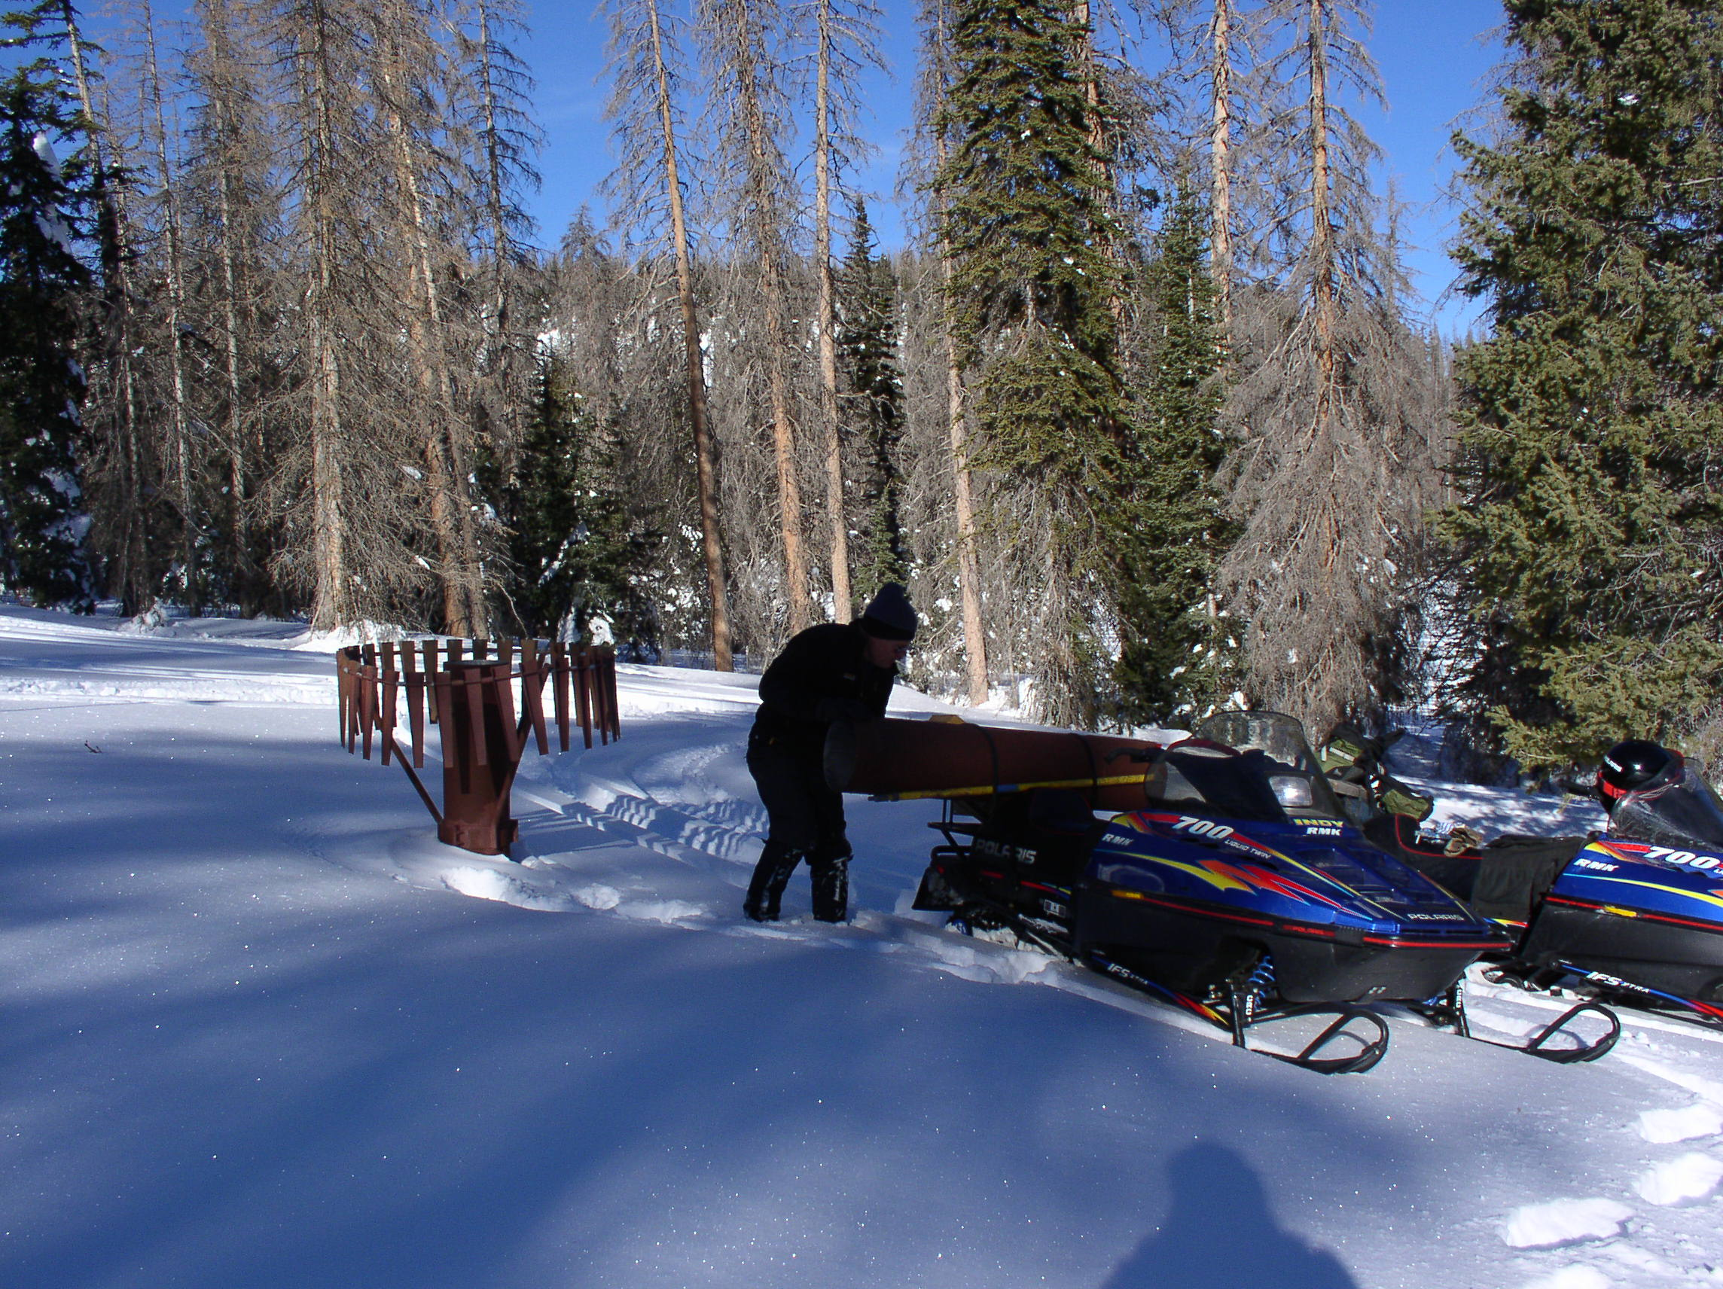
Precipitation: hourly data are poor, daily data are fair to good. Typically +/- 0.1 to 0.2 inch Record Length: 20-30 yrs

Slide 4
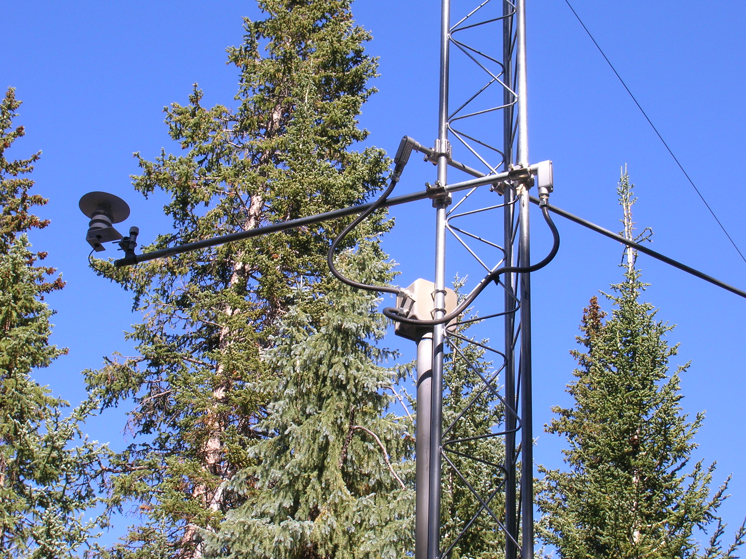
Temperature: Historical can be very poor (caveat emptor - 1 deg C warm bias old sensor to current). Current to past 10/15 years is good to excellent. Typically at 17 feet above ground. +/- 0.2 F Record length: use only the last 10 to 15 yrs. http://www.ut.nrcs.usda.gov/snow/siteinfo/data_bias/The_SNOTEL_Temperature_Data_Set-2.pdf

Slide 5
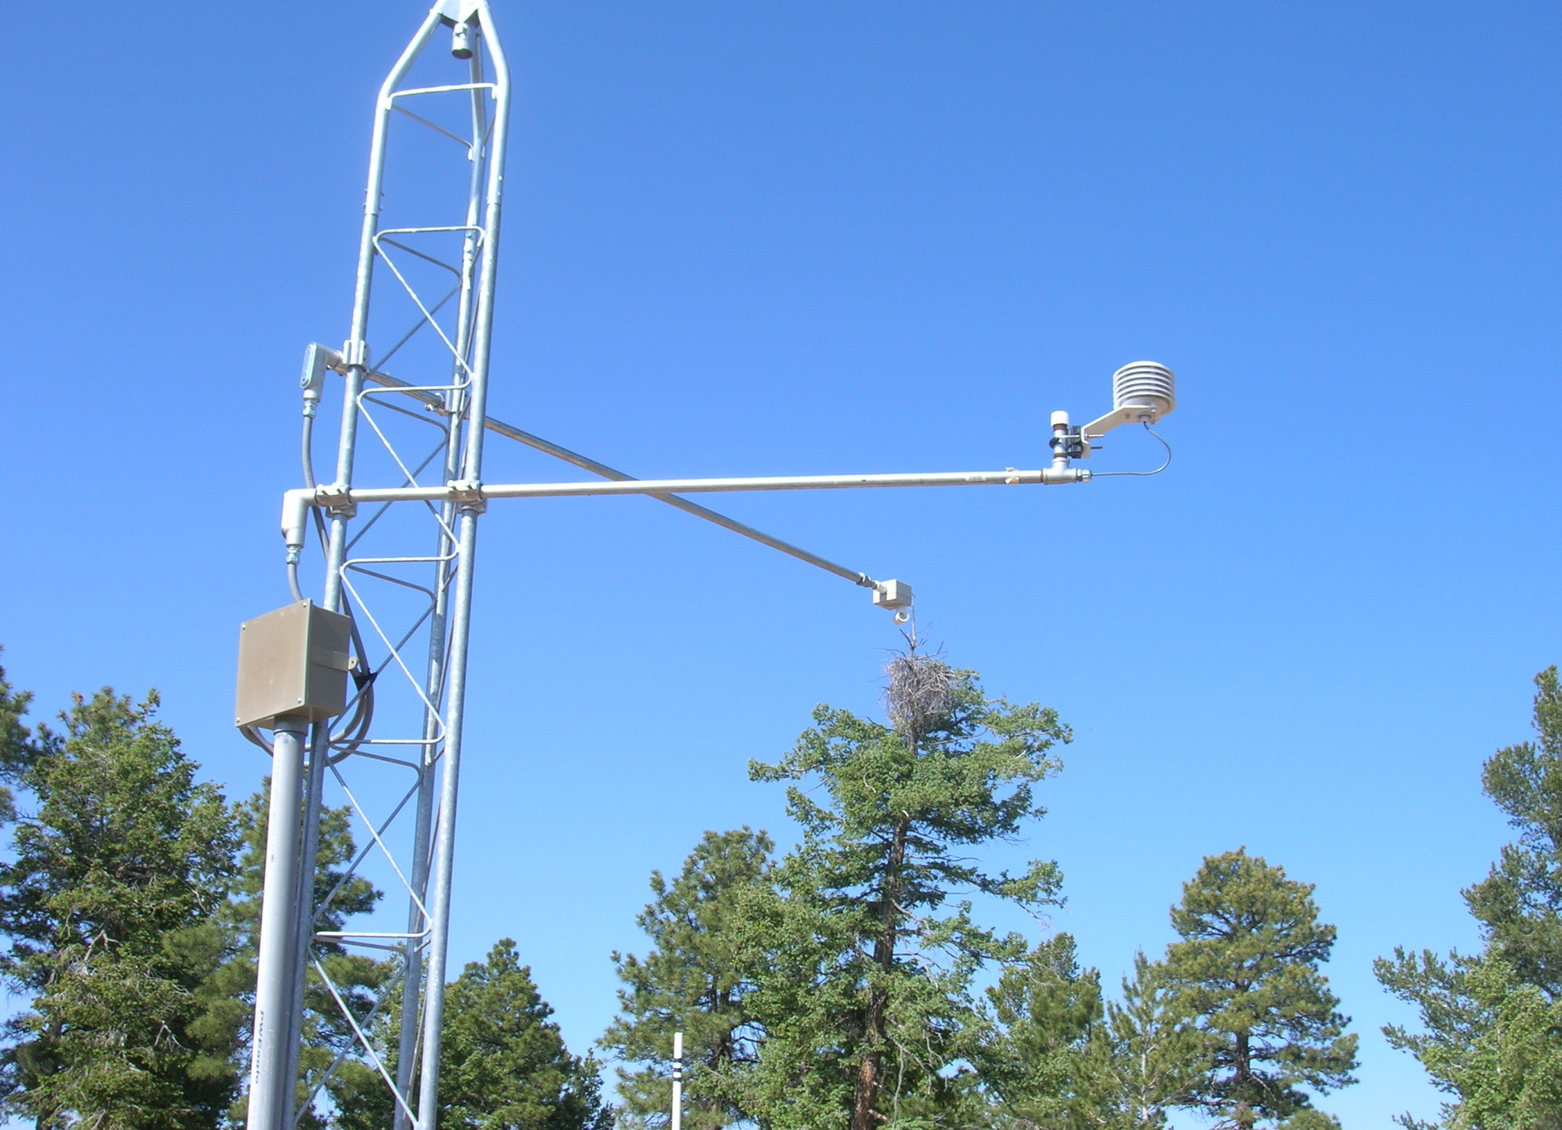
Snow Depth – mostly good except during storm events.
+/- 1 inch. Record Length: 10-20 years.

Slide 6
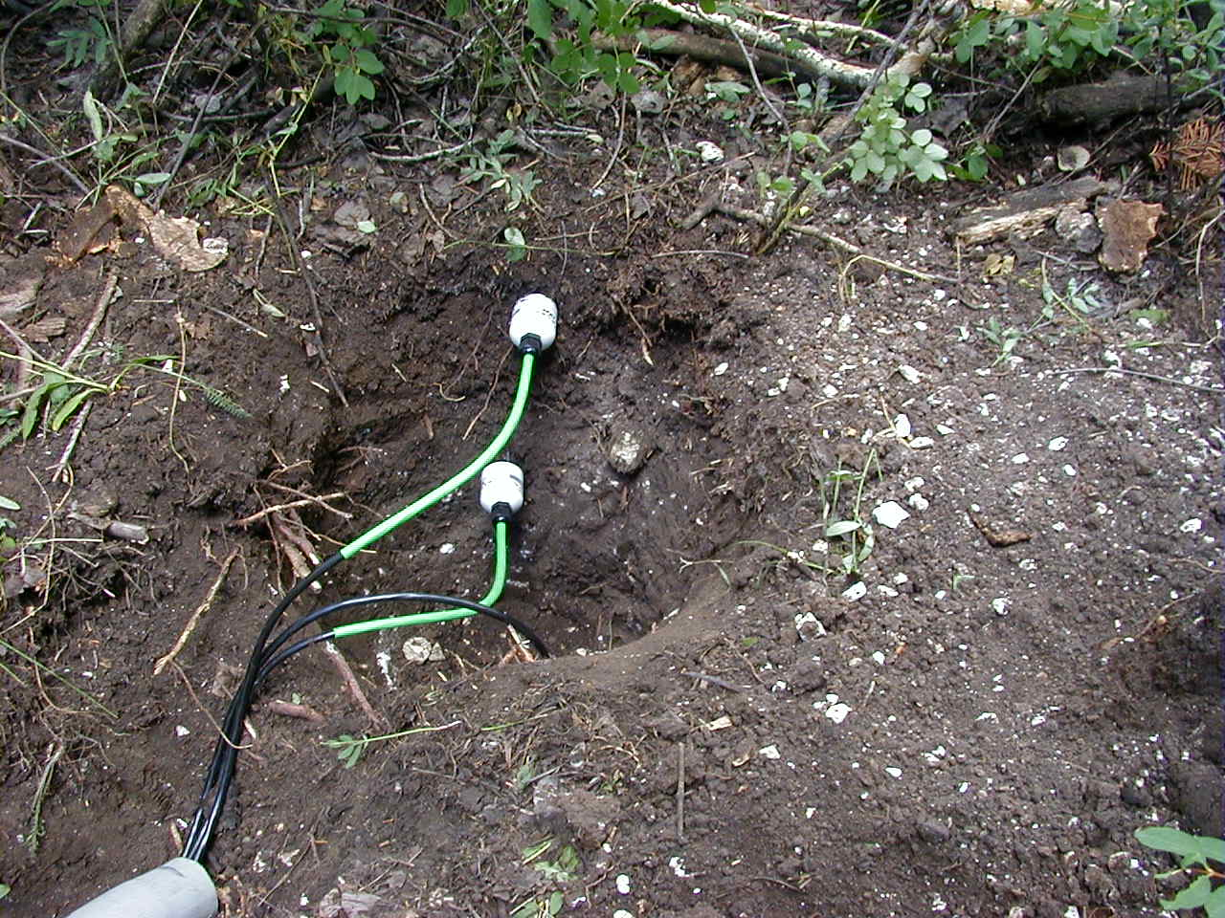
Soil Moisture/Temperature at 2, 8 and 20 inch depths –
Excellent data quality. +/- 0.1 degree. Record Length: 5-10 yrs

Slide 7
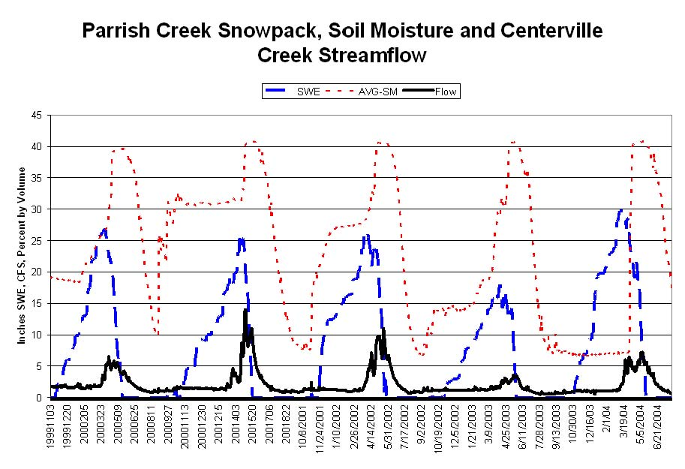

Slide 8
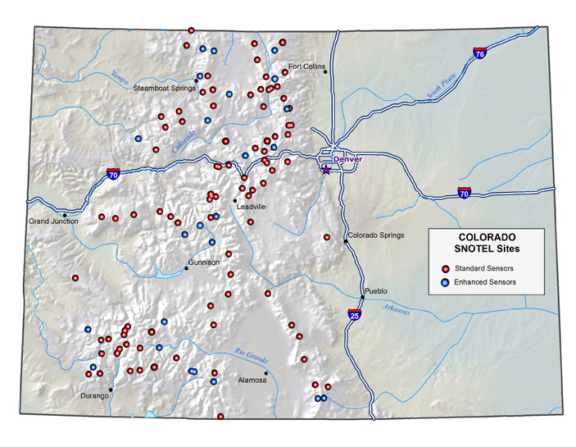
Colorado: 112 Sites, 33 sites with enhanced sensors: soil moisture/temperature and snow depth

Slide 9
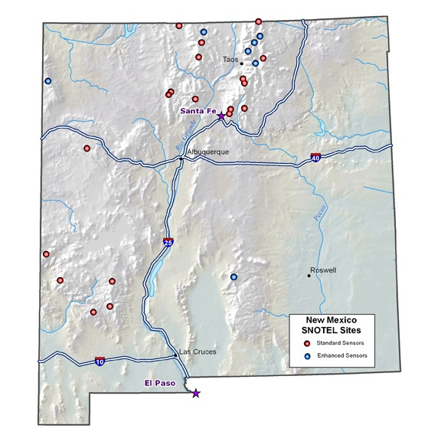
26 SNOTELs, 7 with SM/ST - depth

Slide 10
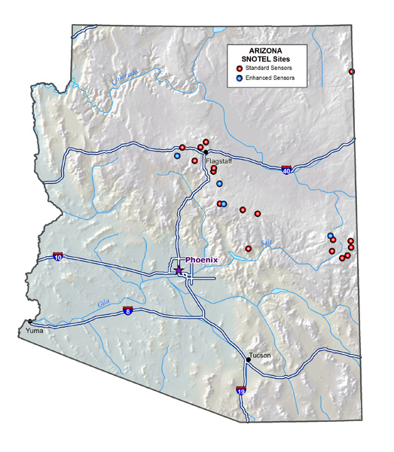
Arizona – 21 SNOTELs
4 with SM/ST and depth

Slide 11
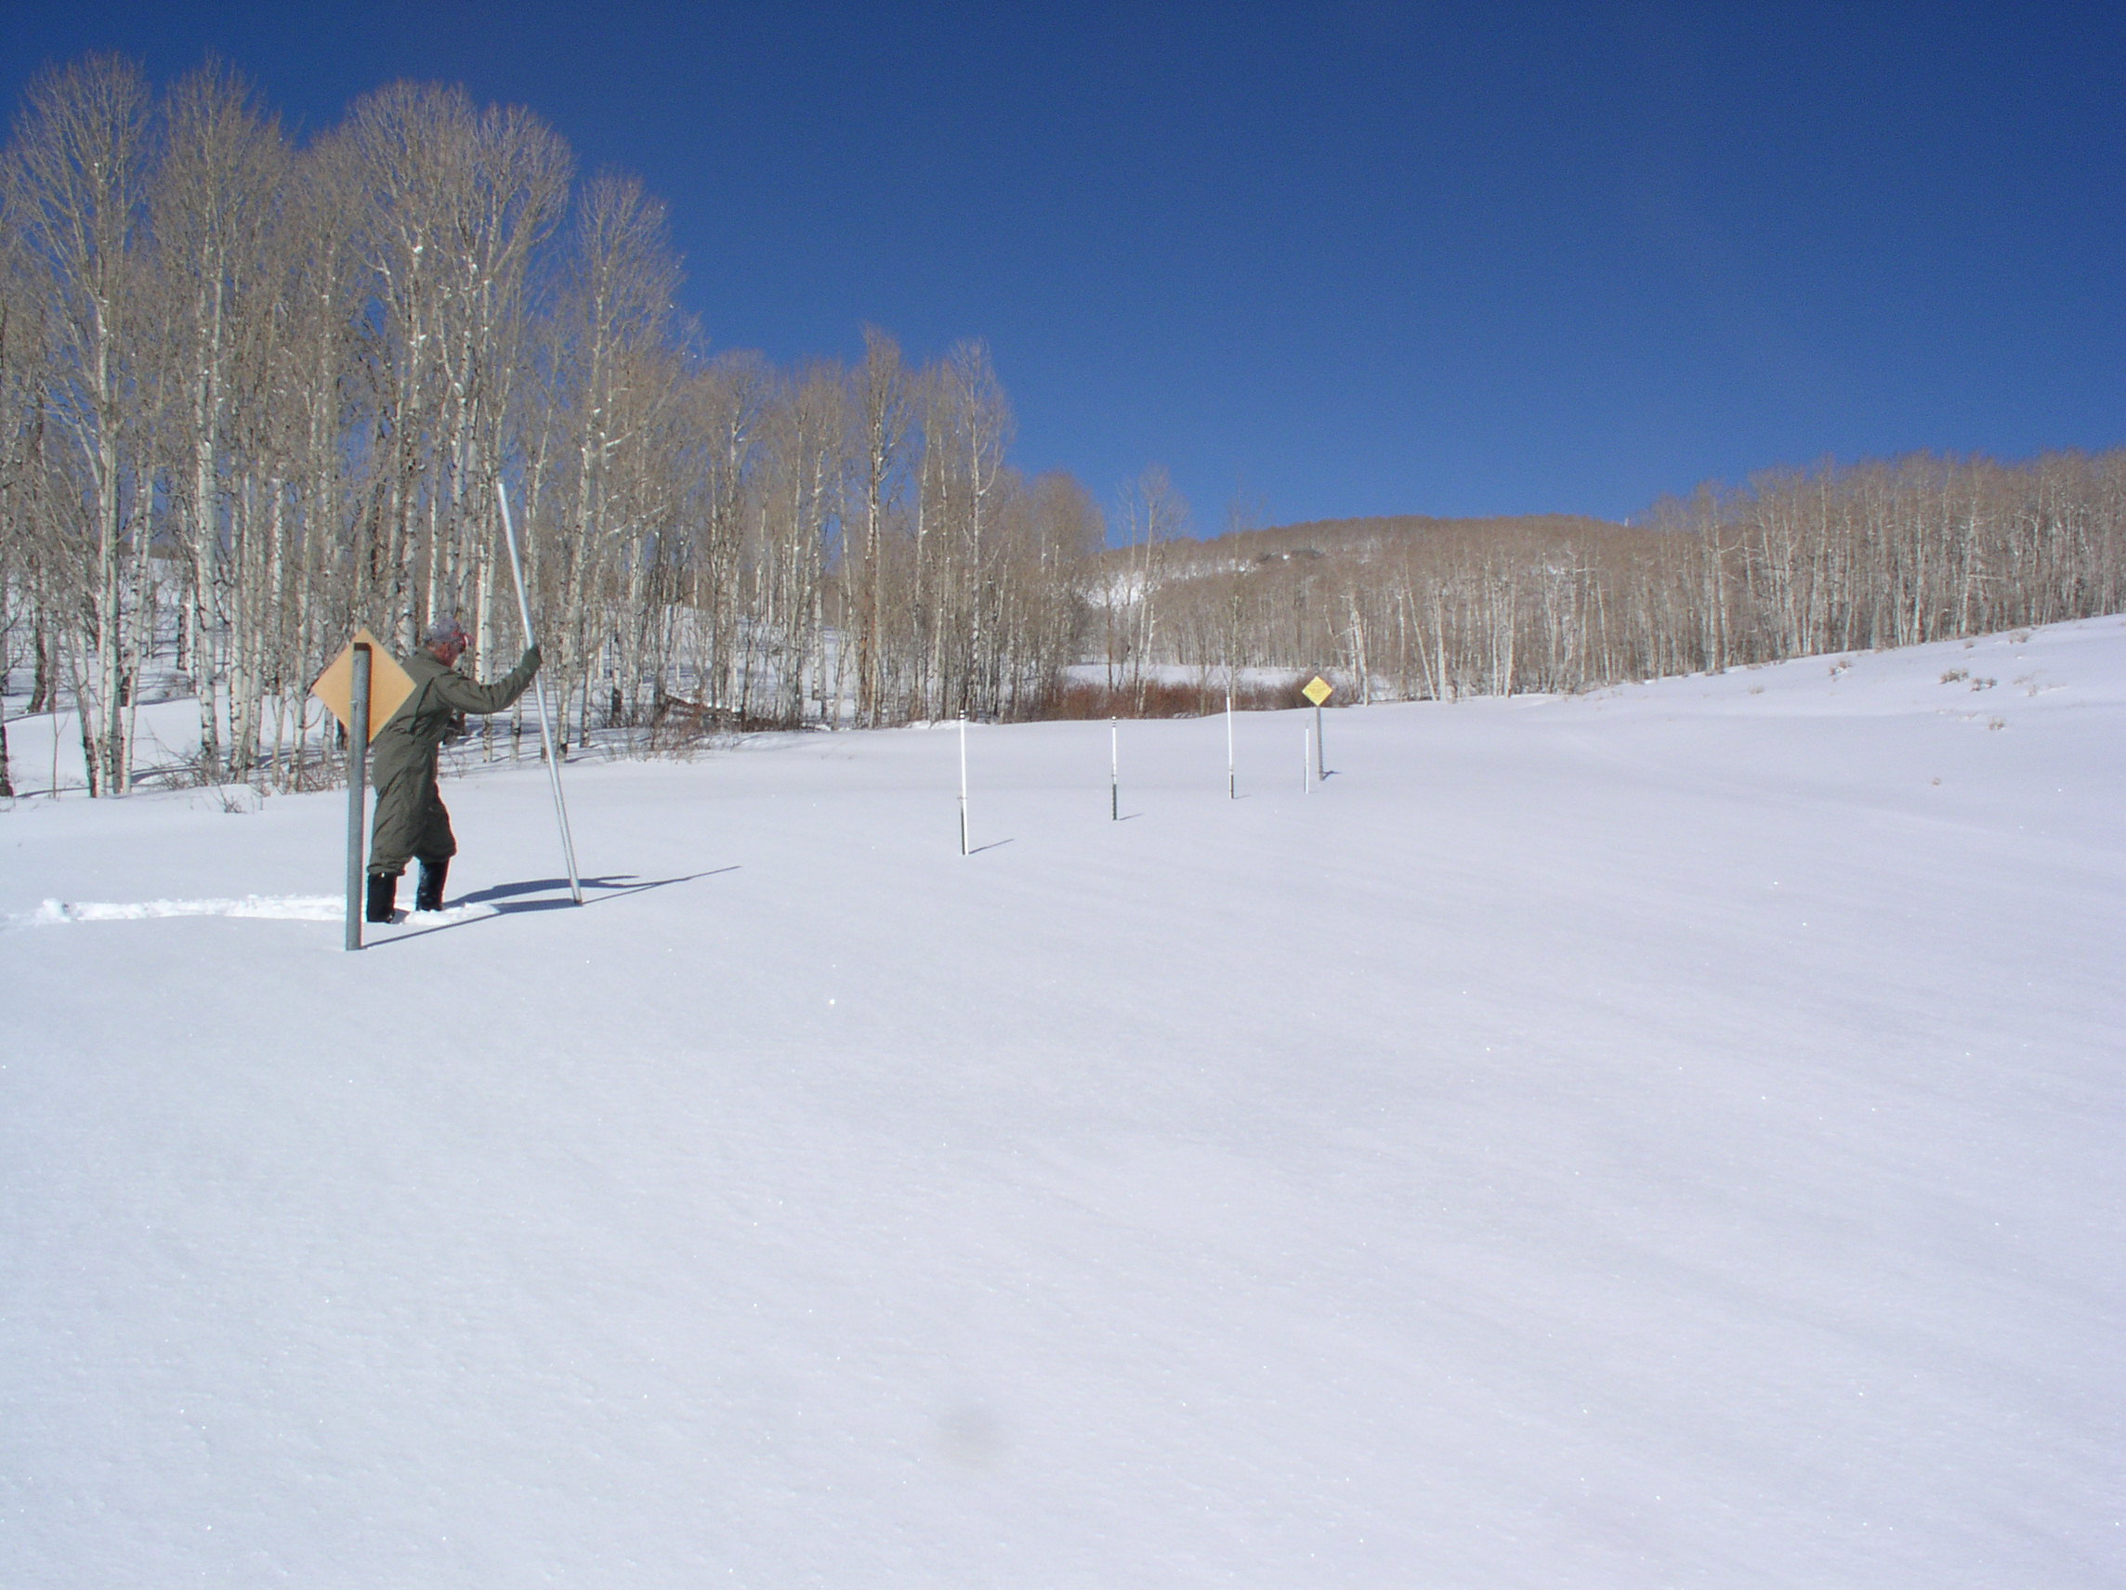
Colorado DCO currently has 112 SNOTELS in Colorado and are installing 3 this year:
Medicine Bow, WY
Black Mesa on the Dolores
Bar-M in Arizona

Slide 12
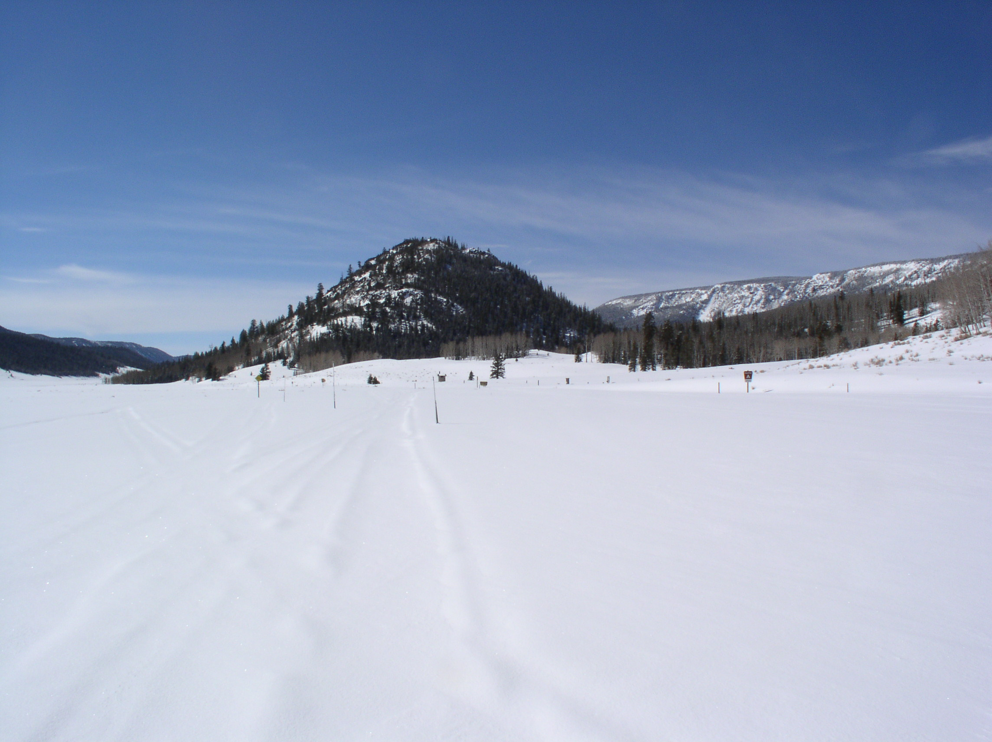
And then 4 more next year and that’s it folks… after that – no more unless they get more staff or different management…
New Mexico – on the Rio Brazos
Sawtooth on the south Platte
Elkhead Divide near Steamboat Springs
High Lonesome near Granby

Slide 13
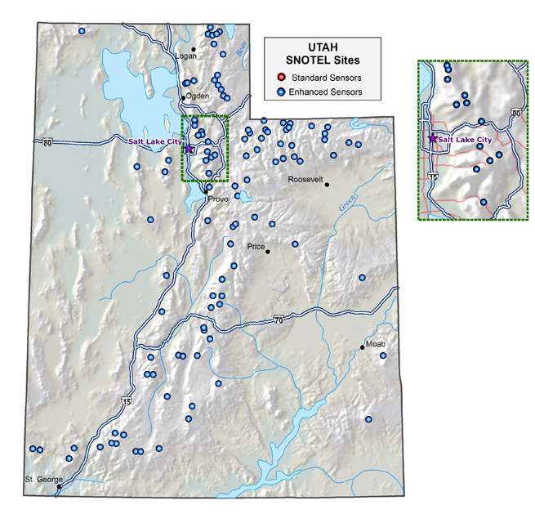
At the end of this and next years field season Utah will have about 125 SNOTEL sites…
All sites have SM/ST and depth.

Slide 14
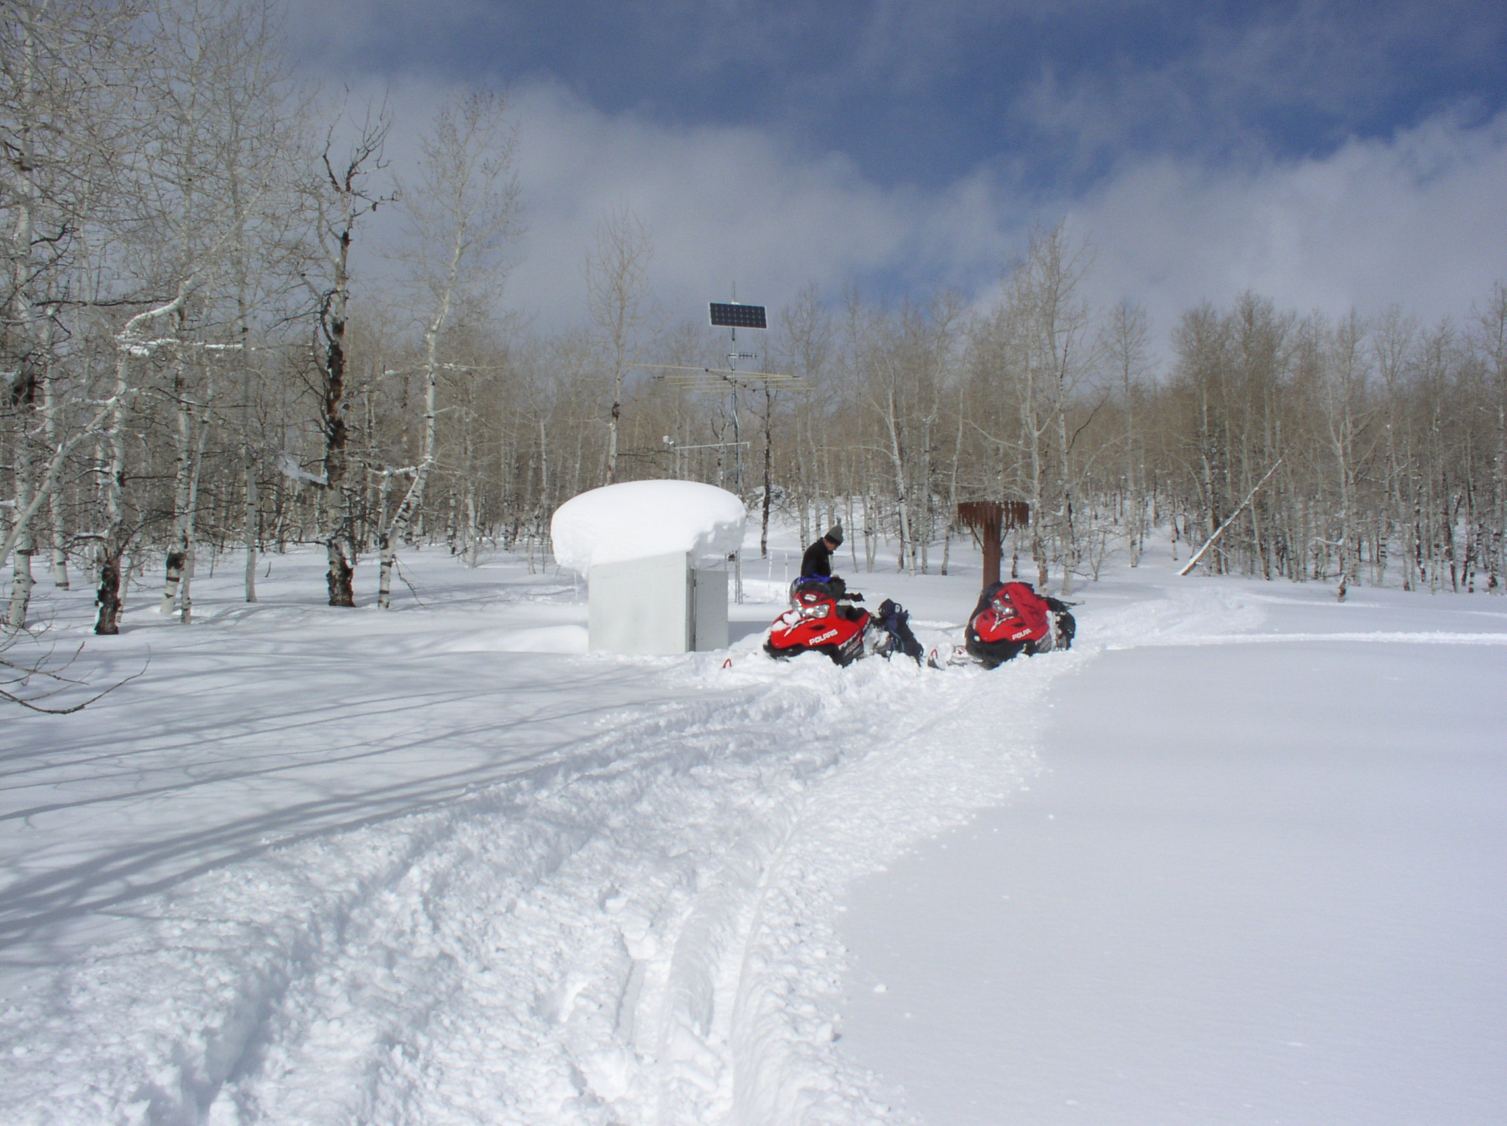
Utah Snotel sites installed this year…

Slide 15
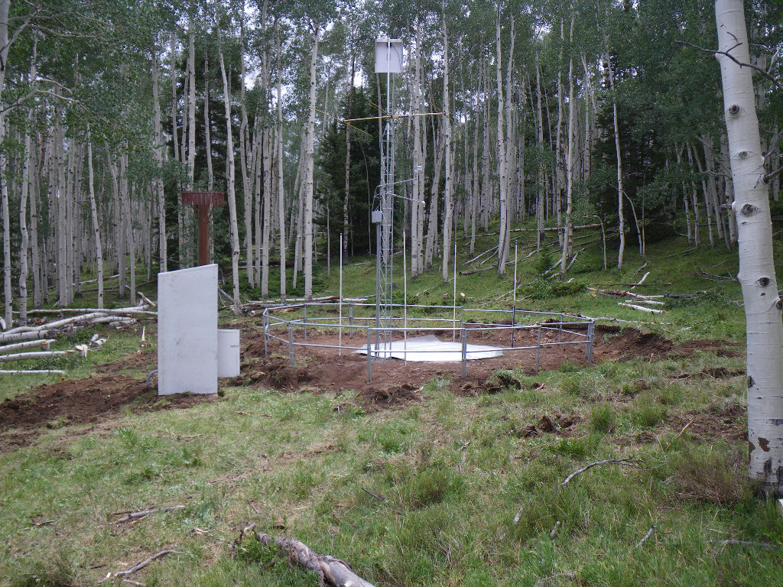
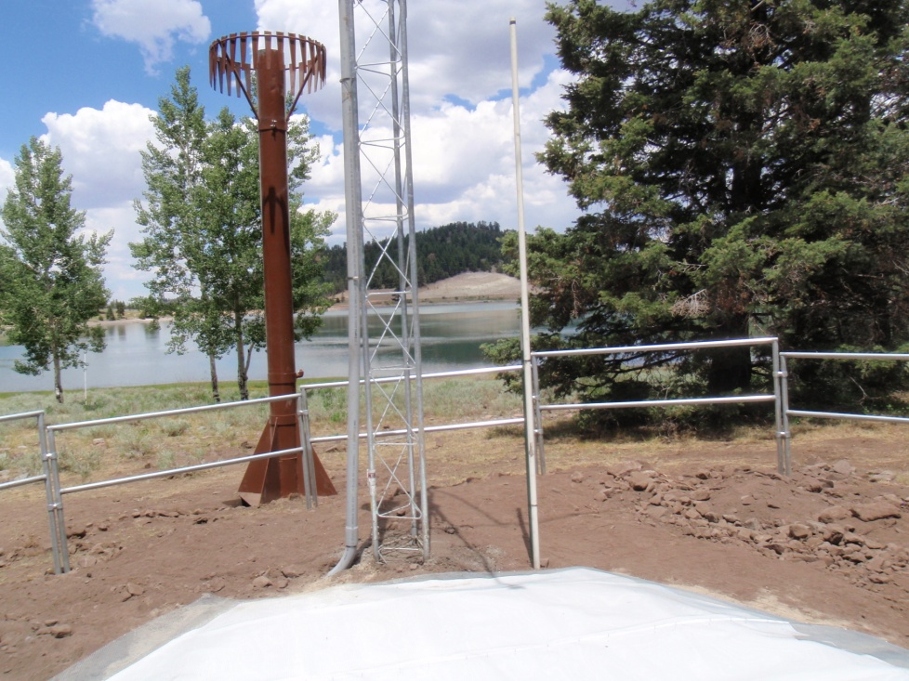
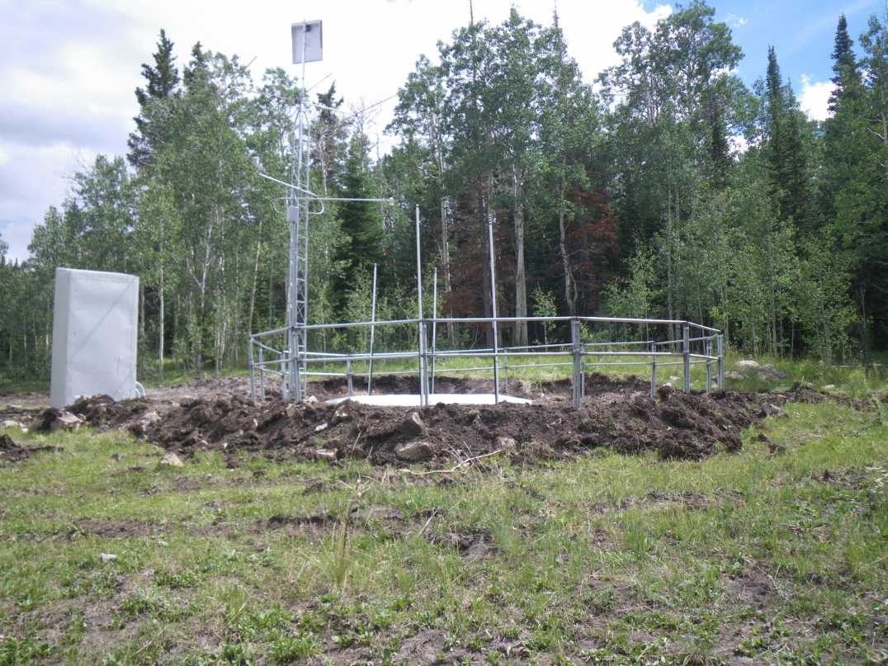
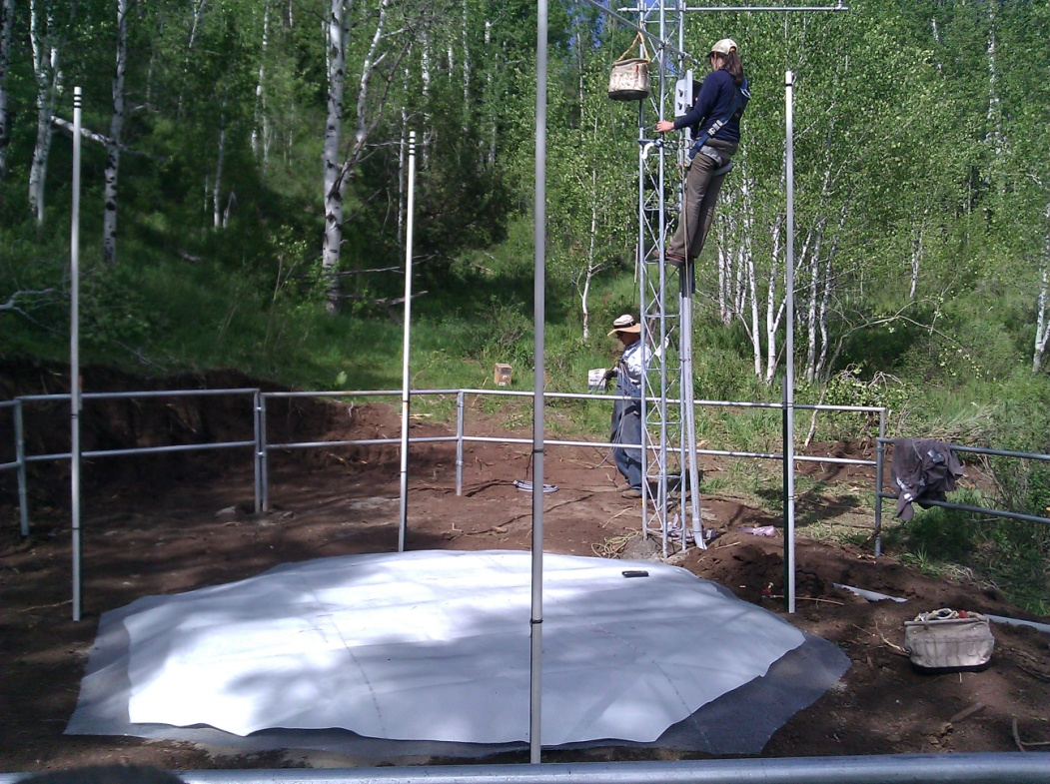
Upper Joes, Wrigley Creek Yankee Reservoir, Rees Flat

Slide 16
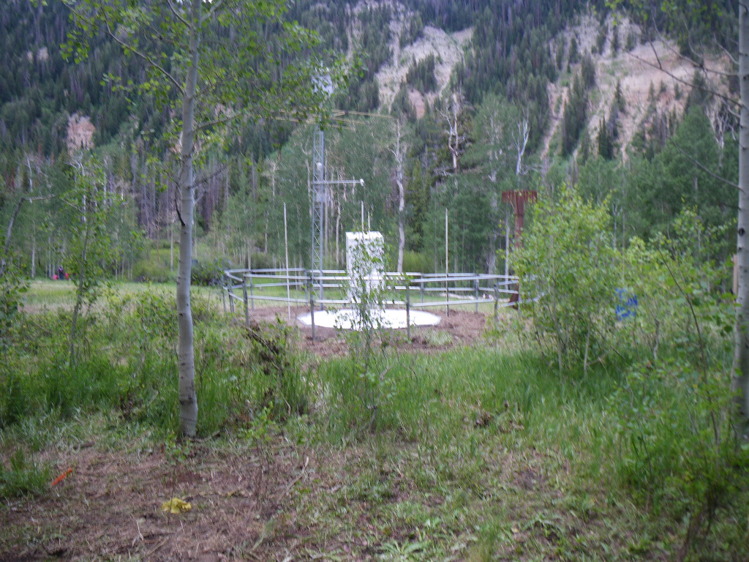
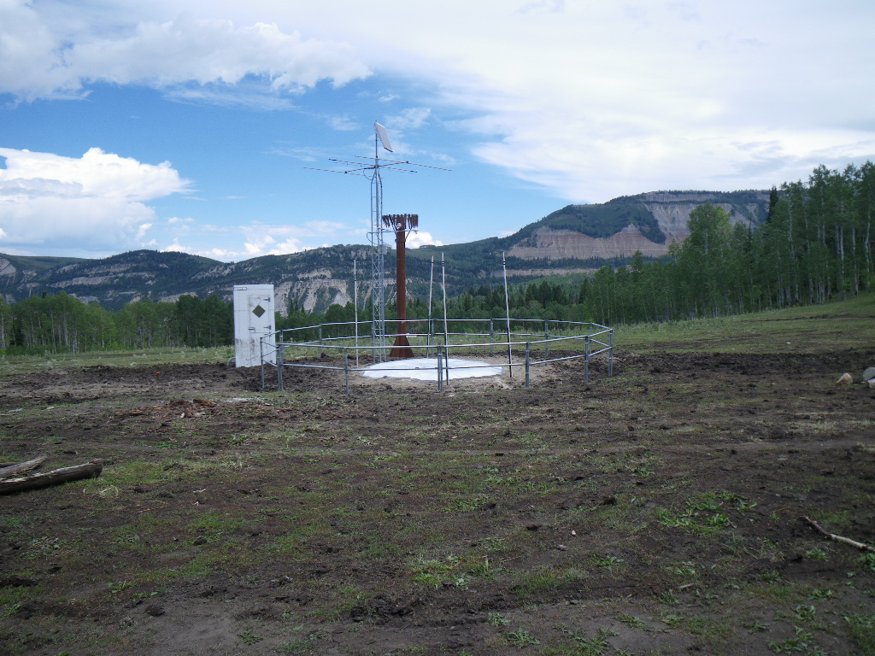
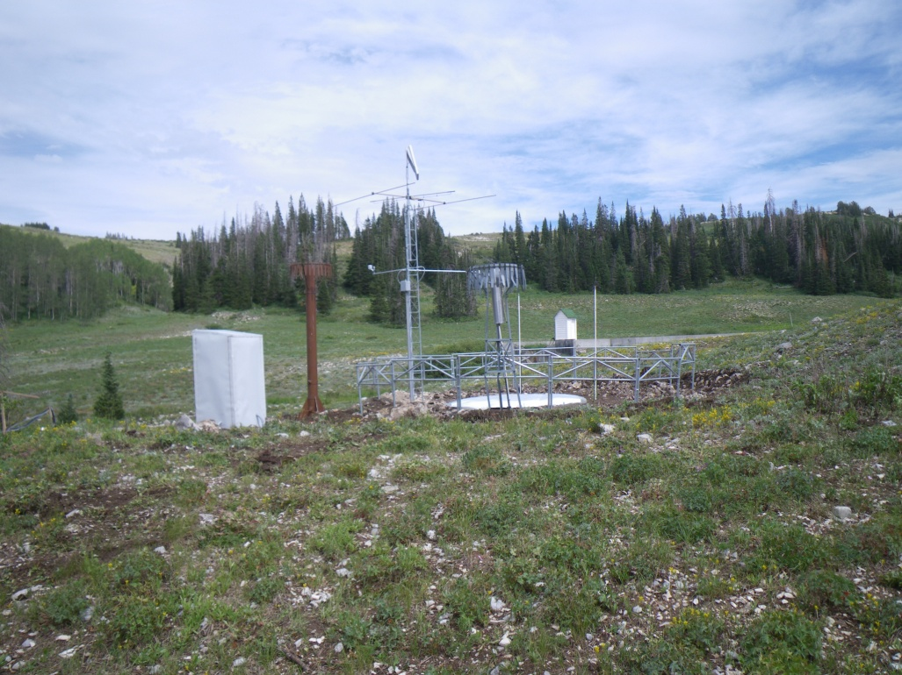
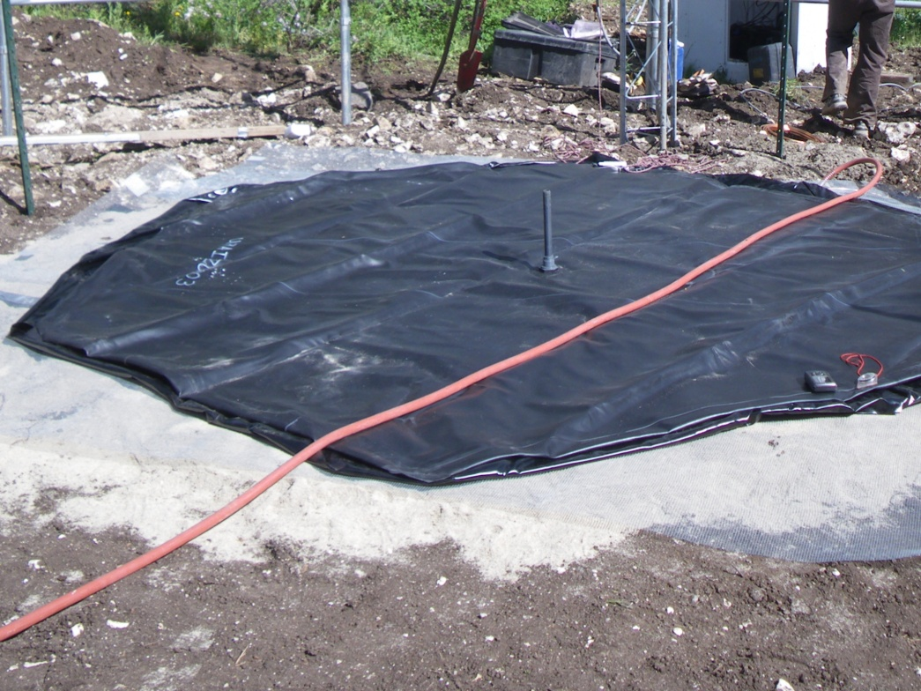
GBRC HQ, GBRC Meadows Thistle Flat, Mt Baldy

Slide 17
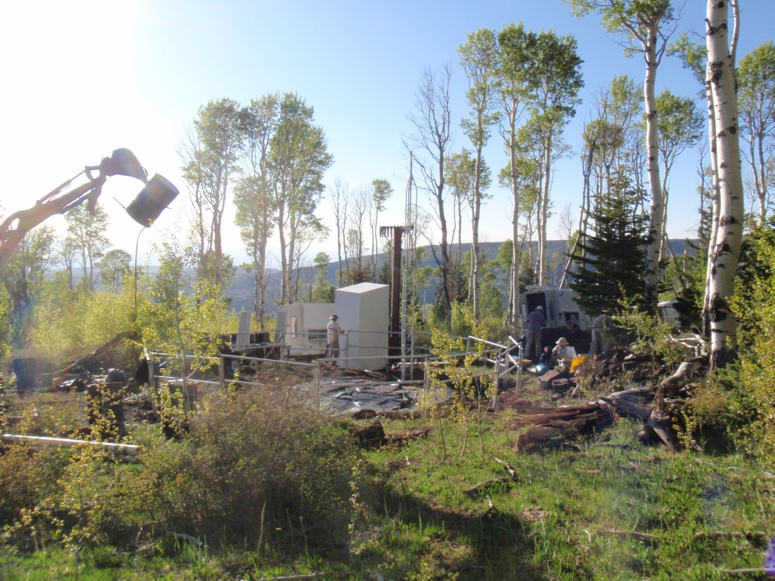
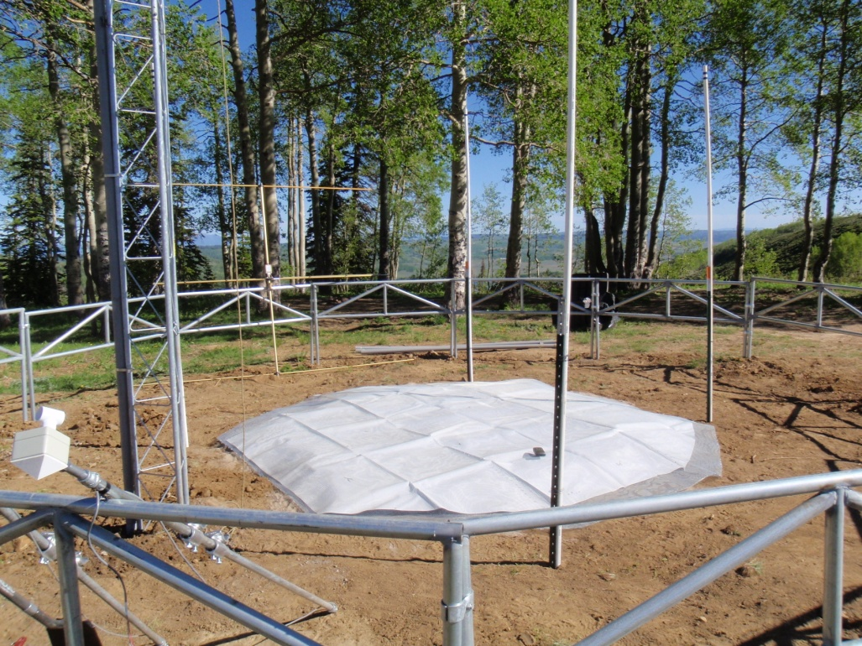
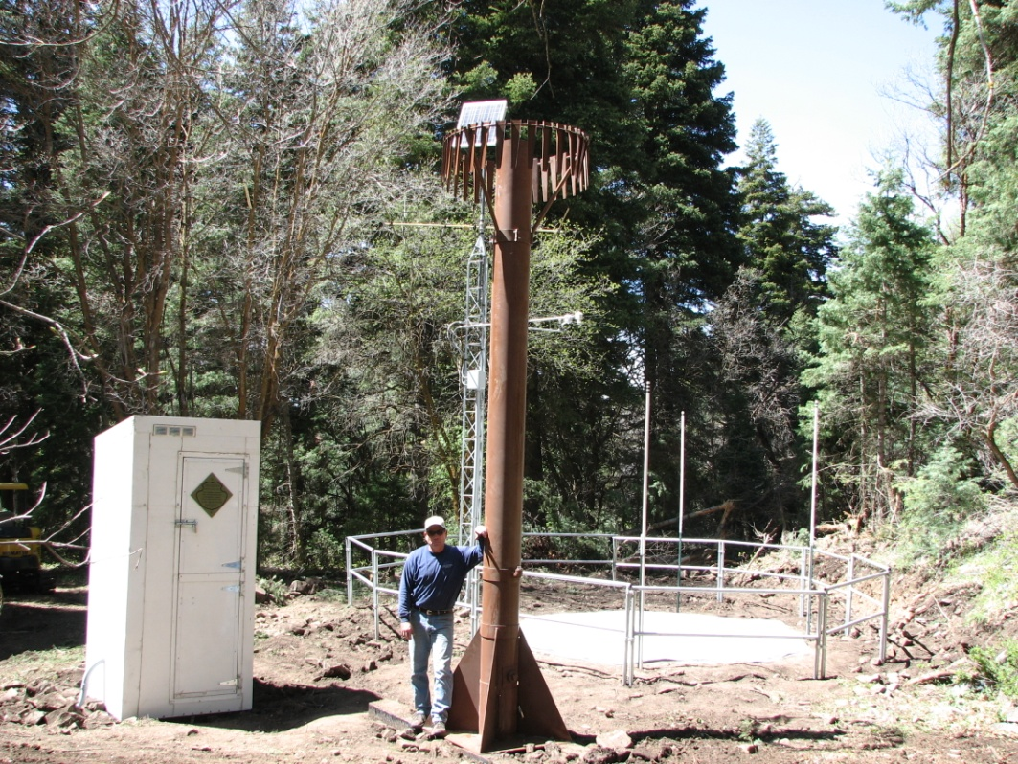
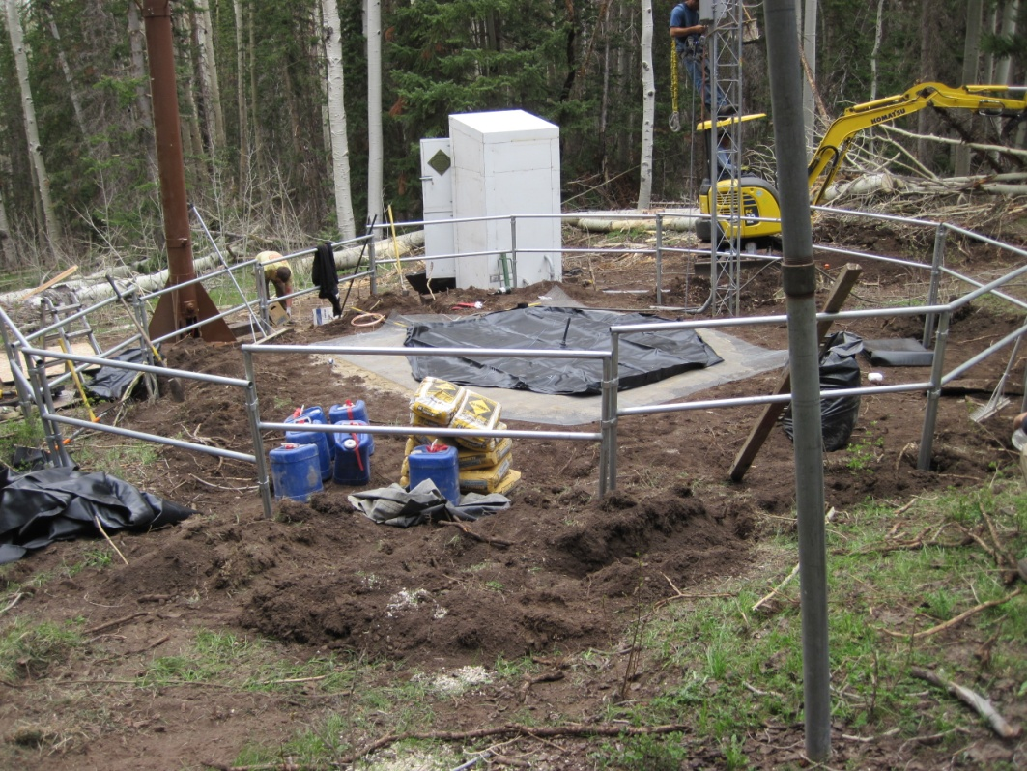
LaSal Mt Lower, Bevans Cabin Huntington Horseshoe, Buckboard Flat

Slide 18
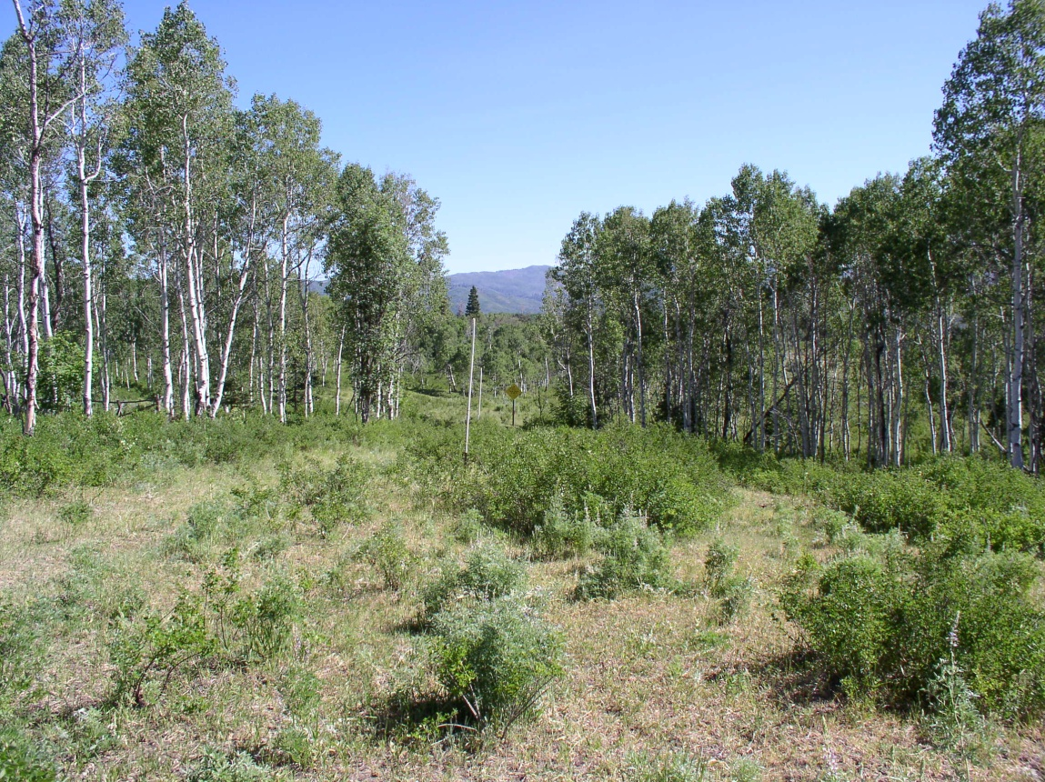
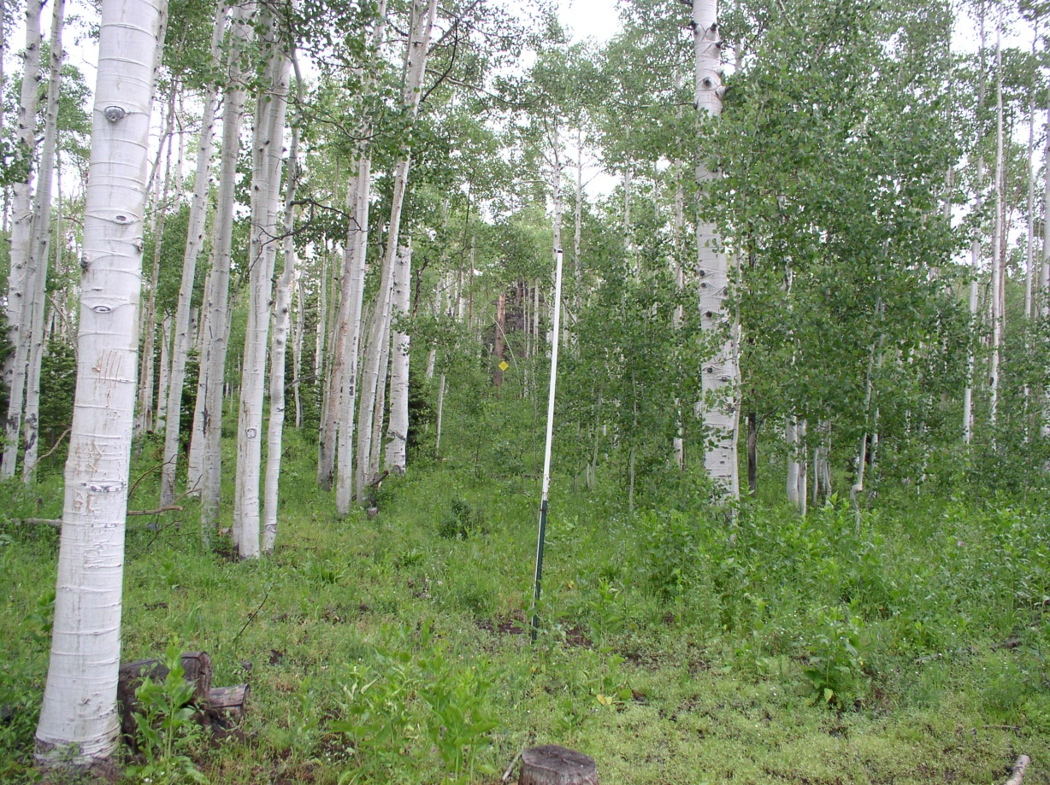
Left to install this year:
Hobble Creek
Redden Mine

Slide 19
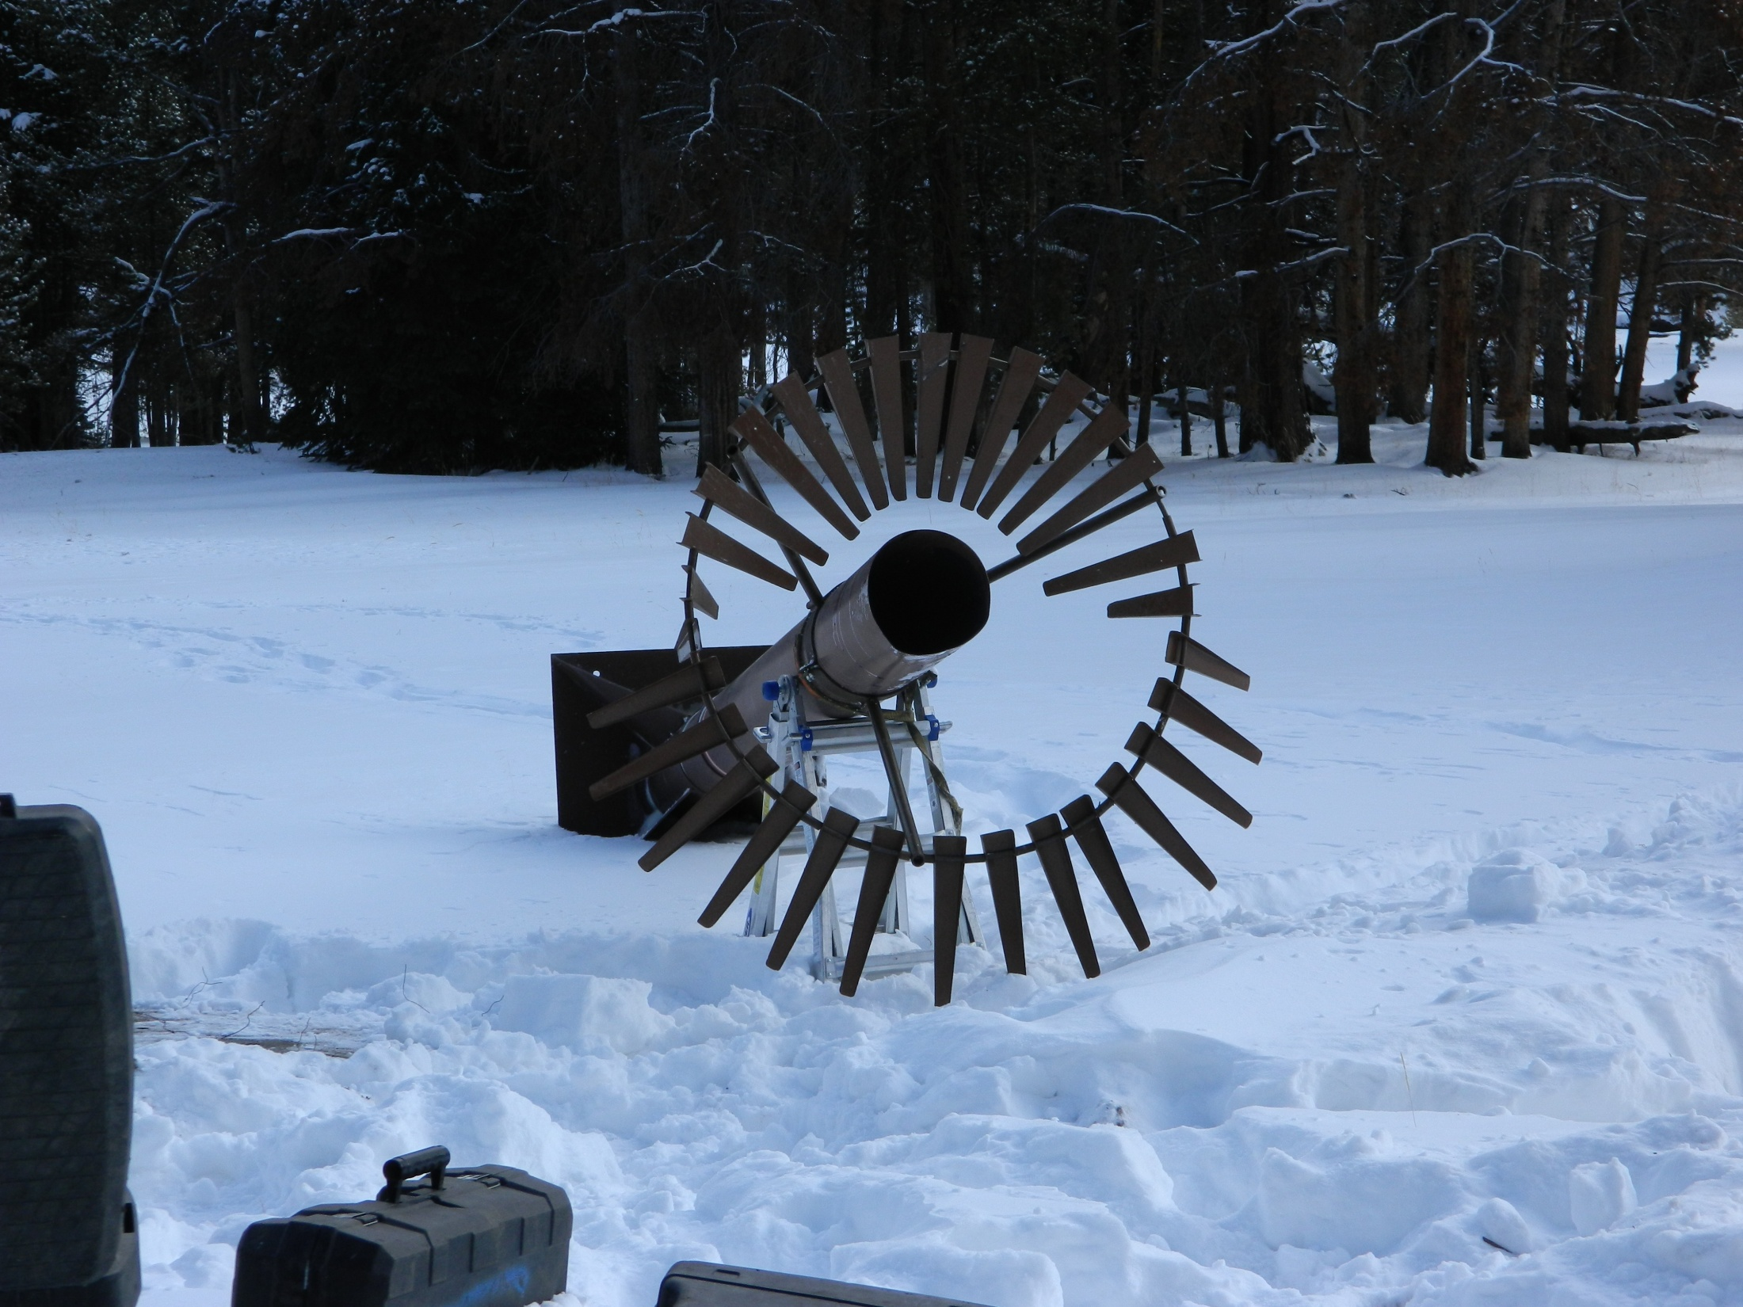
Buck Pasture…
Half done already…

Slide 20
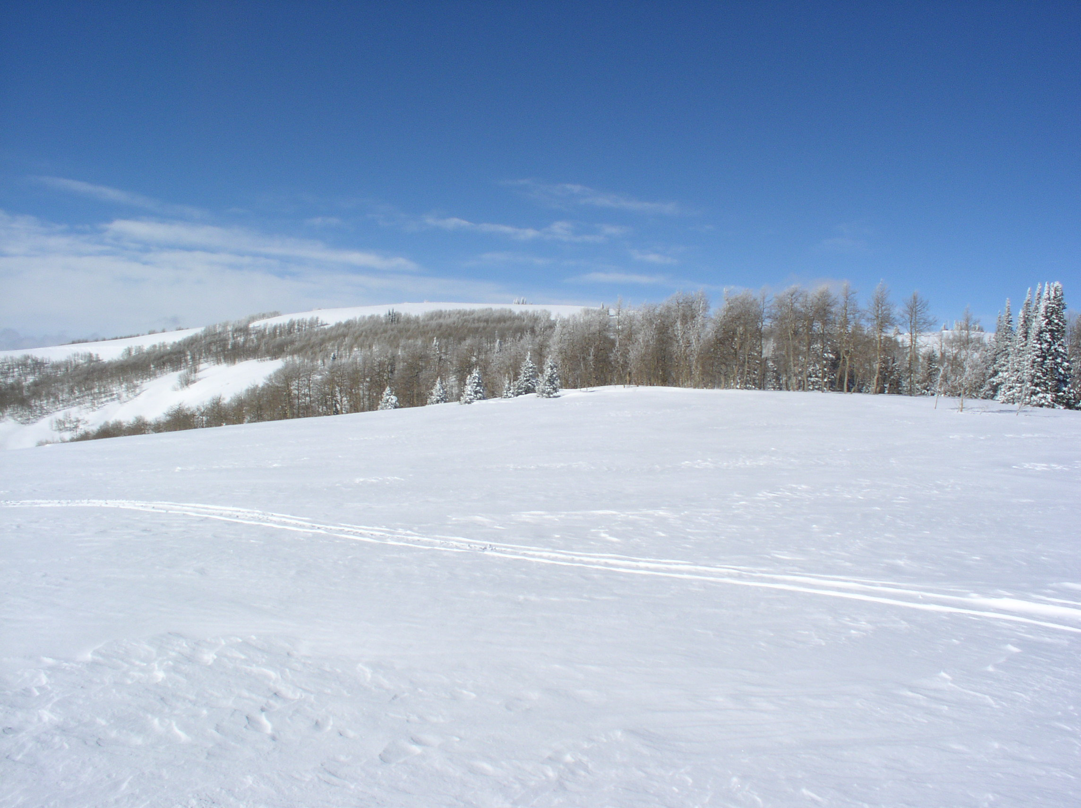
SNOTEL sites to install next year…

Slide 21
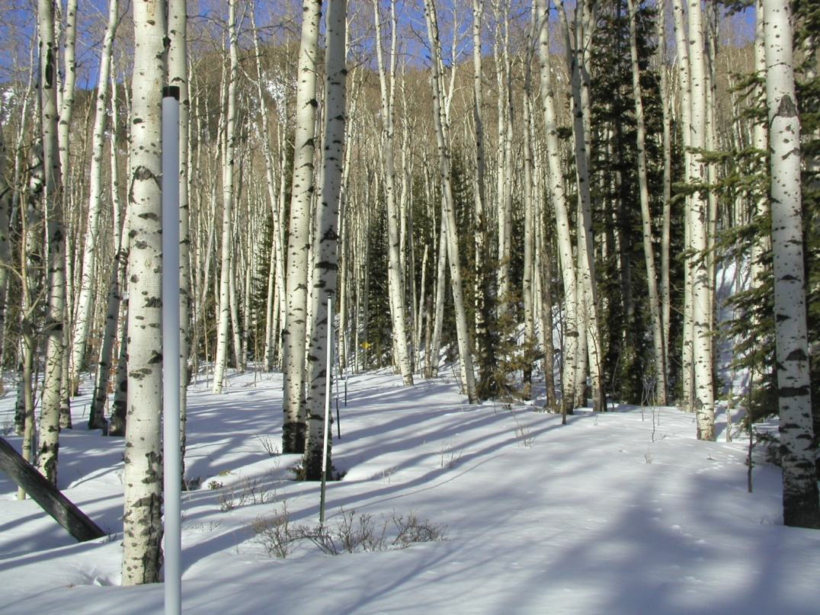
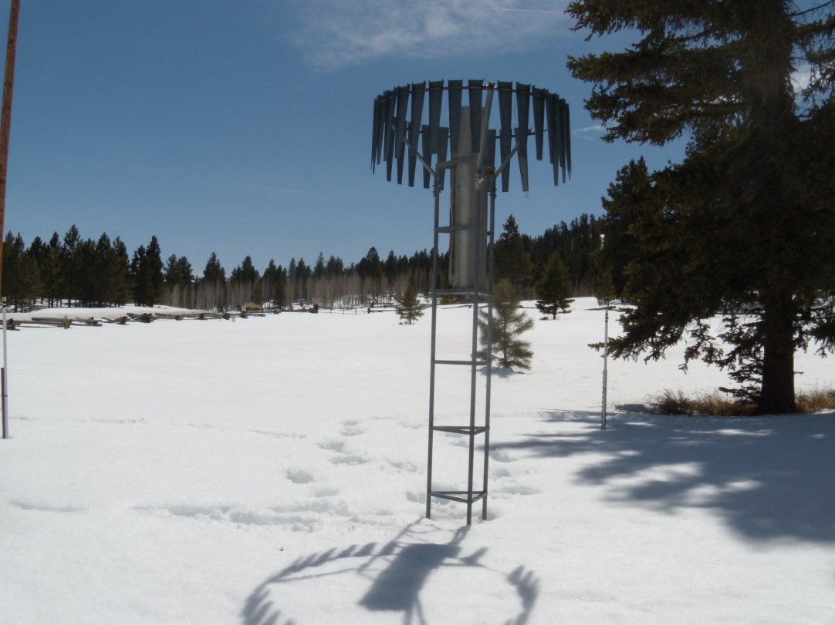
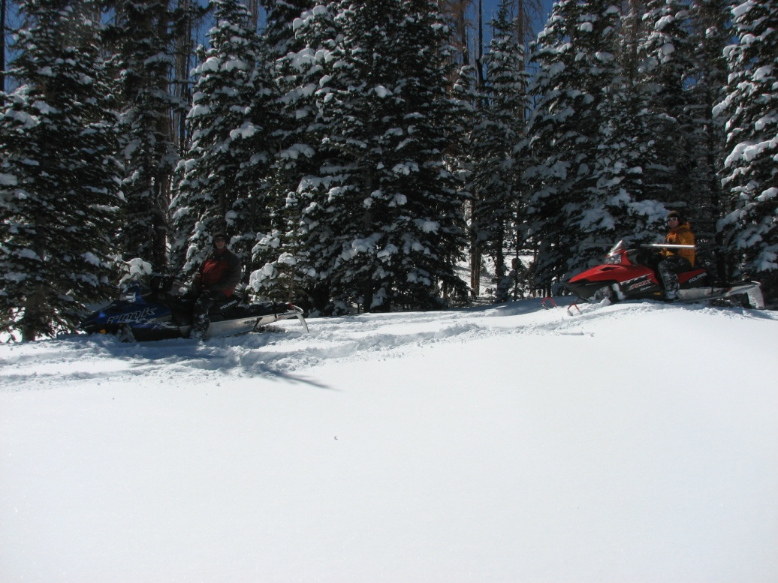
Corral, Sunflower Flat Panguitch Lake and one at Ibapah
As well as 4+ in Nevada…

Slide 22
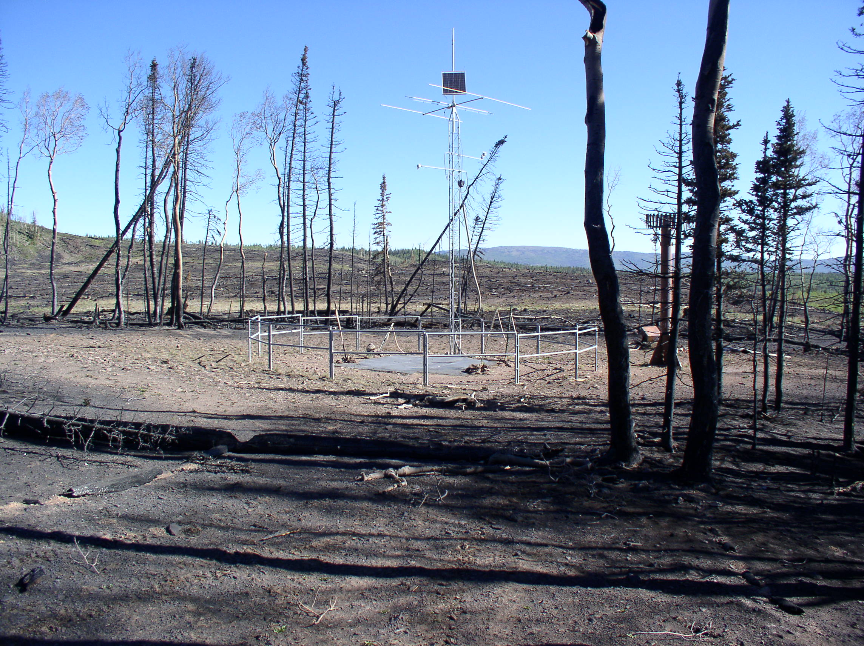
Re-installed Box Creek last week…

Slide 23
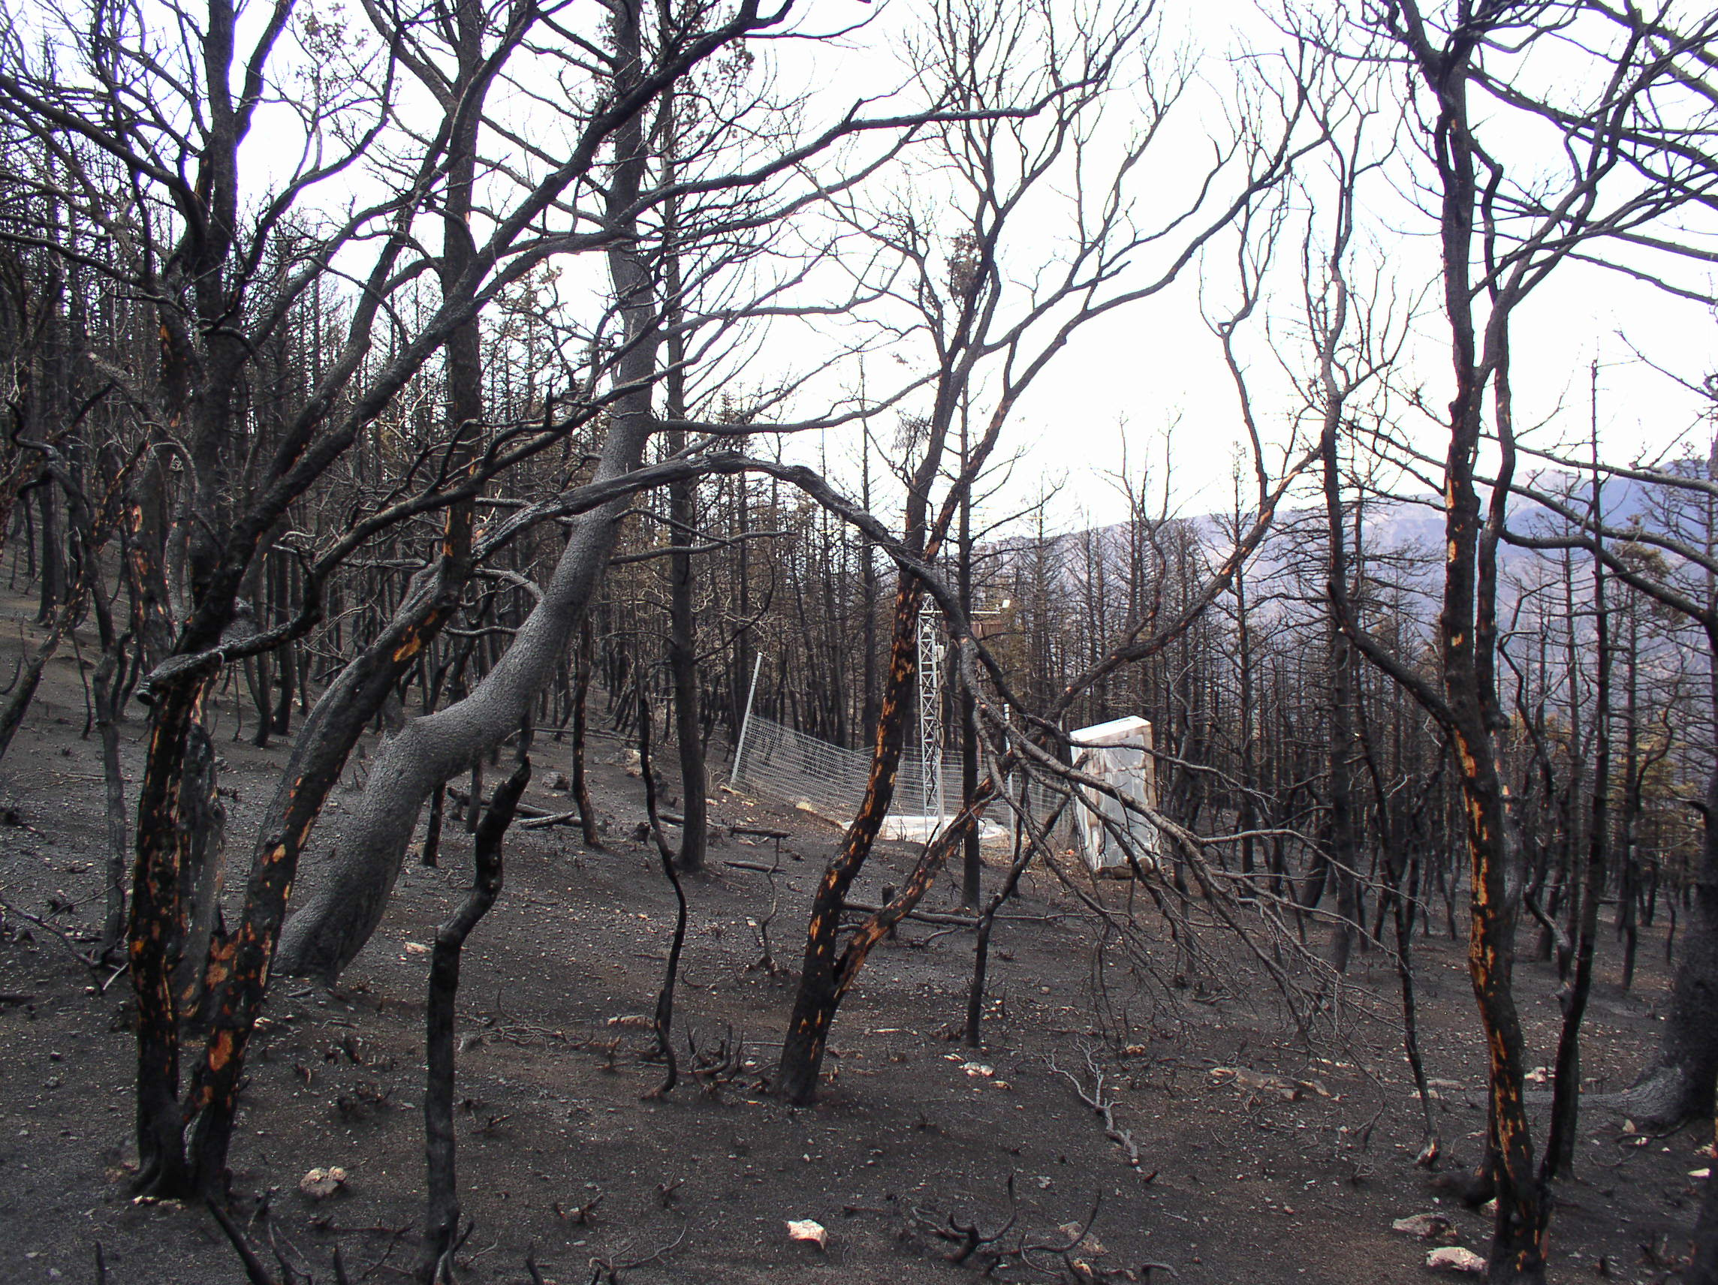
And Oak Creek… no date set yet…

Slide 24
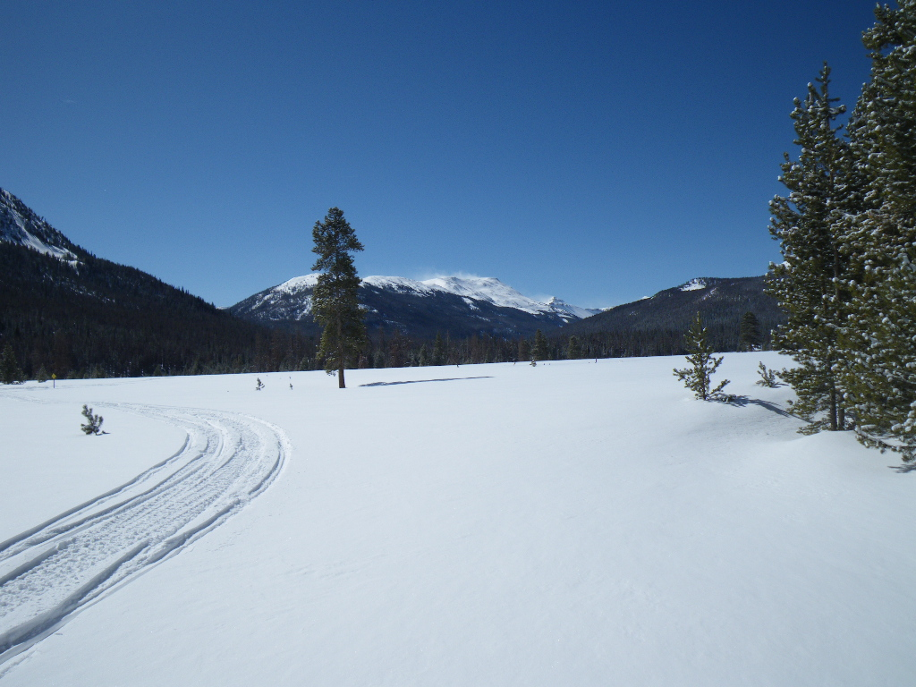
At the end of next year – Utah will have 7 NRCS snow courses that do not have co-located SNOTELs in Utah
6 non NRCS snow courses…

Slide 25
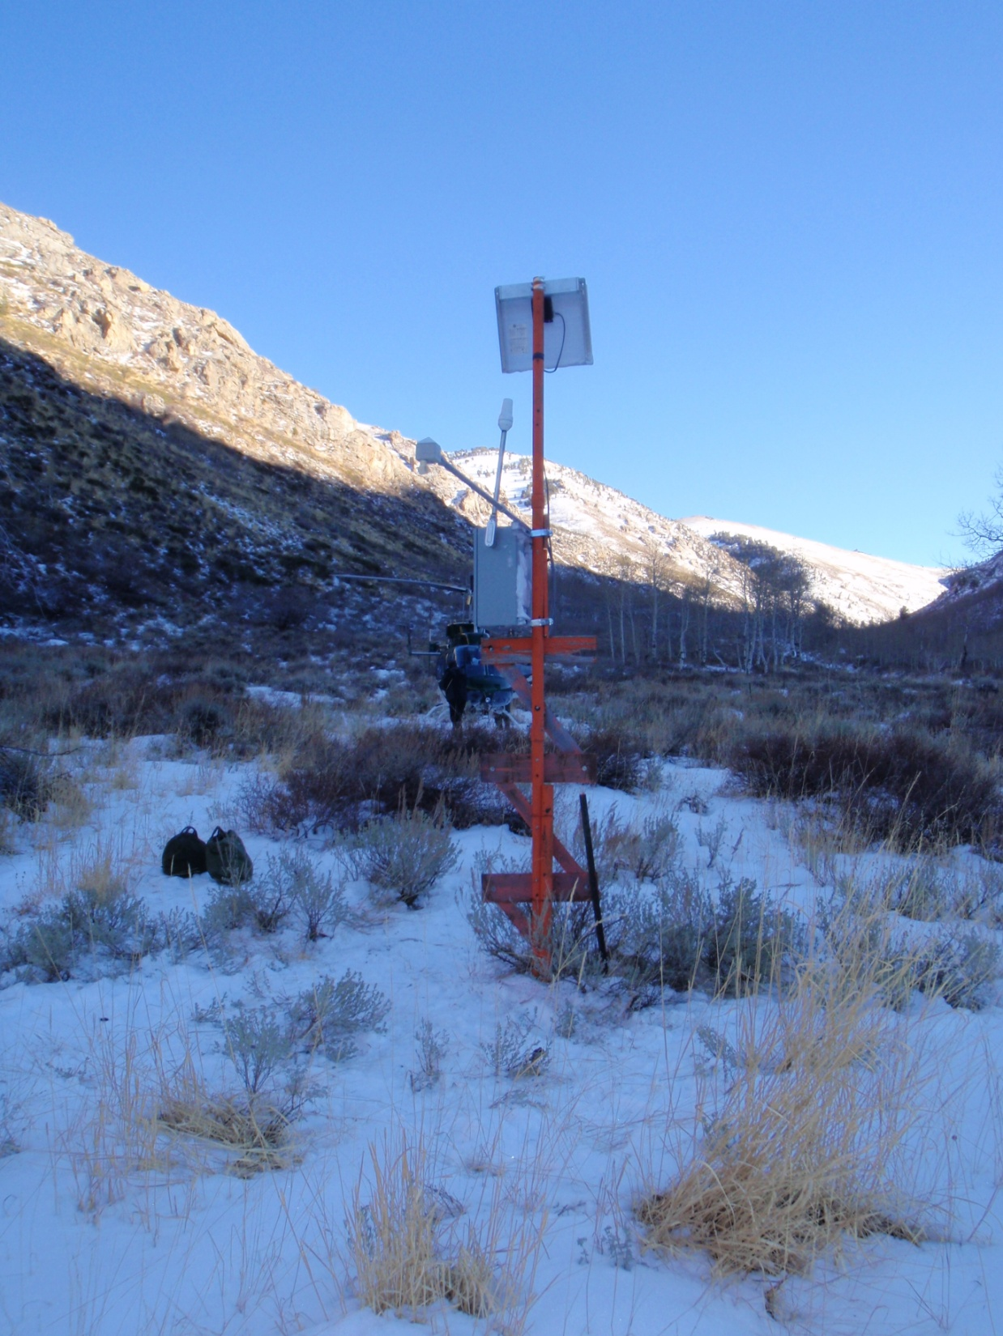
New Technology
Aerial Marker automation
Iridium satellite modems combined with a depth sensor, temp sensor, SM/ST sensors and potentially a small 8 inch rain gage to bring back daily or sub daily data
Small footprint may allow more data from more areas, especially sensitive areas…

Slide 26
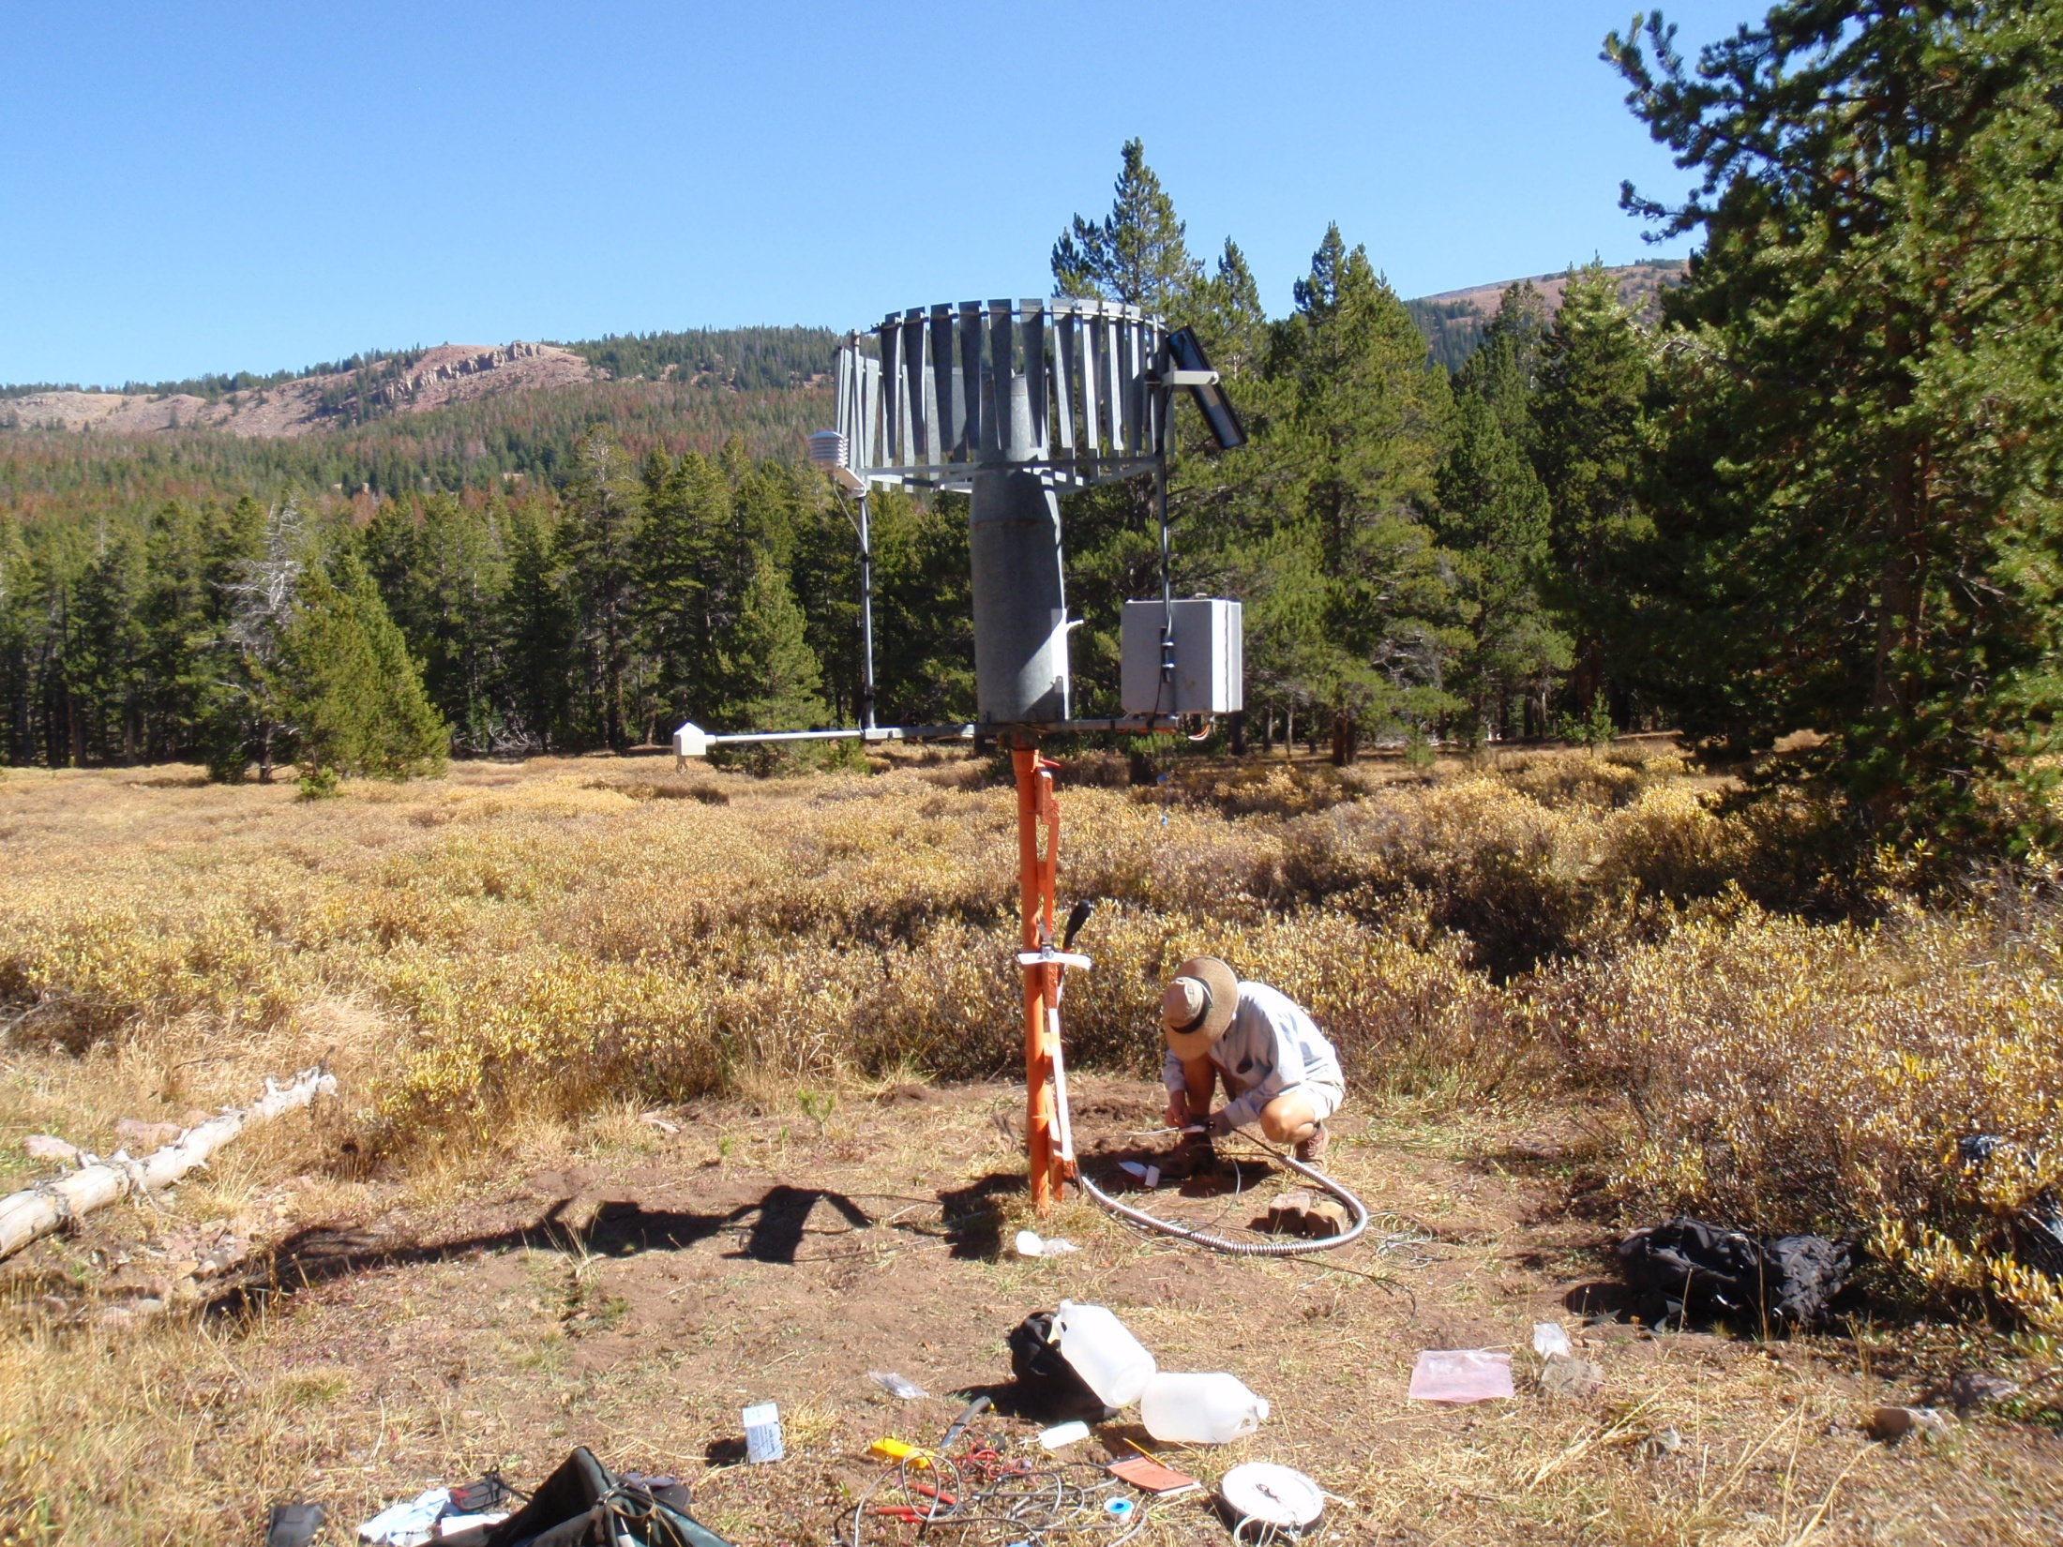
Henrys Fork, High Uintahs Wilderness area…

Slide 27
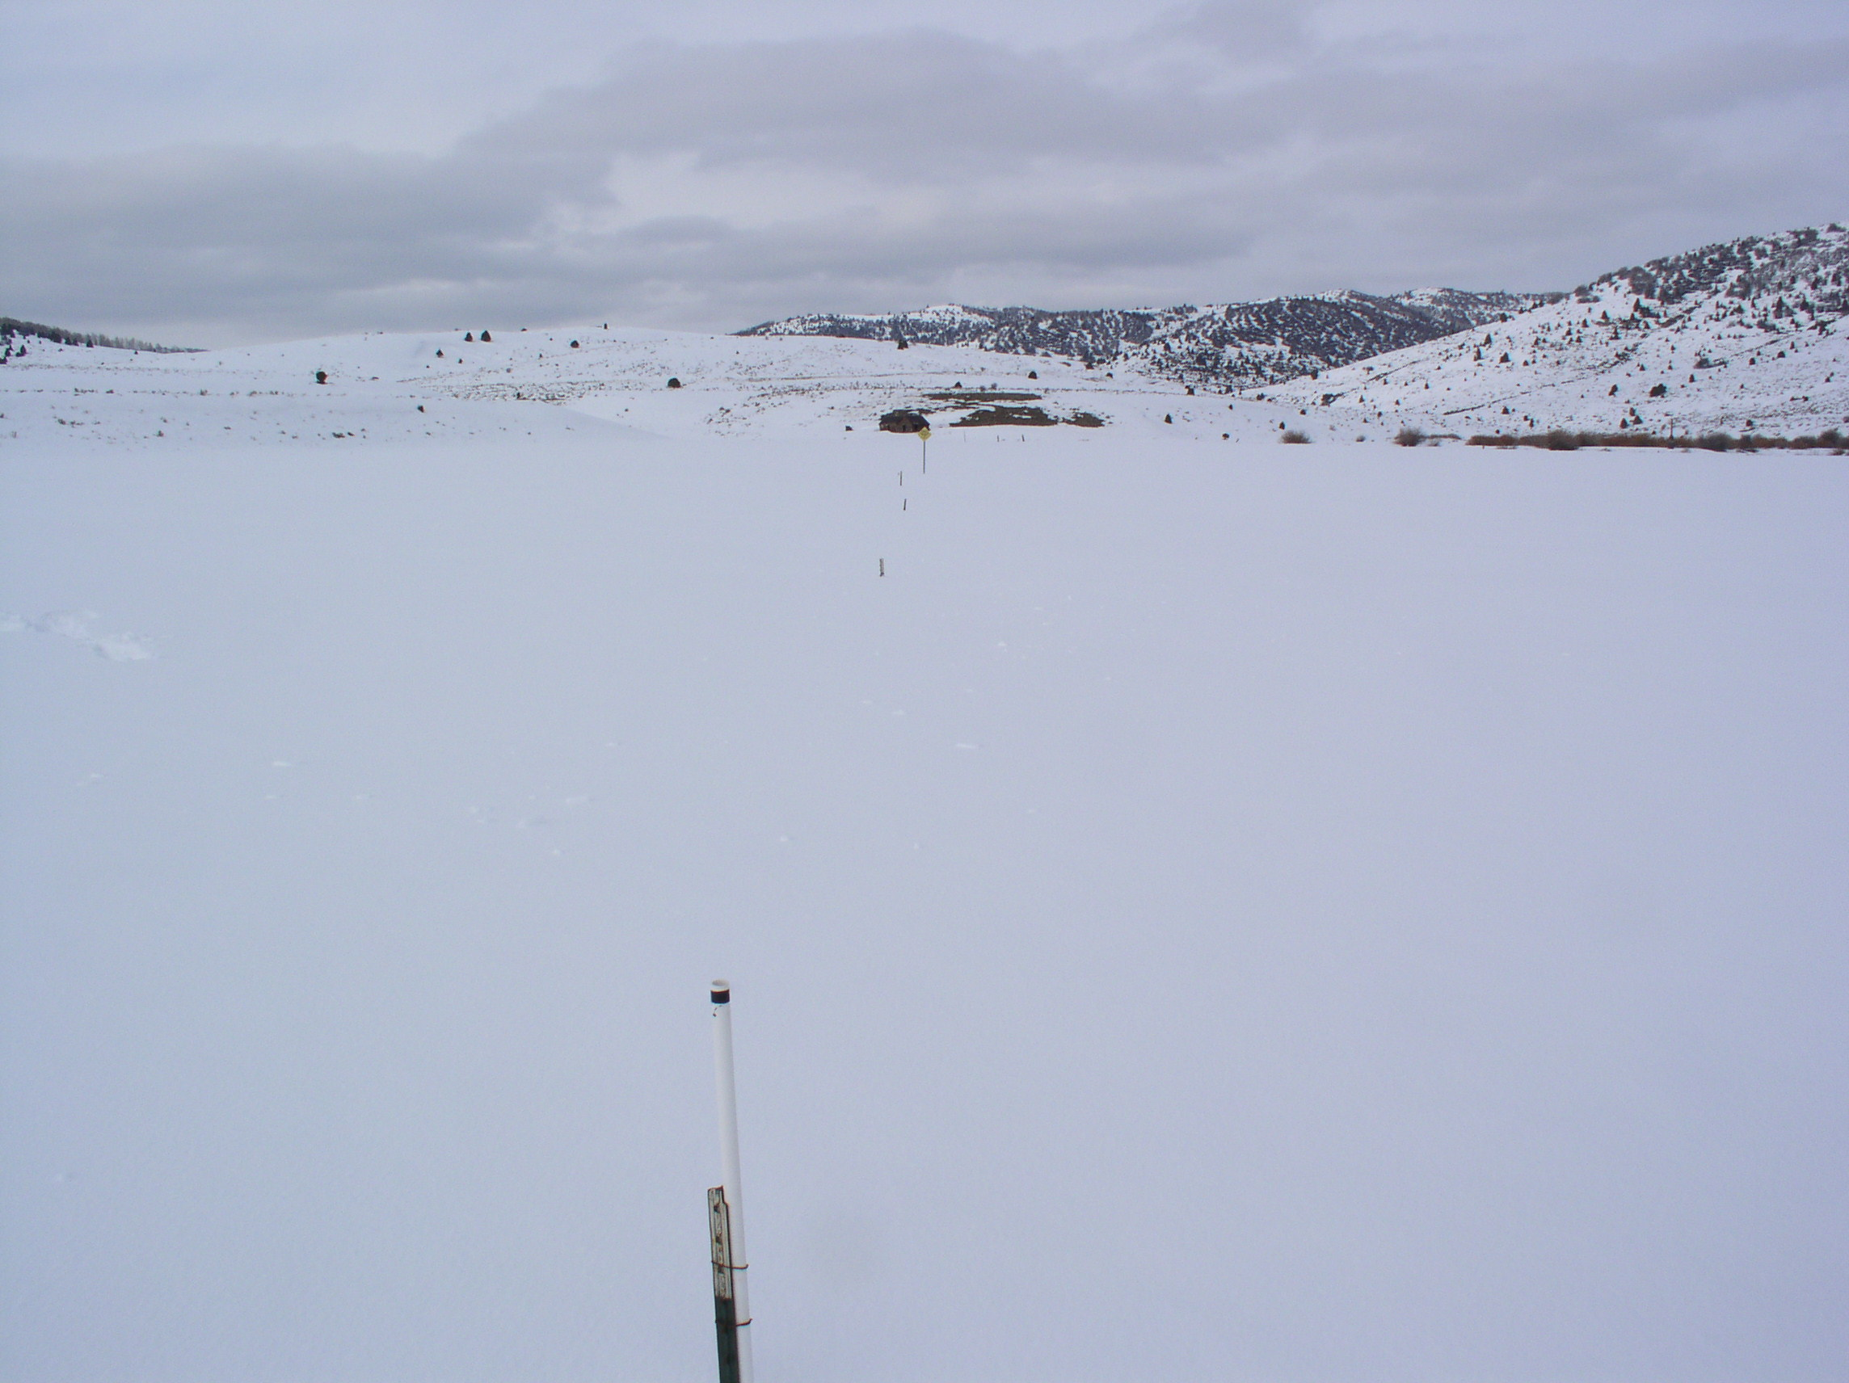
Future directions
We expect budget cuts. All government does….
We are strategizing all areas of our program to obtain greater efficiency and reduce costs. Depending on future reductions we may have to make hard choices on what data and products are most important with regard to our mission of Water Supply Forecasting.

Slide 28
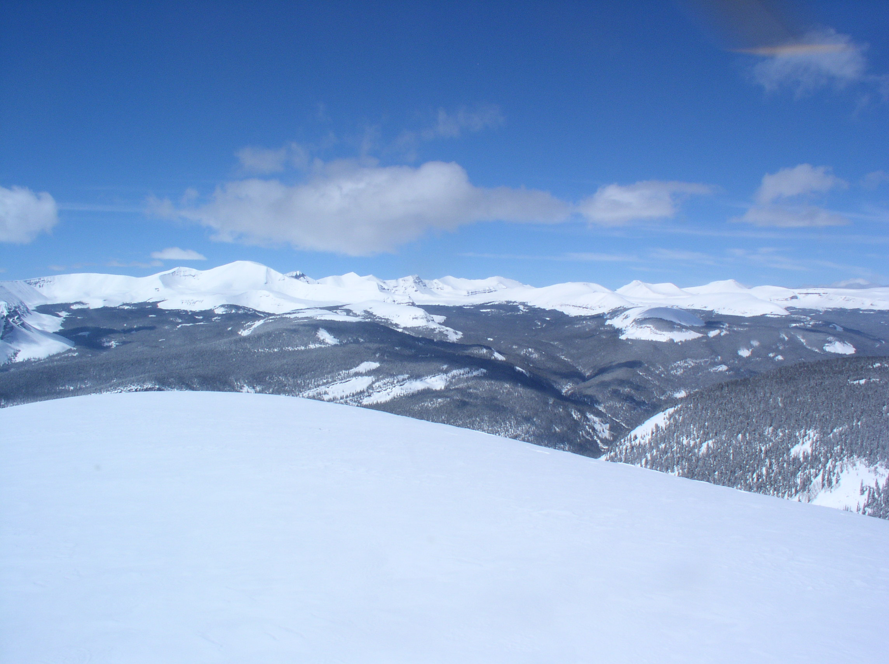
The program has already had budget cuts.
These have so-far been offset by NHQ discretionary funds such that there have been no impacts and in fact – we have had an increase that has allowed the installation of some new sites.

Slide 29
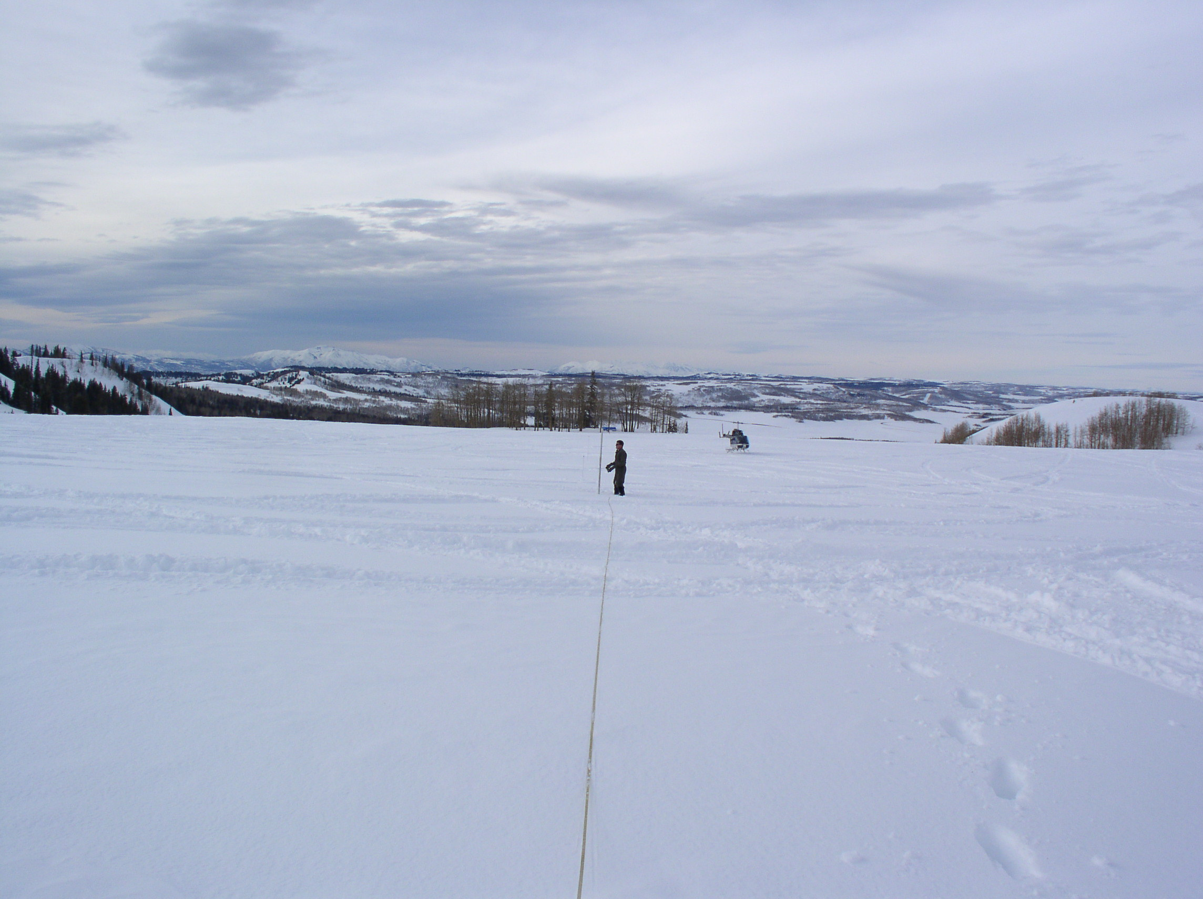
There are about 65 FTE’s in the Snow Survey Program Total…
In a program this small – budget cuts of 10%-20% will have severe impacts on our ability to operate and maintain data and products.
Cumulative effects of annual cuts will be analyzed each year and appropriate steps taken to maintain highest priority data.

