Slide 1
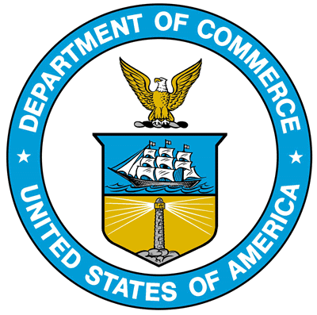
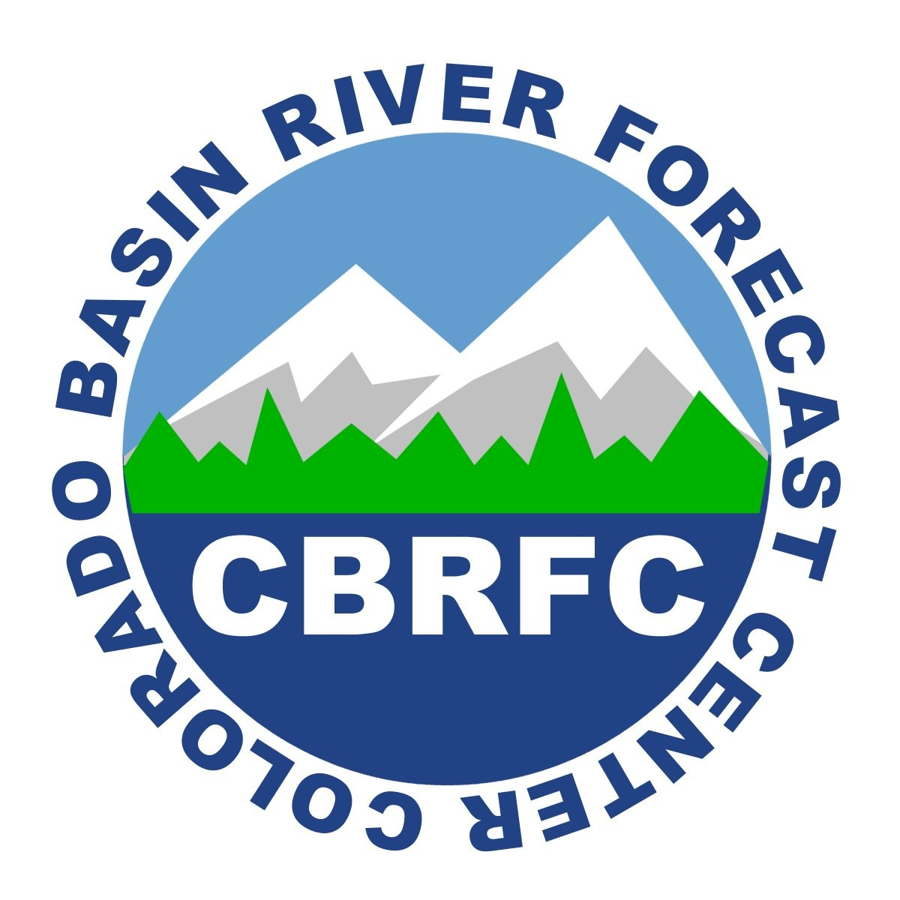
July 31, 2012
Future Colorado Basin Observing System
Kevin Werner
NWS Colorado Basin River Forecast Center
Tim Bardsley
Western Water Assessment

Slide 2
Outline
Previous gaps analyses
Common threads?
Where do we go from here?

Slide 3
Previous Gaps Analyses
Several studies have examined the Colorado Basin observing system:
Proposed Enhancements to the Colorado River Basin Data Network (NWS, 1983)
Western States Watershed Study (2009)
Analysis of Watersheds Monitored by the USGS streamflow-gaging station Network in the Upper Colorado River Basin (USGS, 2011)
A Vision of Future Observations for Western US Extreme Precipitation Events and Flooding: Monitoring, Prediction, and Climate (NOAA, 2011)
NRCS Studies

Slide 4
1983 Studies
“describes the requirements analysis made by the NWS for the design and implementation of an automated real-time data network… In today’s fast-paced, high-tech environment, it is quite difficult to describe accurately…”
“To improve [CBRFC forecasts requires models] that require real-time data from the entire basin to produce the best possible river forecasts… in two parts:”
Lower elevation NWS GOES data sites
Higher elevation SNOTEL
CBRFC conceptual models “used in a limited sense” include “Extended Streamflow Prediction” for Lake Powell inflow forecasts.
“The sparse real-time data network is a primary deficiency found by the CBRFC in using conceptual models”

Slide 5
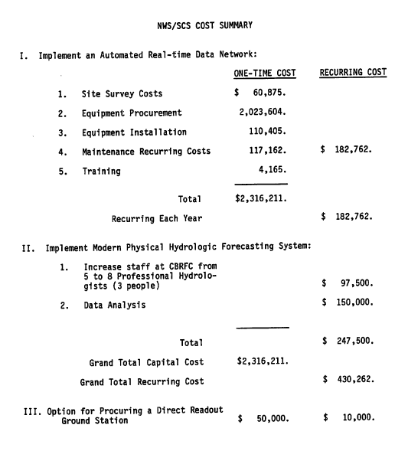

Slide 6
Western States Watershed Study, 2009
USACE led compilation of data collection system requirements for networks important for western water issues including:
Streamgage
Ground Water
Precipitation
Snow
Evapotranspiration
Recommends sustaining support for key networks including USGS stream gaging, NWS COOP, snow remote sensing, and ET networks and leveraging new technologies where appropriate.
Also recommends establishment of a water data portal or hydrologic information system (HIS) through CUAHSI.

Slide 7
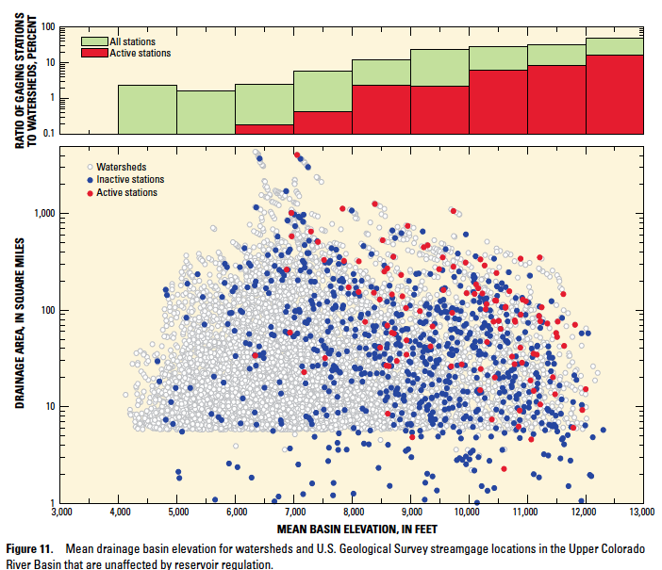
USGS 2011
Analyzed stream gage network for representative of gaged watersheds to all watersheds in the UCRB. Found:
Unregulated watersheds well represented by gage network but not underrepresented by active network
Regulated watersheds well represented by gage network
Gage network includes 1,053 stream gages of which 223 were active in 2010.

Slide 8
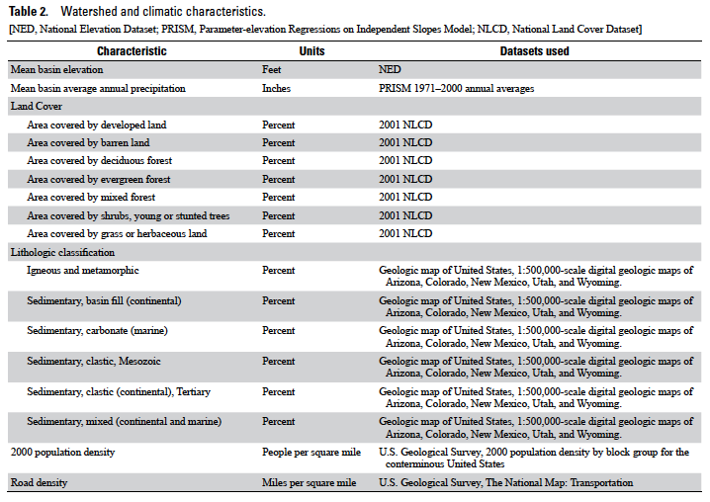

Slide 9
NOAA 2011 (Ralph et al)
A Vision of Future Observations for Western U.S. Extreme Precipitation and Flooding: Monitoring, Prediction and Climate

Slide 11
NRCS
New software developed with Portland State (PSU) to help identify data deficient areas for new site location, with an eye towards more physically based hydrology models
Automation of existing manual snow course network yields hourly vs. monthly data, decrease in travel costs
Automating aerial markers with snowdepth and temperature
Developing new automated daily QC program with PSU to improve timeliness and consistancy

Slide 12
Common Threads
Importance of observing systems – especially snow and streamflow
Maintenance
Strategic expansion to address representativeness
New technology (e.g. snow remote sensing)
Enhanced sensors (solar, soil moisture, wind)
Monitoring atmospheric conditions overland and sea critical to shorter lead forecasting
Efforts are not cheap
Major events (e.g. 1983) can be powerful motivators

Slide 13
Discussion
To what extent is the current observing system sufficient?
Can prolonged drought (e.g. 2000s) be as powerful a motivator as flooding (e.g. 1983)?
Is there critical mass for addressing observing system deficiencies? If so, where to go from here?

