Slide 1
Stakeholder Meeting July 31, 2012
Observing System Overview
Kevin Werner
NWS Colorado Basin River Forecast Center

Slide 2
Importance of Data
Good data is foundational for good forecasts.
Bad data ensures bad forecasts

Slide 3
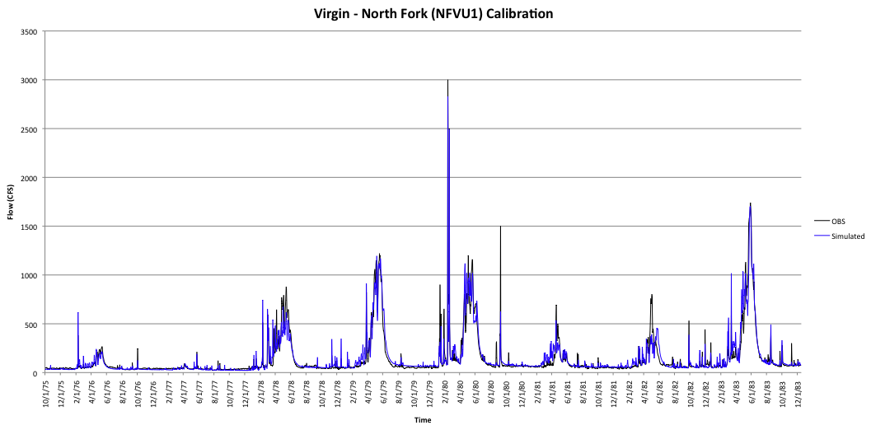
Good calibration – NFVU1
Enough data, good record, many events…

Slide 4
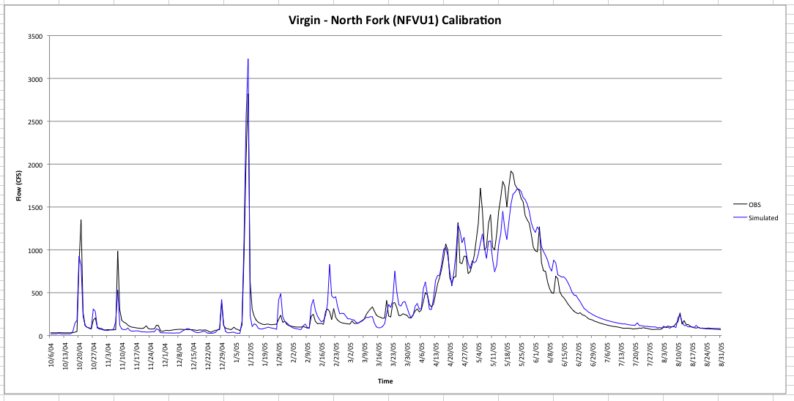
Mean Absolute Error (1979-1995): 30 cfs
Mean Flow (1979-1995): 120 cfs
Flood Flow (current rating): 5517 cfs

Slide 5
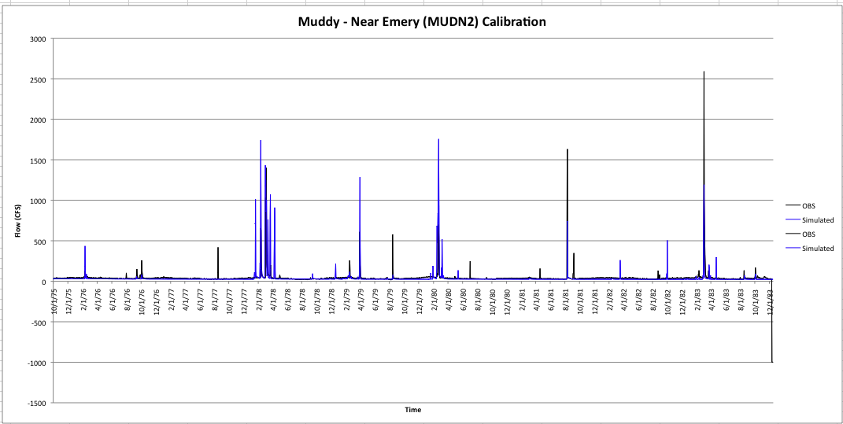
Poor calibration – MUDN2
Almost no data, not much of a record, almost no events to calibrate to….

Slide 6
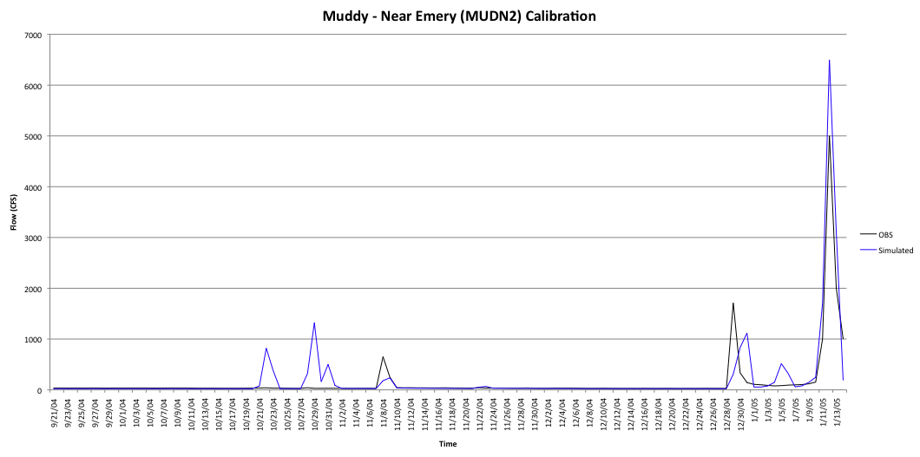
Mean Absolute Error (1979-1995): 56 cfs
Mean Flow (1979-1995): 3 cfs
Flood Flow (current rating): 1197 cfs

Slide 7
Forecast Process
Hydrologic Model Analysis
hydrologic
expertise &
judgment
model
guidance
Weather and Climate Forecasts
River
Forecast
System
Forecast
precip / temp
Outputs
Graphics
River Forecasts
Analysis &
Quality Control
Rules, values, other factors, politics
parameters
Observed
Data
Calibration
Decisions

Slide 8
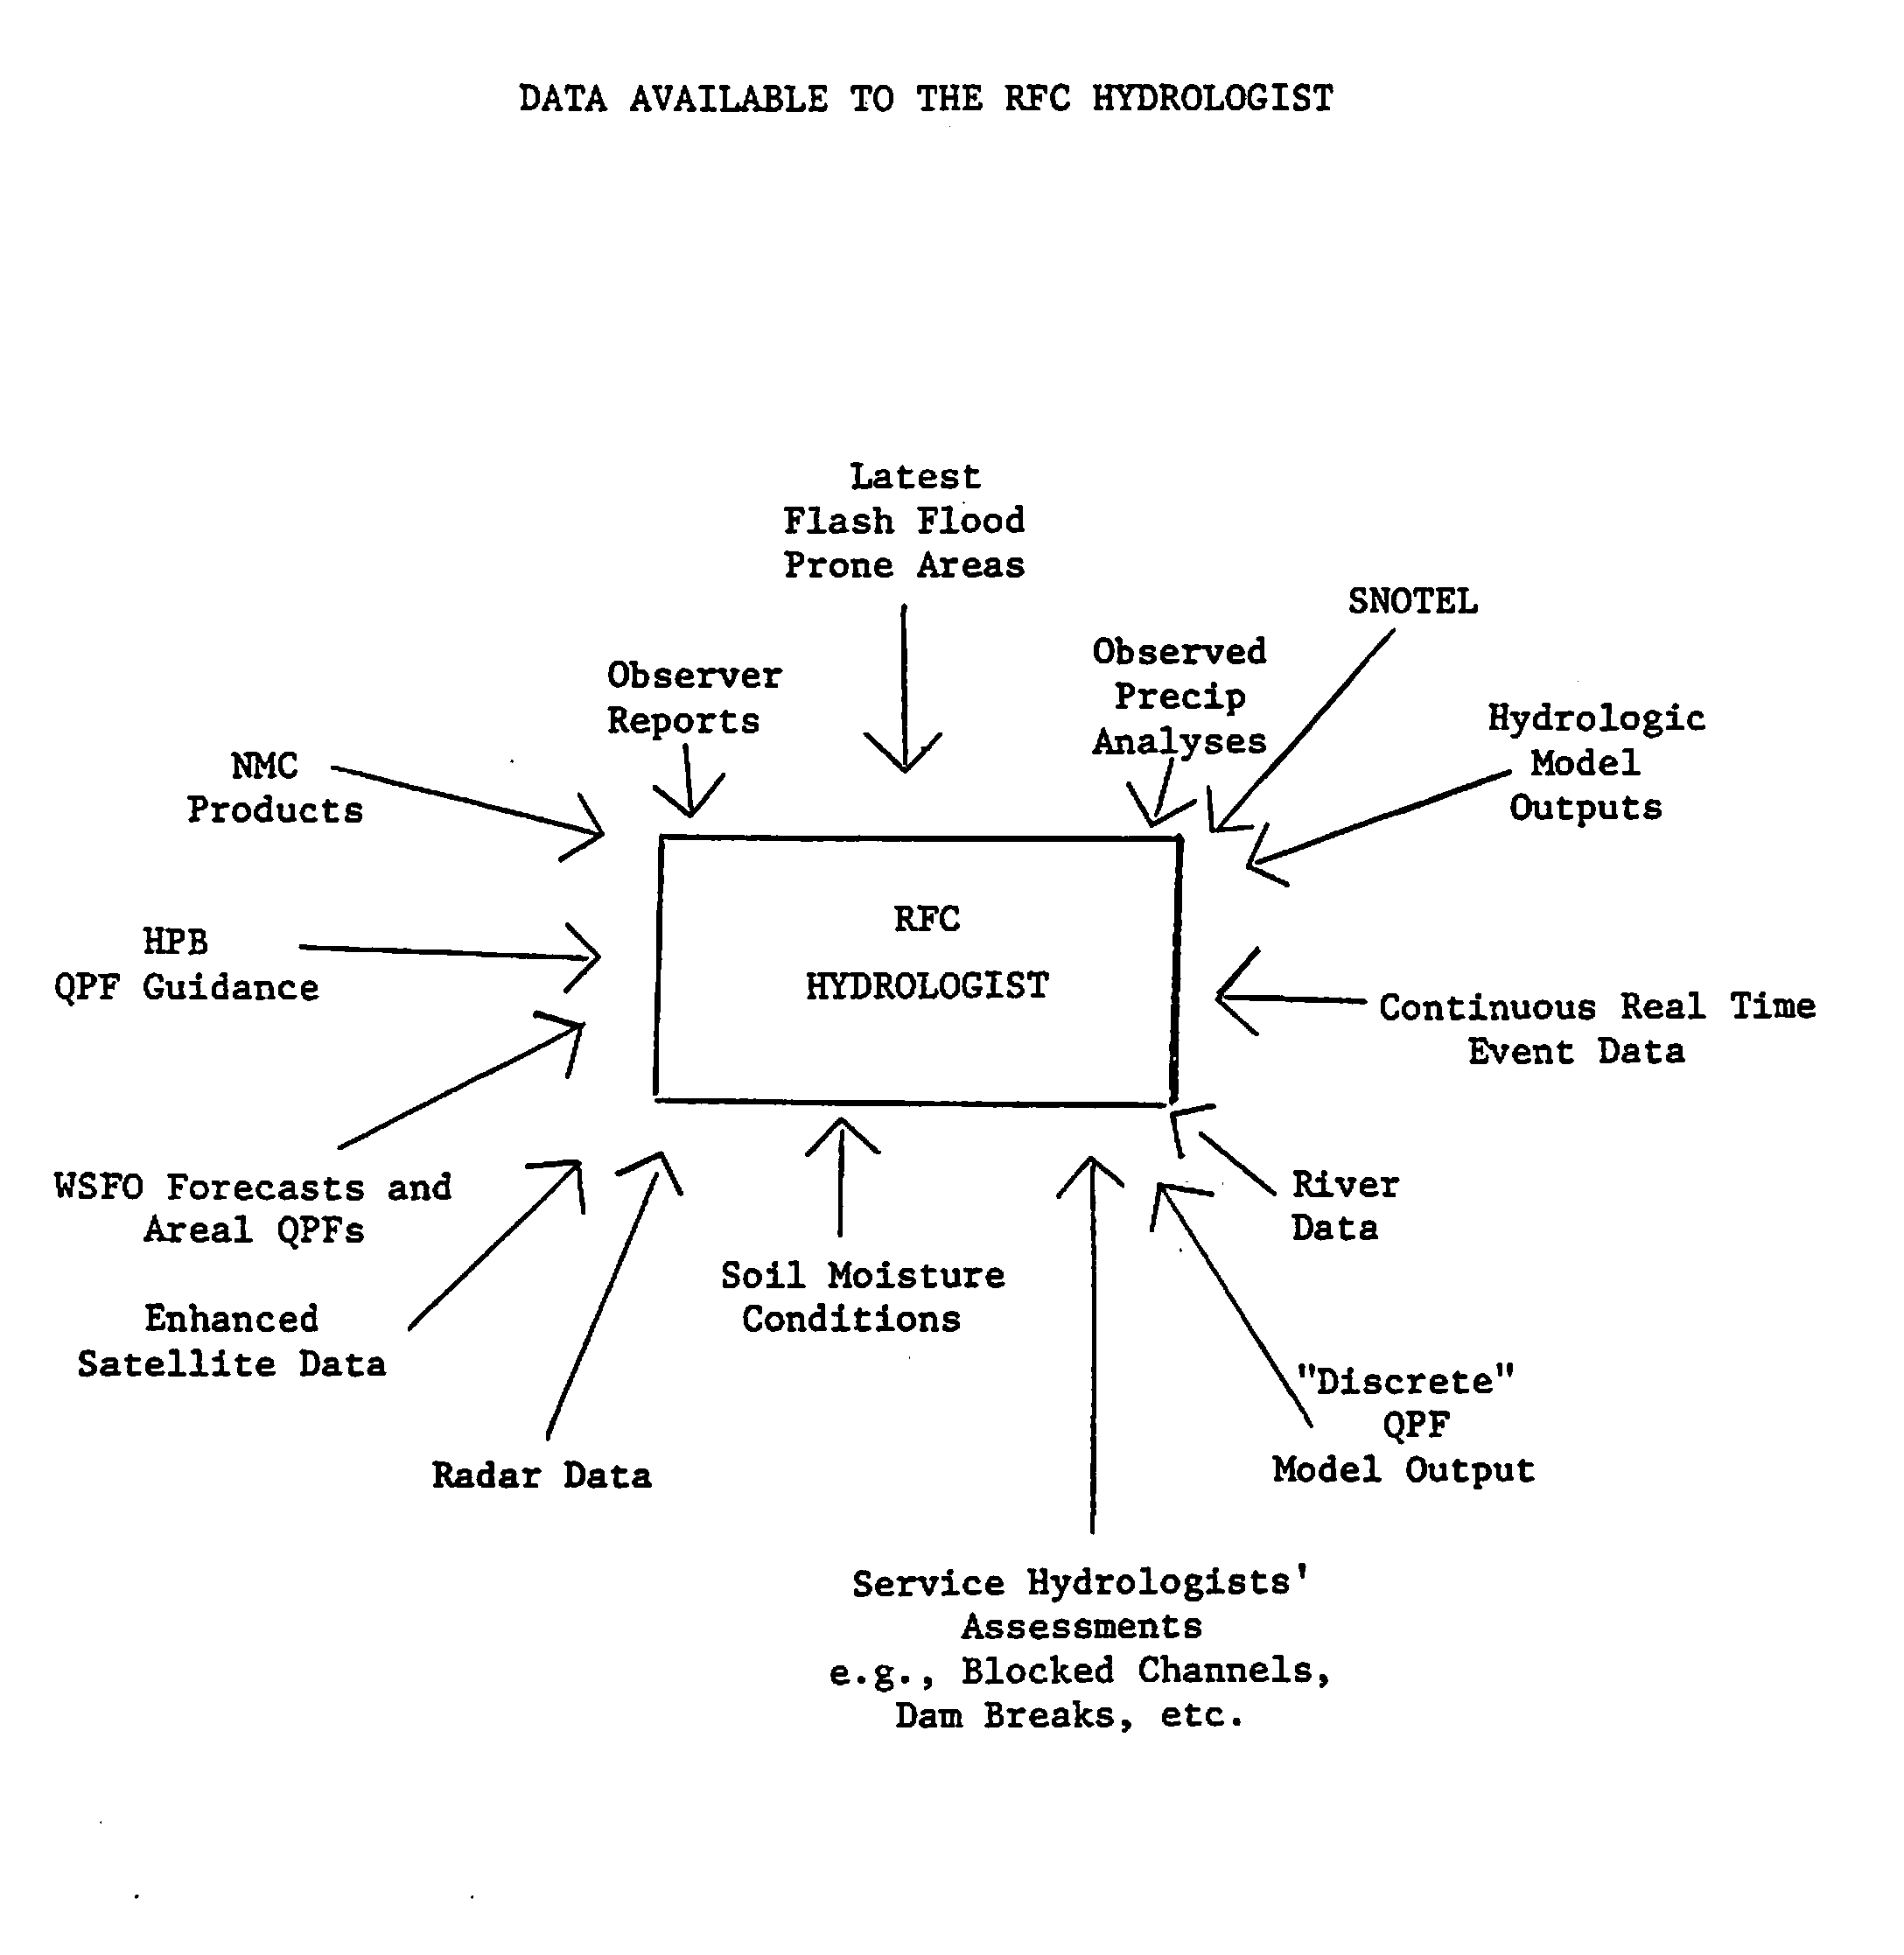
1983 NWS document

Slide 9
CBRFC Data In
Daily data used in CBRFC daily forecasting:
~260 precipitation sites
~330 temperature sites
~875 river flow, reservoir, and diversions
~95 reservoir storage

Slide 10
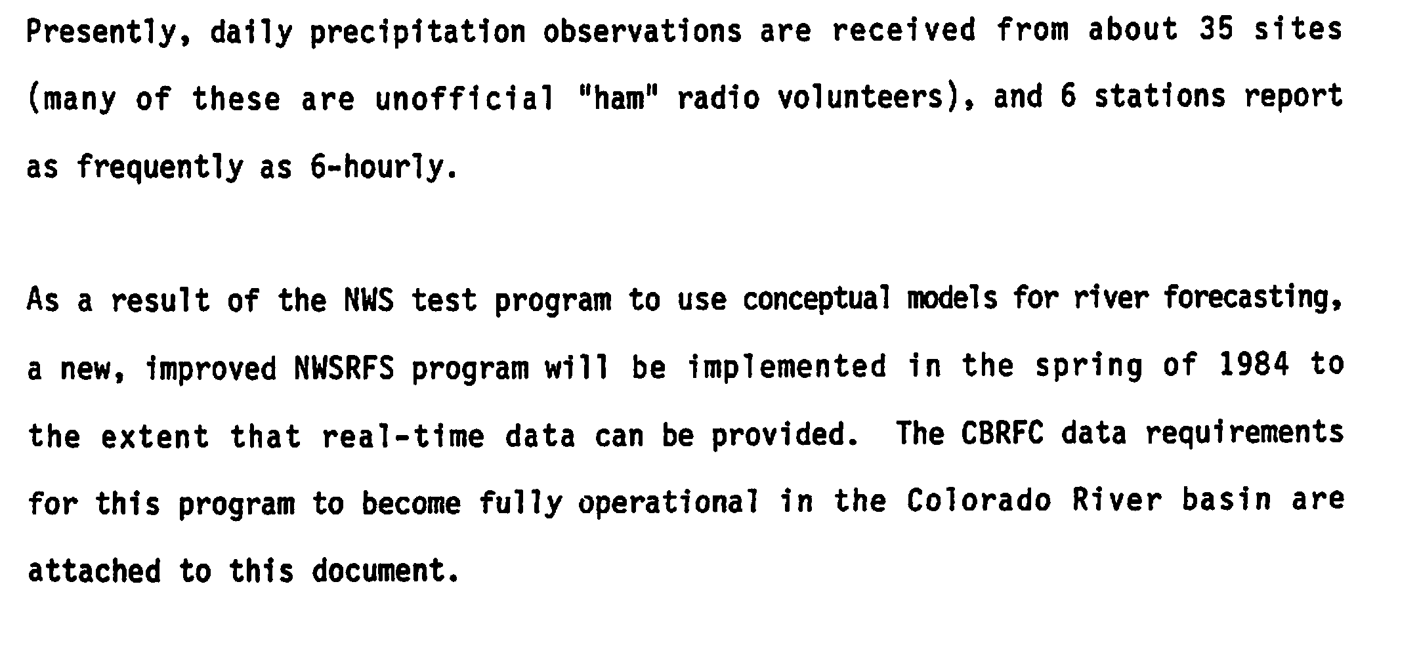
CBRFC Data In circa 1983

Slide 11
Key observing systems
NRCS SNOTEL (Randy Julander)
USGS Stream Gauging (Pat Lambert)
NWS COOP, Radar, etc (Larry Dunn)

