Slide 1
Temperature and Precipitation Data
CBRFC Stakeholder Forum
July 31, 2012

Slide 2
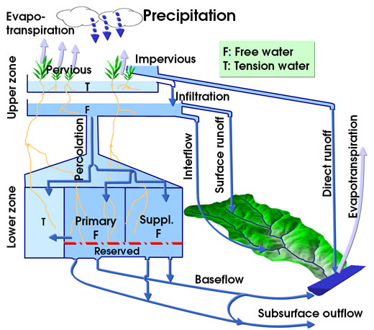
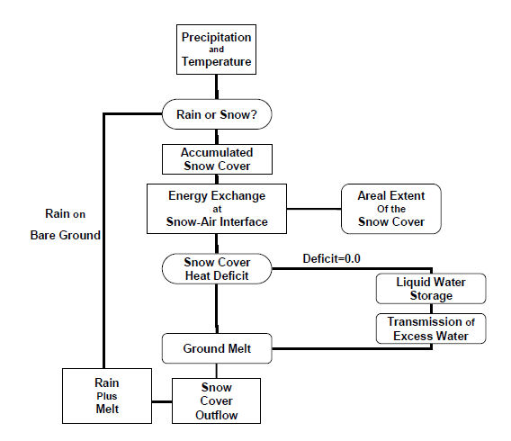
PRECIPITATION DATA– WHY IS THIS IMPORTANT ?
A direct input into the operational soil moisture & snow model
Primary Impacts:
Immediate runoff from rainfall events
Affects soil moisture conditions and seasonal volume forecasts
Combined with temperature to build snowpack in the model
TEMPERATURE DATA– WHY IS THIS IMPORTANT ?
A direct input into the snow-17 operational model
Primary Impacts:
Determine precipitation type -> builds the snowpack
Energy and heat transfer properties:
Extent of snow cover
When the snowpack ripens in the spring
Process of melting the snowpack

Slide 3
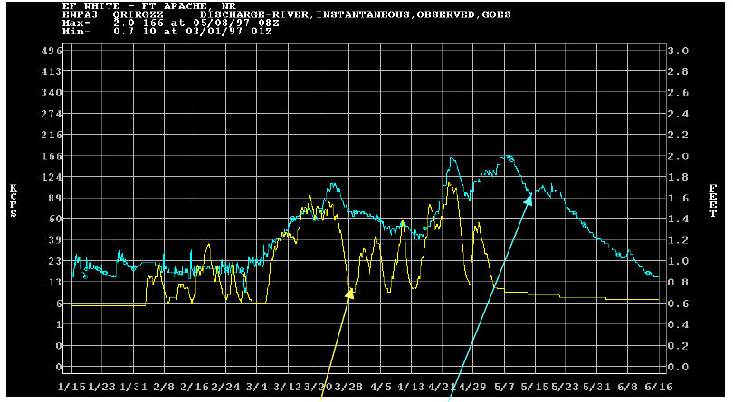
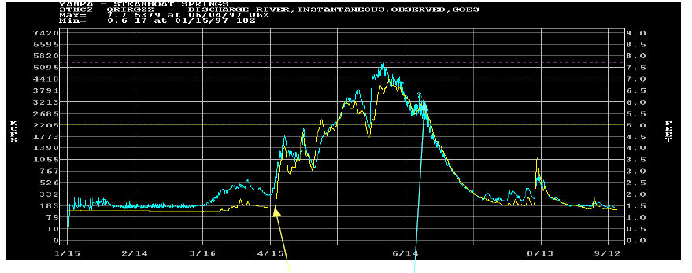
Selection of Temperature & Precipitation Stations Starts with Calibration of the Model
Simulated
(yellow)
Observed
(blue)
Simulated
(yellow)
Observed
(blue)
Data Site Requirements:
Relevant location to the river basin and sufficient historical period of record.
Must be stable through time (spent weeks verifying this through double mass analysis)
Maintain consistency between calibration and daily operations (use same data sites)
These requirements above tend to eliminate many candidates

Slide 4
DATA NETWORKS
SOURCES (Precipitation)
ALERT Networks (Automated Local Evaluation in Real Time-Radio)
GOES Data Collection Platforms (DCP) – includes Upper Colorado Network/RAWS/etc.
SNOTEL *
Cooperators *
CoCoRaHS (Community Collaborative Rain, Hail & Snow Network)
NEXRAD (Radar Products)
Satellite Derived
SOURCES (Temperature)
GOES Data Collection Platforms (DCP) – includes Upper Colorado Network/RAWS/etc. *
SNOTEL *
Cooperators *
* Data sources for model calibration

Slide 5
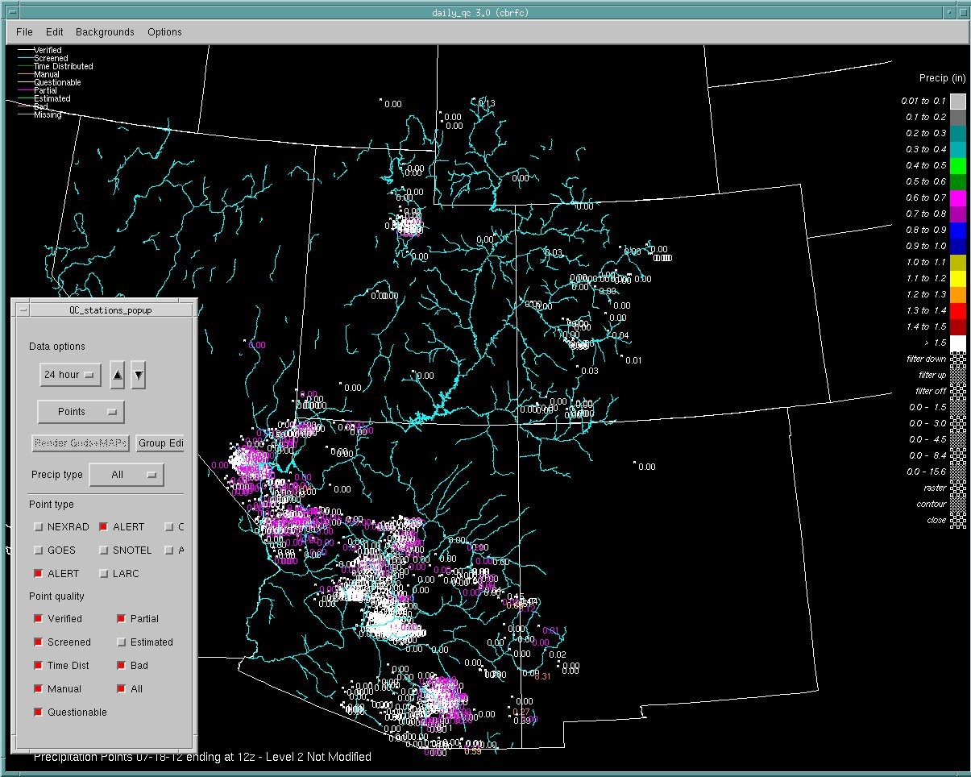
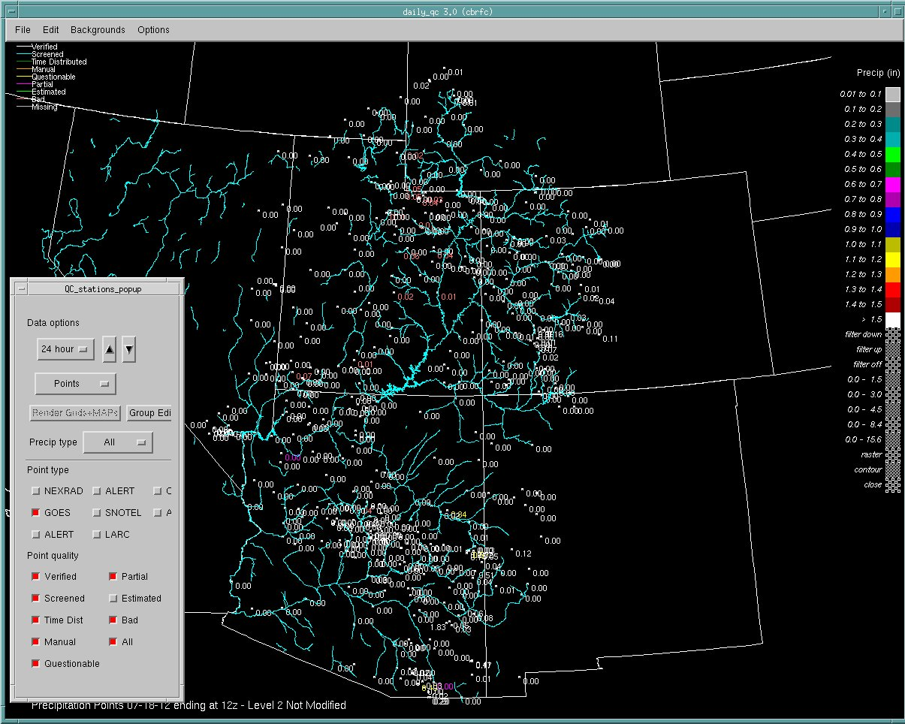
ALERT & CoCoRaHS
Precipitation Data
GOES DCP Precipitation Data

Slide 6
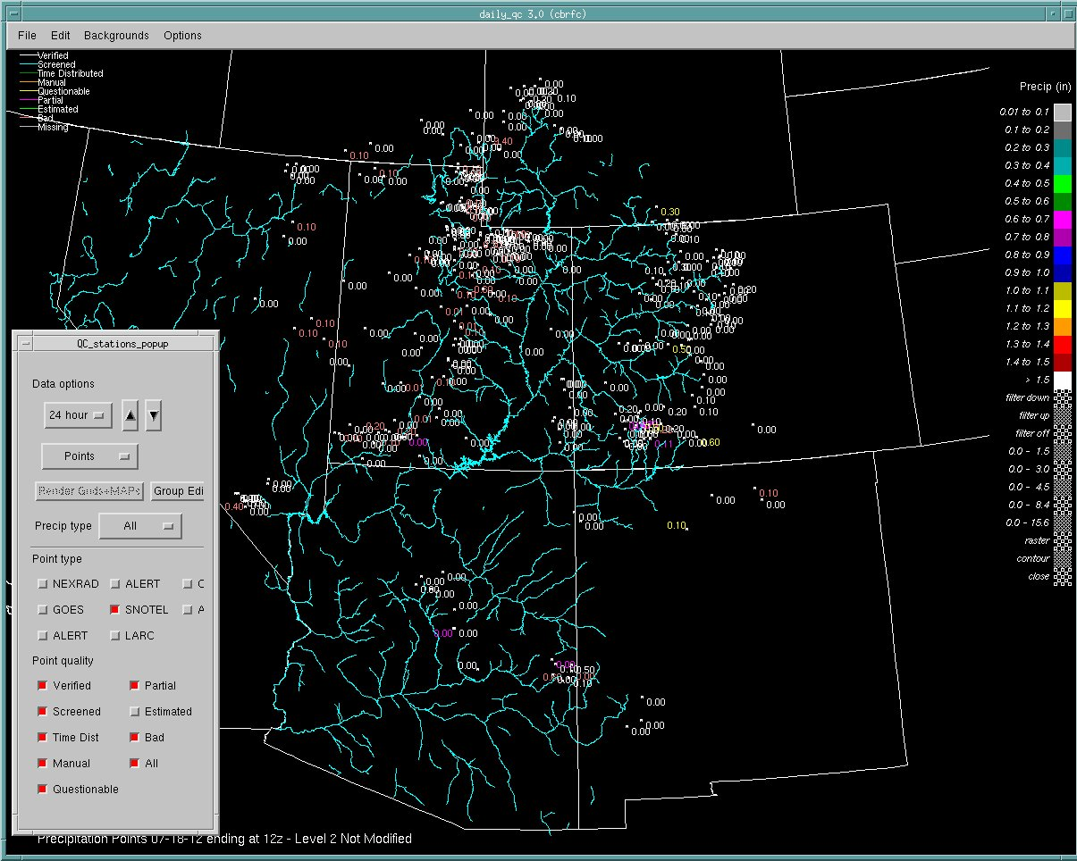
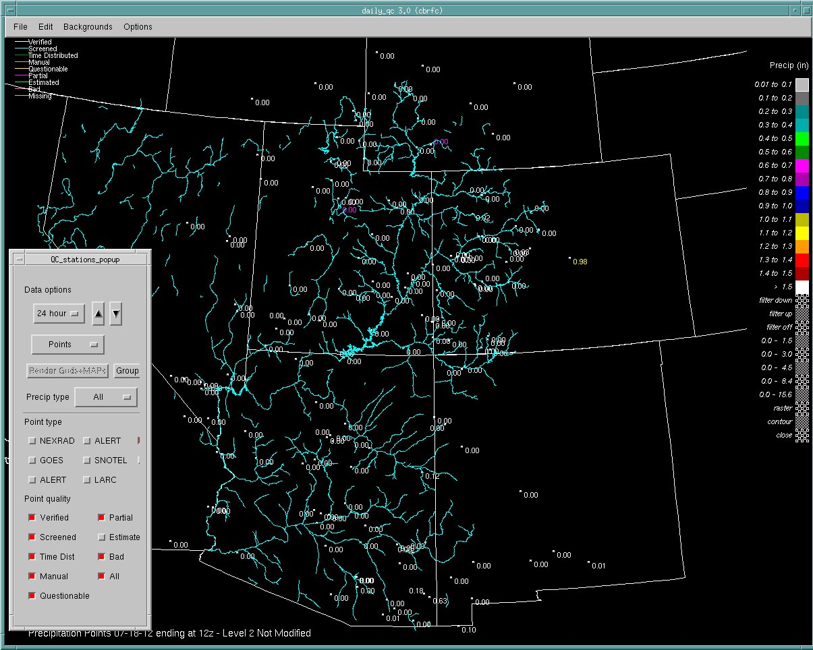
SNOTEL Precipitation Data
Cooperator Network

Slide 7
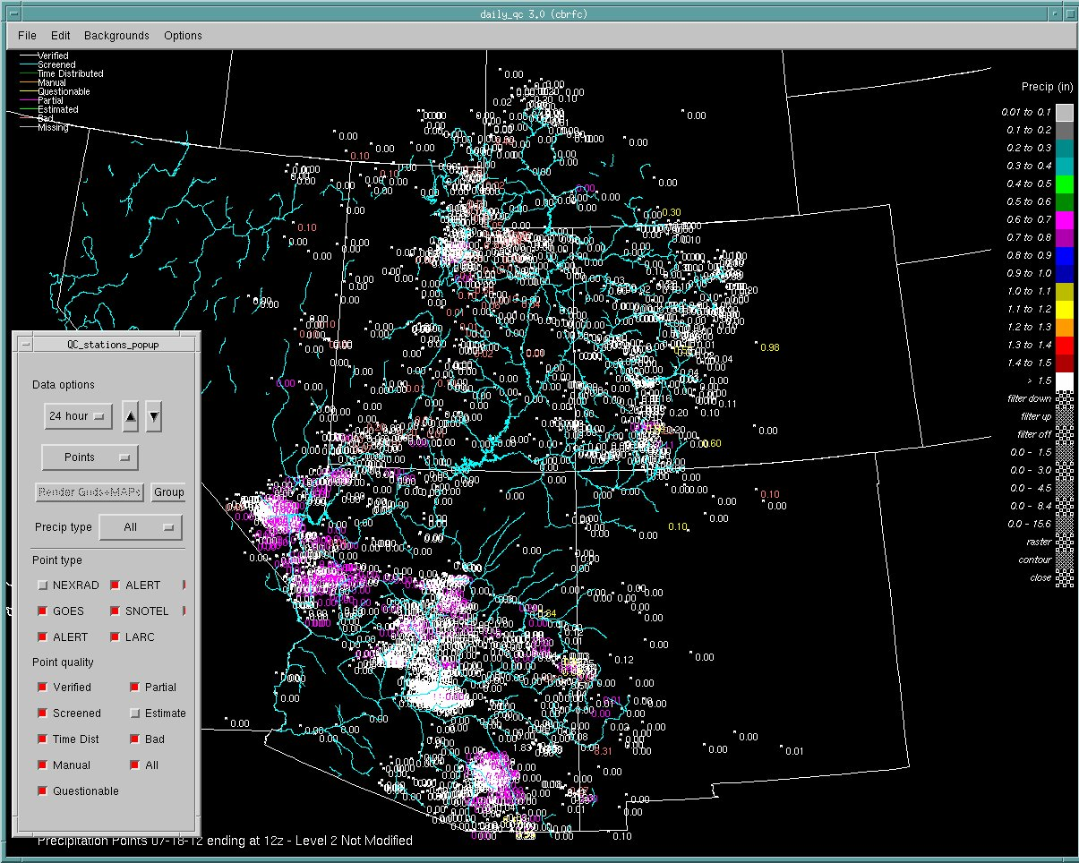
All Precipitation Sites

Slide 8
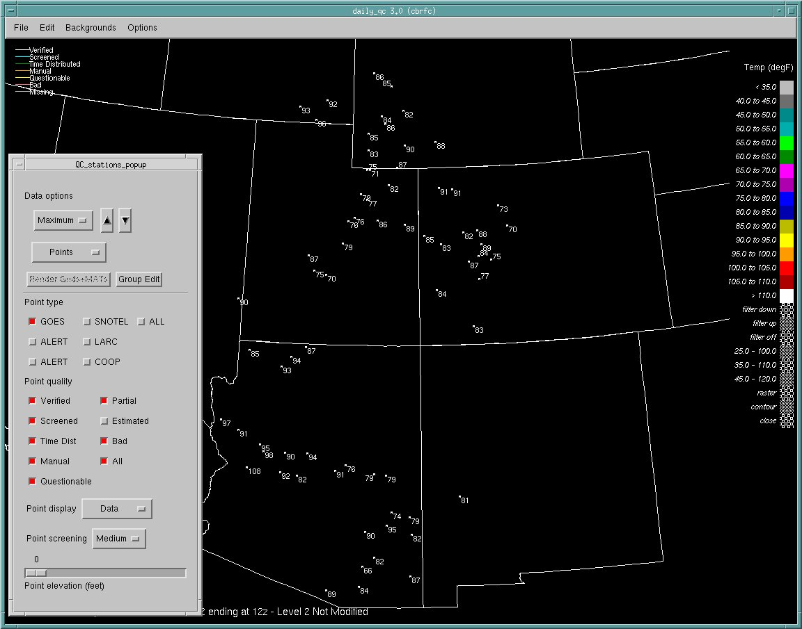
GOES DCP Temperature Data

Slide 9
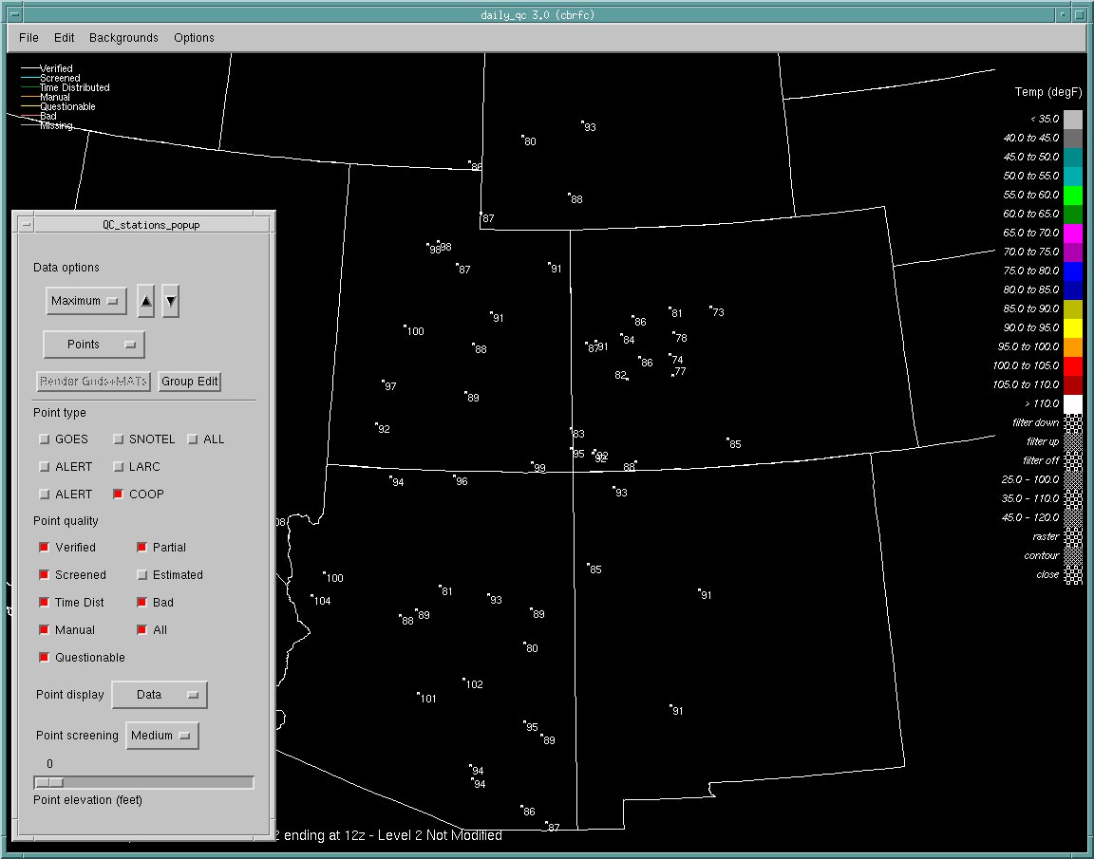
Cooperator Network Temperature Data

Slide 10
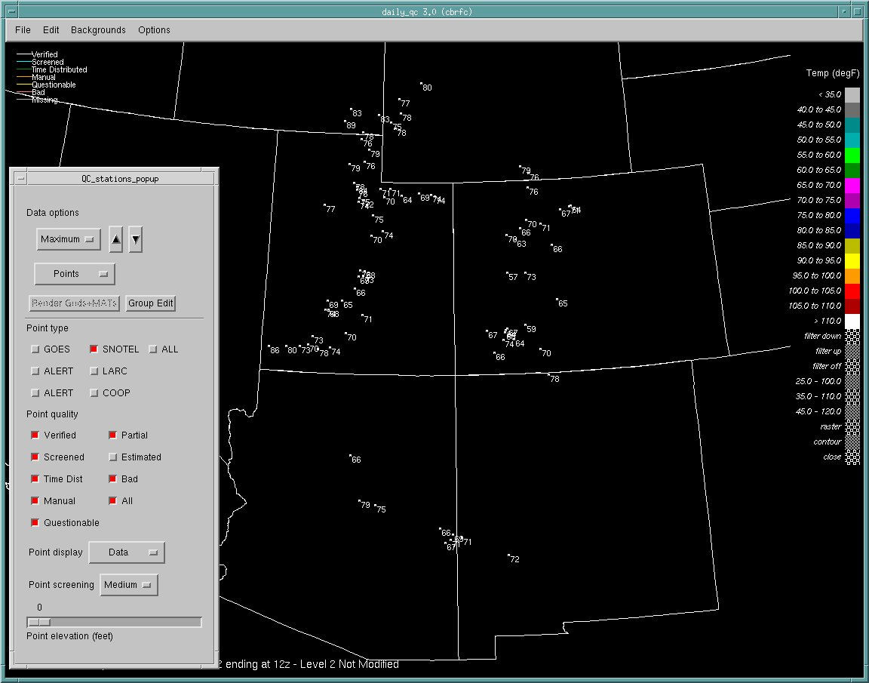
SNOTEL Network Temperature Data

Slide 11
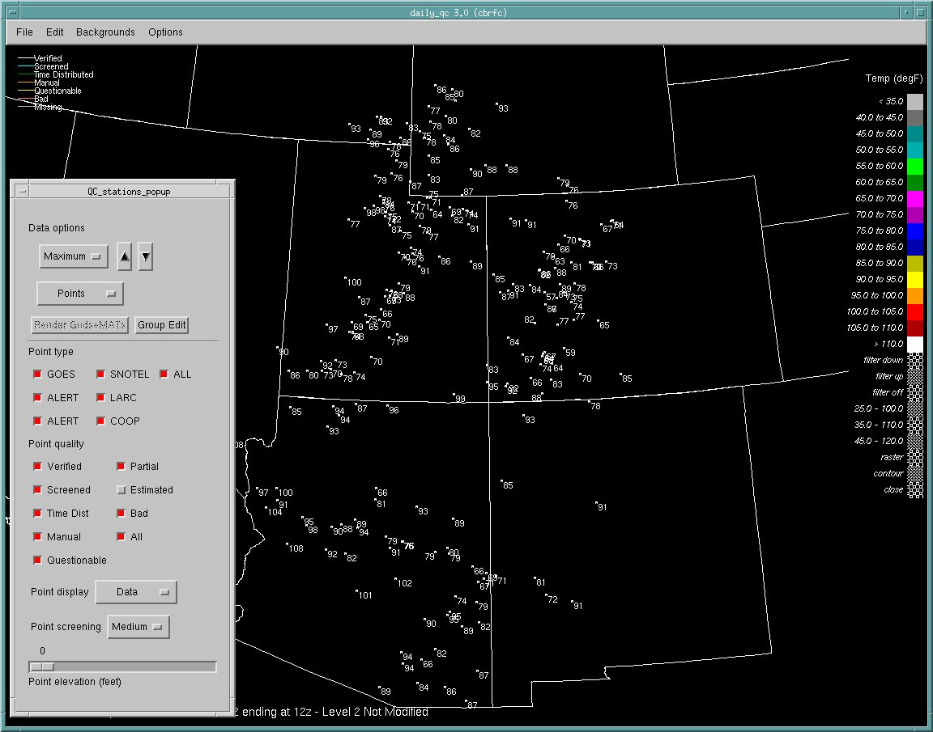
All Temperature Data Networks

Slide 12
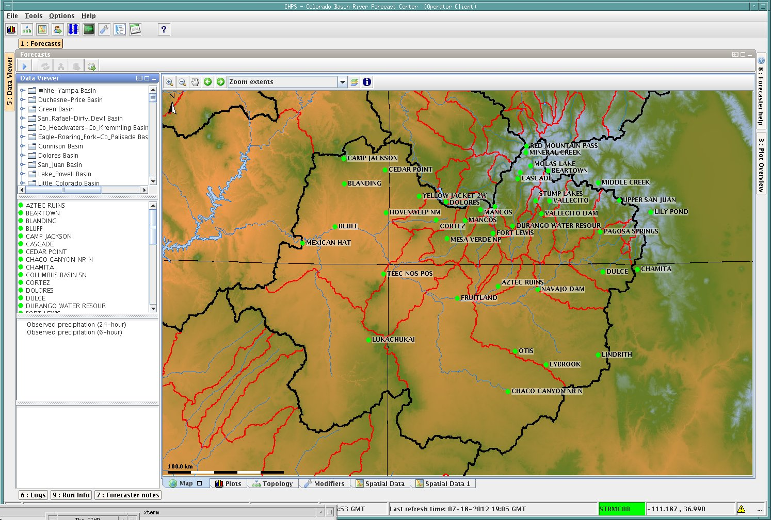
Precipitation gauge sites used in our model for the San Juan Basin (subset of all available)
calibrate and run operationally with the same data (260 sites for CBRFC)

Slide 13
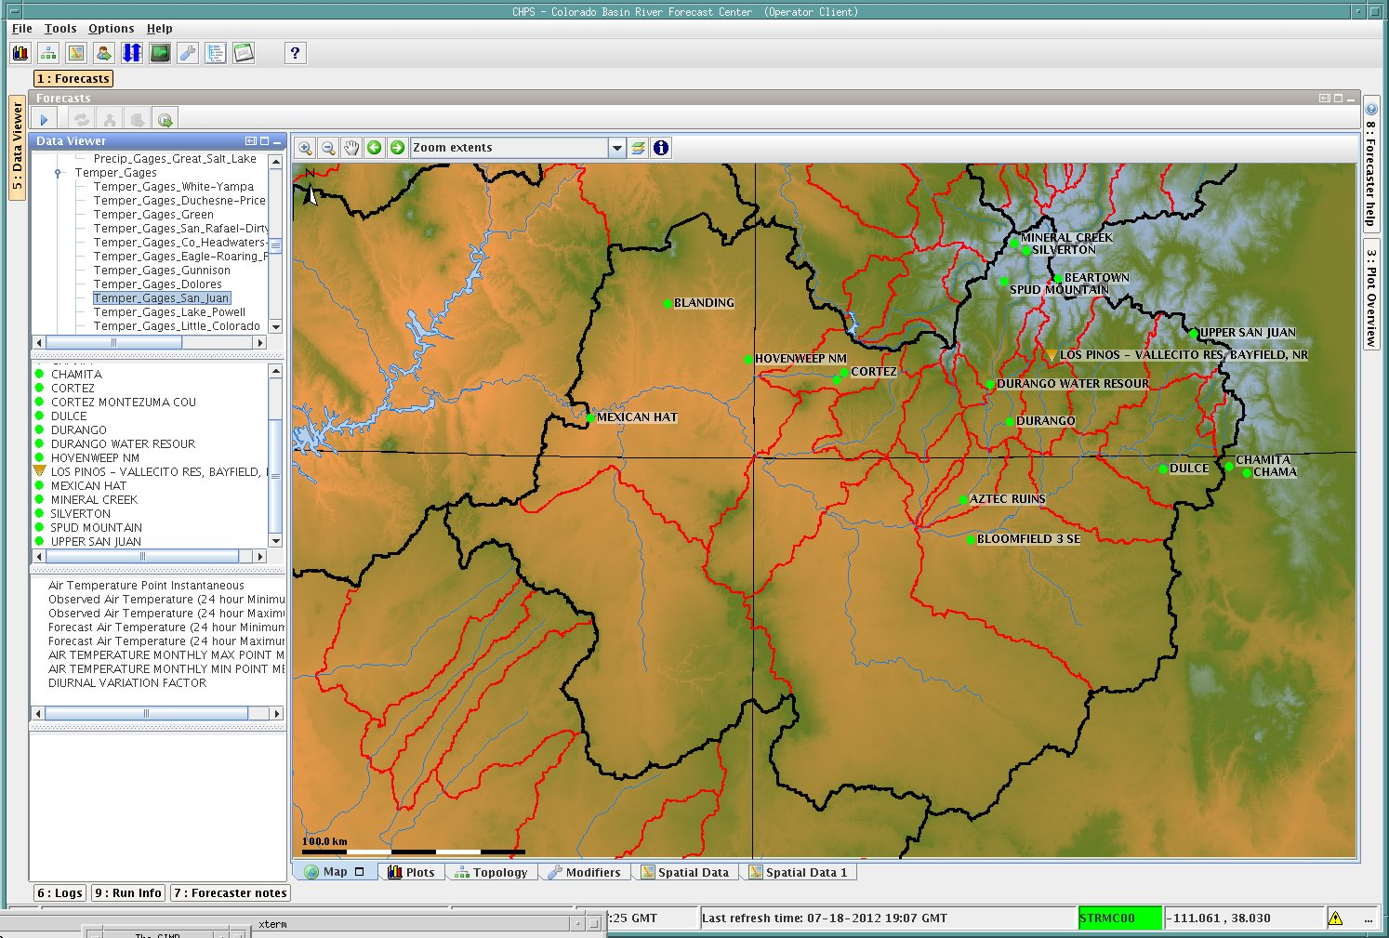
Temperature sites in the model for the San Juan Basin
Calibrate and run operationally with the same data (330 sites for CBRFC)

Slide 14
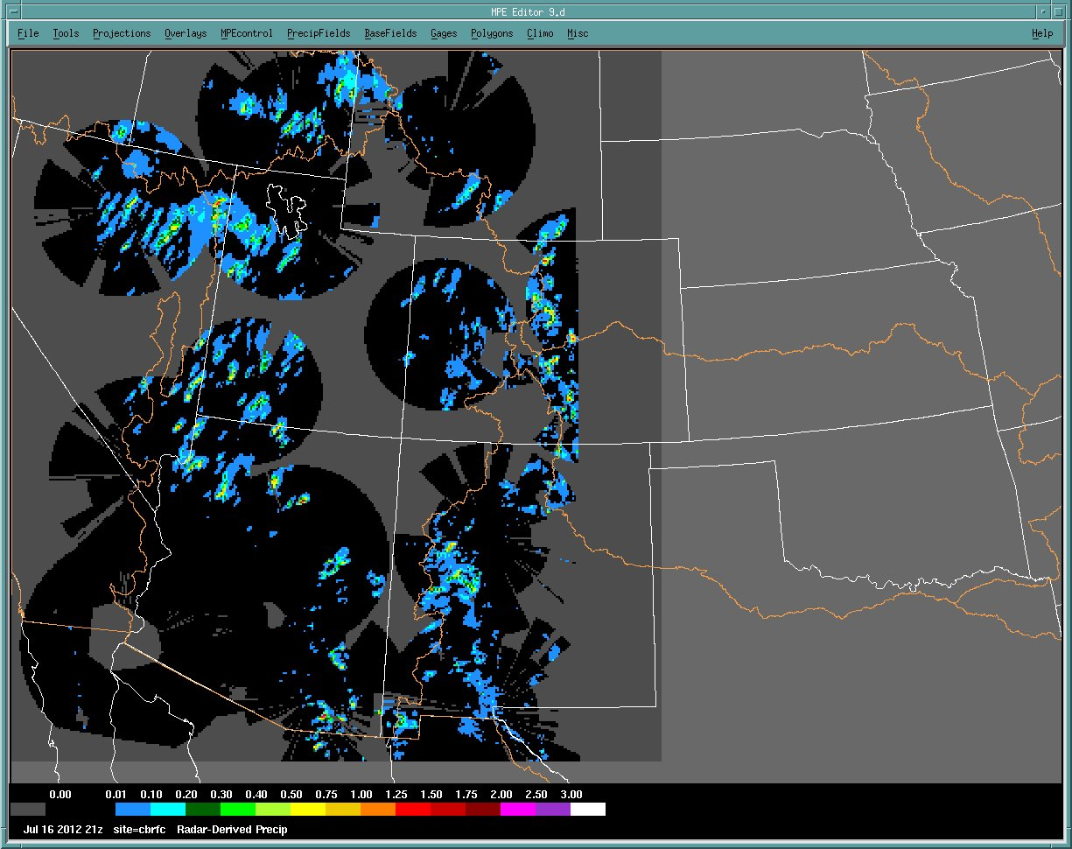
Additional Precipitation Source – NEXRAD Radar Derived Precipitation
No radar coverage Much less in winter

Slide 15
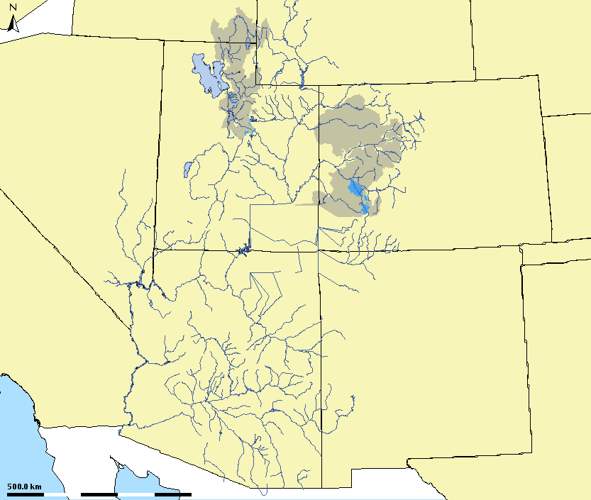
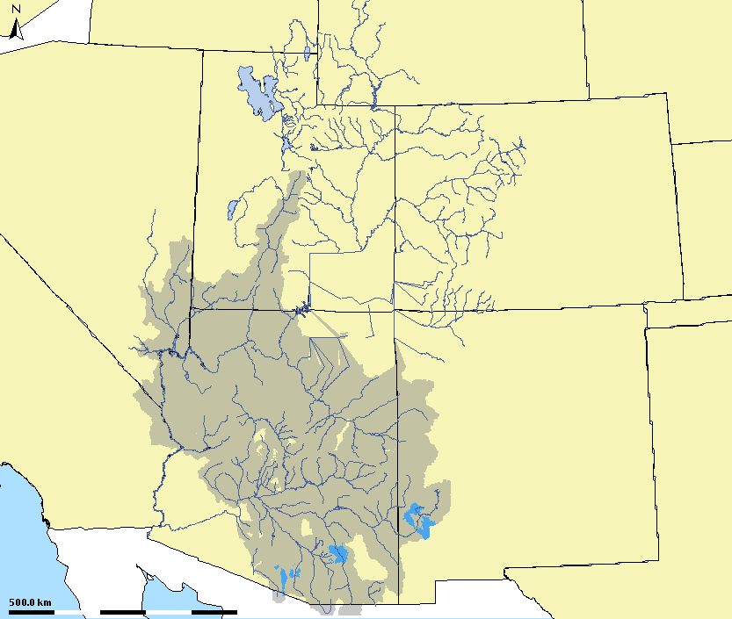
Areas where radar precipitation data may be used (rainfall-runoff hydrology dominates) as input to the hydrologic model.
Hourly radar precipitation data is used in southern Utah, Arizona, and New Mexico (1-hour segments)
The option exists to use radar precipitation data in northern Utah and Colorado during summer months
(6-hour segments)

Slide 16
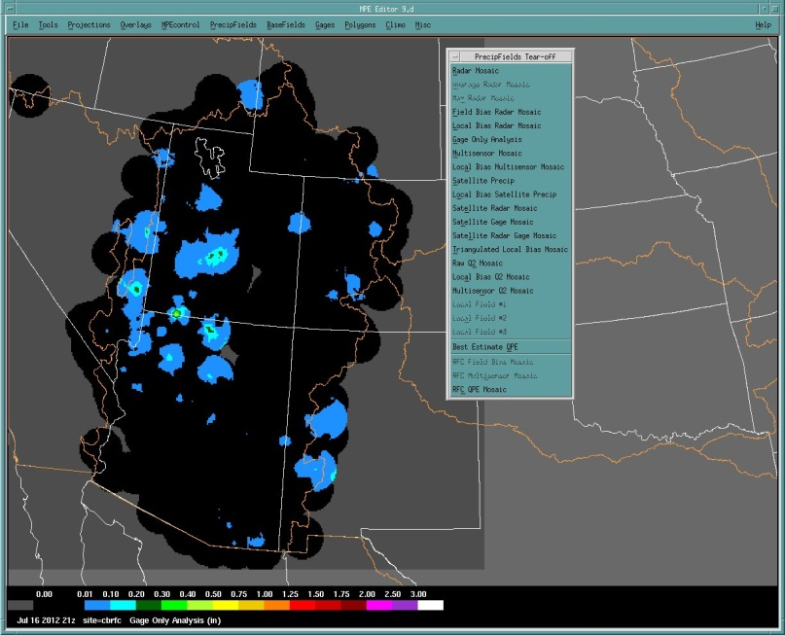
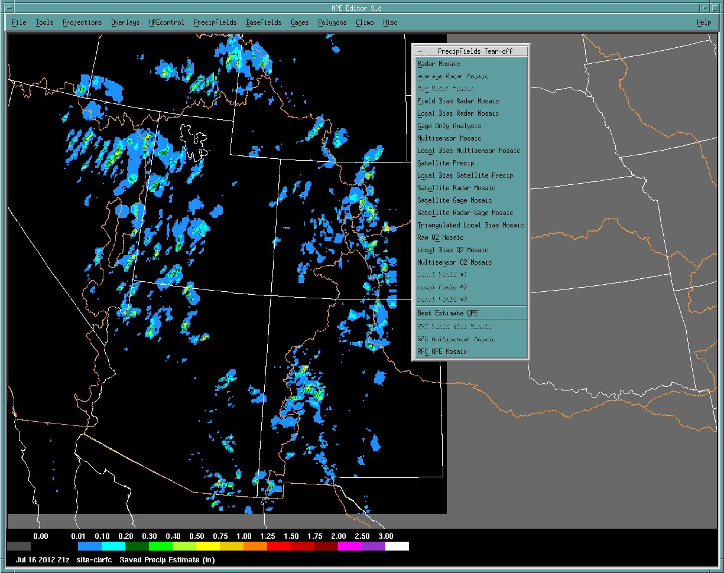
Precipitation Source – Hourly Multi-Precipitation Editor (MPE generated Precipitation)
Radar derived precipitation and gage precipitation are combined to generate an hourly gridded product ingested by our hydrologic model
Satellite derived precipitation is available

Slide 17
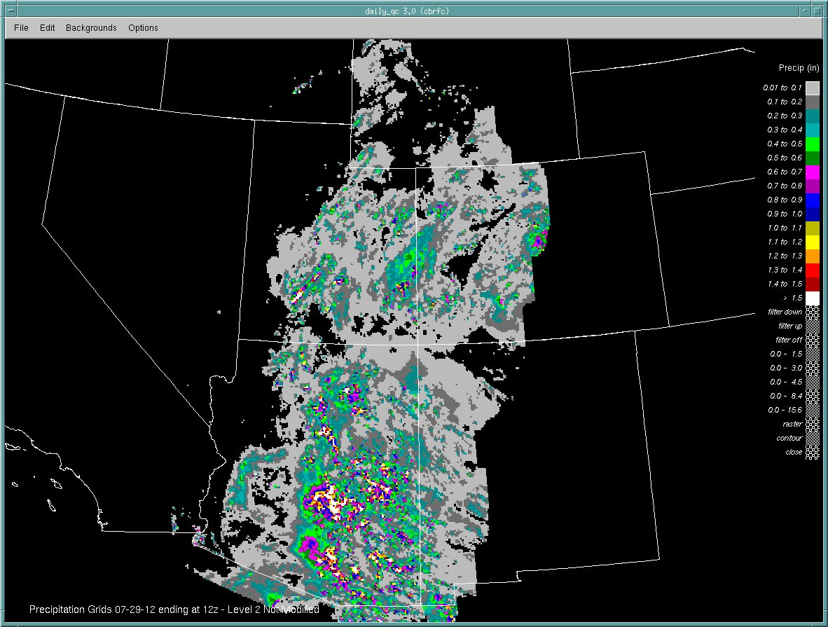
Goal: Combine all precipitation sources into to a coherent precipitation product

Slide 18
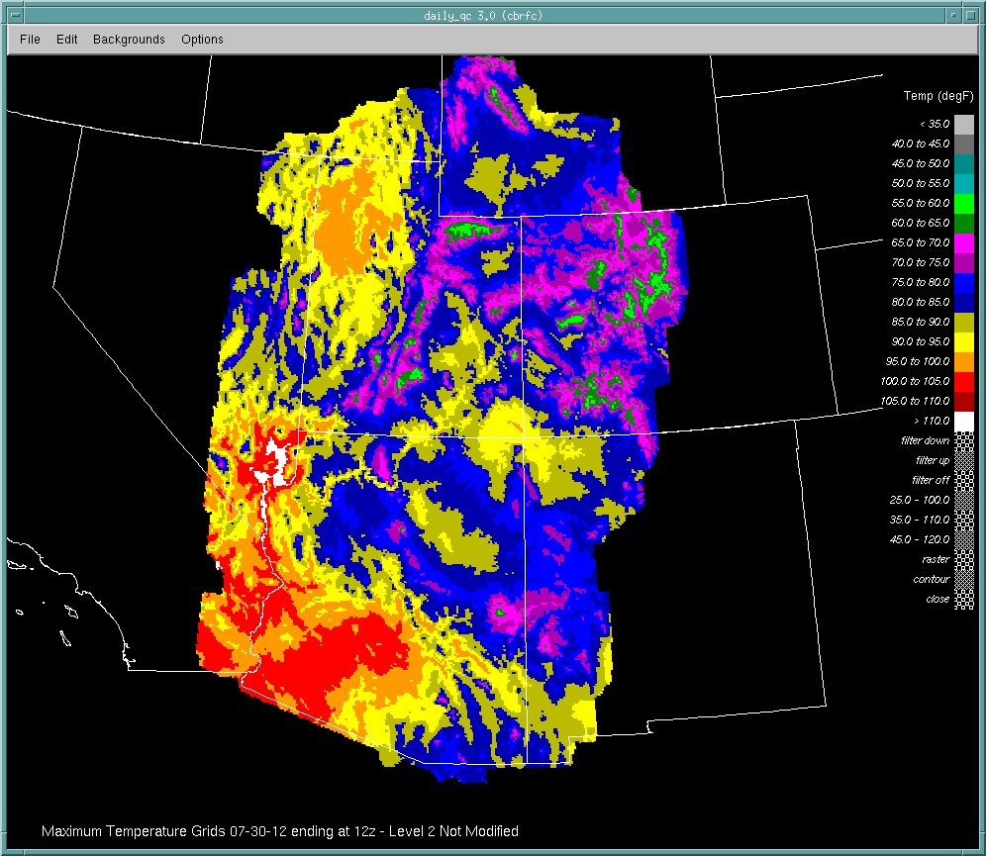
… same goal with temperature

Slide 19
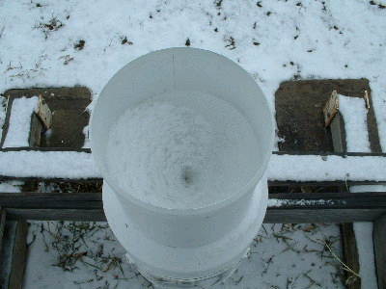
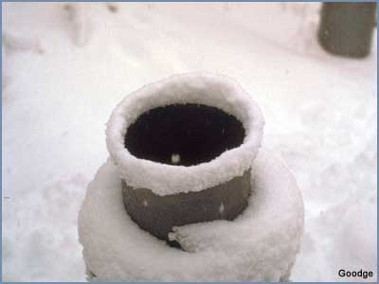
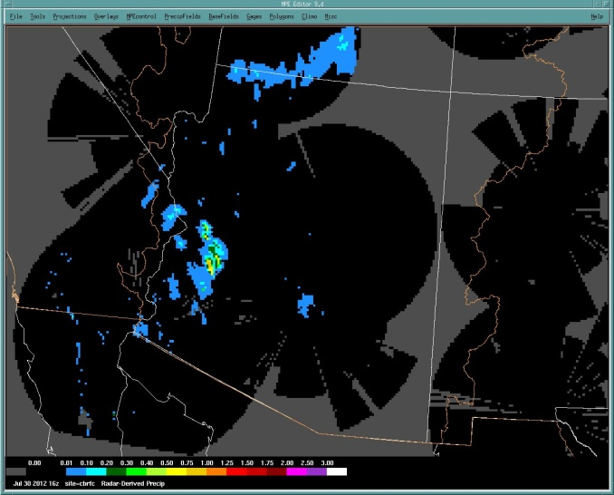
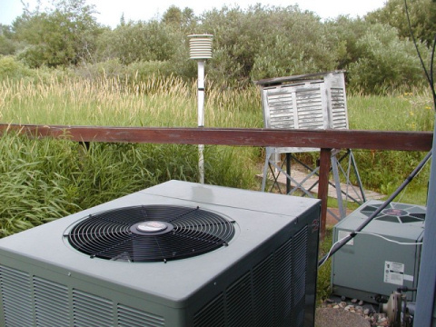
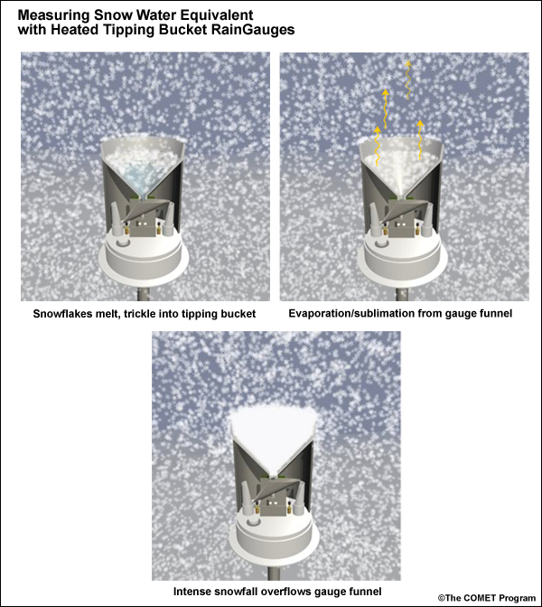
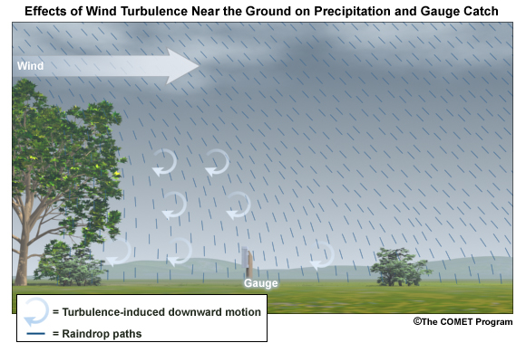
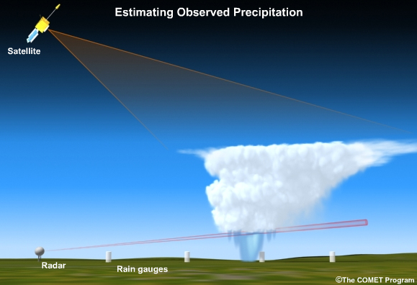
Goal: Combine all precip & temperature data sources into a coherent product
Quality Check All Data
- Use all sites all sources
- Meteorological situation
- Affects gauge performance
- Expected precipitation patterns
False

Slide 20
So what gets in the Model (and Forecast) ?
Quality Check All Data
- Use all sites all sources
- Meteorological situation
- Affects gauge performance
Convert point 24/6 hour gauge data, to a Mean Areal Precipitation value (MAP). Uses only a subset of all sites available. Time step = 6 hours.
Convert point data to Mean Areal Temperature (MAT). Time step = 6 hours.
Incorporates radar data (MPE) to create a Mean Areal Precipitation (MAP) value. Time step = 1 hour.
Observed data (and Forecast precipitation & temperature ) are re-evaluated by forecaster interacting with the model during the daily operational run.

Slide 21
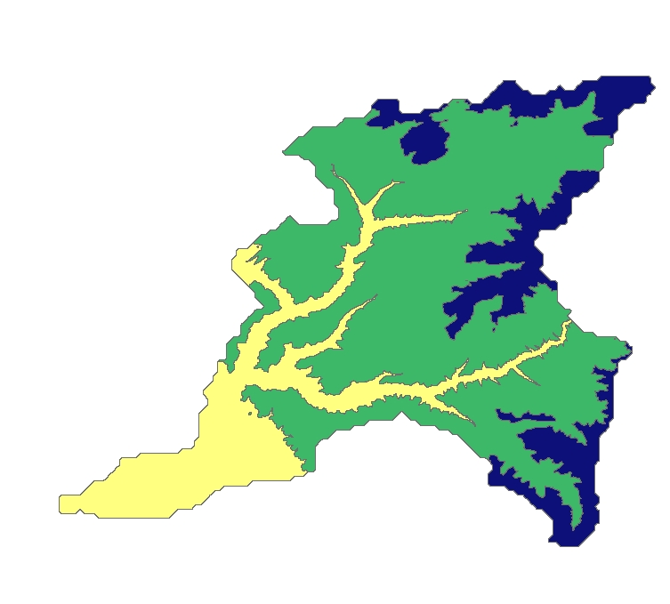
What is a MAP? Example of Stations used to generate Mean Areal Precipitation
Dolores – Dolores (DOLC2) Segment (below Rico)
SAC-SMA Model Sub-Areas
LNCC2
(9600 ft)
Stations used to compute precipitation & their weighting
(locations approximate)
EDSC2
(10,200 ft)
LIZC2
(10,200 ft)
Middle (8500-11500)
El Diente Peak (EDSC2) SNOTEL (.34)
Lone Cone (LNCC2) SNOTEL (.17)
Scotch Creek (SHSC2) SNOTEL (.34)
Dolores- Rico Segment (DRRC2)
SHSC2
(9100 ft)
Lower (7067-8500)
Cortez (CTZC2) Precipitation (1.2)
Upper (11000-12644)
Lizard Head (LIZC2) SNOTEL (.55)
El Diente Peak (EDSC2) SNOTEL (.55)
CTZC2
(6153 ft)

Slide 22
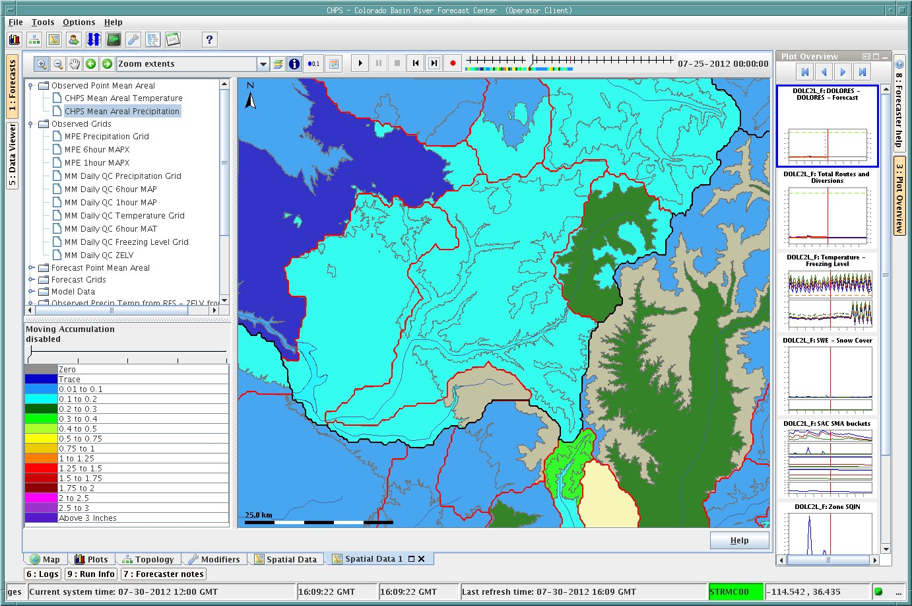
Operational Model Run 07/25 Noon-6 pm Precipitation for Dolores @ Dolores

Slide 23
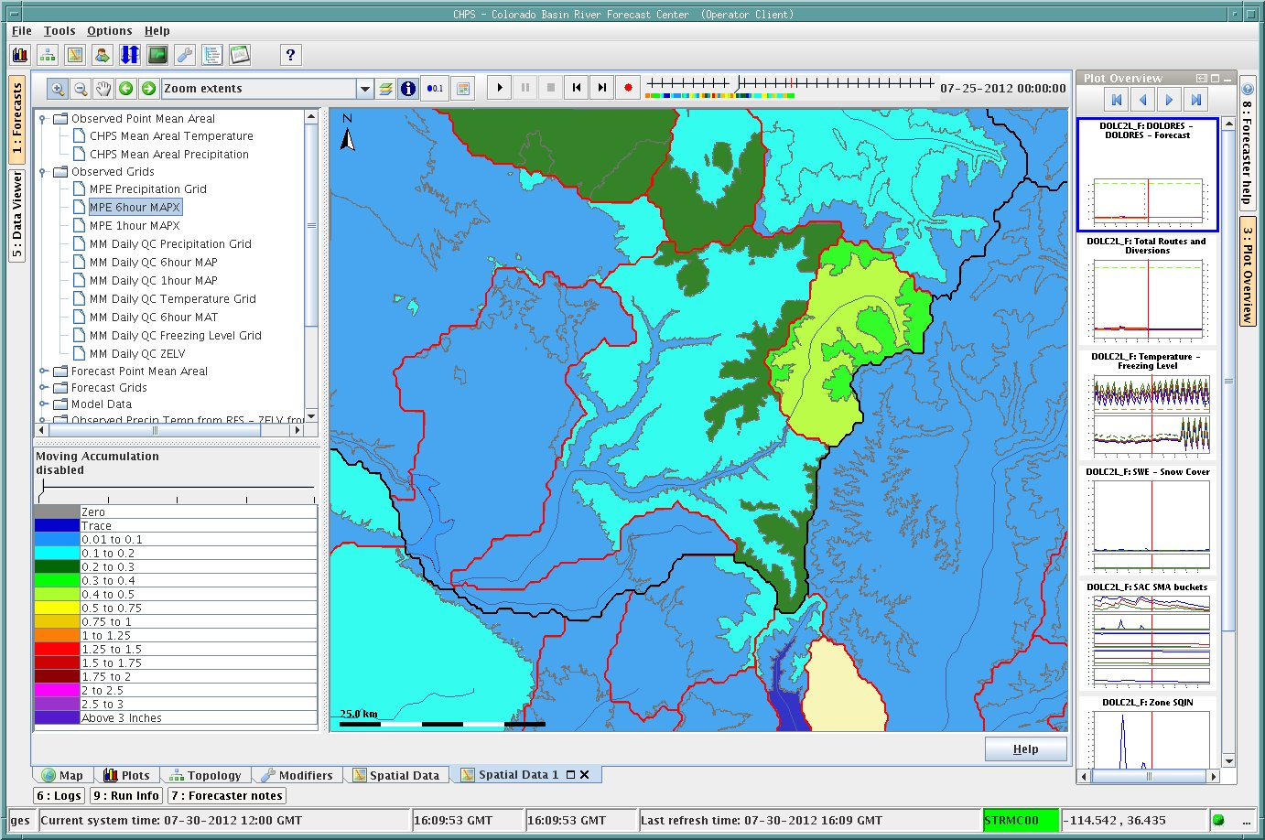
Operational Model Run 07/25 6pm-Midnight Precipitation for Dolores @ Dolores

Slide 24
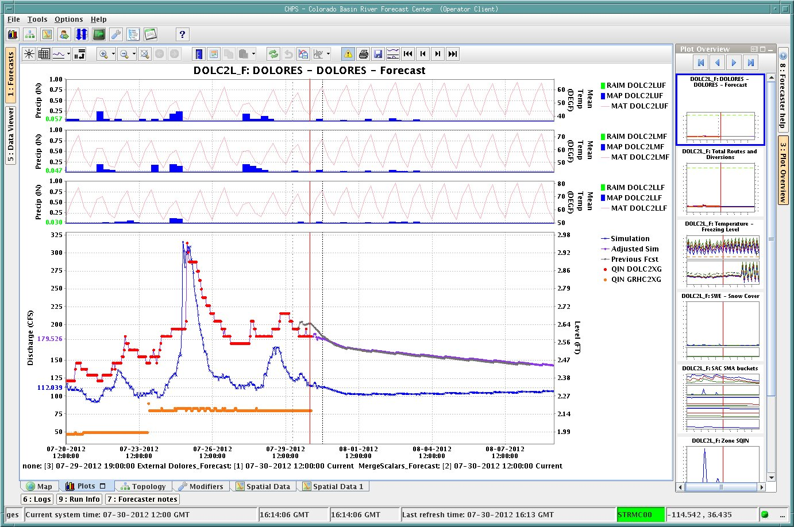
Operational Model Run for Dolores @ Dolores / Precipitation 07/25 Noon-Midnight
Observed
Model simulated

Slide 25
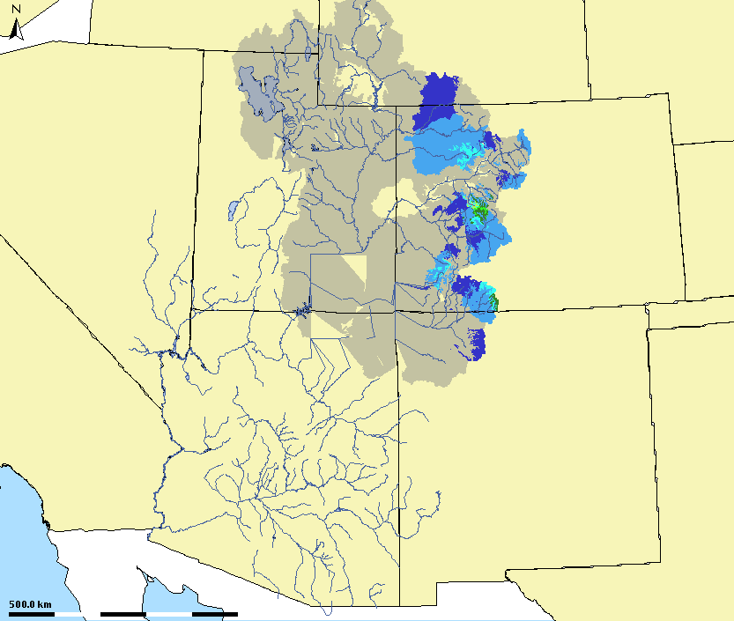
6/24 hour gauge data is used to create MAP’s in the Great Basin and Upper Colorado Basin

Slide 26
SUMMARY
Temperature and Precipitation observing networks are critical as they provide direct inputs into our hydrologic models and drive the streamflow forecasts.
Immediate direct runoff (rainfall-runoff situation)
Soil moisture states (long term volumes & peaks)
Snowpack
Maintaining existing networks is critical to our forecast abilities
Great deal of effort verifying gauge is stable through time.
Priority given to those sites utilized in calibration / long period of records
SNOTEL Network our most critical network
The loss of any site risks degradation of overall data quality & resulting forecasts
Surface network especially critical in West due to radar limitations
Consequences of bad (or limited data) are somewhat obvious
Negatively impact ability to quality control observed data
Misrepresentation of snowpack (seasonal & peak flow implications)
Incorrect classification of precipitation types (further impact model states)
Results: Poor model simulations, missed flood events, poor seasonal forecasts.

