Slide 1
Reservoir and Diversion Data
CBRFC Stakeholder Forum
July 31, 2012

Slide 2
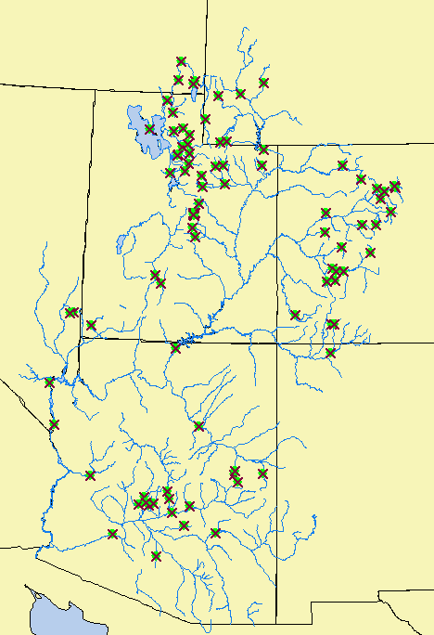
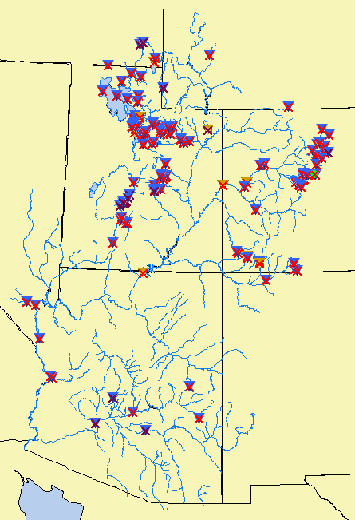
Model Data
There are ~90 reservoirs and over 150 diversions included in our hydrologic model.
  We calibrate the model to ‘natural’ flow.
  Historical reservoir and diversion data is used to calculate the natural flow.
  Real time reservoir and diversion data is needed to simulate and forecast the observed river flows.
  We model reservoir inflow, outflow and pool elevation.
There are unknown reservoirs and diversions we cannot account for explicitly.
  Consumptive Use operations; determined through calibration process.
Reservoirs
Diversions

Slide 3
Data Collection
Sources
  FTP
  Email
  Websites / Web Services
  Satellite (GOES DCP)
Providers
  USBR – Salt Lake City, Provo, Loveland
  Pacificorp
  Denver Water
  Central Utah WCD
  Many other water groups
Methods
  We write programs to parse whatever format is available to us – it varies by source/provider and it just needs to be consistent.
  Many of these programs run automatically, especially the ones that pull data from websites.
  When there is a change in format or website location it takes a lot of work for us to find it and fix it.

Slide 4
Observed Data Needs
Availability of good real time observed data is essential to our forecasting efforts.
  We compare (and adjust as needed) current modeled reservoir states and river flows to observed data in order to produce more accurate forecasts.
  Missing or bad data makes it difficult to determine current conditions, which leads to lower quality forecasts.
Accurate meta data also needed.
  Reservoirs:
    Elevation-storage curves.
    Spillway curves.
    Critical reservoir levels (i.e. spillway, passflow elevations).
    General operating criteria.
  Diversions:
    Maximum capacities.
    Minimum in-stream flow requirements.

Slide 5
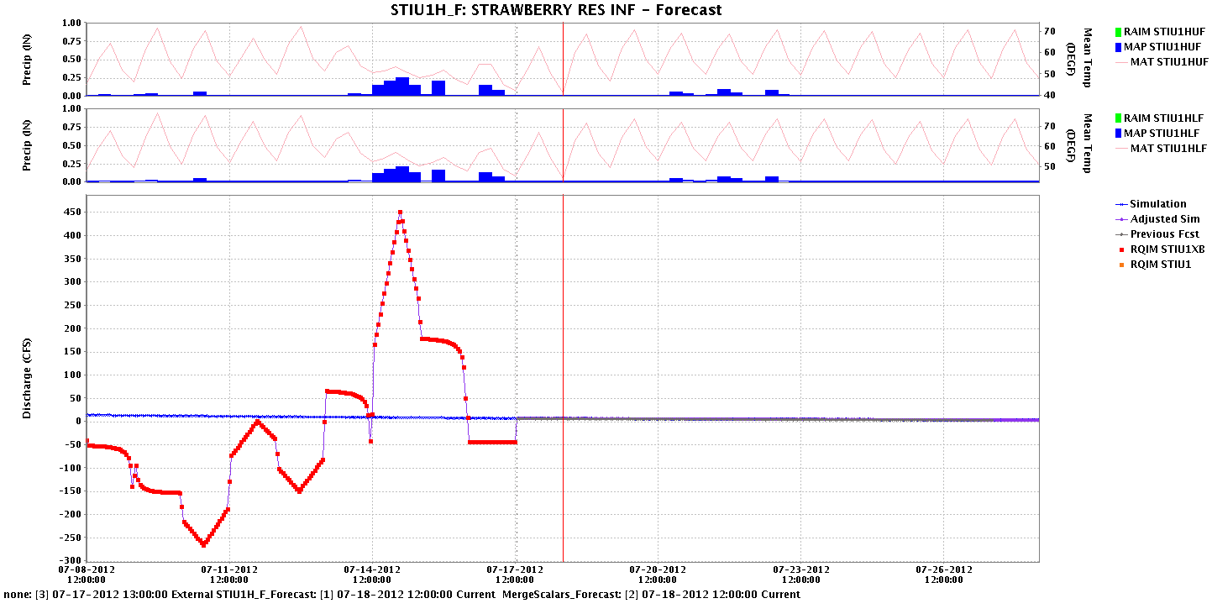
Bad Data
Observed inflow data
-250 – 450 cfs
Model simulated inflow
~15 cfs
Forecast

Slide 6
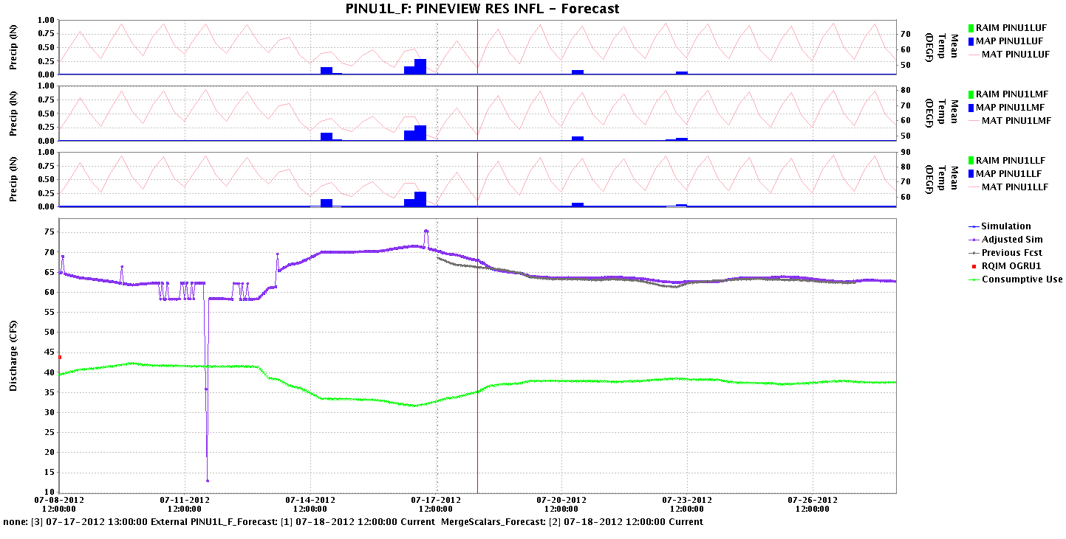
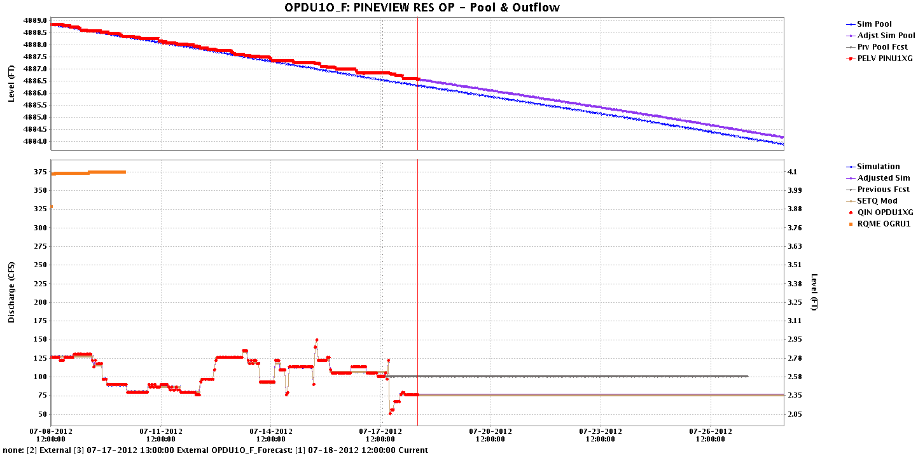
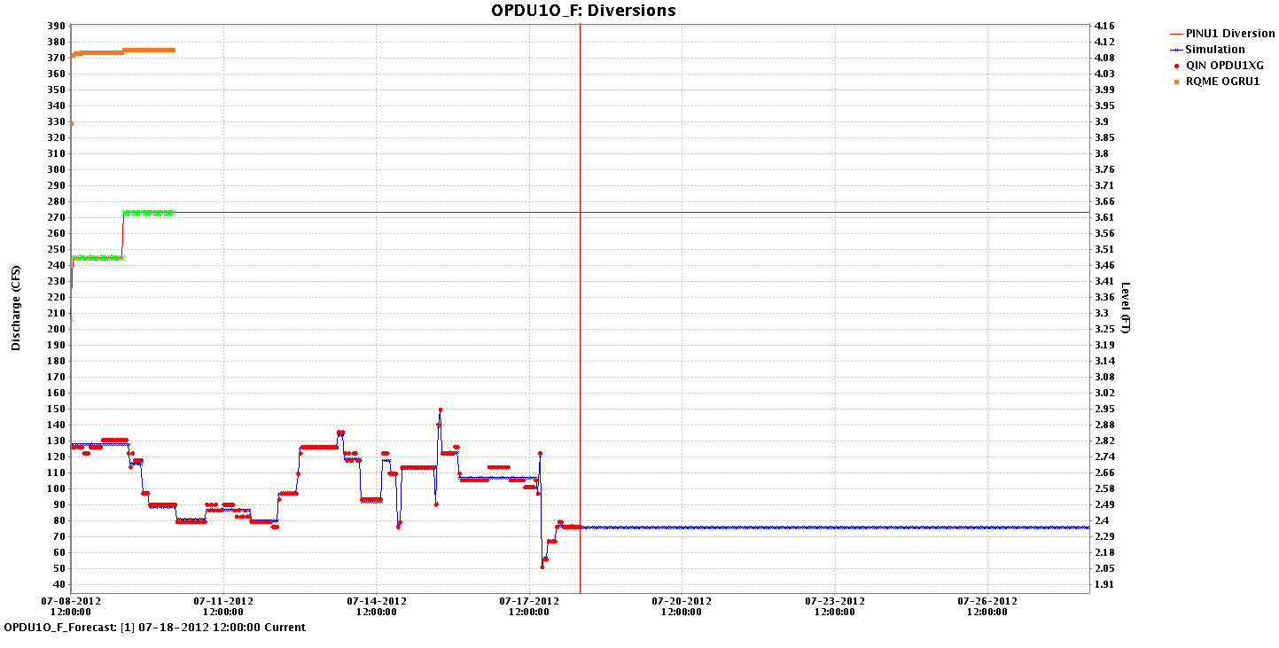
Missing Data
Model simulated inflow
No observed inflow data
Model consumptive use
Forecast
Observed pool elevation
Model simulated pool elevation
Observed release
Forecast
Calculated diversion
Extended diversion
Observed flow below diversion

Slide 7
Future Data – Short Term
Short term (~10 day) reservoir release schedules and diversion plans help with daily forecasting.
  We assume current releases will remain constant if we have no other information (unless spilling).
  Especially important when reservoir is getting close to spill, but reservoir operations are planned to avoid/reduce spill.
    Our forecasts will show big rises downstream due to expected spill.
  Assume either current diversion levels or constant flow left in the river – determined by best guess of forecaster.

Slide 8
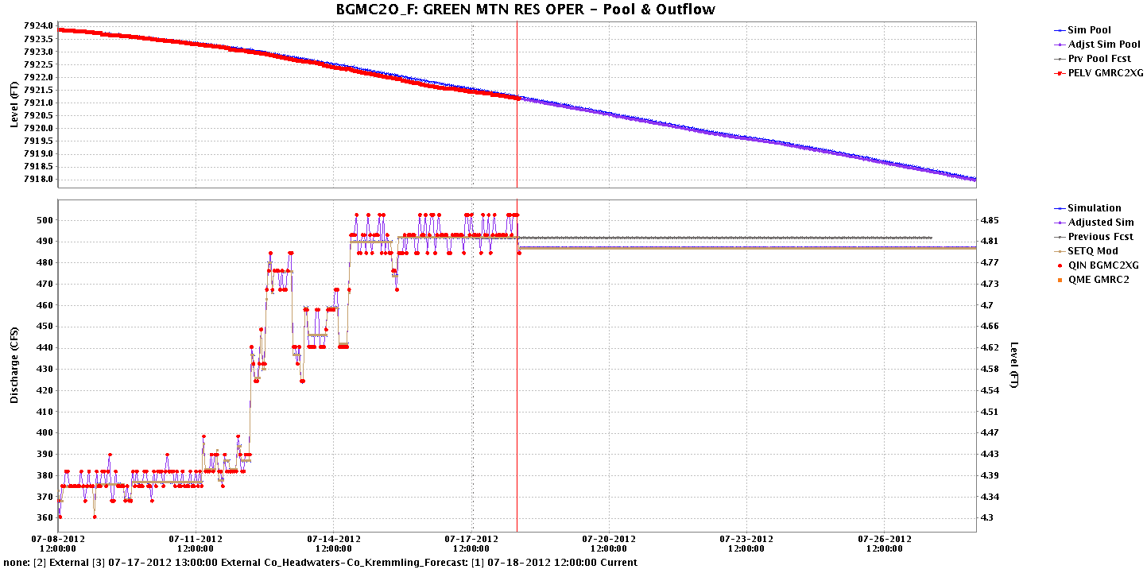
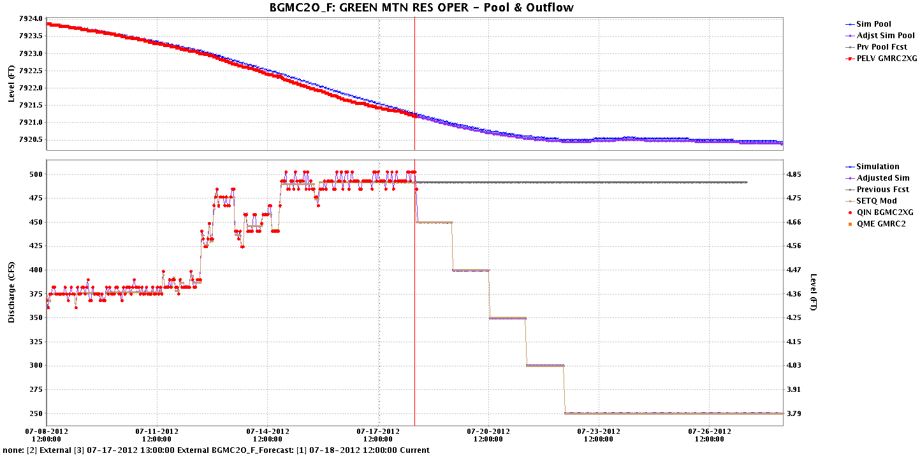
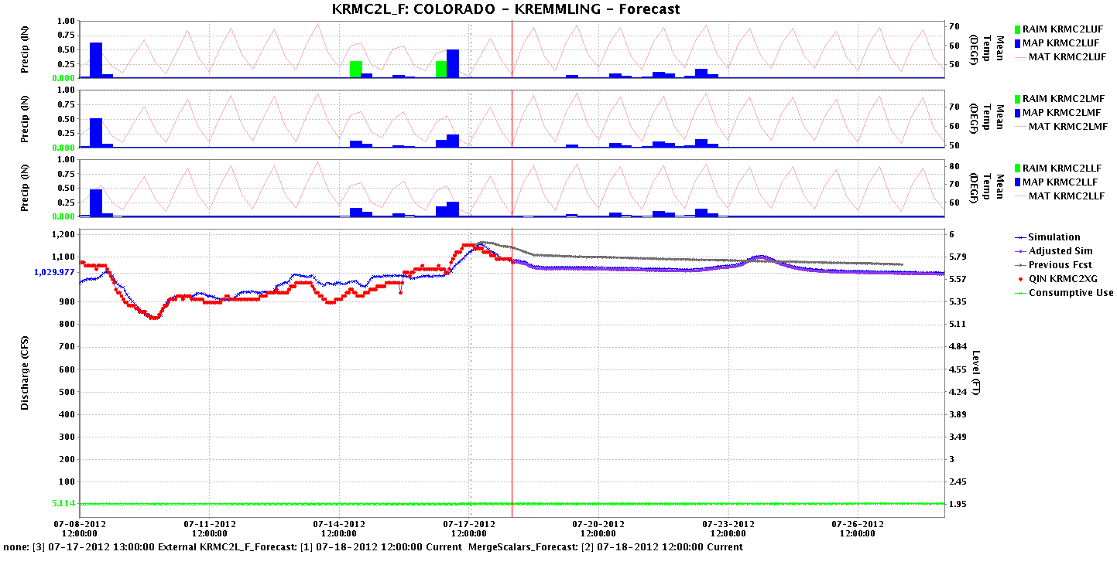
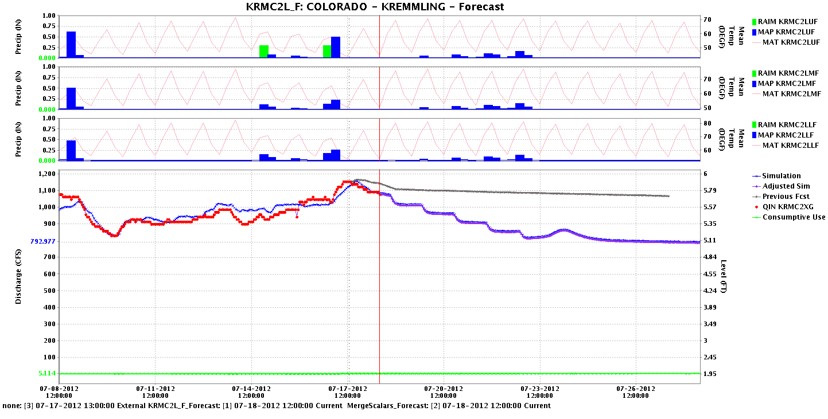
Daily Forecasts – Releases
No Release Schedule
Release Schedule
Pool Elevation
Reservoir Outflow
Observed
Future
Observed
Future
Downstream Site
Observed
Future
Observed
Future

Slide 9
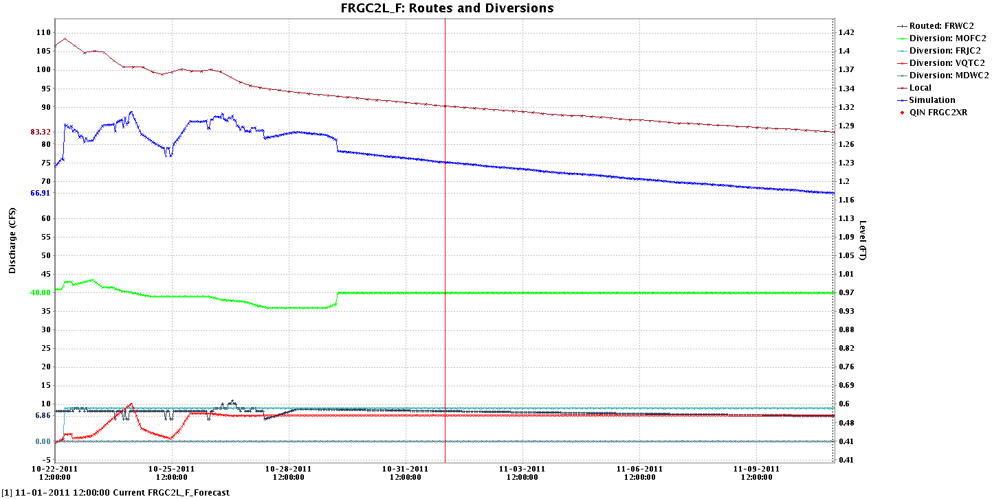
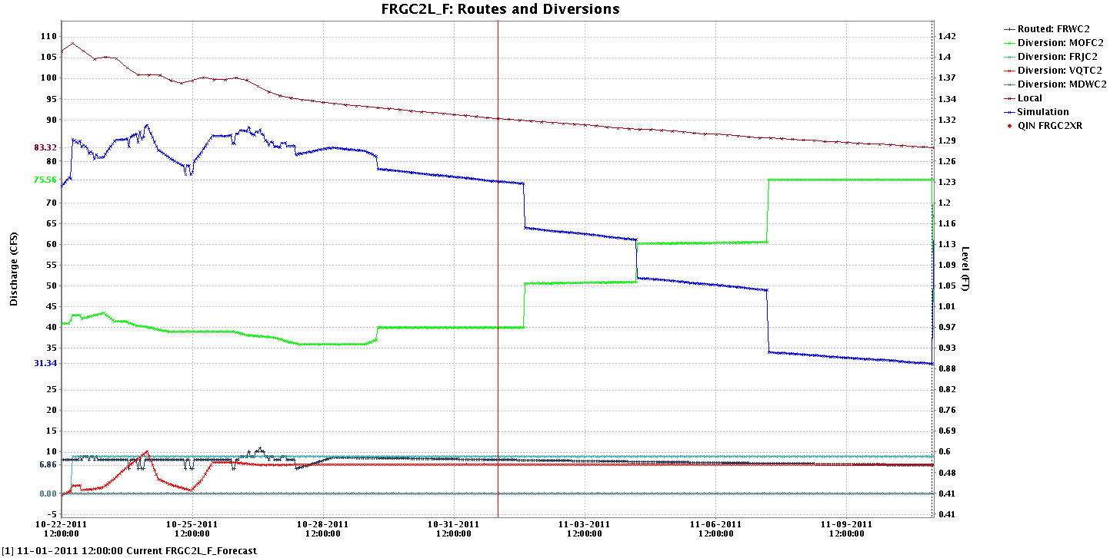
Daily Forecasts – Diversions
Steady Diversion
Changing Diversion
Simulated River Flow
Diversion Flow

Slide 10
Future Data – Long Term
Long term reservoir plans can help with long lead peak flow forecasts and river flow outlooks.
  General reservoir operating rules for any year.
    Regulated ESP uses ‘rules’ written into our model to determine reservoir releases; these are usually based on either the reservoir elevation or the time of year.
  Early season (~Jan-Mar) outlook leading up to the snowmelt runoff season for the current year.
    Will allow our model to have better initial reservoir levels for the start of the runoff.
    When rules kick in beyond planned releases, results will be more reasonable for spill conditions.

Slide 11
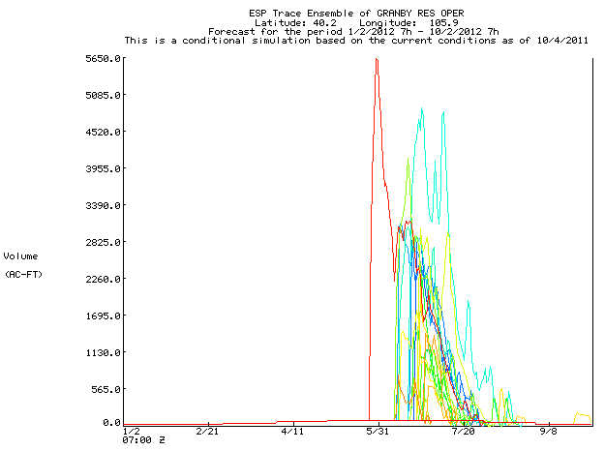
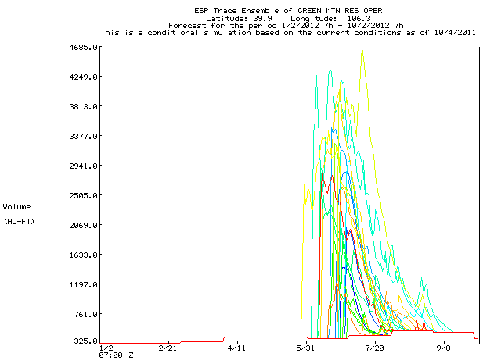
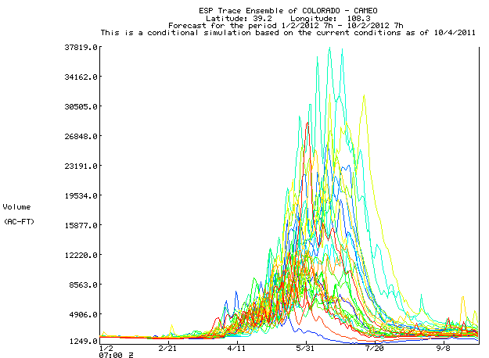
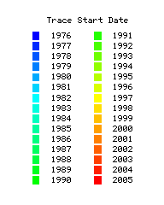
Regulated Esp
Reservoir 1
Spill
Reservoir 2
Spill
Release rules
Release rules
Downstream river site
Routed
Spills
Flood Stage

Slide 12
Summary – What We Need
Accurate real time observed data for reservoirs and diversions.
  Make sure our starting conditions are correct.
Short term (~10 day) reservoir release schedules and diversion plans.
  Help with daily forecasting.
  Especially important when reservoir is getting close to spill, but reservoir operations are planned to avoid/reduce spill.
Long term reservoir plans.
  Help with long lead peak flow forecasts and river flows (e.g. CROS).
  Plans for early season (~Jan-Mar) leading into runoff season.
Updated reservoir information.
  Latest storage and spillway curves.
  Critical elevations.
  Information that would help refine our model rules.

