Slide 1
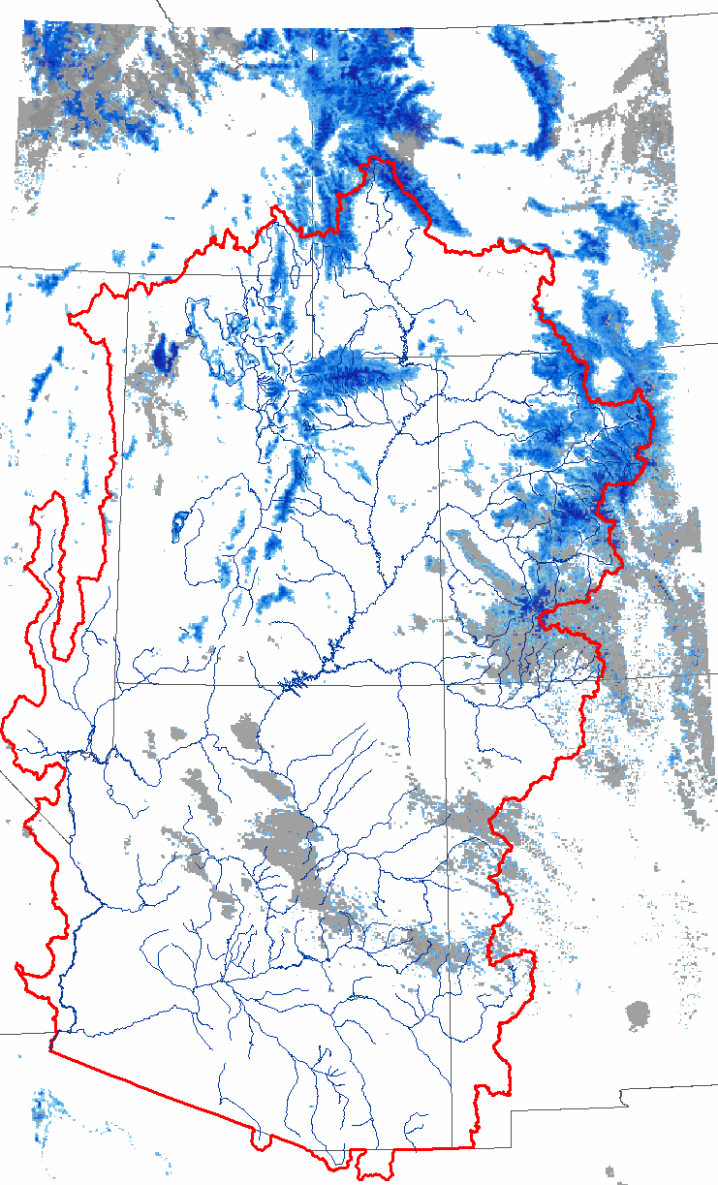
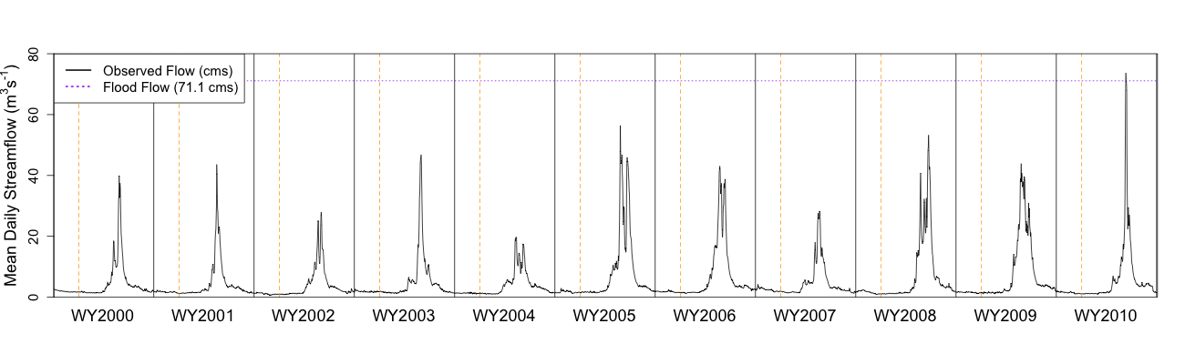
Use of Snow Data from Remote Sensing in Operational Streamflow Prediction
Stacie Bender¹, Thomas H. Painter²,
Paul Miller¹, and Michelle Stokes¹
¹NOAA/National Weather Service
Colorado Basin River Forecast Center
Salt Lake City, UT
²NASA/Jet Propulsion Laboratory
Pasadena, CA

Slide 2
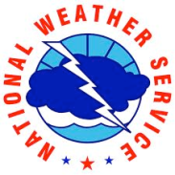

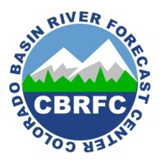
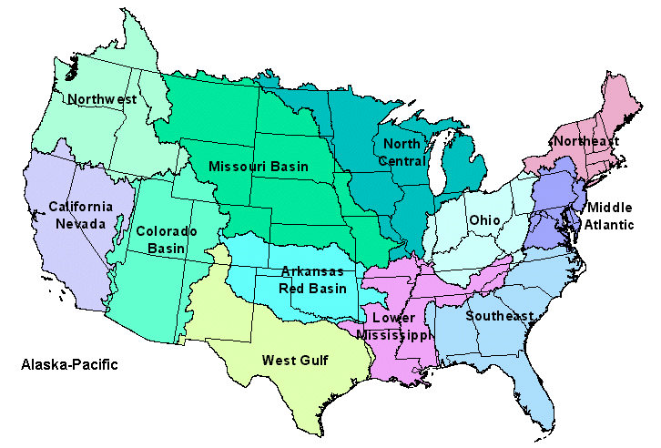
CBRFC
Colorado Basin River Forecast Center (CBRFC)
CBRFC
The R2O Gap
Project Goals and Motivation
MODSCAG & DRFS Datasets
Uses of NASA/JPL Data at CBRFC
Future Directions
Emphasizing the Importance of Collaboration
Summary
Full staff: 3 mgmt, 9 hydrologists, 1 admin, 1 IT
Vacancies: 1 mgmt, 1 hydro
Operational streamflow forecasts across the Colorado River basin and eastern Great Basin
Operational forecast types:
daily streamflow
seasonal peak flow
seasonal water supply volume
National Weather Service River Forecast Centers
www.cbrfc.noaa.gov

Slide 3
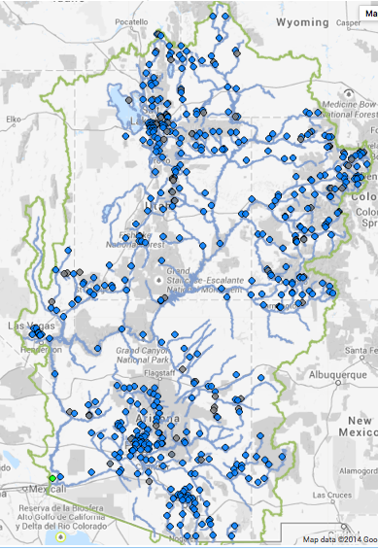
CBRFC
CBRFC
The R2O Gap
Project Goals and Motivation
MODSCAG & DRFS Datasets
Uses of NASA/JPL Data at CBRFC
Future Directions
Emphasizing the Importance of Collaboration
Summary
Colorado Basin River Forecast Center (CBRFC)
Hydrologic regimes:
snow-dominated to flash
flood hydrology
natural to regulated
500+ streamflow forecast points
~1150 modeling units (snow and soil moisture model run on each)

Slide 4
Importance of Snow
CBRFC
The R2O Gap
Project Goals and Motivation
MODSCAG & DRFS Datasets
Uses of NASA/JPL Data at CBRFC
Future Directions
Emphasizing the Importance of Collaboration
Summary
Annual streamflow:
→ primarily snowmelt-driven in CBRFC area of responsibility
Annual hydrographs for the Weber R. headwater basin (northern Utah), water years 2000 to 2010
Streamflow forecast users then, in turn, depend on snow:
      NWS Weather Forecast Offices
      US Bureau of Reclamation
      water conservation districts
      municipalities
      recreational community
      others

Slide 5
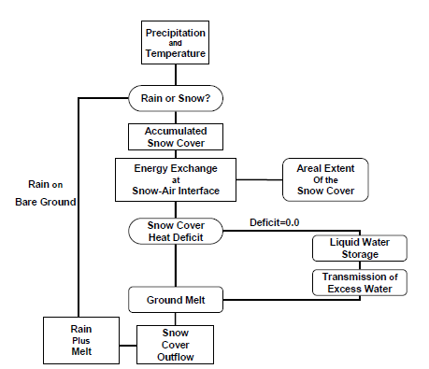
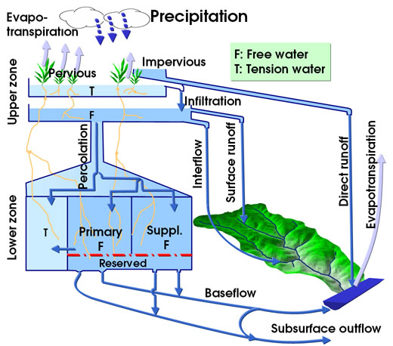
Operational CBRFC Models
CBRFC
The R2O Gap
Project Goals and Motivation
MODSCAG & DRFS Datasets
Uses of NASA/JPL Data at CBRFC
Future Directions
Emphasizing the Importance of Collaboration
Summary
Operational Snow Model:
SNOW17 (temperature-index model)
Operational Soil Moisture Model:
Sac-SMA

Slide 6
Operational CBRFC Models
CBRFC
The R2O Gap
Project Goals and Motivation
MODSCAG & DRFS Datasets
Uses of NASA/JPL Data at CBRFC
Future Directions
Emphasizing the Importance of Collaboration
Summary
Operational Snow Model: SNOW17
minimum inputs: precip and temperature
minimal computational power needed
decades of NWS experience
calibrated to streamflow using the 1981-2010
historical period (manual process at CBRFC)
temperature-index model
→ “melt factor” to relate snowmelt to air temp.
forecasts snowmelt pretty well under near-
normal conditions of the calibration period
doesn’t do so hot when conditions deviate from
near-normal – manual adjustments needed

Slide 7
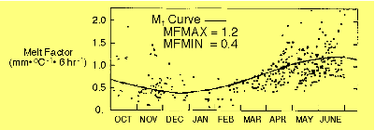
Operational CBRFC Models
CBRFC
The R2O Gap
Project Goals and Motivation
MODSCAG & DRFS Datasets
Uses of NASA/JPL Data at CBRFC
Future Directions
Emphasizing the Importance of Collaboration
Summary
Operational Snow Model: SNOW17
“melt factor” function for the year is a sine curve
two calibrated model parameters define the sine
curve (MFMAX for June 21, MFMIN for Dec 21)
as conditions deviate from the calibration-
defined melt factor function, forecasters may
manually apply a “melt factor correction”

Slide 8
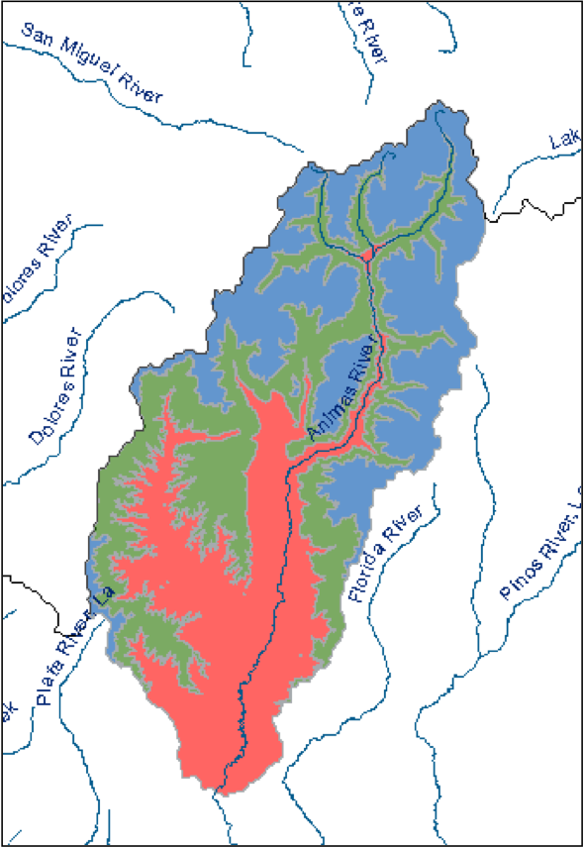
CBRFC Modeling Units
CBRFC
The R2O Gap
Project Goals and Motivation
MODSCAG & DRFS Datasets
Uses of NASA/JPL Data at CBRFC
Future Directions
Emphasizing the Importance of Collaboration
Summary
CBRFC’s operational models: lumped, not distributed
→ Modeling units = elevation bands or zones
→ each zone gets its own set of SNOW17 and
Sac-SMA parameters via model calibration
EXAMPLE: Animas River, Durango, CO
(NWS ID = DRGC2)
Elevation Zone | Mean Elevation (ft)
DRGC2HUF (Upper) | 11956
DRGC2HMF (Middle) | 10211
DRGC2HLF (Lower) | 8374
Durango

Slide 9


Snow and the CBRFC Operational
Forecasting Process
CBRFC
The R2O Gap
Project Goals and Motivation
MODSCAG & DRFS Datasets
Uses of NASA/JPL Data at CBRFC
Future Directions
Emphasizing the Importance of Collaboration
Summary
CBRFC Operational Hydrologic Forecasting Process:
Ultimately driven by CBRFC forecast users, who have decision deadlines and who need forecasts consistently and reliably
where snow improvements may potentially lead to streamflow prediction improvements
Input Datasets:
Must be reliably available in a timely manner
CBRFC Hydrologic Model
Computing = local Linux boxes
(no supercomputer available)
CBRFC Hydrologist / Forecaster (the “human component”)
Given information about hydrologic conditions, the forecaster may modify the forecast that initially comes directly from the model
(including manual adjustment of snow and/or soil model states)
Official CBRFC Streamflow Forecasts
CBRFC Forecast Users and Stakeholders:
NWS Weather Forecast Offices, Bureau of Reclamation, Water Conservation Districts, Recreational River Community, others

Slide 10
Bridging the R2O Gap
CBRFC
The R2O Gap
Project Goals and Motivation
MODSCAG & DRFS Datasets
Uses of NASA/JPL Data at CBRFC
Future Directions
Emphasizing the Importance of Collaboration
Summary
Collaborative partnerships among operational and research-oriented groups
intended to accelerate the improvement of
snowmelt-driven streamflow predictions at CBRFC
Productive research and academic communities
≠
automatic and easy transfer of research to operations (R20)

Slide 11
Bridging the R2O Gap
CBRFC
The R2O Gap
Project Goals and Motivation
MODSCAG & DRFS Datasets
Uses of NASA/JPL Data at CBRFC
Future Directions
Emphasizing the Importance of Collaboration
Summary
Some reasons for the notoriously difficult-to-bridge R20 gap:
Cultural - both sides need to understand their counterparts
researchers – usually have a specialty
NWS operational hydrologists - jacks/jills of many trades
Differences in hydrologic science and models used
Operational time constraints
forecasting agency needs input datasets available in NRT
forecast users need info quickly and reliably → decisions
Scale of datasets (space and time)
field experiments vs. datasets with long period of record
dedicated experimental basins vs. results across a large area
IT Issues
computing power (no supercomputer for NWS hydro)

Slide 12
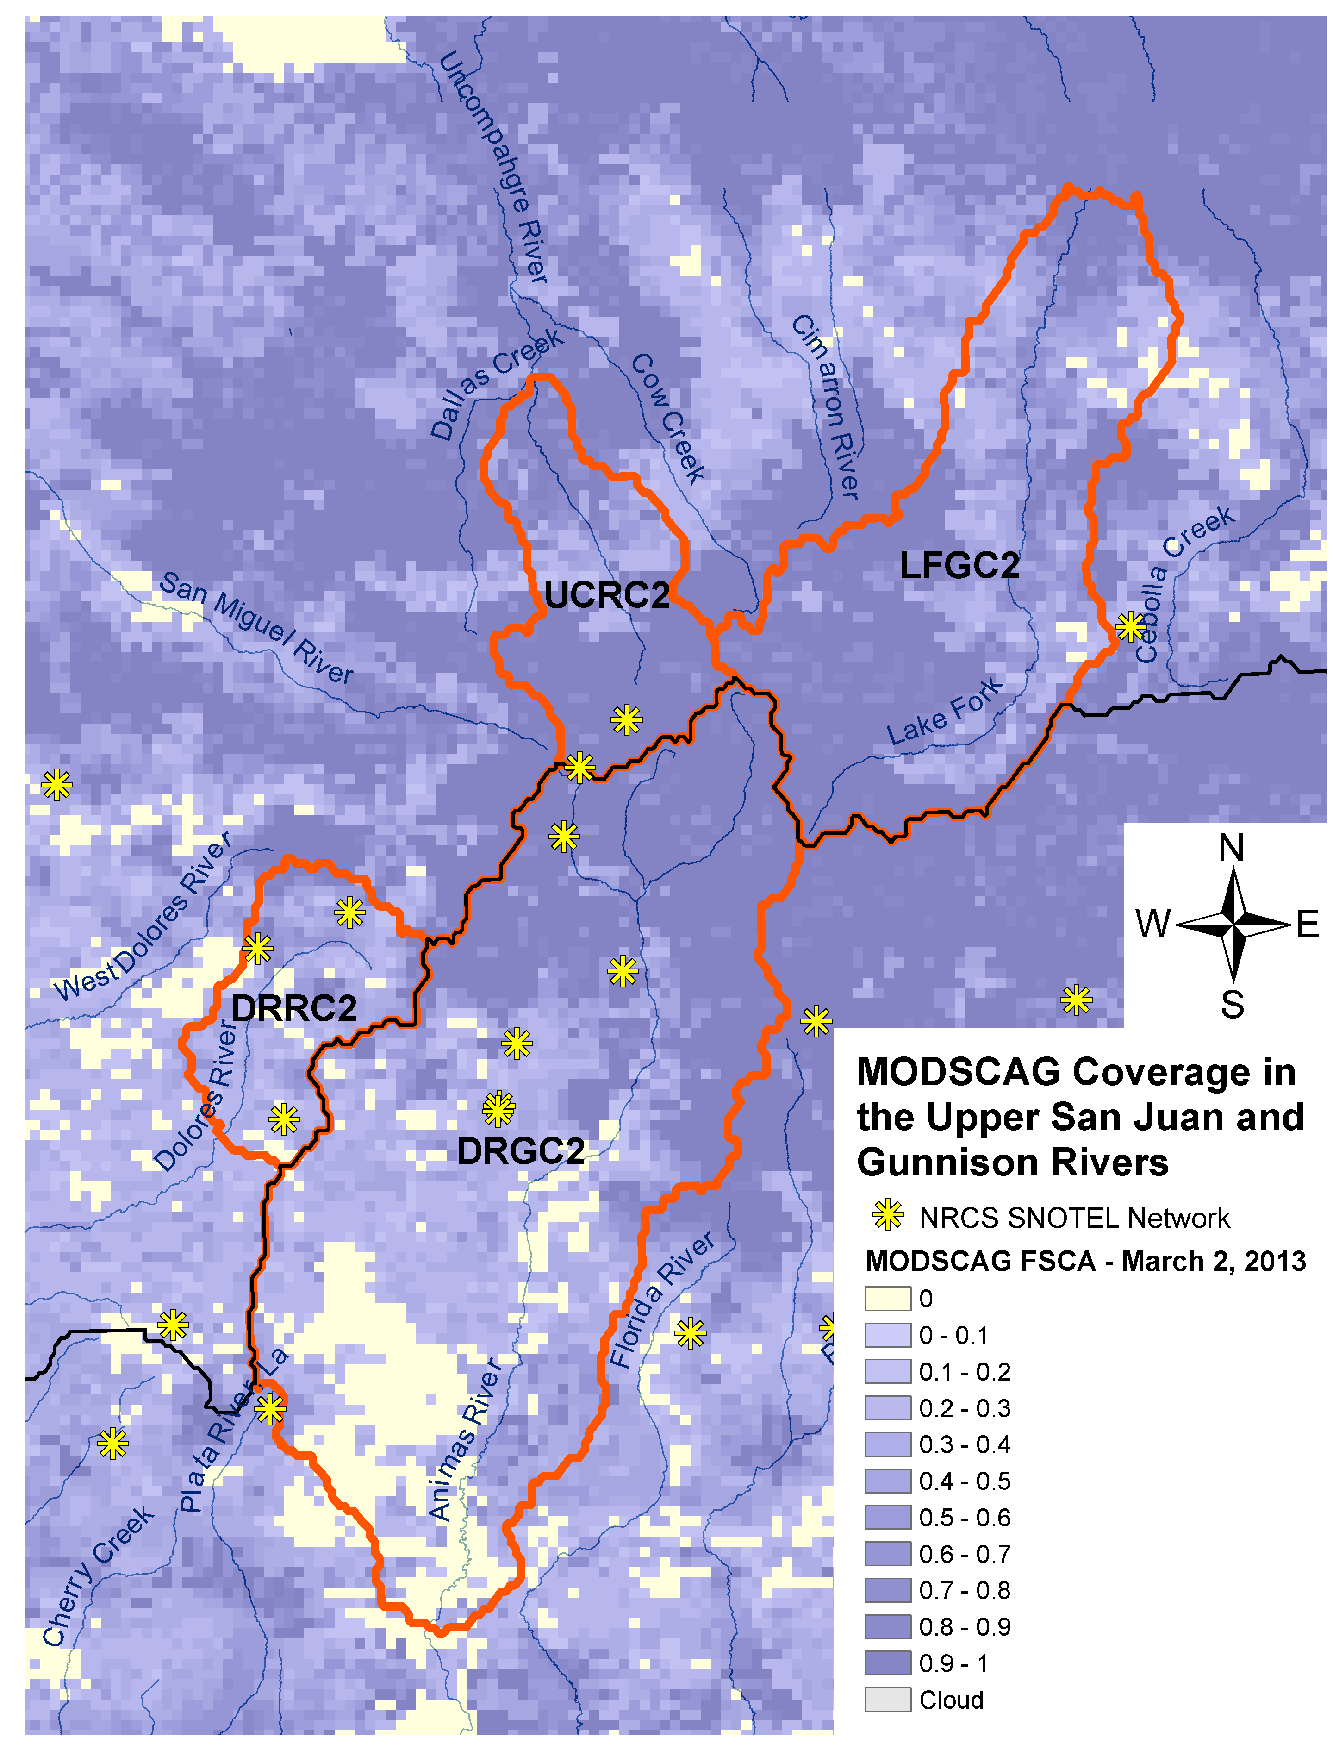

Project Goals and Motivations
CBRFC
The R2O Gap
Project Goals and Motivation
MODSCAG & DRFS Datasets
Uses of NASA/JPL Data at CBRFC
Future Directions
Emphasizing the Importance of Collaboration
Summary
Expanding info available to the CBRFC forecaster:
Snowpack observations → crucial to improving CBRFC streamflow prediction
Point networks (SNOTEL) =the backbone and remain crucial to CBRFC ops.
Remote sensing (RS) data can fill in gaps between point stations, especially at high elevations, in mountainous terrain.
RS of SW CO snow cover from MODIS, with SNOTEL station locations (yellow)
Durango
Past (pre-2013):
Present and future:
Point networks only
Point networks
+
Remote sensing (MODIS, VIIRS)
=
More robust set of snowpack observations

Slide 13
Project Goals and Motivations
CBRFC
The R2O Gap
Project Goals and Motivation
MODSCAG & DRFS Datasets
Uses of NASA/JPL Data at CBRFC
Future Directions
Emphasizing the Importance of Collaboration
Summary
Establish a multi-year CBRFC/JPL collaboration:
Actually get across the R2O gap!
More efficiently integrate RS snow datasets into CBRFC forecasting
Improve overall understanding and communication between operational and research groups
Develop beneficial relationships specifically among snow and remote sensing science researchers and operational hydrologic forecasters

Slide 14
RS Snow Datasets
CBRFC
The R2O Gap
Project Goals and Motivation
MODSCAG & DRFS Datasets
Uses of NASA/JPL Data at CBRFC
Future Directions
Emphasizing the Importance of Collaboration
Summary
Exploit differences in spectral characteristics of snow in the VIS and NIR to derive snow cover and dust information
  MODSCAG provides per-pixel (500 m) fractional snow cover (%)
  MODDRFS provides per-pixel (500 m) radiative forcing by dust in snow (W m⁻²)
Both gridded datasets are available from JPL server in near-real time and over the MODIS period of record (2000-present)
REFERENCES:
Painter, T. H., K. Rittger, C. McKenzie, R. E. Davis, and J. Dozier, Retrieval of subpixel snow-covered area and grain size from MODIS reflectance data, Remote Sensing of Environment, 113, 868-879, doi:10.1016/j.rse.2009.01.001.
Painter, T. H., A. C. Bryant, and S. M. Skiles, Radiative forcing of dust in mountain snow from MODIS surface reflectance data, Geophysical Research Letters, doi: 10.1029/2012GL052457.

Slide 15
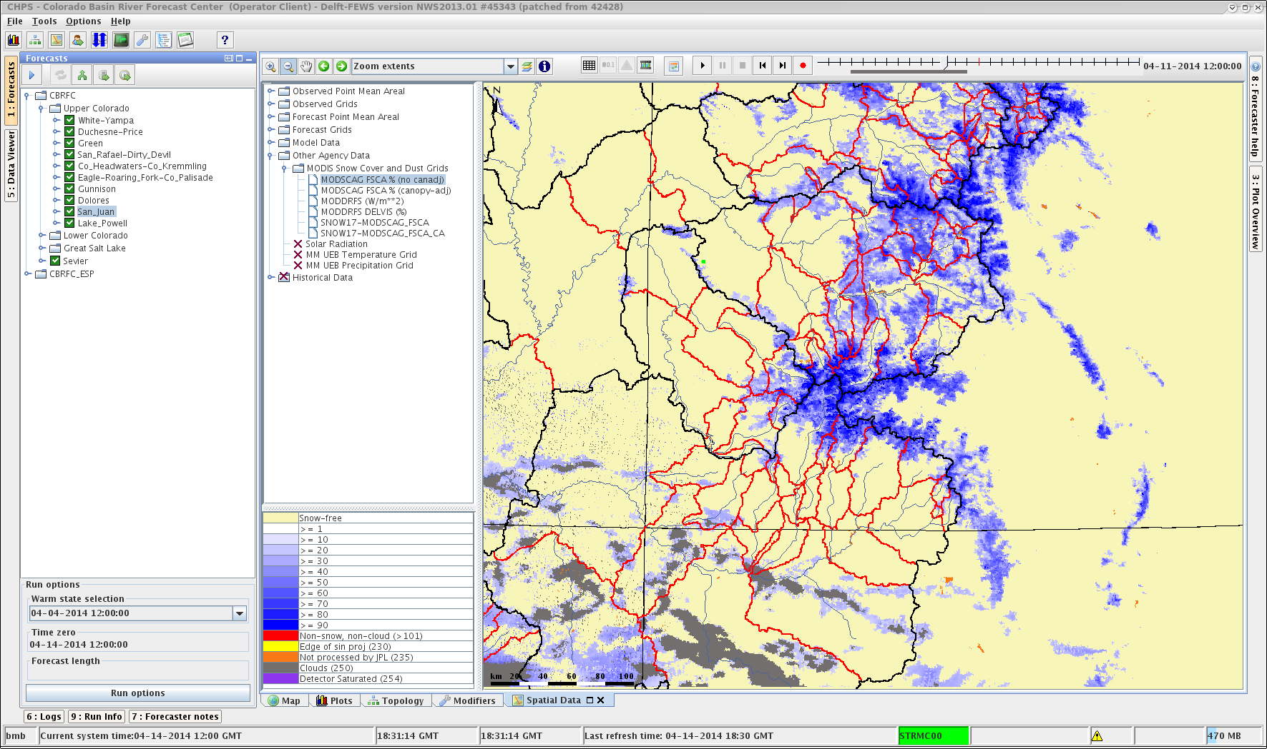
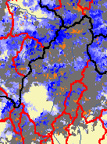
Limitations of MODIS-derived
Snow Data
CBRFC
The R2O Gap
Project Goals and Motivation
MODSCAG & DRFS Datasets
Uses of NASA/JPL Data at CBRFC
Future Directions
Emphasizing the Importance of Collaboration
Summary
No direct SWE information
Limited seasons of usefulness (fSCA values bounded by 0 to 100%)
Impacts of vegetation
Clouds, especially during stormy periods
MODSCAG fSCA April 11, 2014
MODSCAG fSCA April 12, 2014
(clouds = gray)

Slide 16
Timeline of MODSCAG and DRFS
Use at CBRFC
CBRFC
The R2O Gap
Project Goals and Motivation
MODSCAG & DRFS Datasets
Uses of NASA/JPL Data at CBRFC
Future Directions
Emphasizing the Importance of Collaboration
Summary
2012: initial exploratory phase
CBRFC set up NRT processing of data from JPL
both groups began learning what they had gotten themselves into
2013:
semi-quantitative use of MODSCAG fSCA at CBRFC
→ binary indicator of snow presence (or lack of)
→ add/subtract small amount of SWE
historical analysis of patterns in streamflow prediction errors and
MODDRFS dust-on-snow data (Annie Bryant PhD work)
3 week visit to CBRFC during melt season by JPL’s Annie Bryant
2014:
added another version of MODSCAG fSCA to toolbox
automated alerts of model vs. MODSCAG “fSCA differences”
more extensive use of MODDRFS dust data in 2014 than 2013
began refining semi-quantitative method of treating of fSCA and
dust info in CBRFC forecasting and modeling

Slide 17
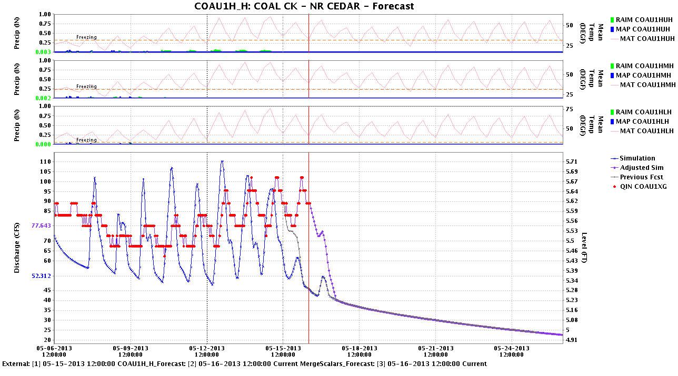
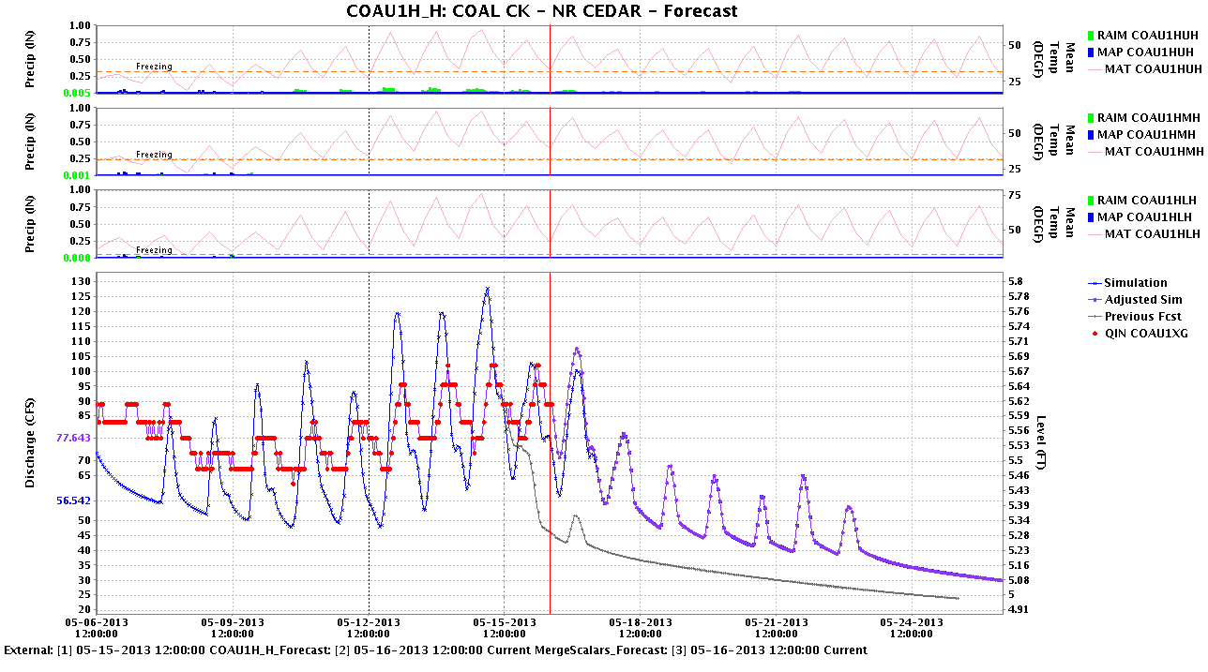
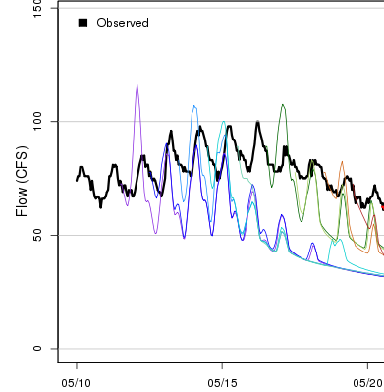
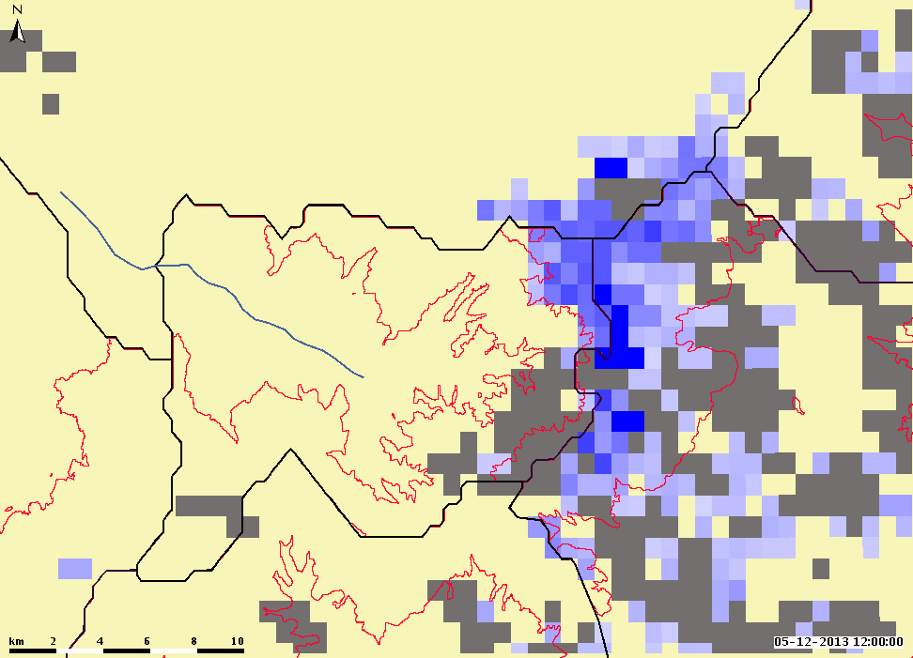
May 16, 2013 CBRFC forecast modifications due to MODSCAG (snow cover)
CBRFC
The R2O Gap
Project Goals and Motivation
MODSCAG & DRFS Datasets
Uses of NASA/JPL Data at CBRFC
Future Directions
Emphasizing the Importance of Collaboration
Summary
Coal Creek, near Cedar City, UT, NWS ID: COAU1/USGS ID: 10242000
Before small SWE adjustment:
After small SWE addition:
Past
Future
Past
Future
Recent Obs Q
Model Sim Q
Official Fcst Q
MODSCAG Snow Cover
Observed Q (cfs)

Slide 18
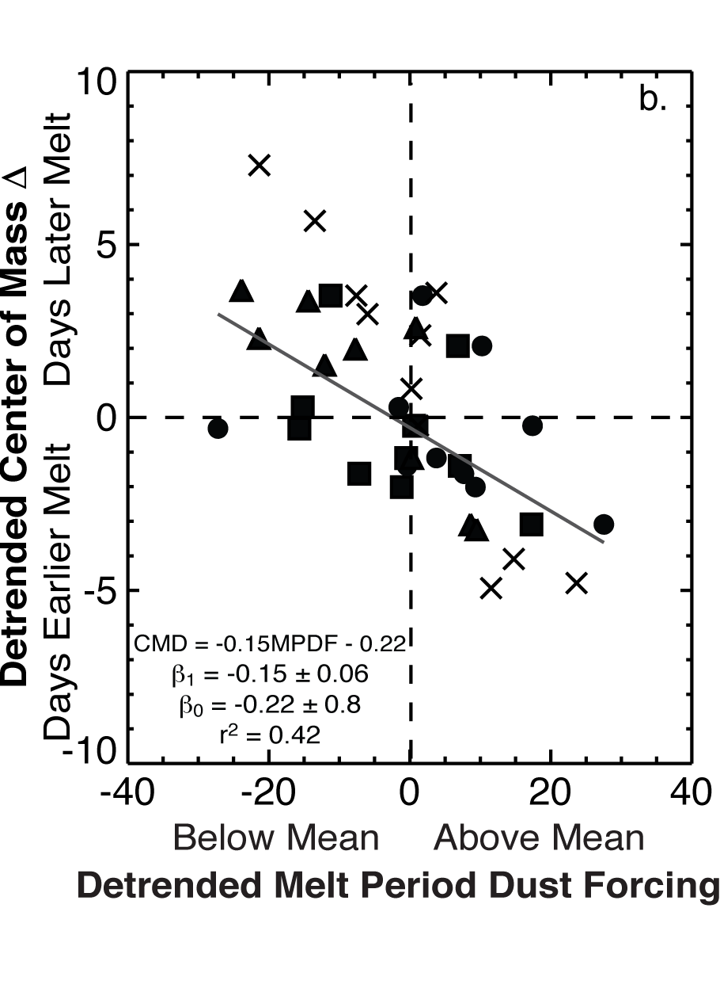
MODDRFS and CBRFC Q Error Patterns
CBRFC
The R2O Gap
Project Goals and Motivation
MODSCAG & DRFS Datasets
Uses of NASA/JPL Data at CBRFC
Future Directions
Emphasizing the Importance of Collaboration
Summary
Dust in the snowpack primarily impacts timing of snowmelt (and timing of subsequent snowmelt-driven streamflow peaks)
Analysis shows that a dustier than average snowpack results in center of mass that is observed earlier than predicted (esp. SW CO)
Very dusty years coincide with larger streamflow prediction errors
REFERENCE:
Bryant, A. C., T. H. Painter, J. S. Deems, and S. M. Bender (2013), Impact of dust radiative forcing in snow on accuracy of operational runoff prediction in the Upper Colorado River Basin, Geophys. Res. Lett., 40, 3945–3949, doi:10.1002/grl.50773.

Slide 19
Multiple MODSCAG fSCA Products
CBRFC
The R2O Gap
Project Goals and Motivation
MODSCAG & DRFS Datasets
Uses of NASA/JPL Data at CBRFC
Future Directions
Emphasizing the Importance of Collaboration
Summary
“Viewable” MODSCAG fSCA
what the MODIS instrument “sees”
→ if trees are snow-free but a snowpack exists under
them, MODIS will not observe that snowpack
more accurate in a remote sensing aspect
MODSCAG fSCA product used by CBRFC during 2013 melt
“Canopy-adjusted” MODSCAG fSCA – new for 2014 melt
In a nutshell: if MODSCAG algorithm detects snow and
green vegetation in the same pixel, the fSCA value is reset
to 100%
higher fSCA value than “viewable” MODSCAG fSCA
less accurate in a remote sensing sense but more
hydrologically useful
closer to SNOW17 values of snow cover extent

Slide 20
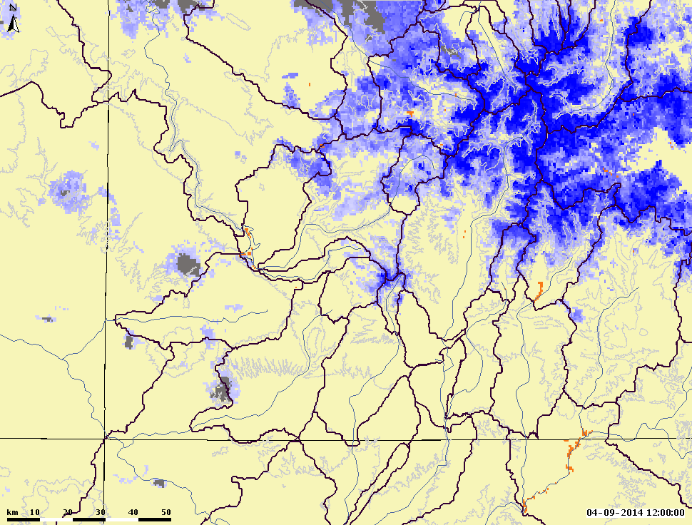
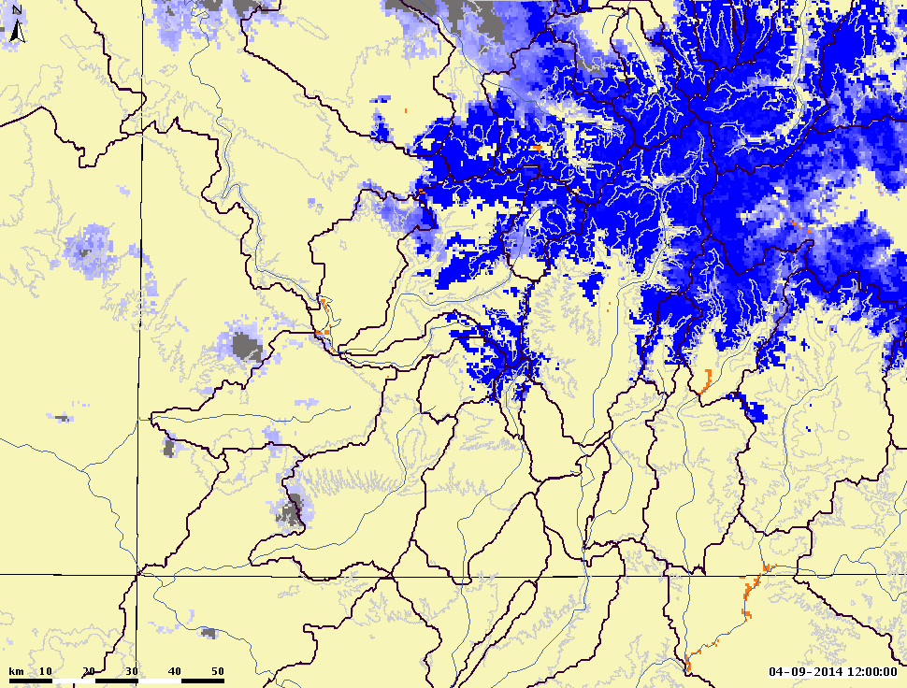
Multiple MODSCAG fSCA Products
CBRFC
The R2O Gap
Project Goals and Motivation
MODSCAG & DRFS Datasets
Uses of NASA/JPL Data at CBRFC
Future Directions
Emphasizing the Importance of Collaboration
Summary
MODSCAG (a) “viewable” and (b) “canopy-adjusted” fSCA over southwestern Colorado, April 9, 2014, as viewed by CBRFC forecasters.
(a)
(b)

Slide 21
Daily “fSCA diff” List
CBRFC
The R2O Gap
Project Goals and Motivation
MODSCAG & DRFS Datasets
Uses of NASA/JPL Data at CBRFC
Future Directions
Emphasizing the Importance of Collaboration
Summary
SNOW17 fSCA vs. MODIS fSCA
--------------------------
Run date: 2014-04-11
Dates to review: 2014-04-07 to 2014-04-11
Type of MODIS obs fSCA used in these comparisons: Canopy-adjusted fSCA
Pedstep of MODIS obs fSCA to use: SADR3ZZ
Sim SWE (inches) range to scan: 0 to 3
MODIS FSCA QC Key (% grid cells that have non-fsca - might be cloud or edge of scan):
A: 0% - best you can get - all pixels w/in elevation zone had valid fSCA values
V: 75.001 to 100.00% - worst - most of pixels in the elevation zone were
Basin Zone Date MODIS FSCA MODIS QC SNOW17 FSCA SNOW17 SWE
-------- -------- ---------- ---------- -------- ------------ ----------
DRGC2H_F DRGC2HLF 2014-04-10 7.25 B 19.34 0.535
** MODIS fSCA < 10% and SNOW17 SWE > 0 - need to take snow out? **
DRGC2H_F DRGC2HLF 2014-04-09 2.29 B 22.60 0.704
** MODIS fSCA < 10% and SNOW17 SWE > 0 - need to take snow out? **
DRGC2H_F DRGC2HLF 2014-04-08 7.20 B 25.36 0.843
** MODIS fSCA < 10% and SNOW17 SWE > 0 - need to take snow out? **
DRGC2H_F DRGC2HLF 2014-04-07 7.50 B 26.26 0.890
** MODIS fSCA < 10% and SNOW17 SWE > 0 - need to take snow out? **

Slide 22
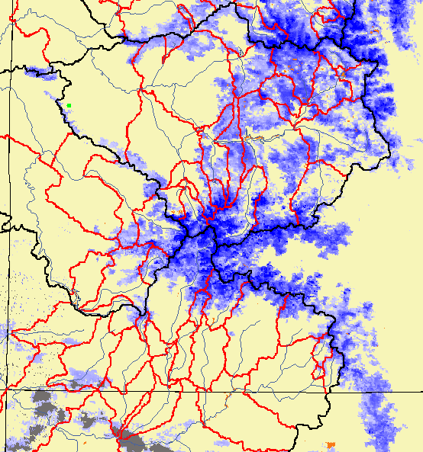
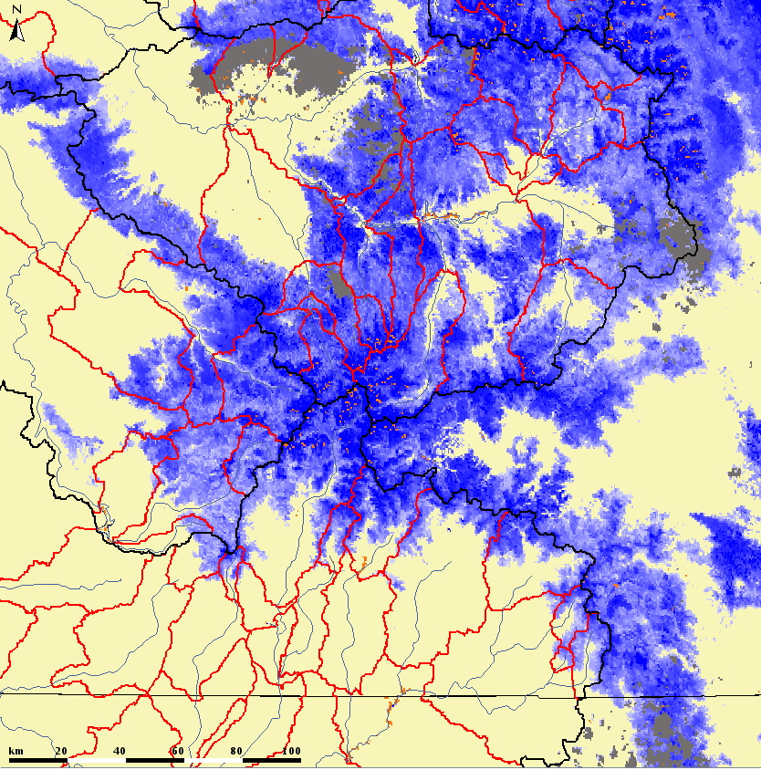
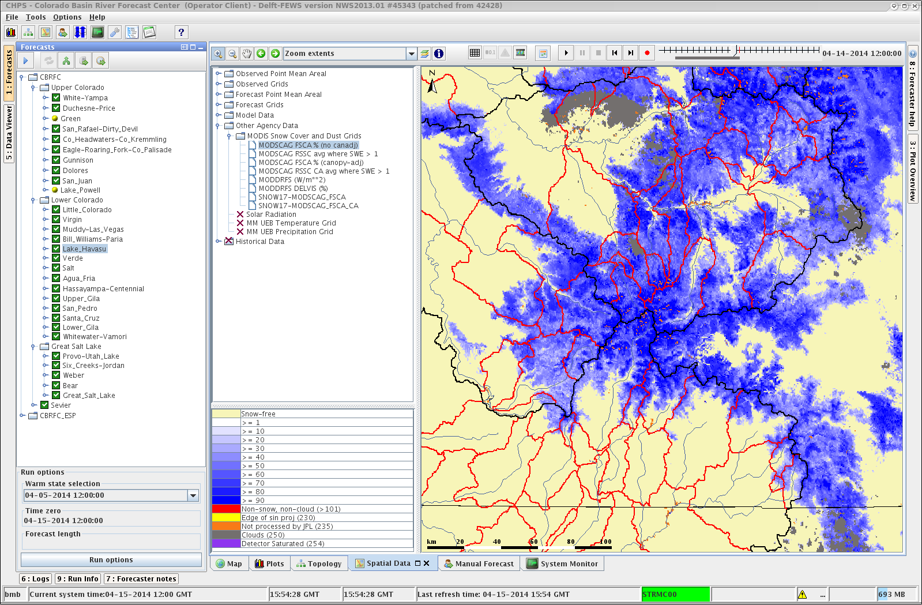
Example: April 2014 Storm
CBRFC
The R2O Gap
Project Goals and Motivation
MODSCAG & DRFS Datasets
Uses of NASA/JPL Data at CBRFC
Future Directions
Emphasizing the Importance of Collaboration
Summary
April 11, 2014
April 14, 2014

Slide 23
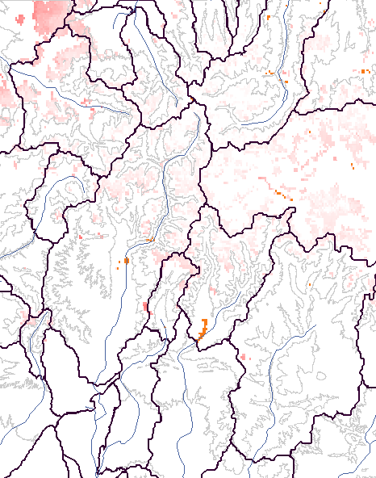
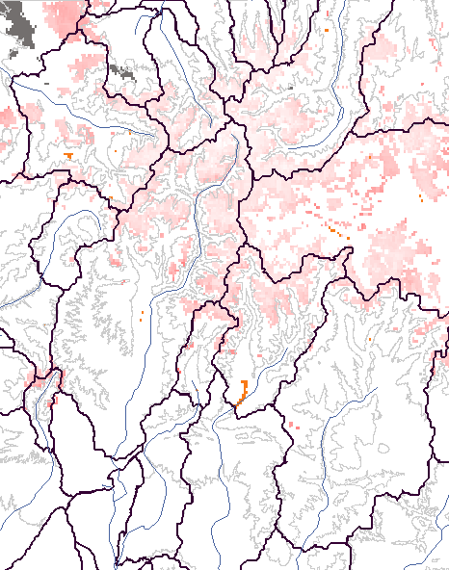
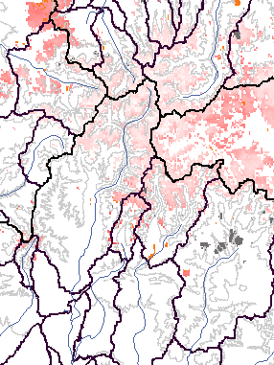
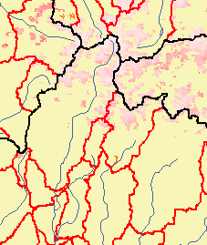
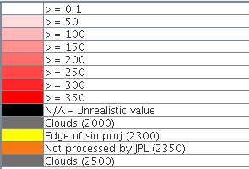
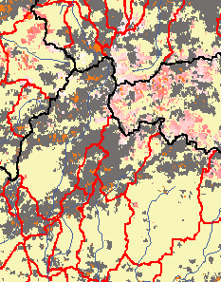
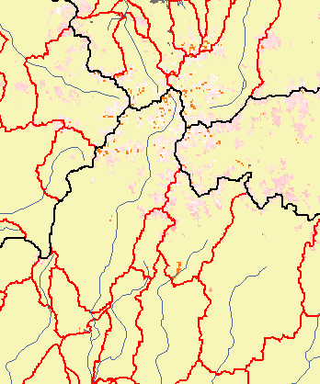
NRT Dust Conditions
CBRFC
The R2O Gap
Project Goals and Motivation
MODSCAG & DRFS Datasets
Uses of NASA/JPL Data at CBRFC
Future Directions
Emphasizing the Importance of Collaboration
Summary
CODOS, April 4: “… dust layer D4 may emerge in the coming week, absorbing solar radiation and accelerating the warming of the underlying snowcover at higher elevations, or enhancing snowmelt rates at lower elevations where the snowcover was already isothermal.”
April 8, 2014
April 9, 2014
April 10, 2014
April 11, 2014
April 13, 2014 – storm/cloudy
April 12, 2014
April 14, 2014

Slide 24
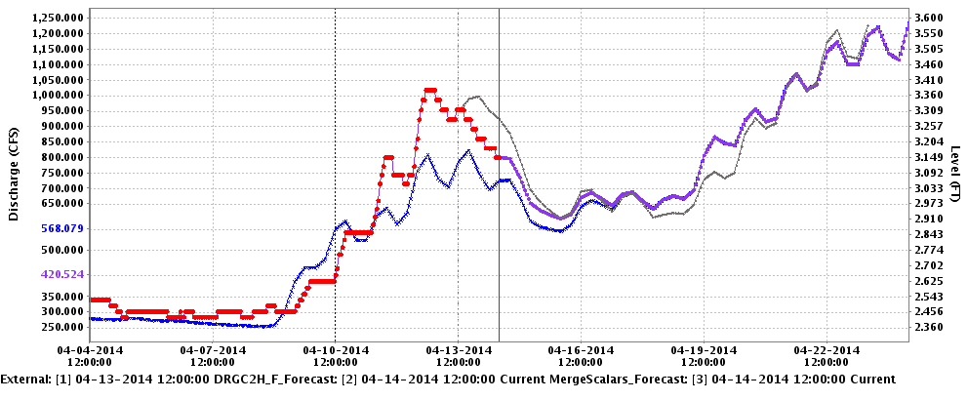
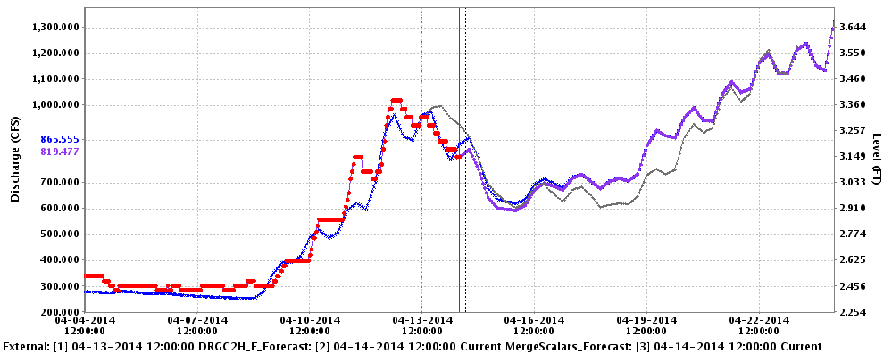
Near Real-time Dust Impacts on
Q Forecasts
CBRFC
The R2O Gap
Project Goals and Motivation
MODSCAG & DRFS Datasets
Uses of NASA/JPL Data at CBRFC
Future Directions
Emphasizing the Importance of Collaboration
Summary
Past
Future
Before “cranking up the melt factor” – sim Q is too low
Recent Obs Q
Model Sim Q
Official Fcst Q
Past
Future
After “cranking up the melt factor” – sim Q matches much better
Recent Obs Q
Model Sim Q
Official Fcst Q

Slide 25
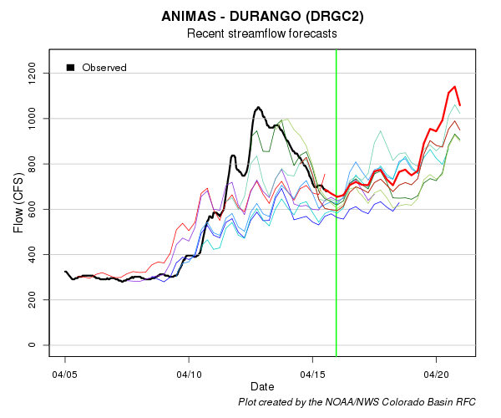
Near Real-time Dust Impacts on
Q Forecasts
CBRFC
The R2O Gap
Project Goals and Motivation
MODSCAG & DRFS Datasets
Uses of NASA/JPL Data at CBRFC
Future Directions
Emphasizing the Importance of Collaboration
Summary
Forecasts issued late in the week and over the weekend were better.
Forecasts issued early to middle of last week were too low

Slide 26
Near Future Directions
CBRFC
The R2O Gap
Project Goals and Motivation
MODSCAG & DRFS Datasets
Uses of NASA/JPL Data at CBRFC
Future Directions
Emphasizing the Importance of Collaboration
Summary
For melt season 2015 (and beyond):
* Continue to use information provided by NASA/JPL at CBRFC
→ manual SWE adjustments from MODSCAG fSCA info
→ “melt factor” (MF) adjustments from MODDRFS dust info
→ Fine-tune the range of allowable SWE and MF adjustments
* Connect patterns in JPL MODIS snow data to patterns in snow model parameters, including calibrated SNOW17 areal depletion curves
* Adjustments to MODIS NASA/JPL datasets – estimates for cloudy pixels, vegetation adjustments (filling in gaps in the time series of data)
* Continue to explore pieces of the snowmelt forecasting puzzle – e.g., energy balance snow modeling
* Improve communication between CBRFC and users of CBRFC forecasts on snow remote sensing data at CBRFC and conditions as melt progresses.
* JPL continues to develop the Airborne Snow Observatory to map
spatial distribution of SWE

Slide 27
CBRFC/NASA/JPL Collaboration
CBRFC
The R2O Gap
Project Goals and Motivation
MODSCAG & DRFS Datasets
Uses of NASA/JPL Data at CBRFC
Future Directions
Emphasizing the Importance of Collaboration
Summary
Collaboration and open exchange of information
→ very beneficial to both CBRFC and NASA/JPL
CBRFC gains detailed knowledge of:
NASA/JPL snow cover and dust-on-snow data and remote sensing in general
How to overcome limitations in datasets (e.g., vegetation, clouds)
NASA/JPL gains awareness of:
CBRFC operational forecasting and modeling process (including the “human component”)
Operational requirements for data availability and timeliness
People involved → KEY to the project’s success.

Slide 28
Summary
CBRFC is using JPL’s snow remote sensing data!
MODSCAG fSCA for SWE adjustments
MODDRFS dust info for “melt factor corrections”
Potential future uses of snow remote sensing data:
Further analysis of historical MODIS datasets
Improvements in JPL remote sensing datasets (estimating conditions on cloud days, further vegetation corrections, ASO)
People make the collaborative R2O wheels go round.
Operational hydrologists
Remote sensing science experts
Take Home Messages
Operational forecasting agencies CAN use snow remote sensing data.
Best, most robust way to use data in operational hydrology is still TBD.
Successful R2O collaborations are driven by dedicated people on the operations side AND the research side.
Contact Info:
CBRFC – Stacie Bender – stacie.bender@noaa.gov
NASA/JPL – Tom Painter – thomas.painter@jpl.nasa.gov

