Slide 1
What Affects Forecast Quality
Uncertainty in weather forecasts
Data
Network density
Quality of measurements
Missing measurements
Loss of data sites used in calibration
Diversions & consumptive use
Model calibration errors (usually tied to historical data)

Slide 2
Precipitation Network (~3000 stations)
NRCS (SNOTEL and SCAN)
COOP
RAWS
ALERT (several counties in AZ, NM and NV)
USRCRN
USCRN
ASOS
AWOS
UCN
COCORAHS

Slide 3
Precipitation Network
Periodically update the metadata
Mainly latitude, longitude and elevation
Additional check using 30 meter DEM data
Goal is to remove obvious errors
Done about once each year
Important for precipitation analysis
Important for radar bias calculation

Slide 4
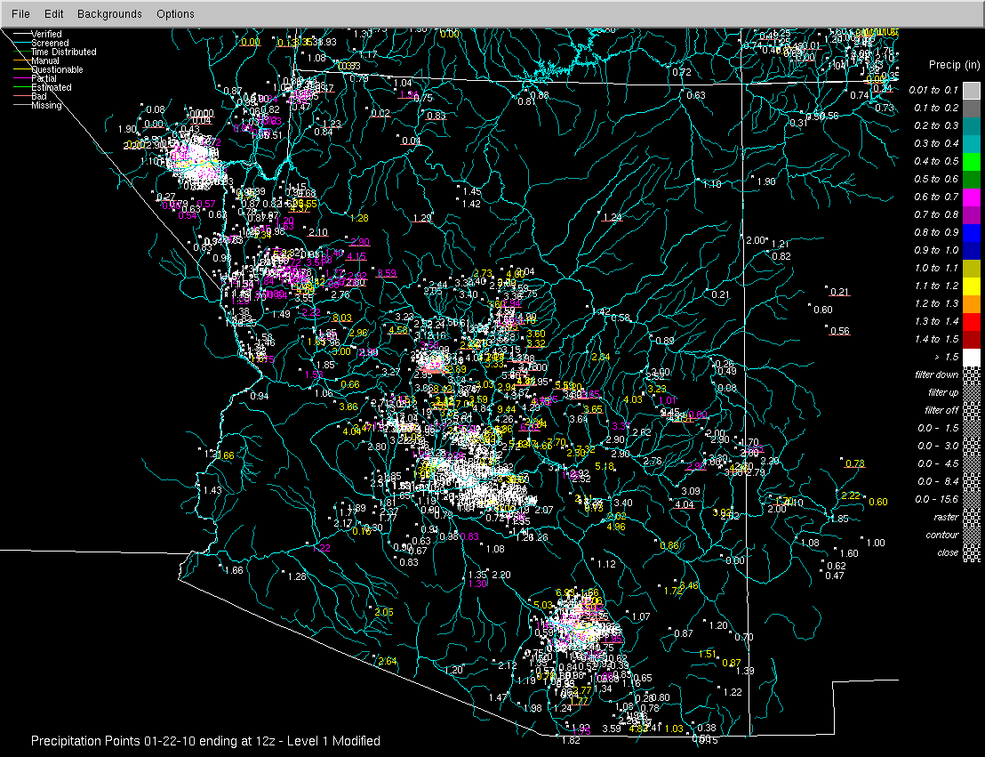

Slide 5
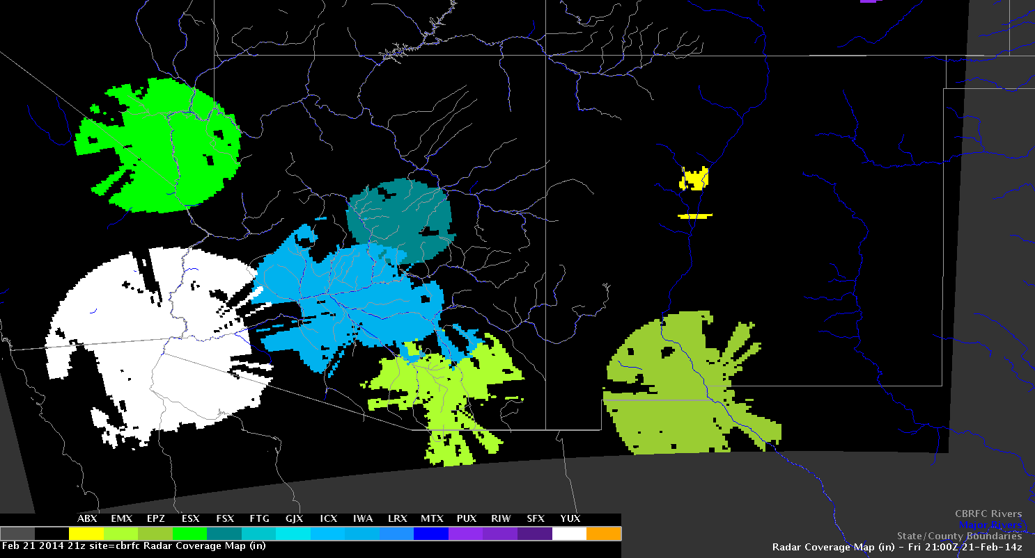
Radar coverage depends on Freezing Level
Adjusting for bias depends on gage network density

Slide 6
Precipitation Network
Upper Colorado
Winter: use predetermined station weights
summer : use all stations including radar, but limit the radar where the mid beam is < 8000 AGL
Lower Colorado
winter : Use all stations including radar but only use radar in areas where it is raining. This results in only using gauges in most areas
summer : use all stations including radar, but limit the radar where the mid beam is < 8000 AGL

Slide 7
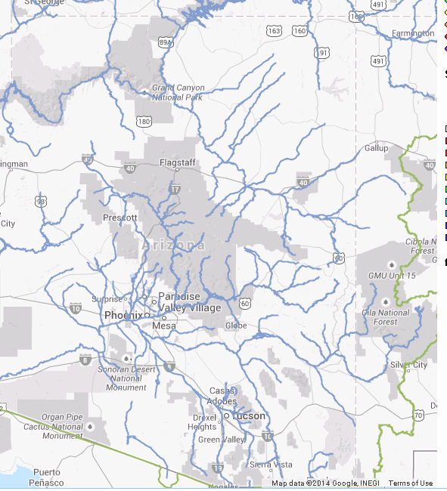
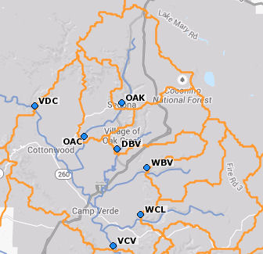
January 2010 Heavy Rain Event
Oak Creek

Slide 8
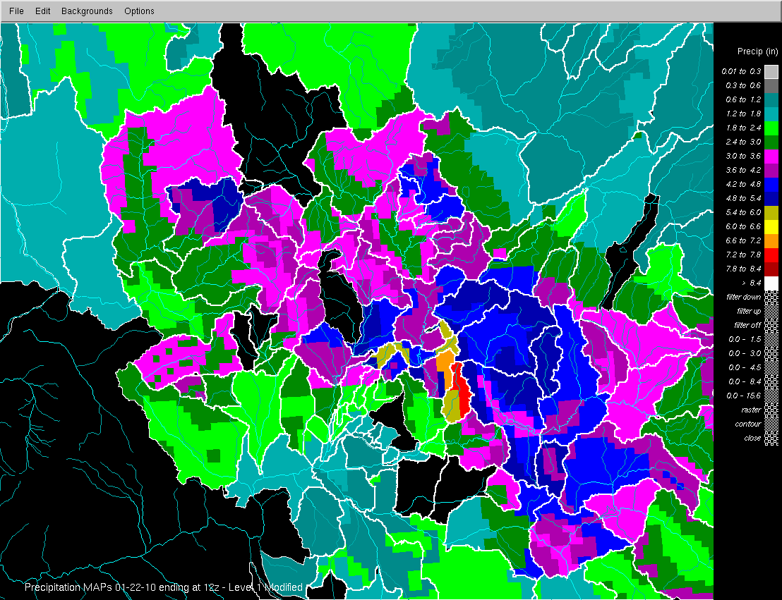
January 21-22 2010 Observed Precipitation

Slide 9
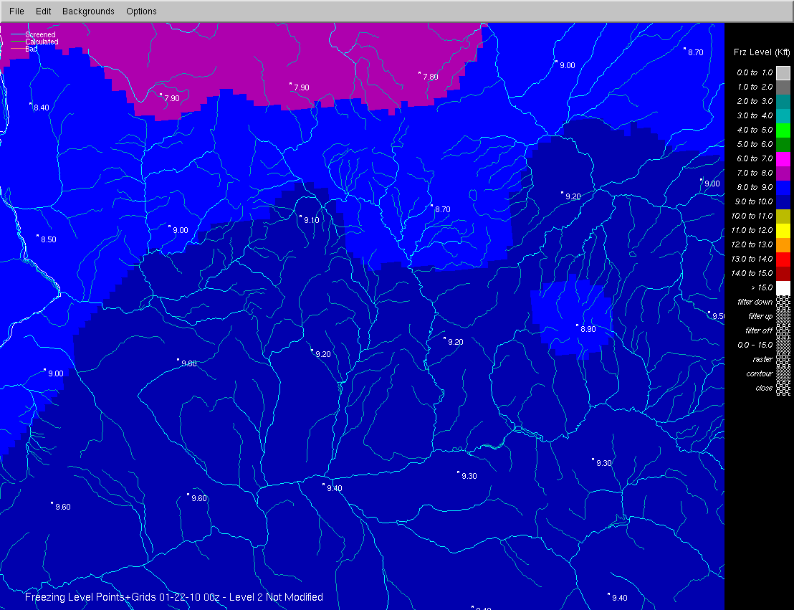

Slide 10
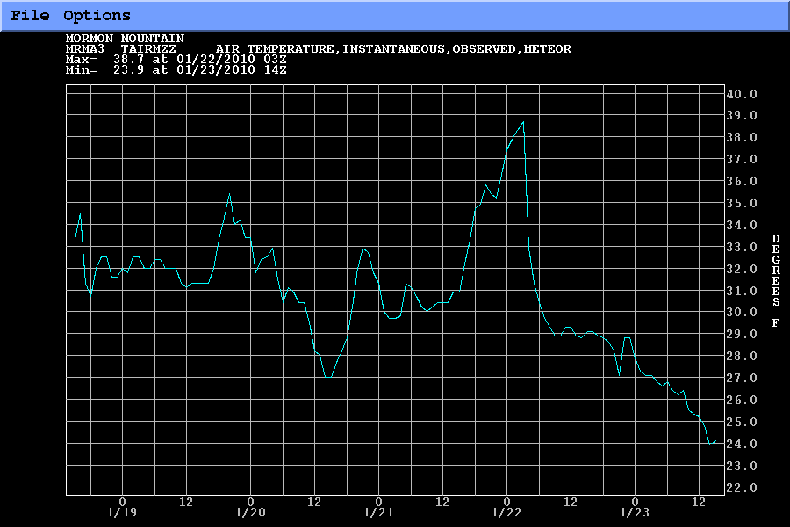
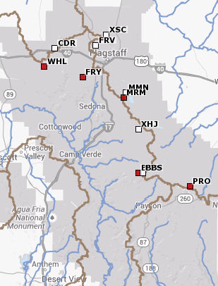
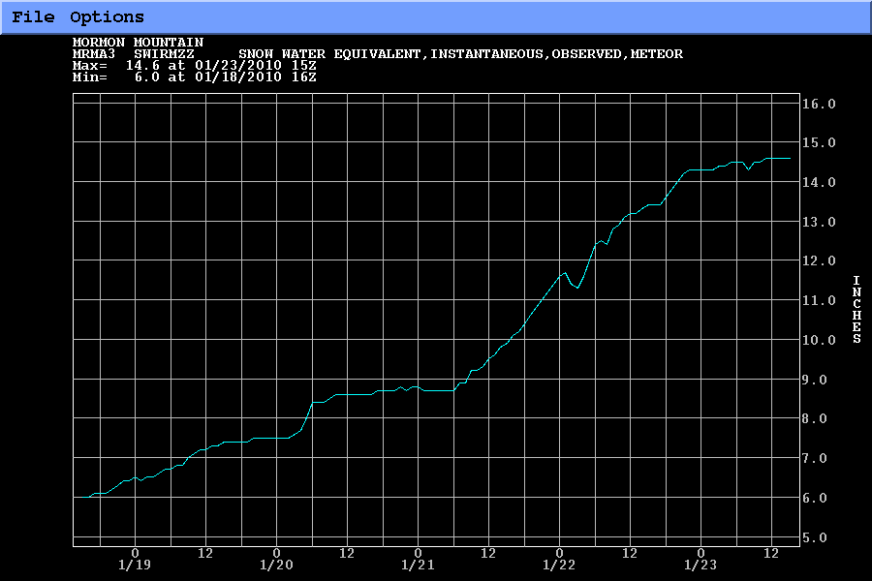
SNOTEL Site: Mormon Mountain
Precip Type – Remained as snow

Slide 11
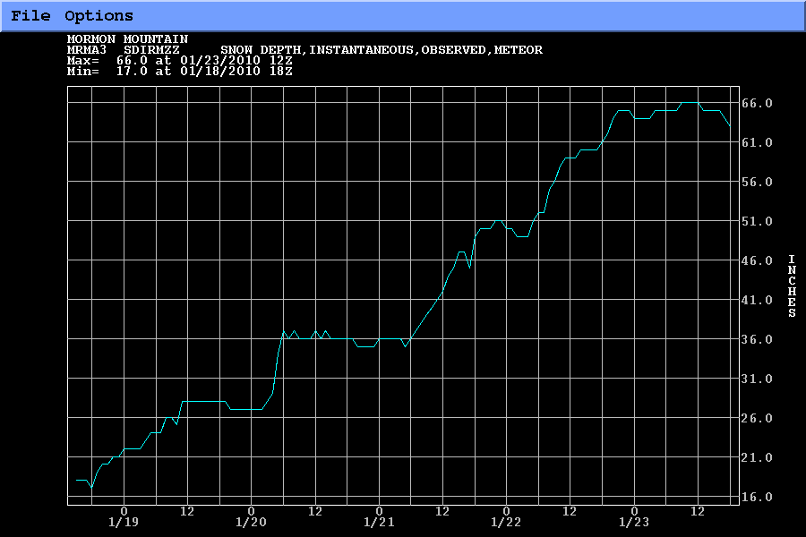
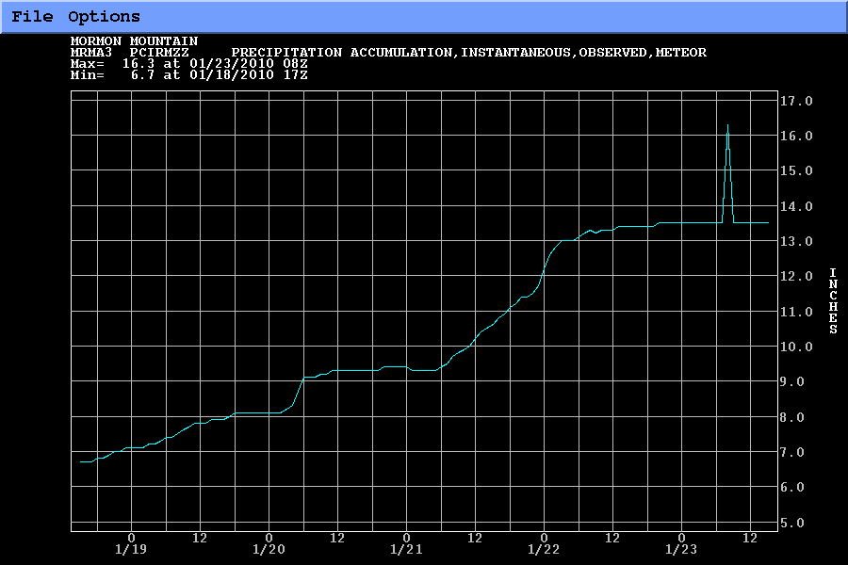
SNOTEL Site: Mormon Mountain

Slide 12
January 2010 Heavy Rain Even - Oak Creek
Large runoff forecast indicated but response was minimal
Never had a good handle on the freezing level, rain/snow line (critical in AZ)
Good data network exists but lower elevation SNOTEL might have helped
Data network limits & uncertainty in future weather (misplaced QPF & challenging Freezing Level) resulted in missed forecast

