Slide 1
Understanding Sources of Error and Uncertainty
NOAA’S COLORADO BASIN RIVER FORECAST CENTER

Slide 2
Understanding Sources of Error
Data
Undetected errors in historical/current observations
Data density/Gage network distribution
Unmeasured Depletions
Forecasted Weather Conditions
Hydrologic Model
The model itself
Initial Conditions
Calibration Error (bias)

Slide 3
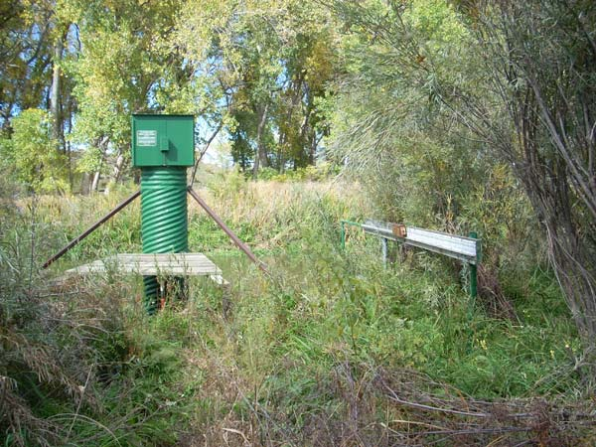
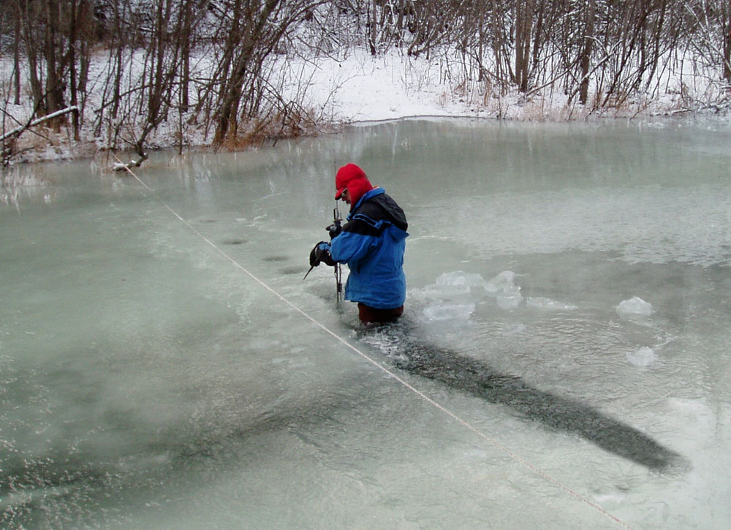
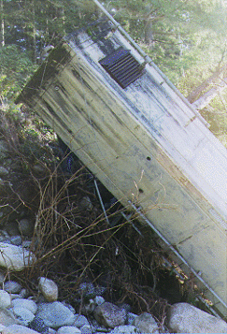
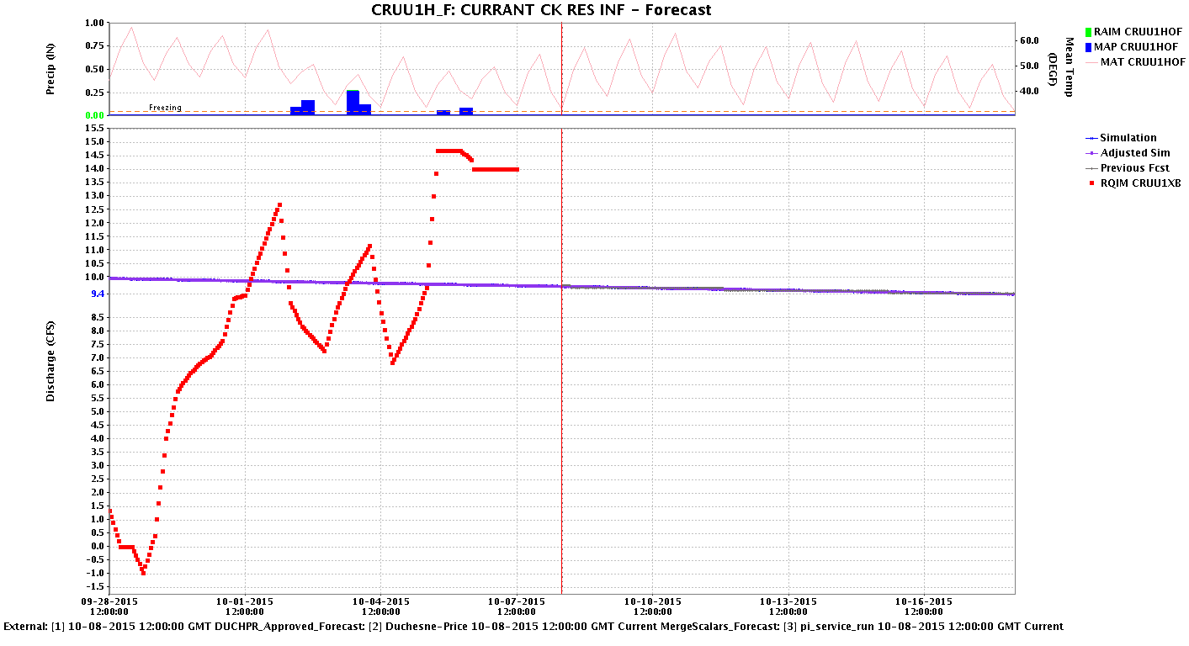
Data
Gage Issues
Freezing, aquatic growth
Malfunctions
Flooding issues (gage destroyed, channel changes, etc…)
Measurement accuracy
Bad data
Missing data
Calculated inflow data
-1 – 15 cfs
Model simulation
10 cfs

Slide 4
Red = observed
Blue = simulated
Colorado – Dotsero
Last visit 10/17
Measured vs. rated = 0% diff
No changes made
~200 cfs
Roaring Fork – Glenwood Springs
Last visit 10/6
Measured vs. rated = -4.2% diff (~30 cfs)
No changes made
Colorado – Glenwood Springs
Last visit 8/13
Measured vs. rated = -0.4% diff
New shift applied
~75 cfs
~175 cfs
Colorado – Cameo
Last visit 10/16
Measured vs. rated = -3% diff (~100 cfs)
No changes made
*These dates are from 2014. The USGS has visited all these sites multiple times since then!

Slide 5
Note shift application
San Juan – Shiprock
Visited 10/9
New rating downloaded 10/14
San Juan – Four Corners
Note shift application
Visited 10/9
New rating downloaded 10/15
San Juan – Bluff, nr
Shift Impacts
Visited 10/1
New rating downloaded 10/1
*Again, these dates are from 2014. The USGS has visited all these sites multiple times since then!

Slide 6
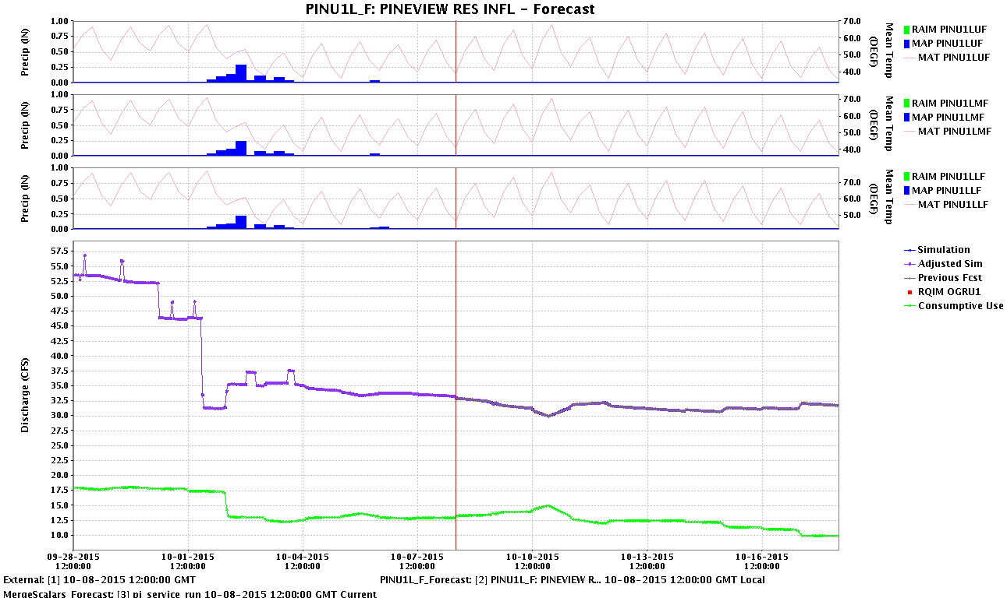
Missing Data
Model simulation
35 cfs
Modeled Unmeasured Depletion
10 cfs

Slide 7
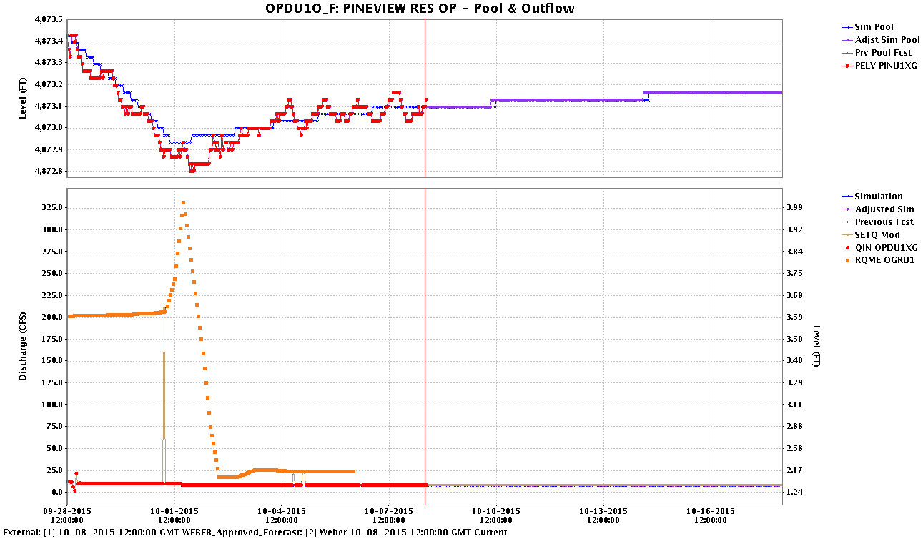
Missing Data
Observed Pool Elevation – This is how we know we’re close!
Reservoir Operations, as best as we know

Slide 8
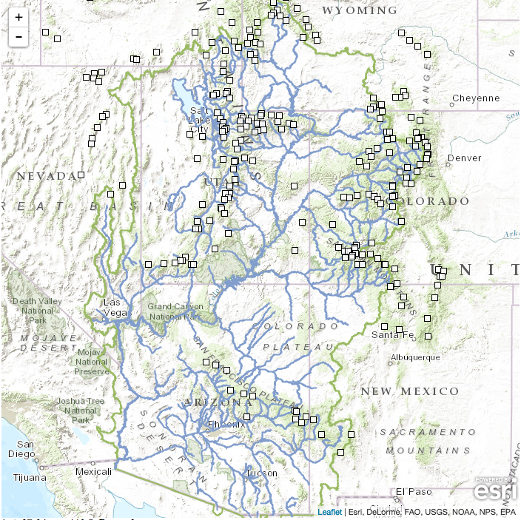
Gage Density
SNOTEL Network
Since it became available, has improved accuracy of forecasts
In some areas the gage density is better
All gages ➔

Slide 9
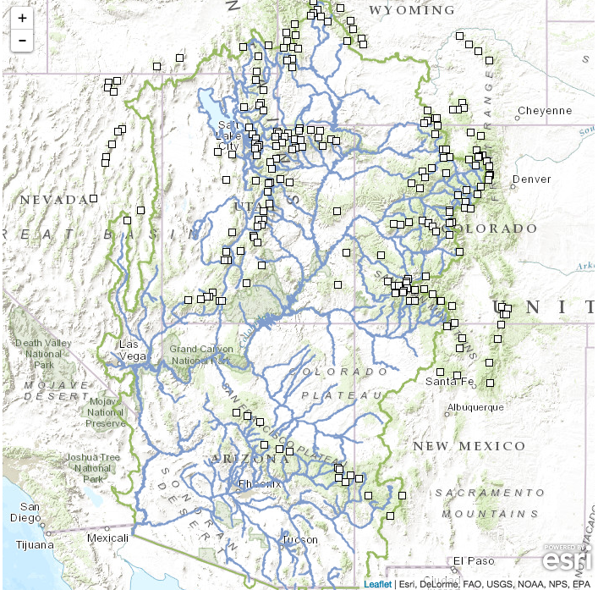
Gage Density
SNOTEL Network
Since it became available, has improved accuracy of forecasts
In some areas the gage density is better
All gages > 7,000 ft. ➔

Slide 10
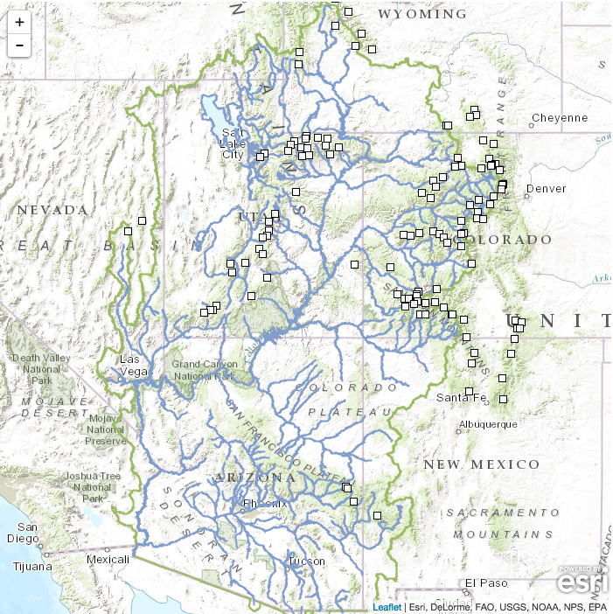
Gage Density
SNOTEL Network
Since it became available, has improved accuracy of forecasts
In some areas the gage density is better
All gages > 9,000 ft. ➔

Slide 11
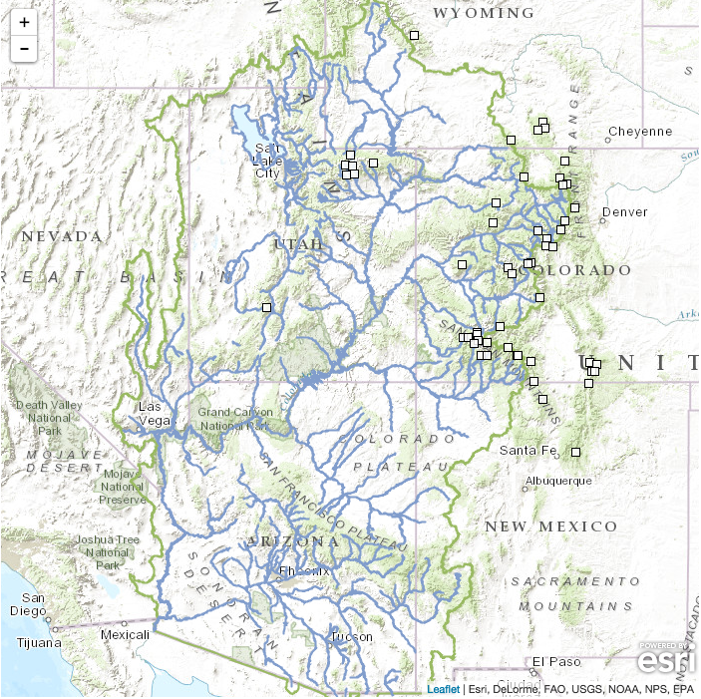
Gage Density
SNOTEL Network
Since it became available, has improved accuracy of forecasts
In some areas the gage density is better
All gages > 10,000 ft. ➔

Slide 12
DAILY_QC 24 HOUR PRECIPITATION ENDING 10/13/2014 12Z
ALL GAGES
SNOTEL ONLY

Slide 13
DAILY_QC TEMPERATURE STATIONS
ALL GAGES
SNOTEL ONLY

Slide 14
SNOTEL Issues
Bad precipitation readings (2014)
Columbine
Lake Irene
Tower
Schofield Pass
Bad pillow readings (2014)
Lily Pond
Changing conditions at the sites
Vail Mountain
Upper San Juan

Slide 15
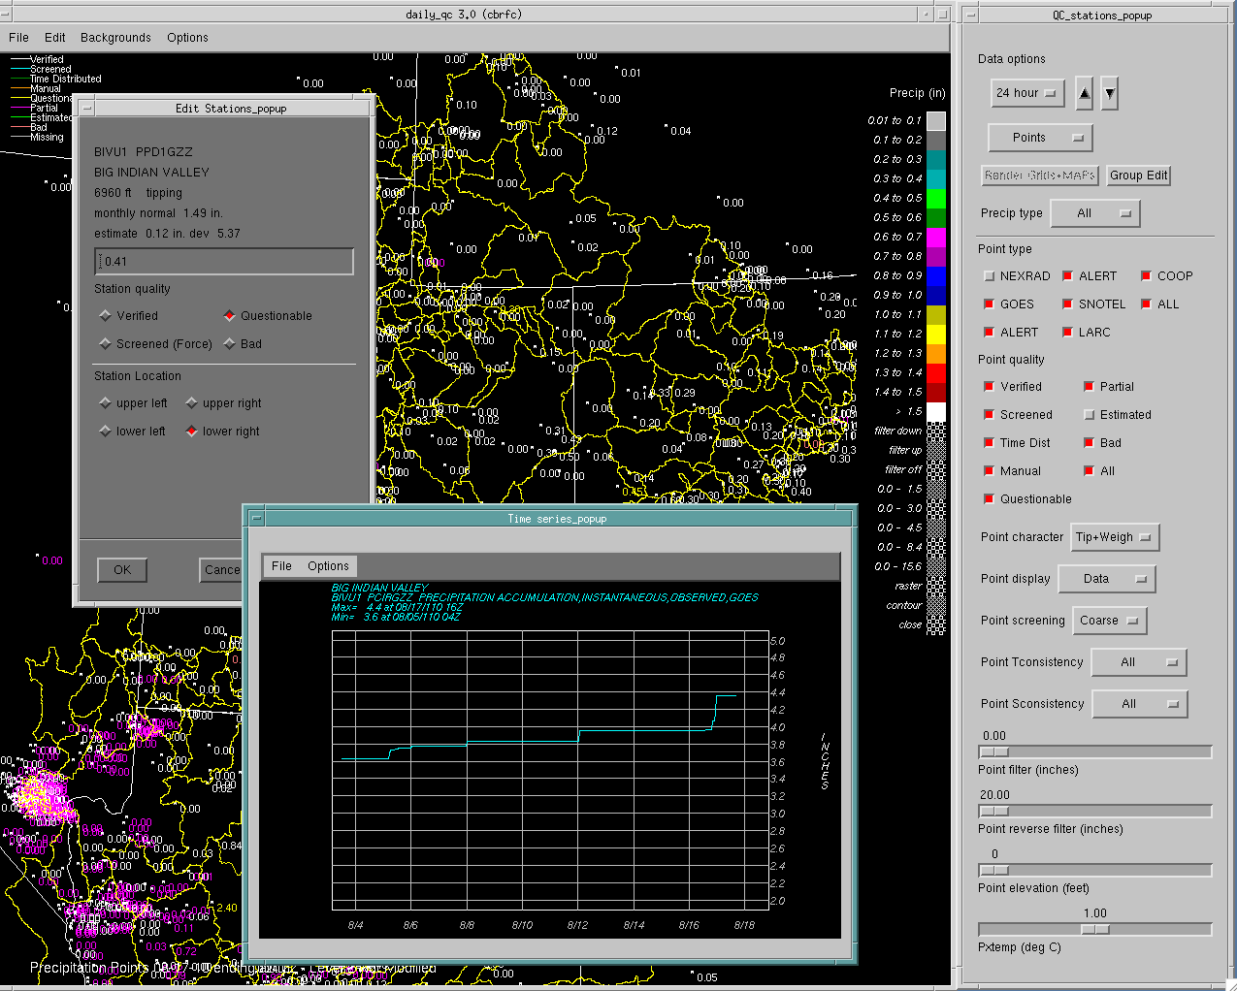

Slide 16
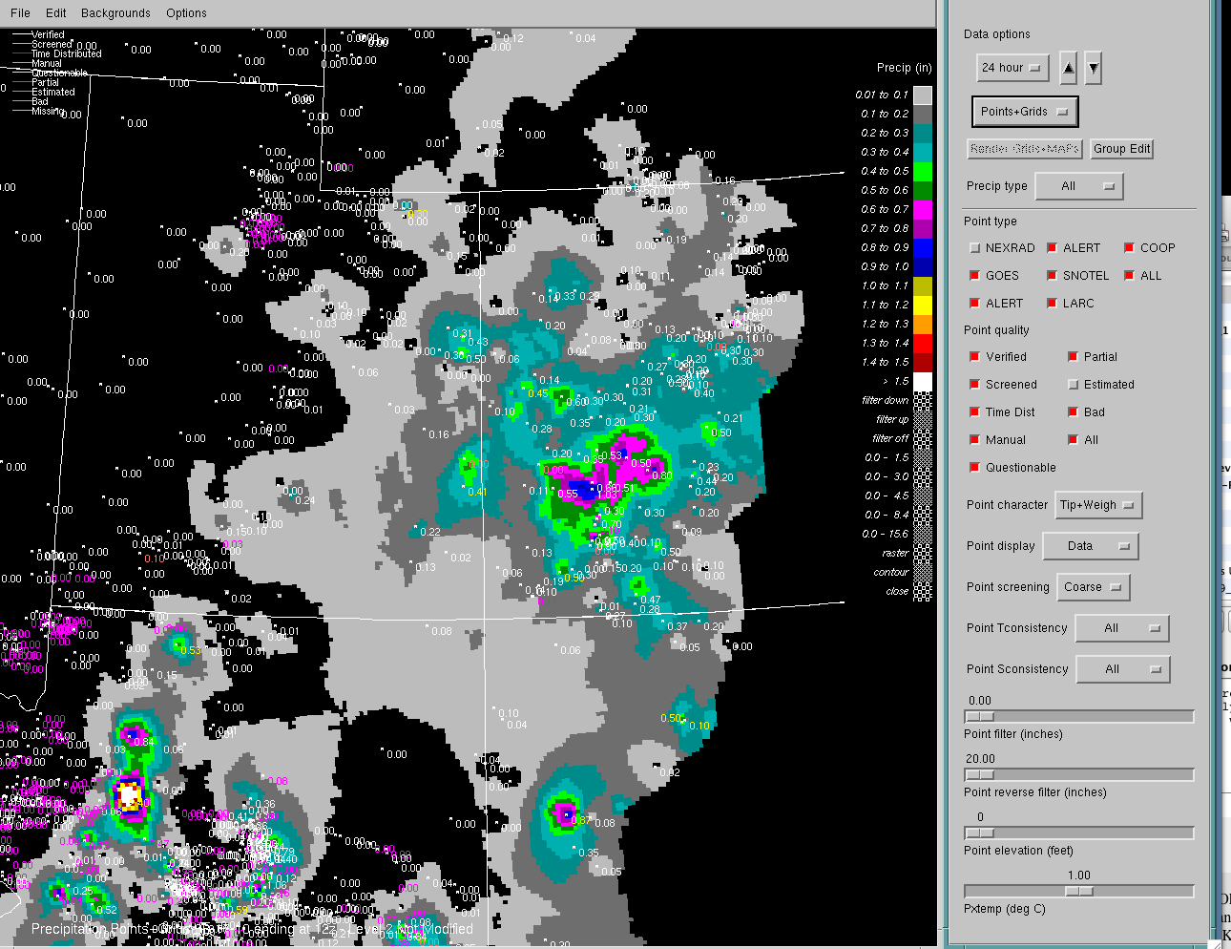

Slide 17
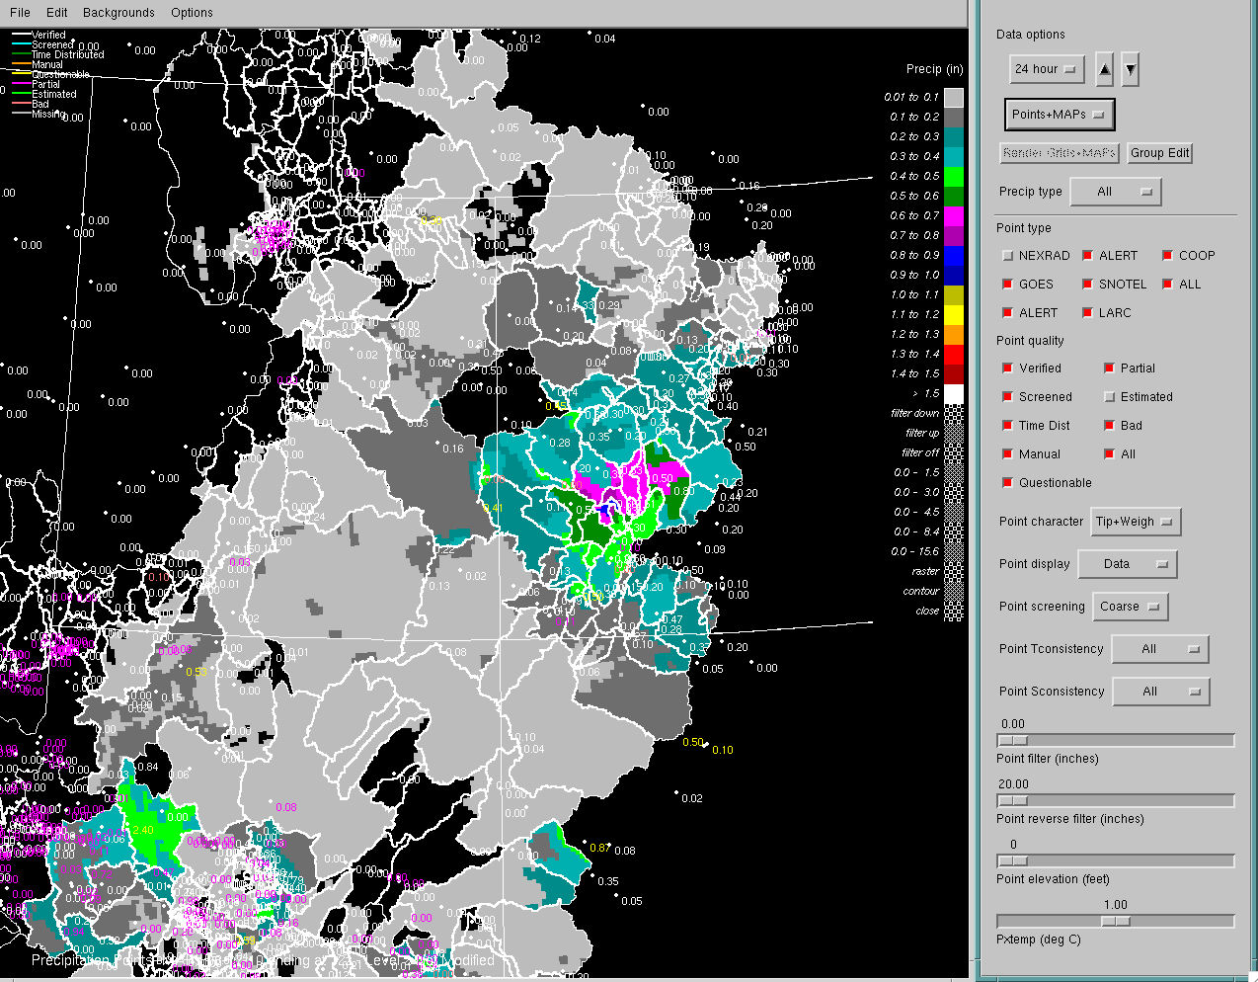

Slide 18
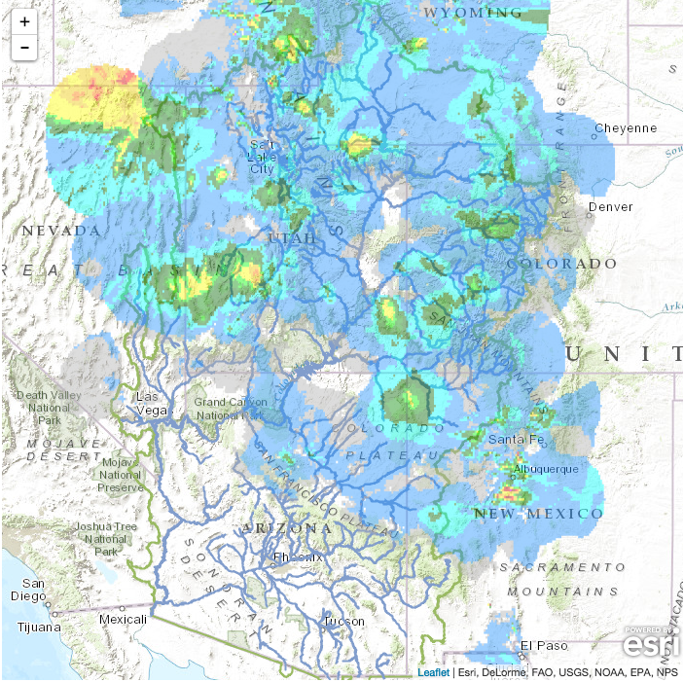
Quantitative Precipitation Estimate (QPE)
Combination of gage, radar, and satellite information
Coverage can vary based on season
Despite QA/QC process, incorrect data can slip through

Slide 19
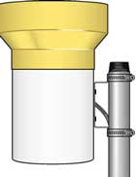
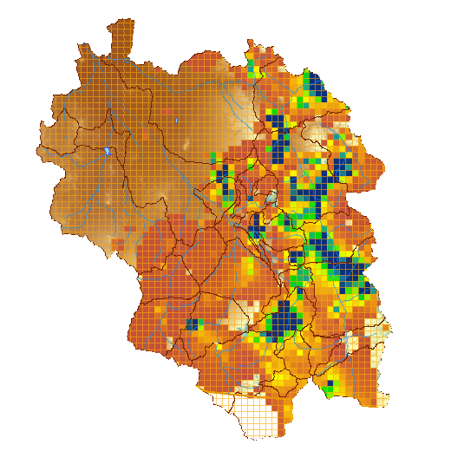
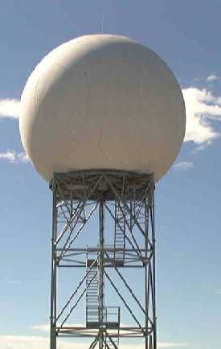
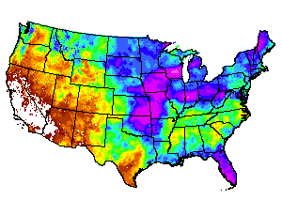
Quantitative Precipitation Estimates (QPE)
Rain Gage Measurement
Gridded Precipitation Estimate
GOES Satellite Estimate
Radar Estimate
Climate patterns
Forecaster Analysis

Slide 20
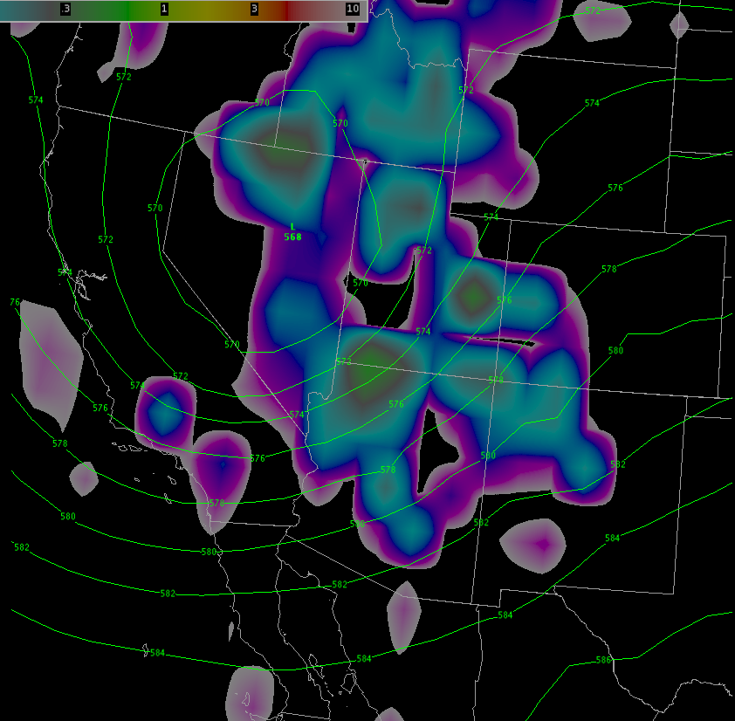
Quantitative Precipitation/Temperature Forecast (QPF/QTF)
We use precipitation forecast out to 5 days
We use temperature forecast out to 10 days
Convective storms are difficult for models to forecast

Slide 21
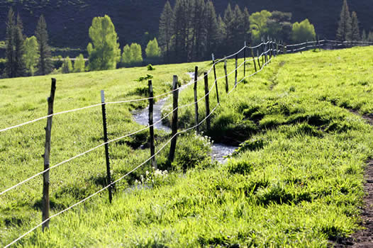
Unmeasured Depletions
Representative of water taken from the basin, but not gaged and/or reported
Function of temperature and irrigated acreage
An calculated value, not based on actual use that may be occurring

Slide 22
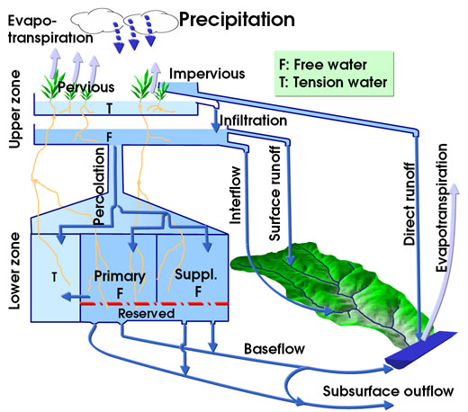
Hydrologic Model
Current model is basically a temperature index model
Could we do better with a more physically based model?
A distributed model?
Could a different model utilize more and new data in a timely way?

Slide 23
CBRFC Soil Moisture
Seasonal volumes are controlled by SWE and soil moisture
Do we have SWE right?
Mischaracterizing rain vs. snow events
Missed precipitation event
Do we have the soil moisture right?
Have we captured baseflow conditions accurately?
Has a storm event impacted soil state conditions?

Slide 24
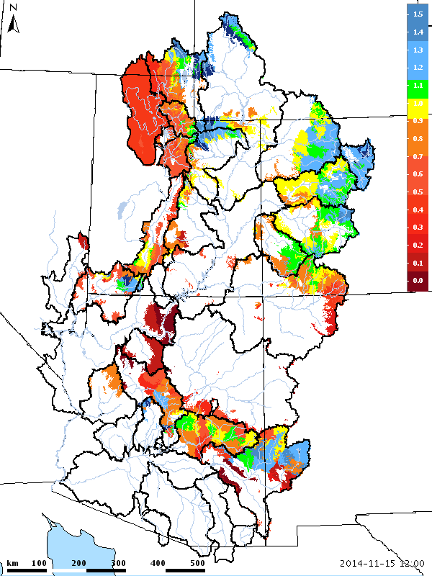
Hydrologic Model
Initial Conditions can be a source of error
Data errors caused by gage malfunction or inaccuracy
Missing Data
Incorrect model states
Common errors
SWE too high/low, snow or rain?
Bad streamflow information
Inaccurate precip/temp
Reservoir conditions
Diversions

