Slide 1
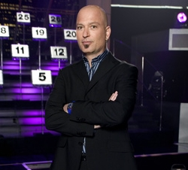

Slide 2
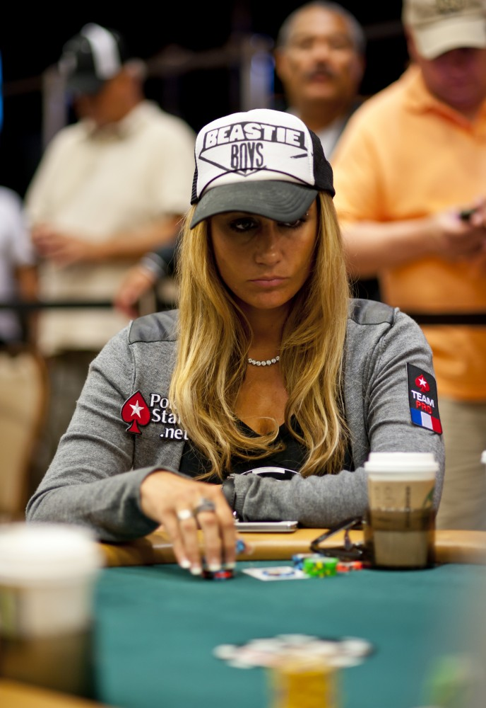
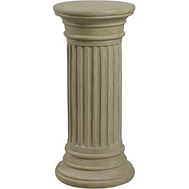
Deal or No Deal
Banker
I want to minimize my loss, but also provide info that is valuable so you can act.
1
2
3
4
5
6
7
8
9
10
Contestant
11
12
13
14
15
I want to maximize my wins, but be comfortable, and understand, my risk.
16
17
18
19
20
21
22
23
24
25
$0.01 | $1 | $5 | $10 | $25 | $50 | $75 | $100 | $200 | $300 | $400 | $500 | $750
$1K | $5K | $10K | $25K | $50K | $75K | $100K | $200K | $300K | $400K | $500K | $750K | $1M

Slide 3
Deal or No Deal
Banker
I’ll use the information I know to make an offer that I think you’ll find useful.
1
2
3
5
6
7
8
9
10
Offer:
Contestant
11
12
13
14
15
I’ll use the information I know, combined with your offer, to make an informed decision.
16
17
18
19
20
4
21
22
23
24
25
$0.01 | $1 | $5 | $10 | $25 | $50 | $75 | $100 | $200 | $300 | $400 | $500 | $750
$1K | $5K | $10K | $25K | $50K | $75K | $100K | $200K | $300K | $400K | $500K | $750K | $1M

Slide 4
Round 1
There is some information to begin making an educated assessment of where the contestant will end up
A range of possibilities is known ($0.01 to $1M)
Lots of uncertainty in the final outcome
As the rounds progress, we have more information on where the contestant will end up

Slide 5
Deal or No Deal
Banker
Based on what was eliminated, and what I know is still available for you to win, I will provide you an offer, which is less than the most extreme amount you can win, and more than the least amount you could win, but is useful to help you make a decision.
1
2
3
5
6
7
8
9
10
Offer: $3,000
11
12
13
14
15
Contestant
Based on the range of outcomes provided, and your offer, I can evaluate the best way for me to manage the possible outcome.
16
17
18
19
20
4
21
22
23
24
25
$0.01 | $1 | $5 | $10 | $25 | $50 | $75 | $100 | $200 | $300 | $400 | $500 | $750
$1K | $5K | $10K | $25K | $50K | $75K | $100K | $200K | $300K | $400K | $500K | $750K | $1M

Slide 6
Hmm, I have a 50/50 chance of winning more or less than the banker’s offer. Some things I should consider:
I have a 5% chance of only get $0.01.
I have a 5% chance of getting $1M!
I have a 75% chance of seeing somewhere between $100 and $400K.
Maybe I can start to make some initial decisions now, since I know the risk is low that I’ll see something really low or high, but maybe I’ll go another round to get more information…

Slide 7
Many Rounds Later
We have more information to make an educated assessment of where the contestant will end up
Uncertainty is decreased, but is still present
We’re closer to the point where the contestant needs to take action and make critical decisions

Slide 8
Deal or No Deal
Banker
Based on what was eliminated, and what I know is still available for you to win, I will provide you an offer, which is less than the most extreme amount you can win, and more than the least amount you could win, but is useful to help you make a decision.
1
2
3
5
6
7
8
9
10
Offer: $210,000
11
12
13
14
15
Contestant
Based on the range of outcomes provided, and your offer, I can evaluate the best way for me to manage the possible outcome.
16
17
18
19
20
4
21
22
23
24
25
$0.01 | $1 | $5 | $10 | $25 | $50 | $75 | $100 | $200 | $300 | $400 | $500 | $750
$1K | $5K | $10K | $25K | $50K | $75K | $100K | $200K | $300K | $400K | $500K | $750K | $1M

Slide 9
Hmm, I still have about 50/50 chance of winning more or less than the banker’s offer. Some things I should consider:
I’m glad I’m out of the woods of only getting a few bucks, but there’s still a 20% chance I only walk away with $50K. But there’s also a 20% chance I get $750K!
I have a 60% chance of seeing at least $200K. It costs $200K to send each of my 2 kids to college, so it’s a critical decision point for me. I could manage conservatively and for sure send 1 to college, or be more aggressive and maybe meet both goals (I could miss both goals too!).
Now that I have lots of information available to me, I can make an informed decision with risk that I’m comfortable with.

Slide 10
CBRFC Forecasts
It’s really a lot like Deal or No Deal
The forecaster is the banker, using the best available information to come up with a most probable value, but you can also see the individual traces
The contestant is the stakeholder, who has all the data available to them distilled to one number, but can use the information to assess their risk and how they want to act
Neither one knows exactly what is in the final case
But the “Briefcases” don’t disappear, and the forecaster is here to help!

Slide 11
FORECAST
NO FORECAST

Slide 12
April through July Forecast Information
Forecaster
I want to minimize forecast error, but also provide info that is valuable so you can act.
1981
1982
1983
1984
1985
1986
1987
1988
1989
1990
Resource Manager/
Stakeholder (You!)
1991
1992
1993
1994
1995
I want to maximize my resource management efficiency, but be comfortable, and understand, my risk.
1996
1997
1998
1999
2000
Future
Observed
2001
2002
2003
2004
2005
2006
2007
2008
2009
2010

Slide 13
April through July Forecast Information
Forecaster
I’ll use the information I know to make a forecast that I think you’ll find useful.
1981
1982
1983
1984
1985
1986
1987
1988
1989
1990
Most Probable Forecast:
1991
1992
1993
1994
1995
Resource Manager/
Stakeholder (You!)
1996
1997
1998
1999
2000
I’ll use the tools that I know, combined with your forecast, to make informed policy decisions.
Future
Observed
2001
2002
2003
2004
2005
2006
2007
2008
2009
2010

Slide 14
Round 1 January
There is some information (like model soil states, early SWE) to begin making an educated assessment of how much runoff we’ll see
A range of possibilities is kinda known (based on historical climatology)
Lots of uncertainty (weather!) in the final outcome
As the months go by, we have more information (SWE primarily, observed weather) on how much runoff we’ll see

Slide 15
April through July Forecast Information
Forecaster
Based on the latest conditions and what I know has happened in the past, I will provide you a forecast, which is less than the most extreme amount I think you could get, and more than the least amount I think you could get, but is useful to help you make a decision.
1981
1982
1983
1984
1985
1986
1987
1988
1989
1990
Most Probable Forecast: 85% avg.
1991
1992
1993
1994
1995
Resource Manager/
Stakeholder (You!)
Based on the range of outcomes provided, and your forecast, I can evaluate how I want to manage possible outcomes.
1996
1997
1998
1999
2000
Future
Observed
2001
2002
2003
2004
2005
2006
2007
2008
2009
2010

Slide 16
Hmm, I have about 50/50 chance of seeing more or less than 85% of average. Some things I should consider:
85% is okay, but there’s still a 10% chance I get more than the maximum probable value. There’s also a 10% chance I get less than the minimum probable value. It’s early in the season, could any of that be a problem for me?
I have an 80% chance of seeing a value between the max and min probable values provided.
It’s still early in the season, so maybe I should start to identify critical decision points that I might be near, and make sure I understand why the forecasters made this forecast. They’ve always been really helpful and cool.

Slide 17
Many Rounds Later April
We have more information (SWE accumulation, observed and non-observed weather) to make an educated assessment of how much streamflow we’ll see
Uncertainty is decreased, but is still present
We’re closer to the point where the resource manager needs to take action and make critical decisions (like an April adjustment? Adaptive Management?)

Slide 18
April through July Forecast Information
Forecaster
Based on the latest conditions and what I know has happened in the past, I will provide you a forecast, which is less than the most extreme amount I think you could get, and more than the least amount I think you could get, but is useful to help you make a decision.
1981
1982
1983
1984
1985
1986
1987
1988
1989
1990
Most Probable Forecast: 75% avg.
1991
1992
1993
1994
1995
Resource Manager/
Stakeholder (You!)
Based on the range of outcomes provided, and your forecast, I can evaluate how I want to manage possible outcomes.
1996
1997
1998
1999
2000
Future
Observed
2001
2002
2003
2004
2005
2006
2007
2008
2009
2010

Slide 19
Hmm, I have about 50/50 chance of seeing more or less than 75% of average. Some things I should consider:
75% of average is the most probable forecast, and the minimum and maximum probable values are closer to this value, so there’s less uncertainty… It’s late in the season, changes could happen (maybe a wet May?), but I can act with more confidence.
To meet a particular flow requirement, it’s very important I get at least 65% of average flow. If not, I need to change my operations. Am I comfortable with the risk that the forecast could fall below 65% of average?
Now that I’ve had lots of information made available to me, I can make an informed decision, but I should still take a look at the extremes and understand those risks…
Does the forecast make sense to me? Will I need to explain it anyone? Do I need to talk to the cool people at the CBRFC?

