Slide 1
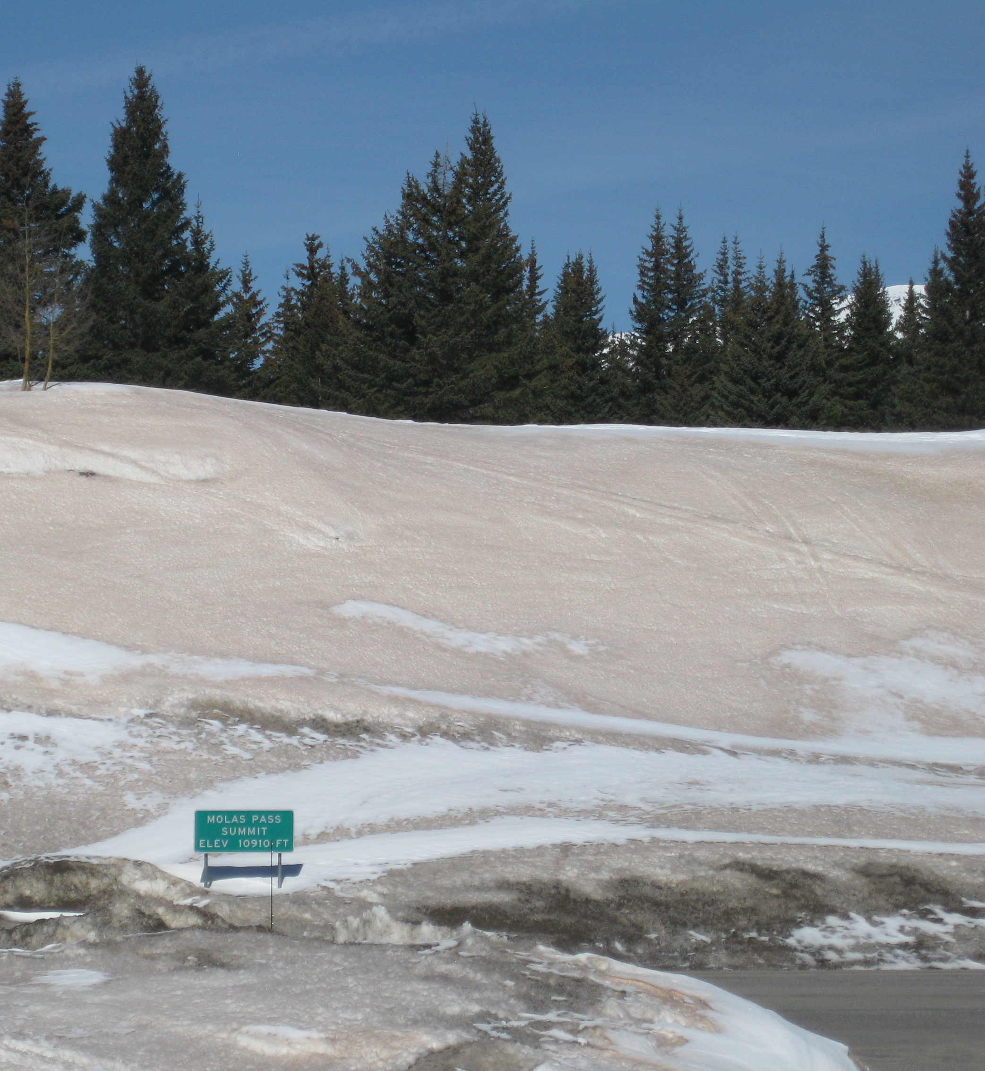
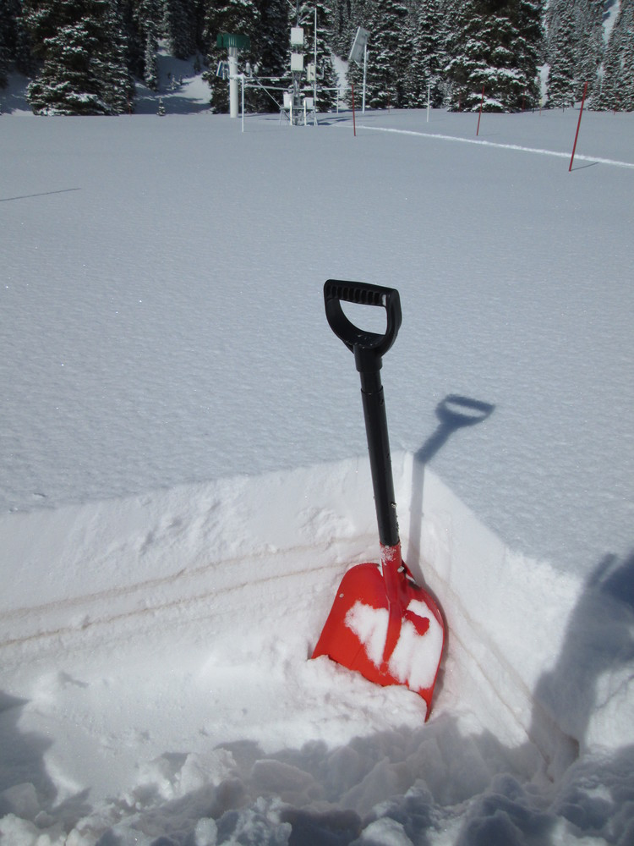
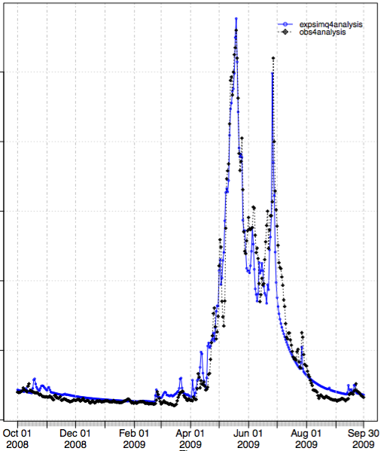
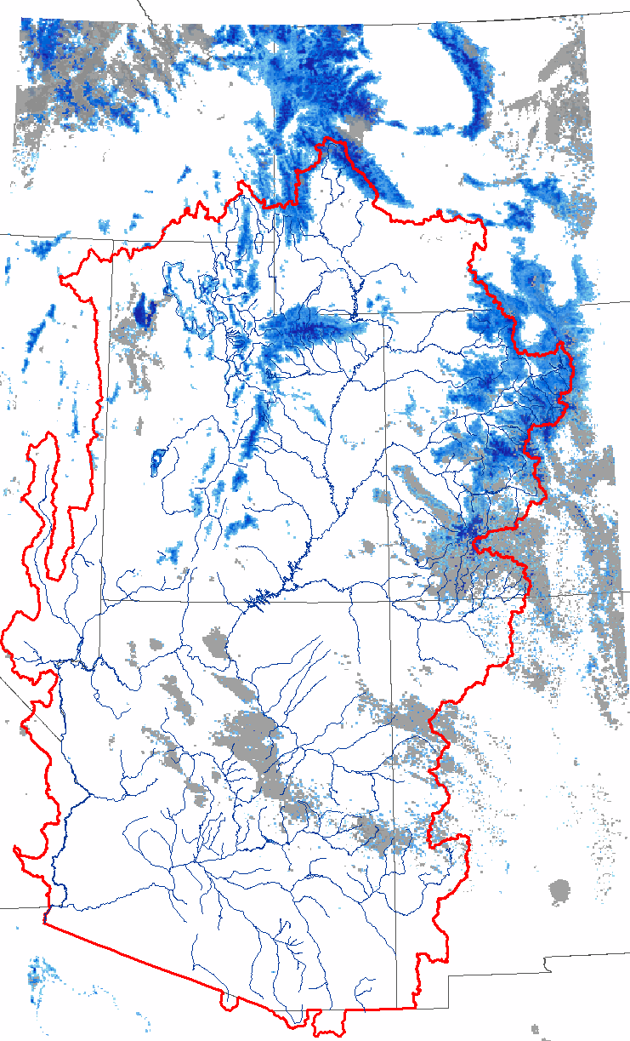
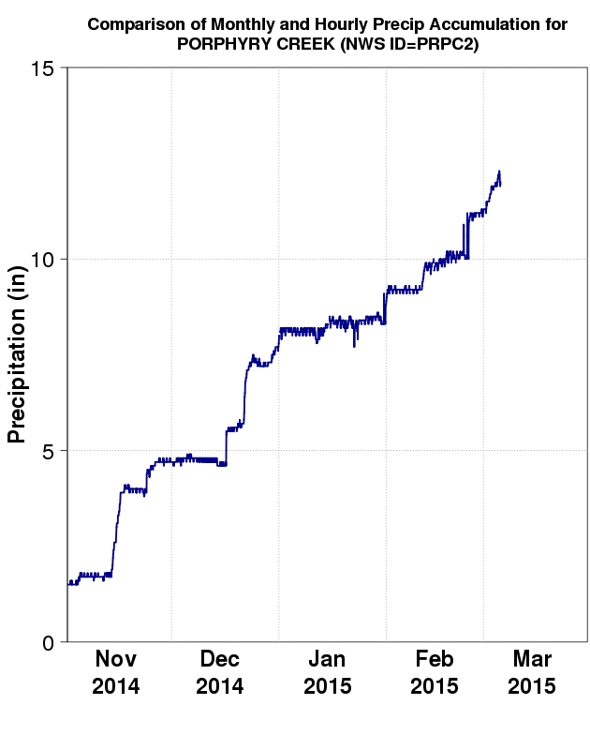
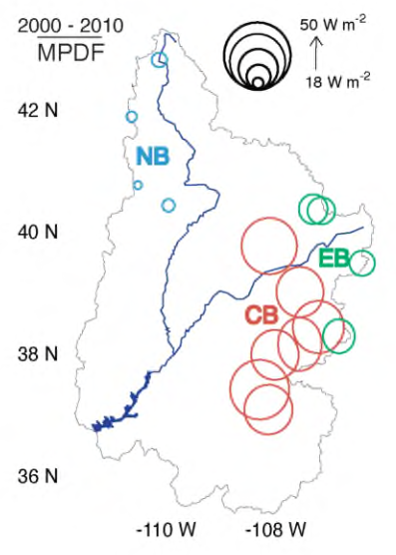
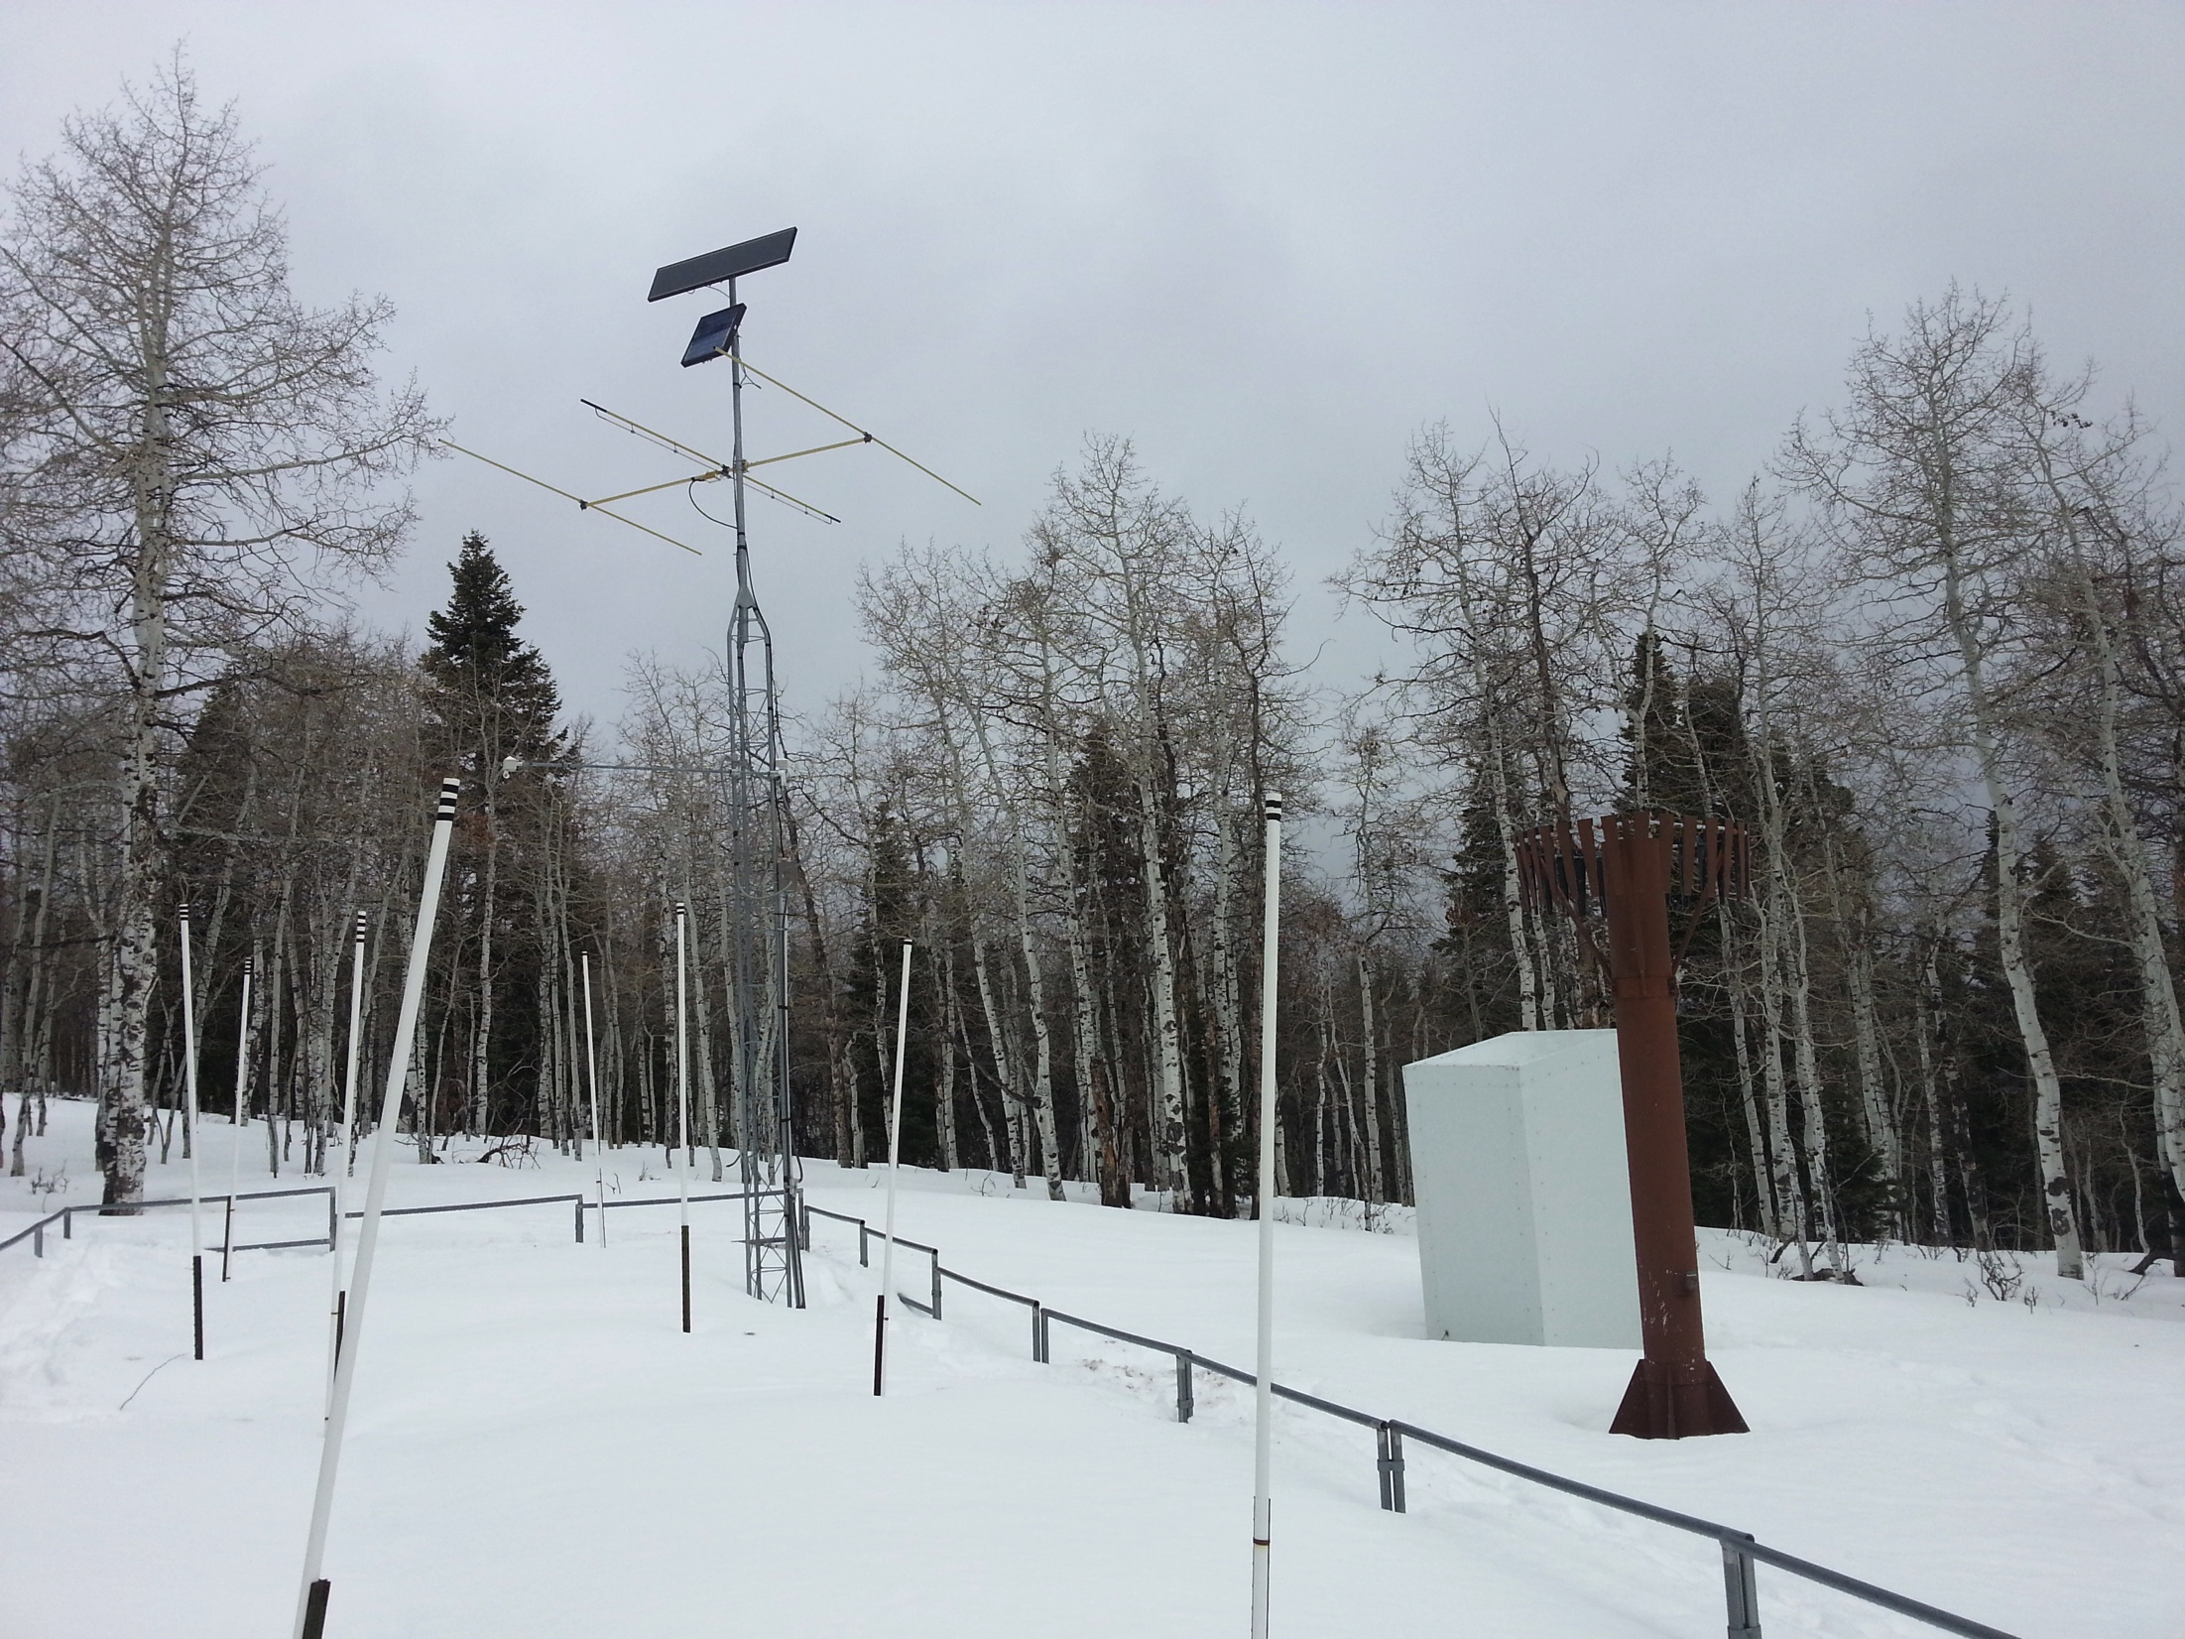
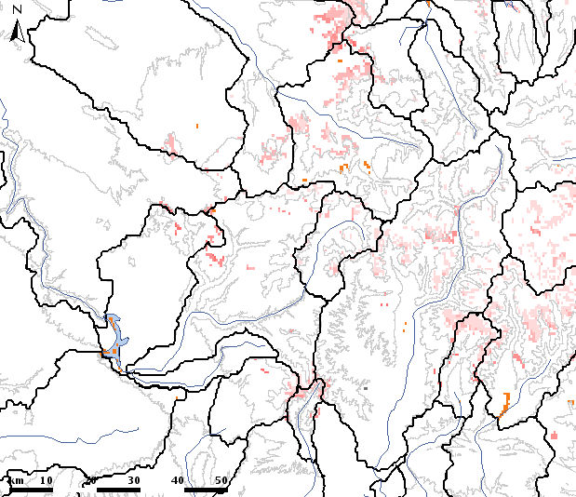
Snow Model Adjustment Methods at NOAA/CBRFC
CBRFC Stakeholder Forum
Salt Lake City
October 20, 2015
Credit: CSAS/CODOS
Credit: Bryant-Burgess, 2014

Slide 2
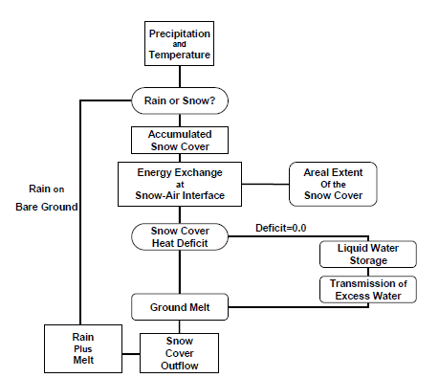
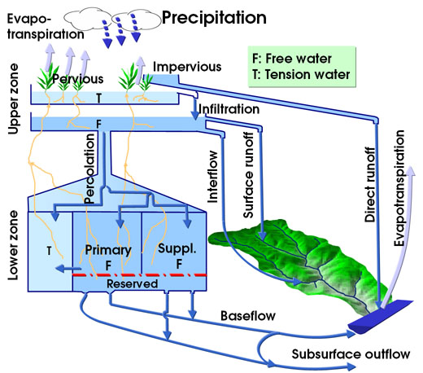
Operational CBRFC Snow Model
Operational CBRFC Snow Model: SNOW17
Overview of Methods
Current Operational Adjustment Method (SWE)
Research/Experimental Methods (SWE, melt rate)
Questions and Comments
Operational Snow Model at CBRFC: SNOW17
minimum inputs and computational power needed
manually calibrated at CBRFC using 1981-2010 historical data
temperature-index model (air temperature used as proxy for energy/radiation)
forecasts snowmelt pretty well under near-normal conditions of the calibration period
doesn’t do so hot when conditions deviate from near-normal –adjustments needed
Water output from SNOW17 is then input to the soil moisture model (Sac-SMA)

Slide 3
Snow Model Adjustment Methods
Operational CBRFC Snow Model: SNOW17
Overview of Methods
Current Operational Adjustment Method (SWE)
Research/Experimental Methods (SWE, melt rate)
Questions and Comments
How can we adjust SNOW17 states computations in hopes of making better snowmelt-driven streamflow forecasts?
Adjust the SNOW17 SWE
Impacts: forecasted flow and forecasted runoff volumes
RFC speak: “make a WECHNG mod”
Modify the SWE using:
Closely QC’d SNOTEL precipitation data
Statistical relationships between SNOTEL SWE obs and SNOW17-simulated SWE
fractional snow-covered area (fSCA) data from remote sensing (from NASA/Jet Propulsion Lab)
Adjust the SNOW17 melt rate
Impacts: forecasted timing of streamflow
RFC speak: “feed modified input temperatures to SNOW17”
Modify the melt rate using:
“dust on snow” data from remote sensing (from NASA/Jet Propulsion Lab)

Slide 4
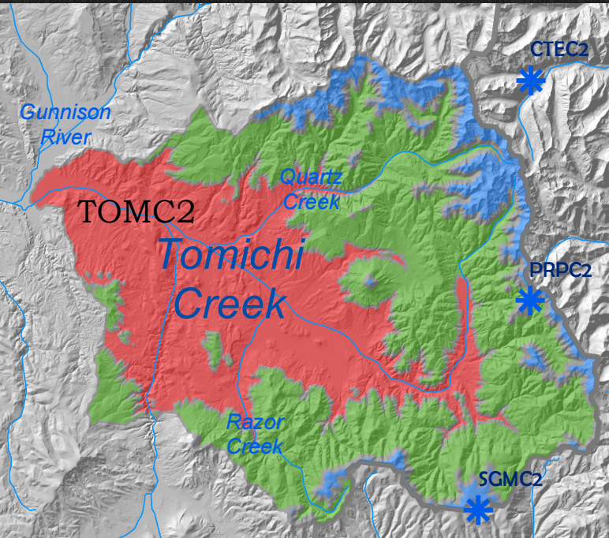
Current Operational SWE Adjustment Method: Using SNOTEL Precip
Operational CBRFC Snow Model: SNOW17
Overview of Methods
Current Operational Adjustment Method (SWE)
Research/Experimental Methods (SWE, melt rate)
Questions and Comments
Getting from point precip observations → SNOW17 SWE
SNOTEL (point) precip data
Freezing level information
(so SNOW17 can type the precip as rain or snow)
SNOTEL station weightings (multipliers determined in manual calib process)
If freezing and precip is typed as snow, add precip as SWE to SNOW17 snowpack.
If not freezing and precip is typed as rain, don’t add SWE to SNOW17 snowpack.
Precipitation estimate for the elevation zone
Point precip observations → SNOW17 SWE process is run for each elevation zone
Elevation Zone | SNOTEL Stations Used to Compute Elev Zone Precip Value
TOMC2LUF (Upper) | PRPC2 (Porphyry Creek)
TOMC2LMF (Middle) | PRPC2 (Porphyry Creek)
TOMC2LLF (Lower) | No SNOTELs used (COOP station CCRC2 is used)

Slide 5
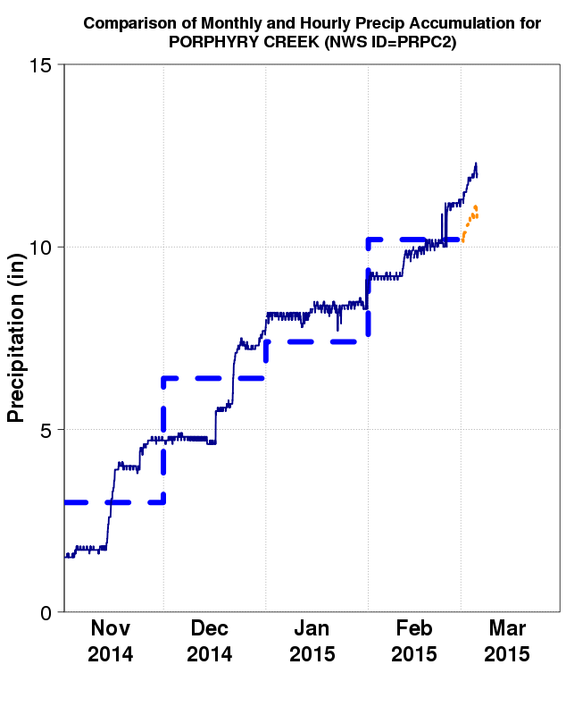
Current Operational SWE Adjustment Method: Using SNOTEL Precip
Building and updating the SNOW17-simulated snowpack
Operational CBRFC Snow Model: SNOW17
Overview of Methods
Current Operational Adjustment Method (SWE)
Research/Experimental Methods (SWE, melt rate)
Questions and Comments
Upcoming experiment:
NRCS (Jordan Clayton) has contributed a set of manually-QC’d, hourly accumulated precip data for select SNOTEL sites
Eliminates most of the “jumpiness” in accumulated SNOTEL precip data
CBRFC will test.
Daily model uses real-time, raw accumulated precipitation – jumpy (source of uncertainty)
So, when QC’d monthly precip obs become available, use those to “update” model SWE.
Example Update Date = Mar 4
accumulated, closely QC’d monthly precipitation data
+ accumulated, real-time precip data (hourly) for any partial months
= “updated” precipitation accumulation (using Mar 4 as an example)
Then, run new “updated” precip accumulation through precip → elev zone SWE computations.
Model is then run forward in time with the new, “updated” estimate of SWE accumulation.

Slide 6
Experimental SWE Adjustment Method: Statistical Models and SNOTEL SWE
Operational CBRFC Snow Model: SNOW17
Overview of Methods
Current Operational Adjustment Method (SWE)
Research/Experimental Methods (SWE, melt rate)
Questions and Comments
How it works (in a nutshell):
Other operational agencies (Bonneville Power Admin., Northwest and California-Nevada RFCs) in western US have this SWE updating method as an option.
CBRFC - configuring it and will be testing it and evaluating results over the next few weeks. (major credit to Taylor Dixon and Kevin Berghoff at NWRFC for assistance to CBRFC)
Depending on results, possibly implement it as an optional method of SWE updating for spring 2016.
Real-time daily SNOTEL SWE
Historical SNOTEL (point) SWE obs
Statistical Relationships
(Principal Components Regression)
Historical SNOW17 SWE for elevation zones
Estimate of what the SWE for an elevation zone should currently be
Forecaster reviews the computed SWE estimates and decides whether or not to use them.

Slide 7
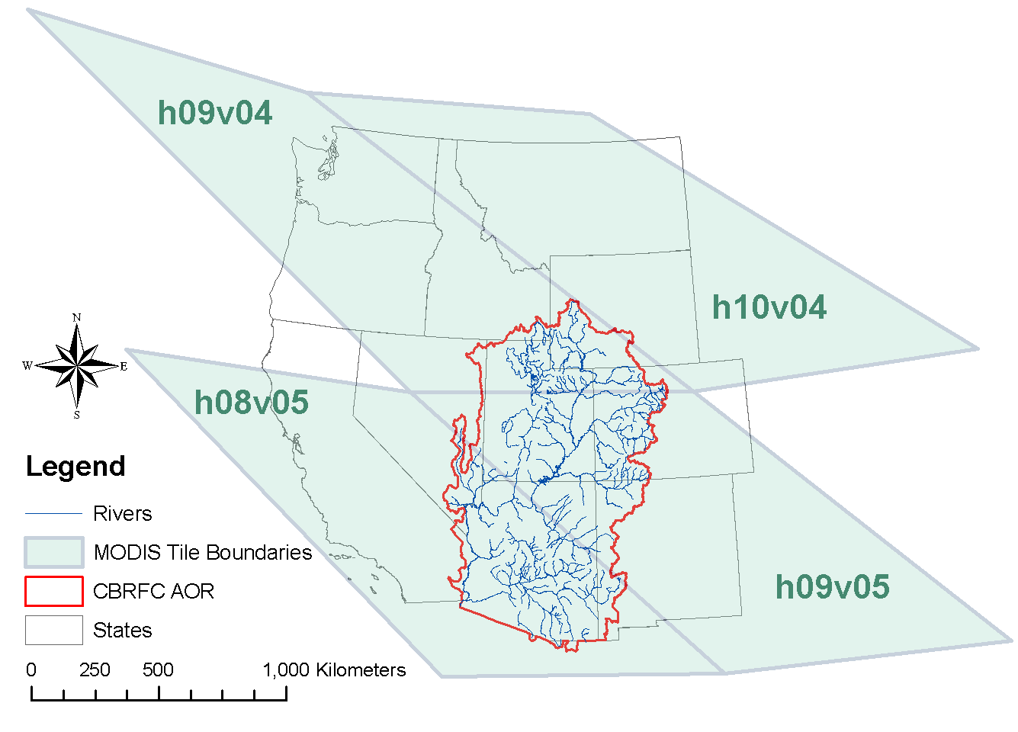
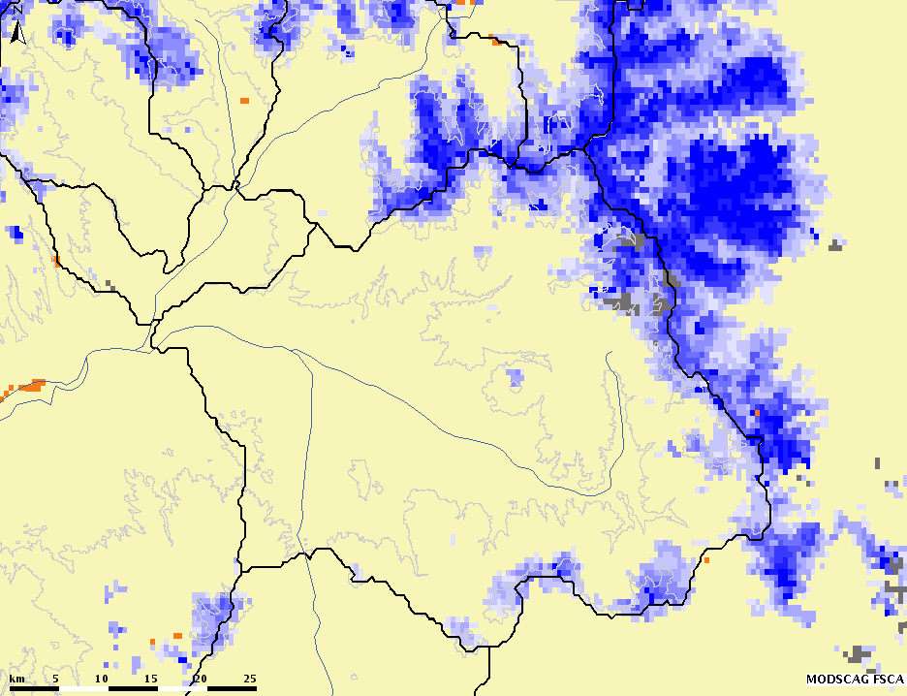
Experimental SWE Adjustment Method: MODSCAG (satellite-based) fSCA
Operational CBRFC Snow Model: SNOW17
Overview of Methods
Current Operational Adjustment Method (SWE)
Research/Experimental Methods (SWE, melt rate)
Questions and Comments
MODSCAG fSCA = global, satellite-based fractional snow-covered area (fSCA) product from NASA/JPL
May be able to use MODSCAG fSCA to estimate SNOW17 SWE
JPL is generating a clean fSCA dataset for full record (2000-present)
CBRFC will finish testing when JPL makes newest version available
MODSCAG fSCA April 29, 2015

Slide 8
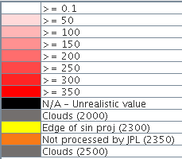
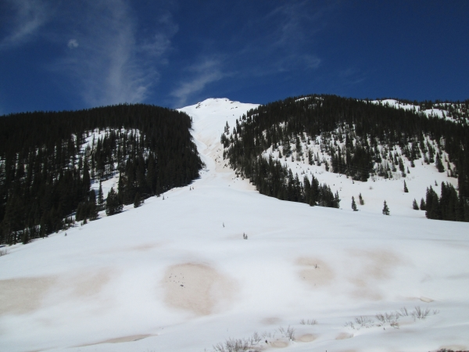
Experimental Melt Rate Adjustment Method: MODDRFS (satellite-based) “dust on snow” data
Operational CBRFC Snow Model: SNOW17
Overview of Methods
Current Operational Adjustment Method (SWE)
Research/Experimental Methods (SWE, melt rate)
Questions and Comments
MODDRFS = MODIS Dust Radiative Forcing in Snow
Satellite-based remote sensing dataset from NASA/Jet Propulsion Laboratory
MODDRFS on April 10, 2014 (W m⁻²)
White = clean
Red = dusty
Durango, CO
Photo: Dust layer D4 emerging on April 10, 2014, in the upper Animas watershed (along Hwy 550 south of Red Mountain Pass). Courtesy Center for Snow and Avalanche Studies, Colorado Dust-on-Snow Program, Silverton, CO
MODDRFS-informed manual (pre-WY16) adjustments to snowmelt rate by CBRFC forecasters are helpful but time-consuming and subjective.
Need a more efficient, objective method of incorporating MODDRFS “dust-on-snow” data into CBRFC forecasting
MODDRFS → use it to tweak temperatures that are input to snow model (SNOW17, which is a temperature-index snow model)

Slide 9
Experimental Melt Rate Adjustment Method: MODDRFS (satellite-based) “dust on snow” data
Operational CBRFC Snow Model: SNOW17
Overview of Methods
Current Operational Adjustment Method (SWE)
Research/Experimental Methods (SWE, melt rate)
Questions and Comments
MODDRFS-informed manual (pre-WY16) adjustments to snowmelt rate by CBRFC forecasters are helpful but time-consuming and subjective.
Need a more efficient, objective method of incorporating MODDRFS “dust-on-snow” data into CBRFC modeling and forecasting for WY 16 and beyond
MODDRFS “dust on snow” data
use it to tweak input temperatures for snow model (SNOW17, which is a temperature-index snow model)

Slide 10
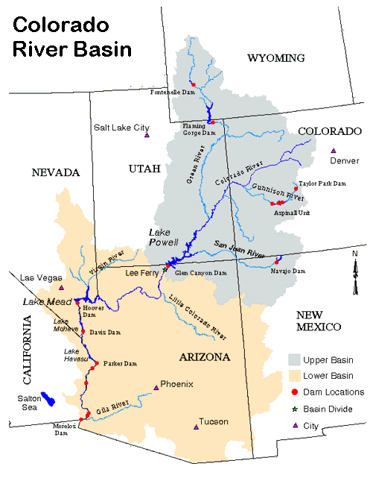
Experimental Melt Rate Adjustment Method: MODDRFS (satellite-based) “dust on snow” data
Operational CBRFC Snow Model: SNOW17
Overview of Methods
Current Operational Adjustment Method (SWE)
Research/Experimental Methods (SWE, melt rate)
Questions and Comments
Where to start experiments w/ “dust on snow”-informed SNOW17 input-temperature-adjustment method?
Mean 2000-2010 melt period dust forcing, where colors denote the Central Basin region, Eastern Basin region, and Northern Basin region (Bryant-Burgess, 2014)
Nutshell:
Larger circles indicate more dust, on average
Map credit: Colorado River Commission of NV, available via http://crc.nv.gov/images/colorado_river_basin.gif)
Initial focus area = southwestern Colorado (most impacted by dust events)
UT and WY are less-impacted by dust events (differences in weather events, dust sources, dust deposition event characteristics…)

Slide 11
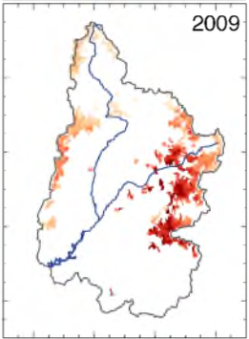
Experimental Melt Rate Adjustment Method: MODDRFS (satellite-based) “dust on snow” data
Operational CBRFC Snow Model: SNOW17
Overview of Methods
Current Operational Adjustment Method (SWE)
Research/Experimental Methods (SWE, melt rate)
Questions and Comments
Methodology, in a nutshell**:
** → If you want details, just ask!
Original, unadjusted input temperatures
+
DRFS values
(remote sensing of dust-on-snow)
Land Cover Info (coniferous veg.)
“dust on snow”-informed, adjusted temperatures that can be input to SNOW17
+
+
=
Preliminary Results for Uncompahgre R. in SW CO – NWS id = UCRC2:
Minimal (+/- 3%) impacts on water year and seasonal runoff volumes (Apr-Jul)
Timing of melt (and snowmelt-driven streamflow) within the April-July runoff period is altered by incorporation of MODDRFS (“dust on snow”) data into SNOW17
2009 Dust:
Heavier, more than
normal
2009 AMJJ runoff:
118% average
Example case for SW CO in WY2009 (heavy dust):
Map credit: Bryant-Burgess, 2014

Slide 12
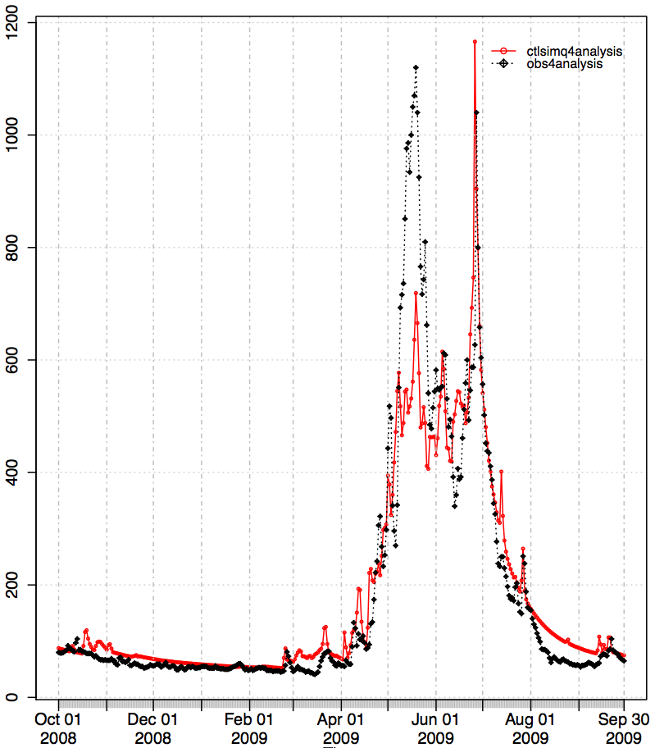
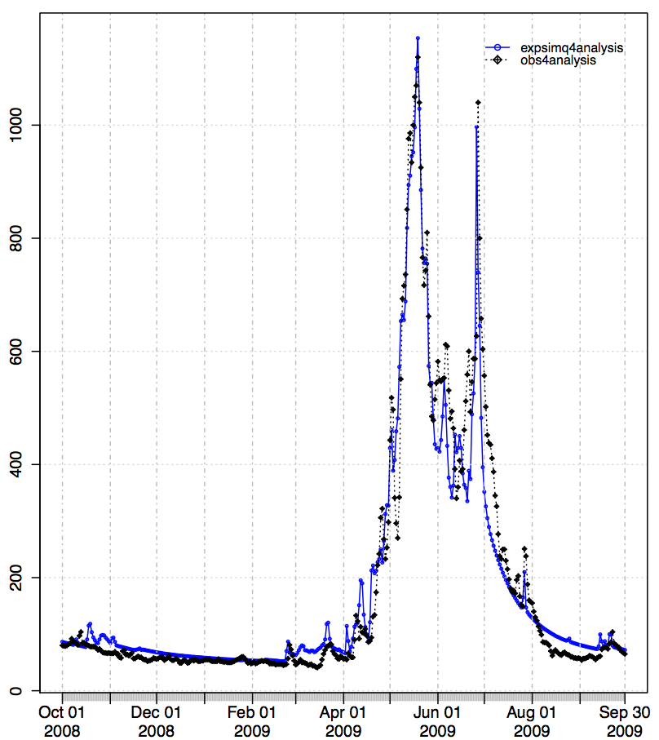
Experimental Melt Rate Adjustment Method: MODDRFS (satellite-based) “dust on snow” data
Operational CBRFC Snow Model: SNOW17
Overview of Methods
Current Operational Adjustment Method (SWE)
Research/Experimental Methods (SWE, melt rate)
Questions and Comments
Let’s look at the hydrographs for WY2009 (more dust than normal in WY09):
Uncompahgre River in southwestern CO (NWS ID = UCRC2)
WY2009 – “heavy dust” year
No “dust on snow”-informed temperature adjustment
May 2009: simulated flow = too low!
WITH “dust on snow”-informed temperature adjustment
May 2009: snowmelt is earlier and simulated flow = much improved!
---- Observed Q (cfs)
---- Simulated Q (cfs)
---- Observed Q (cfs)
---- Simulated Q (cfs)

Slide 13
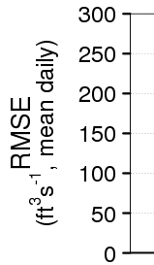
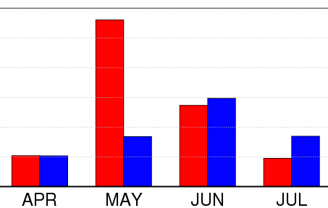
Experimental Melt Rate Adjustment Method: MODDRFS (satellite-based) “dust on snow” data
Operational CBRFC Snow Model: SNOW17
Overview of Methods
Current Operational Adjustment Method (SWE)
Research/Experimental Methods (SWE, melt rate)
Questions and Comments
Breaking down results/error statistics within the April-July runoff period:
2009 (heavy dust) UCRC2 Case:
Including “dust on snow” remote sensing info accelerates the simulated snowmelt (what we would expect with a dusty snowpack in real world)
much more runoff in May
much less in June and July
Comparing error in control simulation (no “dust on snow” info) with error in experimental simulation (WITH “dust on snow” info)
→ Apr = no change
May = most improvement in error
Jun = small change, exp is a bit worse
Jul = larger change, exp is worse
Daily RMSE, broken down within AMJJ period
May exp = much improved & much less error than ctl
It’s a “bargain”! Answer one question, get 2 more!
→ need to check further into other error sources… as always

Slide 14
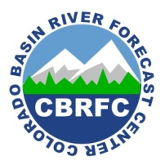
Questions, Comments, and Acknowledgements
Operational CBRFC Snow Model: SNOW17
Overview of Methods
Current Operational Adjustment Method (SWE)
Research/Experimental Methods (SWE, melt rate)
Questions and Comments
CBRFC: www.cbrfc.noaa.gov
Stacie Bender – stacie.bender@noaa.gov
Paul Miller - paul.miller@noaa.gov
Brent Bernard, John Lhotak,
Craig Peterson, Michelle Stokes
NASA/JPL: snow.jpl.nasa.gov
Thomas Painter - Thomas.Painter@jpl.nasa.gov
Catalina Oaida – Catalina.Oaida@jpl.nasa.gov
Kostas Andreadis – Konstantinos.M.Andreadis@jpl.nasa.gov
Kat Bormann, Paul Ramirez, Ross Laidlaw, Michael Joyce, Chris Mattmann,
Ann Bryant Burgess (formerly NASA/JPL and Univ of Utah, now ESIP)
NRCS Snow Surveys: www.wcc.nrcs.usda.gov/snow
CSAS/CODOS: snowstudies.org, codos.org
Chris Landry - clandry@snowstudies.org
Jeff Derry – incoming director

