Slide 1
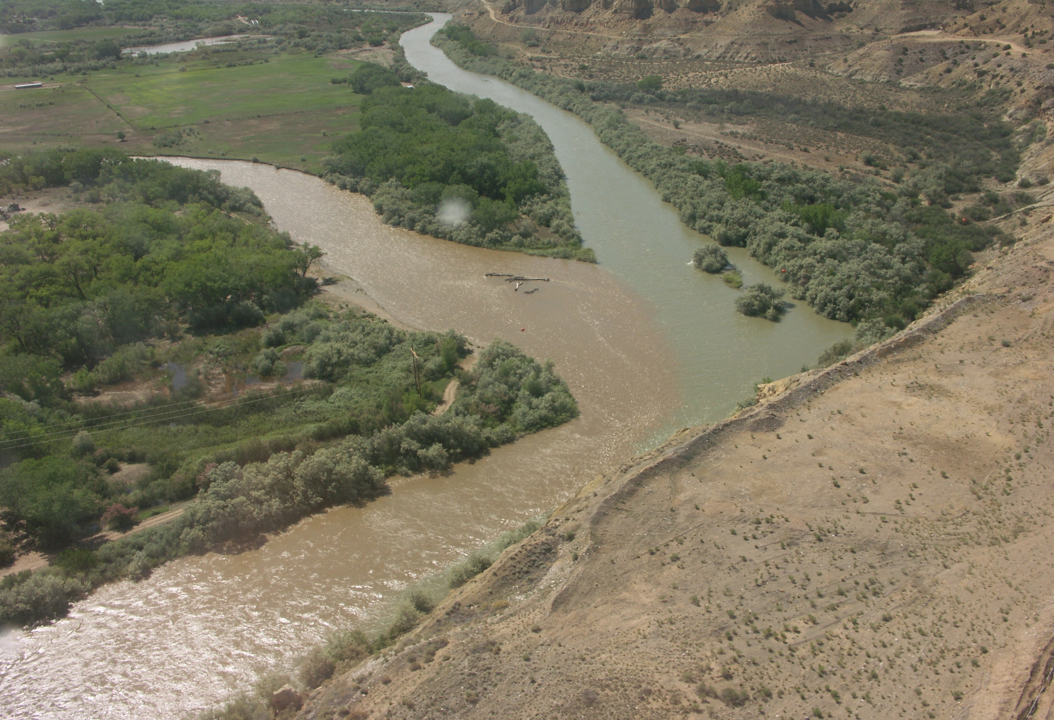
Navajo Reservoir
Water Year 2011
Proposed Operations

Slide 3
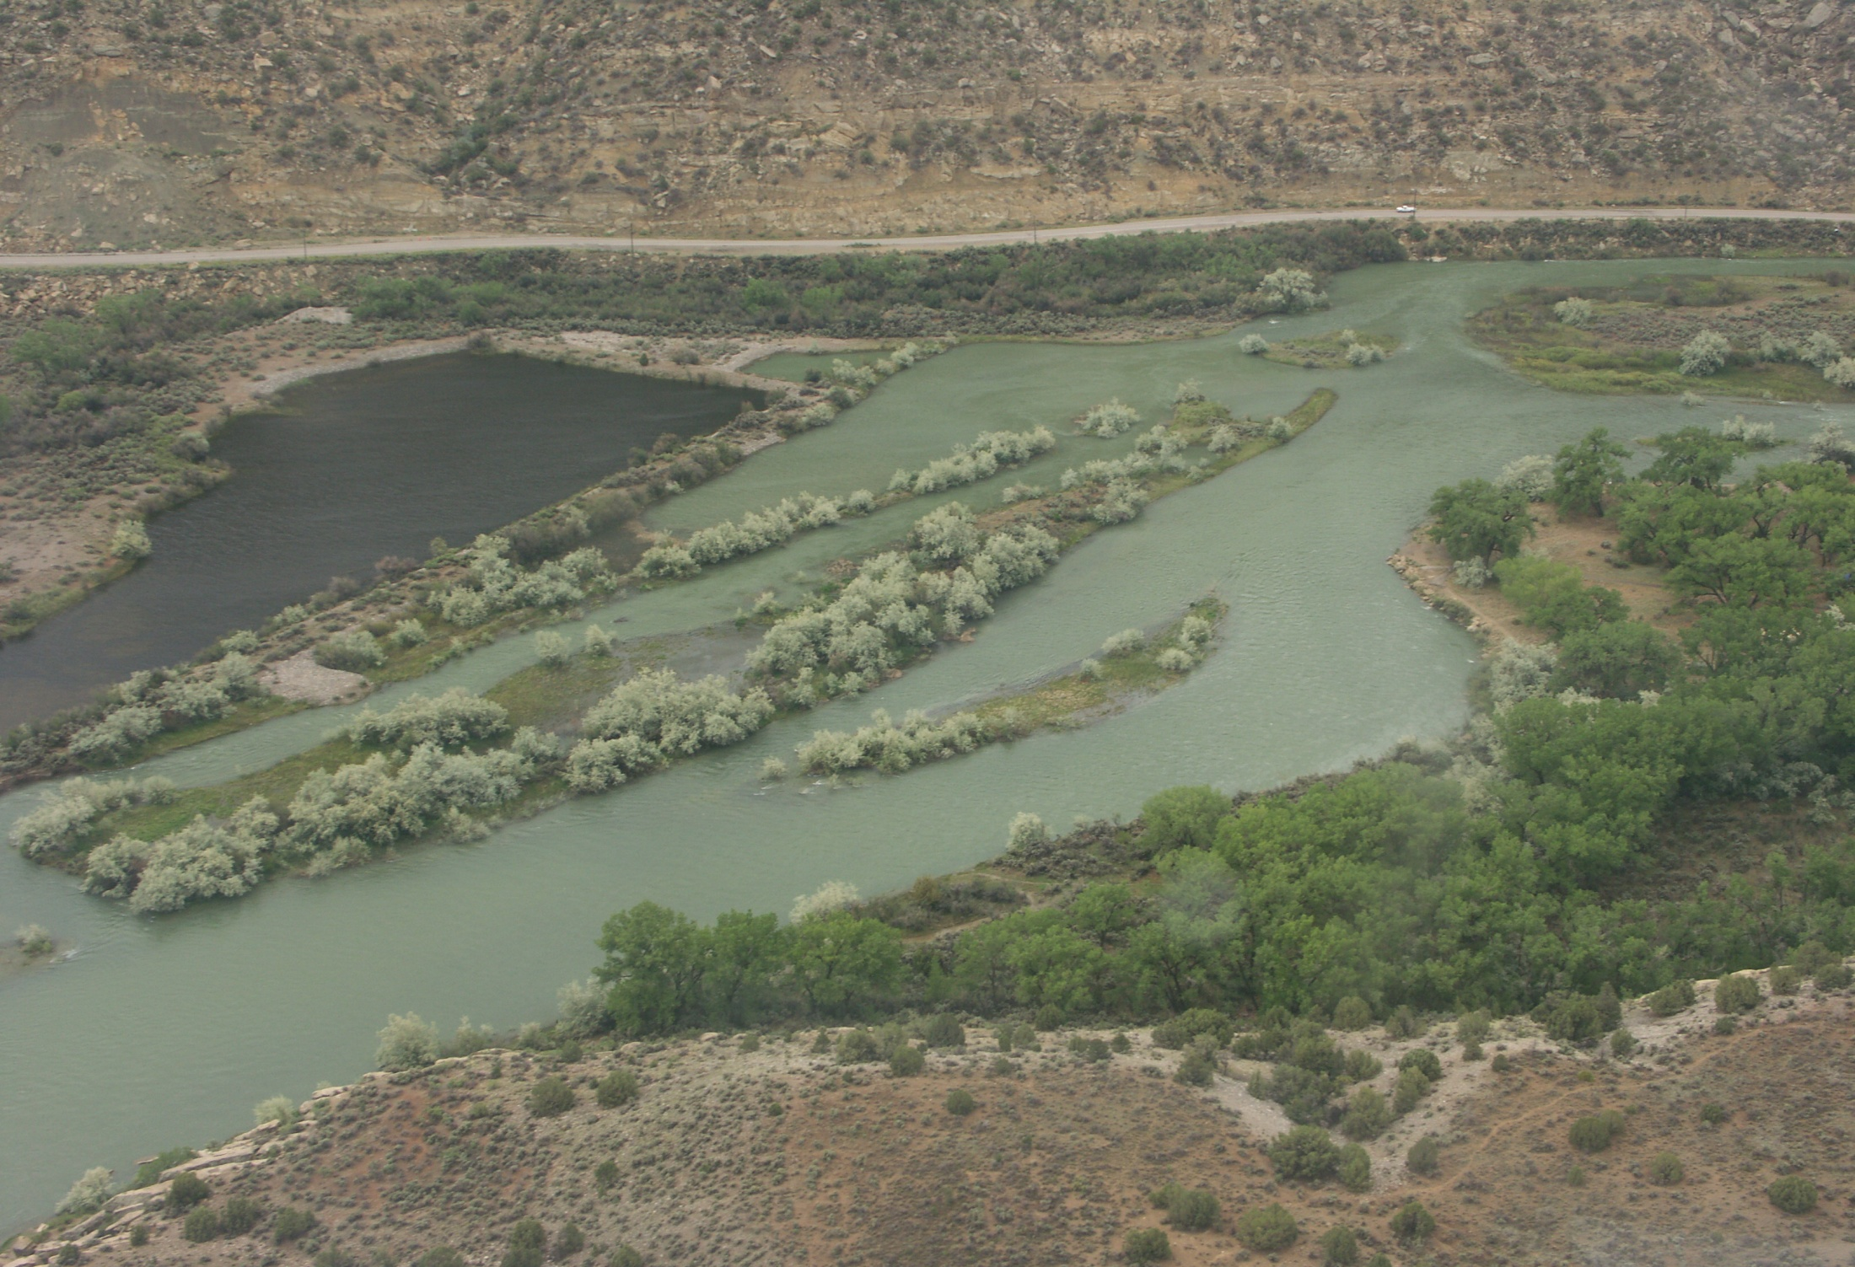
Navajo Current Conditions
(as of 3/24/2011)
Elevation = 6058.27 (102% of Average)
Storage = 1,325,971 af (78% Full)
Inflow = 530-990 cfs
Release = 500 cfs
NIIP = ~250 cfs
San Juan-Chama Diversion = 0-98 cfs

Slide 4
Update SNOTEL!!!

Slide 5
2011 Forecasted April-July Inflow
& Spring Peak Release (mid March)
Most Probable (50% Ex.) - 650,000 af (88% of Avg)
Peak Release = 118,000 af (1 week @ 5000 cfs)
Minimum Probable (90% Ex.) - 405,000 af (55% of Avg)
Peak Release = 118,000 af (1 week @ 5000 cfs)
Maximum Probable (10% Ex.) - 950,000 af (129% Avg)
Peak Release = 478,000 af (Full Hydrograph – 21 days @ 5000 cfs, bench of 1500 cfs into March)
Peak Release centered over Animas at Farmington peak
Base release of 500 cfs for remainder of water year (~362K af)

Slide 6
Put Hydrographs and downstream flow projection data here from 2011
Navajo Release Scenarios

Slide 7
WY2011 Estimated Inflows into Lake Powell from the San Juan
(based on SJ @ Bluff modeled flows)
Most Probable (50% Ex.) - 993,000 acre-feet
(71% of Average WY1981-2010)
Minimum Probable (90% Ex.) - 637,000 acre-feet
(45% of Average WY1981-2010)
Maximum Probable (10% Ex.) - 2,227,000 acre-feet
(158% of Average WY1981-2010)

