Slide 1
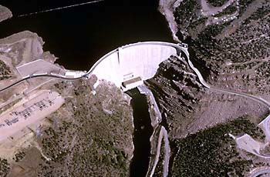
Green River Basin – Fontenelle and Flaming Gorge

Slide 2
Fontenelle Reservoir Elevation
Notes:
Go to P:\FontenelleOps\FontenelleDailyOps.xls to get most recent plot

Slide 3
Fontenelle Inflow and Release
Apr – Jul Inflow
905 KAF (105%)
Projected peak release 4,500 cfs for a month, likely higher, depends on timing
Notes:
Go to P:\FontenelleOps\FontenelleDailyOps.xls to get most recent plot

Slide 4
CRFS Green River Basin April 2010
Live Capacity 3.752 MAF
Capacity on 3/28/11 3.153 MAF
Available Space .599 MAF
Percentage of Full 84 %
Reservoir Elev. (Min Power) 5908.00 feet
Elevation on 3/28/11 6024.81 feet
Elevation above (Min) 117.91 feet
Average Inflow 1,240 cfs
Average Release 810 cfs

