Slide 1

CRFS Technical Meeting
LC Operations Update
March 29, 2011

Slide 2
Topics
Operations Update
Research Efforts
  Real Time Evaporation
  Development of streamflow projections
  Comparison of streamflow projections and operational impacts
Probabilistic Mid-Term Operations Model

Slide 3
Summary of Lake Powell and Lake Mead Operations
Review of 24-Month Study 2011 Water Year Projections
24-Month Study | Projected Powell WY Unreg Inflow | Projected Powell Apr- Jul Unreg Inflow | Projected Lake Powell EOWY Elevation w/ 8.23 maf Release | Projected Glen Canyon WY Release | Projected Amount of EQ Release | Projected Lake Mead EOWY Elevation | Probability of EQ
Jan 2010 | 110% 13.2 maf | 120% 9.5 maf | 3663.31 ft | 11.36 maf | 3.13 maf | 1105.00 ft | 76%
Feb 2010 | 105% 12.6 maf | 113% 9.0 maf | 3657.85 ft | 11.48 maf | 3.25 maf | 1105.00 ft | 71%
Mar 2010 | 105% 12.7 maf | 116% 9.2 maf | 3658.16ft | 11.63 maf | 3.40 maf | 1105.00 ft | 97%
In 2011, the Equalization Elevation is 3643 ft.

Slide 4
Published March 2011 Projection for September 30, 2011
Apr-Jul Forecast = 9.2 MAF
(116% Average)
Lake Powell
Lake Mead
24.322 maf
1,220
25.877 maf
3,700
Equalization Elevation
3632.49 Feet
3,643
1,105
11.9 maf
9.5 maf
3,575
1105.00 Feet
11.63 MAF
0.0 maf
3,370
895
0.0 maf
Dead Storage
1.9 maf
2.0 maf
Dead Storage
Not to Scale
Notes:
THIS SLIDE TO BE UPDATED TO REFLECT APRIL 24-MONTH STUDY

Slide 5
End of Water Year 2011
Lake Mead elevation end of WY 2011: 1105.00 feet
Downstream water use during CY2011 has been lower than expected
January storms and flooding along the Virgin River resulted in an initial increase to Lake Mead’s elevation of approximately 1.5 – 2.0 feet
Since January, dry conditions have persisted in the Southwest

Slide 6
Lower Basin Side Inflows
Glen Canyon to Hoover in WY/CY 2011^{1,2}
Month in WY/CY 2011 |  | Total Intervening Flow Glen Canyon to Hoover (KAF) | Total Intervening Flow Glen Canyon to Hoover (% of Average) | Difference From 5-Year Average (KAF)
H I S T O R Y | October 2010 | 80 | 145% | +25
 | November 2010 | 13 | 24% | -41
 | December 2010 | 248 | 435% | +191
 | January 2011 | 75 | 99% | -1
 | February 2011 | 84 | 91% | -8
P R O J E C T E D | March 2011 | 80
 | April 2011 | 60
 | May 2011 | 49
 | June 2011 | 23
 | July 2011 | 50
 | August 2011 | 109
 | September 2011 | 70
 | October 2011 | 59
 | November 2011 | 48
 | December 2011 | 99
WY11 Totals |  | 941 | 121% | +166
CY11 Totals |  | 806 | 99% | -9
¹Values were computed with the LC’s gain-loss model for the 24-month study
²Percent of average are based on the 5-year mean from 2005-2009 in CY 2010 and the 5-year mean from 2006-2010 in CY 2011.

Slide 7
Water Year 2011 Projected Operations
August 2010 Most Probable 24-Month Study projected Lake Mead elevation on Jan 1, 2010 to be 1086.38 feet
ICS Surplus Condition to govern Lake Mead operations
Mexico deliveries may be reduced
  Minute 318 signed to allow Mexico to store up to 260 KAF through 2013

Slide 9
Real Time Evaporation At Lake Mead
5-Year cooperative project with the USGS
Measure and obtain hourly evaporation rates (and other parameters) from Lake Mead
Develop new monthly coefficients for use in long-term modeling efforts
Maintain program into the future

Slide 10
Comparison to Evaporation Rates in 24 Month Study
Month | 24-Month Study Calculated Evaporation (KAF) | Measured Evaporation from USGS (KAF)* | Difference (KAF)
February 2010 | 30 | 11 | 19
March 2010 | 33 | 20 | 13
April 2010 | 41 | 23 | 18
May 2010 | 47 | 33 | 14
June 2010 | 55 | 21 | 34
July 2010 | 68 | 30 | 38
August 2010 | 72 | 34 | 38
September 2010 | 59 | 32 | 27
October 2010 | 42 | 33 | 9
November 2010 | 39 | 30 | 9
December 2010 | 30 | 11 | 19
January 2011 | 9 | 9 | 0
February 2011 | 10 | 15 | -5
*provisional

Slide 11
Impacts
Will reduce error associated with 24-Month Study side inflow to Lake Mead term
Since February 2010, side inflows would have been lower than previously calculated, most of the time
Lower Basin is actively working with CBRFC to forecast side inflows as well
Would like to keep project going, perhaps investigate bank storage

Slide 12
Recent Research Efforts
Forced CBRFC RFS model with BCSD climate dataset through 2099
  10-15% decrease in flows over Gunnison and San Juan River Basins
  8% increase in flows over Green River Basin
Compared impacts of streamflow projections derived using VIC and RFS to operations over the San Juan
  RFS flows generally lower over water year
  Seasonal RFS flows above Navajo are higher

Slide 13
Development of New Probabilistic Mid-Term Operations Model
Motivation is to better quantify range of uncertainty associated with mid-term operations forecasts
Being developed by CADSWES graduate student in collaboration with Reclamation’s Modeling Work Group
Developed in parallel with the 24-Month Study model
Simulation horizon of 2-10 years
Input is range of probable inflows
  First and part of second year based on CBRFC’s ESP forecasts
  On-going research to develop forecasting techniques beyond 2 years (being done by student developing model)
Results expressed in probabilistic terms
Target end of 2011 for first version of completed model
Notes:
13

Slide 14
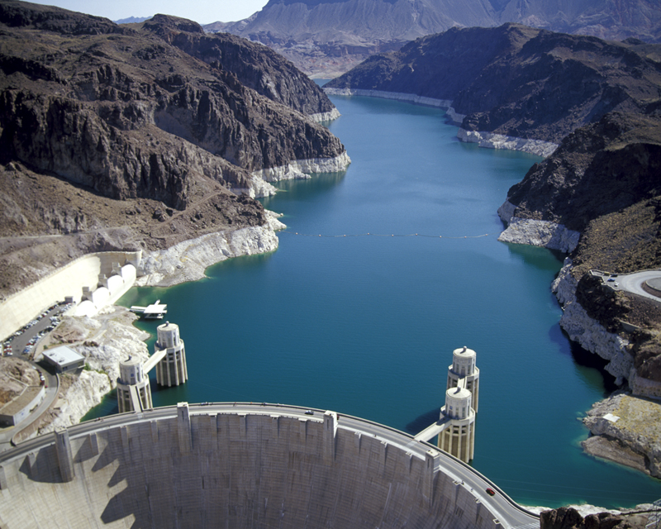
Lower Colorado River
Operations
For further information: http://www.usbr.gov/lc/region

