Slide 1
Green River Basin: Upper Green Yampa/ White Duchesne CRFS March 29, 2010

Slide 2
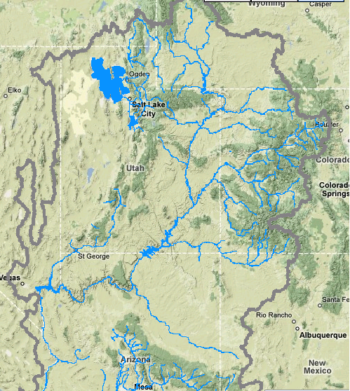
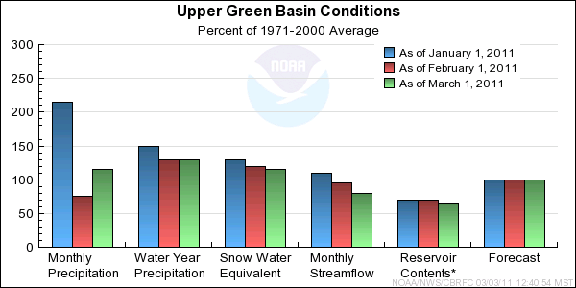
Upper Green

Slide 3
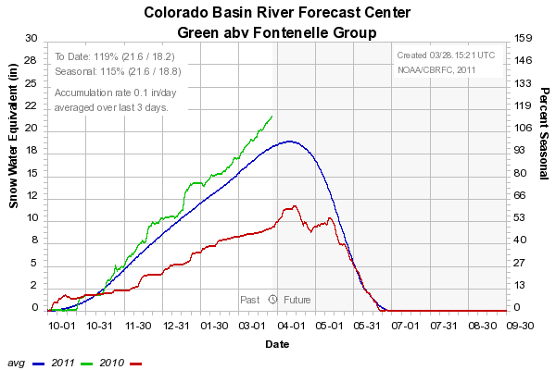
Upper Green: Fontenelle

Slide 4
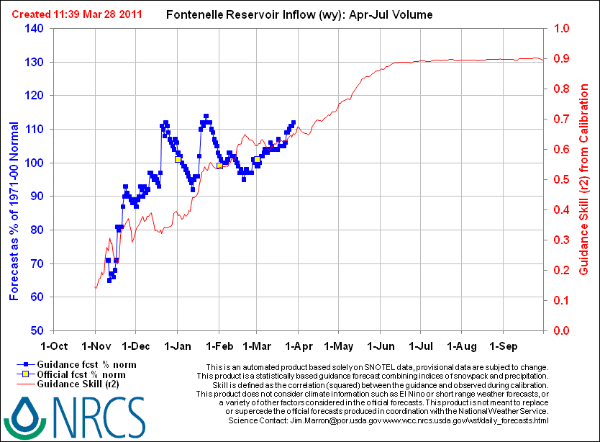

Slide 5
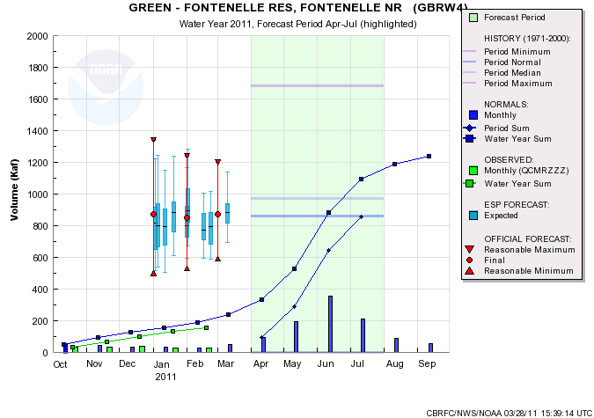
Upper Green: Fontenelle
 | March 1 | March 15 | March 28
CBRFC-SWS | 860
CBRFC-ESP | 865/857 (qpf/no qpf) | 928/902 | 944/963
NRCS- Daily | 850 | 905 | 964
NRCS-Statistical | 885/860r |  | 960/935r
Coordinated | 870/101% | 905/105%
Model Guidance and Forecasts
Notes:
ESP no qpf up ~11% from Mar 1

Slide 6
Upper Green: Flaming Gorge

Slide 7
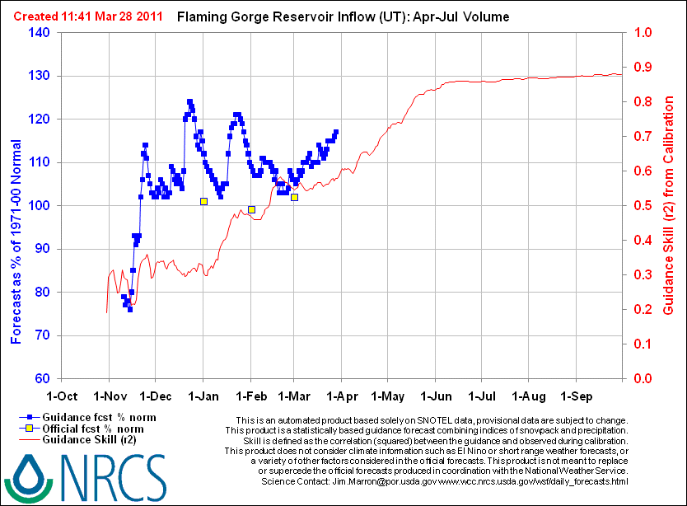

Slide 8
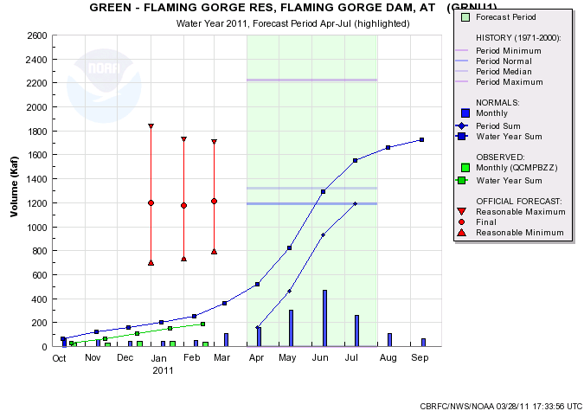
Upper Green: Flaming Gorge
 | March 1 | March 15 | March 28
CBRFC-SWS | 1204
CBRFC-ESP | 1130/1130 (qpf/no qpf) | 1230/1210 | 1227/1277
NRCS- Daily | 1252 | 1270 | 1388
NRCS-Statistical | 1230r |  | 1340r
Coordinated | 1210/102% | 1240/104%
Model Guidance and Forecasts
Notes:
ESP no qpf up 11.5% from Mar 1

Slide 9
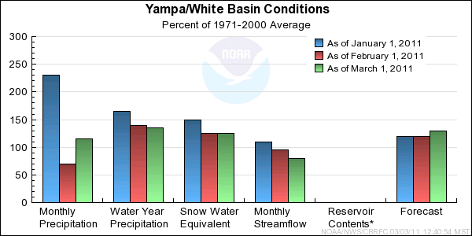
Yampa/White

Slide 10
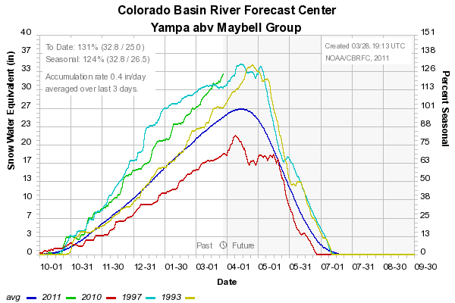
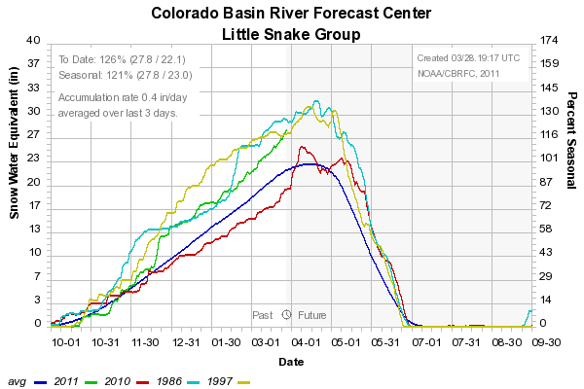
Yampa/White

Slide 11
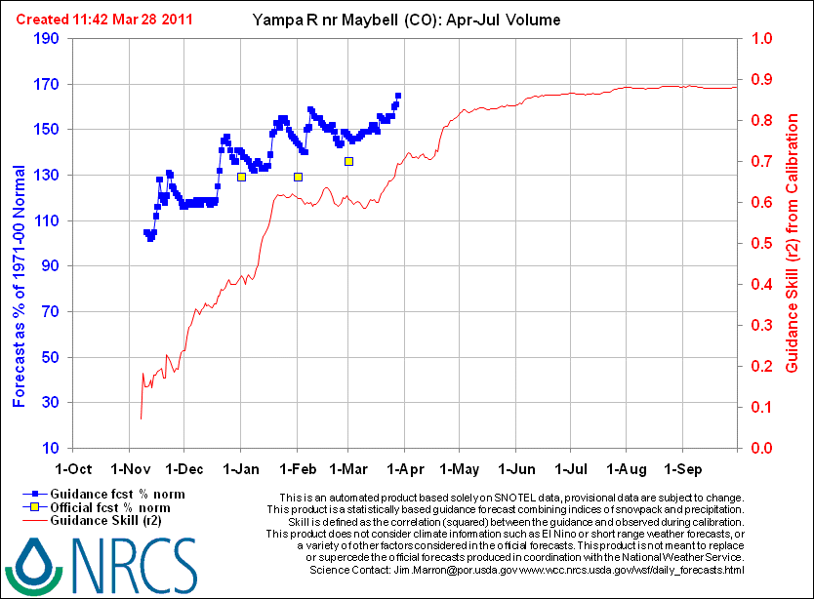

Slide 12
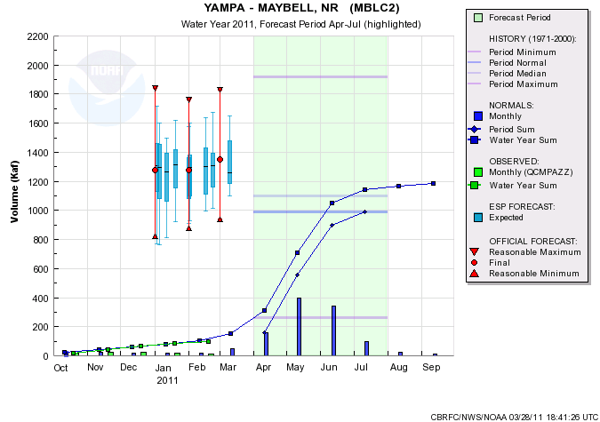
Yampa/White
 | March 1 | March 28
CBRFC-SWS | 1290
CBRFC-ESP | 1325/1350 (qpf/no qpf) | 1400/1377
NRCS- Daily | 1463 | 1631
NRCS-Statistical | 1490/1370r | 1520/1540r
Coordinated | 1350/136%
Model Guidance and Forecasts

Slide 13
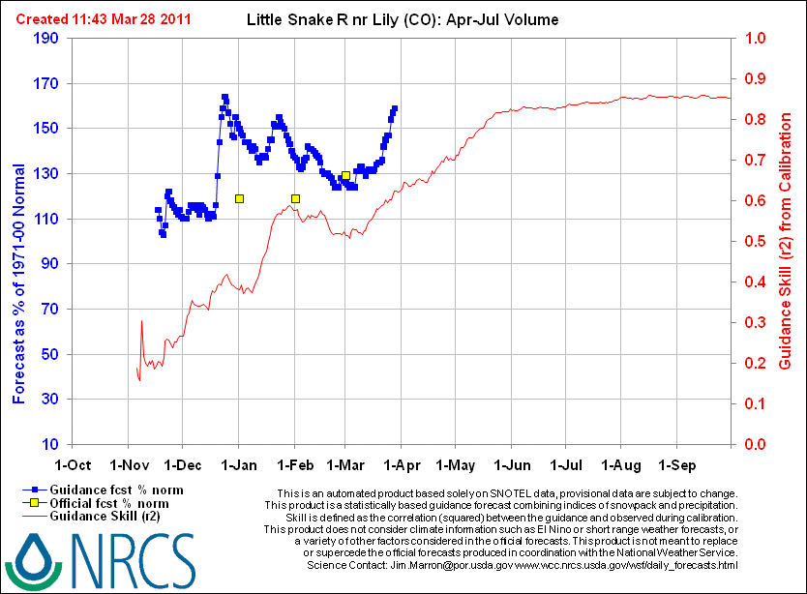

Slide 14
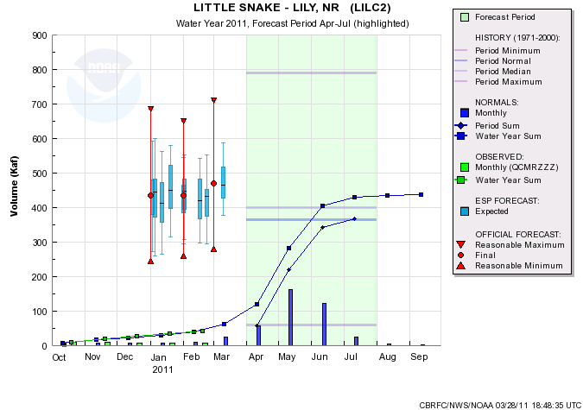
Yampa/White
 | March 1 | March 28
NWS-SWS | 480
NWS-ESP | 475/488 (qpf/no qpf) | 527/538
NRCS- Daily | 452 | 579
NRCS-Statistical | 470 | 545
Coordinated | 470/129%
Model Guidance and Forecasts

Slide 15
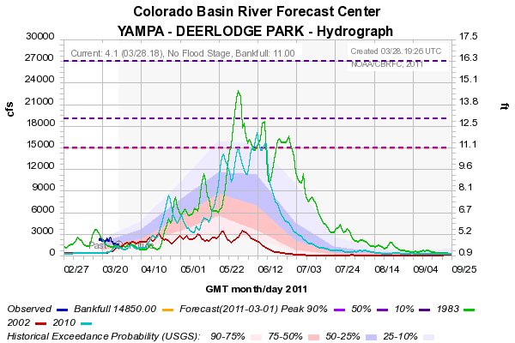
Yampa Deerlodge Peak Flow Forecast
Daily Peak -- Seasonal Maximum
# Exceedance Prob. 0.90 0.75 0.50 0.25 0.10 Units
# ---------------------------------------------------------------------------
16000 18060 20600 23000 26430 CFSD

Slide 16
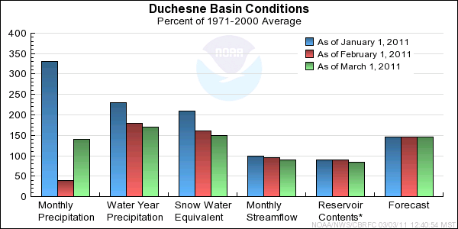
Duchesne

Slide 17
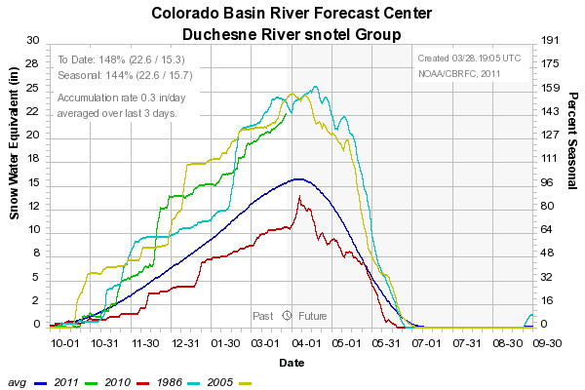
Duchesne

Slide 19
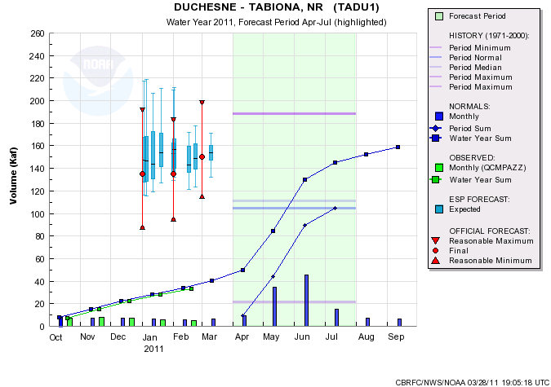
Duchesne
 | March 1 | March 28
CBRFC-SWS | 155
CBRFC-ESP | 154/159 (qpf/no qpf) | 151/157
NRCS- Daily | 165 | 172
NRCS-Statistical | 145 | 154
Coordinated | 150/143%
Model Guidance and Forecasts

