Slide 1
Lower Colorado Basin
CRFS
March 29, 2011

Slide 2
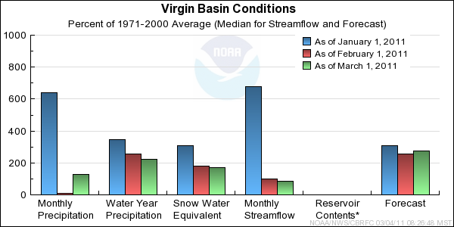
Virgin River
Notes:
Things to Note: The big December, precip, flows, and snowpack contribution during that time. That really provided the foundation for a solid runoff event this year and the model has wet soils due to the December event. The snowpack has been maintained at the mid/higher elevations through March, which doesn’t always happen. Forecasts have fluctuated a little but have been fairly consistent.

Slide 3
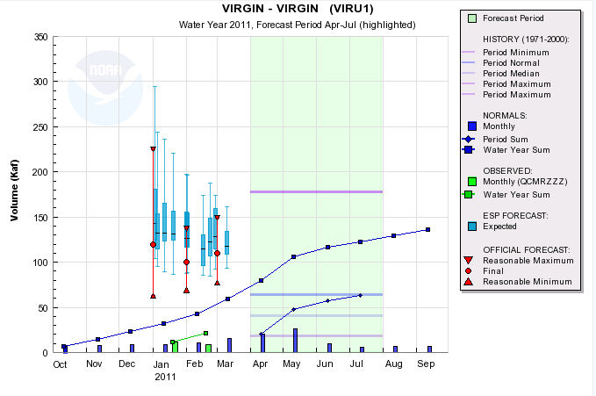
March 1
March 24
NWS-SWS: 135
NWS-ESP: 125 115
NRCS daily: 145
NRCS statistical: 130
Coordinated: 110/ 268% median or 172% average
Notes:
We’ve been running under ESP/Statistical all season due to the La Nina conditions. Several Stat procedures exist and those with SOI were lower than the SWS value indicated here. The typical La Nina conditions really didn’t take hold in the Virgin Basin, but they did further south in Arizona. ESP on Mar 24 is pretty close to the March 1st forecast. Initial thoughts are the forecast volume on April 1st may not change much.

Slide 4
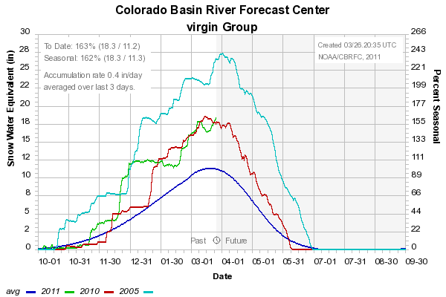
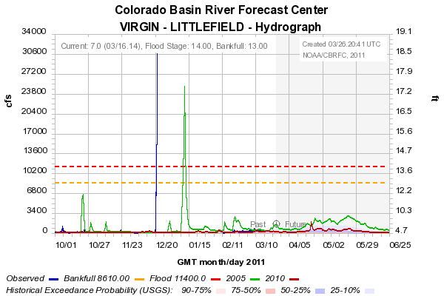
Historical Comparison
Virgin Basin Snow Plot
2005 / 2010 / 2011 / Average
Virgin River Flow (incl. Santa Clara)
2005 / 2010
Dec 2011
2005 Flood
2005 snowmelt
2010 Apr-July 66 KAF
Notes:
The snow graph is a little misleading. As a Basin value, the SWE shows similar to last year. However, the distribution of snow is quite different. Last year a this time, there was more snow at the lowest elevation SNOTEL sites. If you focus on the higher sites, where the bulk of the snow exits, there is quite a bit more snow, 7-8 more inches of SWE, this year compared to last, at some SNOTEL sites. Plus soil moisture conditions entering the season are wetter this year. The 2005 year is here for comparison because there was significant runoff and also a flood event during the winter as we had this year. If you look at the 2005 snowmelt peak, you see it is much smaller than the peak associated with heavy rainfall. We anticipate the same this year. A peak similar to greater than last season, but much lower than the flood flow which was established by liquid events.

Slide 5
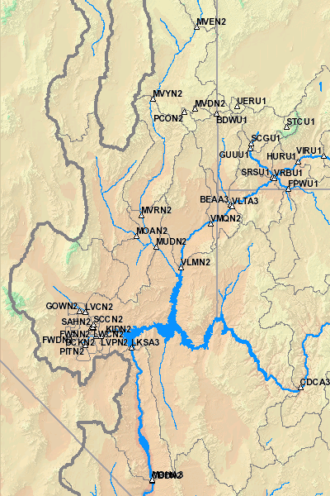
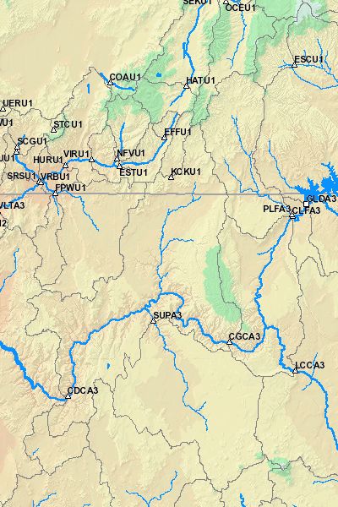
Intervening Flow Forecasts: Lake Powell to Lake Mead / Where is the skill ?
Paria River
Muddy Creek
Virgin River
Little Colorado
Colorado River -
Lake Powell to Diamond Fork
Notes:
These are the forecast segments that I combine to make the Mead Local. Virgin has best skill, then maybe the Little Colorado is next since it is a partial snow melt basin.

Slide 6
2011 LOWER COLORADO BASIN
LAKE MEAD LOCAL (Intervening Flow)
ESP Generated
Issued Mid March
March 110 KAF ( 92 % of average)
April 100 KAF ( 87 % of average)
May 85 KAF (102 % of average)
April - July Forecast: 260 KAF ( 90% of average)
March - July Forecast: 370 KAF ( 90% of average)
Notes:
Changing soil moisture conditions and the Virgin River forecasts are primary influence to the Mead Forecast.
Forecasts heavily follow the ESP climatology, the only real skill is on the Virgin and that skill is similar Jan-Mar, improves quite a bit by April 1st.

