Slide 1
Upper Colorado Mainstem: Lake Powell
CRFS
March 29, 2011

Slide 2
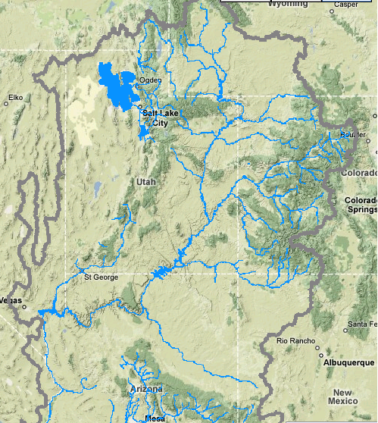
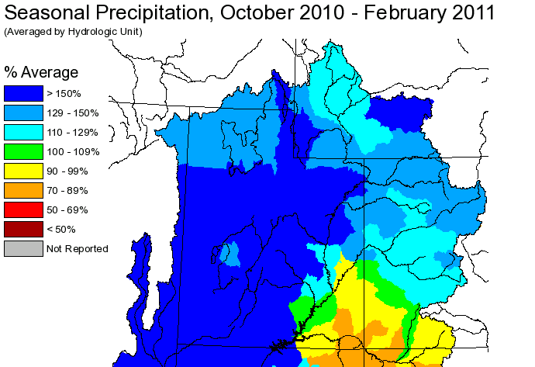
Lake Powell

Slide 3
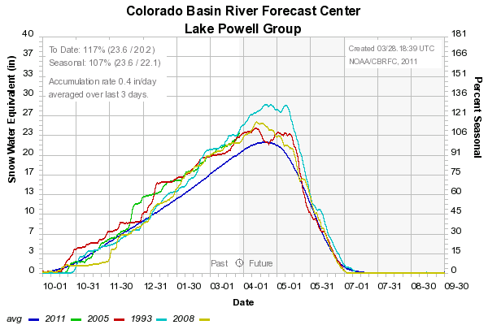
Lake Powell historical inflows
YEAR | OBS VOL (KAF) / %AVG | RANK (101 YRS)
2005 | 8844 / 112% | 39
2008 | 8909 / 112% | 38
1993 | 9984 / 126% | 29

Slide 4
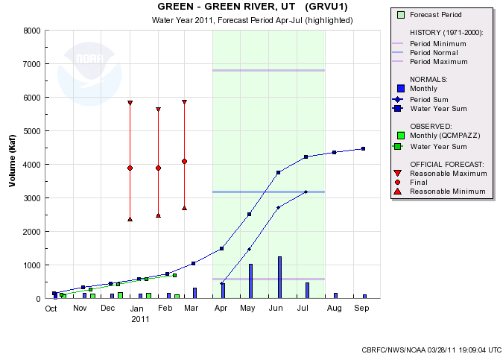
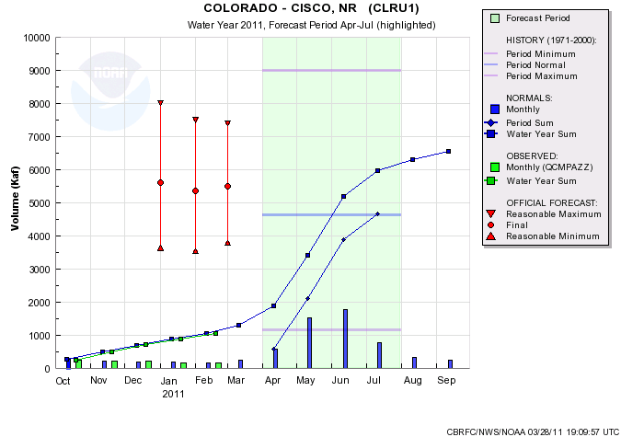
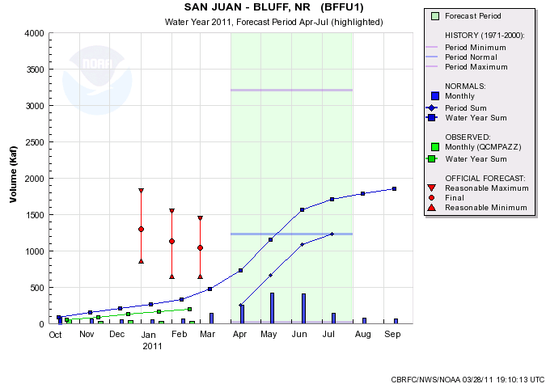
5500/118%
4090/129%
Average contribution to Lake Powell Apr-Jul inflow:
Green River-Green River, UT 34%
Colorado River-Cicso, UT 50%
San Juan River-Bluff, UT 13%
1040/85%

Slide 5
Model Guidance
Green – Green River, UT
 | March 1, 2011 | March 28, 2011 | Historical Ranking
CBRFC ESP | qpf: 4180 no: 4280 | qpf: 4385 no: 4490 | 18/106 5/40
NRCS STAT | 4240 / 4090 | 4880 | 11/106 3/40
COORD FCST | 4090 / 129%
Colorado – Cisco, nr
 | March 1, 2011 | March 28, 2011 | Historical Ranking
CBRFC ESP | qpf: 5125 no: 5376 | qpf: 4875 no: 4965 | 16/40
NRCS STAT | 5630 | 5740 | 11/40
COORD FCST | 5500 / 118%
San Juan – Bluff, nr
 | March 1, 2011 | March 28, 2011
CBRFC ESP | qpf: 980 | qpf: 800 no: 860
NRCS STAT | 1030 | 850
COORD FCST | 1040 / 85%

Slide 6
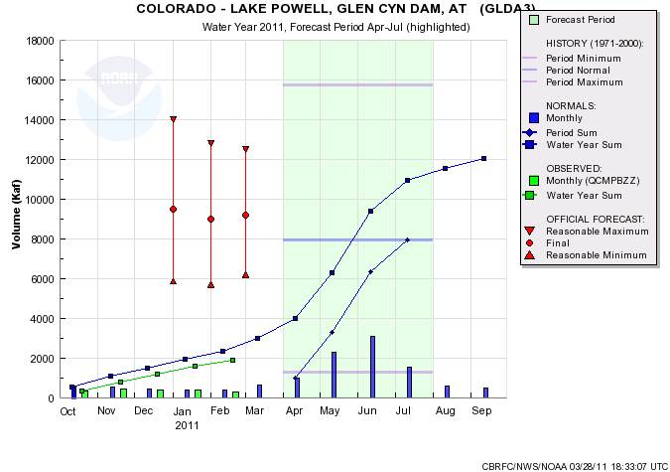
Model Guidance
 | March 1, 2011 | March 15, 2011 | March 28, 2011
CBRFC ESP | qpf: 9250 no: 9520 | qpf: 9340 no: 9350 | qpf: 8810 no: 9160
CBRFC SWS | 30yr:9470 15yr:9110
NRCS STAT | 9200 | 9400 | 10000
COORD FCST | 9200 / 116% | 9200 / 116%

