Slide 1
Upper Colorado Basin:
Gunnison/Dolores/San Juan
CRFS
March 29, 2011

Slide 2
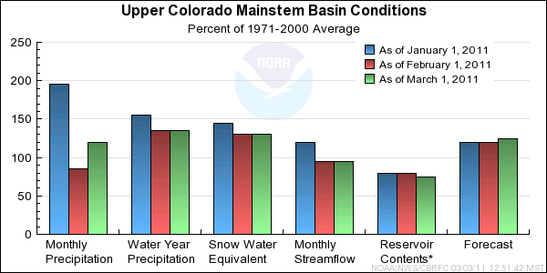
Upper Colorado Mainstem

Slide 3
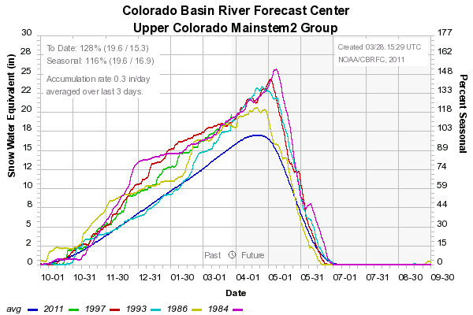
Colorado River near Cameo historical flows
YEAR | OBS VOL (KAF) / %AVG | RANK (77 YRS)
1984 | 4489 / 185% | 1
1997 | 3486 / 144% | 4
1986 | 3372 / 139% | 8
1993 | 3194 / 132% | 11

Slide 4
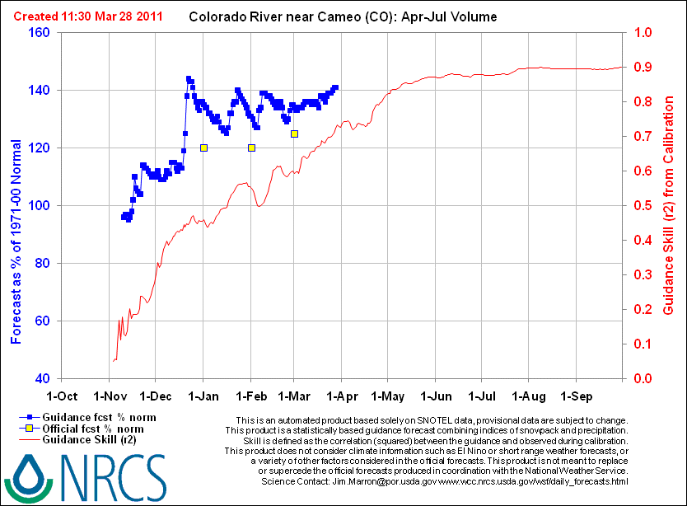

Slide 5
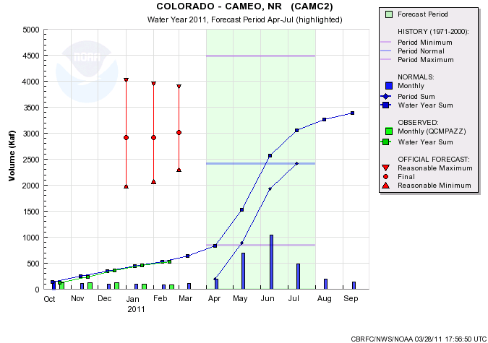
 | March 1, 2011 | March 28, 2011
CBRFC ESP | qpf:2940 no: 3030 | qpf:2910 no: 2985
CBRFC SWS | raw: 3030 rtd: 3045
NRCS DAILY | 3160 | 3410
NRCS STAT | 3090 | 3200
COORD FCST | 3020 / 125%
Model Guidance & Forecast

Slide 6
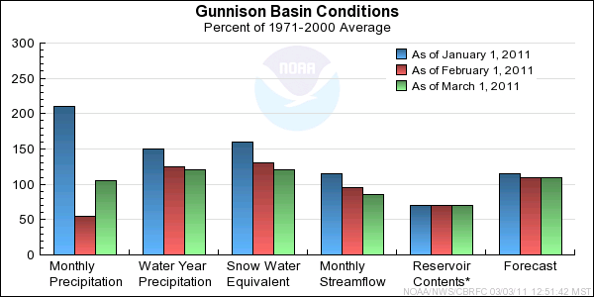
Gunnison

Slide 7
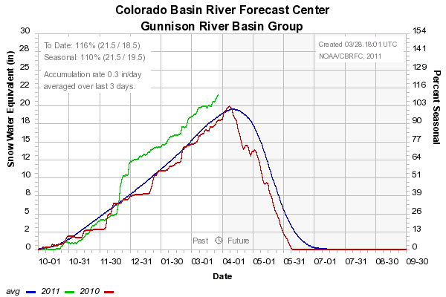

Slide 8
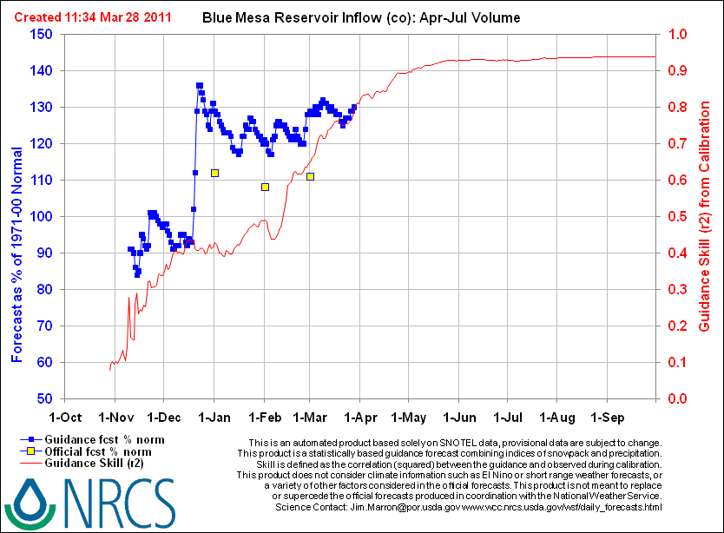

Slide 9
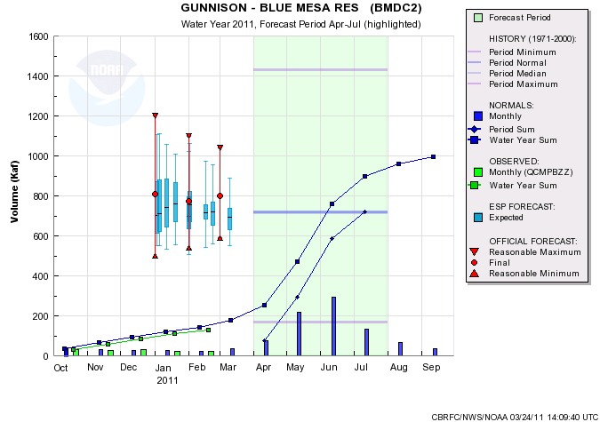
March 1
March 15
March 28
NWS-SWS: 861 no qpf – qpf
NWS-ESP: 744 743 724 704
NRCS daily: 928 928 939
NRCS statistical: 825 850
Coordinated: 800 / 111% 800/ 111%
Model Guidance & Forecast

Slide 10
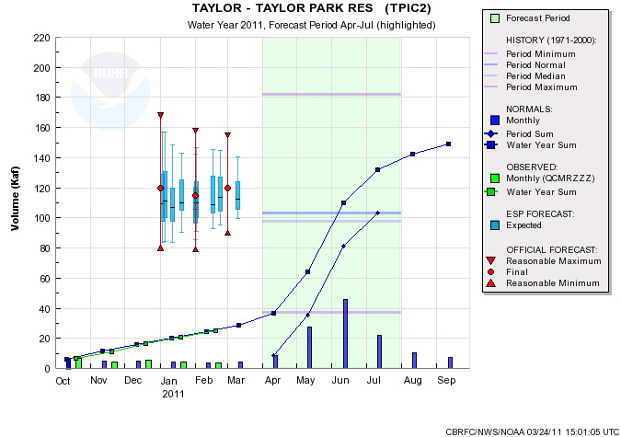
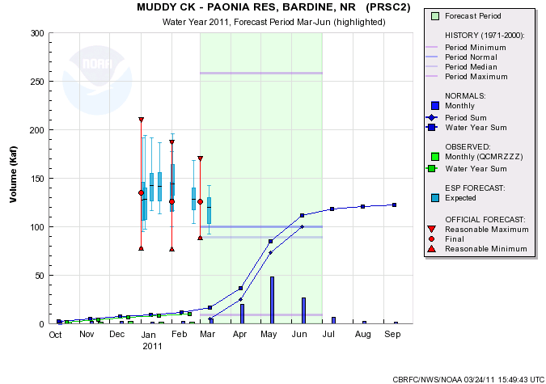
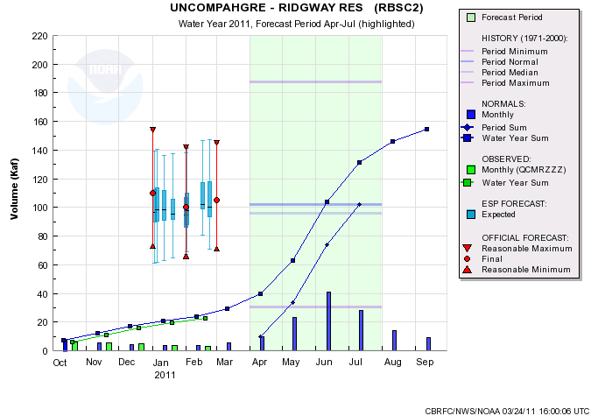
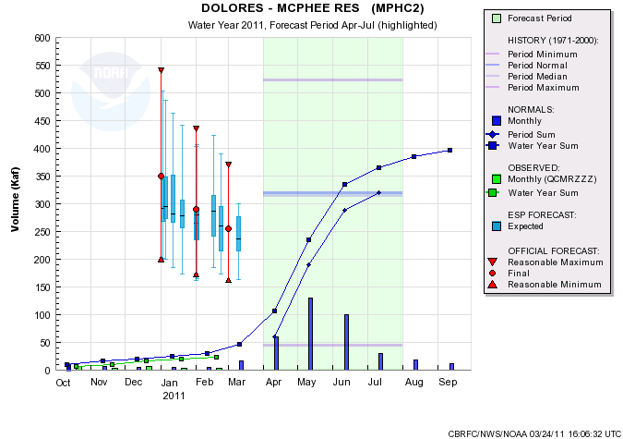
120/117%
85/82%
129/126%
129/126%
255/80%
105/103%

Slide 11
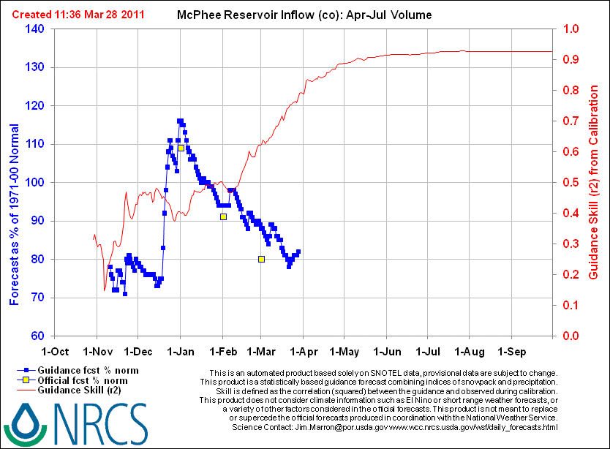

Slide 12
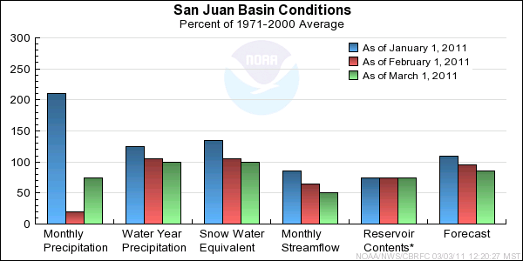
San Juan

Slide 13
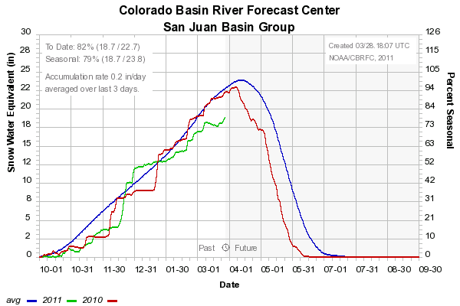

Slide 14
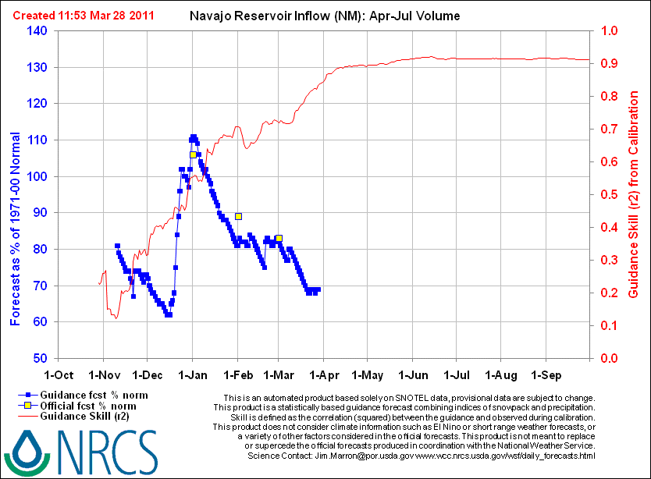

Slide 15
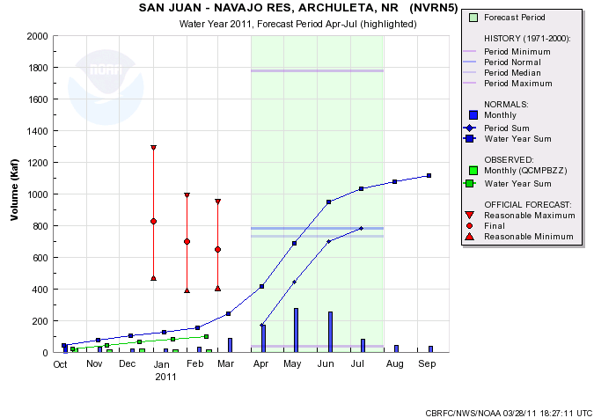
March 1
March 15
March 28
NWS-SWS: 794 no qpf – qpf
NWS-ESP: 651 620 534 – 573
NRCS daily: 647 585 543
NRCS statistical: 635 560
Coordinated: 650 / 83% 650 / 83%
Model Guidance & Forecast

Slide 16
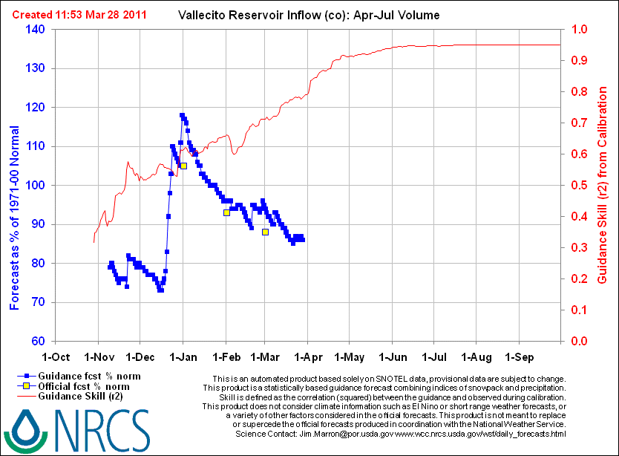

Slide 17
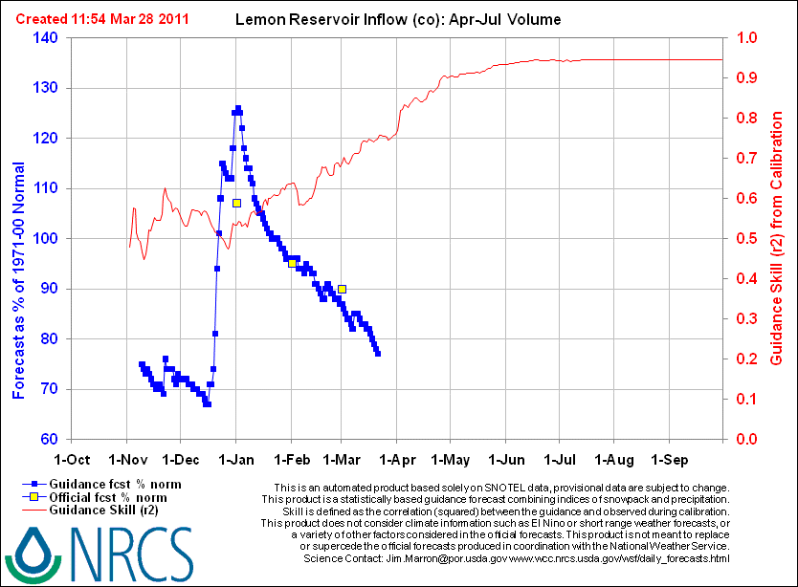

Slide 18
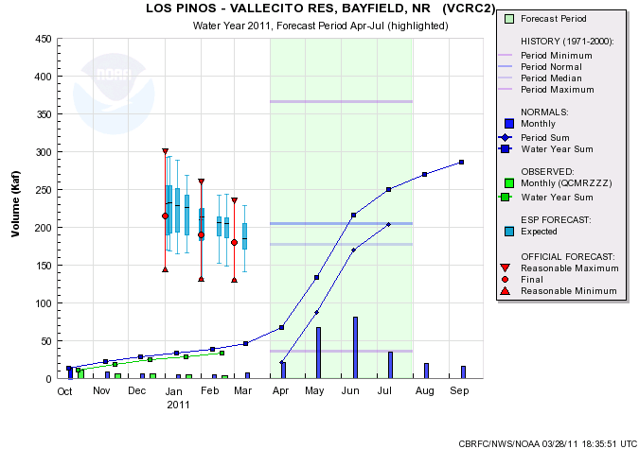
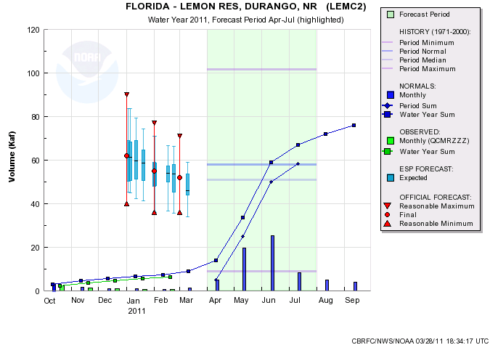
180/88%
52/90%

