Slide 1
CRFS Technical Meeting
UC Operations Update
March 30, 2010

Slide 2
UC Mainstem – Glen Canyon Dam

Slide 3
Review of Operational Criteria Interim Guidelines for Coordinated Operation of Lake Powell and Lake Mead

Slide 4
Lake Powell & Lake Mead Operational Diagrams for 2011 August 24-Month Study
3,629
Projection for
1/1/11
14.7
Projection for
1/1/11
1,086
Projection for
1/1/11
10.3
Projection for
1/1/11
¹ Subject to April adjustments that may result in balancing releases or releases according to the Equalization Tier.
² These are amounts of shortage (i.e., reduced deliveries in the United States).
³ If Lake Mead falls below elevation 1,025 ft, the Department will initiate efforts to develop additional guidelines for shortages at lower Lake Mead elevations.

Slide 5
Lake Powell Equalization Table
Water Year | Lake Powell Elevation (feet)
2008 | 3,636
2009 | 3,639
2010 | 3,642
2011 | 3,643
2012 | 3,645
2013 | 3,646
2014 | 3,648
2015 | 3,649
2016 | 3,651
2017 | 3,652
2018 | 3,654
2019 | 3,655
2020 | 3,657
2021 | 3,659
2022 | 3,660
2023 | 3,662
2024 | 3,663
2025 | 3,664
2026 | 3,666

Slide 6
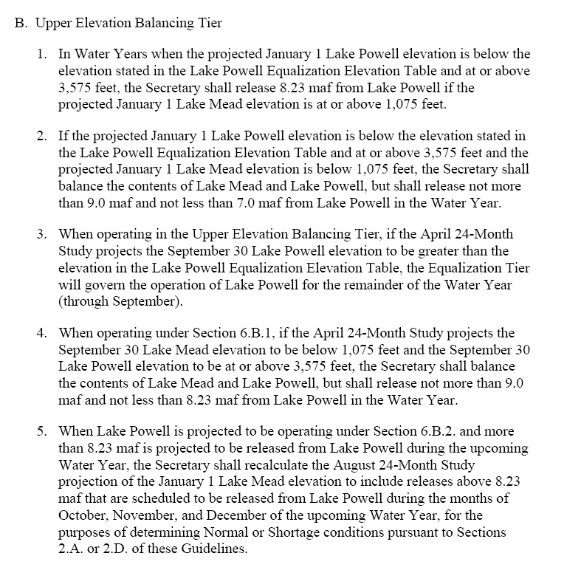

Slide 7
Projected Operation for Remainder of WY2010

Slide 9
Glen Canyon Power Plant Planned Unit Outage Schedule for Water Year 2011
(updated 3-25-2011)
Unit Number | Oct 2010 | Nov 2010 | Dec 2010 | Jan 2011 | Feb 2011 | Mar 2011 | Apr 2011 | May 2011 | Jun 2011 | Jul 2011 | Aug 2011 | Sep 2011
1
2
3
4
5
6 (3/4 Unit)
7
8
Units Available | 4.75 | 5.75 | 6.75 | 6.75 | 4.75 | 4.75 | 4.75 | 5.75 | 6.75 | 6.75 | 6.75 | 4.75
Capacity (kaf) | 990 | 1180 | 1350 | 1350 | 1080 | 1036 | 969 | 1165 | 1309 | 1446 | 1446 | 883
Max (kaf) | 495 | 810 | 847 | 997 | 964 | 1034 | 969 | 1165 | 1309 | 1446 | 1446 | 883
Most (kaf) | 495 | 810 | 847 | 997 | 964 | 1034 | 966 | 1103 | 1179 | 1300 | 1224 | 714
Min (kaf) | 495 | 810 | 847 | 997 | 964 | 937 | 600 | 619 | 652 | 800 | 803 | 476
Notes:
March 19-31, 2 GC units offline
Max release ~19,625, min release 14,000, flat flows on peak. Will carry 41 MW non-spin at Flaming Gorge, 40 MW regulation at GC, and 57 MW spin at GC.
All regulation and reserves will be carried at Glen Canyon.
March total release 1,034kaf.
April 1-3, 2 GC units offline (actually, April 2-3 we'll only have one unit off we'll continue with the March pattern)
Max release ~19,625, min release 14,000, flat flows on peak. Will carry 41 MW non-spin at Flaming Gorge, 40 MW regulation at GC, and 57 MW spin at GC.
April 4-30, 3 GC units offline
Flat release of ~16,000. Will carry 41 MW non-spin at Flaming Gorge, 40 MW regulation at GC, and 57 MW spin at GC.
April total release 966kaf. This is below the DOI/DOE Parameter which requires at least 1,063 kaf.
May 1-13, 3 GC units offline
Max release ~15,000, min release 14,500, flat flows on peak. This allows us to carry all regulation and reserves at GC since Aspinall and Flaming Gorge will most likely be at peak releases.
May 14-31, 1 GC unit offline
Max release 22,000, min release 16,000. All regulation and reserves will be carried at Glen Canyon.
May total release 1,103kaf. This meets the current DOI/DOE Parameter minimum requirement.
June 1-30, 1 GC unit offline
Max release 22,000, min release 14,500, flat flows on peak. All regulation and reserves will be carried at Glen Canyon.
June total release 1,179kaf. This is within the DOI/DOE Parameter. If needed, June could release 1,309 kaf with flat flows of 22,000 cfs all hours.
July, 1 GC unit offline
Current 24-month study shows 1,300 kaf. I'm showing we'll be able to carry all regulation and reserves and fluctuate a bit. This is within the DOI/DOE Parameter. The max we could release with flat flows is 1,446 kaf which is equal to about 23,500 cfs. This is per Montrose calculation as of March 2, 2011. It assumes all GC holds all Regulation and spinning reserves but all non-spin held at Aspinall and FG. It assumes that we abandon the limit of 22,000 cfs per DOI/DOE to achieve EQ by end of WY. It also assumes that all non-spin reserves are held at ASP and FG but all spin and regulation held at GC.
August, 1 GC unit offline
Current 24-month study shows 1,224 kaf. I'm showing we'll be able to carry all regulation and reserves and fluctuate a bit. This is within the DOI/DOE Parameter. The max we could release with flat flows is 1,353kaf. The max we could release with flat flows is 1,446 kaf which is equal to about 23,500 cfs. This is per Montrose calculation as of March 2, 2011. It assumes all GC holds all Regulation and spinning reserves but all non-spin held at Aspinall and FG. It assumes that we abandon the limit of 22,000 cfs per DOI/DOE to achieve EQ by end of WY. It also assumes that all non-spin reserves are held at ASP and FG but all spin and regulation held at GC.
September, 3 units offline
Currently the Steady Flow Target for September is 12,000 cfs which equates to 714 kaf. The capacity at this point is 882 kaf which assumes the maximum cfs release with 3 units out and carrying 51 MW of spinning reserves at GC (non-spin at Aspinall and FG) and 40 MW of regulation. This needs to be checked and refined by Western. Western has checked and they come up with 883 kaf…

Slide 12
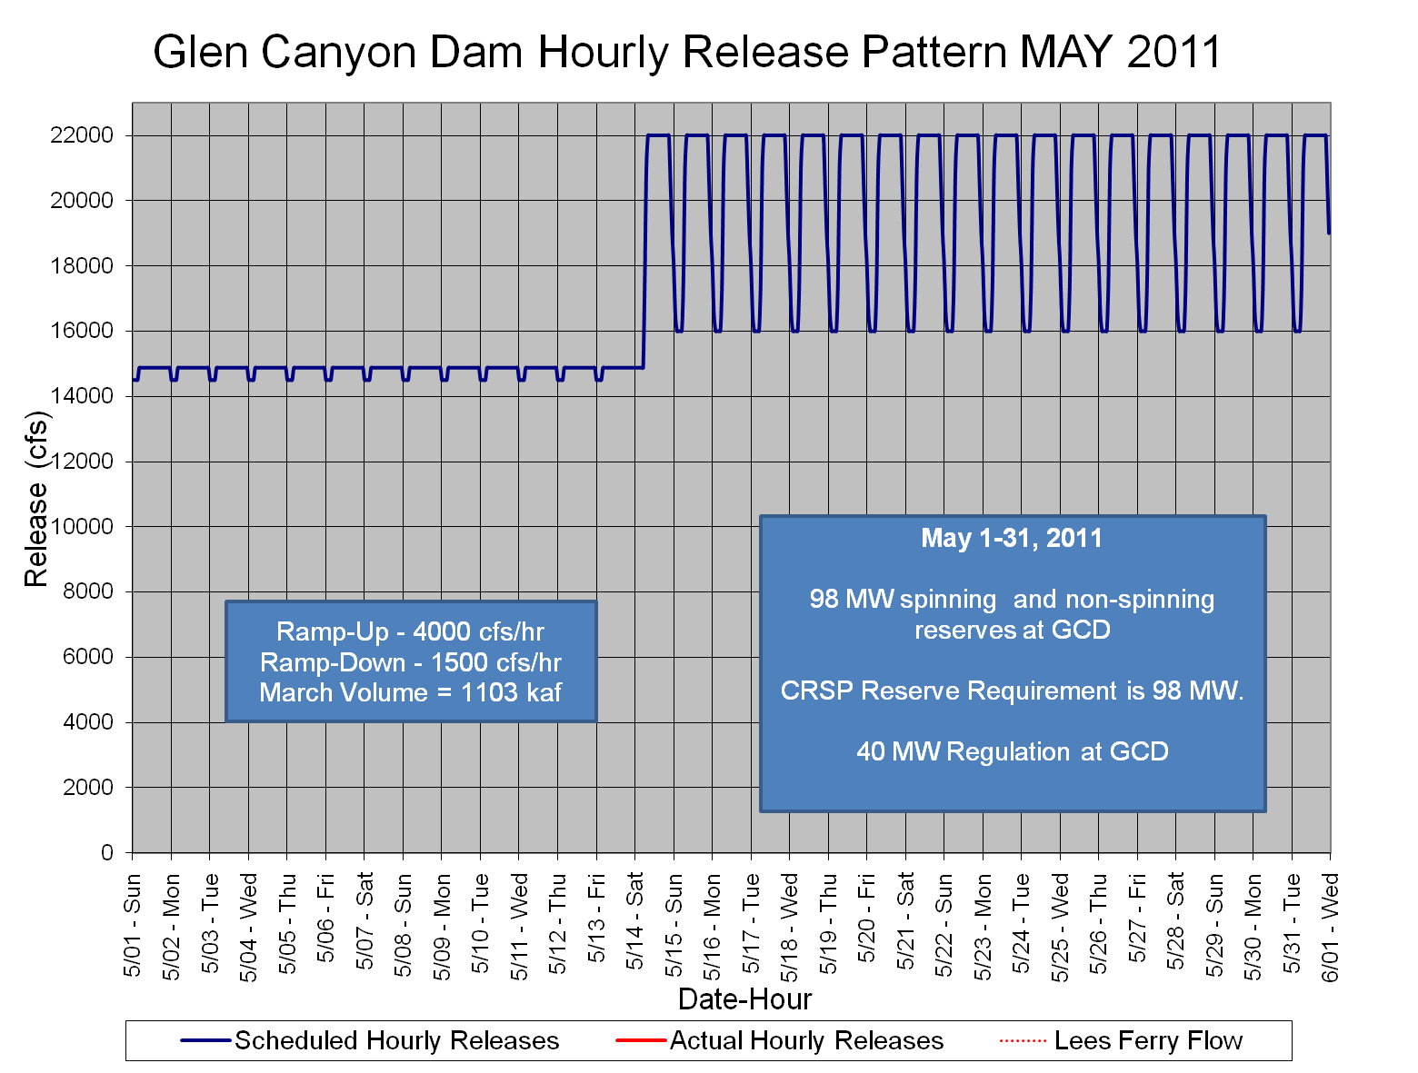

Slide 13
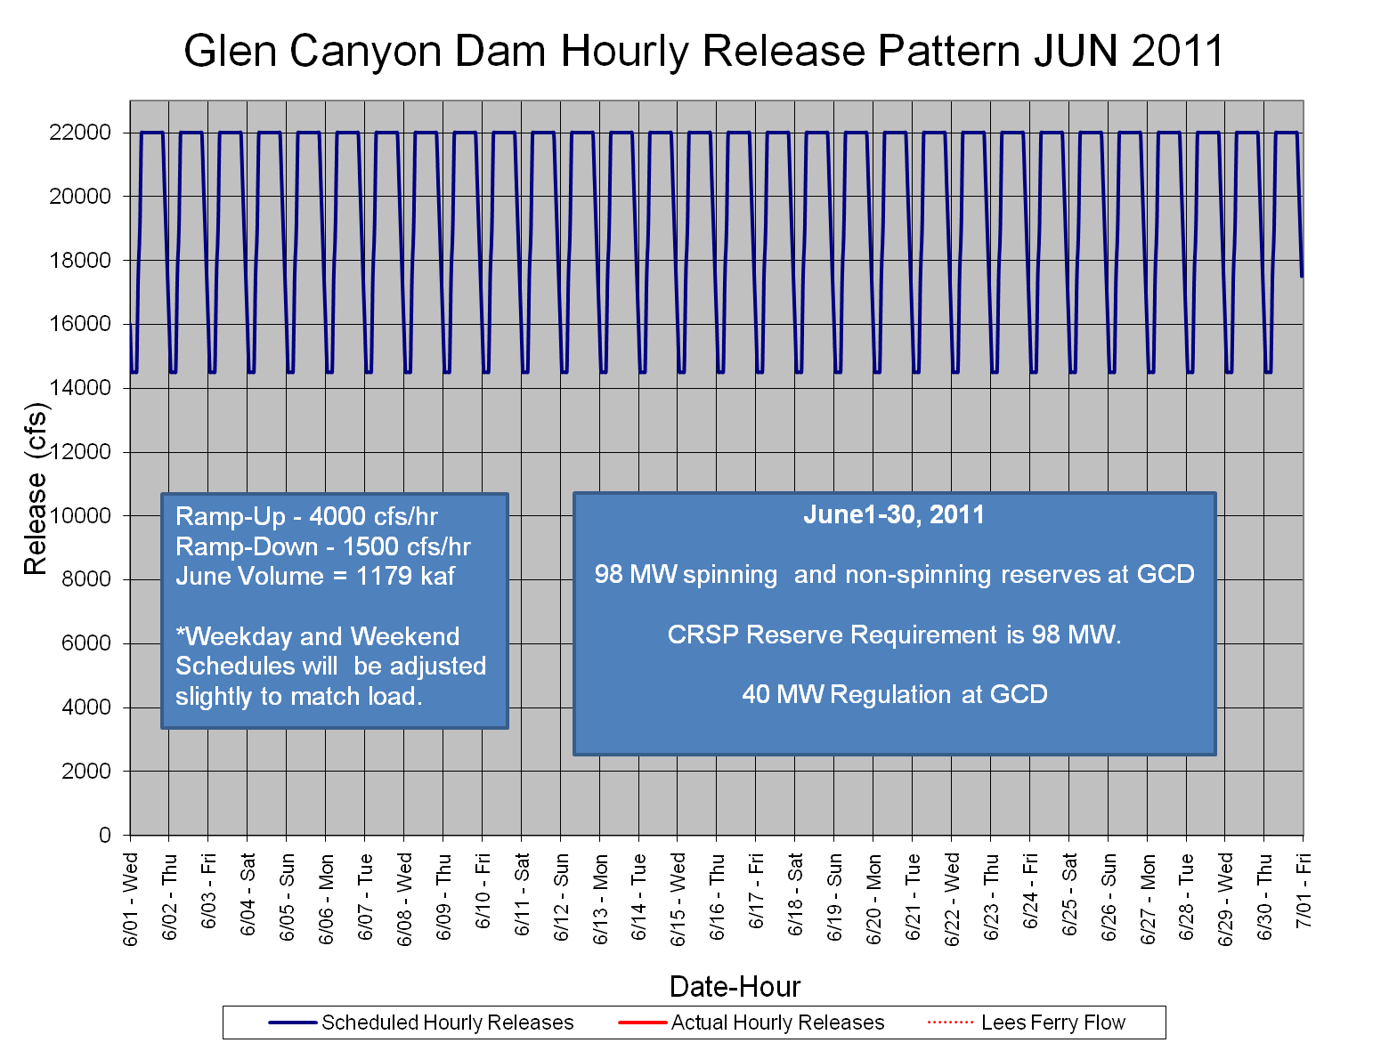

Slide 14
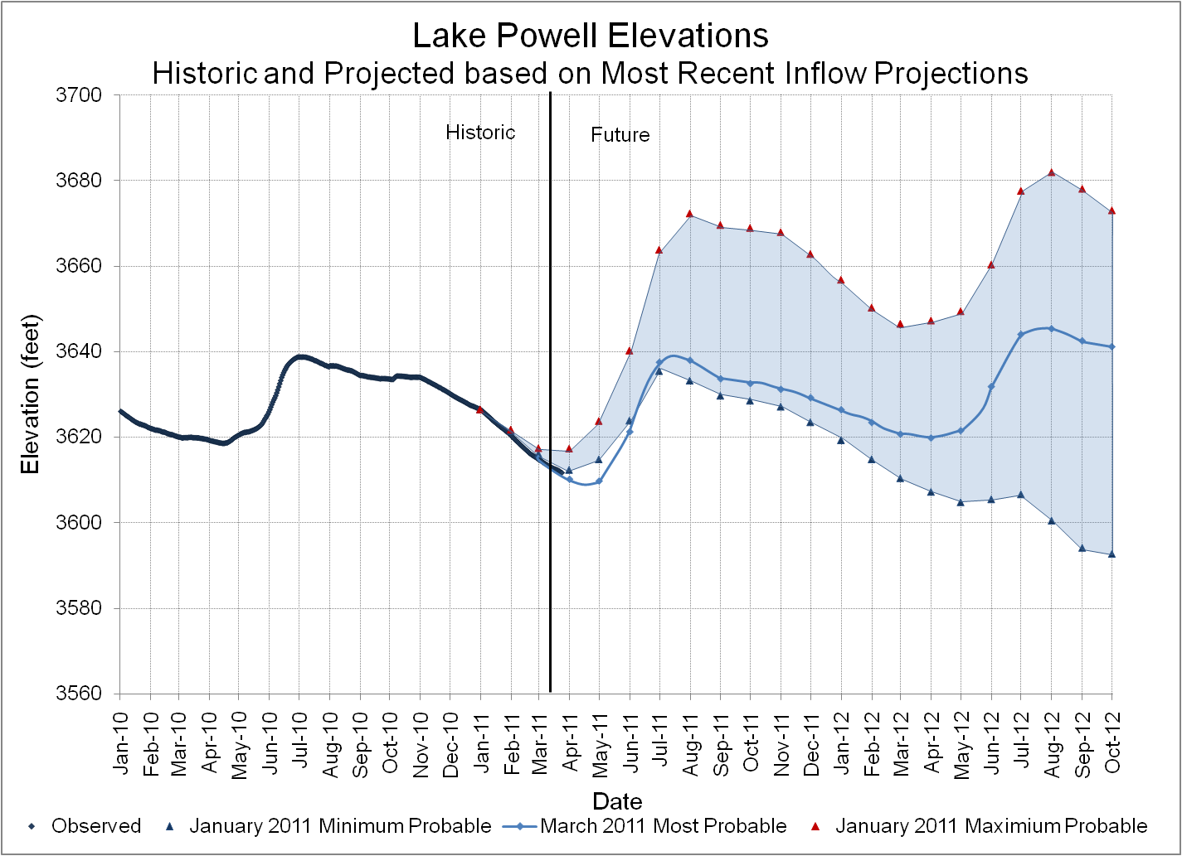
Equalization Level for 2011 is 3643 feet. If inflow conditions become dry, Equalization releases are limited to attempt to maintain the elevation of Lake Powell 20 feet below this level.

Slide 15
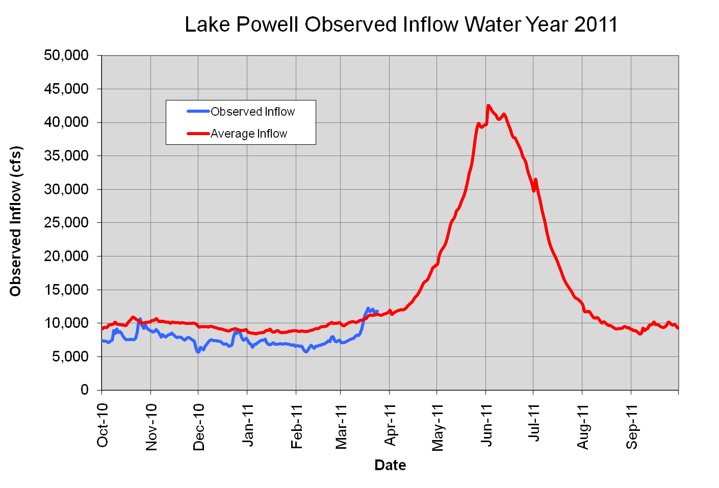

Slide 16
