Slide 1
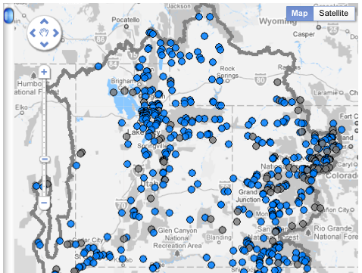
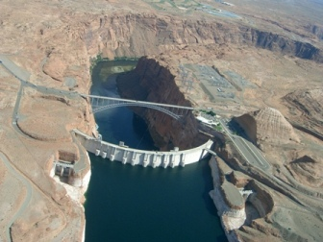
Workshop Summary
SI/Y2 Climate and Streamflow Forecasting Workshop
NOAA/NWS Colorado Basin River Forecast Center
Salt Lake City, UT – March 21-22, 2011
Organized by Sponsored by
CBRFC Colorado Water Conservation Board
USBR NIDIS

Slide 2
Goals
Address Stakeholder Requirements:
Assessment and incorporation of weather and climate forecasts into water supply forecasts
Forecast horizon out to two years
Objective (and repeatable) forecast system
Development and Researcher to Operations
Discussion of State of Practice versus State of Science
Education of External Researchers and Partners
Education of Internal Researchers and Forecasters
Design and Establishment of Testbed for Evaluation and Intercomparison
Next Steps toward Operational Advances

Slide 3
March 2011 Meeting Agenda
Day 1
Introductions
Current and future USBR and CBRFC practices
Ongoing research efforts on seasonal / 2 year prediction in the Colorado Basin
Day 2
Continue discussion on ongoing research efforts
Forecast testbed design and supporting datasets
Discussion: where do we go next?

Slide 4
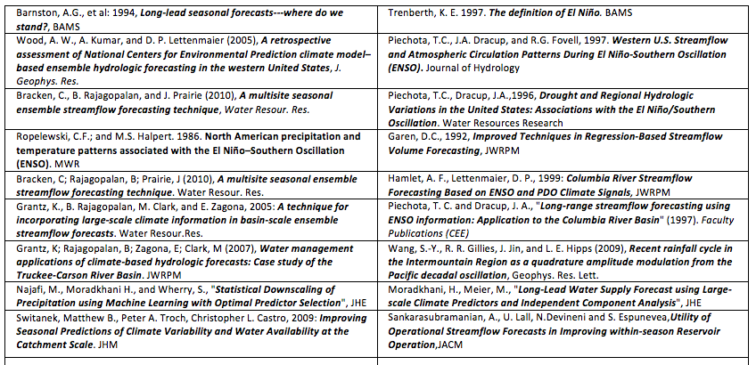
Where are we now?
15 years of applied climate and flow forecasting research pertaining to western US
Variable use of findings within operational water prediction and management
One of the biggest usage gaps: the upper Colorado River Basin
Motivation: Increasing scrutiny of Colorado River water management

Slide 5

No lack of capacity, interest, or will e.g., NWS ESP
ESP Analysis and Display Program (ESPADP) development started
Work to incorporate climate forecasts
NWS/HRL begins ESP development
ESP used for drought assessment
Climate Prediction Center (CPC) forecast pre-adjustment developed for use in ESP
ESP released with NWSRFS
1970
1980
1990
2000
ESP first used at California-Nevada River Forecast Center
Water Resources Forecasting Services (WARFS) quantifies value of ESP
ESP used for water supply forecasts
ESP first presented at the Western Snow Conference
ESPADP deployed to the field
Experimental Ensemble Forecast System (XEFS) work begins
Medium to long-range ESP
short-medium-long range ESP
Western Snow Conference paper, 1977

Slide 6
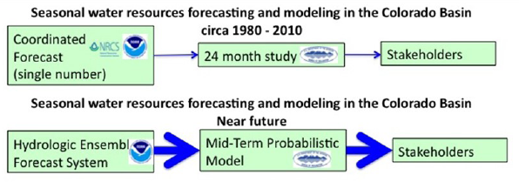
Water Supply Decision Support
The
past
The
future
Efforts in parallel --
CBRFC working to improve probabilistic flow forecasts
BOR working to implement probabilistic water management model

Slide 7
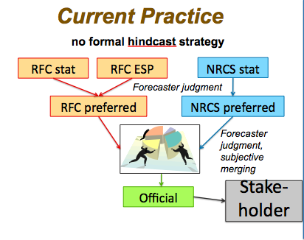
Past CBRFC Methods
Official forecasts coordinated each month with NRCS/NWCC
Skill primarily from accumulating snow pack
Updated monthly or semi-monthly
Probabilistic but not ensemble based
Not repeatable
Subjective
Forecaster Role:
  Monitor forecast process and system
  Add judgement to forecast process

Slide 8
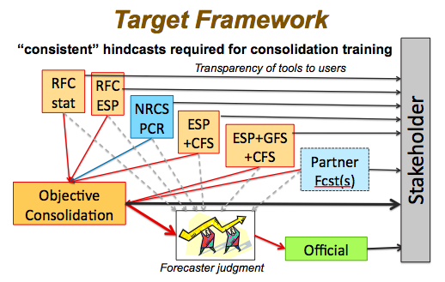
Future CBRFC Methods
Objective, repeatable ensemble forecasts
Integrate skill from weather and climate predications
Tailor to stakeholder thresholds and concerns
Forecaster role:
  Monitor forecast process and system
  Apply judgement (less frequently?)
  Decision support
  Work to improve forecast system and processes based on objective standards
  Follow best practices identified by CPC

Slide 9
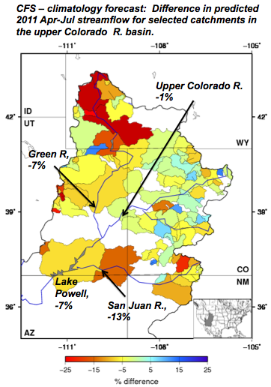
Examples of Experimental Ensembles
CFS-based ensemble forecasts for Apr-Jul 2011 for upper Colorado river basins issued in Dec. 2010 show deficits compared to climatology-based forecasts
Working on verification, diagnosis of WY2011 results during experimental implementation period
Average contribution to Lake Powell Apr-Jul inflow:
  Green River 34%
  Colorado River 50%
  San Juan River 13%
9

Slide 10
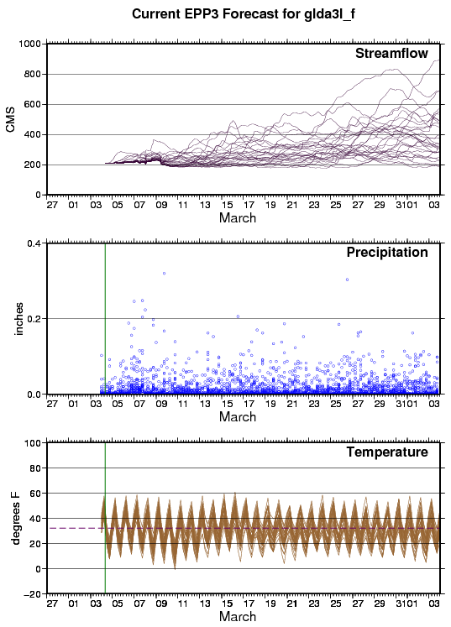
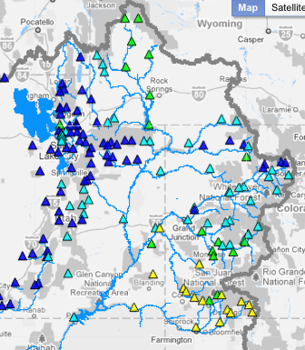
Example of Experimental Ensembles
GFS and/or CFS based ensembles: CBRFC & CNRFC experimental products updated daily
Flow into Lake Powell
GFS
CFS
Contact: Andy Wood (Andy.Wood@noaa.gov)
10

Slide 11
U of Arizona effort:
Matt Switanek, Peter Troch
Goal: Long lead precipitation / temperature forecasts for the Colorado Basin with improved skill over CPC forecasts
Method: Statistical approach based on March – August global SST anomalies predicting Oct-Mar Precipitation and Temperature anomalies over major Colorado river sub-basins
Results: Found improvement over CPC forecasts at the climate division scale

Slide 12
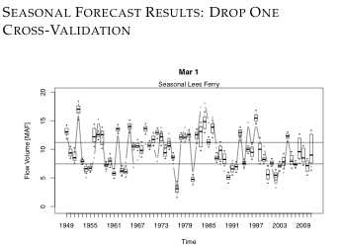
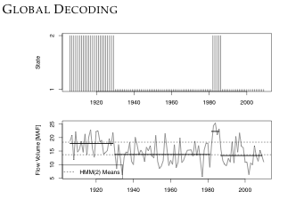
U of Colorado effort:
Bracken, Caraway, Rajagopalan
Goals: (1) Improved probabilistic seasonal predictions, (2) 2 year predictions, (3) streamflow simulations for operations planning
Methods: Various statistical approaches for all goals including time series methods, regression, hidden markov models
Results: (1) Assessed skill of seasonal streamflow forecasts at various sub basins, (2) Identified “hidden states” of Colorado River time series through hidden markov models

Slide 13
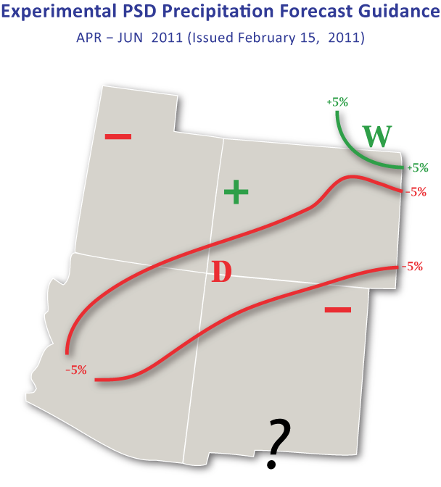
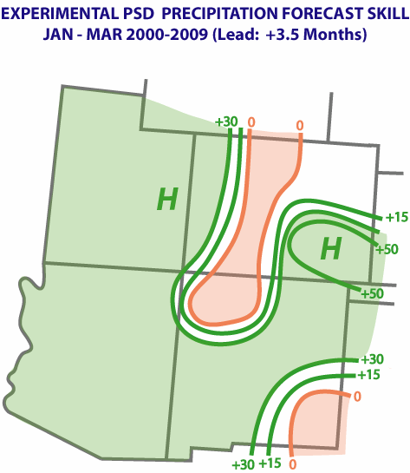
CIRES effort:
Wolter
Goal: Seasonal predictions for precipitation, temperature, and eventually streamflow
Method: Stepwise linear regression based on “flavors of ENSO and non-ENSO teleconnections” to gridded time series, streamflow time series, and modified climate division time series
Results: Seasonal predictions dating back to 2000 with some verification based on the

Slide 14
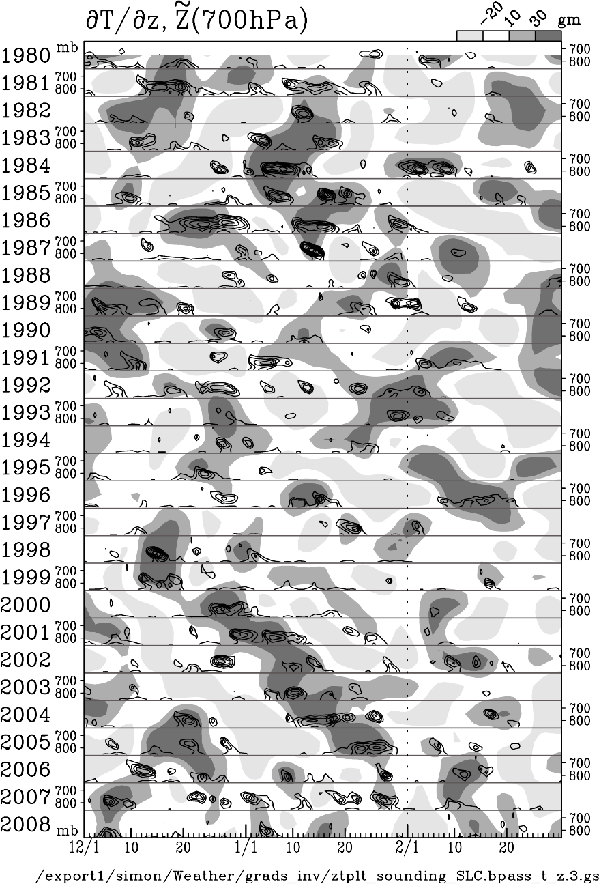
USU Effort:
Gillies and Wang
Goals: Seasonal and longer lead prediction of various climate variables
Method: Apply various statistical techniques including principle component – lagged regression combined model to climate datasets
Results: Seasonal predictions for climate variables such as SLC inversions and longer frequency time series analyses on Utah specific climate datasets such as Great Salt Lake Level

Slide 15
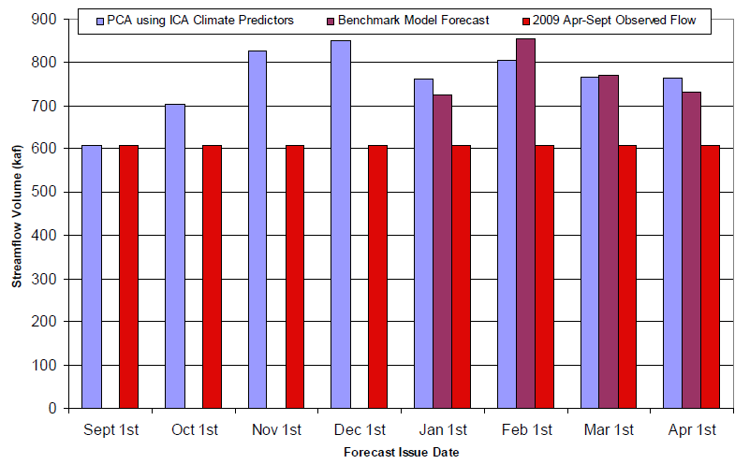
PSU Effort:
Moradkhani
Goal: Seasonal prediction of water supply based on traditional predictors AND climate information
Method: Traditional statistical regression-based models are compared with statistical models such as PCR, PCA, PSLR, PRESS (Prediction Residual Sum of Squares), and Independent Component Analysis (ICA)
Results: Results from the Pacific Northwest compare favorably against official NRCS/NWS coordinated forecasts
Yakima River Basin
Rogue River Basin
BE
BE
BE = Benchmark Efficiency which compares against reference forecasts
Forecast Issue Date
Forecast Issue Date

Slide 16
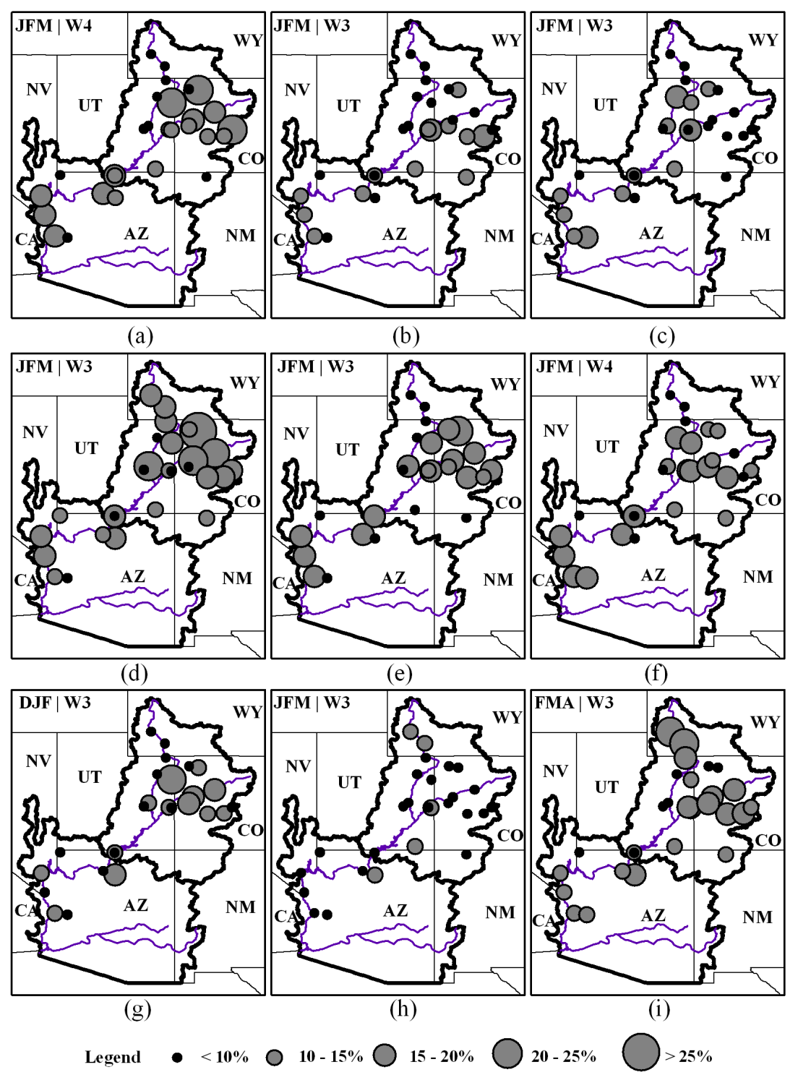
UNLV Effort:
Lamb, Piechota
Goal: Seasonal prediction of water supply based on climate information
Methods: (1) Support Vector Machine, (2) Weighted resampling of observed naturalized streamflow
Results: Results show skill at major streamflow points using LEPS
0 Lag
1-yr Lag
2-yr Lag
Alternative 1
Alternative 2
Alternative 3

Slide 17
Testbed Motivation and Objectives
Motivation:
- Research methods can appear useful in literature, but inference of benefit for operational prediction is typically difficult. Time and space scales may not match. Data used in research may not be available in real time. Research work often not benchmarked against operational products or even against other research efforts.
Objectives:
- reflect the forecasting challenge that’s important to RFC and stakeholders, e.g.,
- initialization times (Aug 1 … July 1)
- predictands in time: sub-seasonal, seasonal, year 2
- predictands in space: catchments driving management
- be consistent with pathways available for innovation
- educate research community about operational constraints
- synchronize research/development in CBRFC and NWS with research outside
- establish baselines for state of practice
- make similar approaches relevant and inter-comparable
- common metrics as well as predictands
- educate research community about operational constraints
- common portal for Datasets and Methods
- determine relative strengths and weaknesses – there is likely to be no clear “best”

Slide 18
Participants and Roles
Researchers / Explorers
  academic, agency
  - illustrate proof of concept
  - push further into comparative evaluation
Operational partners
  “transition agents”
  - wire-up the linkages for operational implementation
  - stakeholder outreach
Stakeholders
USBR, forecasters
- define objectives
- critical oversight and feedback

Slide 19
CRFS Discussion
What are the key capabilities missing from the current CBRFC/USBR forecast operations planning paradigm?
What input do you have on the testbed activities?
What would success look like?
CRFS Meeting:
  What value do you get from this meeting?
  How can this meeting help move the forecast/management enterprise into the future?

