Slide 1
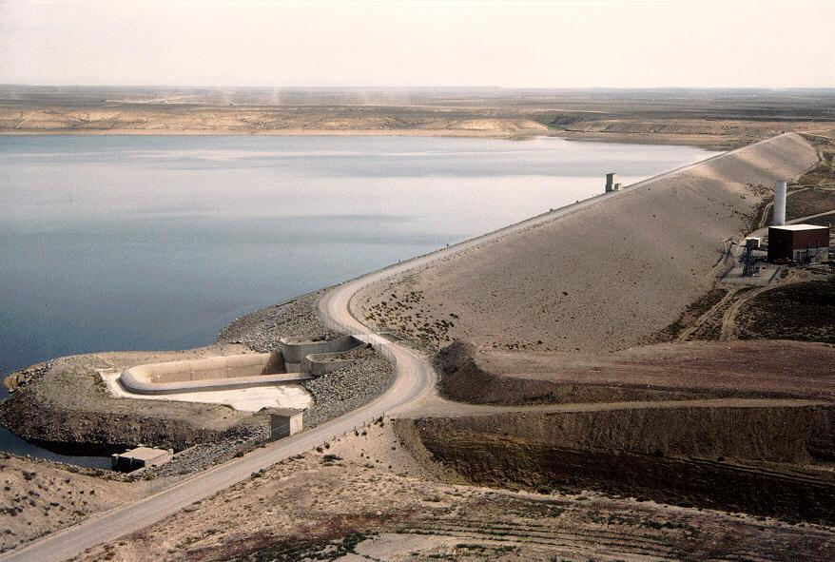
Fontenelle Working Group Meeting
August 18, 2011
Katrina Grantz, PhD Upper Colorado Region Hydraulic Engineer

Slide 2
Water Year 2011
Operations Review

Slide 3
Observed Snowpack Water Year 2011
Snowpack peaked larger and later than usual

Slide 4
Observed Inflow and Release
2009 Apr-Jul Inflow 968KAF (113%)
2011 Apr-Jul Inflow 1221 KAF (142%)
Inflows came larger and later than ususal,
Worry about how much snow actually resided at high elevations
Moved water early to manage risk
2010 Apr-Jul Inflow 488 KAF (57%)

Slide 5
Observed Reservoir Elevation
Drew down reservoir as low as possible (close to losing unit and boat ramps)

Slide 6
Water Year 2012
Projected Operations

Slide 7
Release Scenarios Water Year 2012
Wet soil moisture and relatively high WY forecast→ relatively high fall/winter releases to achieve reservoir drawdown by next spring. (Last year was 1,050 cfs)
Projected Release
Fall / Winter
1,200 cfs

