Slide 1
USBR Updates:
Green River
CRFS Meeting Nov 8, 2011

Slide 2
Green River Operations
Fontenelle
Flaming Gorge
Spring
Base flows
Process
WY 2012

Slide 3
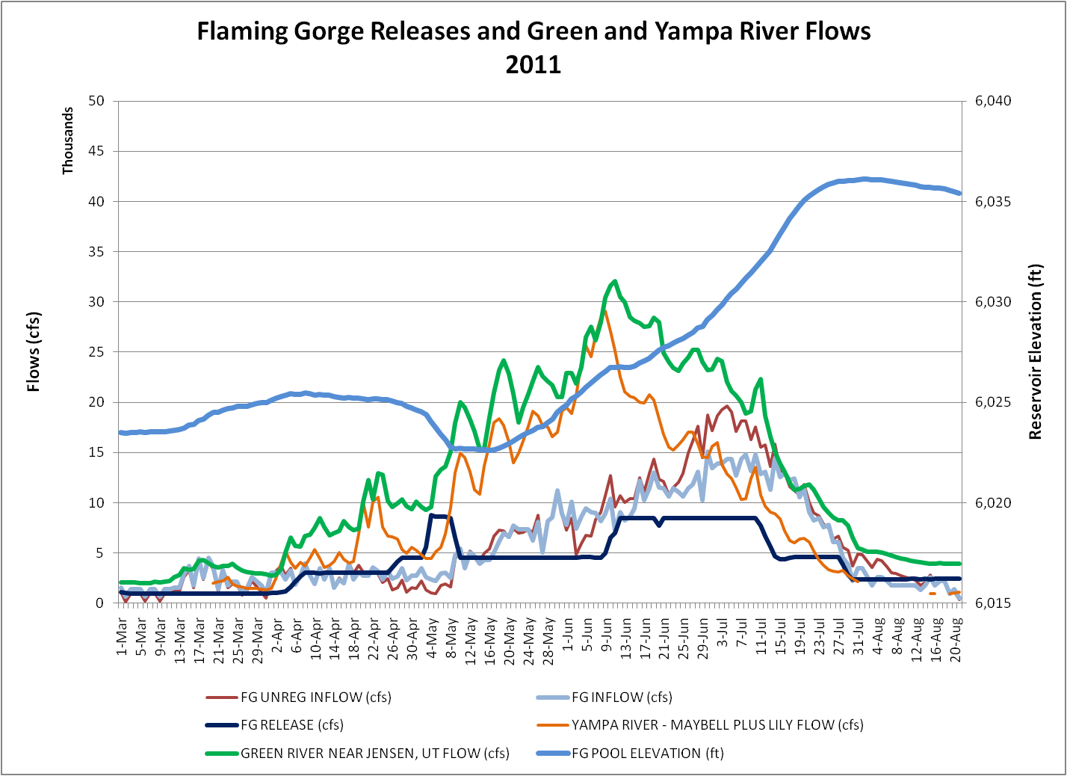
Spring 2011 Hydrograph
FG at Powerplant – 91 Days
FG at Bypass – 35 Days
Jensen >= 15,000 cfs – 68 Days
Jensen >= 18,600 cfs – 58 Days
Jensen >= 22,700 cfs – 36 Days
Jensen >= 26,400 cfs – 15 Days

Slide 4
FG Spring Stories
Spillway Drama
Concrete spalling
Cattlemen’s association
RIP Larval Trigger Experiment

Slide 5
FG Base Flows
Autumn and winter flexibility
Autumn variation of ±40%
Winter variation of ±25%
Current average release 1,500 cfs
Argonne research
Stator wedges
Western has requested monthly variations
December 1,175 cfs average
January 1,875 cfs average
February 1,500 cfs average

Slide 6
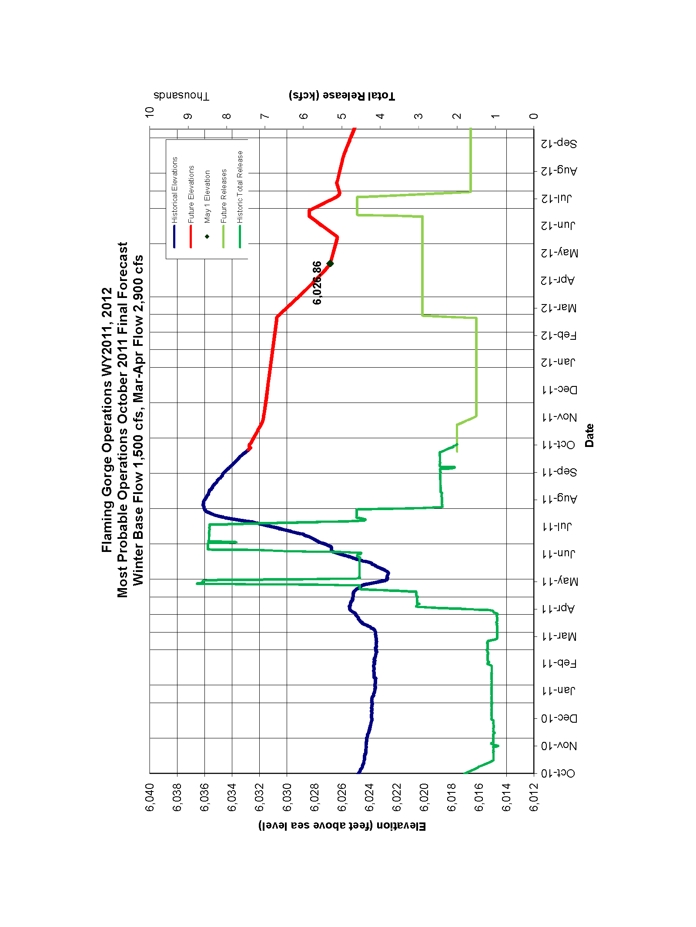
Operations Forecast

Slide 7
Operations Forecast

Slide 8
Flaming Gorge Process

Slide 9
FG WY 2012
March and April large releases
Potential larval trigger for release later in the season

