Slide 1

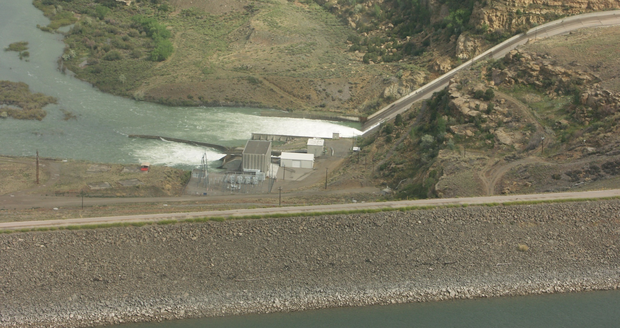
Navajo Reservoir Operations
CRFS Technical Committee
November 8, 2011
Fall Technical Meeting

Slide 2
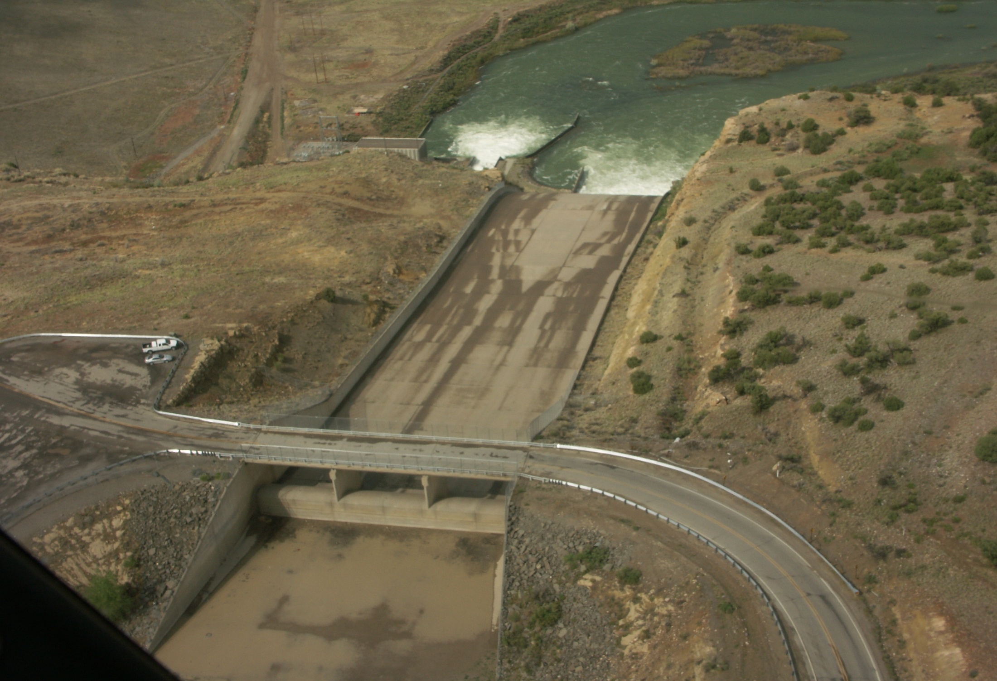
Review of
Water Year 2011
Operations

Slide 4
AVAILABLE WATER (April) PATH
Min Prob: 376,960 af #2
Most Prob: 500,429 af #2
Max Prob: 643,061 af #2

Slide 7
Chasing the Target Baseflow
Temporary increases to 650 cfs were required in mid April and early May due to late runoff and dry conditions
Base releases remained at 500 cfs until August 9th
Late runoff kept the river within Target Base Flow range without additional releases later than usual
Increased release to 800 cfs on August 9th, up to 900 cfs on August 17th
Returned to 500 cfs base release on October 6th.
Reduced release to 350 cfs for trout habitat improvements (should be complete by December)

Slide 9
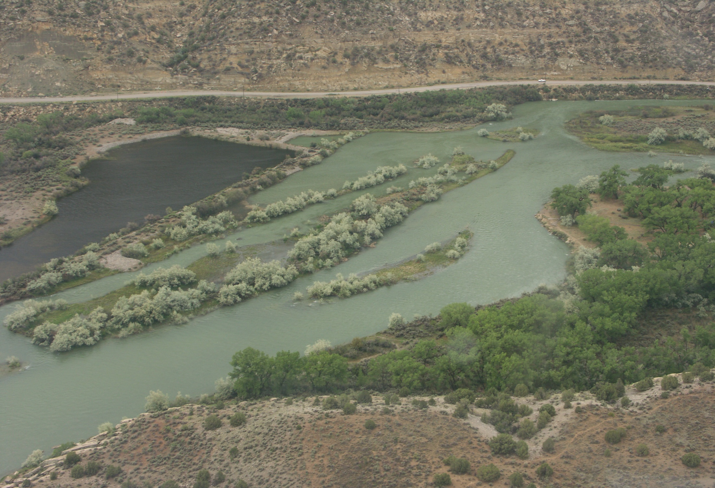
Navajo Current Conditions
(as of 11/7/2011)
Elevation = 6058.4 (97% of Average)
Storage = 1,327,727 af (78% Full)
Inflow = 485 cfs
Release = 350 cfs
NIIP = 6 cfs (Not Diverting)
San Juan-Chama Diversion = 16 cfs

Slide 10
Western Colorado Area Office Contact:
Ryan Christianson
970-385-6590, rchristianson@usbr.gov

Slide 11
Forecasting Challenges
Over forecasting in the winter/early spring
Animas @ Farmington forecast point

Slide 12
Actual Inflow – 576,275 af (78% of Average)

