Slide 1

CRFS Technical Meeting
LC Operations Update
November 8, 2011

Slide 2
Topics
Operations Update
Real-time Evaporation Project
Lake Mead Bathymetry

Slide 3
End of Water Year 2011 Conditions
Observed Unregulated Inflow into Powell = 16.77 maf (139% of average)
Lake Mead
Lake Powell
1,220
25.877 maf
24.322 maf
3,700
16.36 maf
3,653.0 feet
17.59 maf in storage
72% of capacity
3,643
1,145
15.9 maf
1,116.0 feet
12.98 maf in storage
50% of capacity
9.5 maf
3,575
1,075
9.4 maf
12.52 maf
1.16 maf
0.0 maf
3,370
895
0.0 maf
1.9 maf
2.0 maf
Dead Storage
Dead Storage
Not to Scale
Notes:
These “teacup” diagrams represent the coordinated operations of Lake Powell and Lake Mead in water year 2011 under the Interim Guidelines in the June 2011 24-Month Study most probable inflow scenario.
All volumes are in million acre-feet (maf) and all elevations are in feet above mean sea level (feet).
Lake Powell Teacup:
With a projected unregulated inflow of 16.65 maf (138% of average) and an annual release volume of 12.44 maf in water year 2011, the elevation of Lake Powell is projected to be 3,660.94 feet (77% of capacity) on September 30, 2011.
Lake Mead Teacup:
With a projected release volume from Lake Powell of 12.44 maf, projected intervening flows into Lake Mead of 1.07 maf, and a projected release volume of 9.69 maf from Lake Mead in water year 2011, the elevation of Lake Mead is projected to be 1,115.5 feet (50 percent capacity) on September 30, 2011.

Slide 4
End of Water Year 2011
Lake Mead elevation end of WY 2011: 1116.04 feet
Water Use in the Lower Basin has been lower than expected in CY 2011
  California and Nevada are currently projected to come in under their annual apportionments
  Mexico deliveries are expected to be reduced this year under provisions of Minute 318
Over the past water year, Lake Mead’s surface water elevation has increased approximately 38.64 feet
Despite wet conditions in the Upper Colorado River Basin, the Lower Colorado River Basin remained dry and hot

Slide 5
Lower Basin Side Inflows
Glen Canyon to Hoover in WY/CY 2011^{1,2}
Month in WY/CY 2011 |  | Intervening Flow Glen Canyon to Hoover (KAF) | Intervening Flow Glen Canyon to Hoover (% of Average) | Difference From 5-Year Average (KAF)
H I S T O R Y | October 2010 | 80 | 136% | +21
 | November 2010 | 13 | 27% | -35
 | December 2010 | 248 | 251% | +149
 | January 2011 | 74 | 97% | -2
 | February 2011 | 84 | 91% | -8
 | March 2011 | 77 | 96% | -3
 | April 2011 | 140 | 233% | +80
 | May 2011 | 104 | 212% | +55
 | June 2011 | 72 | 313% | +49
 | July 2011 | 74 | 148% | +24
 | August 2011 | 96 | 89% | -13
 | September 2011 | 94 | 134% | +24
 | October 2011 | 65 | 110% | +6
P R J | November 2011 | 48
 | December 2011 | 99
WY11 Totals |  | 1,156 | 142% | +341
CY11 Totals |  | 1,027 | 126% | +212
¹ Values were computed with the LC’s gain-loss model for the most recent 24-month study.
² Percent of average are based on the 5-year mean from 2006-2010 in CY 2011.

Slide 6
Water Year 2012 Projected Operations
August 2011 Most Probable 24-Month Study projected Lake Mead elevation on Jan 1, 2011 to be 1134.12 feet
  Currently projecting 1133.92 feet
ICS Surplus Condition to govern Lake Mead operations
Mexico deliveries may be reduced
  Minute 318 signed to allow Mexico to store up to 260 KAF through 2013

Slide 8
August 2011 Results from CRSS
Probabilities of occurrence, values in percent
 | Event or System Condition | 2012 | 2013 | 2014 | 2015 | 2016
Upper Basin | Equalization release from Powell | 100 | 57 | 54 | 52 | 45
 | Balancing release from Powell | 0 | 0 | 1 | 2 | 4
 | 8.23 maf release from Powell | 0 | 43 | 45 | 39 | 42
 | 7.48 maf release from Powell | 0 | 0 | 0 | 7 | 9
 | 7.00 maf release from Powell | 0 | 0 | 0 | 0 | 0
Lower Basin | Shortage – any amount (Mead ≤ 1,075) | 0 | 0 | 0 | 1 | 7
 | Shortage – 1st level (Mead ≤ 1,075 and ≥ 1,050) | 0 | 0 | 0 | 1 | 7
 | Shortage – 2nd level (Mead < 1,050 and ≥ 1,025) | 0 | 0 | 0 | 0 | 0
 | Shortage – 3rd level (Mead < 1,025 ) | 0 | 0 | 0 | 0 | 0
 | Surplus – (Domestic, Quantified, or Flood Control) | 0 | 43 | 47 | 45 | 46
 | Surplus – Flood Control | 0 | 1 | 4 | 7 | 10
 | Normal or ICS Surplus | 100 | 57 | 53 | 54 | 48

Slide 9
Lower Basin Surplus & Shortage through 2026
Notes:
9

Slide 10
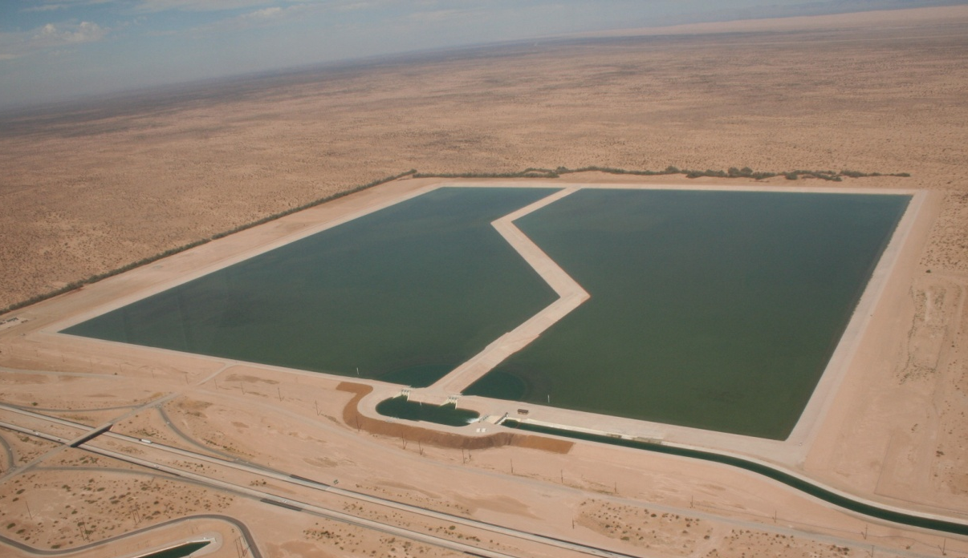
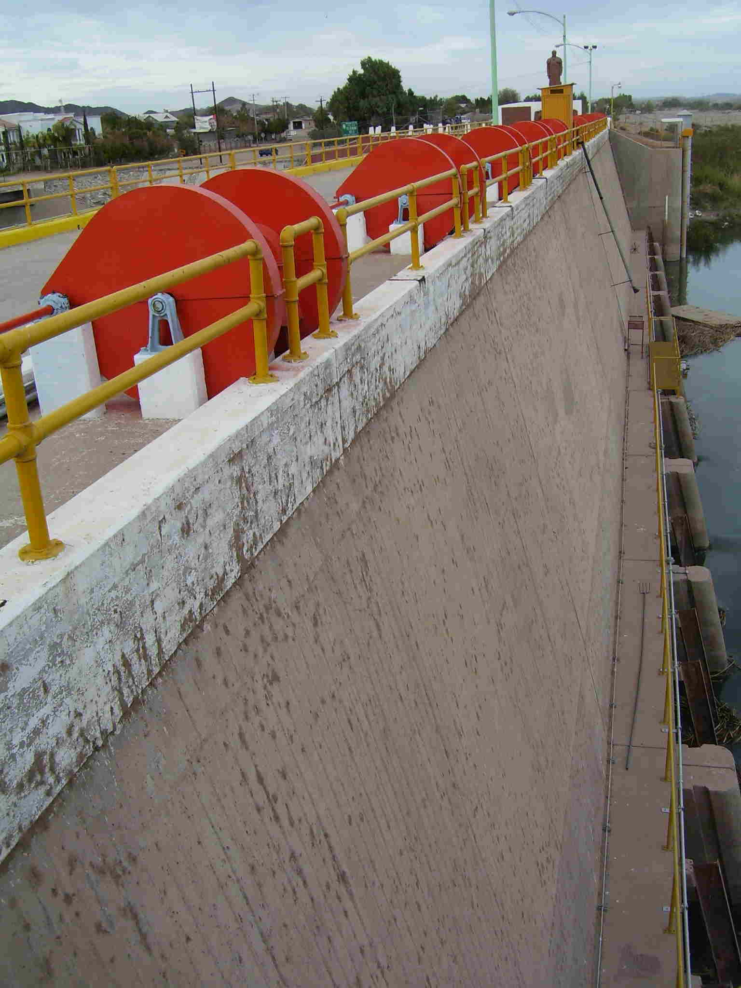
YAO Operations Update
Brock and Senator Wash conservation year-to-date through November 3, 2011
  Brock 105,500 AF
  Senator Wash 92,300 AF
Excess Flows to Mexico year-to-date through November 6, 2011
  62,982 AF
¹ All values are provisional

Slide 11
Real Time Evaporation At Lake Mead
5-Year cooperative project with the USGS
Measure and obtain hourly evaporation rates (and other parameters) from Lake Mead
Develop new monthly coefficients for use in long-term modeling efforts
Maintain program into the future

Slide 12
Comparison to Evaporation Rates in 24 Month Study
Month | 24-Month Study | USGS Measured | Difference
Mar 2010 | 33 | 28 | 5
Apr 2010 | 41 | 36 | 5
May 2010 | 47 | 47 | 0
Jun 2010 | 55 | 49 | 6
Jul 2010 | 68 | 66 | 2
Aug 2010 | 70 | 73 | -3
Sep 2010 | 59 | 61 | -2
Oct 2010 | 42 | 55 | -13
Nov 2010 | 42 | 55 | -13
Dec 2010 | 37 | 30 | 7
Jan 2011 | 31 | 20 | 11
Feb 2011 | 29 | 31 | -2
Mar 2011 | 33 | 25 | 8
Apr 2011 | 40 | 34 | 6
May 2011 | 47 | 46 | 1
Jun 2011 | 57 | 52 | 5
Jul 2011 | 73 | 54 | 19
Aug 2011 | 80 | 61 | 19
Sep 2011 | 67 | 54 | 13
*provisional

Slide 13
Impacts
Will reduce error associated with 24-Month Study side inflow to Lake Mead term
Since February 2010, average difference is about 4 KAF, or a total of 73 KAF
New monthly coefficients for use with Lake Mead Evaporation will be derived
Lower Basin is actively working with CBRFC to forecast side inflows as well
Would like to keep project going, and expand to Lake Mohave

Slide 14
Area-Capacity Update
Developed with 2001 underwater bathymetric survey and 2009 LiDAR survey
LCRO-GIS completed a thorough review and re-derived final surface area and capacity tables
External review by Reclamation’s Provo office
  Methodology determined to be sound
Impacts Analysis
  Comparison against 1963 data
  Sensitivity analysis: 24-Month Study and CRSS
Report Finalized
  Available at: http://www.usbr.gov/lc/region/g4000/LM_AreaCapacityTables2009.pdf
Implementation Date January 1, 2012

Slide 18
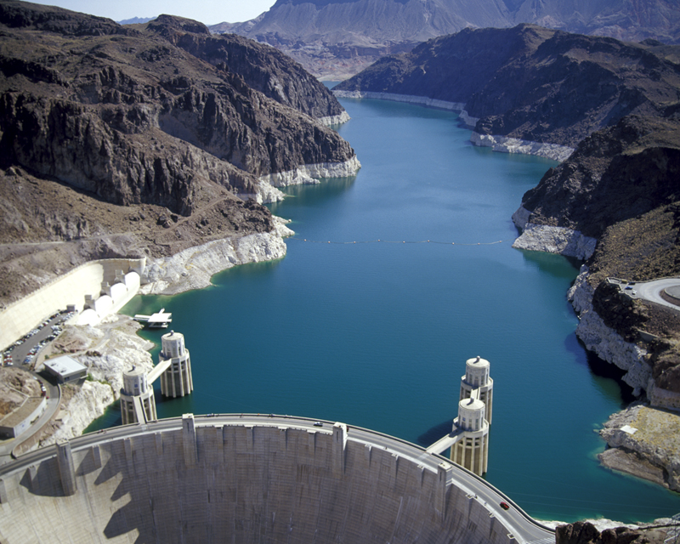
Lower Colorado River
Operations
For further information: http://www.usbr.gov/lc/region

