Slide 1
Water Year 2012: Current Conditions and Forecasts in the Colorado River Basin
CRFS
November 8, 2011

Slide 2
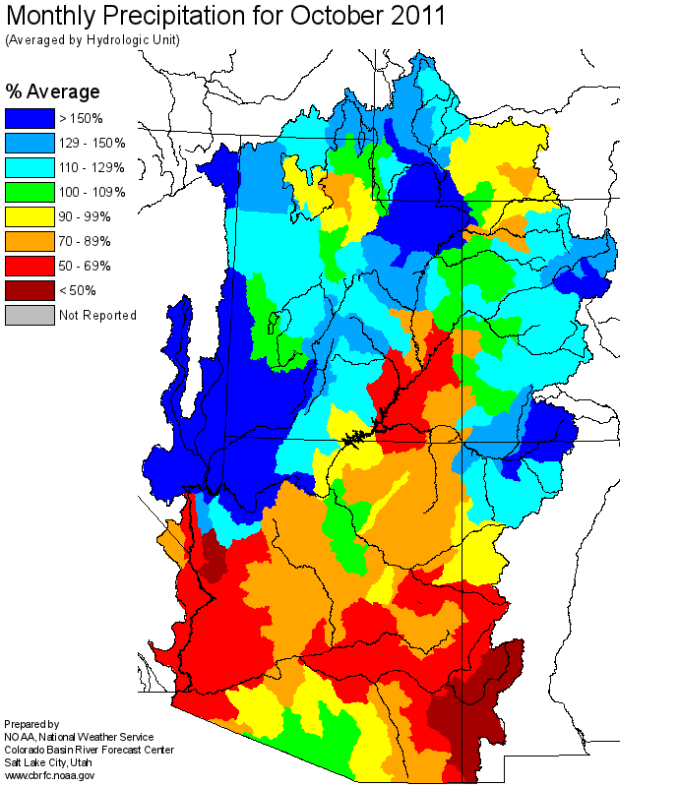

Slide 3
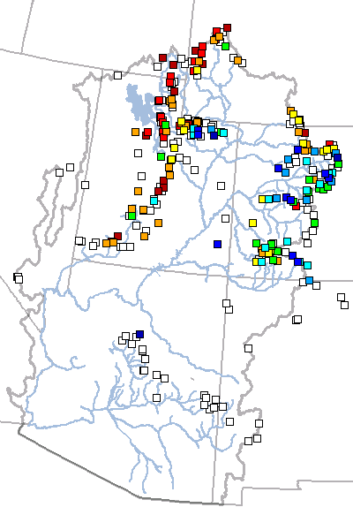
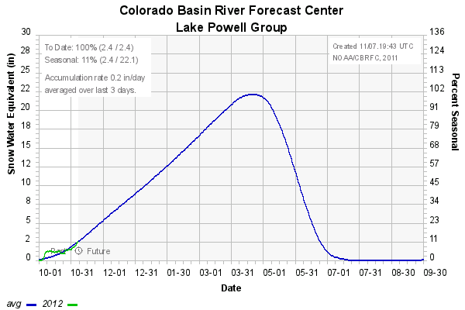
Current Snow
Snow Point Classification: Percent Average
NA < 25% 25-50% 50-75% 75-90% 90-110% 110-125% 125-150% 150-175% >175%
November 7, 2011

Slide 4
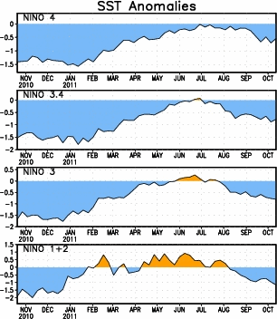
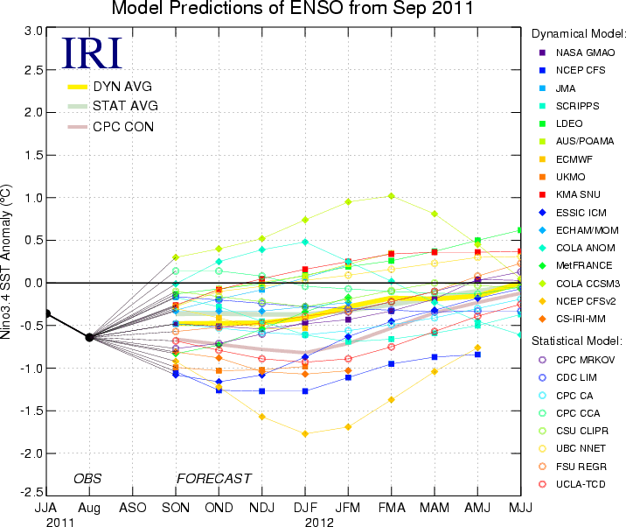
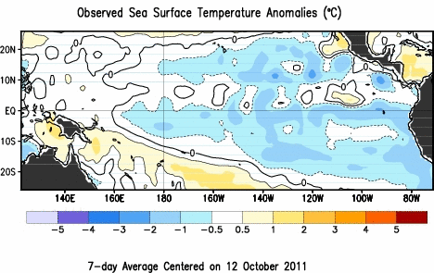
La Nina
Sources: cpc.ncep.noaa.gov and iri.columbia.edu/climate/ENSO

Slide 5
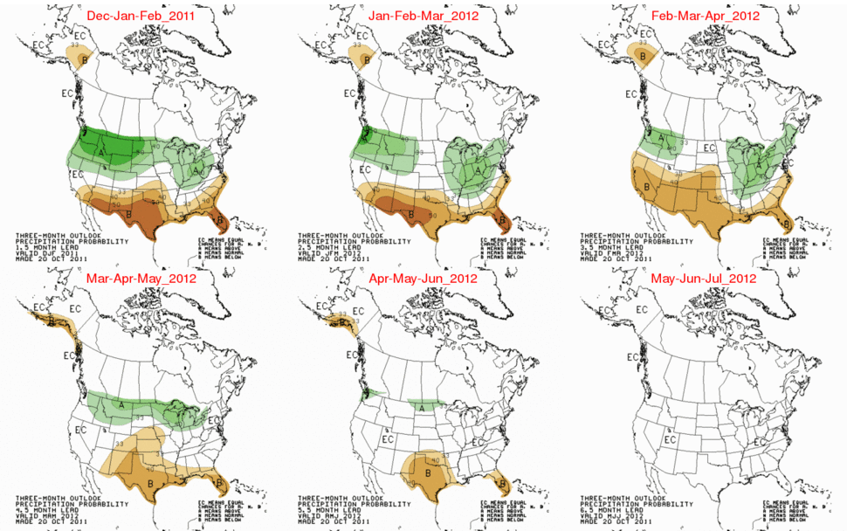

Slide 6
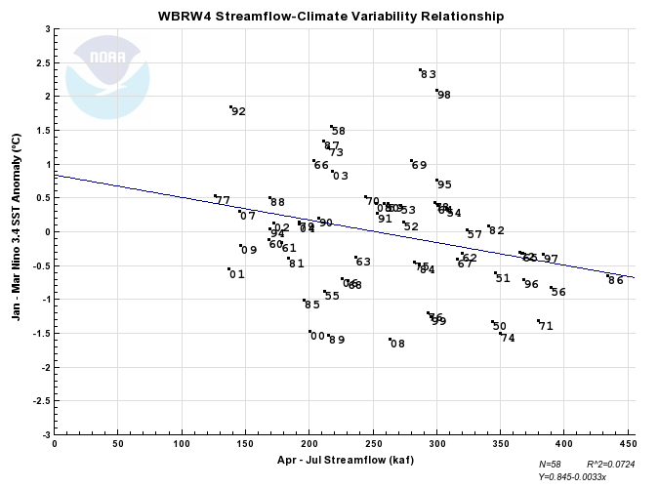
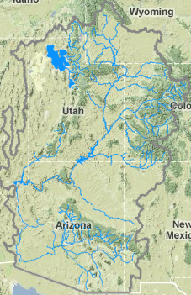
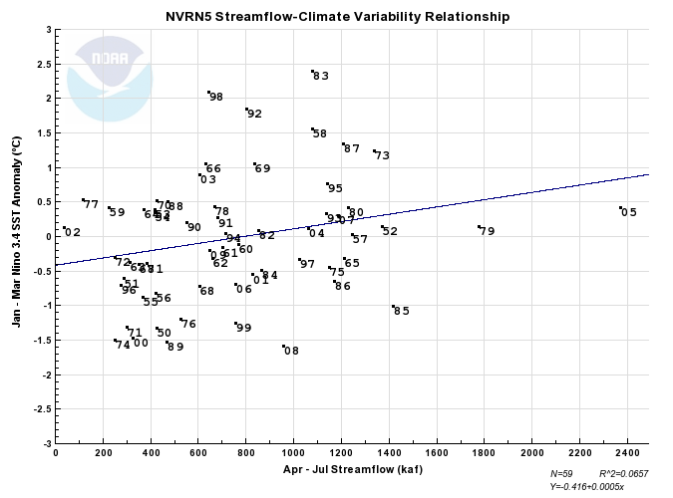
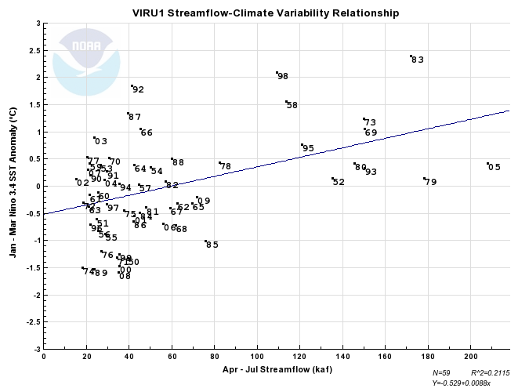
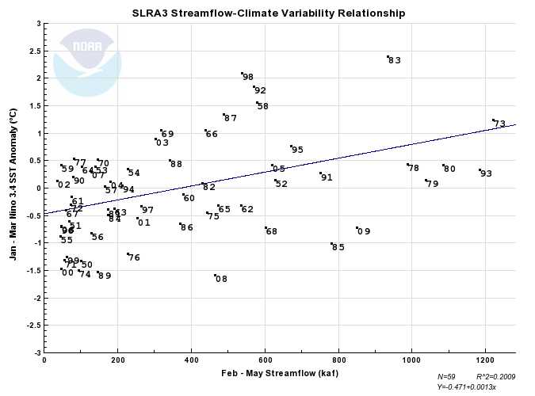
La Nina and Streamflow

Slide 7
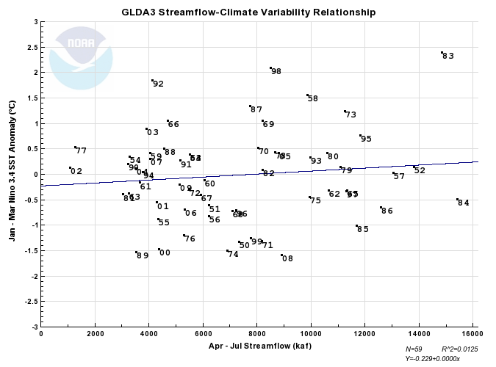
La Nina and Streamflow
Very low correlations in most of upper basin (right: Lake Powell)
La Nina correlated with low streamflow in lower basin at around 0.2 – 0.3
Weaker correlations for San Juan Basin with low streamflow and Upper Green with high streamflow
2012 forecast

Slide 8
Historical Observed Apr-Jul Volumes (kaf) 1970-2010 (winter ENSO status)
( 1) - 1984 - 15406.41 (neutral)
( 2) - 1983 - 14838.93 (el nino)
( 3) - 1986 - 12601.21 (neutral)
( 4) - 1995 - 11833.18 (el nino)
( 5) - 1985 - 11701.11 (la nina)
( 6) - 1997 - 11320.89 (neutral)
( 7) - 1973 - 11262.74 (el nino)
( 8) - 1979 - 11104.25 (neutral)
( 9) - 1980 - 10606.60 (neutral)
( 10) - 1993 - 9984.42 (neutral)
( 11) - 1975 - 9953.16 (la nina 2)
( 12) - 2008 - 8908.50 (la nina)
( 13) - 2005 - 8844.02 (el nino)
( 14) - 1978 - 8678.09 (el nino 2)
( 15) - 1998 - 8510.14 (el nino)
( 16) - 1982 - 8210.63 (neutral)
( 17) - 1971 - 8180.35 (la nina)
( 18) - 1970 - 8037.76 (neutral)
( 19) - 2009 - 7806.72 (neutral)
( 20) - 1999 - 7788.09 (la nina)
( 21) - 1987 - 7758.54 (el nino)
( 22) - 1996 - 7233.47 (la nina)
( 23) - 1974 - 6915.13 (la nina)
( 24) - 2010 - 5795.43 (el nino)
( 25) - 1972 - 5494.26 (neutral)
( 26) - 2006 - 5319.56 (neutral)
( 27) - 1976 - 5297.75 (la nina 3)
( 28) - 1991 - 5159.33 (el nino)
( 29) - 1988 - 4567.47 (el nino 2)
( 30) - 2000 - 4367.05 (la nina 2)
( 31) - 2001 - 4320.62 (la nina 3)
( 32) - 1992 - 4124.42 (neutral)
( 33) - 2007 - 4053.47 (el nino)
( 34) - 2003 - 3910.17 (el nino)
( 35) - 1994 - 3766.48 (neutral)
( 36) - 2004 - 3542.00 (neutral)
( 37) - 1989 - 3524.63 (la nina)
( 38) - 1990 - 3228.85 (neutral)
( 39) - 1981 - 3058.61 (neutral)
( 40) - 1977 - 1277.39 (el nino)
( 41) - 2002 - 1126.76 (neutral)
Multi-year La Nina’s:
1950 – 7.3 maf
1951 – 6.2 maf
1955 – 4.3 maf
1956 – 6.2 maf
1974 – 6.9 maf
1975 – 10.0 maf
1976 – 5.3 maf
1999 – 7.8 maf
2000 – 4.4 maf
2001 – 4.3 maf
2011 – 12.9 maf
2012 – ???

