Slide 1
Modeling Updates
CRFS—Technical Meeting
November 14, 2012

Slide 2
Forecasting and Modeling Updates
24-Month Study
Recent Enhancements (implemented May 2012)
Potential Enhancements
Mid-Term (Probabilistic) Operations Model (MTOM)

Slide 3
Recent Enhancements (implemented May 2012)

Slide 4
24-Month Study Recent Enhancements
No changes to methods or modeling assumptions
No changes to model results
Purpose of enhancements
“Clean Up” Model Workspace
Improve Transparency, Consistency, Efficiency

Slide 5
24-Month Study Recent Enhancements
“Clean Up” Model Workspace
Remove unused data objects
Remove “unused” and misleadingly named reach object
Improve transparency of model
Rename objects to more intuitive and descriptive names
Make 24-Month Study and MTOM more consistent
Yearly data slots vs repetitive monthly data slots
Added efficiencies to process
Ruleset in “reverse” priority order
Added Lower Basin Surplus rules
Notes:
Surplus rules: now we don’t have to manually enter the schedules into the model and sets the surplus operation.

Slide 6
Potential Enhancements

Slide 7
24-Month Study Potential Enhancements
Lees Ferry Intervening flows
Changes to reporting
Changes to model configuration to support reporting
No changes to methods or modeling assumptions
No changes to model results
Purpose of enhancements
More accurately project future flow at Lees Ferry streamgage
Fix “double reporting” of historic flows between Glen Canyon Dam and Lees Ferry streamgage
Improve transparency and consistency

Slide 8
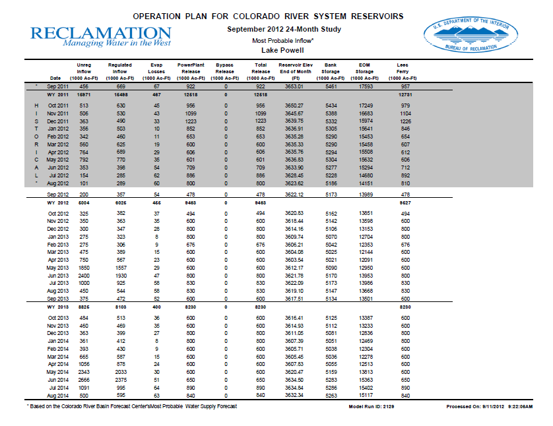
24-Month Study Report Lake Powell Page
Lees Ferry Column
Current:
Future Flow = GCD release
Potential Change:
Future flow = GCD release + 5-yr avg of intervening flow

Slide 9
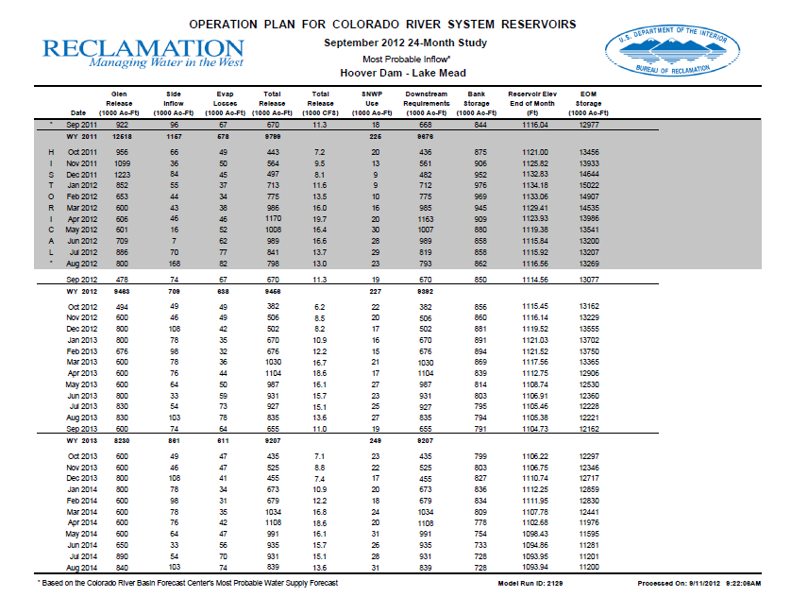
24-Month Study Report Lake Mead Page
Side Inflow Column
Current:
Side Inflow = 5-yr avg of (side inflows above Lees Ferry + side inflows below Lees Ferry)
Potential Change:
Side Inflow = 5-yr avg of side inflows below Lees Ferry

Slide 10
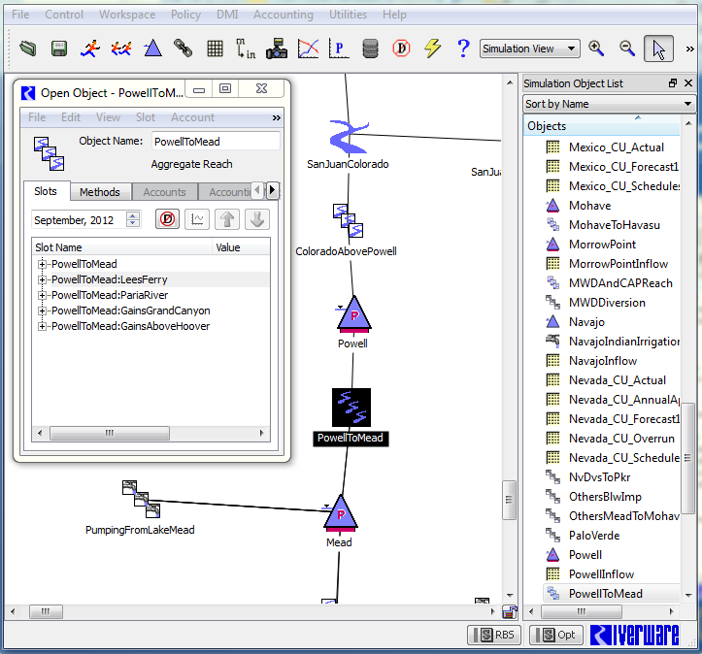
24-Month Study Model Configuration
Add additional Reach to PowellToMead Aggregate Reach
Separates out flows
Sum of reaches remains the same
Modify Data Management Interfaces (DMIs)
move data from model to report
“Mock up” of potential change to model

Slide 11
24-Month Study Potential Enhancements
Lees Ferry Intervening flows
Changes to reporting
Changes to model configuration to support reporting
No changes to methods or modeling assumptions
No changes to model results
Potential Implementation: Jan/Feb 2013

Slide 12
Questions?

