Slide 1

Modeling Development
CRFS—Technical Meeting
November 14, 2012

Slide 2
Mid-Term Operations Model (MTOM) Update

Slide 3
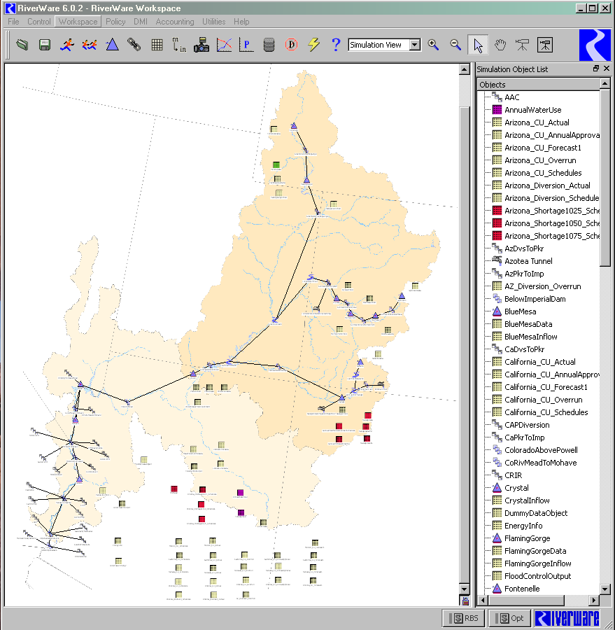
MTOM- Overview
Based on 24-Month Study, but able to simulate multiple traces for a probabilistic output and analysis
MTOM is additional tool to evaluate risk and uncertainty in Colorado River Basin
24-Month Study is still official model for operational tier determinations

Slide 4
MTOM - Current Status
UC/LC operators validating MTOM outputs
  Comparison against official 24–Month Study
  Refine model inputs and rules to improve operations planning
Expect to be ready to share *preliminary* multiple trace results with stakeholders in late 2012
  No change since last update
Expect to share *draft* model, ruleset and documentation with interested technical stakeholders in late 2012 or early 2013
  Basic functionality
  Development will continue

Slide 5
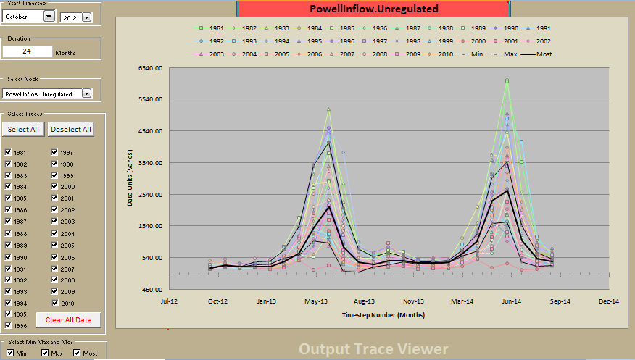
MTOM Updates - Inflows
Bias corrected inflows
  Previously used raw ESP output
  Did not match official forecasts used in 24MS
  Improved consistency of inflow assumptions

Slide 6
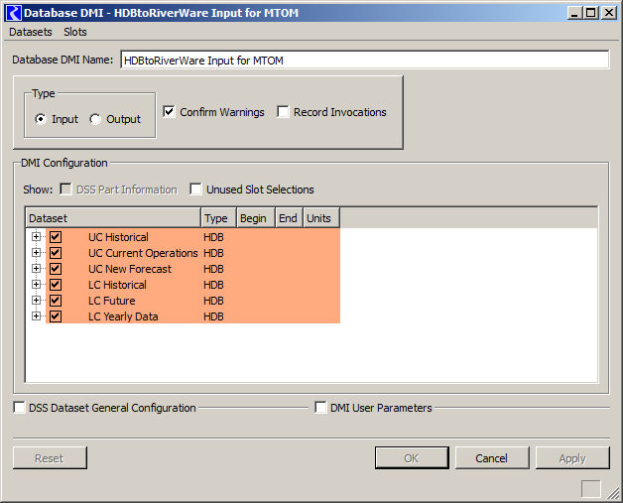
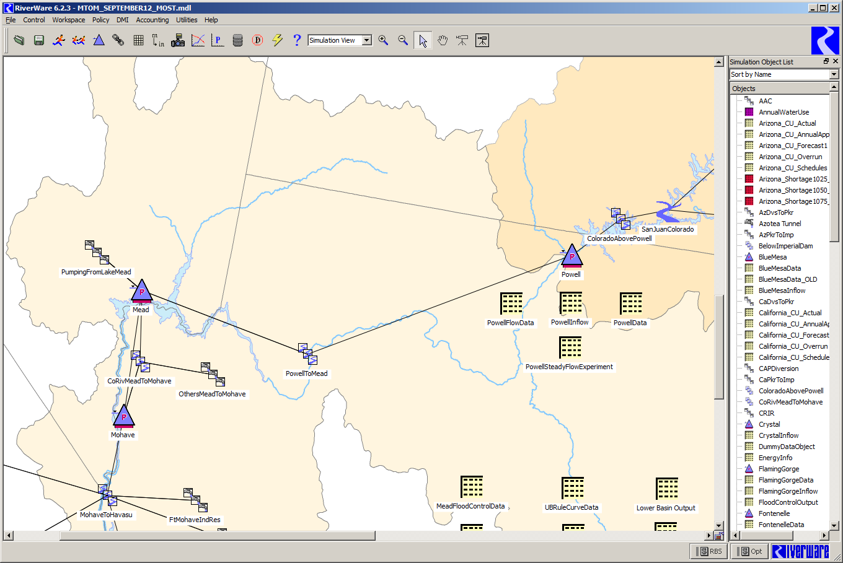
MTOM Updates – Data Management
Improved Data Management Interface
  Previously used Excel pass-through spreadsheets
  Model transfers data directly from HDB
  Improved efficiency

Slide 7
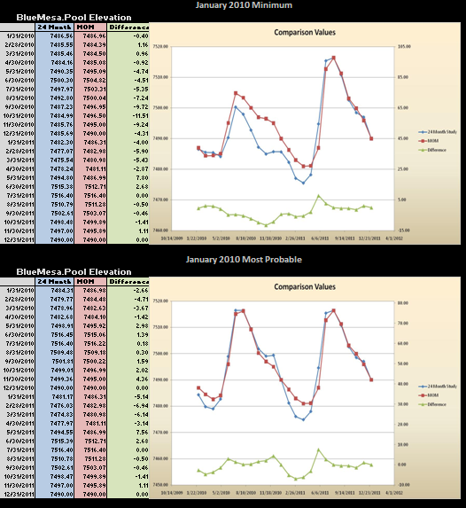
MTOM – Reservoir Ops Validation
Parallel runs began in Jan
Compare 24-MS official results against MTOM (using official forecast) to verify reservoir rules
Evaluate elevations and releases
Work still underway…

Slide 8
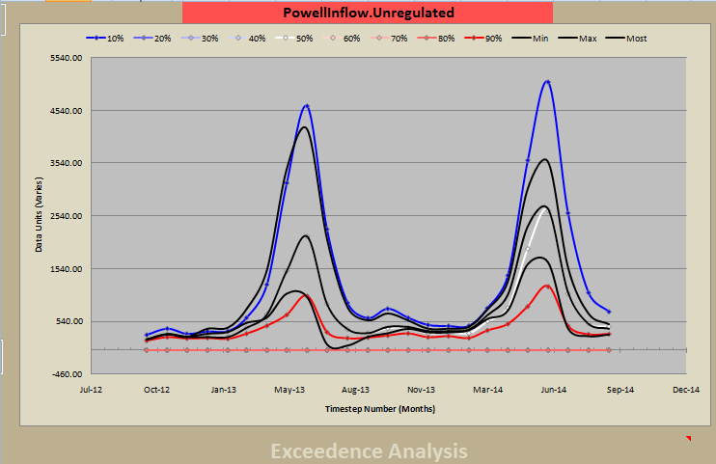
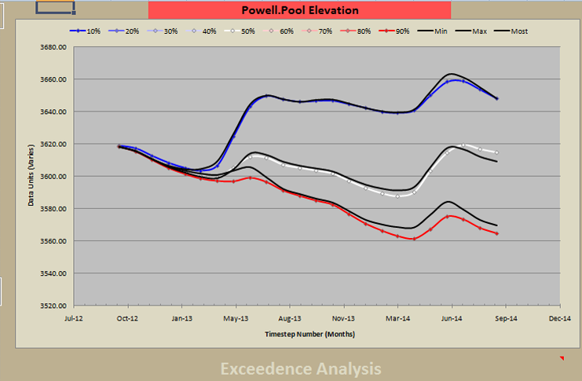
MTOM – Reservoir Ops Validation
Parallel runs began in Jan
Compare 24-MS official results against MTOM (using official forecast) to verify reservoir rules
Evaluate elevations and releases
Work still underway…

Slide 9
Green Results

Slide 10
Prescribed Management and Operational Objectives
Records of Decision
  Navajo Reservoir
  Flaming Gorge
  Aspinall Unit
    Black Canyon Water Right
Authorized purposes
  Fill reservoir annually for water supply
  Generate hydropower
Achieve environmental flow requirements (endangered fish)
  Adaptive management
Regulate the flow of the river for:
  flood control, recreation, fish and wildlife
Notes:
Reservoir capacity compared to Lake Powell capacity

Slide 11
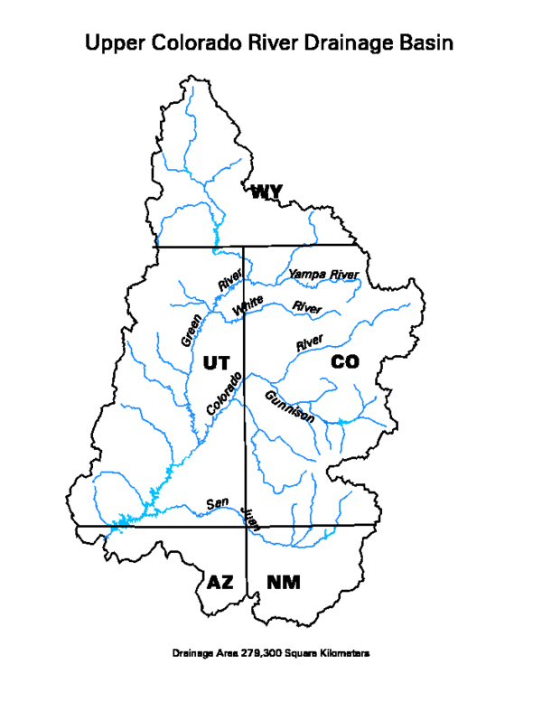
Upper Colorado River Basin
2012 Water Year Inflow
(30-year average stream gage flow, 1981-2010)
Basin | 2012 Annual Flow MAF
Green River above Flaming Gorge | 1.0 (69%)
Gunnison River above Crystal | 0.50 (42%)
San Juan River above Navajo | 0.52 (48%)
Upper Colorado River above Lake Powell | 4.91 (45%)
69%
42%
48%
45%
Notes:
30-year average (1981-2010) stream gage flow

Slide 12
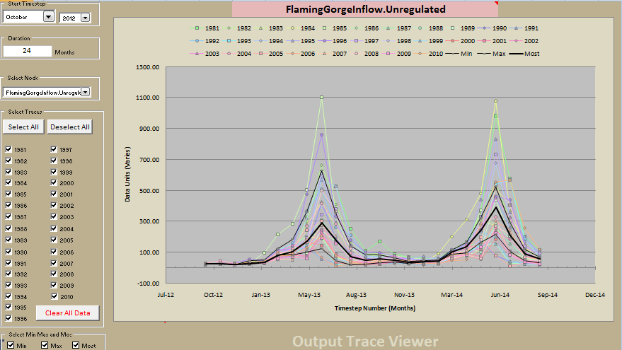
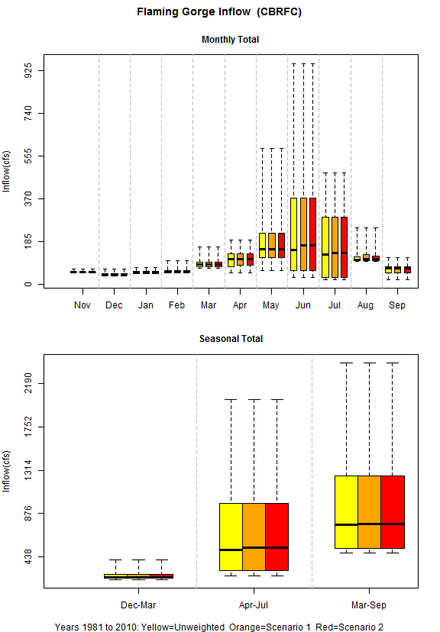
Green River Inflow

Slide 13
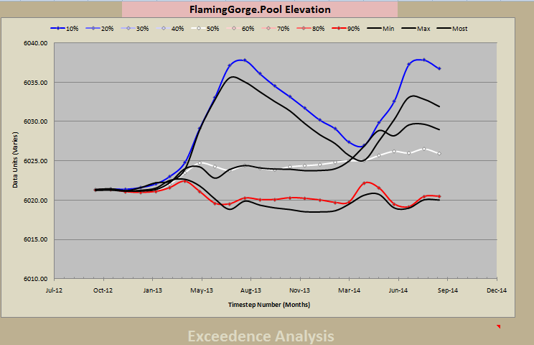
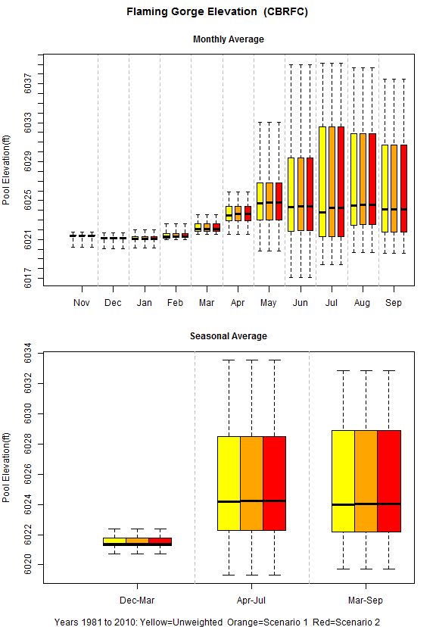
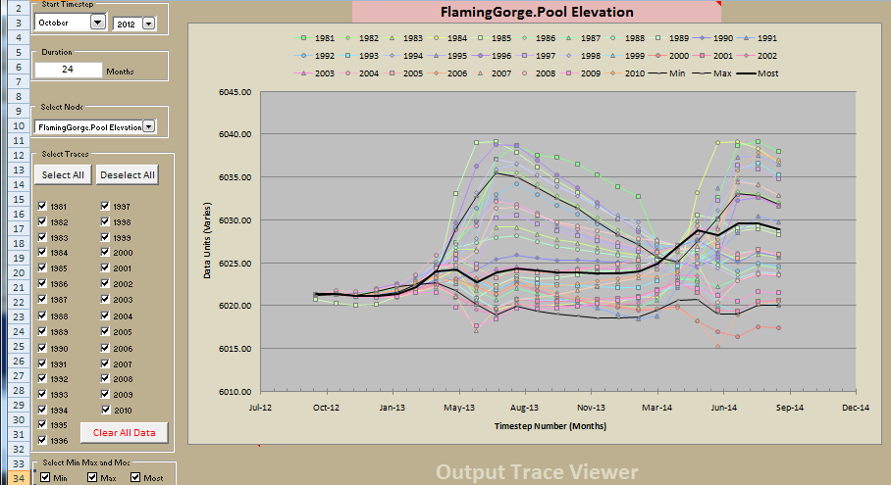

Slide 14
Upper Green 2012 Operations
Notes:
- 2013 Equalization elevation = 3646
- Aug 24 Month Projections for Jan 1, 2013: Powell elev. 3,615’, Mead 1,119

Slide 15
Upper Green 2012 Operations
Notes:
- 2013 Equalization elevation = 3646
- Aug 24 Month Projections for Jan 1, 2013: Powell elev. 3,615’, Mead 1,119

Slide 16
Green River Model (GRM)

Slide 17
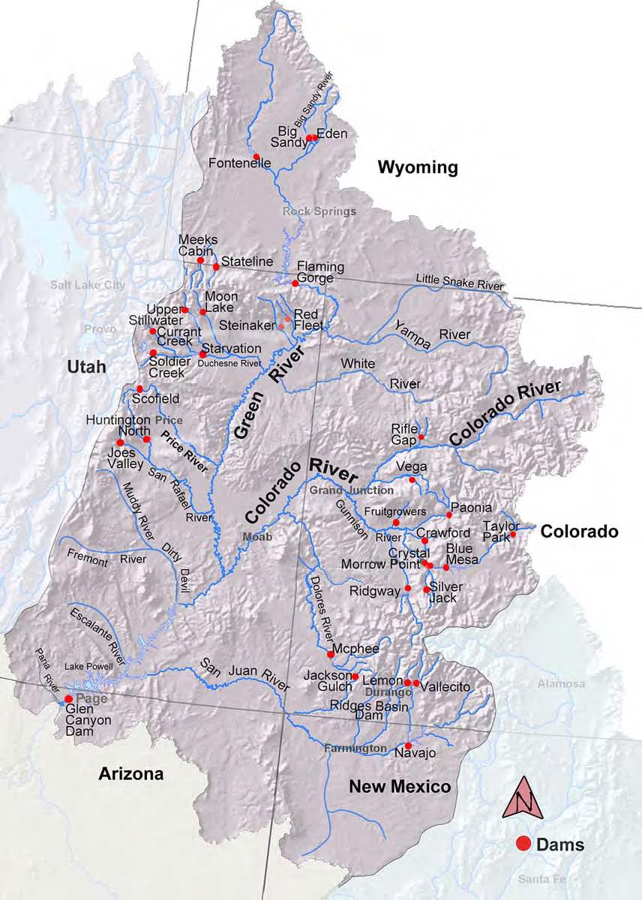
Green River Modeling
Flaming Gorge Dam Operational Objectives:
Fill reservoir annually for water supply
Generate hydropower
Achieve environmental flow requirements (endangered fish)
  Adaptive management
Regulate the flow of the Green River for:
  flood control, recreation, fish and wildlife
Notes:
17
Flaming Gorge Dam is part of the Colorado River Storage Project facilities that provide water storage, delivery and hydropower to Utah and others in the Upper Colorado River basin. FG operations comply with authorized CRSP purposes in coordination with environmental commitments that have been finalized within the last decade.

Slide 18
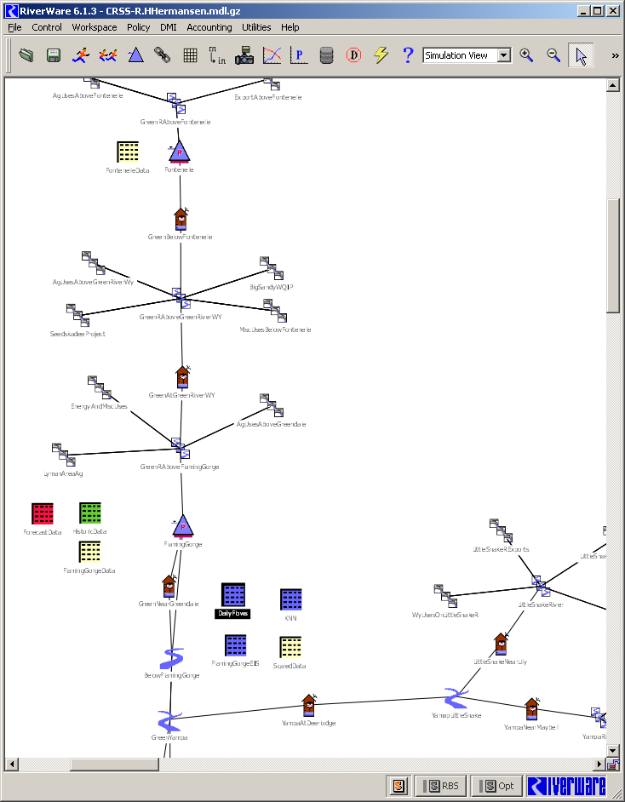
Green River Modeling
Modeling Objectives
    Provide a more detailed and sophisticated review of Green River basin operations
    Utilize / be consistent with Basin Study water supply and demand data
Flaming Gorge operational decisions to be modeled at daily timestep
Results will provide more reliable daily operations and downstream hydrographs for varying inflows and improved determination of water availability
Notes:
18
The Green River Study The Green River Study takes a more detailed and sophisticated look at the monthly Basin Study model results. Within the long-term planning process, operational decisions are made on a daily basis in the best attempt to mimic natural river conditions. The model uses water supply and demand scenarios from the Basin Study and evaluates that data in the Green River basin on a daily timestep. The Green River Study is consistent with the Basin Study and uses its demand data to provide for planning and operational strategies that meet the authorized purposes of water delivery, hydropower, and environmental compliance on a finer temporal scale. The detailed and sophisticated review of operational strategies will inform stakeholders interested in future planning.

Slide 19
CRSS Rule Updates
Direct Natural Flow – Index Sequential Method (ISM)
Daily disaggregation calculations are done at the end of each model run (post processing)
Demands are the 2007 UCRC depletions
Daily disaggregation of Yampa River spring flows
  April-July period
Flaming Gorge daily spring hydrograph
  Record of Decision rule set
  Static start date on May 23
  April-July daily flows and monthly outflow are different due to post-processing being over April-July period
Daily Base Flows (Aug-Mar) are averaged monthly data

Slide 20
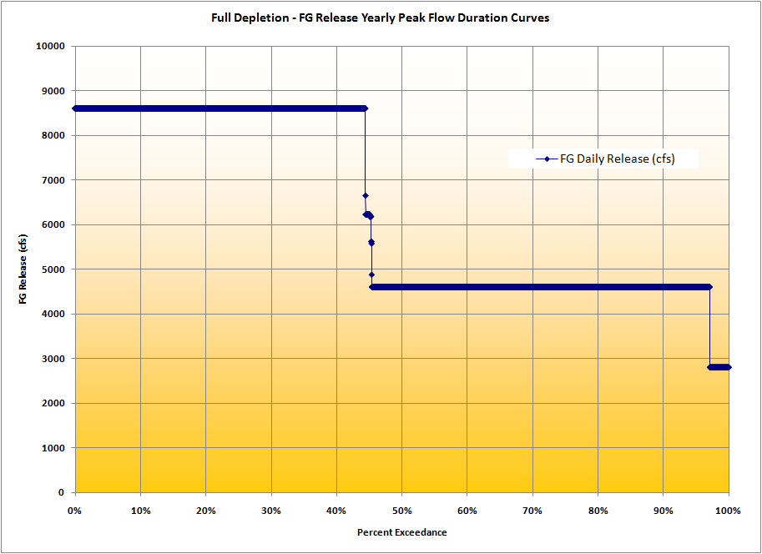
GRM Flaming Gorge Hydrograph
Single FG “Trace”
All FG Releases

Slide 21
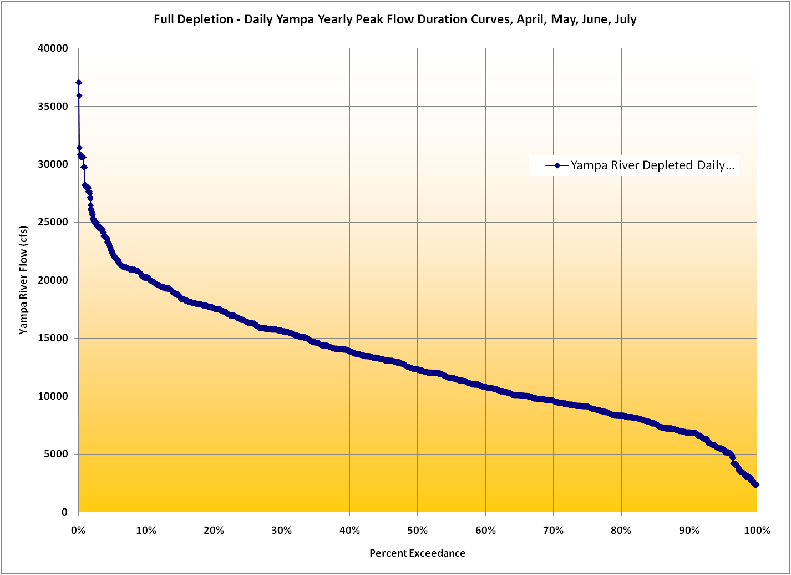
Yampa Daily Disaggregated Spring Peak Flows
Yampa daily disaggregation meets daily spring peak flow of 14,000 cfs is projected 40% of the time. Adding FG power plant capacity of 4,600 cfs results in recommended 18,600 cfs at Jensen.

Slide 22
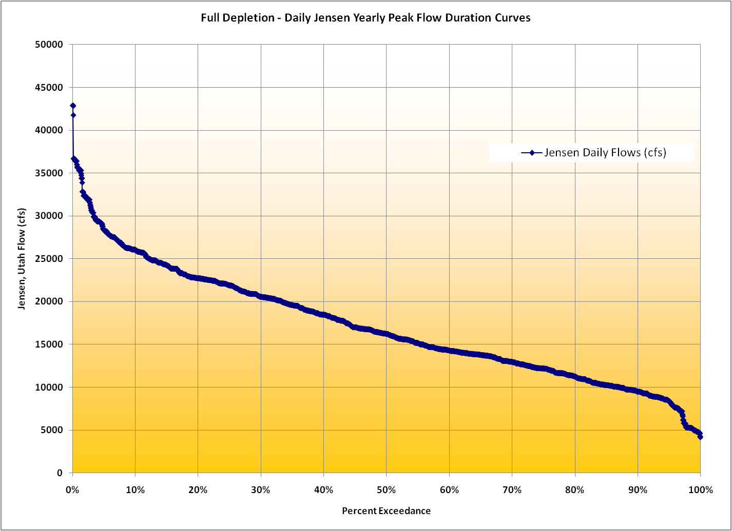
Jensen Daily Peak Flow Hydrograph
Spring flows meet one-day peak requirement of 18,600 cfs at least 40% of the time

Slide 23
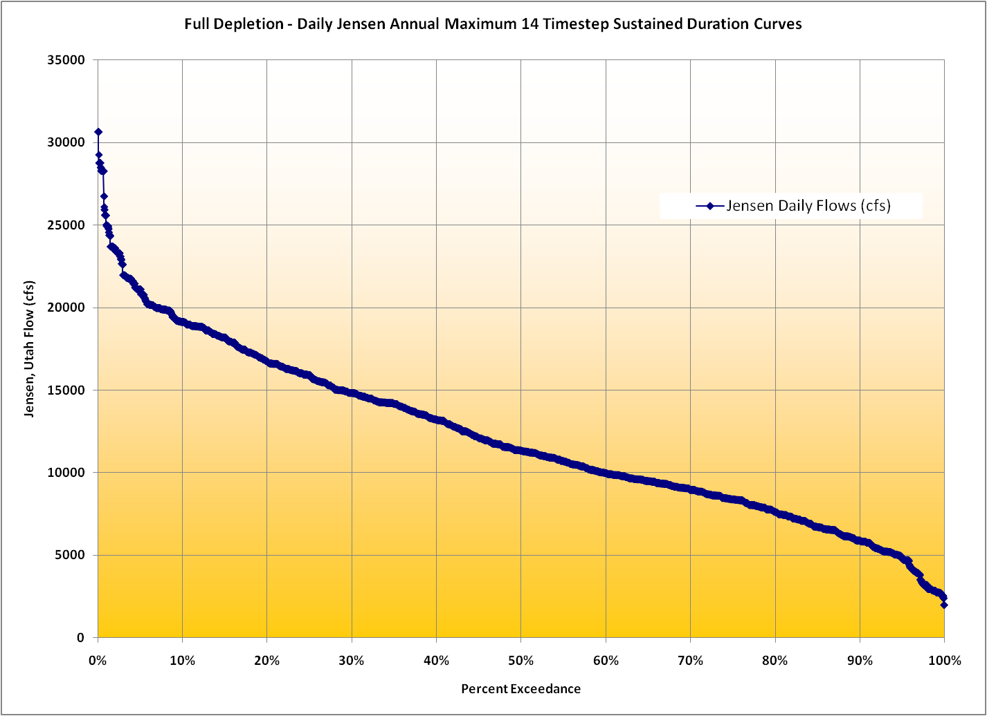
Jensen Daily 14-Day Duration Hydrograph
Static FG start date impacts the ability to model meeting at least 14 days at 18,600 cfs 40% of the time

Slide 24
Enhancements and future development
Green River Model

Slide 25
Green River Model Rule Updates
Calculations are done in March before spring peak and no longer need proportional data
  Allows peak to occur in April
Demands are 2007 UCRC depletions
Daily disaggregation of Yampa River spring flows
  April-July period using same data
Flaming Gorge daily hydrograph
  Record of Decision rule set
  Releases start 3 days before maximum Yampa peak
  April-July daily flows summed to monthly outflow
Daily Base Flows are averaged monthly data

Slide 26
Green River Model Development
Updated rules are limited in hydrologically extreme years
  ISM run aborts in minimum release and flood control situations
Dynamic FG peak release to assist in scenario development
  LTSP
  Basin Study scenarios
Potential to optimize release magnitudes and durations to conserve water and meet flow targets
Utilize Basin Study inflow hydrology and demand scenarios

Slide 27
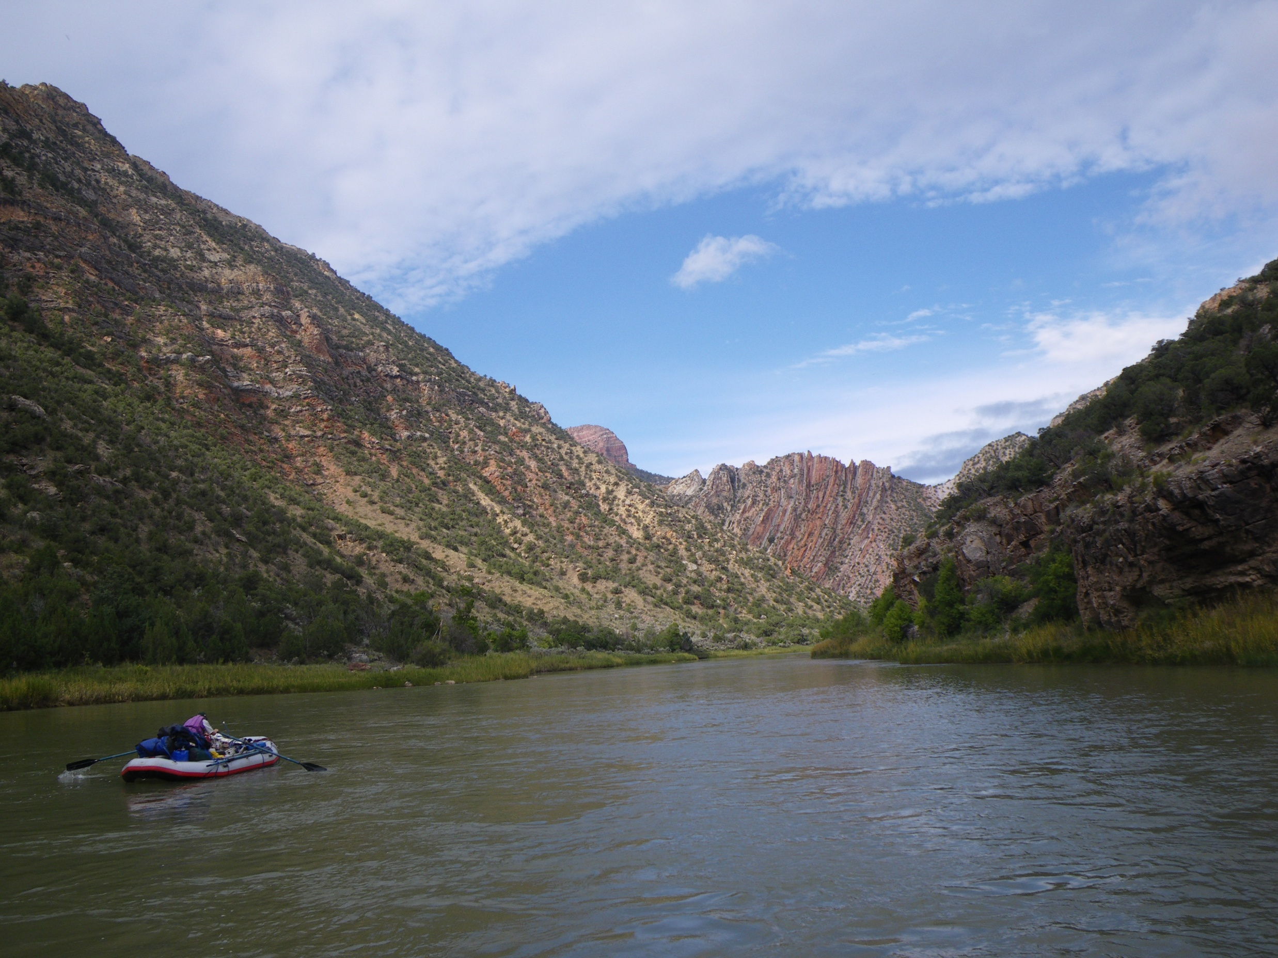
Flaming Gorge Working Group
August 2012
Questions?

Slide 28
Questions?

