Slide 1

Upper Colorado Region Operations
CRFS—Technical Meeting
November 14, 2012

Slide 2
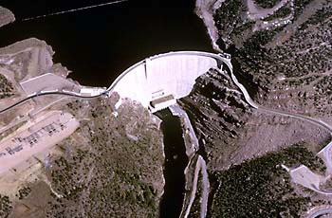
Green River Basin – Fontenelle and Flaming Gorge

Slide 3
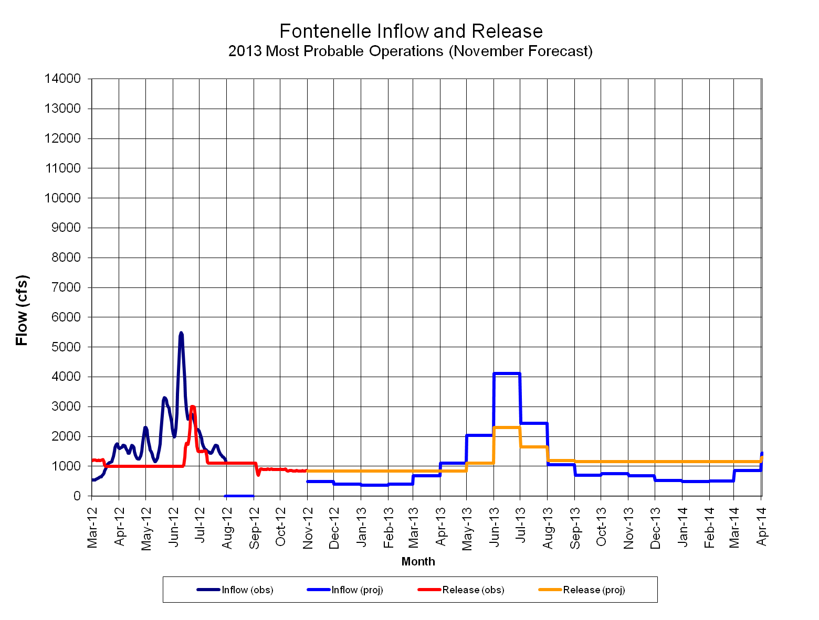
Fontenelle Inflow and Release
2013 Spring Peak 2,300 cfs
Notes:
Go to P:\FontenelleOps\FontenelleDailyOps.xls to get most recent plot

Slide 4
Fontenelle Release
Notes:
Go to P:\FontenelleOps\FontenelleDailyOps.xls to get most recent plot

Slide 5
Fontenelle Reservoir Elevation
Notes:
Go to P:\FontenelleOps\FontenelleDailyOps.xls to get most recent plot

Slide 6
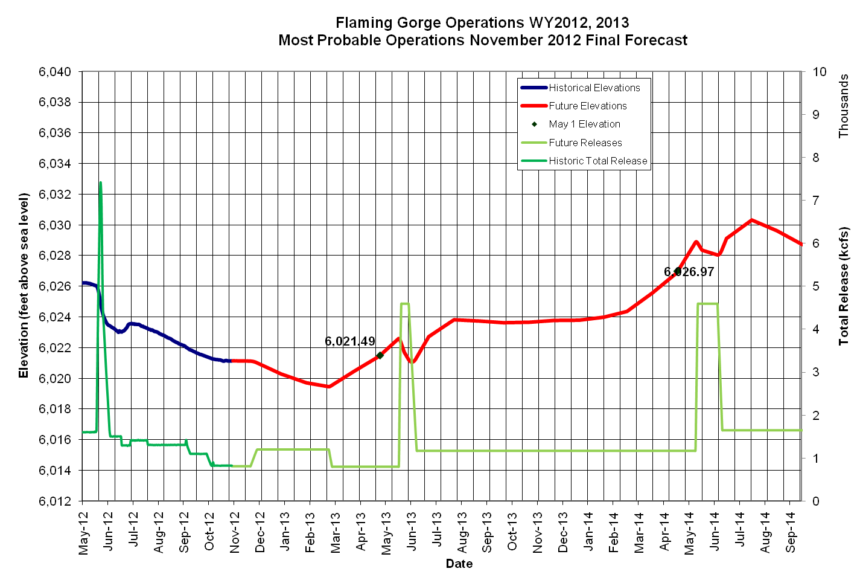
Flaming Gorge Inflow and Release
Notes:
Go to P:\FontenelleOps\FontenelleDailyOps.xls to get most recent plot

Slide 7
Flaming Gorge Reservoir Elevation
Notes:
Go to P:\FontenelleOps\FontenelleDailyOps.xls to get most recent plot

Slide 8
Flaming Gorge Release
Notes:
Go to P:\FontenelleOps\FontenelleDailyOps.xls to get most recent plot

Slide 9
Larval Trigger Study Plan
Notes:
Go to P:\FontenelleOps\FontenelleDailyOps.xls to get most recent plot

Slide 10
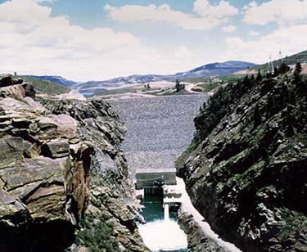
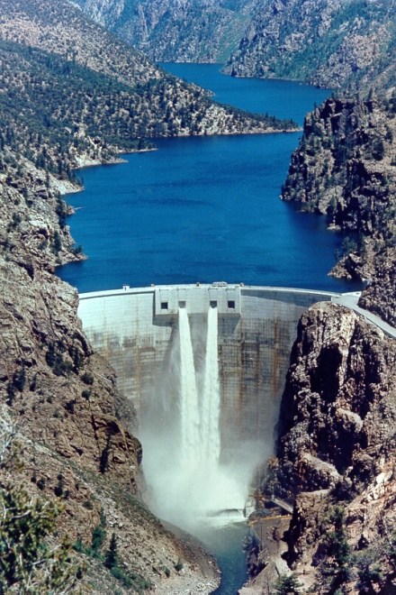
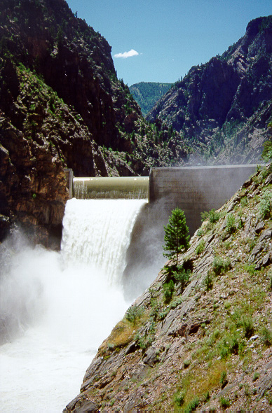
Aspinall Unit Reservoir Operations
2012

Slide 11
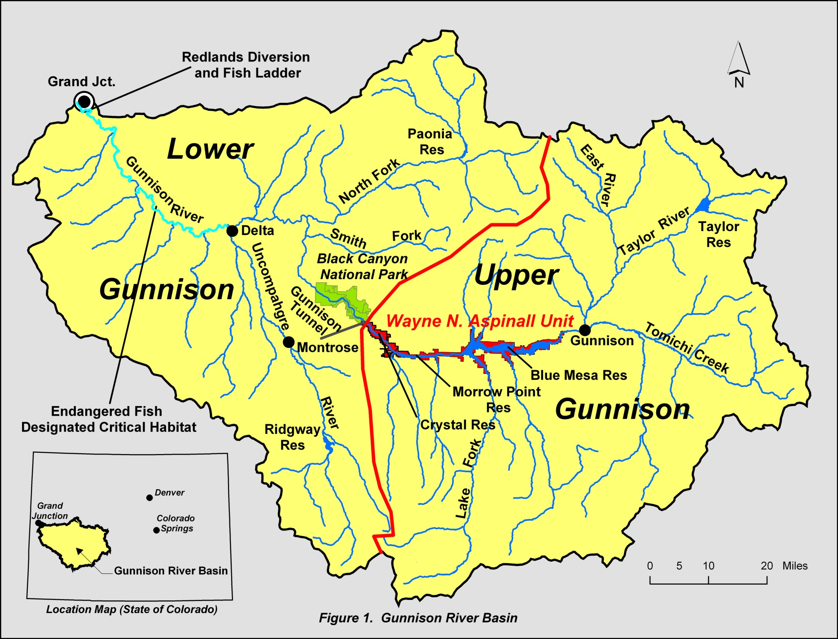

Slide 12
Operational Considerations
Aspinall Unit Purposes
  Water storage / Compact Development
  Power Production
  Flood Control
Downstream Flow Requirements - including Senior Water Rights, timing side-inflows
Target Elevations
Meeting the ROD flow targets at Whitewater
Others - Including Recreation and Safety

Slide 16
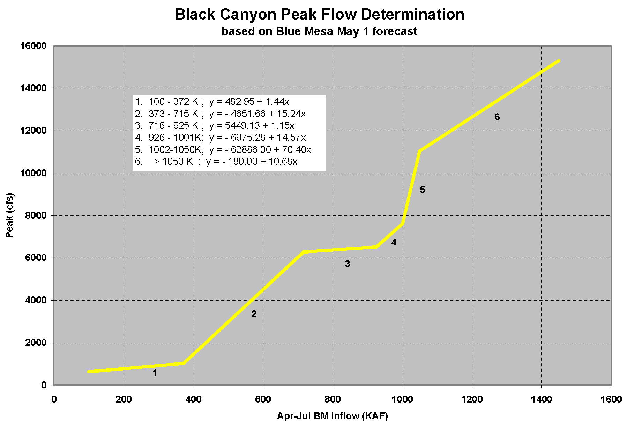
Actual 24 Hr Peak
845 cfs
814 cfs
May 1 Forecast
230 KAF

Slide 18
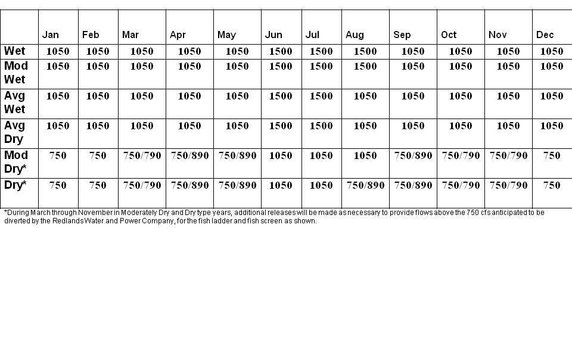
Whitewater Baseflow Targets
Drought Rules
During Dry and Moderately Dry years, if Blue Mesa Reservoir content drops below 600,000 af, the Whitewater baseflow target is reduced from 1050 cfs to 900 cfs until Blue Mesa Reservoir content exceeds 600,000 af

Slide 19
2012 Spring Operational Goals
Black Canyon Water Right
  One Day Peak Target 814 cfs
ROD Peak Flow at Whitewater
  900 cfs (1 days)
<14,000 cfs at Delta, CO
Safe Ramping Rates
Fill Blue Mesa

Slide 24
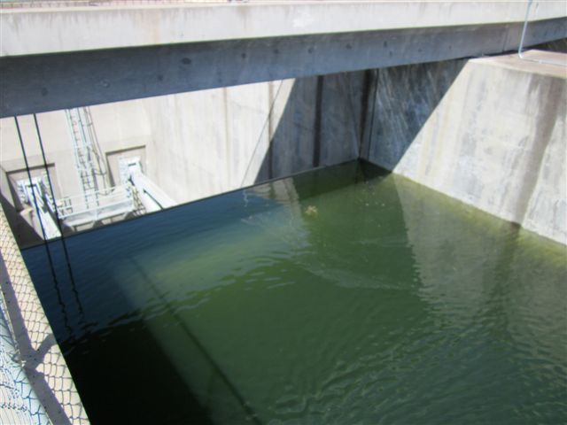
July 16, 2011, Blue Mesa elevation 7519.22 feet, 0.18 feet from top of gate

Slide 25
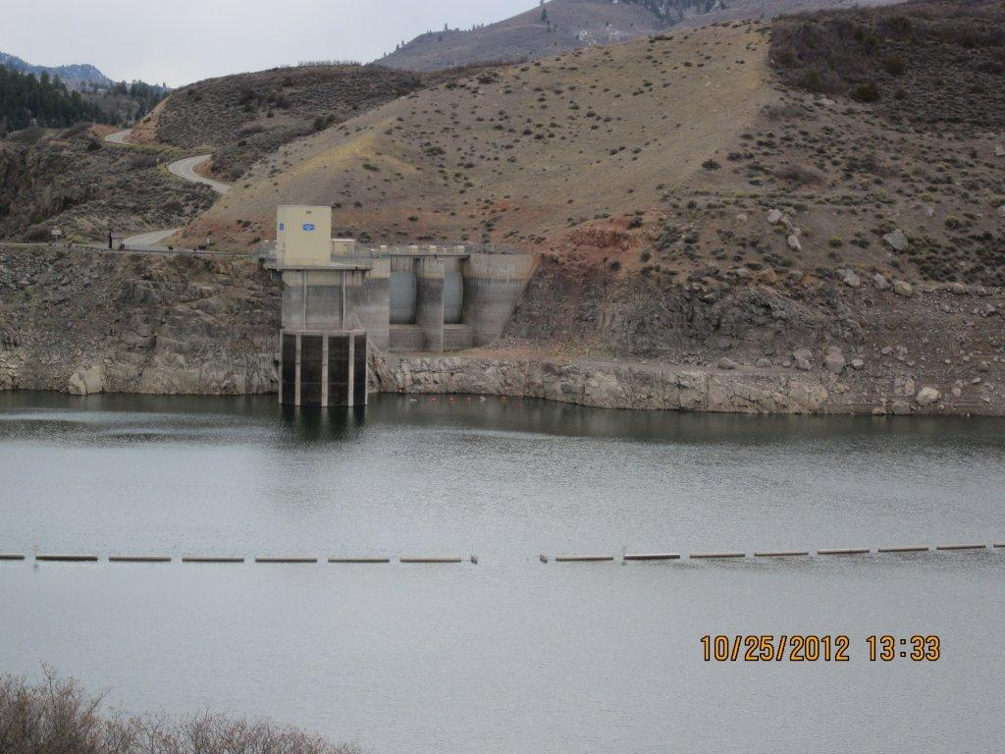
~ 67 feet
Blue Mesa reservoir elevation 7452.42 feet, or 39.3% full.

Slide 26
Lots of Water!
Lots of Concerns….. Complaints?
Concerns from the fishing community
Black Canyon peak is too high
Black Canyon peak is occurring too late
Don’t increase flows during the rainbow trout emergence
No high flows around the Stonefly hatch!
Concerns from the rafting community
Timing with the Cimarron River causes the river to fluctuate
More advanced notice when operation plans will change
Operation plans change too often
River flows are fluctuating too often, there needs to be more consistency
There is no accountability with these operation plans, they can change at any time!
If we can’t tell our clients what the river conditions will be, we look bad

Slide 27
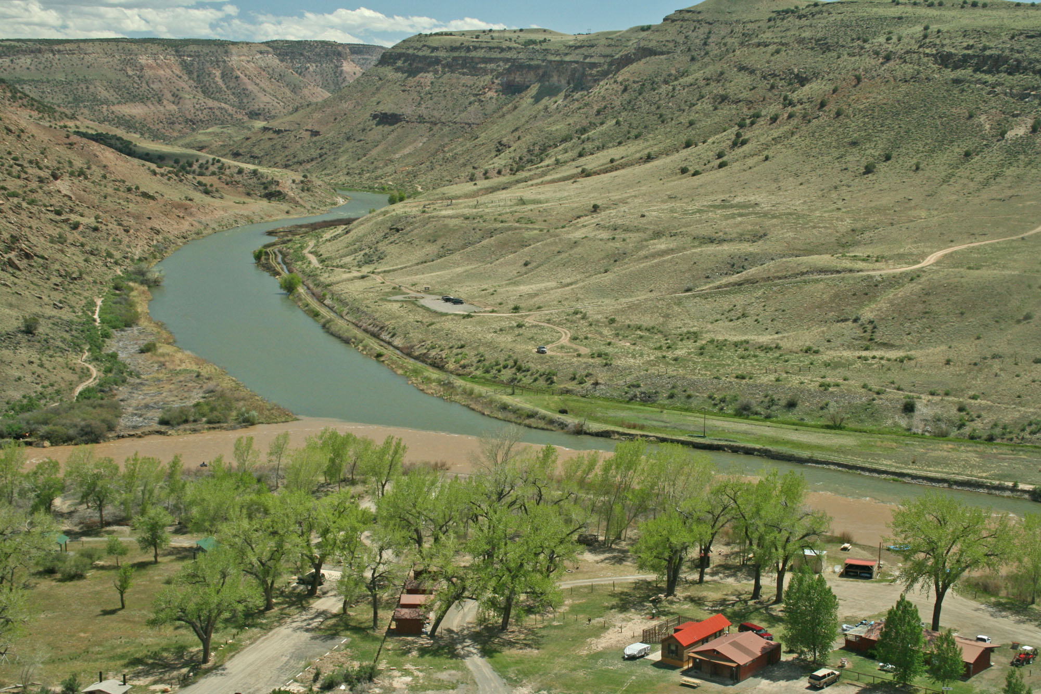
May 15th

Slide 28
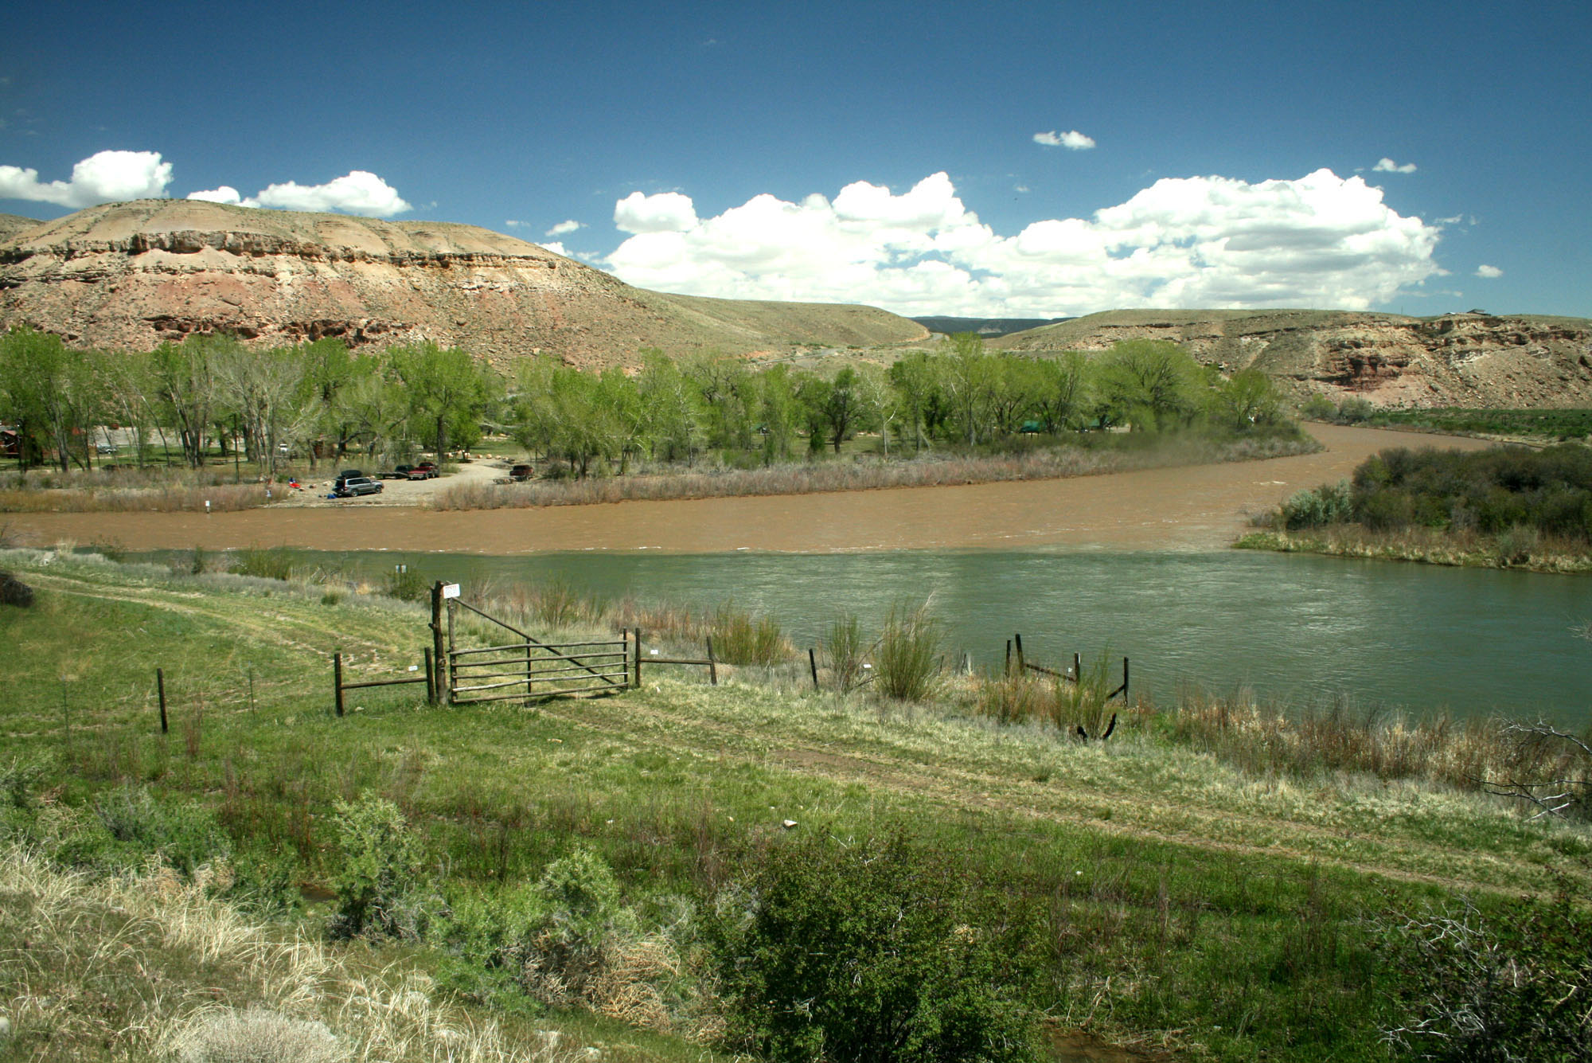
May 15th

Slide 29
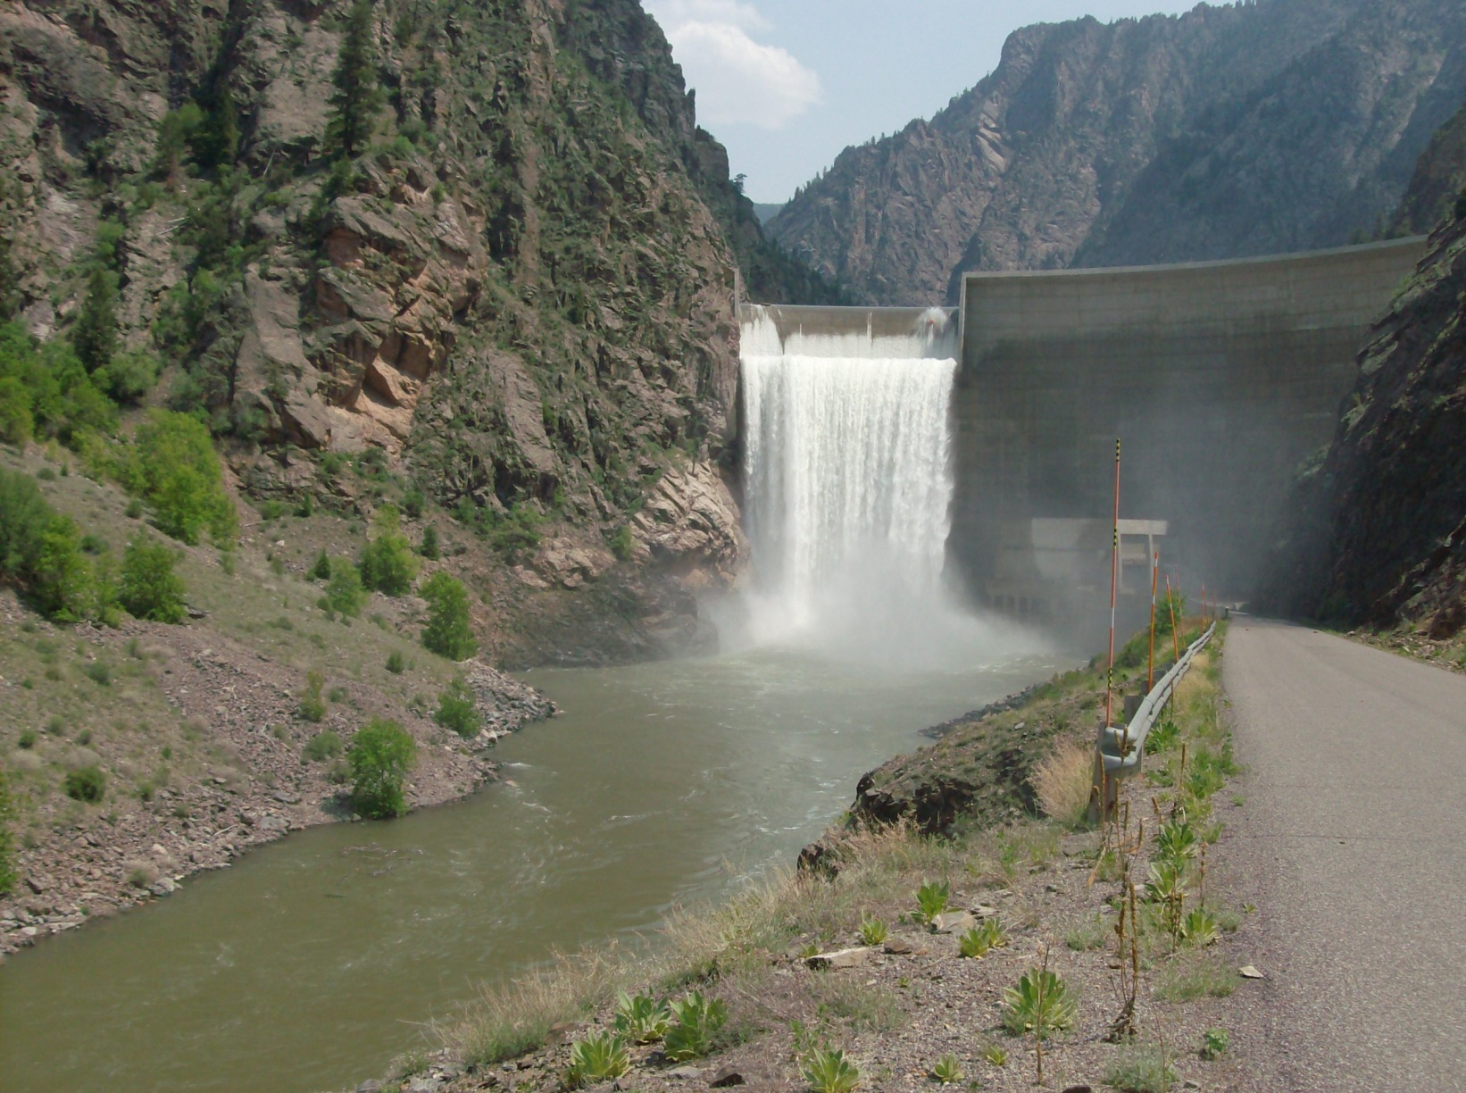
http://www.usbr.gov/uc/wcao/water/rsvrs/mtgs/amcurrnt.html

Slide 30
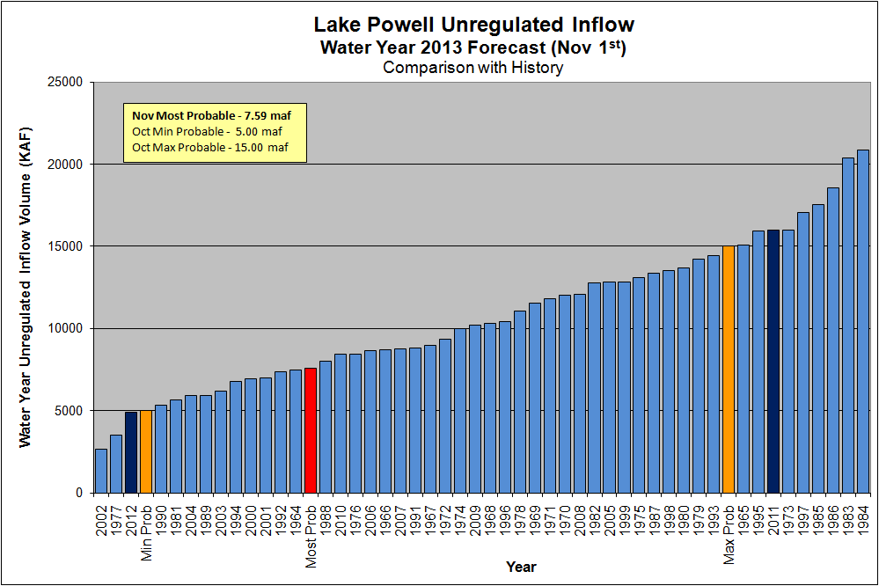

Slide 31
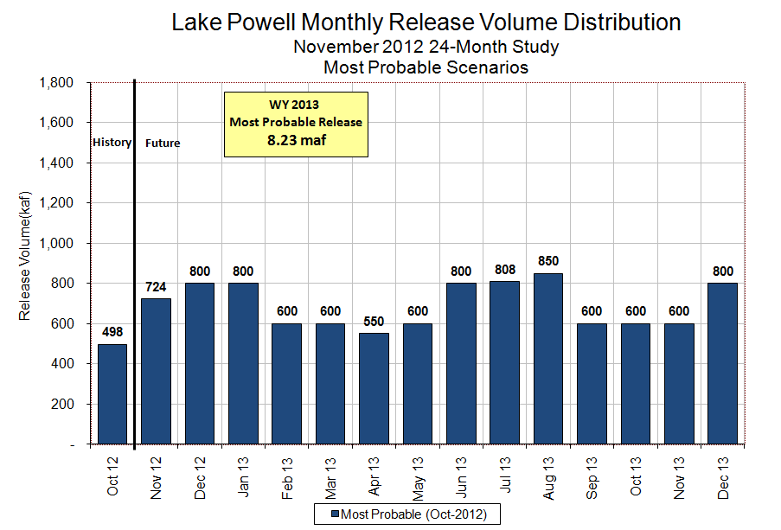

Slide 32
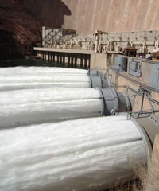
Upper Colorado River – Lake Powell

Slide 33
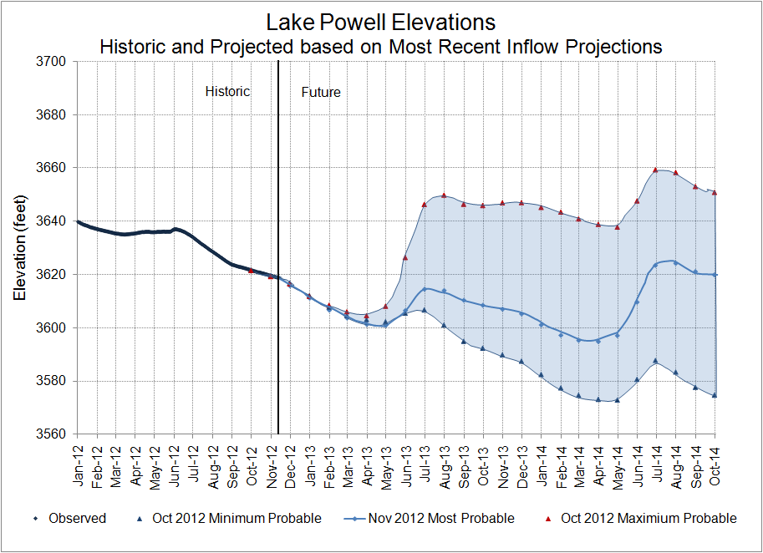
Notes:
Shows the elevation historically with future projections. The range reflects the level of uncertainty of the inflow forecast based on the Min and Max Probable we received in October. The November most probable is reflected by the heavy blue line within the range.

Slide 34
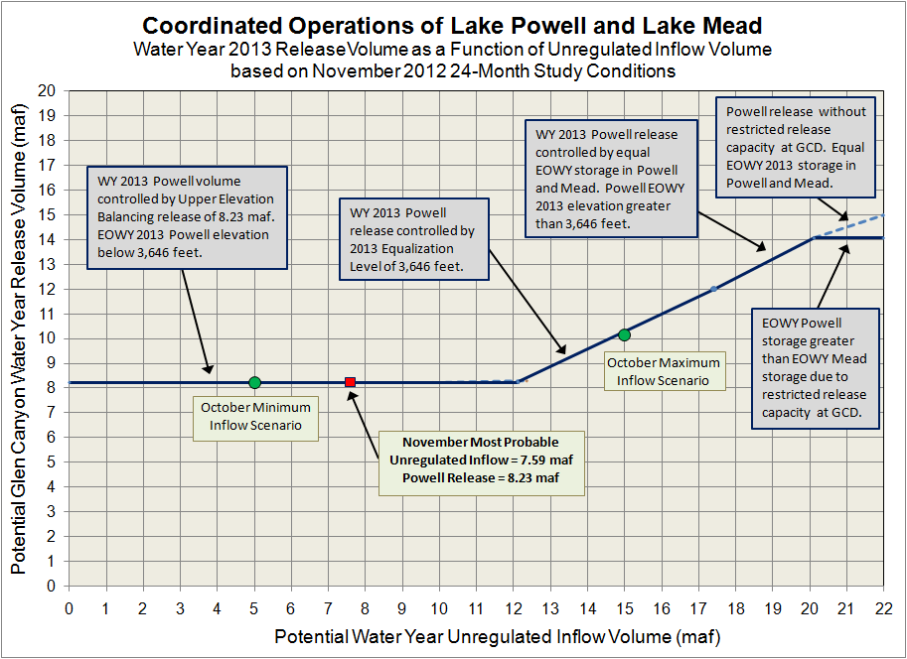
Notes:
Roughly shows the relationship between annual unregulated inflow to Lake Powell and annual release from Lake Powell. 2012 is an Equalization year determined in August of 2012. This relationship is based on how the Equalization Tier would play out under different hydrologic scenarios. How the upstream reservoirs are operated will impact this relationship and this graphic assumes no adjustments are made to operations at the upstream reservoirs.
The Most probable release volume for 2012 is controlled by the Equalization Level for 2012 which is 3645. If conditions are wetter by about 1.5 MAF the Equalization Tier would be controlled by equal volumes in Powell and Mead. If we see a year as wet as 2011 we would again be in a situation where we have to carry some of the Eq water over into 2013.
You can see on the dry side that the min release in 2012 is 9.46 maf which is based on 8.23 + carryover (1.233 maf).

Slide 35
Glen Canyon Power Plant Planned Unit Outage Schedule for Water Year 2013
(updated 11-13-2012)
Unit Number | Oct 2012 | Nov 2012 | Dec 2012 | Jan 2013 | Feb 2013 | Mar 2013 | Apr 2013 | May 2013 | Jun 2013 | Jul 2013 | Aug 2013 | Sep 2013
1
2
3
4
5
6 (3/4 Unit)
7
8
Units Available | 5 |  | 7 | 7 | 5 |  | 7 | 7 | 7 | 7 | 7 | 5
Capacity (cfs) | 19,500 |  | 21,700 | 21,700 | 15,000 |  | 21,700 | 21,700 | 21,700 | 21,700 | 21,700 | 14,800
Capacity (kaf/month) | 1310 | 1380 | 1330 | 1330 | 920 | 1230 | 1290 | 1330 | 1290 | 1330 | 1330 | 940
Max (kaf) | -- | -- | -- | -- | -- | -- | -- | -- | -- | -- | -- | --
Most (kaf) | 494 | 724 | 800 | 800 | 600 | 600 | 550 | 600 | 800 | 808 | 850 | 600
Min (kaf) | -- | -- | -- | -- | -- | -- | -- | -- | -- | -- | -- | --
8
6
7
7
25,200
18,100
21,700
21,700

Slide 36
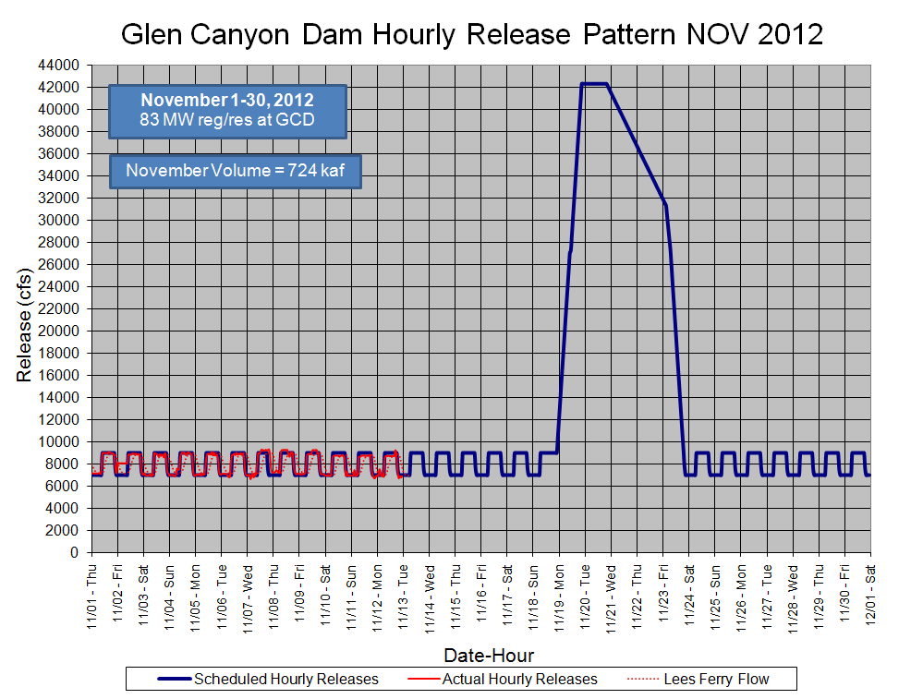
Notes:
U:\1_Powell Ops\5_Spreadsheets\MonthlyReleaseSchedules

Slide 37
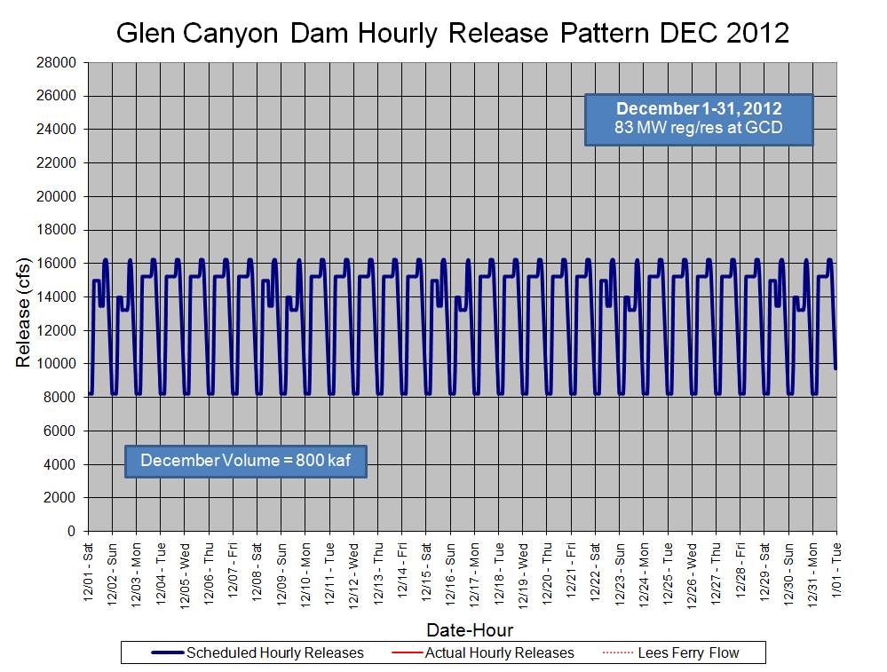
Notes:
U:\1_Powell Ops\5_Spreadsheets\MonthlyReleaseSchedules

Slide 38
