Slide 1

CRFS Technical Meeting
LC Operations Update
November 14, 2012

Slide 2
Topics
Operations Update
Side Inflow forecast comparison
Real-time Evaporation Project

Slide 3
Lower Basin Operations
Water Year 2012
Lake Mead elevation at end of WY 2012: 1115.16 feet, a decrease of 0.88 feet.
CY 2012 Water Use in the Lower Basin is projected to be slightly less than 7.5 maf
  Mexico deliveries will be reduced this year under provisions of Minute 318 by approximately 132,000 acre-feet
Lake Mead’s surface elevation is projected to be 1120.63 at the end of the calendar year, based on the November 24-Month Study
Predominantly*, Lower Basin temperatures have been above average, precipitation below average

Slide 4
Water Year 2012 Projections
October 2011 24-Month Study Most Probable Inflow Scenario
Projected Unregulated Inflow into Powell¹ = 11.60 maf (107% of average)
Lake Mead
Lake Powell
1,219.6
26.120 maf
24.322 maf
3,700
16.6 maf
3,645
3,645.0 feet
16.60 maf in storage
68% of capacity
1,145
16.2 maf
1,143.0 feet
15.71 maf in storage
60% of capacity
1,105
12.2 maf
9.5 maf
3,575
1,075
9.6 maf
12.26 maf
Not to Scale
¹ WY 2012 unregulated inflow volume is based on the CBRFC forecast dated 10/6/2011. Percent of average inflow is based on the 30-year period of record from 1981-2010.

Slide 5
End of Water Year 2012
Unregulated Inflow into Powell¹ = 4.91 maf (45% of average)
Lake Mead
Lake Powell
1,219.6
26.120 maf
24.322 maf
3,700
16.6 maf
3,645
1,145
16.2 maf
3,621.6 feet
13.93 maf in storage
57% of capacity
1,115.2 feet
13.14 maf in storage
50% of capacity
1,105
12.2 maf
9.5 maf
3,575
1,075
9.6 maf
9.47 maf
Not to Scale
¹ Percent of average inflow is based on the 30-year period of record from 1981-2010.

Slide 6
Lower Basin Side Inflows
Glen Canyon to Hoover in WY/CY 2012^{1,2}
Month in WY/CY 2012 |  | Intervening Flow Glen Canyon to Hoover (KAF) | Intervening Flow Glen Canyon to Hoover (% of Average) | Difference From 5-Year Average (KAF)
H I S T O R Y | October 2011 | 66 | 135% | +17
 | November 2011 | 36 | 78% | -10
 | December 2011 | 84 | 78% | -24
 | January 2012 | 55 | 71% | -23
 | February 2012 | 44 | 45% | -54
 | March 2012 | 43 | 55% | -35
 | April 2012 | 46 | 61% | -30
 | May 2012 | 16 | 25% | -48
 | June 2012 | 7 | 21% | -26
 | July 2012 | 69 | 128% | +15
 | August 2012 | 169 | 164% | +66
 | September 2012 | 97 | 131% | +23
 | October 2012 | 56 | 114% | +7
 | November 2012 | 46
 | December 2012 | 108
WY 2012 Totals |  | 732 | 85% | -129
CY 2012 Totals |  | 756 | 88% | -105
¹ Values were computed with the LC’s gain-loss model for the most recent 24-month study.
² Percents of average are based on the 5-year mean from 2007-2011.

Slide 8
Probabilities of Occurrence of Event or System Condition
Results from October 2012 CRSS Run^{1,2} (values in percent)
 | Event or System Condition | 2013 | 2014 | 2015 | 2016 | 2017
Upper Basin – Lake Powell | Equalization Tier | 12 | 31 | 33 | 39 | 43
 | Equalization – annual release > 8.23 maf | 10 | 31 | 33 | 38 | 40
 | Equalization – annual release = 8.23 maf | 2 | 0 | 0 | 1 | 3
 | Upper Elevation Balancing Tier | 88 | 61 | 48 | 44 | 39
 | Upper Elevation Balancing – annual release > 8.23 maf | 0 | 0 | 2 | 15 | 22
 | Upper Elevation Balancing – annual release = 8.23 maf | 88 | 61 | 46 | 29 | 17
 | Mid-Elevation Release Tier (annual release = 7.48 maf) | 0 | 8 | 18 | 9 | 13
 | Lower Elevation Balancing Tier | 0 | 0 | 1 | 8 | 5
Lower Basin – Lake Mead | Shortage Condition – any amount (Mead ≤ 1,075 ft) | 0 | 0 | 1 | 17 | 33
 | Shortage – 1st level (Mead ≤ 1,075 and ≥ 1,050) | 0 | 0 | 1 | 16 | 28
 | Shortage – 2nd level (Mead < 1,050 and ≥ 1,025) | 0 | 0 | 0 | 1 | 5
 | Shortage – 3rd level (Mead < 1,025) | 0 | 0 | 0 | 0 | 0
 | Surplus Condition – any amount (Mead ≥ 1,145 ft) | 0 | 3 | 14 | 19 | 22
 | Surplus – Flood Control | 0 | 0 | 2 | 4 | 5
 | Normal or ICS Surplus Condition | 100 | 97 | 85 | 64 | 45
¹ Reservoir initial conditions based on December 31, 2012, projected conditions from the October 2012 24-Month Study
² Hydrologic inflow traces based on resampling of the observed natural flow record from 1906-2008

Slide 9
Lower Basin Surplus & Shortage through 2026
1,2
¹ Reservoir initial conditions based on December 31, 2012, projected conditions from the October 2012 24-Month Study
² Hydrologic inflow traces based on resampling of the observed natural flow record from 1906-2008
Notes:
9

Slide 10
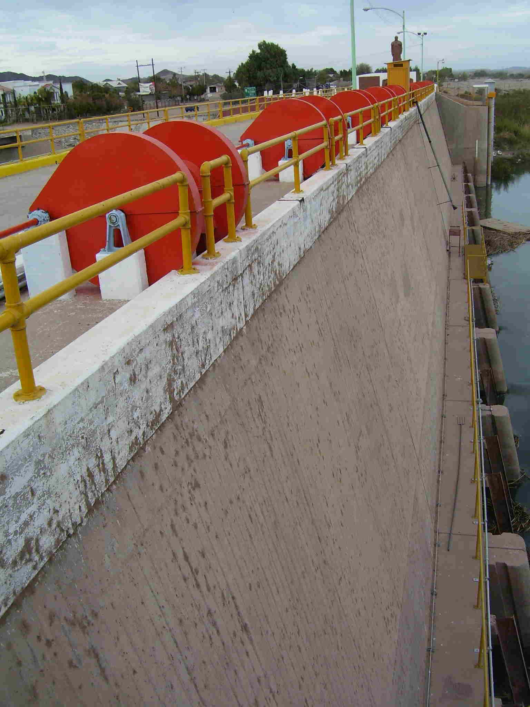
Additional Operational Data
(provisional year-to-date values)
MX Excess Flows
  49,414 acre-feet
Brock Reservoir Total Storage
  119,860 acre-feet
Senator Wash Total Storage
  82,040 acre-feet

Slide 12
Comparing Reclamation and CBRFC Side-inflow Forecasts
We have been comparing side-inflow forecasts made by Reclamation (5-year moving average) and the CBRFC
Forecasts are different because Reclamation forecasts a residual and the CBRFC is forecasting real flow
Continuing to improve through cooperation with CBRFC

Slide 13
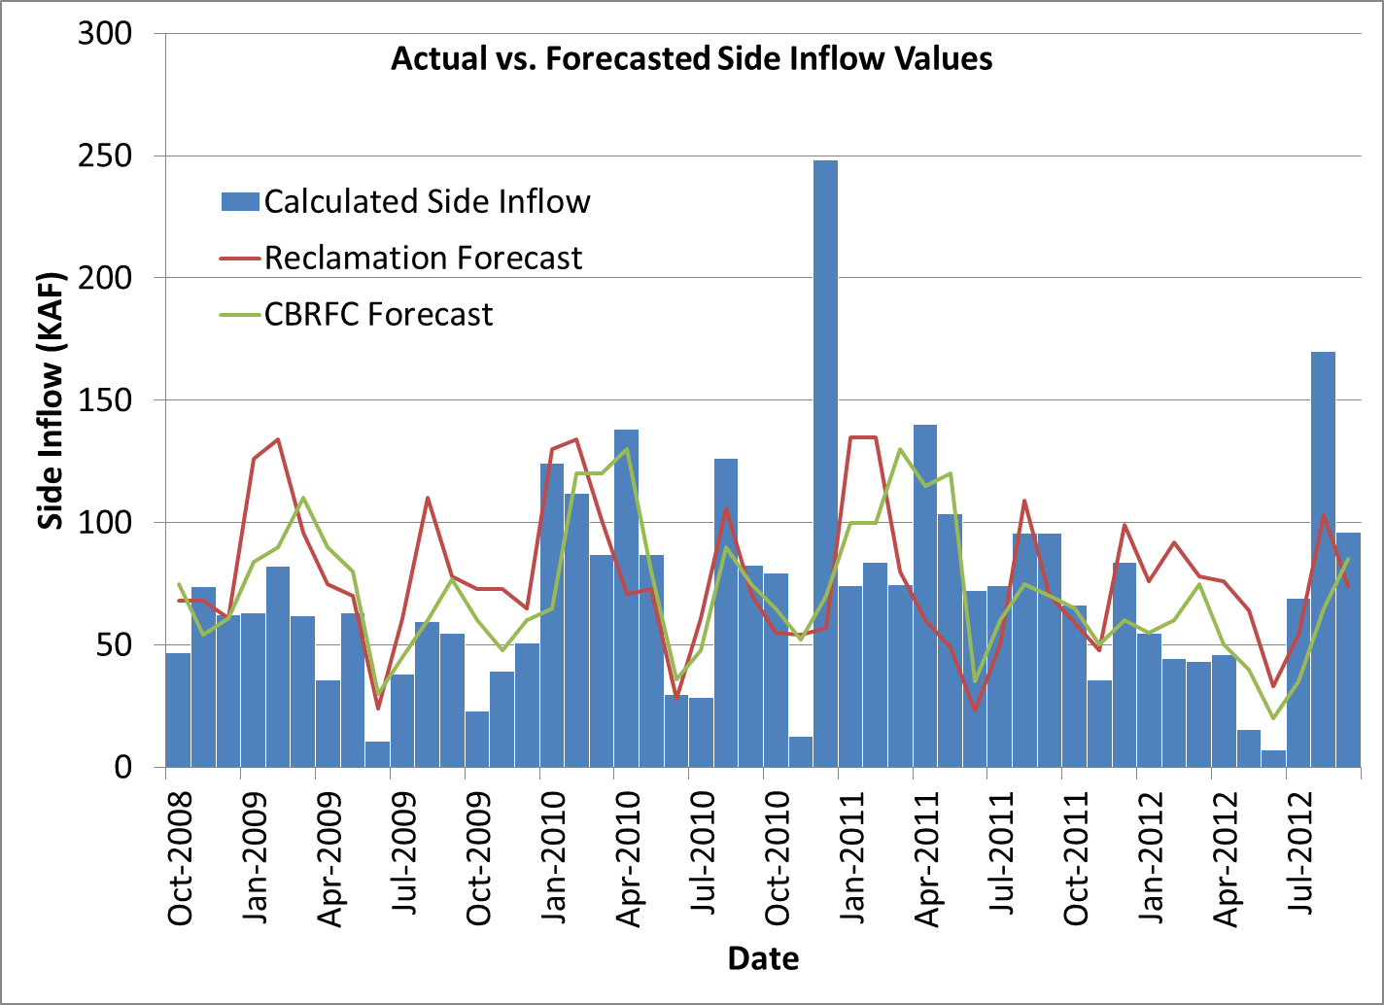

Slide 14
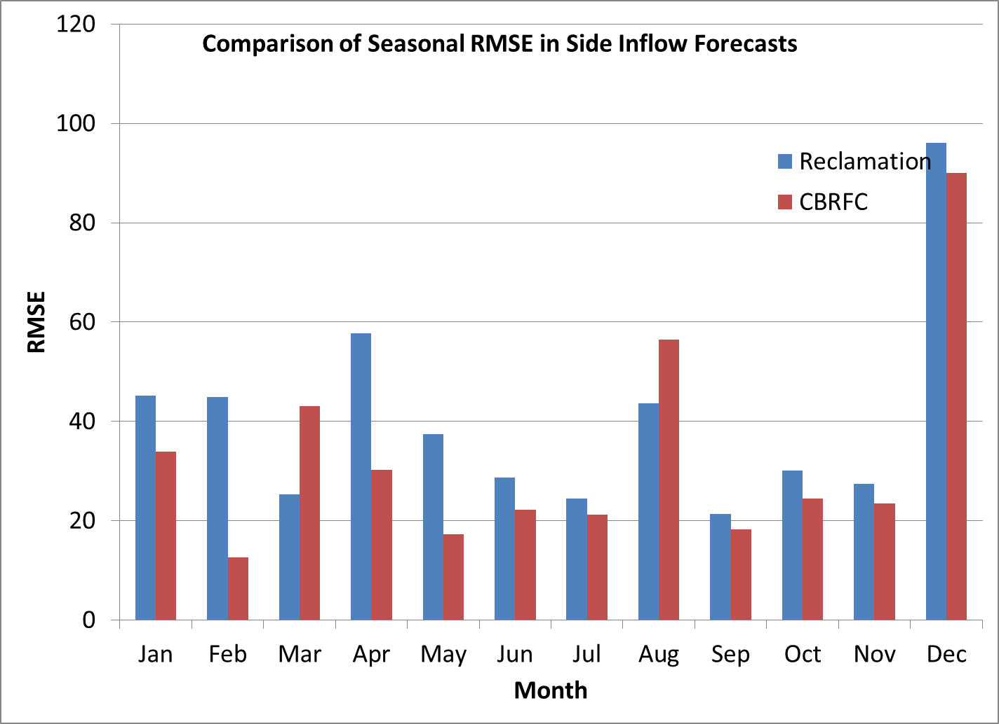

Slide 15
Real Time Evaporation At Lake Mead
5-Year cooperative project with the USGS
Measure and obtain hourly evaporation rates (and other parameters) from Lake Mead
Develop new monthly coefficients for use in Reclamation modeling

Slide 16
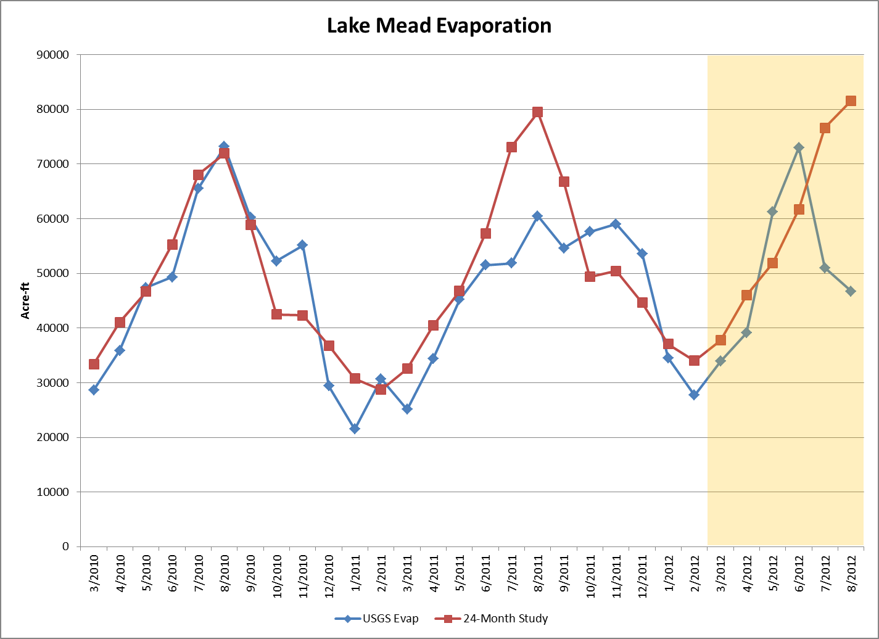
provisional

Slide 17
Next Steps
Currently working to extend project 3 years
A report with new evaporation coefficients is expected within the next 3 months
The next phase will also look at Lake Mohave evaporation
Improved modeling accuracy

Slide 18
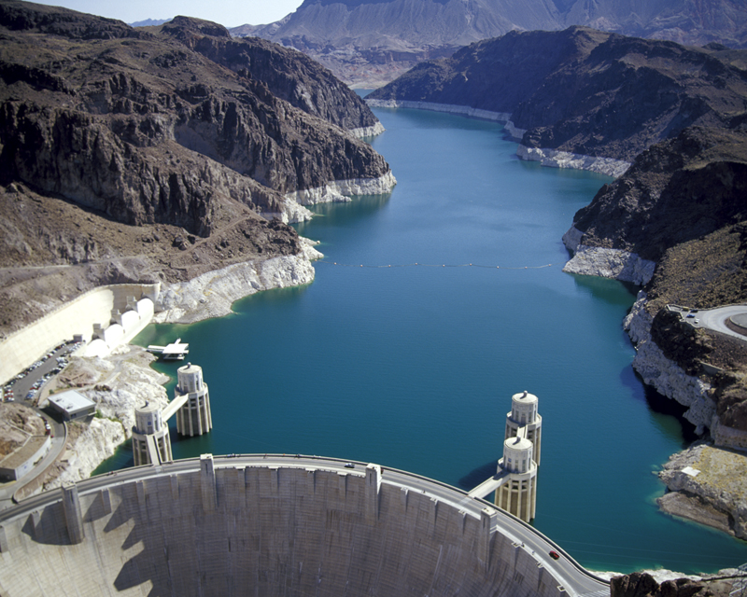
Lower Colorado River
Operations
For further information: http://www.usbr.gov/lc/region

